Slide 1
Shining a light on our analytics and usage data
Ben Showers, Jisc
Joy Palmer, Mimas
Graham Stone, University of Huddersfield
This work is licensed under a Creative Commons Attribution 3.0 Unported License
Notes:
Background image – something along the lines of data visualisations

Slide 2
Why do this?
Notes:
So. How did we get here?
Before I get into the details of the LAMP project I want to give a bit of background and context. Jisc has been involved in looking at activity or usage data and how we can exploit it for some time now. Back in 2007 we started looking at activity data and personalisation, when it was clear that models of consumption were being completely turned on their head by the likes of Amazon
And of course right from the beginning we’ve been interested in how this might apply to the context of the library, and particularly the discovery interface.
…to improve existing services
…to gain insights into user behaviour
…to measure the impact of the library

Slide 3
Library Data at Huddersfield

Slide 4
Library Impact Data Project

Slide 5
To support the hypothesis that…
“There is a statistically significant correlation across a number of universities between library activity data and student attainment”

Slide 6
Library Impact Data Project 1
Original data requirements for each student:
Final grade achieved
Number of books borrowed
Number of times e-resources were accessed
Number of times each student entered the library, e.g. via a turnstile system that requires identity card access
School/Faculty

Slide 7
Library Impact Data Project 1
Showed a statistical significance between:
Final grade achieved
Number of books borrowed
Number of times e-resources were accessed
Across all 8 partners
Not a cause and effect relationship

Slide 8
Library Impact Data Project
Phase I looked at over 33,000 students across 8 universities
Phase II looked at around 2,000 FT undergraduate students at Huddersfield

Slide 9
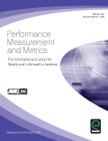
Library Impact Data Project 2
Now with additional data:
Demographics
Discipline
Retention
On/off campus use
Breadth and depth of e-resource usage
UCAS points (entry data)
Correlations for Phase 1

Slide 10
Library Impact Data Project 2
Conclusions:
We showed statistical significance for demographics such as age, gender, ethnicity and country of origin
We showed statistical significance across top level subjects and within these disciplines
We showed a connection between library use and retention
We showed the depth and breadth of a collection may make a difference

Slide 11
Drivers for change 1
And we know all this is firmly on Libraries’ radars
Our survey:
How important will analytics be to academic libraries now and in the future, and what is the potential for a service in this area?
Notes:
And while Huddersfield was the only institution experimenting with data to quite this extent, of course all of this has been very much on most Library’s radars for a while now. Indeed, some of the more competitive library system vendors are building in analytics tools so that some usage data can be tracked on an institutional level.
Just over a year ago we worked with RLUK and SCONUL to conduct a survey to fully understand how important analytics will be to academic libraries now and in the future, and to see also what opportunities there might be for a shared service in this area.

Slide 12
What about sharing your data about usage with other institutions?
There’s a significant appetite for analytics services….But hesitation over sharing entry data and other student data than other forms of usage data.
Only 46% would be willing to share data if the institution was named.
But if institutional identity can be anonymised, that changes to 91%
Notes:
61 institutions responded to the survey, so a pretty good sample.
What we were particularly interested in was the appetite libraries and institutions had for sharing their data.
We found that while there was obvious appetite for analytics services, no surprise there, there was more hesitation over sharing usage data. These concerns were around being ‘named’ and sharing (potentially) sensitive information that could be distorted. In other words, the data might not tell a story an institution wants to tell
(think headline: ‘most chemistry majors who get a first never step foot in the library.’ that sort of thing!).
But this concern diminished if there were reassurances that institutional identity could be anonymised. Respondents could see the value in sharing for purposes such as profiling and benchmarking.

Slide 13
And is this a current strategic priority?
Notes:
We asked people whether this was a key priority. Most people felt that it was an ’important but not essential’ strategic priority

Slide 14
What about in the next five years?
Notes:
But this changed when we asked about the next 5 years, where most felt that it would become a top priortiy.
So this is clearly an area for potential opportunity and growth

Slide 15
Cue
Notes:
Cue the Library Analytics and Metrics or LAMP project.
We started our work early last year, following on from the survey results and also the work of the Library Impact Data project

Slide 16
Can we collect data from institutions and create tools that allow libraries to analyze how their resources are being used, when and by whom?
Notes:
An innovations project, we wanted to explore whether we Can “collect data from institutions and create tools that allow libraries to analyze how their resources are being used, when and by whom.
Many systems vendors are already providing tools in some of these areas, but while they can provide stats on usage, what they can’t do is demonstrate which resources are being used by which different groups. They can’t tell you how resources are being used by first year law students, or second year students from China for example, orby students who were close to failing the previous year.
The ability to work with UCAS data allows us to do this and so provide significantly more value to the tools

Slide 17
What about the benefits of scale?
Can this dashboard also give institutions the tools to compare or even benchmark usage against other institutions?
Notes:
What we’re also interested in though is what the benefits of scaling this activity up might be. Can we also provide institutions to compare and benchmark against one another?
Is this another area where we can add value, but exploiting the potential of this being an above campus, shared service?

Slide 18
What data can we use and get a hold of?
UCAS data, loan data, eResource logins..
(but not data on usage of individual items)
(yet)
Notes:
But of course there are a great deal of unknowns we had to work through first to assess the feasibility of all this.
The first key challenge is around getting the data, which sits in different systems and is often ‘managed’ by different parts of the institution, particularly the UCAS data.
The data we needed (and knew could be available from most institutions, at least from somewhere) was that precious UCAS data (so we can identify the characteristics of users), but we also needed loan data, and eResource logins.
What we didn’t take was usage of individual items, at least not for now. I’ll come back to that.

Slide 19
Our collaborators and data providers:
Notes:
When we initially put feelers out to find out who might be able to work with us on this, we though we might get 2 or 3. But we were very pleased to end up with six institutions, all of whom could provide us with the data we needed and who agreed to trial this with us.

Slide 20
data wrangling:
Getting, analyzing, cleaning, and presenting that data
Notes:
The next phase of work was really around data wrangling. Getting the data (or getting the person who can get the data and the permission to use the data)
Analysing, normalising, and then developing an API for presenting the data in a visualisation dashboard.

Slide 21
A brief (important) word on ethics
Should we be holding and analyzing this kind of data?
Data protection issues & ‘Big brother’ concerns
All students pay the same fees – shouldn’t they be treated the same?
But what if we didn’t do this
What would the reaction be if it was found that we had this data but didn’t act on it?
We have a duty to care for the individual wellbeing of our students

Slide 22
Notes:
Because without a graphical visualisation dashboard, this is what your visualisation tool looks like.
(and actually this is a spreadsheet showing how we’re normalising fields such as ‘ethnicity’ or country of origin)

Slide 23
Working with the API to present the data…
How should users work with the data? What do they want to be able to do?
What do they do? What does the system do?
Notes:
And it’s been in developing the API and considering the requirements of that API that we’ve come into our most challenging and interesting phase of work.
In doing this we’ve needed to ask questions about how users work with the data.
What do they want to be able to do?
And then there are more fundamental questions over what analysis the user undertakes, and what the system does on behalf of the user, which I’ll also come back to

Slide 24
The Epic User Stories
connect the library with the university mission
contribute to the institutional analytics effort
demonstrate value added to users
ensure value from major investments
develop investment business cases
impact student measures of satisfaction, such as NSS
address measures of equality and diversity of opportunity
inform / justify library policy and decisions as evidence led
engage stakeholders in productive dialogue
identify basket of measures covering all key areas
inform librarian professional development
enable the sector to understand the questions to be answered
Notes:
And it’s been in developing the API and considering the requirements of that API that we’ve come into our most challenging and interesting phase of work.
In doing this we’ve needed to ask questions about how users work with the data.
What do they want to be able to do?
And then there are more fundamental questions over what analysis the user undertakes, and what the system does on behalf of the user, which I’ll also come back to

Slide 26
Notes:
And here’s our first basic wireframe, which starts to think in more detail about functionality and the different tasks that users might want to accomplish (for example, tracking usage by discipline or demographics such as country or ethnicity).
But this was still very much exploratory work, and although this looks sensible, as we discovered, the devil is very much in the detail.

Slide 27
Job stories

Slide 28
JiscLAMP – What did we achieve?
LAMP project outputs
We managed to clean up and process the data from all of the partners
We created a prototype – our analytics engine
We performed a benchmarking exercise
We showed that the idea of a shared library analytics service was feasible

Slide 29
What can we do with the data?
We can demonstrate usage by cohorts:
Department
Degree name
Course
Course ‘type’?
Gender/Ethnicity/Nationality/Disability/Age
Level of attainment
Attendance mode (full time/part time)
UCAS points
Notes:
First and foremost we’ve had to work within the constraints of the data that we had.
Here is what we *can* do with the data from those institutions.

Slide 30
What can we do with the data?
And we can demonstrate correlations between usage and attainment, usage and cohort (and attainment and cohort)

Slide 31
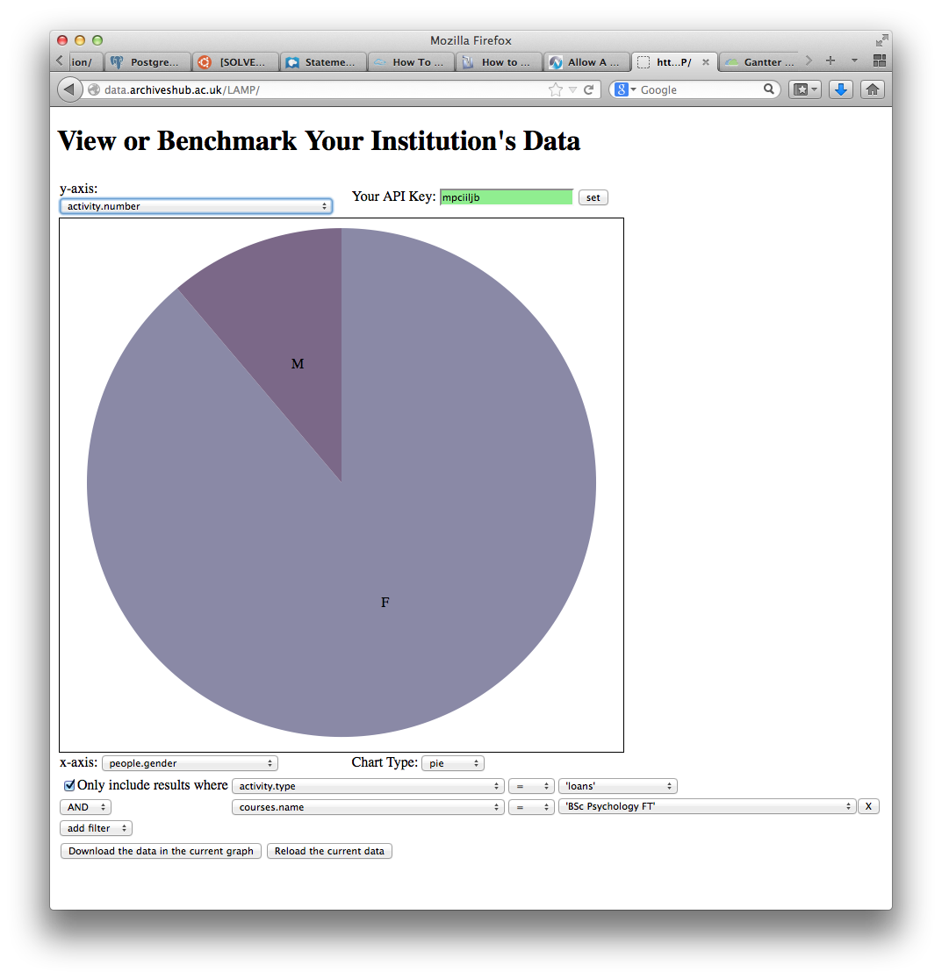
Notes:
And here are some screen shots of the very basic prototype as it’s functioning right now, with live data. So here is a pie chart demonstrating loans activity among students studying for a bachelors in psychology, broken down by gender
Apparently women borrow a lot more – or do they? Or are there simply more women in that discipline? What story is this data actually telling? I’ll let Ellen get into these types of issues

Slide 32
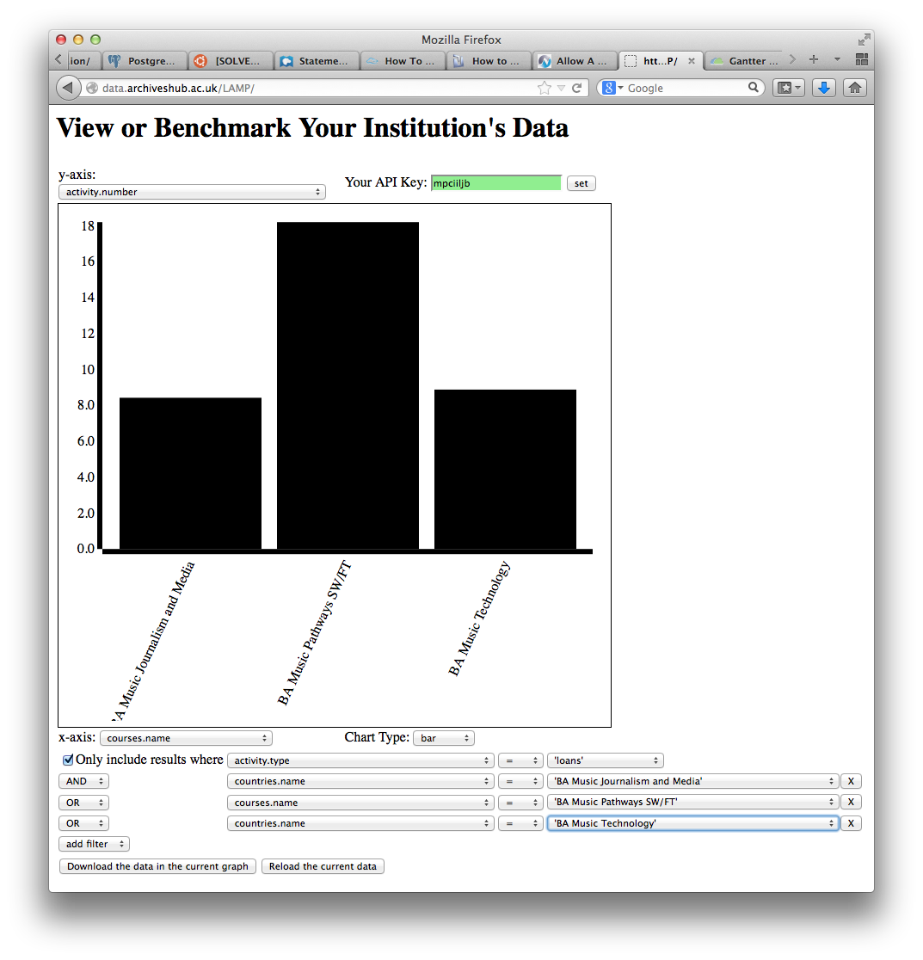

Slide 33
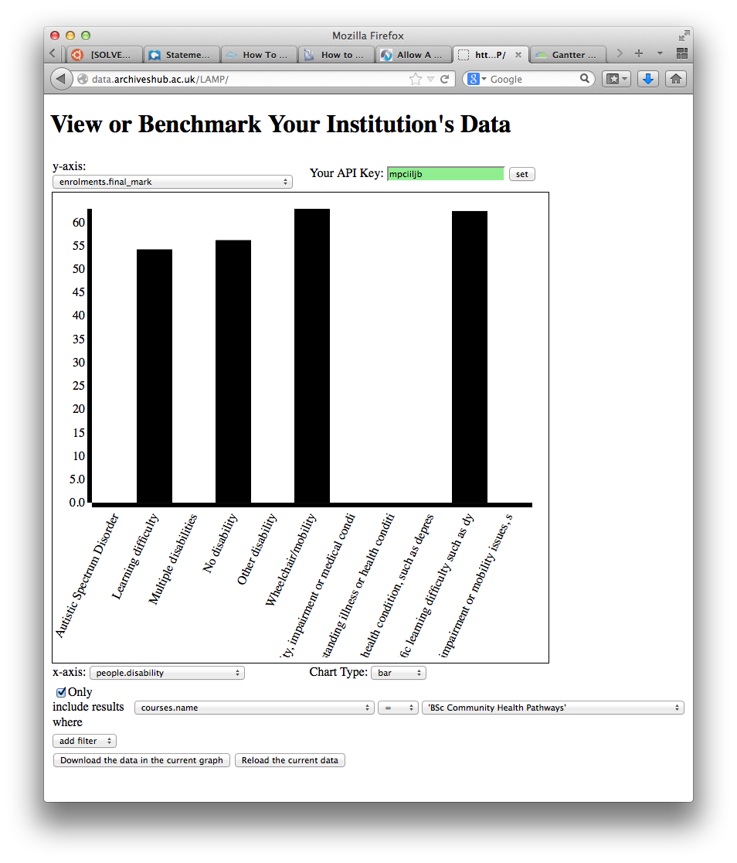

Slide 34
And we can potentially signal if findings are statistically significant or not…
Notes:
For example, we can potentially signal if findings are statistically significant or not.
So is usage by female psychology students from the first graph something to take a note of or not?
This is something we’re going to integrate into the tool into the next phase – the ability to know if what you’re seeing is significant or now.

Slide 35
But where exactly does the user journey and workflow begin? Within the system or outside of it?

Slide 36
How much do we assume the user is analysing the data?
And much analysis should the tool perform on behalf of the end user?

Slide 37
Here’s a simple question:
How do humanities and social science students use books? *
* All the data used in this presentation is completely made up. Any resemblance to real university library usage data, living or dead, is purely coincidental.
Notes:
I’m going to walk you through how complicated it is to structure the service in a way that it actually answers the question the user wants to ask.
Here’s a fairly simple question which we know from the use cases and job stories is a fairly common interest (although the things people compare will vary)

Slide 38
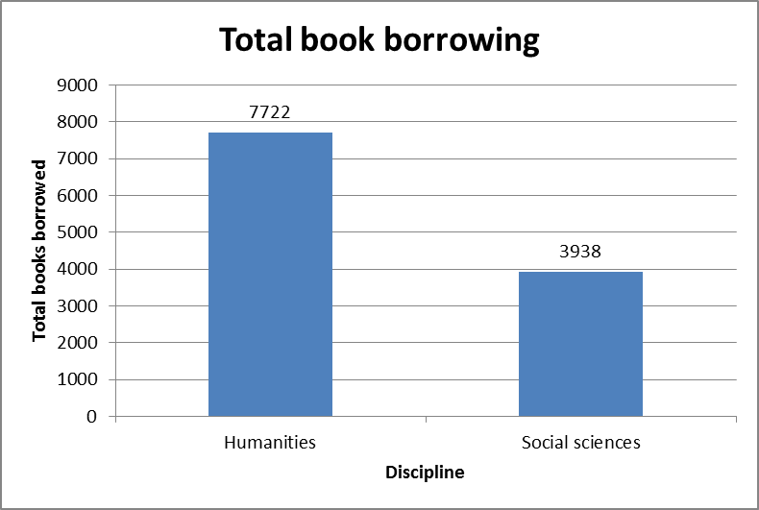
And a simple answer
Humanities bigger users than social sciences
Notes:
The answer is pretty straightforward (the data is made up by the way, you can tell because it is so tidy, humanities have borrowed more books, in this time period, than social sciences

Slide 39
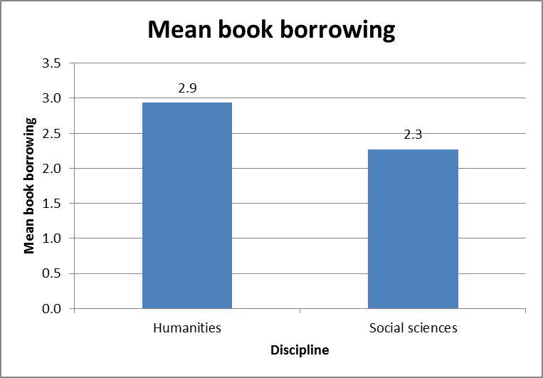
But wait!
Humanities still bigger users, but the difference isn’t so stark
Notes:
But of course this might be because there are more humanities students than social science students – so in fact what the user might really want to know is the average use per student. If we calculate this, we can see that humanities is still the bigger users, but the difference is less obvious than with the simple presentation of counts.
Would the user know that this is what they want, though, when they first ask the question? Would they think about the number of users and how it might affect the total books borrowed?

Slide 40
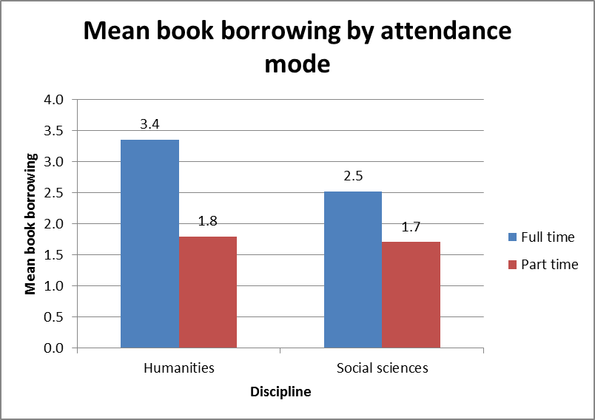
What about other factors?
In both disciplines, full-time students borrow more books than part-time ones
The difference is smaller for social scientists than for humanities students
Part-time students seem quite similar across disciplines
Notes:
And of course there are other factors to take into account besides discipline which might affect usage. For example, mode of study might change how thinkgs look – unsurprisingly, in our example it does! In both disciplines, full time students are bigger borrowers than part time ones. But the difference is smaller for social scientists than for humanities students.

Slide 41
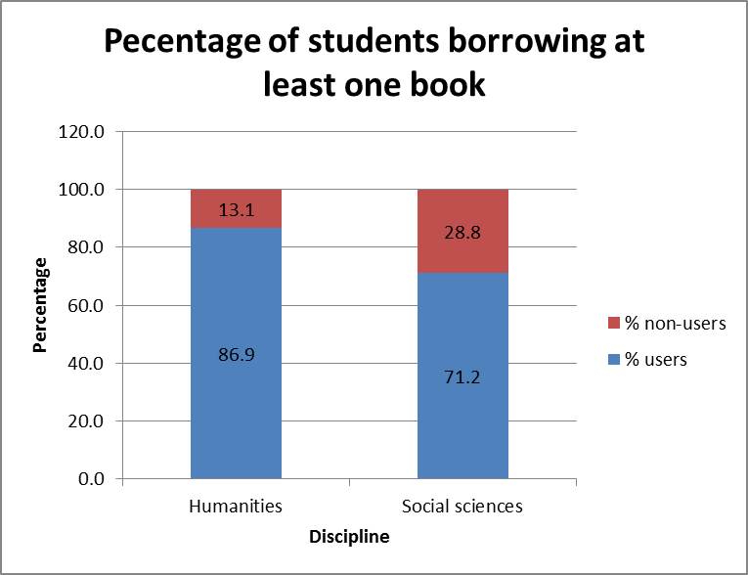
Who’s not borrowing?
So although the means were fairly similar (2.9 to 2.3), proportionally there are lots more social scientists who have never borrowed a book.
Notes:
And remember the original question – how do humanities and social science students use books? Well, what about people who aren’t using books at all? Nothing we’ve looked at so far tells you anything about them, but it’s probably quite important to know.
This graph shows us that although the mean use was fairly similar in both subjects, there are a lot more social scientists who have never borrowed a book

Slide 42
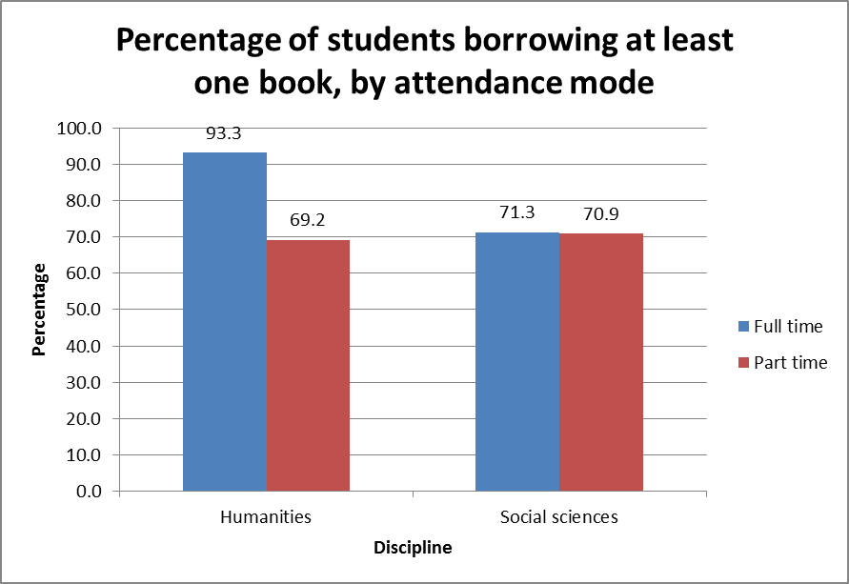
Who’s not borrowing?
There’s clearly a big problem with part-time students in the humanities
In the social sciences, everyone is equally in need of help
Social science part-timers are more likely to borrow books than humanities part-timers – why might that be?

Slide 43
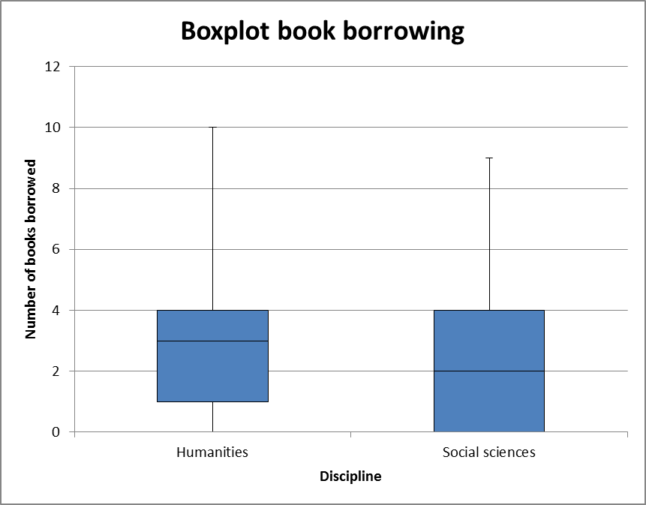
Who’s not borrowing?
Shows median borrowing (humanities = 3, social sciences = 2)
Shows upper and lower quartiles
Shows max and min values
Standard way of describing data – but is it useful here?
Notes:
We can get even more fancy – this is a boxplot, which is a fairly common way of showing the distribution of a dataset.
It shows the median average
(basically of you lined up, say, 100 data points in numerical order from low to high, the median is the value that would appear in position 50)
and the upper and lower quartiles
(again, all your data points lined up but in this case the values that appear at the position 75 and 250 and also the maximum and minimum values - 100 and 1 in the lineup).
People who are familiar with statistics would get a lot of useful information from this chart – but is it just going to be confusing to the non-expert user?

Slide 44
Where do we go from here? Phase 2
We have funding for Phase 2
We’re now testing the ‘ugly prototype’
Currently putting together the new project and marcomms plan

Slide 45
Our key areas for focus 2014-15
Make the data beautiful and compelling….
Develop a dashboard UI through iterative testing and development

Slide 46
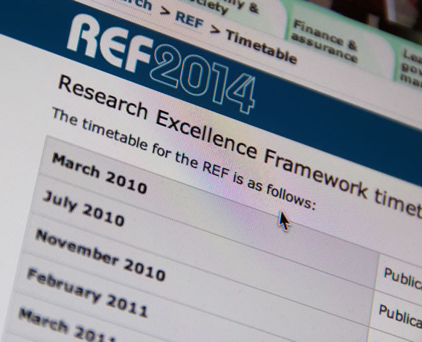
Our key areas for focus 2014-15
Usage data to ‘profile’ individuals, e.g. for REF or intervention purposes?
What are the ethical or legal issues?

Slide 47
Our key areas for focus 2014-15
eResource item level usage and the current approach of the UK Access Management Federation
Is it possible to crack that nut?

Slide 48
Our key areas for focus 2014-15
NSS data and SCONUL stats. Integration would be of major value.
How can we bring that data into scope?

Slide 49
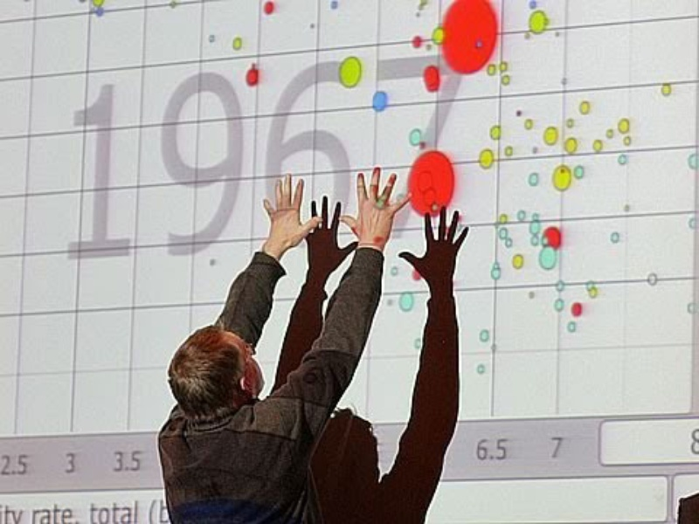
Our key areas for focus 2014-15
Data literacy
What does it mean? Who needs it?
What needs to be automated and what needs to be taught as a skillset?

Slide 50
Our key areas for focus 2014-15
Benchmarking.
The killer app?
Is there a business case for the service if it doesn’t provide the capability to compare across institutions?
How would this work?

Slide 51
JiscLAMP – Phase 2
Workshop with SCONUL (London 7 May 2014)
Key contacts/relationships for next phase
HESA (NSS)
Shibboleth/Athens
SCONUL (performance group)
Developing the business case and model

Slide 52
How can you get involved?
Follow and comment on our blog: http://jisclamp.mimas.ac.uk
Attend a LAMP workshop (tba)
Become a data contributor!
email: b.showers@jisc.ac.uk
email joy.palmer@manchester.ac.uk
email g.stone@hud.ac.uk
Notes:
Can usage data be used to ‘profile’ individuals, e.g. for REF or intervention purposes? What are the ethical or legal issues?
eResource item level usage. Is it possible to crack that nut? How are other countries tackling this? And is this service viable without that data?
NSS data and SCONUL stats. How can we bring that data into scope and help streamline reporting processes?
Data literacy. What does it mean? Who needs it? What needs to be automated and what needs to be taught?
Benchmarking. The killer app? We need data first…

