Slide 1



A Partnership Model: Student Teaching and Learning Consultants
HEA Annual Conference, The University of Warwick, 3-4 July 2013
Kathrine Jensen, Dr Liz Bennett, Julia Kendrick

Slide 2
Workshop overview
First Activity:
Different methods for student engagements.
Explore models of participation/engagement.
Second Activity:
Evaluating activity 1 in relation to model.
Third Activity:
Characteristics of the methods.
Present our Student as Teaching and Learning Consultants model.

Slide 3
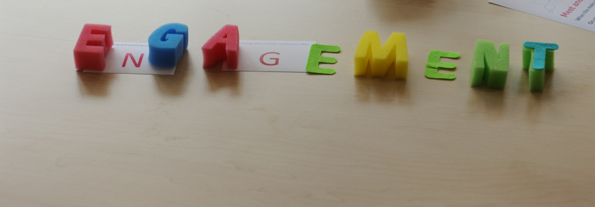
Group - Activity 1
How do you engage students and get their feedback on teaching and learning?
See cards – any others? (write your own)

Slide 4
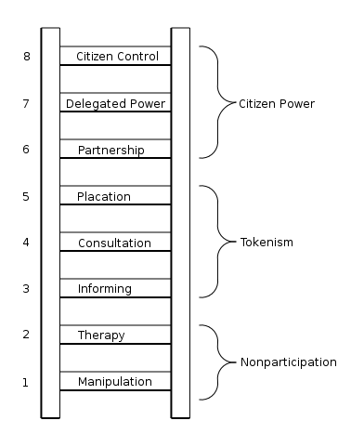
Arnstein’s ladder of citizen participation
Notes:
Eight rungs on the ladder of citizen participation
http://lithgow-schmidt.dk/sherry-arnstein/ladder-of-citizen-participation.html#download
The bottom rungs of the ladder are (1) Manipulation and (2) Therapy. These two rungs describe levels of "non-participation" that have been contrived by some to substitute for genuine participation. Their real objective is not to enable people to participate in planning or conducting programs, but to enable powerholders to "educate" or "cure" the participants. Rungs 3 and 4 progress to levels of "tokenism" that allow the have-nots to hear and to have a voice: (3) Informing and (4) Consultation. When they are proffered by powerholders as the total extent of participation, citizens may indeed hear and be heard. But under these conditions they lack the power to insure that their views will be heeded by the powerful. When participation is restricted to these levels, there is no follow-through, no "muscle," hence no assurance of changing the status quo. Rung (5) Placation is simply a higher level tokenism because the ground rules allow have-nots to advise, but retain for the powerholders the continued right to decide.
Further up the ladder are levels of citizen power with increasing degrees of decision-making clout. Citizens can enter into a (6) Partnership that enables them to negotiate and engage in trade-offs with traditional power holders. At the topmost rungs, (7) Delegated Power and (8) Citizen Control, have-not citizens obtain the majority of decision-making seats, or full managerial power.
Obviously, the eight-rung ladder is a simplification, but it helps to illustrate the point that so many have missed - that there are significant gradations of citizen participation. Knowing these gradations makes it possible to cut through the hyperbole to understand the increasingly strident demands for participation from the have-nots as well as the gamut of confusing responses from the powerholders.

Slide 5
Ladder of student participation in curriculum design
Students increasingly active in participation
Students in control
Students control
decision-making and have substantial influence
Partnership - a
negotiated curriculum
Student control of
some areas of choice
Students have some choice and influence
Students control of
prescribed areas
Wide choice from
prescribed choices
Tutors control decision-making informed by student feedback
Limited choice from
prescribed choices
Participation claimed,
tutor in control
Tutors control decision-making
Dictated curriculum – no interaction
Notes:
From Bovill, C. and Bulley, C.J. (2011) A model of active student participation in curriculum design: exploring desirability and possibility. In Rust, C. Improving Student
Learning (18) Global theories and local practices: institutional, disciplinary and cultural
variations. Oxford: The Oxford Centre for Staff and Educational Development, pp176-
188.

Slide 6
‘LADDER’ OF PARTICIPATION
Type of participation
Learner control
Delegated power
Type of involvement
Learners initiate agendas and are given responsibility and power for management of issues and to bring about change. Power is delegated to learners and they are active in designing their education
Level of engagement
Learner empowerment
Learner empowerment
Tokenism
Tokenism
Tokenism
Non participation
Non participation
Non participation
Partnership
Placation
Consultation
Informing
Decoration
Manipulation
Staff still inform agenda for action but learners are given responsibility for managing aspects or all of any initiatives or programmes that result. Decisions are shared with staff
Learners are consulted and informed in decision making processes. Outcomes are the result of negotiations between staff and learners
Learners are consulted and informed. Learners’ views are listened to in order to inform the decision making process but this does not guarantee any changes learners may have wanted
Learners are kept fully informed and encouraged to express their opinions but have little or no impact on outcomes
Learners may be indirectly involved in decisions or ‘campaigns’ but they are not fully aware of their rights, their possible involvement or how decisions might affect them
Learners are directed by staff and tend not to be informed of the issues. Learners may be asked to ‘rubberstamp’ decisions already taken by staff
Learners are merely informed of action and changes but their views are not actively sought
Notes:
After a table from Learnervoice – a handbook from Futurelab (2006:11). Authors Tim Rudd, Fiona Colligan and Rajay Naik

Slide 7
Activity 2 Types of engagement – ladder participation
Which level of the ladder are the types of activity?
Try to place the types of engagement card on a level of the ladder

Slide 8
Activity 3- diamond 9
What are the characteristics of student participation that you think is effective in enhancing T&L?
Most Important
You may wish to replace a card with one of your own statements
?

Slide 9
Student as partners model
Joint Students’ Union and Teaching and Learning Institute project.
Funded by Higher Education Academy Individual Teaching Development Grant.
One year project (Aug 2012 – Aug 2013).
Staff volunteer to participate.
Students recruited by SU, trained and paid.
Inspired by Dr Crawford’s SCOT Project.

Slide 10
Project aims
to promote authentic student engagement in the enhancement of teaching and learning (and explore the nature and construct of inspirational teaching).
to create opportunities for student and staff to engage in reflection and dialogue around teaching and learning approaches.
offer academic staff a qualified student perspective (at points of need) that goes beyond the typical end of module evaluation response or NSS survey.

Slide 11
Consultation process
Lecturer contacts project coordinator (PC) with request
Project coordinator contacts student consultants (SC) with task
SC carries out task
Student sends evaluation of consultation to PC
Lecturer sends of consultation to PC
SC arranges feed back meeting with lecturer
SC share reflections via online platform to support SCs
SC contacts lecturer to set up meeting

Slide 12

11 student consultants.
Gained skills/confidence.
Invented a new role for students.
“Nice to feel on par with a lecturer and work ‘with them’ rather than ‘for’ or ‘against’ them”.
Notes:
In the evaluation survey 11 out of 11 staff would recommend working with a student consultant, all found feedback positive and all found students to be professional

Slide 13
The Partnership ethos
“Working with the student consultants was a real delight; they were professional and polite throughout. They also provided some really useful feedback in a very objective and non-judgmental way; nowhere near as scary as one might first imagine!”
“The opportunity to engage a student perspective is refreshing and challenging. I think this is valuable.”
“It was good to be able to speak in a relaxed and informal way about the delivery of the course.”

Slide 14

Thoughts on feedback - authentic
“I thought it was amazing. We looked at what students wanted from feedback as opposed to what I want them to learn.”
“I thought the feedback was incredibly useful. It had both positive and negative points and he had clearly thought about the activity and its use to students.”

Slide 15

Thoughts on feedback - process
“The feedback received provided some very useful insights. The feedback was delivered in written and verbal form, written first followed by a face-to-face meeting. This was very useful, since it allowed time for reflection …before being given further comments and being able to ask for clarification on a couple of points.”

Slide 16

Impact
Student consultants as internal ‘experts’ available to get involved
Building relationships within organisation

Slide 17
Impact on Teaching and Learning
“I will be much more careful in how I give my feedback, and in particular be sure that feedback fits with the rubrics rather than to the learning outcomes…”
“We will continue asking for a different lecture room for next year. Otherwise, feedback was very positive, which helped reassure us we did certain things right, which is not always obvious”

Slide 18
Reflections
Face to face feedback = conversations.
Developing impact evaluation.
Encourage staff to market at course committee level.
Who engages with the scheme?
Scope and scale of the scheme.
Notes:
Conclude with an upbeat message
Conversations that are authentic, go beyond constraints of teacher student relationship because within the liminal space outside of the traditional power dynamic. – remember Mike Neary’s empty room where people didn’t know how to behave
Conversations are about teaching and learning that help to have an impact to change t&l “we learnt more about the students’ perspective and felt differently about our students as a result”
Conversations work both development of individuals (Ie CPD) and also as a different QE process

Slide 19
More information
Project webpage: http://bit.ly/Zgc2WB
Contact: k.jensen@hud.ac.uk
Twitter: @kshjensen
Blogposts tagged with HEASTLC: http://bit.ly/13l205S

Slide 20
Image References
Engagement: photo by Mark Curry, University of Huddersfield, All rights reserved.
Splash photo by Carola http://www.flickr.com/photos/carolags/
All other graphics are clipart.

