Slide 1
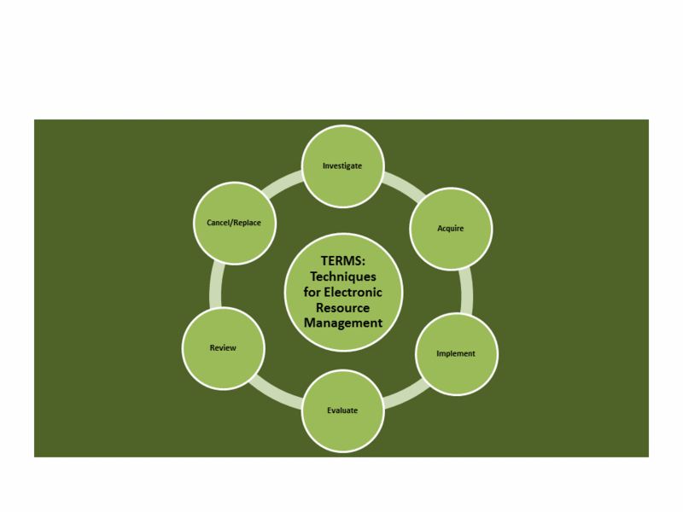
#6terms
TERMS and conditions apply: refining best practice
for Electronic Resource Management
This work is licensed under a Creative Commons Attribution 3.0 Unported License

Slide 2


Techniques in E-Resources Management
TERMS 1
  Investigating New Content for purchase
TERMS 2
  Acquiring New Content
TERMS 3
  Implementation
TERMS 4
  Ongoing Evaluation and Access
TERMS 5
  Annual Review
TERMS 6
  Cancellation and Replacement Review
Notes:
Librarians and information specialists have been finding
ways to manage electronic resources for over a decade
now. However, much of this work has been an ad hoc
and learn-as-you-go process. Chapter 1 of Library Technology
Reports (vol. 49, no. 2)”Techniques for Electronic
Resource Management” shows that the literature on
electronic resource management is segmented into many
different areas of traditional librarian roles within the
library. In addition, the literature shows how management
of these resources has driven the development of various
management tools in the market, as well as serving as
the greatest need in the development of next-generation
library systems. Techniques in Electronic Resource Management
(TERMS) is an attempt to create an ongoing and
continually developing set of management best practices
for electronic resource management in libraries

Slide 3
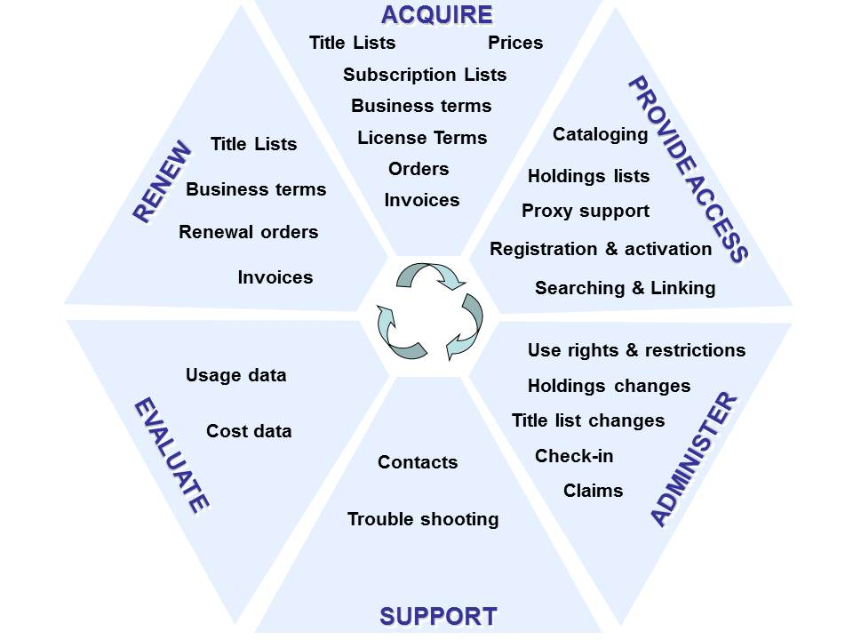
#6terms
Pesch’s electronic resources life cycle. Source: Oliver Pesch,
“Library Standards and E-Resource Management: A Survey
of Current Initiatives and Standards Efforts,” Serials Librarian
55, no. 3 (2008): 482, doi:10.1080/03615260802059965.

Slide 4
Needs assessment
#6terms
Collection development
“Over half of the libraries tried to address ER [Electronic Resources] in some way. However, most policies contain traditional language with a section on library ER inserted into the latter portion of the document”
Mangrum and Mary Ellen Pozzebon (2012)
“a lack of established policies and procedures for assessment puts a library at risk for financial loss…”
Thomas (2012)
“Many procedures are not documented and rely on informal channels of communication”
Adlington (2006)
Notes:
Librarians and information specialists have been finding
ways to manage electronic resources for over a decade
now. However, much of this work has been an ad hoc
and learn-as-you-go process. Chapter 1 of Library Technology
Reports (vol. 49, no. 2)”Techniques for Electronic
Resource Management” shows that the literature on
electronic resource management is segmented into many
different areas of traditional librarian roles within the
library. In addition, the literature shows how management
of these resources has driven the development of various
management tools in the market, as well as serving as
the greatest need in the development of next-generation
library systems. Techniques in Electronic Resource Management
(TERMS) is an attempt to create an ongoing and
continually developing set of management best practices
for electronic resource management in libraries

Slide 5
Needs assessment
ERMs and workflows
“less like a silver bullet and more that a round of buckshot.”
Collins and Grogg (2011)
“[o]ver a third of librarians surveyed prioritized workflow or communications management, and they called it one of the biggest deficiencies (and disappointments) of ERMS functionality.”
Collins and Grogg (2011)
“rethinking e-resources workﬂows and developing practical tools to streamline and enhance various inelegant processes have become the priorities.”
Han and Kerns (2011)
Notes:
Librarians and information specialists have been finding
ways to manage electronic resources for over a decade
now. However, much of this work has been an ad hoc
and learn-as-you-go process. Chapter 1 of Library Technology
Reports (vol. 49, no. 2)”Techniques for Electronic
Resource Management” shows that the literature on
electronic resource management is segmented into many
different areas of traditional librarian roles within the
library. In addition, the literature shows how management
of these resources has driven the development of various
management tools in the market, as well as serving as
the greatest need in the development of next-generation
library systems. Techniques in Electronic Resource Management
(TERMS) is an attempt to create an ongoing and
continually developing set of management best practices
for electronic resource management in libraries

Slide 6
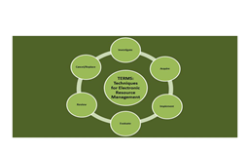
TERMS 1: Investigation of New Content
Know what you want to achieve
Write Your Specification Document
Get the Right Team
Do a Desktop Review of Market and Literature and Then a Trial Set-Up
Talk to Suppliers or Vendors
Make Your Choice
Notes:
Chapter 2 of Library Technology Reports (vol. 49, no.
2) ”Techniques for Electronic Resource Management”
presents a basic framework that should be considered
with every new purchase or addition to content selected
for inclusion in the twenty-first-century library. While
collection management and development policies help
outline the general aspects for collection purchase, in
today’s libraries, many of the standard rules applied to
print acquisition are no longer sufficient. This is especially
true with the advent of patron-driven purchasing models
for e-books. The selection of purchasing models in themselves
now plays a role in how and why specific content
is selected for inclusion in any given collection of library
material. Before any e-resources are purchased or selected
for addition, there are some basic guidelines to consider
when making selection decisions for content.

Slide 7
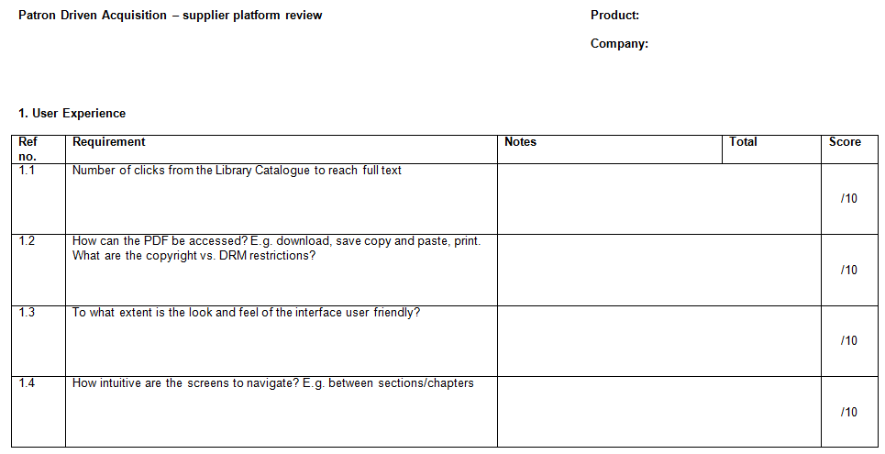
TERMS 1: Write your specification document
Notes:
Chapter 2 of Library Technology Reports (vol. 49, no.
2) ”Techniques for Electronic Resource Management”
presents a basic framework that should be considered
with every new purchase or addition to content selected
for inclusion in the twenty-first-century library. While
collection management and development policies help
outline the general aspects for collection purchase, in
today’s libraries, many of the standard rules applied to
print acquisition are no longer sufficient. This is especially
true with the advent of patron-driven purchasing models
for e-books. The selection of purchasing models in themselves
now plays a role in how and why specific content
is selected for inclusion in any given collection of library
material. Before any e-resources are purchased or selected
for addition, there are some basic guidelines to consider
when making selection decisions for content.

Slide 8



TERMS 1: Sustainability
What kind of resource are you buying?
Does it need to be sustainable?
How do you measure sustainability
  Publisher platforms vs. aggregators
  Post cancellation access
  LOCKSS, CLOCKSS or Portico
Notes:
Chapter 2 of Library Technology Reports (vol. 49, no.
2) ”Techniques for Electronic Resource Management”
presents a basic framework that should be considered
with every new purchase or addition to content selected
for inclusion in the twenty-first-century library. While
collection management and development policies help
outline the general aspects for collection purchase, in
today’s libraries, many of the standard rules applied to
print acquisition are no longer sufficient. This is especially
true with the advent of patron-driven purchasing models
for e-books. The selection of purchasing models in themselves
now plays a role in how and why specific content
is selected for inclusion in any given collection of library
material. Before any e-resources are purchased or selected
for addition, there are some basic guidelines to consider
when making selection decisions for content.

Slide 9

TERMS 1: Desk top review and trial
Fiscal responsibility
  Check the product hasn’t already been purchased
  Use overlap tool available from the vendors
Multiple platforms
  Is there a preferred choice?
Trial
  1 month is not enough!
    Sponsored trials?
  Timing and dissemination are crucial
  Record the feedback
http://www.flickr.com/photos/dalboz17/209945979/
Notes:
Chapter 2 of Library Technology Reports (vol. 49, no.
2) ”Techniques for Electronic Resource Management”
presents a basic framework that should be considered
with every new purchase or addition to content selected
for inclusion in the twenty-first-century library. While
collection management and development policies help
outline the general aspects for collection purchase, in
today’s libraries, many of the standard rules applied to
print acquisition are no longer sufficient. This is especially
true with the advent of patron-driven purchasing models
for e-books. The selection of purchasing models in themselves
now plays a role in how and why specific content
is selected for inclusion in any given collection of library
material. Before any e-resources are purchased or selected
for addition, there are some basic guidelines to consider
when making selection decisions for content.

Slide 10
TERMS 2: Acquisition
Compare specifications
Negotiate license
Review the license
Renegotiate the license
Sign the agreement
Record metadata

Slide 11
TERMS 2: Compare Specifications
Purchase order needed for invoice?
DDA-need a deposit account?
Contract that outlines purchasing terms?
Request a license for review
Annual review process?
Discounts for multiyear deals?

Slide 12
TERMS 2: Negotiation Points
Definition of site
Definition of users
Remote access
IP authentication
Article-level linking
Mutual indemnification
Privacy clauses
Provision of usage statistics
Content transfer
Use of third party discovery tools
Funding out clause
Venue definition
Perpetual access clause
Price cap allowance

Slide 13
TERMS 3: Implementation
Test
Market
Train and Document
Do a Soft Launch
Assess Feedback
Launch

Slide 14
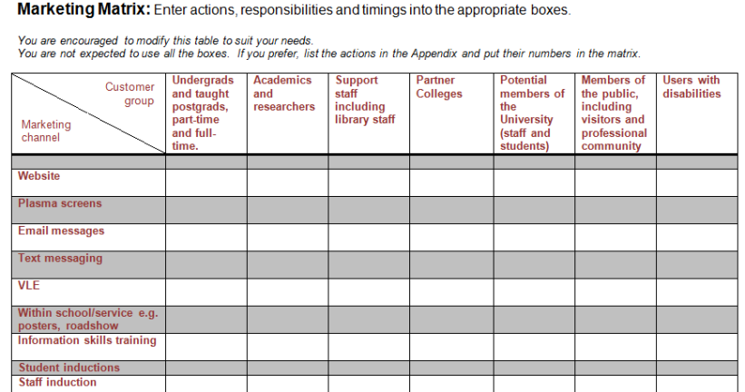
TERMS 3: Market
Notes:
Chapter 2 of Library Technology Reports (vol. 49, no.
2) ”Techniques for Electronic Resource Management”
presents a basic framework that should be considered
with every new purchase or addition to content selected
for inclusion in the twenty-first-century library. While
collection management and development policies help
outline the general aspects for collection purchase, in
today’s libraries, many of the standard rules applied to
print acquisition are no longer sufficient. This is especially
true with the advent of patron-driven purchasing models
for e-books. The selection of purchasing models in themselves
now plays a role in how and why specific content
is selected for inclusion in any given collection of library
material. Before any e-resources are purchased or selected
for addition, there are some basic guidelines to consider
when making selection decisions for content.

Slide 15
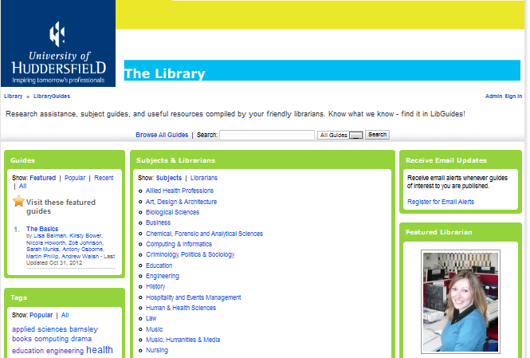
TERMS 3: Train and document
Use the free training – you’ve paid for it
  Tip for vendors – give us CC-BY guides!
Libguides
Notes:
Chapter 2 of Library Technology Reports (vol. 49, no.
2) ”Techniques for Electronic Resource Management”
presents a basic framework that should be considered
with every new purchase or addition to content selected
for inclusion in the twenty-first-century library. While
collection management and development policies help
outline the general aspects for collection purchase, in
today’s libraries, many of the standard rules applied to
print acquisition are no longer sufficient. This is especially
true with the advent of patron-driven purchasing models
for e-books. The selection of purchasing models in themselves
now plays a role in how and why specific content
is selected for inclusion in any given collection of library
material. Before any e-resources are purchased or selected
for addition, there are some basic guidelines to consider
when making selection decisions for content.

Slide 16

TERMS 3: Soft launch / launch
Depending on the scale and type of resource
  Subscriptions: as soon as the guides are ready
  PDA may only be a soft launch
  A platform may need both to gather feedback
Notes:
Chapter 2 of Library Technology Reports (vol. 49, no.
2) ”Techniques for Electronic Resource Management”
presents a basic framework that should be considered
with every new purchase or addition to content selected
for inclusion in the twenty-first-century library. While
collection management and development policies help
outline the general aspects for collection purchase, in
today’s libraries, many of the standard rules applied to
print acquisition are no longer sufficient. This is especially
true with the advent of patron-driven purchasing models
for e-books. The selection of purchasing models in themselves
now plays a role in how and why specific content
is selected for inclusion in any given collection of library
material. Before any e-resources are purchased or selected
for addition, there are some basic guidelines to consider
when making selection decisions for content.

Slide 17
TERMS 4: Ongoing Evaluation & Access
Types of Evaluation
Check the Implementation
Ask Your Users
Check Changes to Coverage of Resources or Platform Migration
Track Downtime and Availability
Communicate with the Vendor

Slide 18

TERMS 4: Check the implementation
Around 1 month in…
  Check the access points including remote access
…then afterwards on a monthly, quarterly or half yearly basis
http://www.flickr.com/photos/vestman/3871170258/
Notes:
Chapter 2 of Library Technology Reports (vol. 49, no.
2) ”Techniques for Electronic Resource Management”
presents a basic framework that should be considered
with every new purchase or addition to content selected
for inclusion in the twenty-first-century library. While
collection management and development policies help
outline the general aspects for collection purchase, in
today’s libraries, many of the standard rules applied to
print acquisition are no longer sufficient. This is especially
true with the advent of patron-driven purchasing models
for e-books. The selection of purchasing models in themselves
now plays a role in how and why specific content
is selected for inclusion in any given collection of library
material. Before any e-resources are purchased or selected
for addition, there are some basic guidelines to consider
when making selection decisions for content.

Slide 19

TERMS 4: Ask your users
Use evaluation tools such as:
  LIBQUAL+, National students Survey results (UK) or other survey techniques
Record comments and access queries
  Comments pages
  Emails
  Student panels
http://www.flickr.com/photos/gabenl/2617316249/
Notes:
Chapter 2 of Library Technology Reports (vol. 49, no.
2) ”Techniques for Electronic Resource Management”
presents a basic framework that should be considered
with every new purchase or addition to content selected
for inclusion in the twenty-first-century library. While
collection management and development policies help
outline the general aspects for collection purchase, in
today’s libraries, many of the standard rules applied to
print acquisition are no longer sufficient. This is especially
true with the advent of patron-driven purchasing models
for e-books. The selection of purchasing models in themselves
now plays a role in how and why specific content
is selected for inclusion in any given collection of library
material. Before any e-resources are purchased or selected
for addition, there are some basic guidelines to consider
when making selection decisions for content.

Slide 20

TERMS 4: Communicate with the vendor
Keep a dossier of correspondence
  Problems, troubleshooting etc.
Talk to the community
  Listservs
  Shared notes on KB+ or consortia pages
User Groups
  Find out if there is one
  Talk to colleagues at regional and national meetings
  Feed back ideas
http://www.flickr.com/photos/lenore-m/467996341/
Notes:
Chapter 2 of Library Technology Reports (vol. 49, no.
2) ”Techniques for Electronic Resource Management”
presents a basic framework that should be considered
with every new purchase or addition to content selected
for inclusion in the twenty-first-century library. While
collection management and development policies help
outline the general aspects for collection purchase, in
today’s libraries, many of the standard rules applied to
print acquisition are no longer sufficient. This is especially
true with the advent of patron-driven purchasing models
for e-books. The selection of purchasing models in themselves
now plays a role in how and why specific content
is selected for inclusion in any given collection of library
material. Before any e-resources are purchased or selected
for addition, there are some basic guidelines to consider
when making selection decisions for content.

Slide 21
TERMS 5: Annual Review
Schedule
Confirm ongoing costs
Usage statistics
Report to stakeholders
Make choice
Renew or cancel

Slide 22

TERMS 5: Set a Schedule
August-October
November-January
February-April
May-July

Slide 23
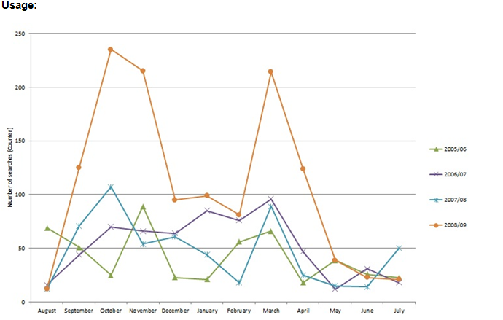
TERMS 5: Example of resource report

Slide 24
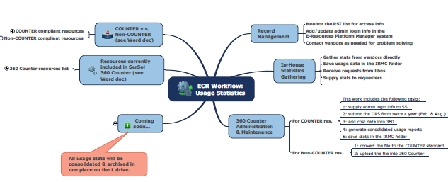

TERMS 5: Example of usage workflow

Slide 25
TERMS 6: Cancellation & Replacement
Consult with stakeholders
Notify provider/vendor
Notify patron base
Notate records
Investigate open access options
Evaluate replacement options

Slide 26
TERMS 6: Consultations
Stakeholders
Provider/Vendor
Patron Base

Slide 27
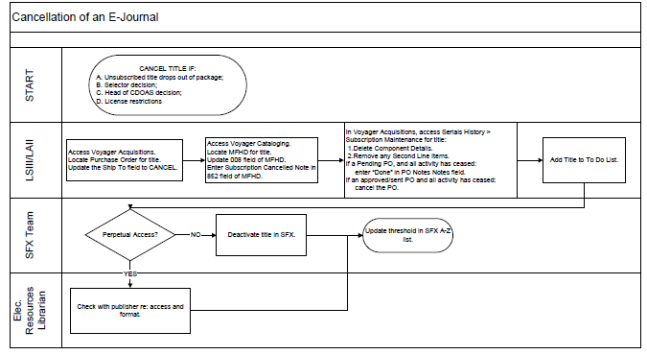
TERMS 6: Example of Cancellation
Shared by staff at Texas A&M University

Slide 28

TERMS 6: Explore OA Options
DOAB
DOAJ
Digital Humanities Now
OJS Publishing
Repository Publishing
http://www.flickr.com/photos/24343741@N06/4049306395/

Slide 29

FUTURE CONSIDERATIONS
E-Book Management
Article Publishing
New Forms of Scholarship
Next-Gen Library Management Systems
Web Scale Management
Workflow Versions
http://www.flickr.com/photos/chrisinplymouth/4408009361/

Slide 30
Contact Information
TERMS1 EDITOR: Ann Kucera (akucer01@baker.edu)
TERMS2 EDITOR: Nathan Hosburgh (nathan.hosburgh@montana.edu)
TERMS3 EDITOR: Stephen Buck (stephen.buck@dcu.ie)
TERMS4 EDITOR Anita Wilcox (a.wilcox@ucc.ie)
TERMS5 EDITOR: Anna Franca (anna.franca@kcl.ac.uk)
TERMS6 EDITOR: Eugenia Beh (ebeh@library.tamu.edu)
Jill Emery jemery@pdx.edu
Graham Stone g.stone@hud.ac.uk

Slide 31
Where to find us
TERMS Tumblr blog
  http://6terms.tumblr.com
TERMS Facebook group
  https://www.facebook.com/groups/174086169332439
6TERMS on Twitter
  https://twitter.com/6terms
TERMS Wiki: Main Page
  http://library.hud.ac.uk/wikiterms/Main_Page
Library Technology Reports
  Forthcoming
Notes:
Librarians and information specialists have been finding
ways to manage electronic resources for over a decade
now. However, much of this work has been an ad hoc
and learn-as-you-go process. Chapter 1 of Library Technology
Reports (vol. 49, no. 2)”Techniques for Electronic
Resource Management” shows that the literature on
electronic resource management is segmented into many
different areas of traditional librarian roles within the
library. In addition, the literature shows how management
of these resources has driven the development of various
management tools in the market, as well as serving as
the greatest need in the development of next-generation
library systems. Techniques in Electronic Resource Management
(TERMS) is an attempt to create an ongoing and
continually developing set of management best practices
for electronic resource management in libraries

Slide 32
References
Suzanne Mangrum and Mary Ellen Pozzebon, "Use of collection development policies in electronic resource management," Collection Building 31, no.3 (2012: 113. http://dx.doi.org/10.1108/01604951211243506.
Marcia L. Thomas, “Disruption and Disintermediation: A Review of the Collection Development and Management Literature, 2009–10,” Library Resources and Technical Services 56, no. 3 (2012): 192.
Janice Adlington, “Electronic Resources Management Systems: Potentials for Eresource Management,” White paper to Vanderbilt Library (Nashville, TN, Vanderbilt Library, 2006), http://libstaff.library.vanderbilt.edu/rs/techserv/E-Resources/ERMSystems_Jan2007.pdf
Maria Collins and Jill E. Grogg, “Building a better ERMS,” Library journal 136, no.4 (2011): 22.
Ning Han and Rick Kerns, “Rethinking Electronic Resources Workflows,” Serials Librarian, 61, no.2 (2011): 208. http://dx.doi.org/10.1080/0361526X.2011.591042.
This presentation: http://eprints.hud.ac.uk/17129

