Slide 1
Radical or reined in? Web 2.0 and its impact on pedagogy
Liz Bennett
University of Huddersfield
BERA 2012
@lizbennett1
e.bennett@hud.ac.uk
Notes:
Quote comes from Sian Bayne and Ray Land’s study published in 2008 funded by HEA which was based on evaluating what happens in practice

Slide 2
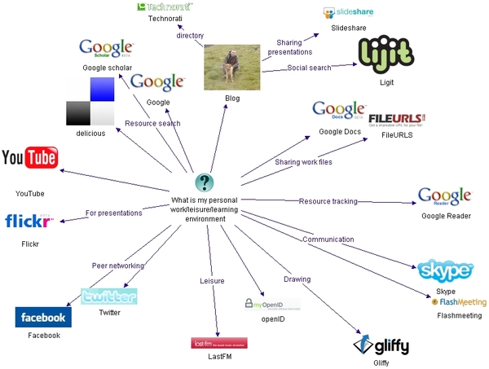
Web 2.0 = collaborative and participatory
Weller (2007) http://nogoodreason.typepad.co.uk/no_good_reason/2007/12/my-personal-wor.html
Notes:
Dynamic ie changes over time and personal

Slide 3
Structure
Possibilities of web tools
for education
Outline of my research
methodology
the radical
reined in

Slide 4
Crook’s 4 features of web 2
Scaling up participation, where quality of the service is improved with greater number of participants;
Sharing and joint knowledge building functions, i.e. user collaboration;
Using a range of formats, not just text e.g. video and picture and audio;
Rich and democratic forms of participation means there are novel frameworks for research and inquiry (2008, p.9).
Notes:
Web 2.0 fit with good practice ie Franklin and Van Harmelem (2007) say web 2.0 allows:
greater student independence and autonomy, greater collaboration, and increased pedagogic efficiency. (2007, p.1)

Slide 5
David Willey’s dichotomy;
Then
Analogue
Now
Digital
Tethered
Isolated
Generic
Consuming
Closed
Mobile
Connected
Personal
Creating
Open
Willey (2008)
www.slideshare.net/opencontent/openness-and-the-disaggregated-future-of-higher-education-presentation

Slide 6
David Willey’s dichotomy;
Then
Analogue
Now
Digital
Tethered
Isolated
Generic
Consuming
Closed
Mobile
Connected
Personal
Creating
Open
Constructivist teaching not yet the norm (Bradwell 2009 p.42)
Notes:
Only changed the channel not changed the philosophy and pedagogy underpinning
Bradwell new forms of constructivist teaching not yet the norm 2009 p42

Slide 7
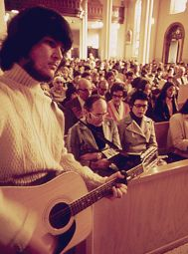
Mass in Latin or folk mass?
Byer (nd) http://nationalhumanitiescenter.org/tserve/twenty/tkeyinfo/tmainstr.htm
Notes:
Online is different but we are still celebrating mass in latin when our students are expecting in folk mass David Wiley

Slide 8
Pedagogies of web 2.0
Emergent learning (Williams et al., 2011)
Connectivism (Siemens, 2004, Downes, 2006)
Participatory Learning (Davidson and Goldberg 2009)
Rhizomatic learning (Cormier, 2008)
Learning 2.0 (Downes, 2005)
Networked Learning (Goodyear et al. 2004)
Ubiquitous Learning (Cope and Kalantzis 2008)
Communities of Inquiry (Wenger 1998, Garrison and Anderson 2003)
Abundant learning Weller (2011)
Notes:
Flipped curriculum – student as teacher/teacher as student is this another example
Under evaluated in practice????

Slide 9
Common features
Student led – agency
Student activity
Knowledge creation
Use of networks
Learning with and through conversations

Slide 10
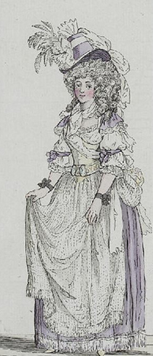
What is radical?
The free access which many young people have to romances, novels, and plays has poisoned the mind and corrupted the morals of many a promising youth; and prevented others from improving their minds in useful knowledge.
Reverend Enos Hitchcock, Memoirs of the Bloomsgrove Family, 1790
http://www.techdirt.com/blog/?tag=moral+panic
Notes:
Slippery dangers of hype

Slide 11
Over hyped- Gartner’s hype cycle for emerging technologies 2011
http://ebiquity.umbc.edu/blogger/2011/08/24/2011-hype-cycle-for-emerging-technologies/
Notes:
Keri Facer wondering about the potential of prosthetics, of simultaneous translation software,
Gamification?
What examples do you have of hype? What concern do you have about hype?

Slide 12
Or over hyped?
Profound effects on education
Stephen Heppell
MOOCs (massively online open courses)
What I want to do in this talk / my research is to get beyond rhetoric to look at what is understood and impacting on practice

Slide 13
Possibilities of web tools
for education
Outline of my research
methodology
the radical
reined in

Slide 14
Problem space
Rhetoric of pedagogies
Anecdotal examples
Theorising space between
Focusing on early adopters
Their lived experience

Slide 15
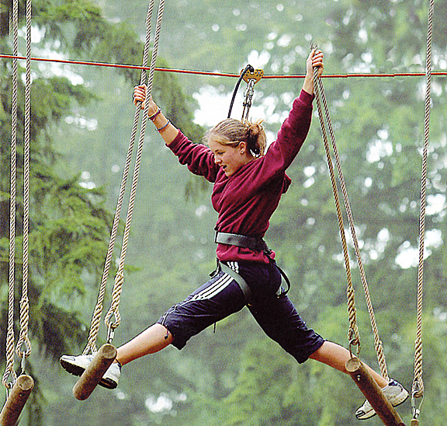
The early adopters
http://glam.co.uk/2011/04/2011s-top-ten-family-destinations/go-ape/
Notes:
Hold the lived experience; taking the risks, innovating in their practice

Slide 16
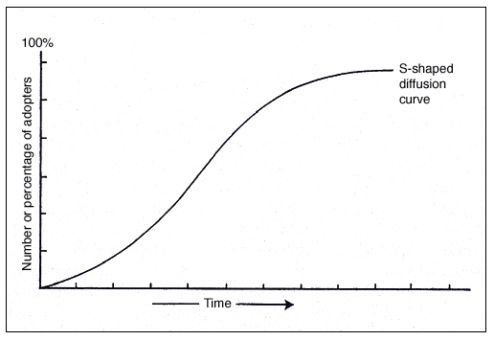
Early adopters from Rogers 1983
Notes:
Focus on lecturers; Ecclesfield and Rebbeck argue that e-maturity in colleges is not about the kit but about the skills
Focus on what can be learnt from lecturers; in terms of their rationale for uptake, personal journeys – structure and agency, their motivations, emotional journey, their skills and how acquired

Slide 17
Not the laggards or technophobes
Youtube Ipad
Notes:
Focus not on the laggards – SimFin’s blinkered horses, or technophobes
Ipad clip – learning what new pedagogies are in practice- are they just new tools used in old ways?
Know that they will talk about the time, the skills, support ‘the usual suspects’

Slide 18
A comment on methodology
Learning from the voices of practitioners;
‘shed light on the interactions between professional identity and agency and how this impacts on their professional practices in times of change’ (Jephcote and Salisbury, 2009, p.967)

Slide 19
Methodology
Phenomenological
Small scale (n=16) lecturers
Across the university – post 1992
Semi structured interviews
Thematic analysis

Slide 20
Possibilities of web tools
for education
Outline of my research
methodology
the radical
reined in

Slide 21
What were they doing?
Knowledge building using wikis (5 cases)
Reflective activities using blogs (4 cases)
Discussion based (2 cases)
Community building using Facebook and forum (2 cases)
Sharing the teaching and learning experience (1 case)
Integrating several pedagogical functions (2 cases)
Classification extended from Kennedy and Lefevre’s (2009)
Notes:
Community building international students, placement students
Sharing learning experience was vidoe distributed for ipod via VLE
Integrative eportfolio, reflections and wiki for skills development module
Not using Twitter mix of VLE and non VLE tools

Slide 22
How the radical is understood; learning as becoming
what I show them is what is out there in the community, other people who are blogging and who are working in this way and the variety of ways that a reflective journal can be written and how cleverly and subtly it can be marketing yourself ... show them the value of developing this way of reflecting on their own work. Which is essentially what it is, but the value for them is they have an identity online. [Adrian]
Notes:
CoP – learning as becoming

Slide 23
How the radical is understood; learning as connected authentic - lived
Catherine: what I was asking the students to do is to respond to a set of ideas and a set of online tools and to make public their responses to them and to theorise to them, and to do it as individuals instead of as part of a discussion board... What I was aiming to do was to feel like the tutor was actually there, and to feel like they were actually working together and learning stuff not just reading stuff. It was like
Interviewer: lived
Catherine: lived exactly lived

Slide 24
How the radical is understood; challenging authority of the academy
The democratisation of knowledge and web 2 is really changing what academia is. And that is a really vital part of post colonial theory and critical pedagogy. And if I am able through my teaching and learning to dismantle the academy then I’ve succeeded... I think that web 2 has an enormous part to play in this. Web 2 is making it seem more and more ridiculous in that we try to maintain this crumbling ivory tower that we are living it. [Claudia]
Davidson and Goldberg 2009
Notes:
Horizontal learning and knowledge creation
The uncertainty of knowledge – even in a more traditional discipline eg control engineering

Slide 25
How the radical is understood; lifelong, personally owned
What I wanted to do was to come up with … some kind of portfolio tools, that allowed for that sort of developmental learning. [Sue]
Notes:
Learning without the middle man davidson and goldberg

Slide 26
How the radical is understood; valuing students’ expertise
I don’t know how many within the group have retail jobs or have experience, but where does the experience lie? They are obviously far more experienced in their subject area. Certainly I felt that I was learning from them. [Adrian]
Notes:
Learning without the middle man davidson and goldberg
The notion referred to by Davidson and Goldberg (2009) as horizontal access of the web to information in which knowledge making is “much less the function of a credentialed elite and increasingly collaboratively created” (p.25) is valued and encourage by lecturers
Flipped curriculum

Slide 27
David Willey’s dichotomy;
Then
Analogue
Now
Digital
Tethered
Isolated
Generic
Consuming
Closed
Mobile
Connected
Personal
Creating
Open

Slide 28
David Willey’s dichotomy;
Understood?
√
flexibility
√
√
√
sometimes
Now
Digital
Mobile
Connected
Personal
Creating
Open
Notes:
Will return to the notion of openness; openness were it add value to students eg becoming a member of a professional community, developing a professional identity

Slide 29
Possibilities of web tools
for education
Outline of my research
methodology
the radical
reined in

Slide 30
Reining in? Students’ expectations
I’ve actually now got the students sending me links: “I saw this and this and it was very good” or “what about this article?” and they actually send them to me which is quite interesting. I still think they see me as being in charge [Rachel]

Slide 31
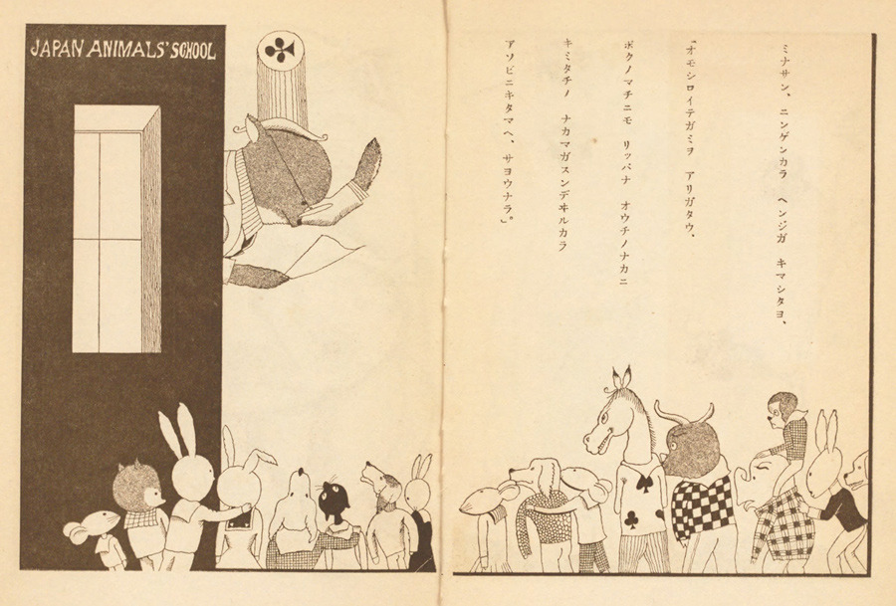

Slide 32
Reined in by conservative expectations
I had high aspirations of it, seeing it as something as lifelong, developmental. But I think in the end I think that students tend to think of it as something that students see as part of first year. [Sue]
Notes:
Institutionalisation of students

Slide 33
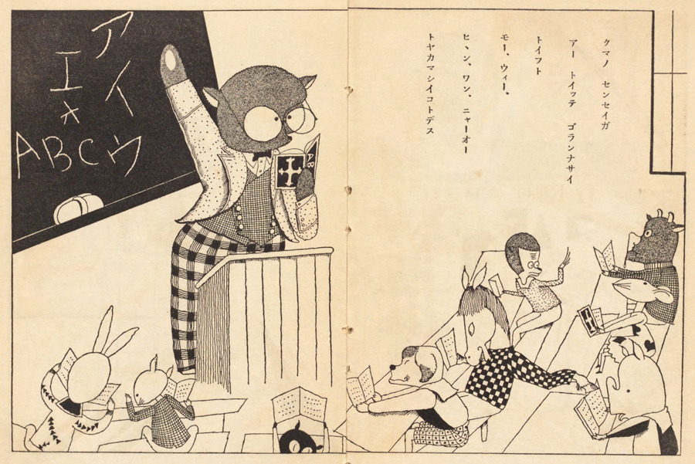

Slide 34
Reined in – does more mean different?
I think that students can get overwhelmed by too much information sometimes. When it comes down to it what they like is to sit down at a table with you and a piece of paper, and talk about what they know and what they don’t know. They have a lot of information at the their finger tips but they still have to engage with it and there is nothing changed there really. [Claire]
Notes:
They still want guidance
They have more info but what they need is to engage with it

Slide 35
Reined in; is openness a good thing?
we didn’t [encourage commenting] that was a distinct decision that we took. It was supposed to be a really safe space and absolutely safe. Given what they’ve written I think that was the right decision. It is meant to be really quite a deep reflection on their own learning and inevitably that means that they do expose themselves... it is fairly private for some of them. [Sue]
Notes:
Openness not always desirable for safe learning

Slide 36
Reined in - by
Our expertise rather than ‘the bloke in his bedroom writing a blog’
The role of adult educators was seen as crucial for all learners, and for those displaying higher levels of autonomy, the educator was perceived as a trusted “human filter” of information. The research... challenges the notion that knowledge and learning are revolutionized by new social media. It shows that a trusted “knowledgeable other” is still at the heart of a meaningful learning experience. (Kop, 2010, p.i)
Our duty of care; awareness of cognitive load on students

Slide 37
Reined in by
Institutional structures; modules
Institutional processes; rolling over
Summative assessment; thought of by students as final
Walled garden has value;
time to learn,
robustness,
emergent thinkers
Consistency and familiarity
Notes:
David Mitchel’s self censorship of students blogging individually
Simon Finch’s children need consistency in implementation of policies on Social media

Slide 39
Surprises
‘stream of unanswered questions’ (Clegg et al., 2006, p.96) not an issue
That is loss of control/lecturer vulnerability not an issue
Less surprising
Time as investment
Notes:
Epistemological challenge

Slide 40
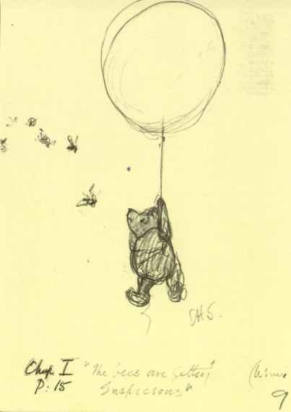
Some conclusions;
Danger of cherry picking quotes;
Radical potential appears to be understood by many;
Cautiously applied; duty of care (Jephcote and Salisbury, 2009);
Institutional, and factors relating to students’ expectations are some of the barriers;
Rather than tutors’ conservatism;
Lecturers’ emotion response to change is another story.

Slide 41
Radical or reined in? Web 2.0 and its impact on pedagogy
Liz Bennett
@lizbennett1
e.bennett@hud.ac.uk

Slide 42
References
Bradwell, P. (2009). The Edgeless University - Why Higher Education must embrace technology: Demos.
Clegg, S., McManus, M., Smith, K., & Todd, M. J. (2006). Self-development in Support of Innovative Pedagogies: Peer support using email. International Journal for Academic Development, 11(2), 91 -100.
Cope, B., & Kalantzis, M. (2008). Ubiquitous Learning: An Agenda for Educational Transformation. Paper presented at the Proceedings of the 6th Networked Learning, Greece.
Cormier, D. (2008). Rhizomatic Education: Community as Curriculum. Innovate: Journal of Online Education, 4(5).
Crook, C. (2008). Web 2.0 technologies for learning: The current landscape – opportunities, challenges and tensions: Becta.
Downes, S. (2006). Learning Networks and Connective Knowledge.
Garrison, D. R., & Anderson, T. (2003). E-learning in the 21st century: A Framework for Research and Practice. London: Routledge Falmer.
Goodyear, P., Banks, S., Hodgson, V., & McConnell, D. (2004). Research on network learning:an overview. In P. Goodyear, S. Banks, V. Hodgson & D. McConnell (Eds.), Advances in research on networked learning. Dordrecht: Kluwer Academic Publishers.
Jephcote, M., & Salisbury, J. (2009). Further education teachers' accounts of their professional identities. Teaching and Teacher Education, 25(7), 966-972.
Kennedy, D., & Lefevre, D. (2009). Epigeum: Learning Technologies Online. In T. Anderson (Ed.), Internet Based Collaborative Technologies
Kop, R. (2010). Networked Learning and Connectivity: Social Media, the Knowledgable other and Distance Learning University of Wales, Cardiff.
Rogers, E. M. (1983). Diffusion of Innovation (Third ed.). London: Free Press.
Siemens, G. (2004). Connectivism: a learning theory for the digital age. Retrieved 24 March 2012, from http://www.elearnspace.org/Articles/connectivism.htm
Weller, M. (2011). A pedagogy of abundance. Spanish Journal of Pedagogy, 249, 223–236.
Wenger, E. (1998). Communities of practice: learning, meaning, and identity. Cambridge: Cambridge University Press.
Wiley, D. (2008). Openness and the Disaggregated Future of Higher Education. Retrieved 10 March 2012, from www.slideshare.net/opencontent/openness-and-the-disaggregated-future-of-higher-education-presentation
Williams, R., Karousou, R., & Mackness, J. (2011). Emergent Learning and Learning Ecologies in Web 2.0. International Review of Research in Open and Distance Learning 12(3), 1-21.

