Slide 1
Keep taking the tablets
Alison Sharman
@asharman
LILAC 2012

Slide 2
Library Impact Data Project
“There is a statistically significant correlation across a number of universities between library activity data and student attainment.”
http://library.hud.ac.uk/lidp

Slide 3
E-resource usage
http://www.flickr.com/photos/davepattern/6928727589/in/set-72157629087302688/
Notes:
Based on an analysis of our EZProxy logs.

Slide 4
Average number of library loans
http://www.flickr.com/photos/davepattern/6785023236/in/set-72157629087302688/
Notes:
The graph shows 6 separate years of honours degree graduates and the average number of total items they borrowed during the 3 years up to their graduation (i.e. their loans during the final year of study, plus the previous 2 years).
Interestingly, the gradual decline we saw in borrowing by those who got a Third has been dramatically reversed by the 2010/11 graduates.

Slide 5
Visits to the Library 2007/8 & 2008/9

Slide 6
But...
Many students are missing out on the resources we provide

Slide 7
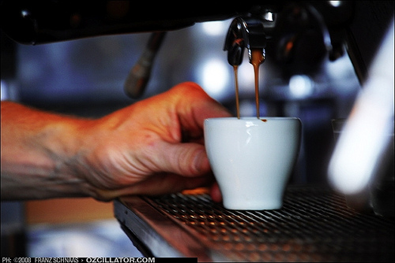
So, if Mohammed will not go
to the mountain...
Students Union Coffee bar
Stand with laptops
Engaged with the students
Tablets required
http://www.flickr.com/photos/corvillegroup/4476474971/

Slide 8
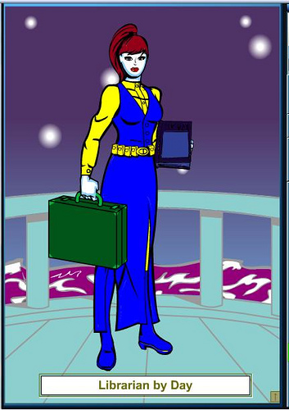
Vision of the Roving Librarian
Info on the move
at the point of need
Go out to the students
Move from the traditional library environment
Reach potential library “non users”
http://www.flickr.com/photos/librarianbyday/2744512265/in/pool-846852@N21/

Slide 9
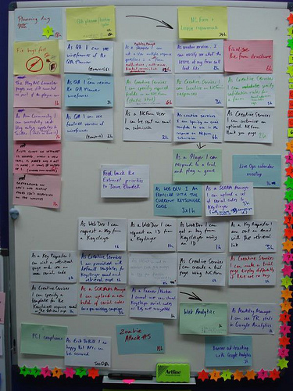
The plan...
http://www.flickr.com/photos/jnicho02/2637002496/
Apply for internal funding
Set up informal sessions
Equip librarians with slates
Promote sessions
Evaluate the impact
Publish findings
http://www.flickr.com/photos/jnicho02/2637002496/

Slide 10
What does the literature say?
http://www.flickr.com/photos/carowallis1/4297460415/

Slide 11
Tablets: choice of two
Most librarians chose the Android tablet over the iPad
iPad
http://www.flickr.com/photos/yto/4891249900/
Android tablet: Asus Eee Pad Transformer
http://www.flickr.com/photos/whichtechnology/5337338563/
Notes:
Android tablet: Asus Eee Pad Transformer: Winner of Stuff’s Magazine’s Gadget of the Year 2011
Most librarians selected the Asus Eeee transformer as the added keyboard gave greater flexibility but librarians from Human and Health chose the iPad as some students within the School had been given iPads as part of a long running commitment to supporting their placement students with new technologies. The tablets are extremely portable and would allow flexible roaming rather than staff having to be fixed to a desk. They require little set-up, are easily connected to the university network and thus allow us to roam anywhere but still have access to the electronic resources.

Slide 12
Time to play...
Time to play with new technology
Use tablets
Compare apps/tools
Librarians better equipped to support mobile technology
http://www.flickr.com/photos/andrewpescod/272080926/
Notes:
Indeed, each librarian was encouraged to use the tablets as much as possible prior to roving, experiment with downloading apps, making notes and generally exploring the capabilities of these mobile devices. We found like Cheetham and Gray (2007) that it is vital to allow staff to have “‘time to ‘play’ with the new technology is invaluable for staff to get used to it.” To facilitate this preparation, meetings were scheduled for staff to share any apps or tools they had found useful as well as talk about the practice of roving.
As an additional benefit of equipping staff with tablet computers, our librarians are now better equipped to support mobile learning within the university and have a better understanding of staff and student needs as they use these types of devices themselves.

Slide 13
Need a recognisable brand
Librarians out of context may not be recognised
Need a logo/image that students can associate with the roving librarian
Martini advertising slogan: information anytime, anyplace, anywhere
http://www.flickr.com/photos/grahamsblog/5169357774/

Slide 14
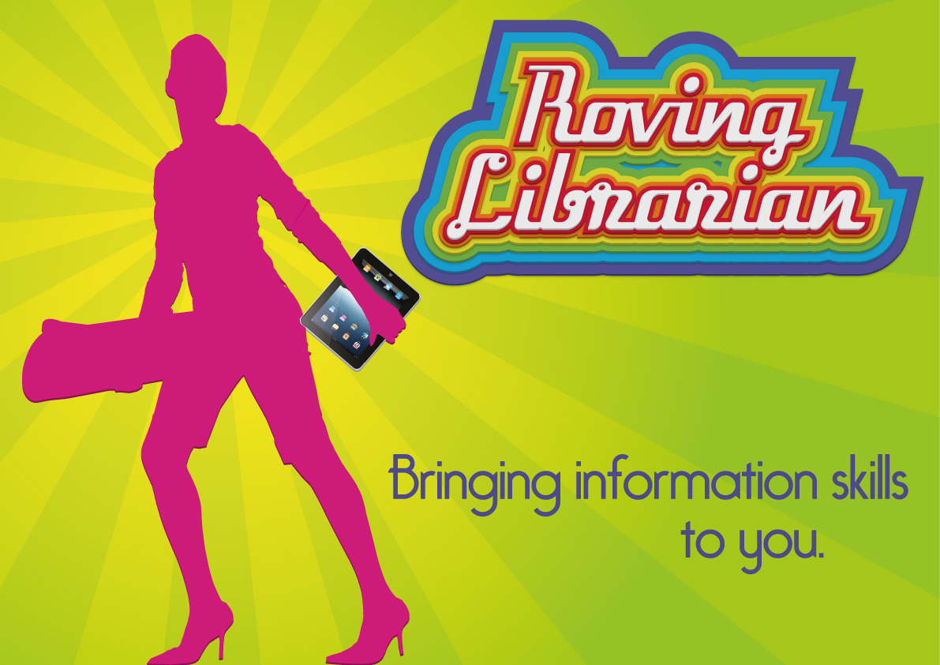
The Result!

Slide 15
Logo
Used this logo for
Stickers
Adapted for School Plasma screens
Advertising on library Facebook page
Notes:
It was decided to use this as the logo and create stickers for the backs of the tablets that students would see when they encountered a roving librarian. The graphic designer produced a poster version of the logo for us to add the location and times when we would be roving. This was adapted so that it could be displayed on the School plasma screens.

Slide 16
Plasma Screen Advert

Slide 17
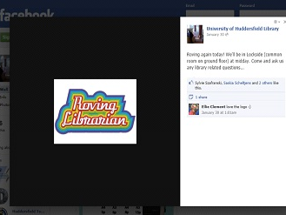
Library Facebook page

Slide 18
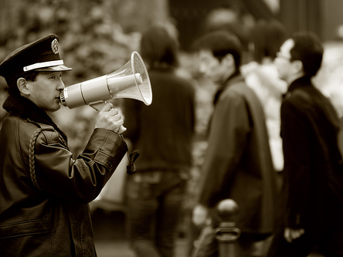
Spread the word: Roving librarian
is coming to YOU!
Tweet on Hudlib
Retweeted by other Uni tweeters
UniLearn
Emails to academic staff
Emails to students
http://www.flickr.com/photos/59461128@N00/456554634/
Notes:
Invaluable – getting to know Learning Technologists, people responsible for Marketing in the Schools plus the general support of academic staff.
This approach has worked and several times roving librarians have arrived at their post to be greeted by students awaiting their help. Having a student presence also helps to create a bit of a buzz and helps encourage other students to ask for help. Academic staff were also contacted inviting them to come and see us and asking them to promote the service to their students. Staff were generally very supportive and did publicise our services,
For example...

Slide 19
Email from Computing Lecturer
Sent: 10 November 2011 09:14 To: N455 - BSc (Hons) Computer Games Programming; N655 - BSc (Hons) Computer Games Programming FT route Subject: FW: Roving librarian coming to Canalside West on Monday 14th Nov 11-1 Importance: High
Do you know what a library is? Did you know we have one? Do you understand the concept of a book, with actual old fashioned paper in it!? So retro!
Only kidding guys, but if you don’t use our library you are probably missing out on some pretty awesome services, check out the below, and go see them if you have questions.

Slide 20
Roving Strategies
Times and locations
Regularity
Method of roving
Opening line
Questionnaire
Freebies
http://www.flickr.com/photos/mawts-1comcam/6256228473/
Notes:
The subject librarians have arranged times and locations to rove in the Schools that they represent. Their choice of location depended upon the School and the available facilities. The space quite often determines the method of roving. Some Schools have resource centres which seem to be an ideal place to just get on with your work and wait to be approached by the students. The librarian roving in the Applied Sciences resource centre after successfully helping a student with his work received the brilliant feedback, “You must have been sent by God”!
In social spaces such as the Business School’s Street Cafe students were approached as they walked past the stand and asked questions such as “do you use Summon?”. Some librarians went to chat to students as they were drinking their coffee and talking in groups. Approaching the students with the question “Do you use Summon?” always seems to lead to further discussion, with draws in other elements of using the library’s resources and other issues the students may require assistance with. Usually students had never used Summon or they had used it and encountered some problem with viewing the retrieved article or not found what they were looking form. In such cases, librarians were able to produce their tablet and repeat the search previously conducted by the student and then either help them view the articles or by a series of questions to the student, improve the search strategy to find relevant articles.

Slide 21
Roving, roving, roving
All librarians have been roving
Varying degrees of success
Proactive approach
Trial and error
Mostly positive response from academics
Relationships established
Notes:
Some librarians felt uncomfortable with the proactive approach

Slide 22
Response from students
Questionnaire: will encounter with roving librarian result in increased resource usage?
Notes:
Some student are non users. Others don’t perceive they need help.

Slide 23
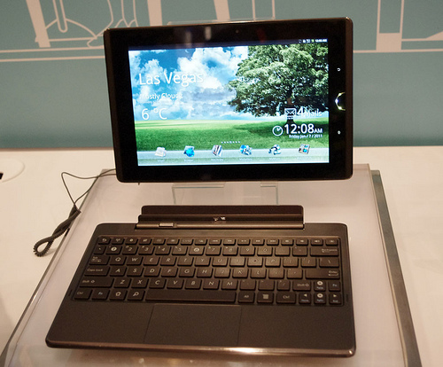
Effectiveness of tablets in supporting teaching on the move
Highly portable (both)
Flexible (both)
Attractive to students/ Conversation starter (both)
Can do other work (both)
Sometimes problems with network strength/Speed(both)
Disadvantage not having a keyboard (iPad)
Screen not as responsive as iPAd (Asus)
Problems charging it up (Asus)
http://www.flickr.com/photos/yto/4891249900/
http://www.flickr.com/photos/whichtechnology/5337338563/

Slide 24
Some keys to success
Be proactive
Engage the students in conversation
Know your subject
Experiment
Timing
Go out in pairs
Freebies help
Use colleagues
http://www.flickr.com/photos/happylobster/3228866041/
Notes:
Contrasting styles – Martin stops people in the street. Uncomfortable with talking with students in coffee shop – feels he is infringing upon their free time
I don’t like stopping people in the street as much – prefer to make my way round the cafe and talk to people. Never been turned away. Had good conversations with people

Slide 25
Roving librarian: the future
Work on the brand
More call for roving in library?
Develop the strategy
Continue to up skill librarians in using tablets
http://www.flickr.com/photos/42438552@N00/6762367425/
Notes:
Pair librarians up – put someone who is not as confident with someone who is enthusiastic

Slide 26
More sources
Sharmana http://sharmana.wordpress.com/
Library Impact Data Project: Just another JISC Activity Data project blog! http://library.hud.ac.uk/blogs/projects/lidp
Sharman, A. and Walsh, A. (2013) Roving librarian at a mid-sized, UK based university. Library Technical Reports: tablets in reference and instruction. ALA Jan 2013

