Slide 1
Handheld Information Literacy
Mobilising existing models?
Andrew Walsh,
HHL4,
24th Feb 2011.
Notes:
Hello everyone! I’m guessing that most people here will be involved in designing or delivering mobile friendly content to your library users – whether you are doing so already, or thinking how you may use handheld devices in future. I am myself, and I know it’s really easy to get carried away in particular applications of handheld technology or just in the fun of it all. What I’m going to talk about in this keynote however, is not details of the technology or the applications we may be able to put it to, but something a little harder that I believe we need to consider more – that is, what does all this wonderful tech mean to our users? In particular, what does the mobilising of search and information sources mean to OUR ideas of information literacy?

Slide 2
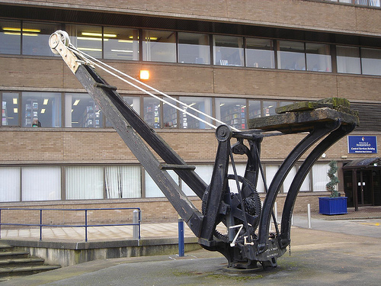
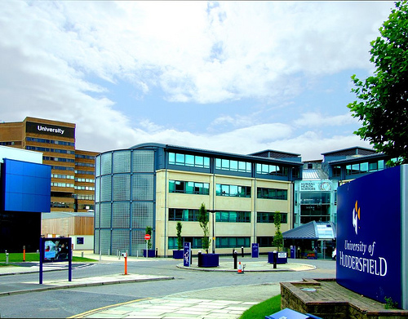
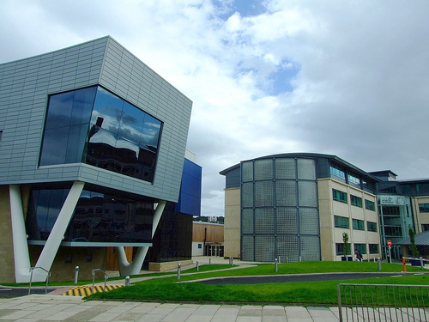
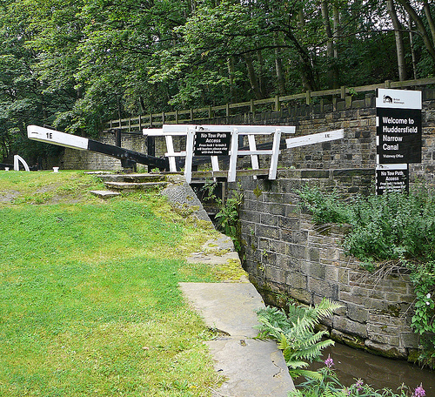
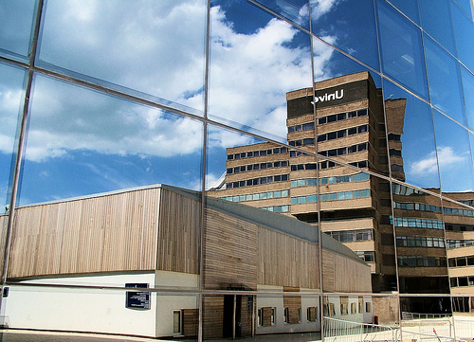
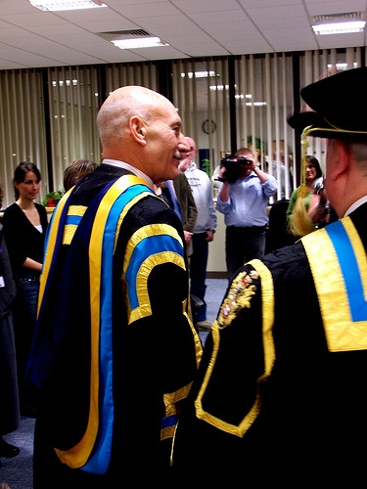
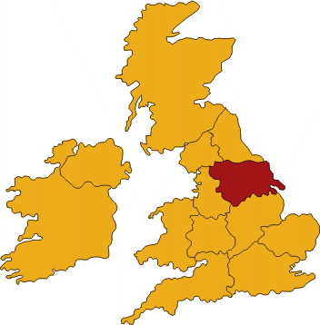
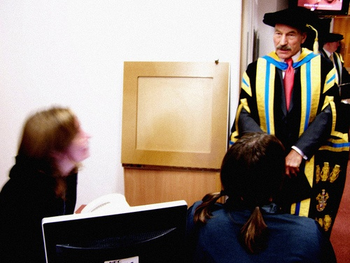
Where I’m from...
Notes:
. I work at the University of Huddersfield, which is in Yorkshire, the North of England – a mid sized UK university, we have just over 23,000 students, of which around 3,000 are post-graduates (http://www2.hud.ac.uk/about/facts/index.php). Some of you may recognise the chancellor of our university, Patrick Stewart, who is a local lad and really helps out at the university a lot.
We have, as a joint computing and library service, a fairly simple & perhaps vague sounding aim - “To deliver an inspiring information environment for the digital age.” This works together with a set of objectives that go into a little more detail, mentioning things like “Delivering accessible, reliable and innovative digital technologies” and “Building information skills for life”. (http://www2.hud.ac.uk/cls/aboutus/aim.php).
The way these aims and objectives, however, are reflected in our everyday work, is by us having a certain element of freedom to innovate, to constantly improve services and though we don't have much money, we have enough freedom to “hit above our weight” in many ways. So, for instance, Dave Pattern was one of Library Journal’s “movers and shakers” last year and the only English one. Just to name a few concrete things - we’ve a fantastic library catalogue (http://webcat.hud.ac.uk), were the first UK University to subscribe to Summon (http://library.hud.ac.uk/summon), have been investigating mobile technologies over the last year or so (for example, Walsh 2010a and Walsh 2010b), and have recently found a firm link between the use of library resources and academic achievement (White & Stone, 2010).

Slide 3
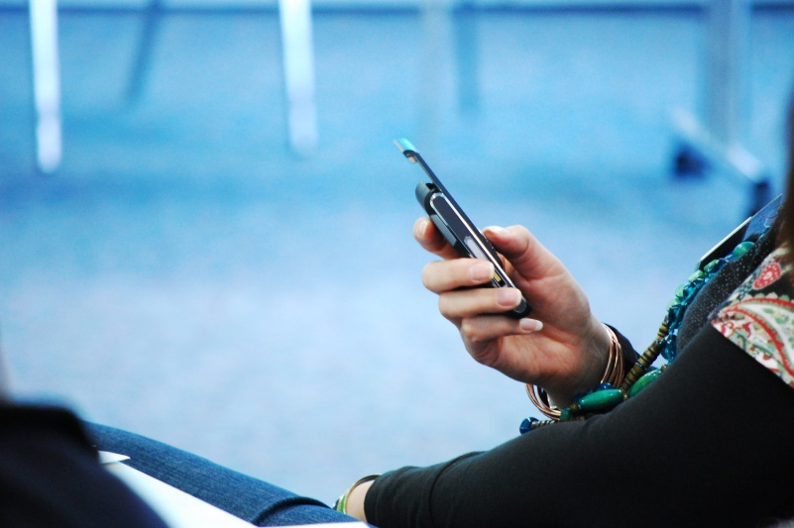
Back to mobiles & IL

Slide 4
Facts & figures
Neilsonwire forecast that by the end of 2011 more smartphones will be sold in the US than “normal” standard mobile phones...
Notes:
The near ubiquitous nature of cell phones combined with WIFI hotspots and 3G networks allowing fast and easy access to the internet from handheld devices, has meant an explosion in mobile internet use. The Pew Mobile access 2010 report (Smith, 2010) found that in early 2010 almost two thirds (59%) of American adults go online wirelessly. This included 40% of American adults accessing the internet from a mobile phone. If there is any doubt that this figure is increasing, the same report also highlights that in the 18-25 year old age group, 65% of people in their study accessed the internet from their mobile phone. This message is reinforced by the ECAR study of US students (Smith & Caruso, 2010), which found that 63% of students surveyed owned an “internet capable handheld device”. About half (43%) of these used the internet from their device daily (up from 29% in 2009). So increasingly it is the norm to access the internet from small, mobile, handheld devices and to do so regularly, as a normal part of people’s daily life.
The phrase used in the ECAR study, an “internet capable handheld device” is also important. Mobile phones are near ubiquitous and it is more likely than ever that a new mobile phone will be capable of accessing the internet. Indeed, it is forecast by Neilsonwire that by the end of 2011 more smartphones will be sold in the US that “normal” standard mobile phones (Entner, 2010). However, as the phrase “internet capable handheld device” suggests, they are not alone in providing internet access on the move. Most handheld games devices (for example, Nintendo DS; Apple iPod Touch, Sony PSP) include WIFI access to the internet as do netbooks and slates, with slates such as the iPad from Apple having the option of inbuilt 3G connectivity through the mobile phone networks.

Slide 5
Development of IL
When was the term “information literacy” first used?
1968
1974
1982
1990
2001

Slide 6
Early Information Literacy
Paul Zurkowski (1974): “people trained in the application of information resources to their work can be called information literates. They have learned techniques and skills for using the wide range of information tools as well as primary sources in molding information solutions to their problems.”.
Notes:
The concept of Information Literacy has evolved since the term was first used in the early 1970s by Paul Zurkowski (then president of the Information Industry Association). Carbo (1997, p. 395) quotes Zurkowski as saying “people trained in the application of information resources to their work can be called information literates. They have learned techniques and skills for using the wide range of information tools as well as primary sources in molding information solutions to their problems.”. Others, including Curran (1993) confirm that Zurkowski was the first to use the phrase “information literacy”. Further early definitions carried forward this broad definition, including the IIA's definition (Garfield, 1979), stating that the information literate person is one “who knows the techniques and skills for using information tools in moulding solutions to problems”. Taylor (1979, p. 1875) pulled together some of these early ideas about information literacy noting the elements that any definition of information literacy should include :
That solutions to many (not all) problems can be aided by the acquisition of appropriate facts and information.
That knowledge of the variety of information resources available (who and where) is a requisite of this literacy.
That the informing process, which is continual, is as important as the spot information process which is occasional.
That there are strategies (when and how) of information acquisition.
These early broad definitions, however, suffered from a lack of hard measures and firm attributes against which people could be measured. There is a natural desire to take the concept of information literacy and want to measure people (often students) against it. Once we think we know what information literacy is, we want to know how information literate people are.

Slide 7
Early Information Literacy
According to Taylor (1979) the elements that any definition of information literacy should include :
That solutions to many (not all) problems can be aided by the acquisition of appropriate facts and information.
That knowledge of the variety of information resources available (who and where) is a requisite of this literacy.
That the informing process, which is continual, is as important as the spot information process which is occasional.
That there are strategies (when and how) of information acquisition.

Slide 8
Fleshing out the concept
Early 1990s onwards dominated by Delphi study by Doyle (1992)
Long lists of “attributes”
Fed into standards and models such as:
ACRL standards (ACRL, 2000)
CAUL standards (Council of Australian University Librarians, 2001/2004)
SCONUL 7 pillars model (SCONUL Task Force on Information Skills, 1999)
Big Blue model (JISC, 2002)
Notes:
This developing desire to define information literacy in a more detailed way led to the formation of a National Forum on Information Literacy (NFIL) in the United States composed of representatives from 46 different interest organisations (Carbo, 1997). This Forum produced a definition of Information Literacy, similar to that decided upon by the American Library Association (ALA) in 1989, but this time together with a detailed list of discrete attributes of an information literate person:
The ALA definition, along with the United States National Education goals of 1990, fed into the shortened 1992 definition from the National Forum on Information Literacy (Doyle. 1992) of information literacy being “the ability to access, evaluate and use information from a variety of sources.”, with this being backed up by lists of discrete attributes they expect to see in an information literate person, a precursor to the ACRL standards developed later (ACRL, 2000). This definition and lists of “outcome measures” were derived from a Delphi study of 56 invited experts, more than half of which represented associations or groupings on information professionals (the rest were from educational associations or groupings). By the end of the third round of the Delphi study there was agreement on 11 statements as part of the definition, 21 subtopics under the educational goals, and 45 (out of 90) outcome measures.
There have been various attempts to turn these definitions and ideas of information literacy into formal models. Though some information literacy models, particularly early ones such as Marland (1981) or the Big 6 (Eisenberg & Berkowitz, 1990) focus on the problem solving, or research process rather than Information Literacy per se, most of the information literacy models and standards can be split into two categories.
The first, and dominant, category is exemplified by the ACRL standards (ACRL, 2000) along with the Australian standards based upon them (Council of Australian University Librarians, 2001 and revised in 2004); the SCONUL 7 pillars model (SCONUL Task Force on Information Skills, 1999); and the Big Blue model (The Joint Information Systems Committee (JISC), 2002). All of these show the characteristics or attributes of the “information literate person”. They may have levels built into or added onto them (for example Big Blue has four levels), but essentially they describe the requirements one must meet to be described as information literate according to each model. They all derive from similar definitions (as described above), are essentially based on the opinions of a group of selected experts, and there is therefore a great deal of overlap between the different models and standards. Much of the original investigation was carried out in the early 1990s, which also places the ideas within the context of a pre-world wide web, pre-mobile world, with any adaptions to take into account the changing context “bolted on” to existing ideas and models.

Slide 9
The alternative: relational models
Christine Bruce (1997) “seven faces”
Sylvia Edwards (2006) “Net Lenses” model
Notes:
These models above also imply it that it is relatively easy to work out who is information literate. The models apply primarily to higher education, but they imply that if you measure a student against their lists of attributes, whatever the subject area, you will produce a clear score of how information literate that student is.
This flaw in the idea of measuring generic information literacy is shown and addressed in the relational models of information literacy. This second category of information literacy models is most clearly shown in the research carried out in Australia. Christine Bruce (1997) developed her own model of information literacy, the “seven faces”, as the first relational model. It reflects how people experience finding and using information in their own way and as such is very different to the lists of characteristics or attributes described by the models above. It is significant that the relational models take the experiences of users to their core, as opposed to the “competency” based models above that are based around the opinions and experiences of “experts”.
This idea of information literacy depending on the person and how they intend relating to information at that time were also taken up by the “Net Lenses” model (Edwards, 2006), though in this case the four areas could be seen as leading one onto the other as the person becomes more “information literate”.
To move from one category of searching to the next requires reflection and understanding of the search process and the context in which you are searching. The use of a single search box tool like Google may encourage and typify the “needle in the haystack” type of searching, with the highly filtered and specialist searching encouraged in health professionals more like the “panning for gold” idea.
Although the ability to search using each lens could be seen as being necessary to be information literate, that doesn't imply that the fourth, most “advanced” lens should always be used. Instead, people should be able to decide themselves what approach is appropriate in the context they are currently looking for information in. The lenses act as a repertoire of approaches, from which the information literate person is free to choose.
Just from these general models, it can be seen that a simple list of attributes is insufficient to measure whether one is information literate. The concept of information literacy means subtly different things depending on the process you are undertaking or the context in which you are operating.
Beetham et al (2009, p. 67) in their Learning Literacies in a Digital Age (LLiDA) report, reinforce the idea that taking only a competency based view is insufficient, stating that it is wrong to “imply a single model of digital competence rather than the multiple modes of engagement, varieties of digital scholarship, and numerous specialist applications, which characterise the academic experience”.

Slide 10
The differences (from Bruce, 1997)
Doyle's (1992) picture of information literacy | The relational picture of information literacy
Derived from scholars' views | Derived from users' experiences
Derived from seeking consensus | Derived from seeking variation
Derived using the Delphi technique | Derived using phenomenography
Recommends constructivist approaches to teaching and learning | Recomends relational approaches to teaching and learning
Sees information literacy as measurable | Does not see information literacy as measurable
Sees information literacy as definable | Sees information literacy as describable
Sees information literacy as quantifiable, asks how much has been learned? | Does not see information literacy as quantifiable, asks what has been learned
Portrays information literacy in terms of attributes of persons | Portrays information literacy in terms of conceptions, i.e. subject-object relations
Focuses on personal qualities of the individual apart from the environment | Focuses on personal qualities in relation to the environment

Slide 11
Bringing mobiles into IL
Existing models have weaknesses flagged up by “relational” models
Existing models essentially pre-world wide web, pre-mobile 1980s, early 1990s in nature
Notes:
Mobile usage and information literacy
The move towards the searching for and using information on the move, from a variety of handheld devices, moves us further away again from the comprehensive competency based approach of the dominant information literacy models. The frame or lens which we would need to make sense of information literacy within a mobile context is massively different to a lens that would fit a fixed environment. It is no longer good enough to use the competency based models, but instead we need to consider the unique nature of satisfying information needs on the move.
I would argue that there are four key areas in which mobile information literacy would vary from traditional views of information literacy, or “fixed” information literacy.

Slide 12
Four areas where mobile IL varies
 | “Fixed” IL | “Mobile” IL
Where? | Largely in “set” places. At a desktop computer (with little variation in software); at a fixed workplace; within a library. | Anywhere; any mobile device (phone, games device, eBook reader – massive variation in device).
What? | Anything? | Normally quick information, often context or location specific?.
How? | Range of established tools to access and manage wide range of information sources. Standard search engines. | Often narrow Apps and individual specialist sites rather than open web.
Time spent? | Varies. Often slow, long access. People spending long periods searching for, organising and extracting information, especially for academic use. | Quick / Fast only. Shorter searches. Little pondering and extracting information. Favour short chunks of info. “Convenience” of device.
Notes:
Where it is manifested. Traditionally searching for information, evaluating it, and using that information may have been expected to happen in a limited range of contexts. Searching for information may happen in a library, from a fixed workspace, possibly at a fixed mutli-purpose computer with a large screen. Mobile search can happen anywhere from a range of devices with massive variation in functionality. Besides the original mobile search tool, the book, mobile search can happen from practically any mobile device that includes the ability to connect to the internet. People now search for information from mobile phones, PDAs (Personal Digital Assistants), handheld games devices, eBook readers, Slates (touchscreen portable computers), netbooks, laptops, and more. This can happen anywhere with a mobile phone or wireless internet signal. Search no longer happens in fixed, controlled environments, but in random, messy, uncontrolled ones from crowded public transport on the way to work, to the loneliness of Mount Everest (Wood, 2009).
Church and Smyth (2009) in a diary study of mobile information needs, found that over 67% of information needs in their participants were generated when the user was mobile. The quantity and penetration of mobile internet capable devices mean that these people can increasingly attempt to meet these needs when they occur. Indeed, Hemoinen (2009) found that amongst already active mobile internet users, virtually all of these “on the move” type of information needs were addressed through mobile devices as they occurred (145 out of 147 information needs), with the only failure to address a need occurring due to a mobile phone battery running out.
What searches are carried out. Mobile information needs are dominated by the desire for quick, often context specific information particularly regarding local services, travel and trivia (Church & Smyth, 2009 and Heimonen 2009). Whereas with searching and using information in a fixed, traditional location we may search for anything and everything, this isn’t the case for mobile use. The searches we carry out on a mobile device are much more likely to be an additional activity rather than the sole focus of our attention, and therefore influenced by the primary activity we are also engaged in, that is the context in which we find ourselves (Hinze et al., 2010). The information we seek on the move is about facts and small elements of information. We look for the time of the next train, the way to the station, perhaps the closest place to eat while we are waiting, not for discussions on train reliability, the reasons why a train station is located there, or the place of take away cuisine in our cultural heritage. There is likely to be limited evaluation of the information we find, and little opportunity to take detailed information away and derive new knowledge from it. Detailed information is to be avoided as hard to read on the small screens we may be using, or to time consuming to look at in this context.
How we search.
Searching for information online from a desktop computer allows access to a wide range of established tools and information sources. It is normal to start searching for information with a generic search engine, which may then lead onto more specialist sites or search tools. It could be characterised by the breadth of sources and tools available and used. Mobile search, however, is heavily influenced by the natural constraints of using a device with a small screen, a small or virtual keyboard and may be characterised by narrowness of sources used. Mobile phone users are often encouraged to access the web through their mobile networks own portal, which were until recently the most visited mobile websites (Church & Smyth, 2009), and through that access only a small part of the mobile web. Nearly 40% of mobile users also go direct to a known URL within less than 10% starting with a search engine (Fusco, 2010). Studies in 2008 were however showing amongst more experienced and confident mobile users a greater proportion using a mobile web search engine, with 60% of attempts to address an information need starting this way (Heimonen, 2009). Using mobile search engines, average search query length tends to be shorter than using a desktop computer, though the variation is less for iPhones (Kamvar et al, 2009). Kamvar et al. (2009, p.804), also believe that mobile users search for more context or location specific information than fixed users, but “may look for this information within an application that can provide a richer experience than what a browser can provide”. Kamvar et al.’s study was carried out in the summer of 2008, around the same time as Apple’s App Store was launched, making it easy for iPhone users to find and install large numbers of small, dedicated applications (apps). These are now readily available for most smartphones, and are are now emerging as the dominant way of accessing information from smartphones. Rather than search the open web, smartphone users are tending towards the installation and use of specialist apps, rather like using a small and somewhat random selection of dubious quality reference books rather than a well stocked library. Social networks / twitter instead of “search”?
Time spent on searching.
Kamvar et al. (2009, p.805), found less time spent refining searches on mobile phones, including iPhones, with 1.94 queries per search session on a desktop, 1.82 from an iPhone and 1.70 from other mobiles.
In Hemoinen’s (2009) study, it was found that 35% of information needs occurred in the home. Even though a fixed computer (or laptop) may have been available, the speed, proximity and convenience of using a mobile device trumped the more powerful device.
People turn to their mobile devices for quick and dirty searches for information. They want to know something, and they want to know it now!
I carried out focus groups a little while ago and when we talked about being able to search our electronic resources on the move the students were excited by the idea of searching for a book or journal article during a lecture, so they could decide if it was worth them reading the article later, or so they could beat their peers to the book in the physical library. Instant gratification!

Slide 13
Concluding thoughts...
Desire for information on the move
Competency based IL models don’t cut the mustard any more
Need to research & define mobile IL to equip us for the near future
Notes:
There is a desire for information on the move, a need that is often context or location specific. With the recent increase in internet enabled mobile devices, from iPhones to eBook readers it is becoming the norm to possess devices that we can use to try and satisfy those information needs and desires.
The current dominance of competency based information literacy models do not take into account the changing nature of information discovery and use on the move and never could, due to the rapidly evolving technological landscape. Instead, we should be carrying out research into mobile information literacy to create new, relational models that reflect that mobile information literacy is different to “fixed” information literacy, even within the same individual. The particular areas we should look at are the differences in information literacy affected by the Where, What, How and Time spent aspects outlined above.
There are no current models that reflect adequately the meeting of information needs on the move. New research, developing new models could help us define how we can help users become information literacy in a new, possibly mobile dominated, environment. It may be that this means in future showing users how to select the apps with the most reliable information, how to construct concise searches in small, awkward, mobile interfaces, or how to use express a question on social networks like Twitter in 140 characters to get sensible responses in return.
Until we know how information literacy is changed through the ability to meet information needs on the move, and two thirds of our information needs are generated on the move (Church and Smyth, 2009) we can’t pretend that the existing models meet our needs.
Hopefully I’ve given you all something to think about – thank you for listening!

Slide 14
A (select) bibliography pt 1
Bruce, C. (1997) The seven faces of information literacy. Adelaide: Auslib Press.
Bruce, C. Edwards, S. Lupton, M. (2006) Six Frames for Information literacy Education. Italics, 5(1). Available at: http://eprints.qut.edu.au/5011/ [Accessed 4th Feb 2010]
Carbo, T. (1997) Mediacy: Knowledge and Skills to Navigate the Information Highway. International Information & Library Review. 29, pp.393–401
Doyle, C.S. (1992) Outcome measures for information literacy within the National Education Goals of 1990. Final Report ED351033 to the National Forum on Information Literacy. US Department of Education, Washington, DC.
Edwards, S.L. (2006). Panning for Gold: information literacy and the net lenses model. Adelaide: Auslib Press.

Slide 15
A (select) bibliography pt 1
Entner, R. (2010) Smartphones to Overtake Feature Phones in U.S. by 2011. Neilsonwire - http://blog.nielsen.com/nielsenwire/consumer/smartphones-to-overtake-feature-phones-in-u-s-by-2011/ {accessed 11th Dec 2010}
Heimonen, T. (2009) Information needs and practices of active mobile internet users. Mobility '09 Proceedings of the 6th International Conference on Mobile Technology, Application & Systems Nice, France — September 10 - 13, 2009
Kamvar, M. Kellar, M. Patel, R. & Xu, Y. (2009) Computers and iPhones and mobile phones, oh my: A logs-based comparison of search users on different devices! In WWW '09 Proceedings of the 18th international conference on World wide web
Zurkowski, P. (1974) The information service environment relationships and priorities. Washington, D.C.: National Commission on Libraries and Information Science.

Slide 16
Thanks for listening
Slides are at http://eprints.hud.ac.uk/
More stuff at http://bit.ly/lilacAW
I’m at a.p.walsh@hud.ac.uk or @andywalsh999 on Twitter

