Slide 1



Benchmarking stadium operations to identify the effects of operations on performance.
Jim Bamford
Benjamin Dehe
David Bamford
Iain Reid
Marina Papalexi

Slide 2
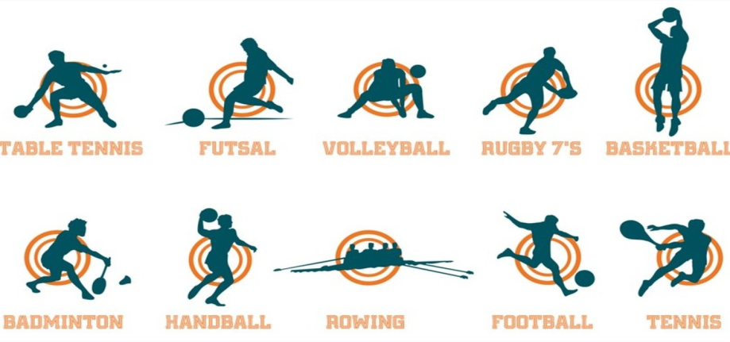

Introduction
Research related to operations management in sport stadiums relatively immature & underdeveloped
Research to date focuses on fan or athlete satisfaction
This is rather a missed opportunity as sport provides the potential for rich data and findings
  In the USA, the total fitness club industry revenue is sizable and is estimated to be $24.2 billion per annum (Statista, 2015)

Slide 3

The Aim
To develop and test a benchmarking framework to assess and quantify sport infrastructure and their operation focusing on three key themes:
  Estates and Premises
  Services offered
  Operations Management

Slide 4

Existing Literature
Research into sports operations management is incoherent and confused (Wright, 2009)
Very limited research into sporting facilities or layout (Bamford et al, 2017), or how the running of the stadium might affect the fan experience or outcomes (Vega-Vazquesz,2013)
Some identification of operations management issues that could improve customer satisfaction (Kauppi et al, 2013; Fitzsimmons,1985; Lovelock, 1992)

Slide 5

Methodology
A benchmarking framework based on existing literature and publicly available data was developed.
Three main themes emerged:
  Estates and Premises
  Services offered
  Operations Management

Slide 6
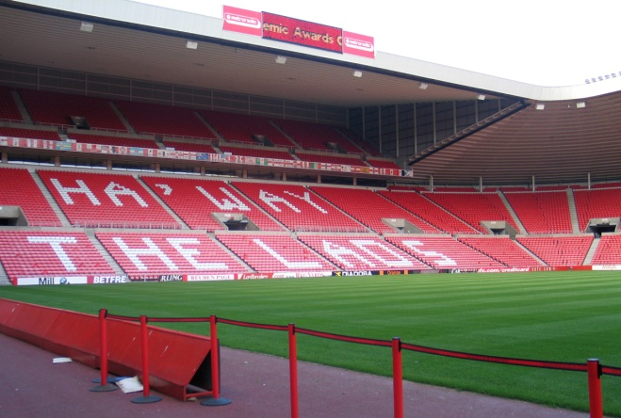
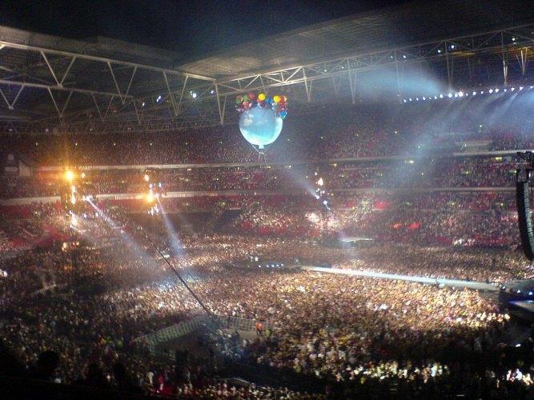
Benchmarking Framework
Ref | Indicator | Description
Estates and Premises
A1 | Design | The stadium is recognisable and there are clear ideas behind the design reflecting the clubs values
A2 | Size | The stadium has an appropriate scale and feels welcoming
A3 | Capacity and Utilisation | The capacity of the stadium suits demand
A4 | Estates Running Costs | The total yearly premises operating costs
A5 | Building Layout | The interior is logical, aesthetically pleasing and appropriately signposted
A6 | Building Facilities | Changing Rooms and player facilities are appropriate
A7 | Quality | General and durable finish
A8 | Ownership | How many different owners does the stadium have?
A9 | Age of Stadium | Year opened and date of last expansion or update
Services
B1 | Services Provision | A number of extra services are provided to the consumer
B2 | Connectivity | Does the Stadium have good wifi accessibility
B3 | Technology | Other technological services are offered (e.g. apps)
B4 | Ticketing | Amount taken from tickets / Tickets sold
B5 | Sponsorship | Sponsorship Services Provided
B6 | Hospitality | Number of boxes
B7 | Impact on the Community | The clubs impact on the community
Operations Management
C1 | Stadium Utilisation | How often is the stadium in use
C2 | Consumer Pathways | There are clear designed pathways for fans and spectators
C3 | Consumer Satisfaction | The fans/spectators satisfaction is assessed and corrective actions are taken
C4 | Accessibility | Public transport, road, parking, pedestrian access
C5 | Health & Safety | Health and Safety has clearly been taken into account (e.g. signposting, design)

Slide 7

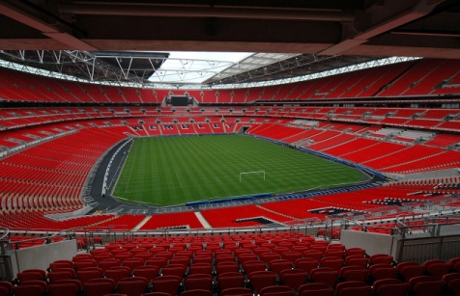

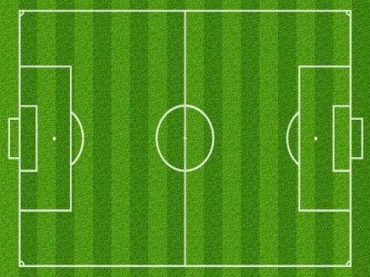
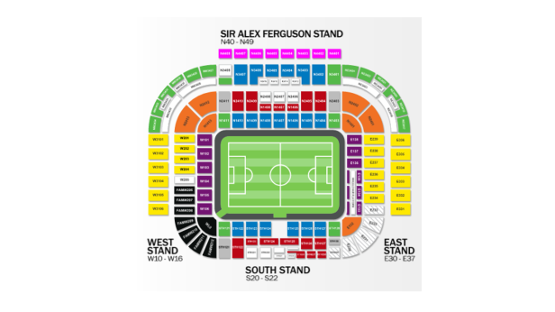
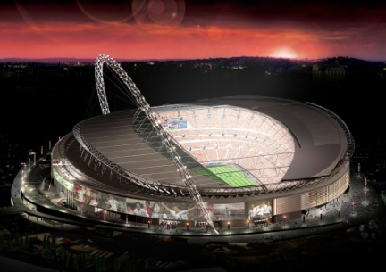
Methodology
Mixed approach – Qualitative and Quantitative data
Primary and secondary data
Stadium tours
Official statistics
Data translated to a 9 point scale to allow for comparisons

Slide 8
Findings
 | Indicator | Wembley | St James' Park | Stamford Bridge | Emirates | City of Manchester Stadium | Stadium of Light | Anfield | White Hart Lane | Old Trafford | Riverside | Average per Indicator
 | Estates and Premises
 | A1 | 9 | 5 | 7 | 5 | 9 | 9 | 5 | 3 | 9 | 9 | 7
 | A2 | 9 | 9 | 3 | 7 | 7 | 7 | 7 | 3 | 7 | 9 | 6.8
 | A3 | 9 | 9 | 3 | 7 | 7 | 7 | 7 | 3 | 9 | 7 | 6.8
 | A4 | 9 | 9 | 3 | 7 | 7 | 7 | 5 | 3 | 9 | 5 | 6.4
 | A5 | 7 | 3 | 7 | 9 | 3 | 9 | 7 | 9 | 5 | 1 | 6
 | A6 | 7 | 5 | 7 | 3 | 7 | 7 | 5 | 5 | 7 | 7 | 6
 | A7 | 7 | 9 | 9 | 9 | 7 | 7 | 7 | 5 | 9 | 9 | 7.8
 | A8 | 9 | 9 | 7 | 7 | 9 | 7 | 7 | 5 | 7 | 9 | 7.6
 | A9 | 5 | 9 | 9 | 9 | 9 | 9 | 5 | 9 | 5 | 5 | 7.4
 | Average | 7.89 | 7.44 | 6.11 | 7.00 | 7.22 | 7.67 | 6.11 | 5.00 | 7.44 | 6.78 | 6.87
 | Services
 | B1 | 9 | 9 | 5 | 7 | 7 | 7 | 7 | 3 | 9 | 7 | 7
 | B2 | 7 | 3 | 7 | 3 | 7 | 1 | 7 | 5 | 5 | 9 | 5.4
 | B3 | 5 | 5 | 3 | 5 | 9 | 1 | 7 | 1 | 9 | 9 | 5.4
 | B4 | 7 | 5 | 7 | 7 | 7 | 7 | 7 | 7 | 5 | 9 | 6.8
 | B5 | 9 | 9 | 9 | 9 | 9 | 5 | 7 | 7 | 9 | 7 | 8
 | B6 | 9 | 7 | 9 | 7 | 7 | 5 | 5 | 9 | 9 | 3 | 7
 | B7 | 9 | 9 | 3 | 7 | 9 | 9 | 9 | 3 | 7 | 7 | 7.2
 | Average | 7.86 | 6.71 | 6.14 | 6.43 | 7.86 | 5.00 | 7.00 | 5.00 | 7.57 | 7.29 | 6.69
 | Operations Management
 | C1 | 9 | 9 | 3 | 7 | 3 | 3 | 3 | 3 | 9 | 3 | 5.2
 | C2 | 7 | 3 | 7 | 3 | 7 | 5 | 7 | 3 | 9 | 7 | 5.8
 | C3 | 5 | 9 | 9 | 5 | 7 | 3 | 5 | 7 | 7 | 7 | 6.4
 | C4 | 9 | 7 | 5 | 5 | 9 | 7 | 3 | 5 | 3 | 5 | 5.8
 | C5 | 9 | 3 | 9 | 5 | 9 | 5 | 9 | 5 | 9 | 9 | 7.2
 | Average | 7.8 | 6.2 | 6.6 | 5 | 7 | 4.6 | 5.4 | 4.6 | 7.4 | 6.2 | 6.08
 | Stadium Average | 7.86 | 6.90 | 6.24 | 6.33 | 7.38 | 6.05 | 6.24 | 4.90 | 7.48 | 6.81 | 6.62

Slide 9

Discussion
Benchmarking scores
  Context is needed to explain some of the scoring
Benchmarking framework and Methodology
  Conflicting data from different sources
  Tours not representative of actual operations
  Subjective nature of qualitative indicators
  Data translation

Slide 10

Conclusions
Benchmarking in this setting is a useful tool to compare the operations management of different sporting stadiums
The framework developed needs to be improved, other sources of data need to be considered, and the methodology needs to be adapted
The sample needs to be expanded, and needs to include other sporting venues

Slide 11
Thank you!
Any Questions?

Slide 12
References
Bamford.D, and Dehe.B (2013), “Servicescape in Sports: levels of fan satisfaction in a UK Rugby League Club”, in proceedings of 20th International Annual EurOMA Conference, Dublin, Ireland.
Bamford, D., and Dehe, B. (2015) Service quality at the London 2012 Games – a Paralympics Athletes Survey. International Journal of Quality & Reliability Management
Bamford, D., Dehe, B., Reid, I., Bamford, J. and Papalexi, M. (2017) ‘POM for sports’. In: The Routledge Companion to Production and Operations Management. Oxford, UK: Routledge. p. 28
Fitzsimmons, J.A. (1985),Consumer participation and productivity in service operations, Interfaces, Vol. 15 No. 3, pp. 60-67.
Howat, G. Murray, D. Crilley, G. (1999), The relationship between service problems and perceptions of service quality, satisfaction and behavioural intentions of Australian public sports and leisure centre customers, Journal of Park and Recreation Administration, Vol. 17, No. 2, pp. 42–64
Kauppi.K, Moxham.C, and Bamford.D. (2013) “Should we try out for the major leagues?” A call for research in sports operations management, International Journal of Operations and Production Management, 33 (10):1368-1399.
Lovelock, C. (1992), Strategies for managing capacity-constrained resources, in Lovelock, C. (Ed.), Managing Services: Marketing, Operations and Human Resources, Prentice-Hall, Englewood Cliffs, NJ.
Parasuraman, A. Zeithaml, V. Berry, L. (1985), A conceptual model of service quality and its implication for future research, Journal of Marketing, Vol. 49, pp. 41–50.
Statista – the statistics portal (2015) “U.S. fitness center / health club industry revenue from 2000 to 2014 (in billion U.S. dollars)”, http://www.statista.com/statistics/236120/us-fitness-center-revenue/ accessed 21 /07/15
Vega-Vazquez, M., Revilla-Camacho, M., and Cossío-Silva, F. (2013),"The value co-creation process as a determinant of customer satisfaction", Management Decision, Vol. 51 Iss 10 pp. 1945 - 1953

