Slide 1
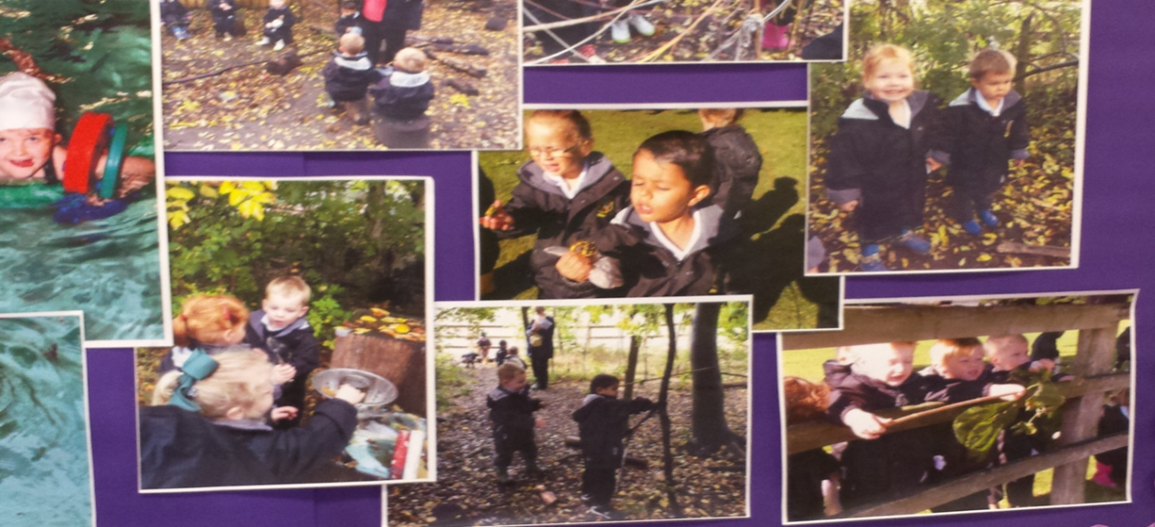
SEPD Staff Conference
7th April 2016
What’s so interesting outside?
‘Well-being and Involvement Scales’
Judith Hunter

Slide 2
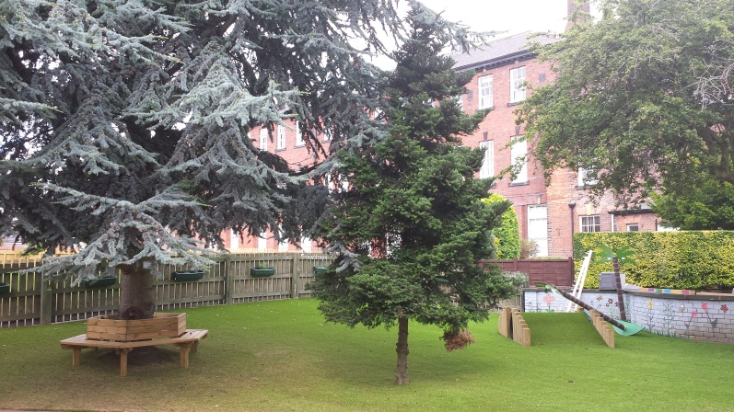
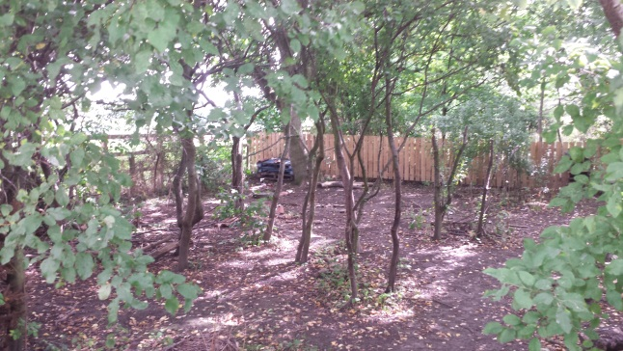
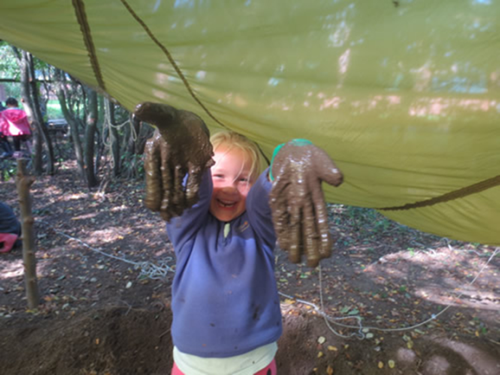
Outdoor Play Spaces & Pedagogy
An exploration into the different affordances of outdoor play spaces and the relationship to early childhood pedagogy

Slide 3
Research aims
To gain a deeper understanding of the ways in which children are given opportunities to shape their learning in outdoor environments.
To explore the interactive relationship between teachers, children and their environment.
To identify how outdoor environments affect the pedagogy of teachers and practitioners.

Slide 4
Children as co-researchers
Young children as active participants and competent meaning makers as explorers of their environment
To identify aspects of the outdoor environment that are of special interest to them and not that imposed by adults.
The Mosaic approach (Clark and Moss, 2001) brings together a range of methods for listening to young children about their lives.
Notes:
Co-researchers, participatory to develop relationships
Intention is to observe how the children, practitioners using a range of outdoor play spaces

Slide 5
Literature
The positive experiences offered to children are dependent on the practitioners’ values and expertise (Jarvis, Brock & Brown, 2014).
The need to inspire practitioners to build learning outside the classroom in natural environments into their teaching practice (Rickinson, Hunt, Rogers and Dillon,2012).
Working outside requires practitioners to develop a range of pedagogical skills. Through considering progression in learning, we can move away from activity-driven experiences to learning dispositions developed through inter-curricular experiences from birth to 11 years old (Warden, 2015).

Slide 6
Forest School

Slide 7
Ferre Laevers (2005)

Slide 8
Leuven Scales: Well-being
Children with a high level of well-being feel great. They enjoy life to the full.
They have fun, take joy in each other and in their surroundings.
They radiate vitality as well as relaxation and inner peace.
They adopt an open and receptive attitude towards their environment.
They are spontaneous and can be fully themselves.
Well-being is linked to self-confidence, a good degree of self-esteem and resilience.
All this is based on being in touch with themselves, with their own feelings and experiences.

Slide 9
Leuven Scales: Involvement
Children with a high level of involvement are highly concentrated and absorbed by their activity. They show interest, motivation and even fascination. That is why they tend to persevere.
Their mimic and posture indicate intense mental activity. They fully experience sensations and meanings.
A strong sense of satisfaction results from the fulfilment of their exploratory drive.
When there is involvement we know children are operating at the very limits of their capabilities.
Because of all these qualities involvement is the condition that brings about deep level learning.

Slide 10
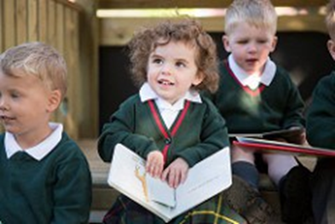
Meet Ruby...

Slide 11
Ruby and cobwebs

Slide 13
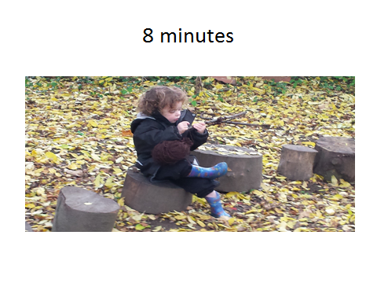

Slide 15
Analysis: Ruby ...
Scale of well-being
During the observation Ruby is enjoying the activity:
looks happy and cheerful;
talks to herself, hums;
is relaxed, does not show any signs of stress or tension;
is open and accessible to the environment;
expresses self-confidence and self-assurance.
Ruby’s well being is extremely high
Scale of Involvement
During the observation Ruby is continuously engaged in the activity and completely absorbed in it:
is absolutely focussed, concentrated without interruption;
is highly motivated, feels strongly appealed by the activity, perseveres;
even strong stimuli cannot distract her;
is alert, has attention for details, shows precision;
her mental activity and experiences are intense;
she constantly addresses all her capabilities; imagination and mental capacity are in top gear;
obviously enjoys being engrossed in the activity.
Ruby’s involvement is extremely high

Slide 16
References
Blandford, S. and Knowles, C. (2009). Developing Professional Practice 0 – 7. Harlow: Longman.
Clark, A. and Moss, P. (2001). Listening to Young Children: The Mosaic approach. London: National Children’s Bureau.
Greenfield, C. (2004). ‘Transcript: 'Can run, Play on Bikes, Jump on the Zoom Slide and Play on the Swings’’; Exploring the Value of Outdoor Play’. Australian Journal of Early Childhood 29(2):1-5.
Jarvis, Brock & Brown, (2014). Three Perspectives on Play in Brock, A., Jarvis, P. and Olusoga, Y. (Eds) in Perspectives on Play: Learning for Life. (2-28). London: Routledge.
Rickinson, M., Hunt, A., Rogers, J. & Dillon, J. (2012). School Leader and Teacher Insights into Learning Outside the Classroom in Natural Environments – A study to Inform the Natural Connections Demonstration project. London: Natural England.
Warden C. (2015). Learning with Nature; Embedding Outdoor Practice. London: Sage.

