Slide 1
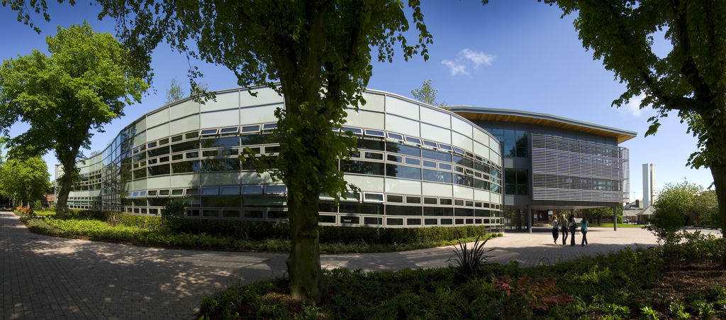
SOLSTICE & CLT Conference 2014
Encompassing design – exploiting the VLE to create the online resource for nursing students planning a voluntary placement
Karen Currell and Paul Dagg, University of Huddersfield
5th & 6th June 2014

Slide 2
Why?
Curriculum Driver
Employability – competitive job market
Gives our students a USP
Adds to richness of training
Can help meet EU Experience requirements

Slide 3
Why Unilearn?
Flipping the VLE
Walled Garden
Accessibility
Ease of use for staff and students

Slide 4
Branding
EnCompass:
Compass : instrument to find way – navigate
En - enable , enveloping , involving all

Slide 5
Content
Local, national and international opportunities
Funding
Student stories
Discussion boards

Slide 6
Content

Slide 7
Security and Safety
Legal disclaimer
Guidelines
Student behaviour
Monitoring for inappropriate use of site

Slide 8
Future plans
Blogs
Student Stories
Discussion Board
Expand Across University

Slide 9
THANK YOU !!
Questions

