Slide 1
Widening Participation, Social Mobility and Higher Education in Further Education Colleges
Kevin Orr
University of Huddersfield
Notes:
Personal attachment; I have taken an HE in FE course; I am a module leader; VOCATIONAL
HE in FE has a value. Keep recognising structural barriers to mobility.
But in this paper I want to take a critical look at claims that HE in FE provides any systematic or general route to social mobility or even social justice. I will use data from various official sources to examine what is happening in HE and in FE in HE in particular.

Slide 2
Overview
Policy Exchange described HE in FE as having the potential to be an “engine for widening participation and social mobility” (Hartley & Groves, 2011, p. 5)
What is social mobility?
How does widening participation in education relate to social mobility?
What is the value of HE in FE?
Notes:
Other questions have arisen along the way?
So, statistics; what inferences we can make from those statistics; then some discussion of the implications.
In 2011, for example, the influential Policy Exchange thinktank argued precisely that HE in FE in England can be an “engine for widening participation and social mobility”,

Slide 3
Statistics and statistical reports
Types of HE in FE: prescribed and
non-prescribed
Main sources of data:
HEFCE
HESA
UCAS
Notes:
Here I focus on prescribed (directly funded by HEFCE), larger but more easily available data.
Hoelscher and Hayward: amongst those to criticize lack of a single useable dataset.
I have not used any statistical modeling, not had access to raw data, which is a weakness. Possible to look at Youth Cohort Study for some more granularity.
Young people only

Slide 4
What is social mobility?
The former Coalition government was keen to promote social mobility (Cabinet Office, 2011) defining it as “a measure of how free people are to improve their position in society” (Cabinet Office, 2011, p. 15).
The government specified its commitment to a relative measure of social mobility and to the upward movement of people by comparison to general society.
Notes:
any relative measure of social mobility “necessarily implies downward mobility for children from rich/middle income families”, which poses significant political challenges for any government to express. So, at least in England, downward mobility is unmentioned.

Slide 5
What is Widening Participation?
The Higher Education Funding Council for England (HEFCE) describe WP as “the opportunity of successful participation in higher education to everyone who can benefit from it” (HEFCE, n.d.).
Office for Fair Access (OFFA) states on their website that WP “refers to the participation of disadvantaged groups in higher education generally.”

Slide 6
Trends in English higher education
Application rates to all higher education for those aged 18 in 2014 and 19 in 2015 increased in England to 44 per cent by the January 2015 deadline. There are significant regional variations.
Fall in applications from those aged over 19.
(UCAS, 2015)
Notes:
Emphasis on England but…all of HE huge change, even before removal of the cap on student numbers
This masks some wide regional variations: for example the rates were 44 per cent in London and 30 per cent in the South West (HEFCE, 2014a 12-13).

Slide 7
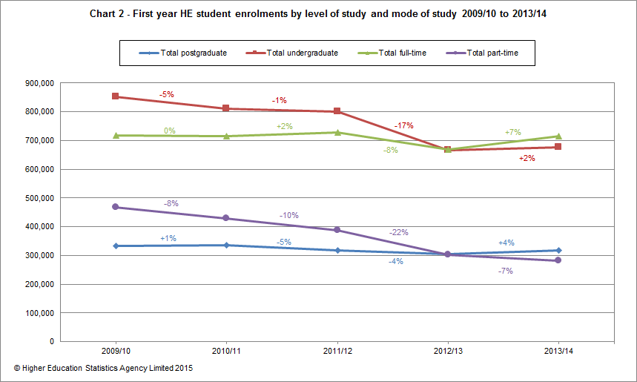
First year HE enrolments by level of study and mode of study
2009/09 to 2013/14
Notes:
There has been a recovery this year, but look at PT, which is nose-diving. UK figures

Slide 8
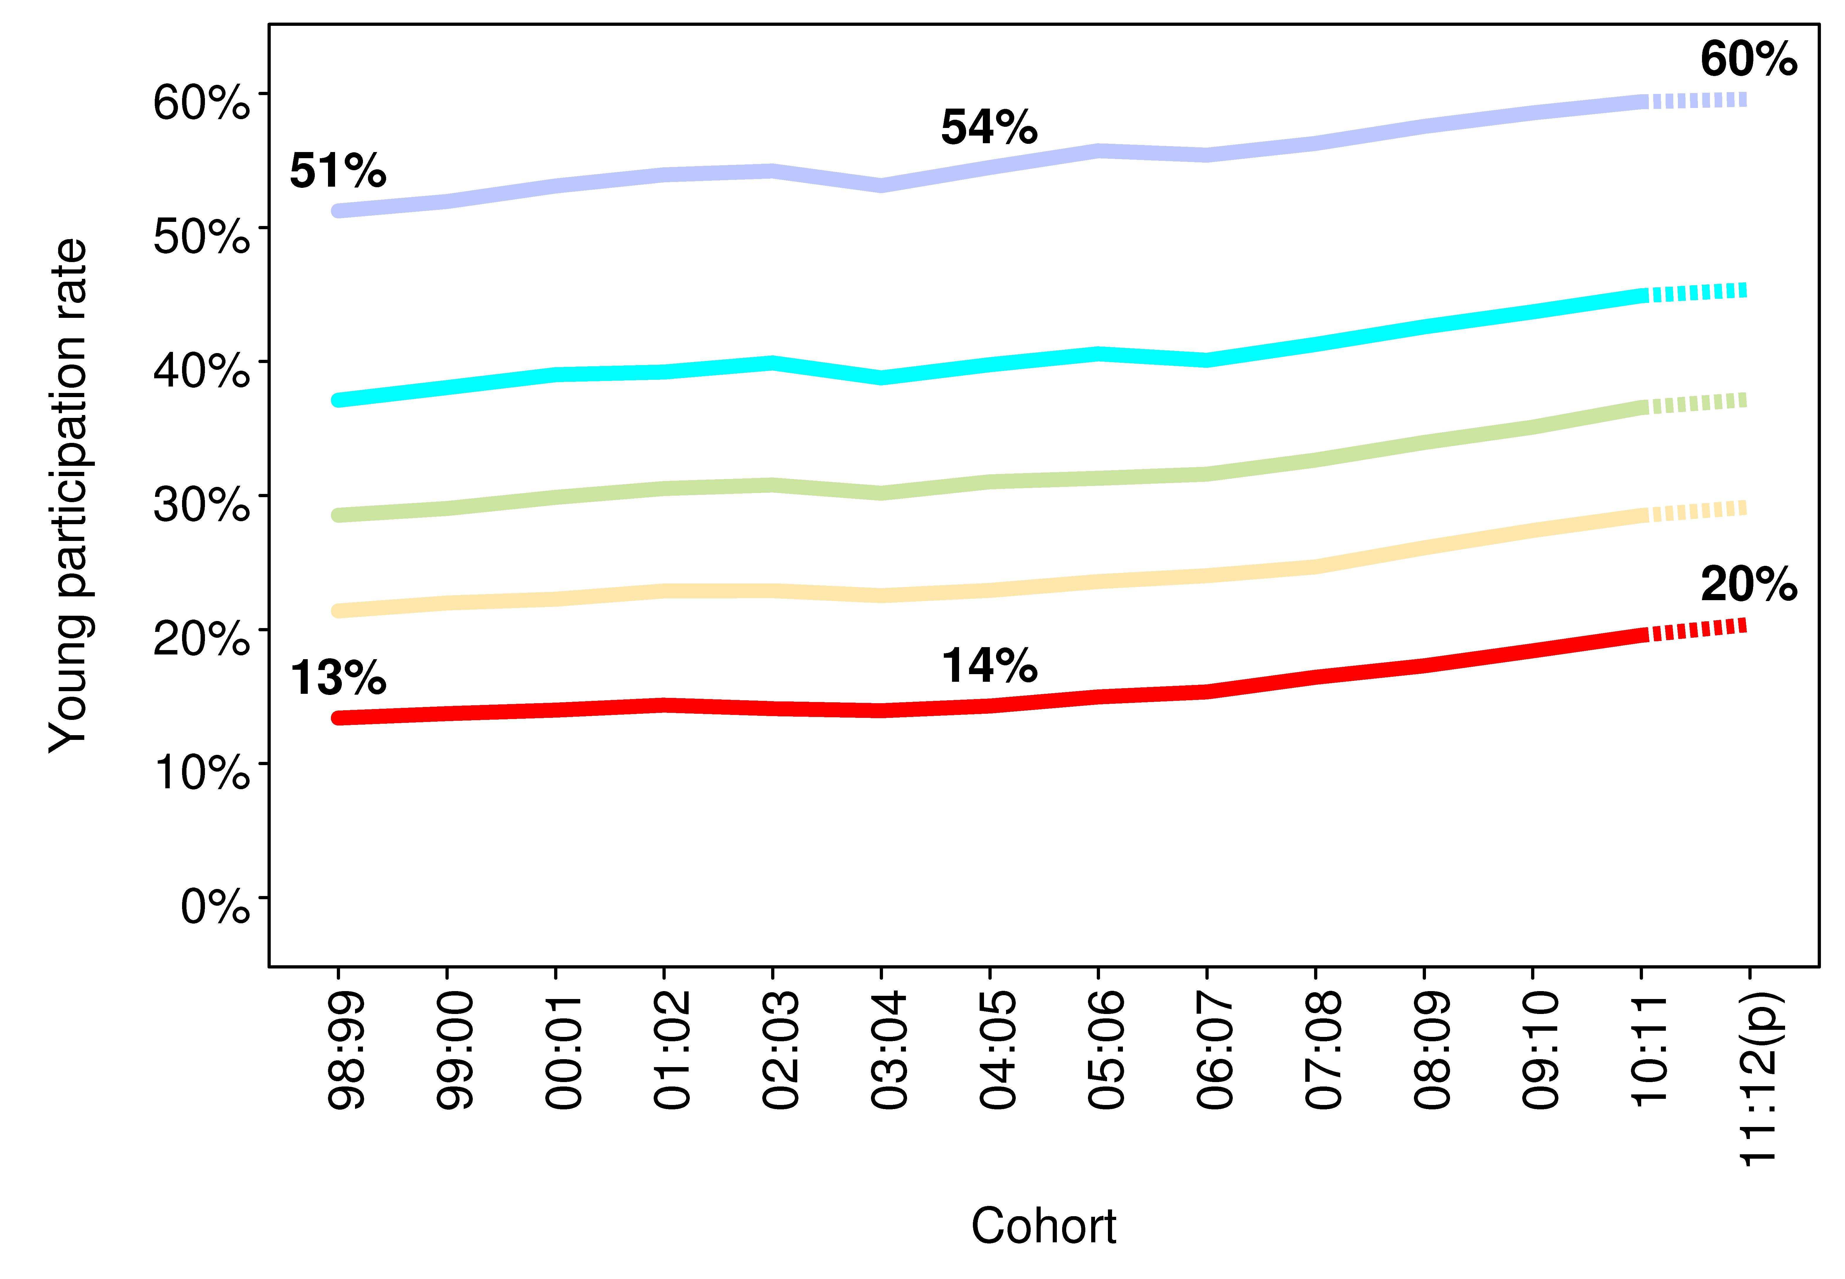
Trend in young participation rate for areas classified by HE participation rates
(POLAR3 classification, adjusted)
Notes:
We have had WP. A significant success
The cross-section of the population in education is similar in its proportions, even if the numbers in that cross-section are stable. So, as FE colleges transform their HE provision, the students proportionally remain those who are most disadvantaged. Plus ça change, plus ç’est la meme chose.
This is also borne out in Free School Meal statistics, which are in the paper,
So what of FE in HE?
Explanations suggested by Parry et al (2012: 11):
“the specificity of the local and regional markets for students and for courses sought by employers”
“low visibility and status” of HE in FE
the organisation of higher education so as “to keep HE and FE in separate sectors”
Resilience and adaptability of FE in HE and of colleges more specifically.
One more: the changing nature of inequality and its durability

Slide 9
Trend in young participation rate for areas classified by HE participation rates
(POLAR3 classification, adjusted)
Notes:
The differential remains.
The cross-section of the population in education is similar in its proportions, even if the numbers in that cross-section are stable. So, as FE colleges transform their HE provision, the students proportionally remain those who are most disadvantaged. Plus ça change, plus ç’est la meme chose.
This is also borne out in Free School Meal statistics, which are in the paper,
So what of FE in HE?
Explanations suggested by Parry et al (2012: 11):
“the specificity of the local and regional markets for students and for courses sought by employers”
“low visibility and status” of HE in FE
the organisation of higher education so as “to keep HE and FE in separate sectors”
Resilience and adaptability of FE in HE and of colleges more specifically.
One more: the changing nature of inequality and its durability

Slide 10
Social justice or human capital?
The OECD (2001: 18) defines human capital as: The knowledge, skills, competencies and attributes embodied in individuals that facilitate the creation of personal, social and economic well-being.
The concept of human capital has the effect of rendering individuals responsible for their own perpetual development to enhance their value in the market place, regardless of structural restrictions.
Notes:
While the economic crisis has somewhat dampened rhetoric associated with the knowledge economy, there remains in the UK an emphasis on the supply side for skills, as a means to economic development.
So, for government, the job is done (not quite mission accomplished) for widening participation. More people in HE (worried about drop, now recovered), but those in colleges tend to be on lower level, lower status courses.
this does not necessarily suggest social mobility as the social differences remain intact

Slide 11
Destinations of full-time first degree qualifiers from English HE providers by academic year and institution type

Slide 12
Full-time first degree qualifiers in full-time paid UK employment by salary band and institution type six months after graduation
Notes:
More figures in the paper, but essentially, HE per se does not lessen inequality, and HE in FE certainly does not.
Danny Dorling
Wilkinson and Picket
HE in FE teachers can only fail to achieve social mobility.

Slide 13
So…
We have seen significant widening participation in higher education.
Widening participation in college-based HE has not systematically led to social mobility measured in income or by occupation.
Notes:
To ask it to do so is to ask to much

Slide 14
So, can HE in FE promote social justice?
Notes:
Assessing the systematic economic outcomes of HE in FE is important, but those are not the only criteria by which to judge the value of college-based HE, at least for individual students. What Gale graphically explains for the context of Australian HE also holds for England:
Simply persuading more people from disadvantaged backgrounds onto HE in FE courses is, perhaps, an example of such a limited view of equity.

Slide 15
“While university student recruitment departments focus on ‘bums on seats’, equity advocates draw attention to which bums, in what proportions and, more to the point, which seats, where. But if the counting of ‘bums’ is crude, so is the differentiation of seats. Just distinguishing between courses and universities and scrutinizing the distribution of groups is a limited view of equity.”
(Gale, 2012, p. 138)
Notes:
Simply persuading more people from disadvantaged backgrounds onto HE in FE courses is, perhaps, an example of such a limited view of equity.

Slide 16
HE in FE practitioners
“Progressive educators practicing (sic) in less elite settings are trapped into a series of promises they cannot realise, while those in elite institutions are largely involved in a logic of reproduction not transformation.”
“Thinking about curriculum is essential for a critique of the utilitarianism that underpins much pedagogy” (Clegg 2011: 94)
Notes:
HE in FE educators cannot affect the weak exchange value of their courses which reflect their position.
Bums on seats
Employability discourse

Slide 17
Curriculum matters
“If vocational education qualifications are to enable people to gain valuable knowledge and skills, and are to open up opportunities rather than constrain and limit futures, then questions of knowledge in these qualifications, and how these questions are decided, are crucial.”
Bathmaker (2013: 88)

Slide 18
For many individuals who otherwise would never access HE, HE in FE courses are transformative because they open up fields of knowledge that may explain and enhance experience and they may also open up opportunities for employment.
That may not change society, but it might change lives.

