Slide 1
Embedding Open Access at
The University of Manchester
Helen Dobson
Scholarly Communications Manager

Slide 2

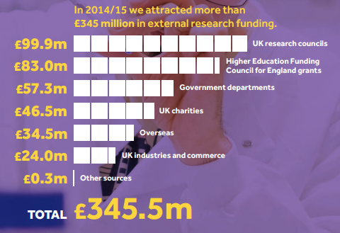
4000 research staff
3500 PGR students
5000 research papers

Slide 3

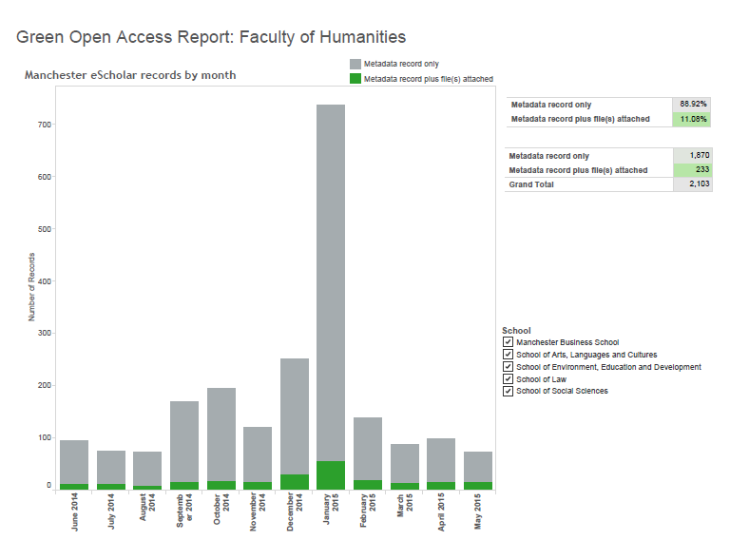

Slide 4
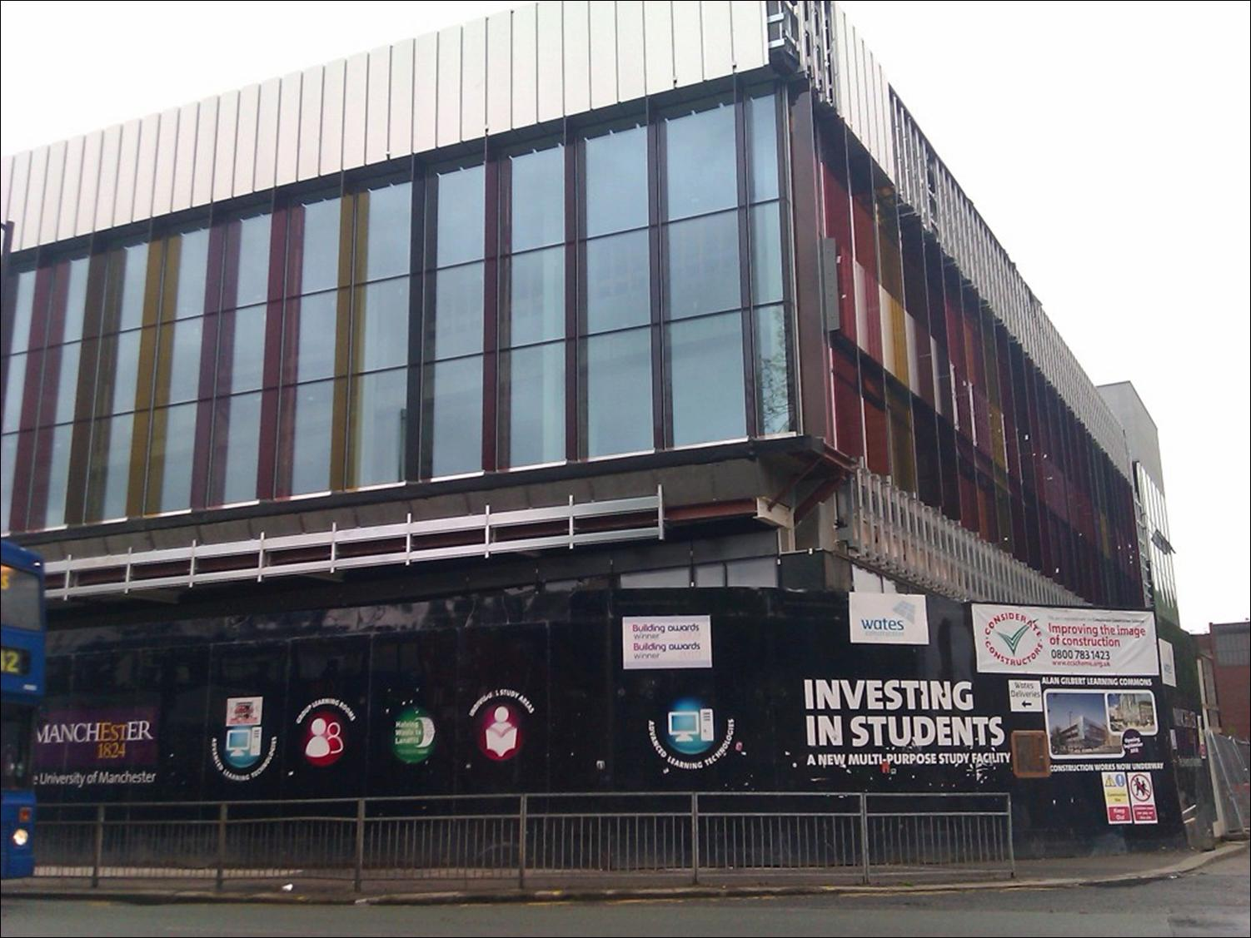
Faculty Team
Faculty Team
Faculty Team
Faculty Team
Faculty Team
E Learning Support
Information Skills
Teaching & Learning
Research Services
Academic Engagement

Slide 5
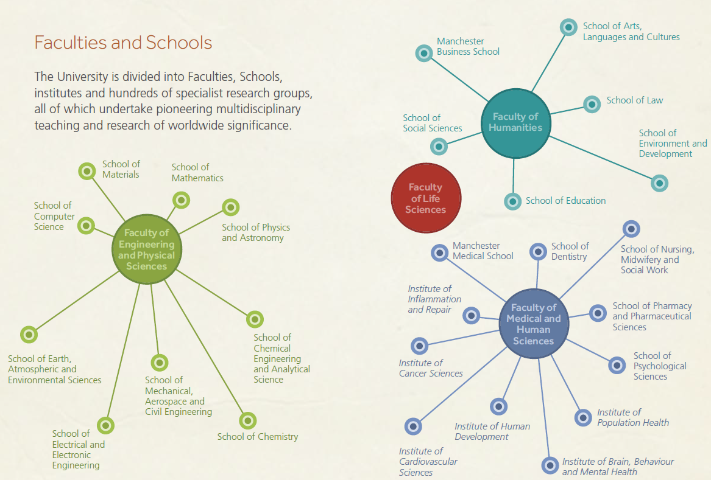

Slide 6
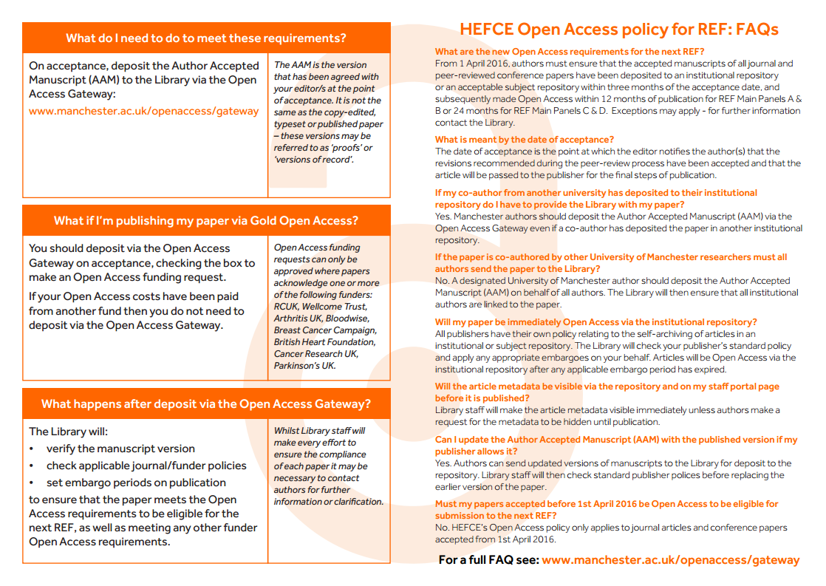
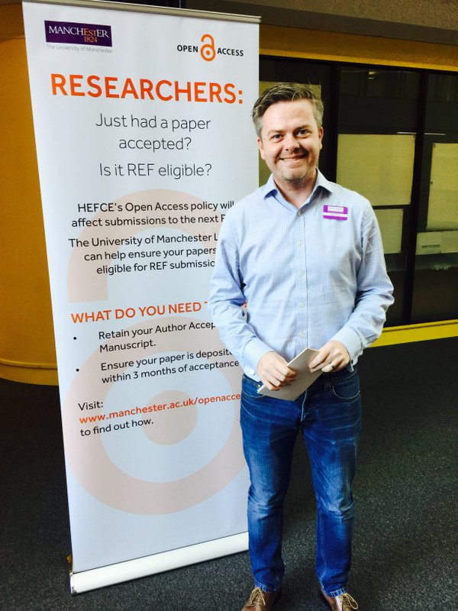





Slide 7

Notes:
To keep high on agenda

Slide 8
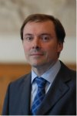
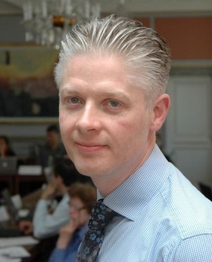
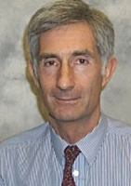
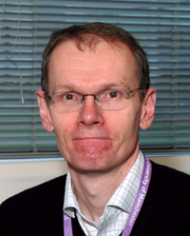
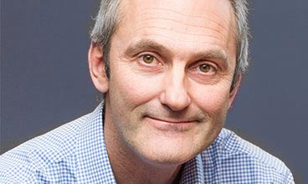
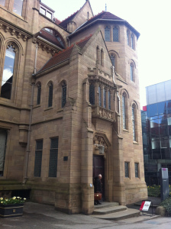
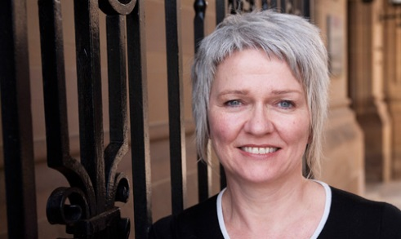
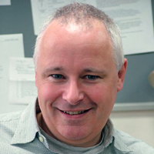
Notes:
https://culturecafecapital.wordpress.com/tag/manchester-history/

Slide 9


Slide 10
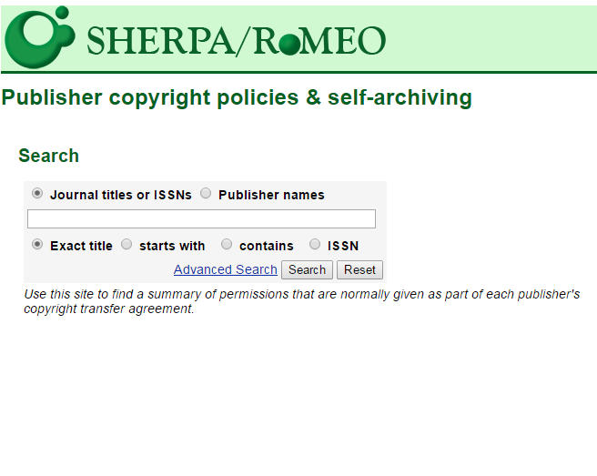
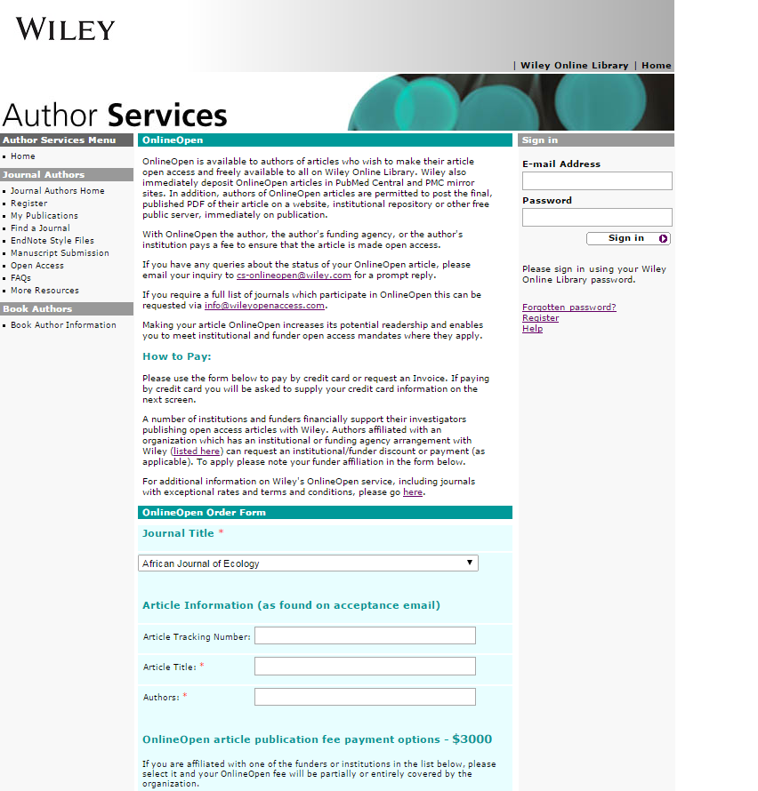
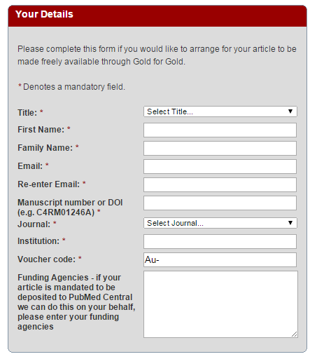
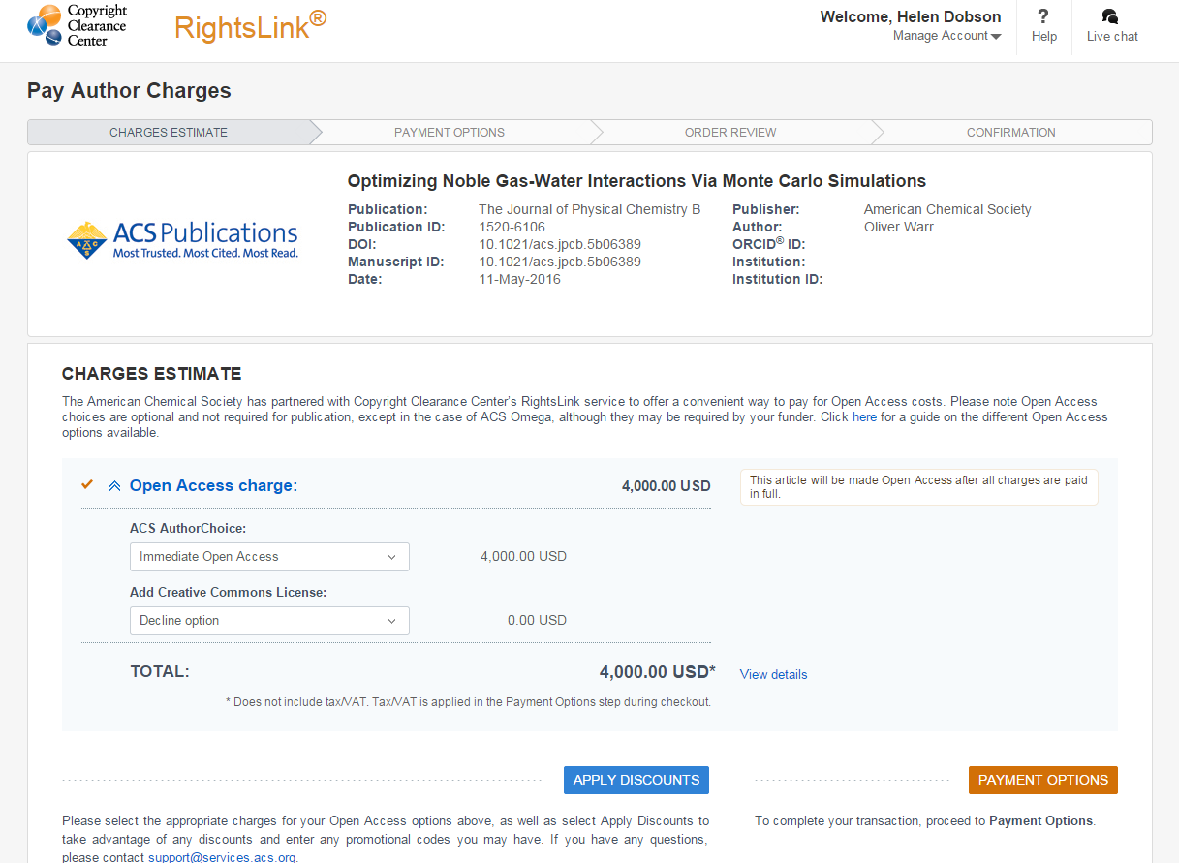

Slide 11
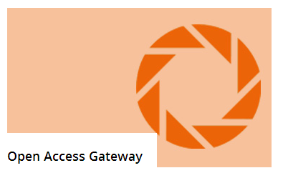

Slide 12
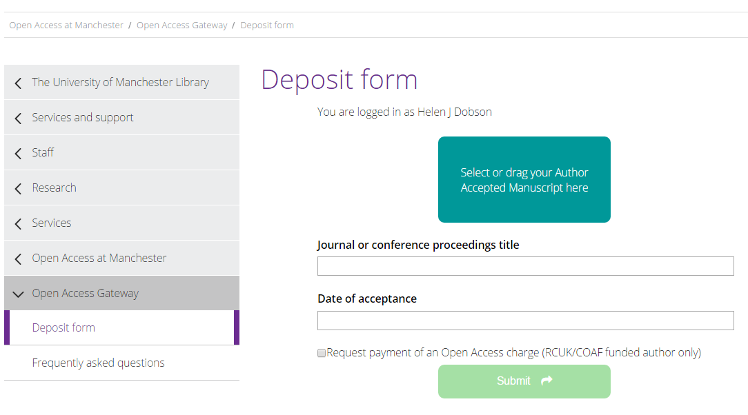
Screenshot of Open Access Gateway deposit form

Slide 13
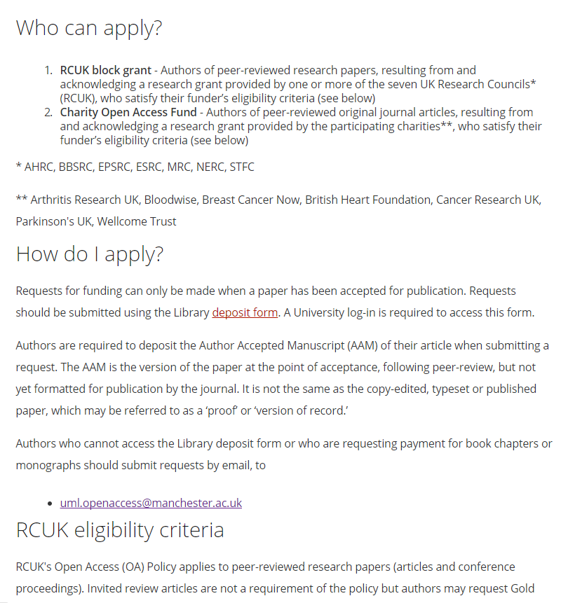

Slide 14
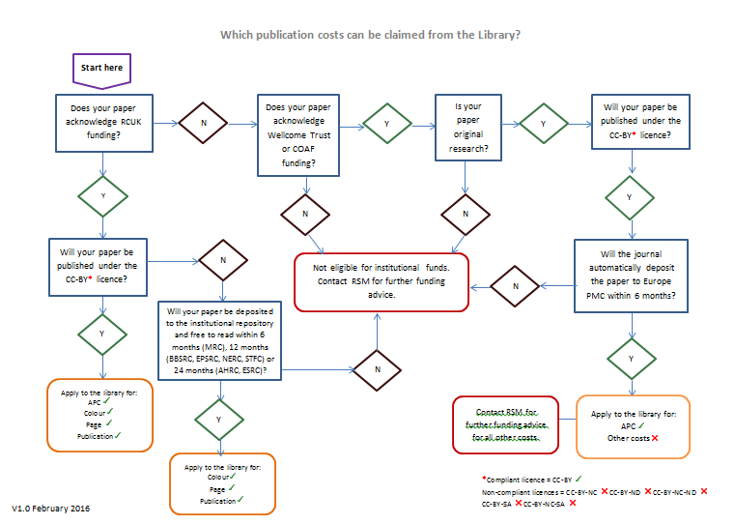

Slide 15
Publisher | Summary |  | Acceptance email | Post-acceptance admin
Wiley | For RCUK-funded authors only Wiley OnlineOpen 25% discount on APC We have deposited a sum of money into a pre-payment account. Eligible APCs can be paid for via deduction of this account Payment handled via Wiley dashboard | Prepaid APC (no invoice requirAPC payment conditions ed) | Select generic email template ‘Accept – RCUK + Wiley’ Your request of xx/xx/xxxx, for payment of an Article Processing Charge (APC) relating to the following publication has been accepted. Article title: Journal title: Please now complete your publisher's OnlineOpen form. Wiley OnlineOpen form On this form, select Manchester University from the 'Funder/institution Payment drop-down box' and use the following information to complete the Billing Address:... See Guidance material 20 for non-standard Wiley journals. For standard journals: | Check Wiley dashboard for funding request (we receive email notifications of new dashboard requests). If APC already created and accepted, approve. We may receive Wiley dashboard requests before APC created. Determine funder, and use either Email template 3 , 4 or 5 to contact author.

Slide 16
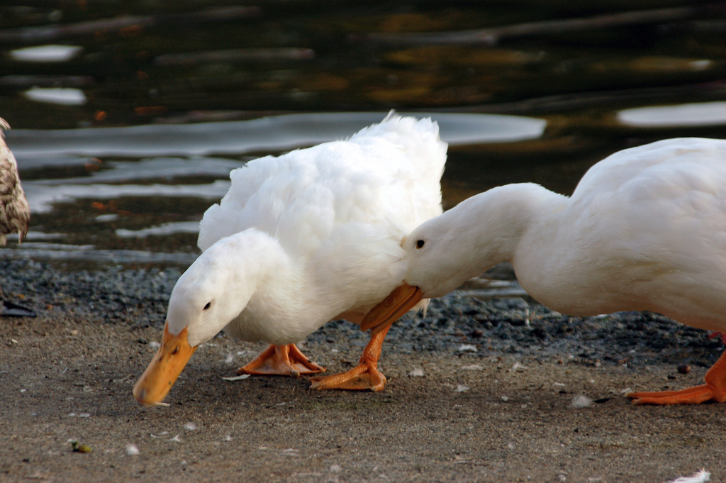
Notes:
https://www.flickr.com/photos/motleye/1459708018/in/photolist-3dZokC-32HAS-32HET-D1fU-dJA5qf-32HC4-32HDi-32HFs-2rDfwk-8sFd2C-32HzJ-32HJ4-dfFULs-7mZVbY-pXZkyf-4Repfx-cn3Vbq-bFtHC8-884PDy-nhDa5k-5eBZRo-nV9Fe9-7GzLX4-9hDhxw-77rKbq-5E3qgK-ocmcyF-6NBX6-8M1DmN-7VRCpS-ocDsEx-8MRARC-VA9VX-nVa3b8-nVaTJe-s4sru-4Hybht-5ZdFwL-5UXTEf-aBEf9h-eSvi31-vsAKYF-6ZNse6-ivChyz-nV9FuQ-5hgL8v-LqLA6-32HBq-oaB9Ld-oeqq7Z

Slide 17
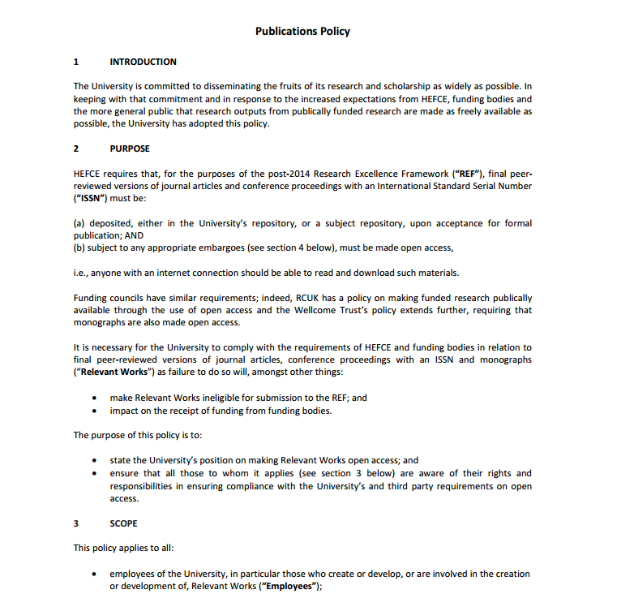

Slide 18
Non-HEFCE

Slide 19
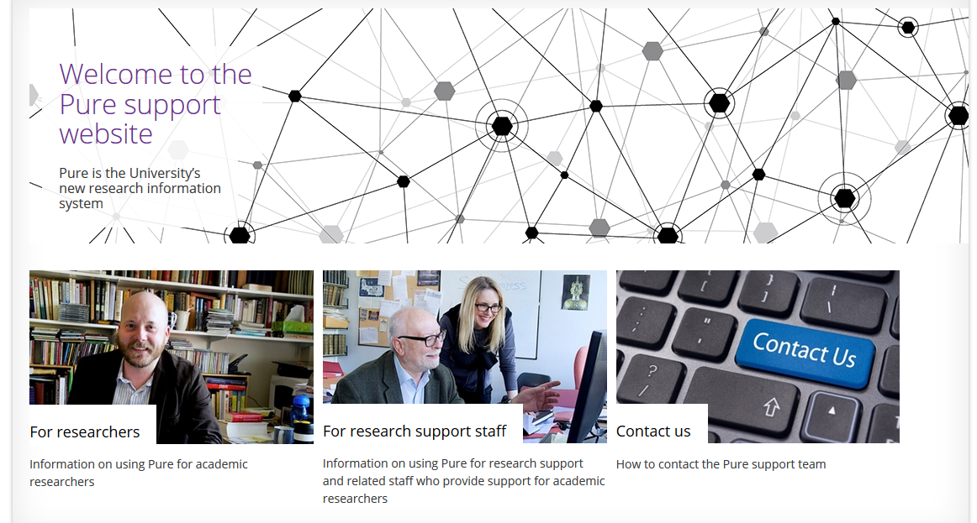

Slide 20
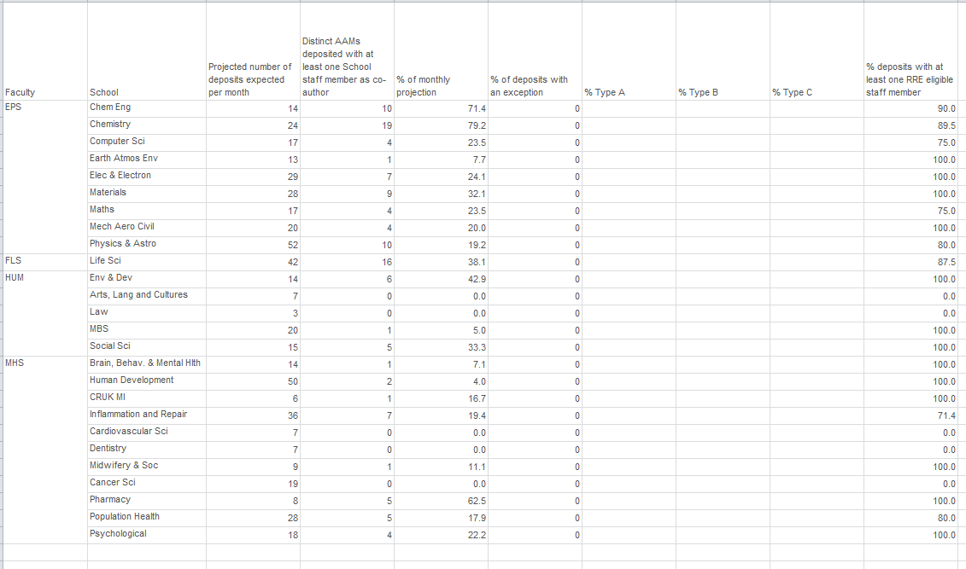

Slide 21
