Slide 1
OA at Lancaster University
Louise Tripp
Academic Liaison Librarian and Open Access Manager
l.tripp@lancaster.ac.uk
@WeesyT

Slide 2
2
Agenda

Slide 3
Agenda
3
1. E2E project
The overall aim of the project.
5. Structures supporting OA
How Lancaster University developed its OA policy, and the support for implementing it.
2. Systems
The use of EPrints for OA at Glasgow and Pure/Hydra at Lancaster University.
6. Advocacy
How Lancaster University is getting the OA message across.
3. Processes
How the E2E project influenced Lancaster University to change its OA processes.
7. Future Developments
What Lancaster University hopes to implement in the future.
4. Compliance reporting
How Lancaster University created compliance reports at the start of the project, and the role Pure plays in these.
Questions

Slide 4
E2E project

Slide 5
E2E Project Aim
Open Access process review and improvements
End-to-End
E2E partners: University of Glasgow, Lancaster University, University of Southampton, University of Kent.
Aim of the project: to improve OA metadata management via EPrints whilst considering transferability of outputs to other platforms.
http://e2eoa.org/

Slide 6
Systems

Slide 7
Systems used in E2E Project
7
GLASGOW
Uses Eprints. Case study:
McCutcheon, V and Eadie, M, Managing open access with EPrints software: a case study, Insights, 2016, 29(1), 45–52; DOI: http://dx.doi.org/10.1629/uksg.277
LANCASTER
Uses Pure, but is exploring the use of Hydra as a secondary repository. HHuLOA is looking at Hydra as part of its project.

Slide 8
Processes

Slide 9
9
Change of Processes at Lancaster University
Evidence of acceptance
After comparison with other institutions Lancaster no longer requires evidence of acceptance to be stored in Pure.
Efficiency in applications
HoD or ADR approval no longer required for RCUK funding requests.
Simplification of deposit requirements
Ask author to complete essential fields only. Customisation of Pure by adding highlighting to these fields.
Using additional publisher/database feeds
Utilising feeds from Elsevier, Scopus and Web of Science. Following up with emailing author for AAM.

Slide 10
Reporting

Slide 11
Reporting on Compliance
11
Start of the Project
HEFCE policy was not in place. Data capture from Pure combining reports. Much manual work.
Summary of compliance from Pure for 2015 53% of those journal articles and conference papers published 01/05/15-31/12/15 were compliant. Much manual work to enhance Pure report: combine several reports; web services to extract licence information; reformatting of data; no information on timing of deposit. Used as a basis to communicate with depts.
Compliance check on validation
Lancaster University OA policy means all Pure records checked for compliance since 1 May 2015.
Follow up in Library Enquiry System
Contact author if: no AAM, no acceptance date, no project code.
If no reply from author send follow up in 7 days.
Further follow up in 14 days.
Run monthly report to contact department if still no contact.
Pure reporting in 2016
Seen some improvements, but still having difficulties.
Awaiting bug fix so that data in single fields can be separated out.
Again combined multiple reports and some manual work checking records.
Monthly reports to departments.

Slide 12
Structures
supporting
Open Access

Slide 13
13
ROADMaP
Research, Open Access, Data Management and Pure
ROADMaP Steering Group
Chaired originally by PVC(R) and now by Director of Research, Enterprise and Innovation.
Membership includes Director of ISS, Head of Research Services, Head of Digital Innovation, Head of Academic Services, ADRs for all faculties.
Introduction of OA policy 1 May 2015
Policy incorporates key elements of the HEFCE OA policy.
Checklist summarises key points of the policy.
Communication
Strengthening OA message via ADRs and Research Directors.
Open Access Working Group
Comprising research directors, Library staff, academic staff in departments.
Working alongside working groups for Pure and RDM to work through processes, address issues e.g. journal compliance.

Slide 14
Advocacy

Slide 15
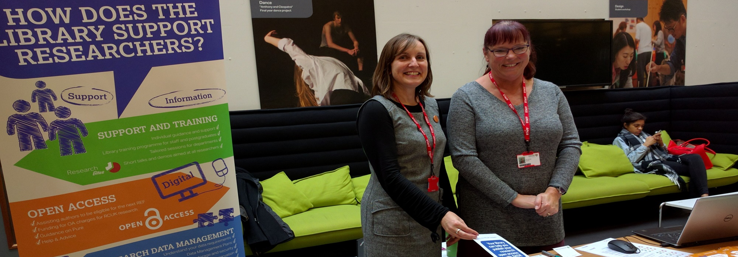
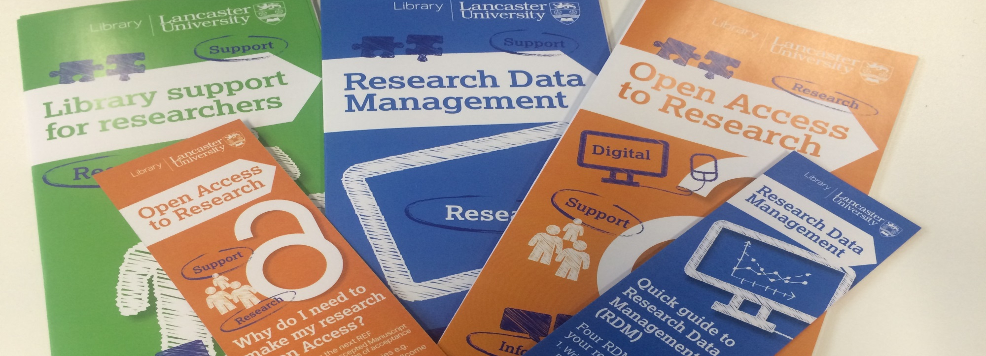
What Do We Do ?
Liaison/Events
Open Surgeries and Roadshows across campus, establishing links with research administrators
Attendance at departmental meetings, combining OA and RDM
OA drop-in sessions, Research Bites, Research Programme OA session.
Guidance
Leaflets and bookmarks, combining with RDM
OA webpages
Online OA and RDM course in development – compulsory for all new staff

Slide 16
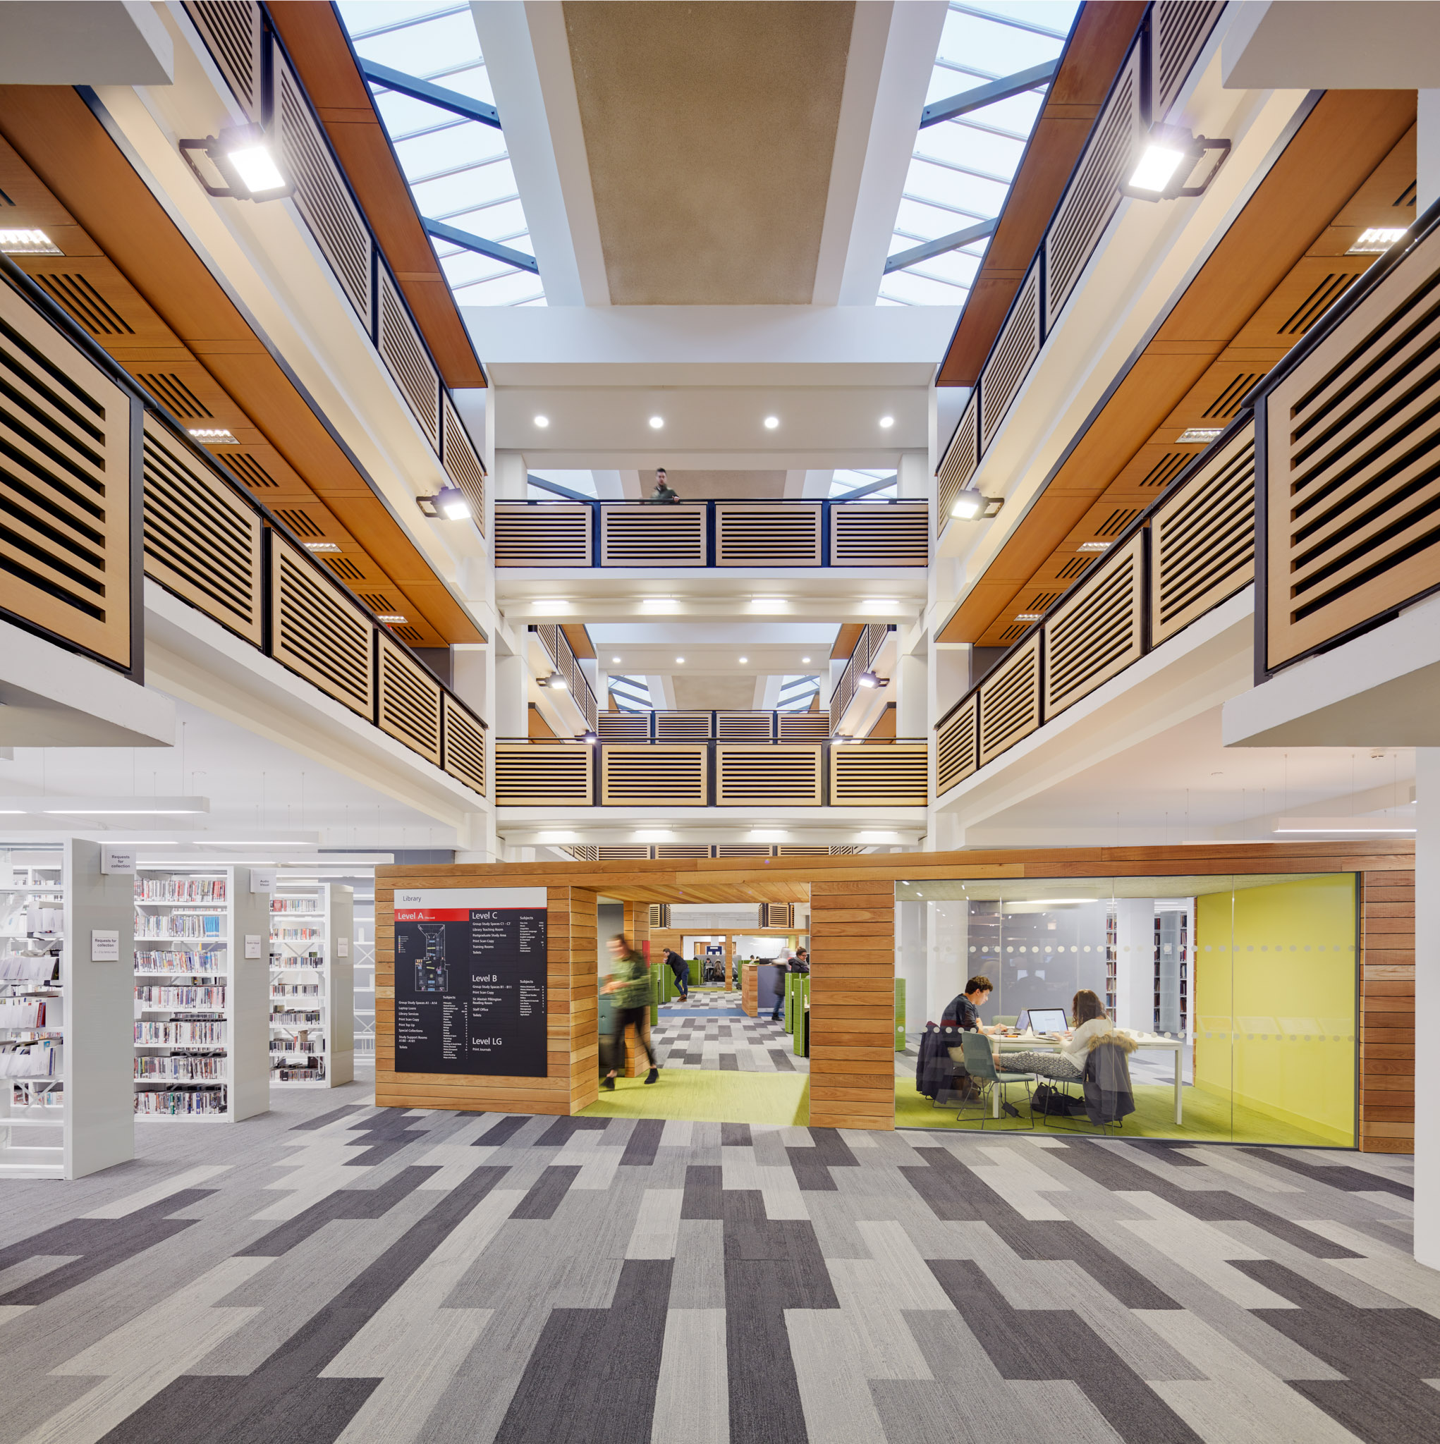
Future Developments

Slide 17
Future Developments
Publications Router
Institutional Funding
Pure is not fully RIOXX compatible yet so can’t use default Publications Router.
Exploring the use of APIs of Publications Router to get information into Pure
Institutional Funding
Small fund of 25k only to be used where green OA is not compliant and research is 4*
Pure Upgrades
Improved reporting and tracking function.
Simplified funding applications
Online forms for RCUK and Institutional funding requests
Minimal information required
E2E Project
Will meet to run through our individual OA processes and suggest further improvements
There are many variations of the passages but the majority

Slide 18
Questions

Slide 19
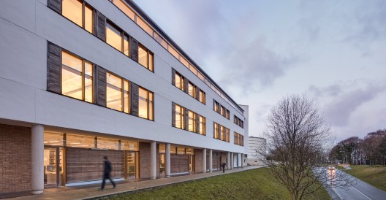
THANK YOU
Open Access Team
at Lancaster
Open Access Manager: Louise Tripp
Open Access Administrator: Diane Scholey
Senior Library Assistant (Pure validation): Richard Ingham
openaccess@lancaster.ac.uk

