Slide 1
Psychogeography: Anti-Psychologies and the Question of Social Change/s
Dr Alexander J Bridger
University of Huddersfield

Slide 2
Aims of session
Explain the term ‘psychogeography’
Discuss academic literature on environments and why research needs to be explicitly political
Discuss recent research and community work
Provide reflections and implications of that work

Slide 3
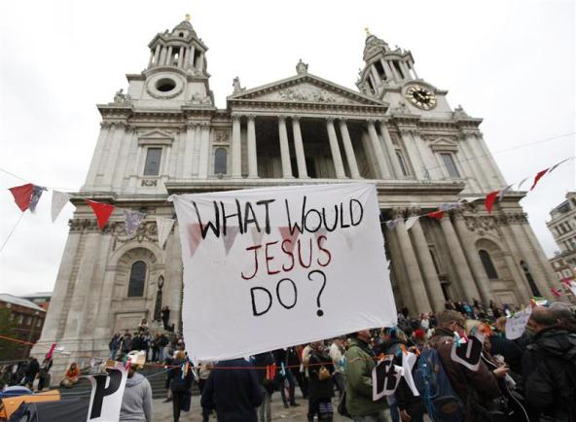
Occupation, space and cities
Notes:
Occupy Movement
Wall Street
London

Slide 4
Mainstream and critical psychologies
Limits of research from environmental psychology (cognitions) and social psychology (place identity)
Turn to a ‘politics of space’
Cultural geography - subjectivity
Critical psychology – mobile methods, situationist work
Affect and psychoanalysis – unconscious/conscious
Situationism – social change

Slide 5
Linking research with political practice?

Slide 6
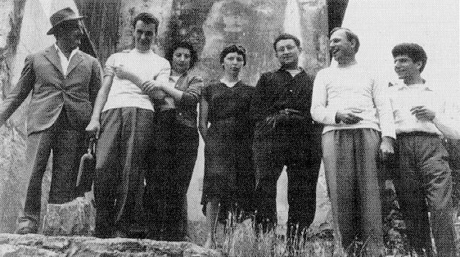
Situationism and psychogeography
‘Psychogeography could set for itself the study of the precise law and specific effects of the geographical environment, consciously organised or not, on the emotions and behaviours of individuals’
(Debord, 1955: n.p).
Notes:
Routine modes of behaviour – free association, spontaneity ….
Their first task was to ‘enable people to stop identifying with their surroundings and with model patterns of behaviour’
(Kotanyi & Vaneigem, 1961).

Slide 7
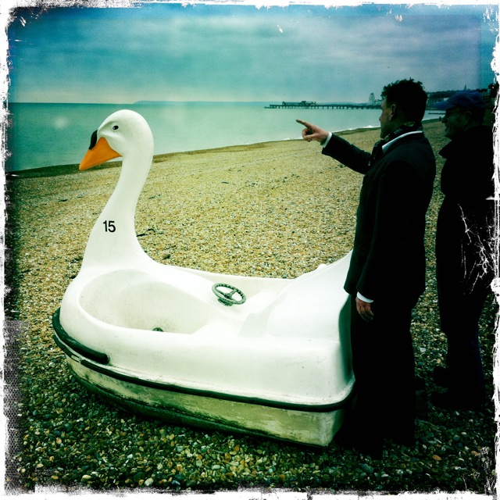
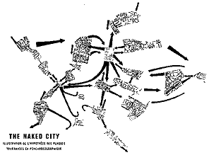
Situationist psychogeography: Concepts and ‘playful’ tactics
Spontaneity vs control
Play vs studies
Dérive vs process
Creating ‘situations’
vs outcomes
Notes:
‘The desire to play has returned to destroy the hierarchical society which banished it. At the same time it is setting up a new type of society, one based on real participation’ (Vaneigem, 1967: n.p)

Slide 8
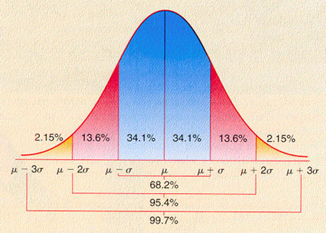
OMD Obsessive methodolatry disorder
Situationism and the anti-methods approach?
Chamberlain on methods
Tactics and strategies rather than methods
Intervening and creating situations rather than simply measuring and interpreting environments?

Slide 9
A ‘how to’ guide to psychogeography!
Begin with a theme to explore say consumerism, privatisation, surveillance and power relations in spaces …
Choose a psychogeography approach like a dice walk or a map swap
Consider the following sorts of questions: What does it feel like where you walk? How do you engage with your surroundings? Do you notice any notable changes in ambience? What do you think of the environment? What do you think needs to be changed in the environment? What should the environment look like?
Document and write up the dérive
Conduct further dérives!

Slide 10
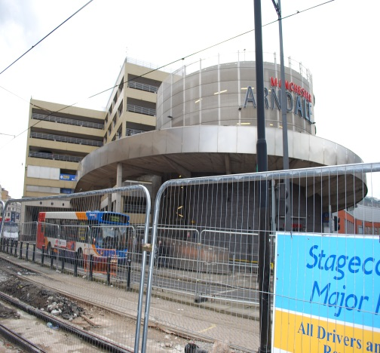
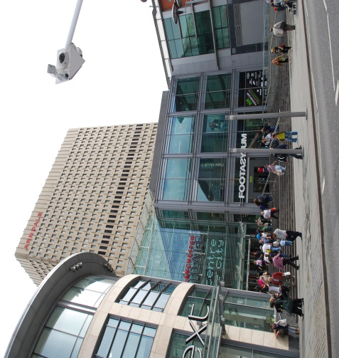
A psychogeographical study – Manchester Arndale Centre
My ‘Visualising Manchester…’ paper
Site specific study – post IRA bomb and gentrification
Themes: consumerism and privatisation; surveillance and control

Slide 11
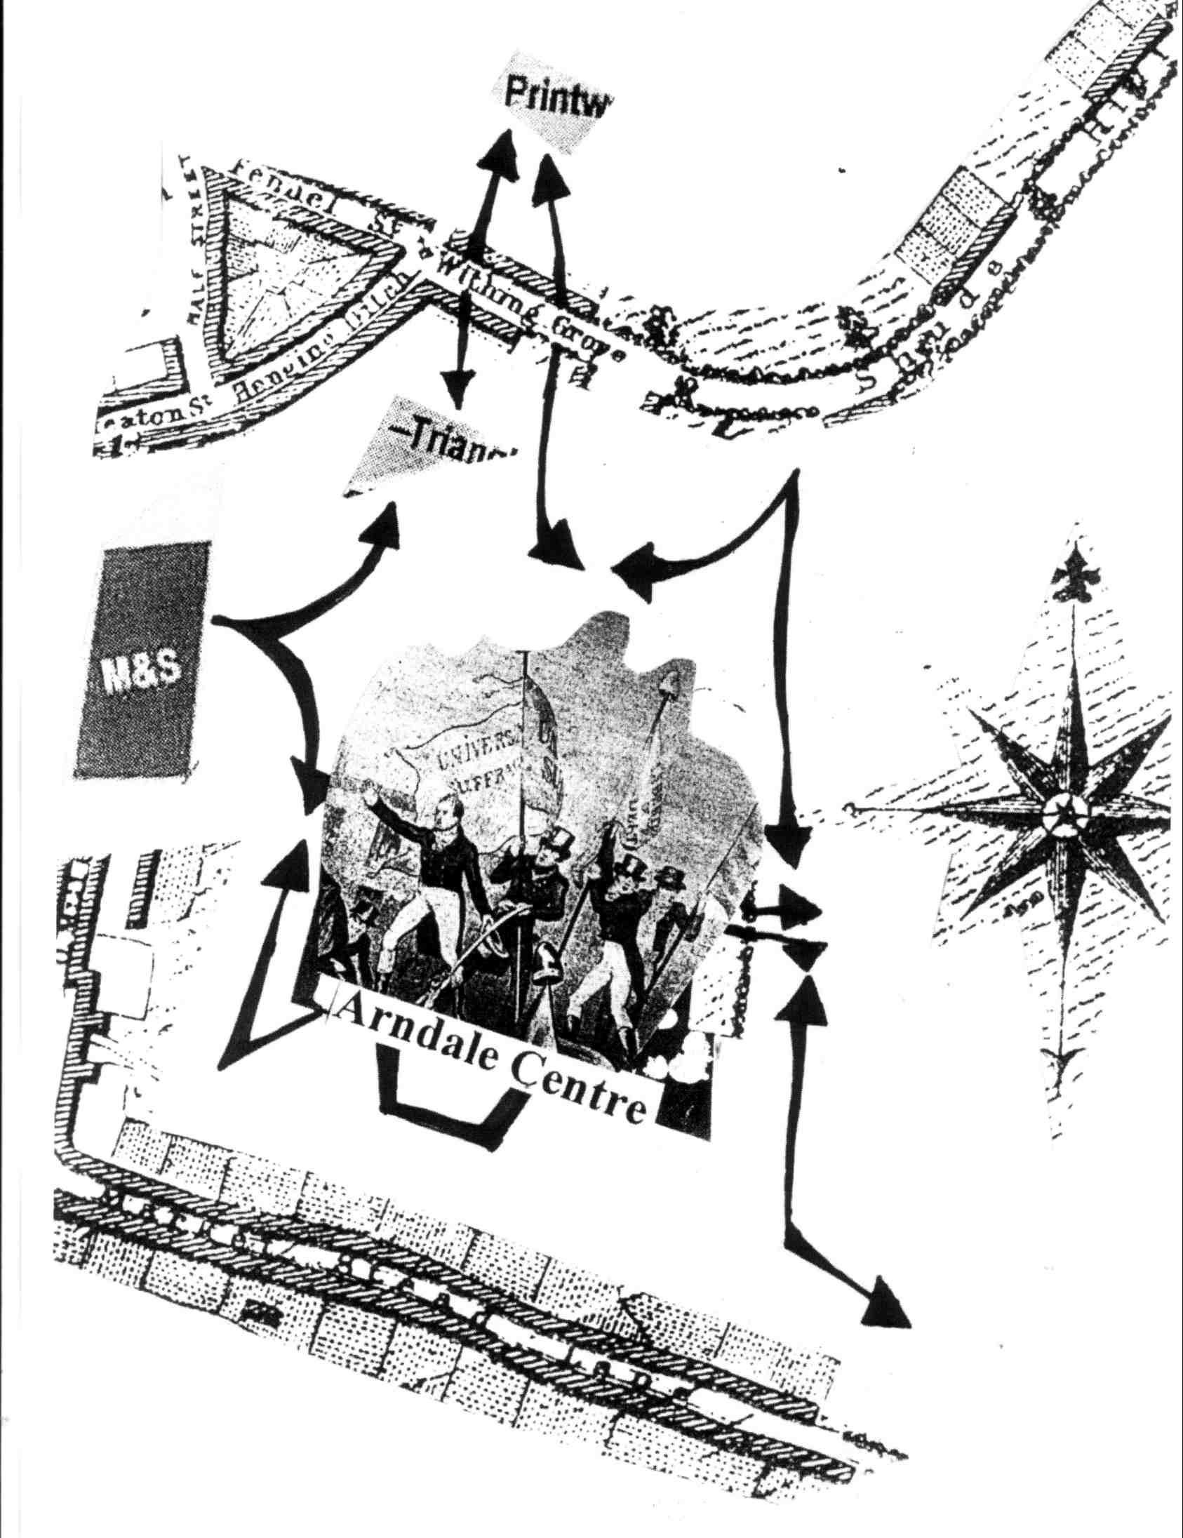
Not a ‘garden path analysis’ (Richards, 1998)
Extract from dérive report: ‘So then having walked endlessly around the Arndale Centre, the food court and the Arndale Market, I decided to walk through the glass tunnel to the building which houses Selfridges and Marks and Spencers. On route, I encountered many visual and textual motifs of consumerism such as ‘The centre of your city’, being encouraged to ‘Shop. Eat. Relax. Treat’ and to consider ‘shopping, fashion, eating and drinking’. Here is evidenced a new Western discourse of consumption which can be linked to individualism and consumer citizenship’ (Bridger, 2014: 88).

Slide 12
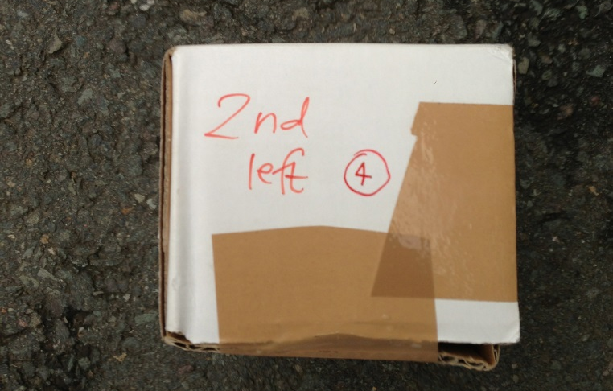
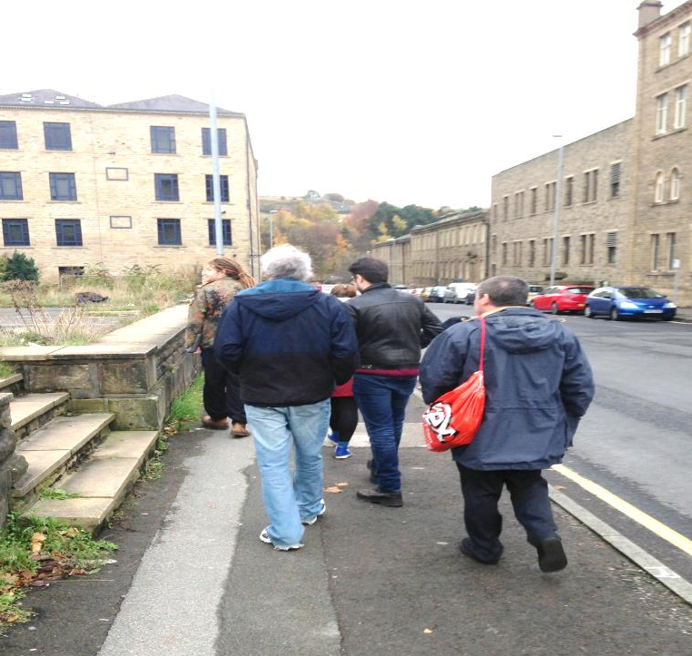
Community psychogeography work
Hoot community centre - Huddersfield
Workshops and art gallery exhibition, i.e. dice walks, map making and scavenger hunts!
Dialogues about well being, the built environment and peoples’ histories

Slide 13
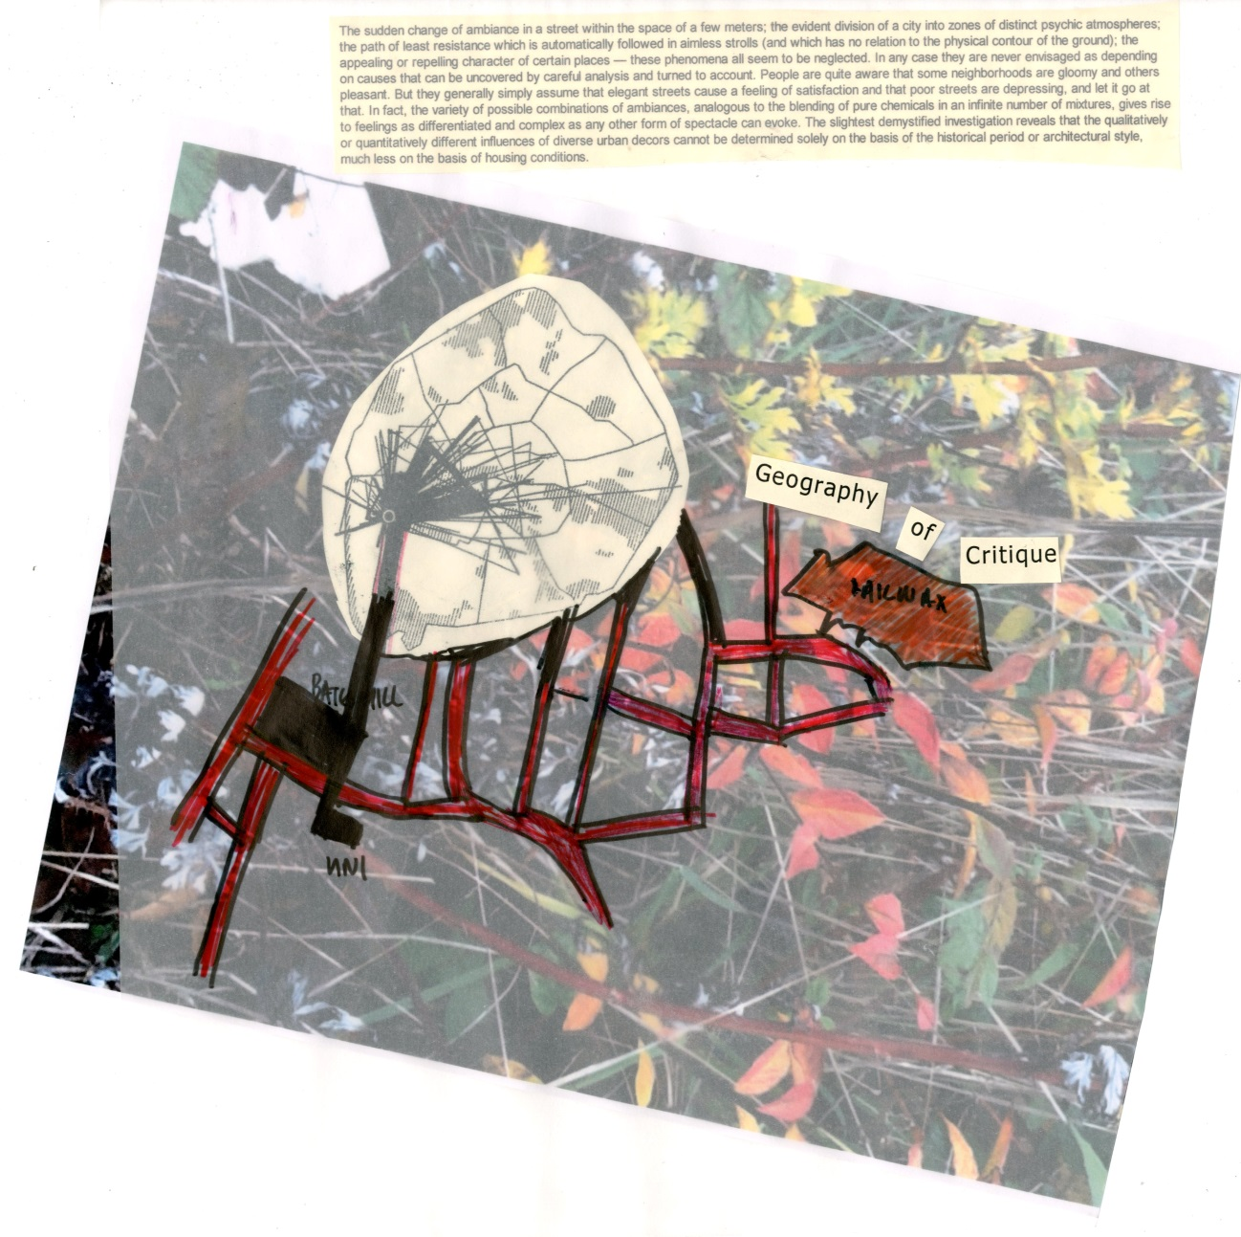
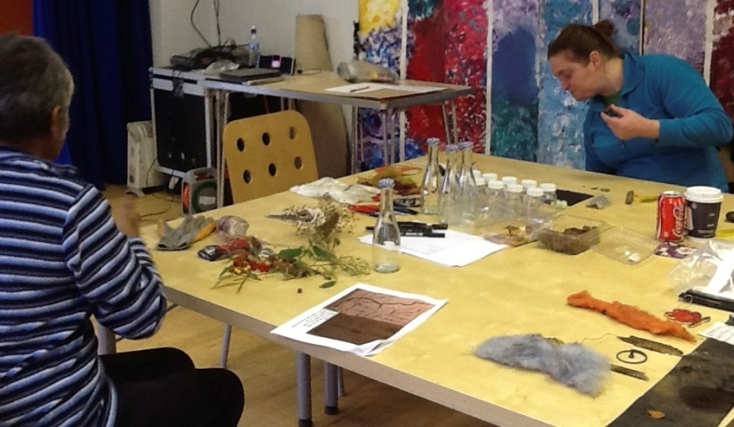
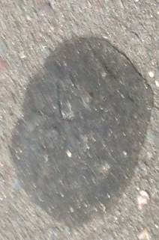
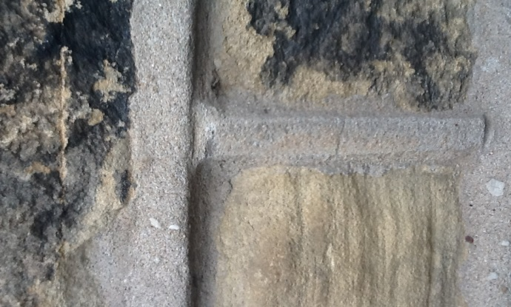
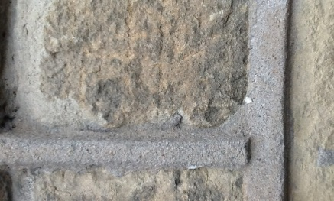

Slide 14
Dialoguing in other disciplines
‘Framing the tourist experience of space: Psychogeographical perspectives’ paper by Stephen Wearing, Matthew McDonald, Alex Bridger and Jess Ponting
Literature on Tourism studies, consumer psychology and psychogeography

Slide 15
Conclusions
Contributing to psychogeographical studies
Form, function and use of neoliberal environments
Political analyses of environments
Need for developing further psychogeographical work
Drawing alliances – academia, art, activism

Slide 16
Teaching and writing
Psychogeography groups, individual and public activity
Public consultations
And deradicalisation and recuperation?
‘Creating situations’ and revolution?

Slide 17
Any questions?
My contact details:
Email: a.j.bridger@hud.ac.uk Work web: http://www2.hud.ac.uk/hhs/staff/shumajb.php
Facebook: Huddersfield Psychogeography Network Blog: notanotherpsychogeographyblog.wordpress.com

