Slide 1
A new era for library publishing? - the potential for collaboration amongst new University Presses
Sue White and Graham Stone
University of Huddersfield
SCONUL Winter Conference 27 November 2015

Slide 2
Session outline
Outline initial activity by the NC to explore potential for new models of collaboration in University publishing
Using University of Huddersfield Press as a case study, demonstrate challenges and enablers facing new University Presses
With assistance from participants, identify those areas of publishing which lend themselves to collaboration
Identify next steps

Slide 3
NC initial activity
Oct 2014 NC exploratory meeting
June 2015 Discussion paper to Jisc:
- Data gathering/ Benchmarking exercise
- Best practice/workflow
efficiencies
- Explore library publishing coalition for UK (or Europe)
Nov 2015 Jisc to work on benchmarking & workflows with community

Slide 4
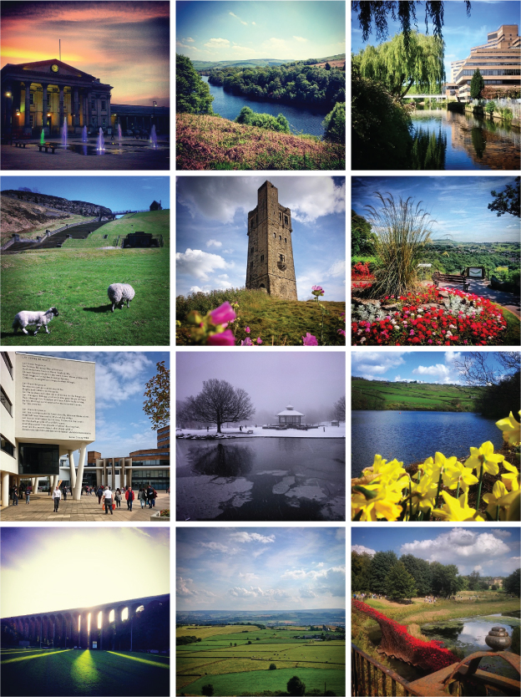
University of Huddersfield Press Re-launched 2010
Press re-launched as a primarily open access press – scholarly monographs, peer reviewed journals, sound recordings

Slide 5
University of Huddersfield Press Drivers and principles
Drivers:
Monograph crisis
Funder mandates, RCUK, HEFCE, COAF
Early career researchers
Principles governing the Press:
All publications to be of high quality and peer reviewed
As a general rule, material should be published on Open Access via the University Repository, to maximise the potential for dissemination
Managed by the Library, academically lead
The business model is one of scholarly communication not profit, with any surplus being reinvested into the Press

Slide 6
University of Huddersfield Press Open Access Monographs
12 monographs published since 2011; 6 OA monographs
Discoverable through Google (via OAI-PMH compliance in Repository), Library web scale discovery (includes membership of Directory of Open Access Books), Jisc/OAPEN open access monograph service

Slide 7
University of Huddersfield Press OA journals
Methodology developed in Jisc HOAP project (2011)
7 current Journals +1 archived title, hosted via the University Repository; preserved in Portico.
Discoverable through Google (via OAI-PMH compliance in Repository), Library web scale discovery (includes membership of Directory of Open Access Journals).

Slide 8
Huddersfield Contemporary Records
9 CDs & 1 DVD
1 Digital download album
Published with CeReNeM (Centre for Research in New Music) and hcmf// (huddersfield contemporary music festival)
Distributed via NMC Recordings

Slide 9
University of Huddersfield Press Enablers
Senior support within University (DVC level)
Capacity and enthusiasm of Information Resources Manager to absorb Press into existing role; admin support available
Editorial Board comprising senior academics, researchers, library staff
Existing Repository infrastructure – developed journal publishing platform with Jisc support (HOAP)
Established principle that institution/sponsors (not the Press) should provide funding
University initiatives helped raise profile e.g. FIELDS student research journal
DOAB and DOAJ have helped raise profile and dissemination of outputs

Slide 10
University of Huddersfield Press Challenges
At a strategic level:
Establishing reputation
Convincing potential stakeholders of value and impact
Long term funding – difficult to forward plan
At a practical level:
Operating on a shoe string
Staff resource – as the Press grows, need specialist support e.g. publications and marketing manager
Little in the way of professional support/networks
Avoid re-inventing the wheel
Author contracts / licences (esp. music. Legal support required)

Slide 11
Collaboration: challenges and enablers
The H form
From this:
To this:

Slide 12
Collaboration: challenges and enablers
☹ Write down challenges/barriers to Press collaboration (one per post-it) 5 mins
As a group add these to the sheet, clustering where themes/duplicates appear. 5 mins
☺ Write down areas which lend themselves to potential Press collaboration (one per post-it) 5 mins
As a group add these to the sheet, clustering where themes/duplicates appear. 5 mins
As a group write down suggestions for resolving these barriers in the idea space. Turn these into top 3 priority actions. 10 mins

Slide 13
Thank you
Thank you for your participation.
Please contact us with any additional ideas or for further information.
Sue White Graham Stone
s.a.white@hud.ac.uk g.stone@hud.ac.uk
http://eprints.hud.ac.uk/26550/
This work is licensed under a Creative Commons Attribution 4.0 Unported License

