Slide 1
Embedding OA within research practice The HHuLOA Jisc OA Pathfinder project
Chris Awre, University of Hull
Graham Stone, University of Huddersfield
Northern Collaboration Conference, 10th September 2015
This work is licensed under a Creative Commons Attribution 3.0 Unported License

Slide 2
HHuLOA project
Hull, Huddersfield and Lincoln Open Access
https://library3.hud.ac.uk/blogs/hhuloa/
June 2014 – May 2016
“The aim of this good practice project is to identify how open access support mechanisms can be used to assist with the development of research. Working together, the three institutions will explore this link, with the aim of supporting other institutions developing their research capacity and looking to understand how open access can be used as a means of supporting this.”

Slide 3
Tweeting
#hhuloa

Slide 4
Jisc OA Pathfinders
HHuLOA is one of nine Jisc Open Access Pathfinder projects
http://openaccess.jiscinvolve.org/wp/pathfinder-projects/
Others involved within Northern Collaboration include:
Northumbria / Sunderland
Newcastle
Lancaster
Manchester / Edge Hill / Liverpool John Moores / Liverpool / Salford
Aimed at:
Recognising OA work within institutions
Stimulating collaboration
Highlighting good practice
Preparing for the introduction of the HEFCE REF Open Access policy, April 2016

Slide 5
Open access and research
Open access is aimed at:
Expanding audiences for research
Increasing the impact and benefit of research
Open access should be good for research development and reputation
Open access and research dissemination
Open access has always been an option
Many have chosen to make use of this
Open access is now a policy requirement
Aim is to maximise the advantages
How do academics and institutions make open access work for them?

Slide 6
Open access options
Green open access
Making use of an institutional (and/or other) repository for open dissemination via the repository and web search engines
How does an institution make its repository work for it?
Gold open access
Open access via an intermediary, most usually a publisher
Usually involves a fee – Article Processing Charge (APC)
How does an institution manage this approach?
Allocation of funds
Management of workflow

Slide 7
HHuLOA project 2
The HHuLOA project has looked at open access from two perspectives
Getting our house in order so open access processes work
Capturing work in progress
Navigating funder policies
Identifying gaps and putting everything together in a lifecycle
Exploring how open access links into research development
Open access lifecycle from different stakeholder perspectives
Practicalities of how open access can be embedded in research
Open access and research strategy
Perspective of three institutions with developing research portfolios

Slide 8
HHuLOA areas of focus
Baseline capture of information
And progress from this baseline
Breakdown of funder open access policies
Navigation through this information
Open access lifecycle
Open access from start to finish
Technical development
RIOXX / REF metadata
Open access and research development
What can open access contribute?
Jisc Monitor / OA and library supply chain workflows

Slide 9
Baseline record template
Purpose
To capture information about practical open access issues
To share these through an open document
To encourage others to share their information
To draw out good practice based on community activity
Format
Google spreadsheet – CC-BY 4.0 licence
Information captured periodically
Six month intervals starting September 2014
https://goo.gl/TpQnU4

Slide 10
Areas covered
Systems
Workflow
Gold/green
Metadata
Policy
Staffing
Advocacy
Success stories
Issues
Open access development
Additional information

Slide 11
Participants so far
Hull
Huddersfield
Lincoln
Glasgow
Leeds Beckett
Queen Mary London
Keele
Bournemouth
Sussex
Cardiff
Northumbria
Teesside
Reading

Slide 12
Participants so far
Hull
Huddersfield
Lincoln
Glasgow
Leeds Beckett
Queen Mary London
Keele
Bournemouth
Sussex
Cardiff
Northumbria
Teesside
Reading

Slide 13
How can it be used?
Identify gaps in service provision based on what is happening elsewhere
Identify opportunities to make a relevant business case to develop open access
To help understand what is happening elsewhere to help guide local development and practice
…?

Slide 14
Key points arising 1
Mixed environment across most areas
With common threads to track
QA sits with Library regardless of deposit mechanism
Text-mining a largely unexplored area
Issue with predominant file type – PDF
Heaviest focus is on Green OA, with Gold an add-on
Reporting an undeveloped area
Metadata entry uses automated schemes (e.g., via DOI), but still appears to be lots of manual effort

Slide 15
Key points arising 2
Widespread use of policies/mandates
Informed by specific open access committee / WG or University Research Committee
CC licences used widely, but often only when required
Most sites now have 1 or more FTE on open access
Widespread mix of institutional units involved in OA
Commonly Library, Research Office, Finance
Less direct academic involvement as yet
Main concerns are resources and time – and acceptance date!

Slide 16
Funder policy breakdown and navigation
Spreadsheet of funder policies broken down
https://goo.gl/5m1GUA
Intention is to find a way for academic staff to navigate information so they know what they need to do
Recognises that research often funded by multiple funders
Related initiatives
PASTEUR4OA project – developing proposed schema for how such policies should be structured
Sherpa JULIET – individual funder policy presentation

Slide 17
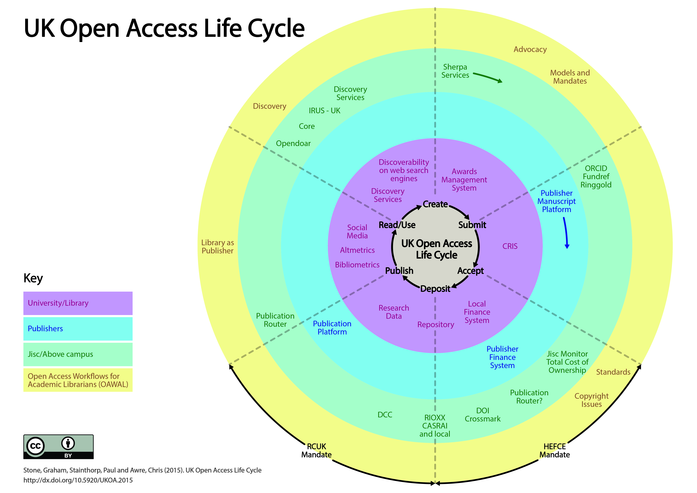
Open access life cycle
http://eprints.hud.ac.uk/24260/

Slide 18
Open access life cycle
7 stages of the publishing process as described by Neil Jacobs (Jisc OA Services)
Institutional processes – not all institutions will have all processes up and running
Publisher services that directly impact upon the work of the open access team
Jisc OA and above campus services
6 sections of Open Access Workflows for Academic Librarians (OAWAL - https://library3.hud.ac.uk/blogs/oawal/) showing where it fits with the life cycle

Slide 19
Technical development
Hull – Hydra / Fedora
Huddersfield – Eprints (hosted)
Lincoln – Eprints (local)
Three case studies of how to make the technology work for REF / open access
RIOXX metadata review undertaken to assess implementation requirements
Baseline review from March indicated many waiting on implementation
REF metadata review forthcoming

Slide 20
RIOXX
RIOXX metadata schema
Combination of Dublin Core and specific fields
Designed for RCUK open access reporting
Being seen as de facto schema for HEFCE reporting
CERIF-lite
http://rioxx.net
Repository systems need to capture this information
Mixed picture
Implementation progress being tracked at http://rioxx.net/implementation
Repository staff need to understand where the information is coming from

Slide 21
RIOXX analysis
HHuLOA analysed the RIOXX schema and has circulated proposed practice on its adoption
https://library3.hud.ac.uk/blogs/hhuloa/2015/06/29/rioxx-review-and-proposed-practice/
Two key questions
License information
OK if licensed under Creative Commons
Unclear that publishers provide this in a consistent and persistent manner, hence, default to ‘all rights reserved’ otherwise
Versioning
Version vocabulary is good, but there is no standard definition of which type of document constitutes which version

Slide 22
Open access and research development
Making the case for open access is generally based on the advocacy / dissemination advantages
It is sometimes left to researchers to work out how to fit this into their existing practice
How can we best embed open access within research practice?
Two perspectives to addressing this
Day to day activity
Strategy

Slide 23
Research facets
Financial, legal, research dissemination function, technical, staffing, community, other?
How can open access support each of these?
Questions to ask for each facet
What benefits does open access offer?
Which stakeholders need to be involved in this?
What outcomes would use of open access result in?
Information gathered within project and through project event
Watch project blog for dissemination

Slide 24
What do you think?
Exchanging information on open access can help development
Please turn to your neighbour (preferably from a different institution) and ask,
How could open access help support research development at your institution?
Who needs to be involved (institutionally) to make this work?
One answer each – please note on post-its

Slide 25
Looking ahead
Baseline development
Funder policy navigation
OA life cycle for different stakeholders
Technical implementation
Research and open access survey (October 2015)
Open access and library supply chain parallels

Slide 26
Jisc Monitor
Jisc Monitor was initially funded 2014-15 to investigate shared services that could support open access
https://www.jisc-collections.ac.uk/Jisc-Monitor
Project is now developing services
Monitor local
A local software application enabling institutions to record and report on data relating to OA outputs
Monitor UK Aggregator
A shared service that combines OA data from across institutions to provide a sector-wide picture to inform policy and content negotiations
HHuLOA will be assisting with these service developments

Slide 27
Please engage
The more we share about our open access implementations, the more we can learn from each other
The more we can learn about how to make open access work for our institutions
Steps to take
Add data to baseline template
Respond to open access and research survey
Attend Pathfinder events
Use Pathfinder outputs – and feed back on their use to help improve them

Slide 28
Pathfinder outputs
All outputs from Pathfinder projects can be found through the quarterly updates and other Jisc documentation
http://openaccess.jiscinvolve.org/wp/pathfinder-projects
http://repository.jisc.ac.uk/6143/1/oa-top-tips.pdf
Plenty more outputs will emerge in the coming months
Keep watch via the OAGOODPRACTICE Jiscmail list
http://www.jiscmail.ac.uk/oagoodpractice
Look out for upcoming events from the projects
These will be announced via the above list and related repository / open access lists

Slide 29
Thank you c.awre@hull.ac.uk g.stone@hud.ac.uk (and pstainthorp@lincoln.ac.uk)
This work is licensed under a Creative Commons Attribution 3.0 Unported License

