Slide 1
University of Huddersfield Teaching and Learning Conference 2014
Use of GradeMark to Improve Student Achievement
Sue Folley – CLS
Chris Ireland - BS

Slide 2
Introduction to the reports you can get out of GradeMark
How to run the reports
Ways of using the Data
Questions/ Discussion
Example of use: Targeted screencasts
Notes:
Introduce us and what we are going to cover
Ways you can get data out of GradeMark
Not got time to fully show the how to do all of this – there are SD courses for this – just going to give a taste of what is possible and something things to think about in setting these up.
So I will show you the type of reports you can get out of GradeMark and how to run these reports and explain the set up you need to think about to get some useful data
Then Chris is going to show you how he has helped provide some targeted feedback on the academic skills issues in GradeMark
Hopefully at the end there will be time for some questions and discussion.

Slide 3
Types of Report from GradeMark
Turnitin
QuickMark Sets
Rubrics
GradeMark
Originality
PeerMark
Notes:
Two main types of report from GradeMark – and these are using the QuickMark Sets and Rubrics.
Possibly do a quick show of hands as to who knows what QuickMark sets are and who has used them and ditto for rubrics to get an idea of what level to talk at.
Re-iterate that we are not showing you how to do these things – the intro to GradeMark SD covers the creation of QuickMark sets and we are going to develop an advanced course to cover rubrics and some of the reporting aspects of GradeMark.
The important point to be made here is that both these things need to be set up correctly, thought through well, and used consistently to yield any useful data.
So it does need a lot of preparation and thought into what data would be useful to you.

Slide 4
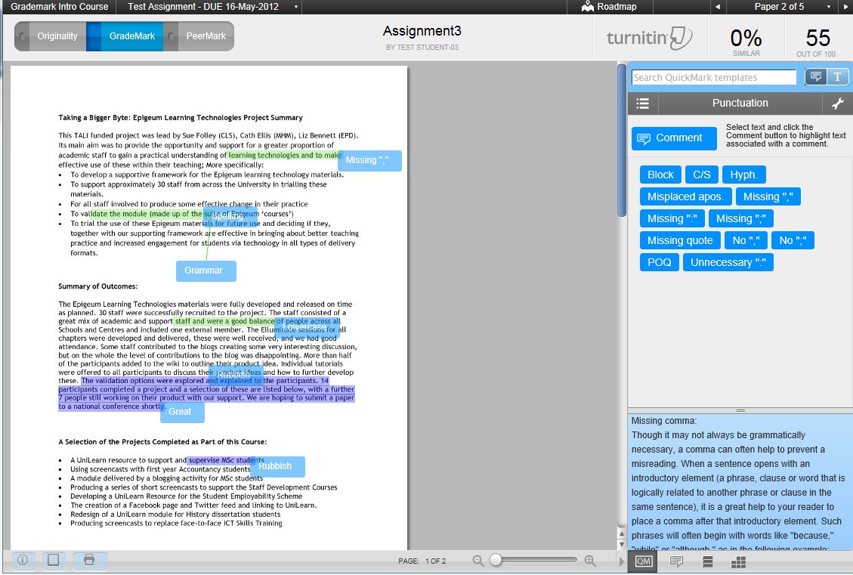
QuickMark Sets
Notes:
This is an example of a QuickMark set in GradeMark – if you are not familiar with them you there are some defaults ones but you can create your own based on comments you frequently use – to save typing and repetition.
Each of the short comments has a longer explanation – which you provide.
You can share the comment sets across modules and save and send to other members of staff – so the data produced can later be pooled.

Slide 5
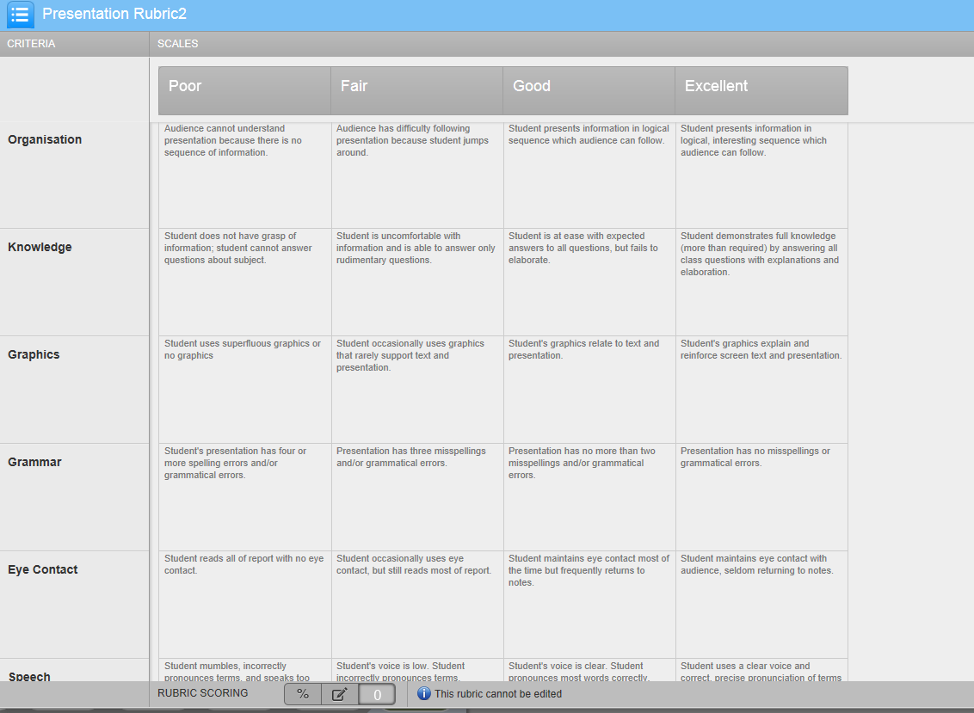
Notes:
This is an example of a rubric – you can create calculated rubrics where it works out a score for you – or a non-calculated rubric like this one which just gives feedback against a list of criteria.
This is just a simple one which feeds back on presentations.

Slide 6
Notes:
And just to show you what the student view of this would be: they need to click on the rubric at the bottom of the panel and it will display the rubric results, as they clicked on each of the numbers it gives the corresponding feedback in the box below.

Slide 7
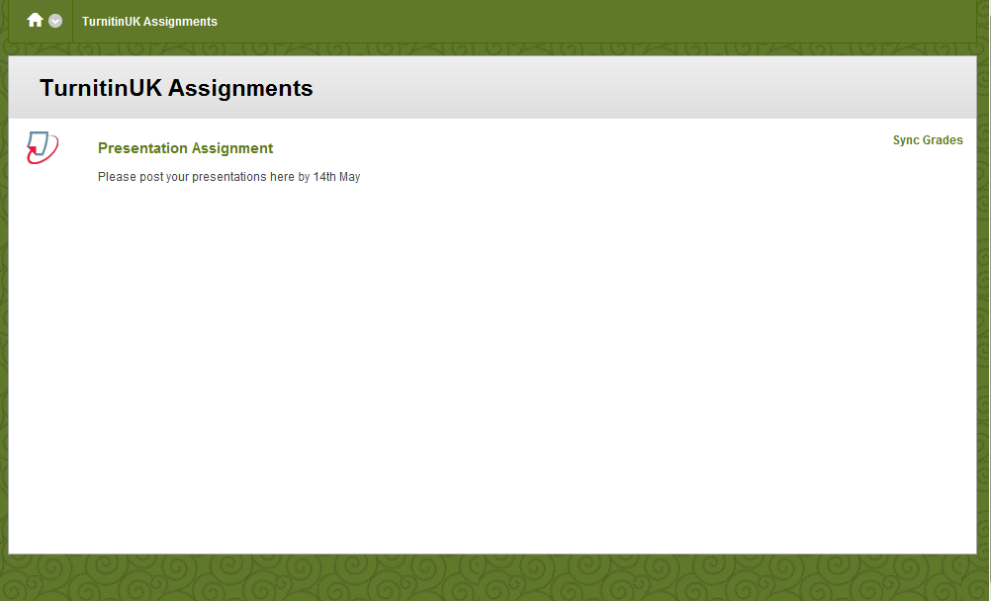
Notes:
Once all assignment have been marked using either the QuickMark Sets and/or the rubric – to access the reports you need to go into the assignment inbox first.
So this is in Module Tools>Turnitin Assignments>then pick the assignment you would like the report for and click on it – in this case it is the presentation assignment.

Slide 8
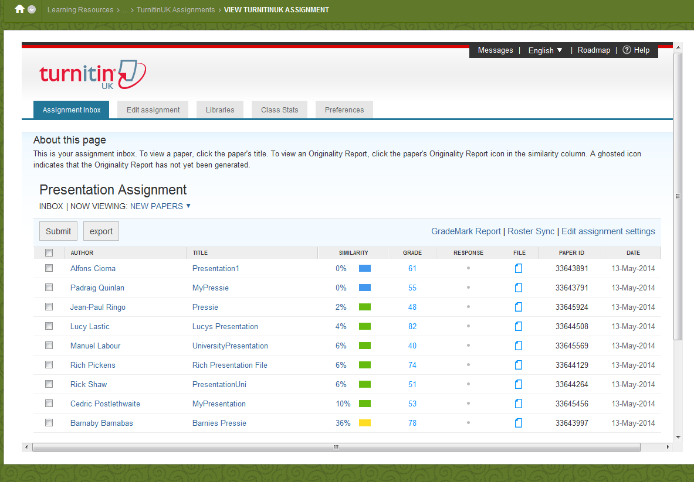
Notes:
This will open the assignment inbox for that assignment, as you can see all the assignments here have been graded.
The reports can be accessed by clicking on the GradeMark Report link here

Slide 9
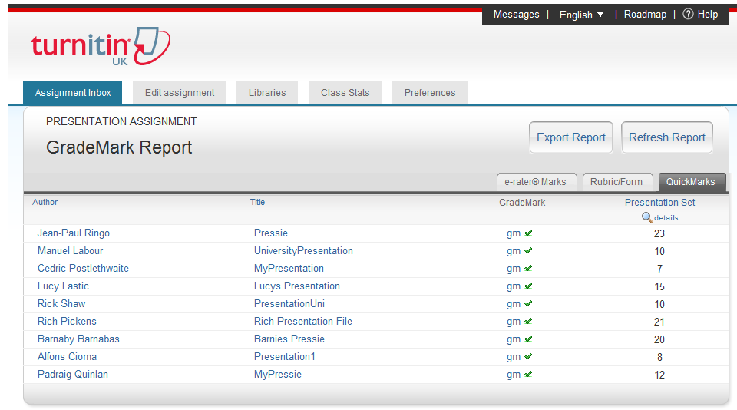
Notes:
There are two tabs we are interested in – the rubric one and the quickmark one.
First we will look at QuickMark, which I think is the default tab selected.
For each QuickMark set you have used there will be a column with the number of total comments on each student’s assignment. We have only used one set here – called the presentation set.
To drill down the data a bit more, you need to click on the link to the details of that report.

Slide 10
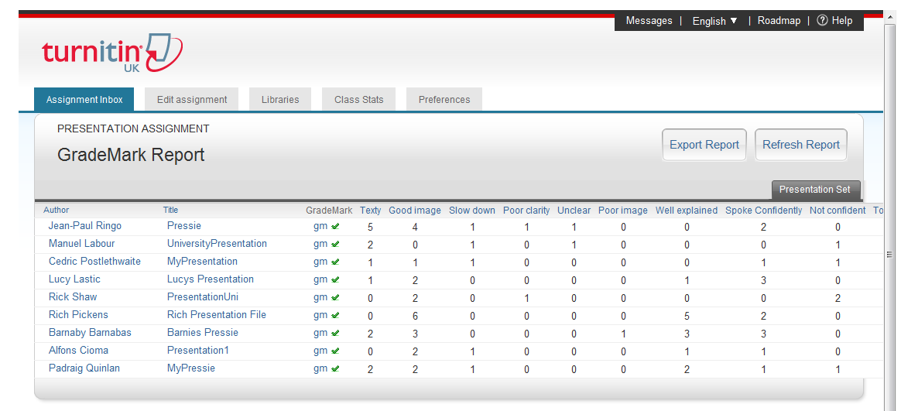
Notes:
This will list the number of times you have used each comment in that set for each student.
To export that data click on ‘Export Report’

Slide 11
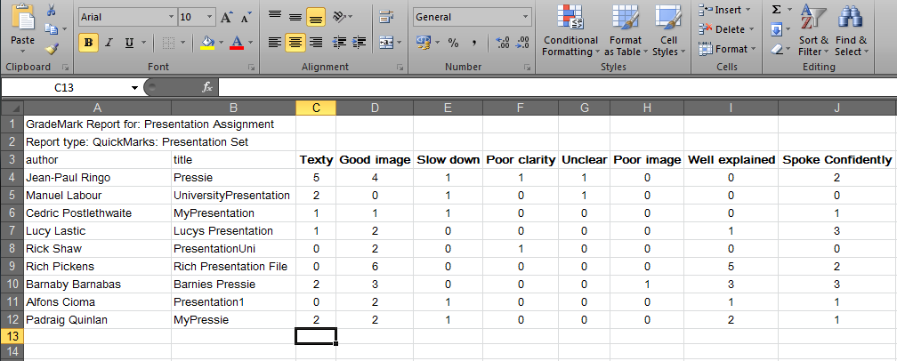
Notes:
The report will be exported as an Excel spreadsheet which then you can save.
The report is basic and you will need to do a little work on it to produce some summary results and graphs.
So for this report it would be useful for example to total up the number of times you have used each comment.

Slide 12
=sum(range)
=sum(c4:c12)
Notes:
For this you need the Sum formula in Excel. For this click in the cell where you would like the sum to display.
Then click on the sum command in the menu. Excel will guess the row/column of data that it thinks you want adding – if it guesses correctly, click enter, if not select the range of data with the mouse and click on enter.
Alternatively you can just type the formula in to that cell. All formula in Excel starts with an = sign, then type Sum ( range of date ) then enter.
You can then use your fill handle to copy that formula to the other cells.

Slide 13
Notes:
From this data, it is very quick to produce a simple graph like this which indicates for the thing that need improving – how many times you used that comment and how many different students you added that comment at least once.
From this data you can decide which things need addressing and where interventions can take place to improve things.
So from this graph about student presentations you can see that there were quite a few comments and a high percentage of students where their slides were too texty – so this could be fed back to them.

Slide 14
Notes:
Similarly this list of positive comments shows that on the whole students used good images and relevant content.

Slide 15
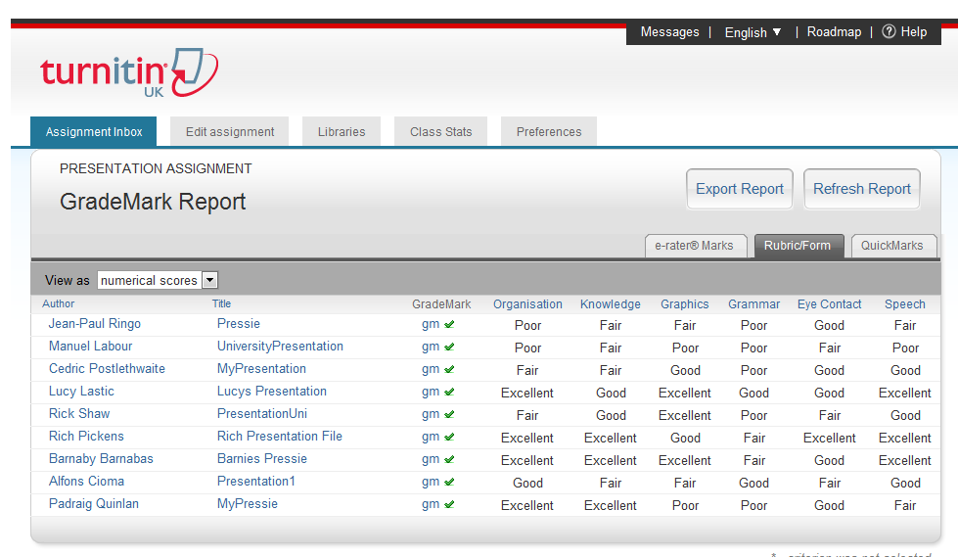
Notes:
So moving onto the rubric report. If you click on the rubric tab within the GradeMark reports section of the Assignment inbox, it will list the rubric results for each student for each criteria.
Again to export this to Excel click on the Export Report as shown here.

Slide 16
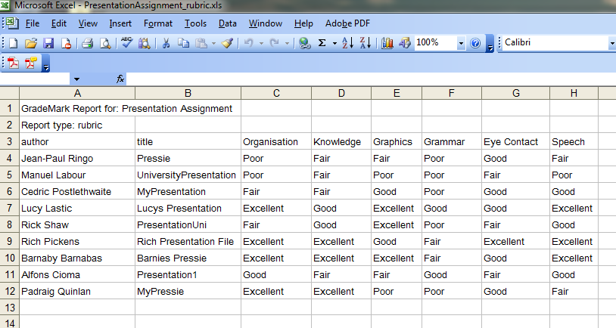
Notes:
Again this will create a basic Excel spreadsheet with the data, listing the results from the rubric, so again you have to manipulate this data to create some useful graphs etc.
The Excel formula which will be useful this time is the Countif() function.

Slide 17
=countif(range, criteria)
=countif(C4:C12, “Poor”)
Notes:
So somewhere below your graph you need to basically count the number of time ‘poor’, ‘fair’, ‘good’ and ‘excellent’ appears in each of the columns and totals of these for each of the students.
To do this go into the cell you want and use the countif function by typing = (for a forumla) countif ( range, criteria) like the example above.
You need to repeat this for each column and each row.

Slide 18
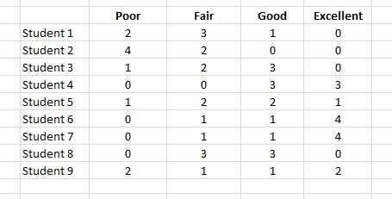
Notes:
When you have done it for each row and column, you can end up with tables like this which can produce a graph like this:

Slide 19
Notes:
This graph is by criteria – so you can see in this case there is a lot of poor grammar, so this may need to be investigated and acted upon.

Slide 20
43
35
53
75
55
72
63
55
55
Notes:
This one is by student – so again you would be able to target particular students with interventions if appropriate.
Here if you have a look at student 8 and 9, you can see they both ended up with the same overall score. However, how it is made up is very different. Student 8 is more of an average students, fair at some things and good at others. Student 9 though is more extreme – doing some things excellent and some things poorly. Interesting that this student would still get a pass for this even though he/she is doing some things in the criteria well below standard. This student could be targetting with some specific interventions to pull up the poor areas.
Also this is not just useful for those students who are at risk or who are failing. It could be used to bring up the ‘good’ students to excellent as they could have different interventions to show them how to make the excellent grade.

Slide 21
Think very carefully about what data would be useful when creating your QuickMark sets and rubrics
However please don’t forget the primary purpose of these tools is to provide useful feedback/feed-forward to the students
Think about opportunities for sharing and collaboration across student cohorts where you could use the same QuickMark sets and/or rubrics and pool the results.
Thinks about the types of interventions that could be put in place to target either individual students or individual issues.
Notes:
So just a few things to think about if you are keen on taking this forward.

Slide 22
Use of Screencasts to Produce Targeted Feedback
Chris Ireland

Slide 23
Project
Analysing feedback to produce audio-visual feed-forward

Slide 24
Assignment feedback
Students reported:
Unhelpful comments (e.g. vague)
Issues identified offering no solution (e.g. poor language skills)
Elaborate over detailed
Rising numbers of international students
Need for usable feedback

Slide 25
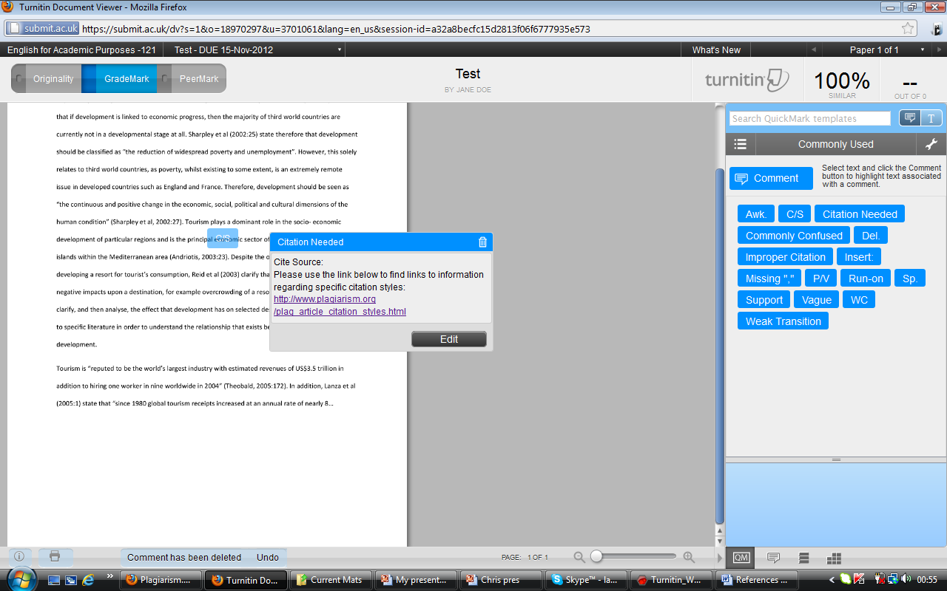
Sample QuickMark

Slide 26
“For rich feedback ... to occur, information must be presented in an engaging manner” (Wilkinson, Crews, & Kinley, 2008, p.75).
Informed by our Reading
“Students want feedback in a variety of formats, including verbal, written and electronic.”
(NUS, 2010)
“Tell them there is a problem and show how they can improve!” (Cree, 2010)

Slide 27
“For rich feedback ... to occur, information must be presented in an engaging manner” (Wilkinson, Crews, & Kinley, 2008, p.75).
Informed by our Reading
“Students want feedback in a variety of formats, including verbal, written and electronic.”
(NUS, 2010)
“Tell them there is a problem and show how they can improve!” (Cree, 2010)

Slide 28
“For rich feedback ... to occur, information must be presented in an engaging manner” (Wilkinson, Crews, & Kinley, 2008, p.75).
Informed by our Reading
“Students want feedback in a variety of formats, including verbal, written and electronic.”
(NUS, 2010)
“Tell them there is a problem and show how they can improve!” (Cree, 2010)

Slide 29
“For rich feedback ... to occur, information must be presented in an engaging manner” (Wilkinson, Crews, & Kinley, 2008, p.75).
Informed by our Reading
“Students want feedback in a variety of formats, including verbal, written and electronic.”
(NUS, 2010)
“Tell them there is a problem and show how they can improve!” (Cree, 2010)

Slide 30
Sample Audiovisual
Notes:
Here we can show an example of our solution.

Slide 31
Data collection
GradeMark users provided data on their frequency of QuickMark use
Results showed feedback items most likely to be reused

Slide 32
Data: Frequency of use
The QuickMarks from the Commonly Used list
Improper Citation 698
Awkward 417
Spelling error 336
Del. 153
Citation needed 138
Word choice 104
Missing “,” 51
Commonly confused 35
Vague 27
Insert 19
Support 2
Notes:
Just top 3

Slide 33
Data: Frequency of use
The QuickMarks from the Commonly Used list
Improper Citation 698
Awkward 417
Spelling error 336
Del. 153
Citation needed 138
Word choice 104
Missing “,” 51
Commonly confused 35
Vague 27
Insert 19
Support 2
Notes:
Just top 3

Slide 34
Data: Frequency of use
The QuickMarks from the Commonly Used list
Improper Citation 698
Awk. 417
Spelling error 336
Del. 153
Citation needed 138
Word choice 104
Missing “,” 51
Commonly confused 35
Vague 27
Insert 19
Support 2
Notes:
Just top 3

Slide 35
Data: Frequency of use
The QuickMarks from the Commonly Used list
Improper Citation 698
Awkward 417
Spelling error 336
Del. 153
Citation needed 138
Word choice 104
Missing “,” 51
Commonly confused 35
Vague 27
Insert 19
Support 2
Notes:
Just top 3

Slide 36
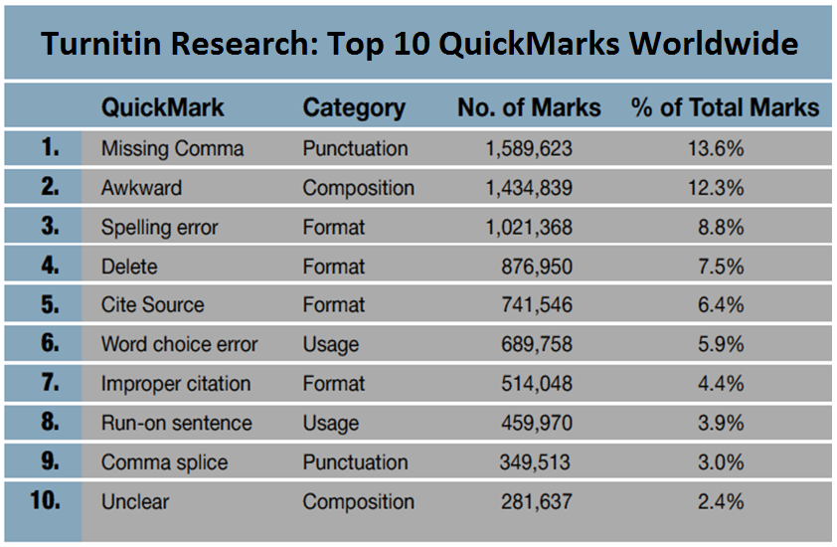
Notes:
Again mention

Slide 37
Screencasts from first data
Their / there / they’re
Practice / Practise
Improper citation
Direct Quotation

Slide 38
Further Screencasts from second data
Comma splice
Paragraphing
Secondary Referencing
Academic Introductions
Use the Surname
Contractions
Apostrophe

Slide 39
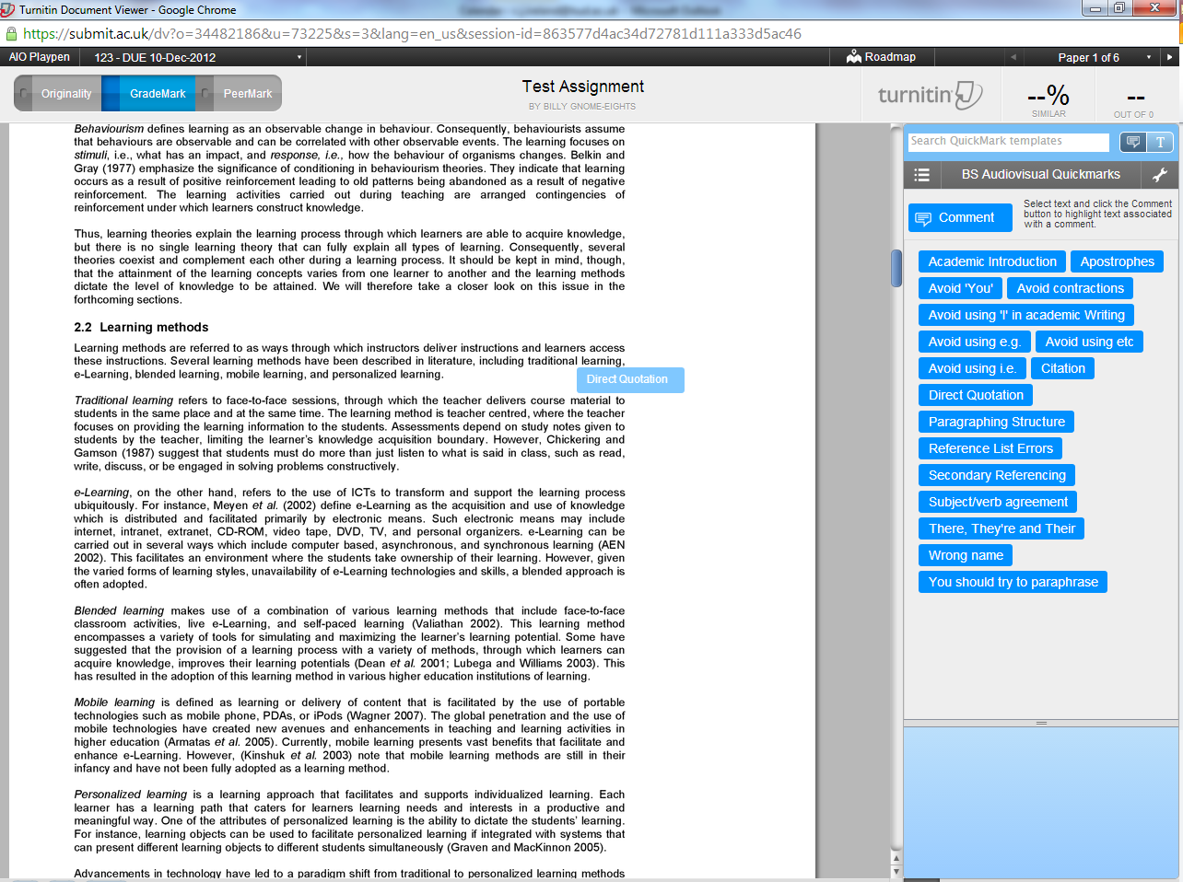

Slide 40
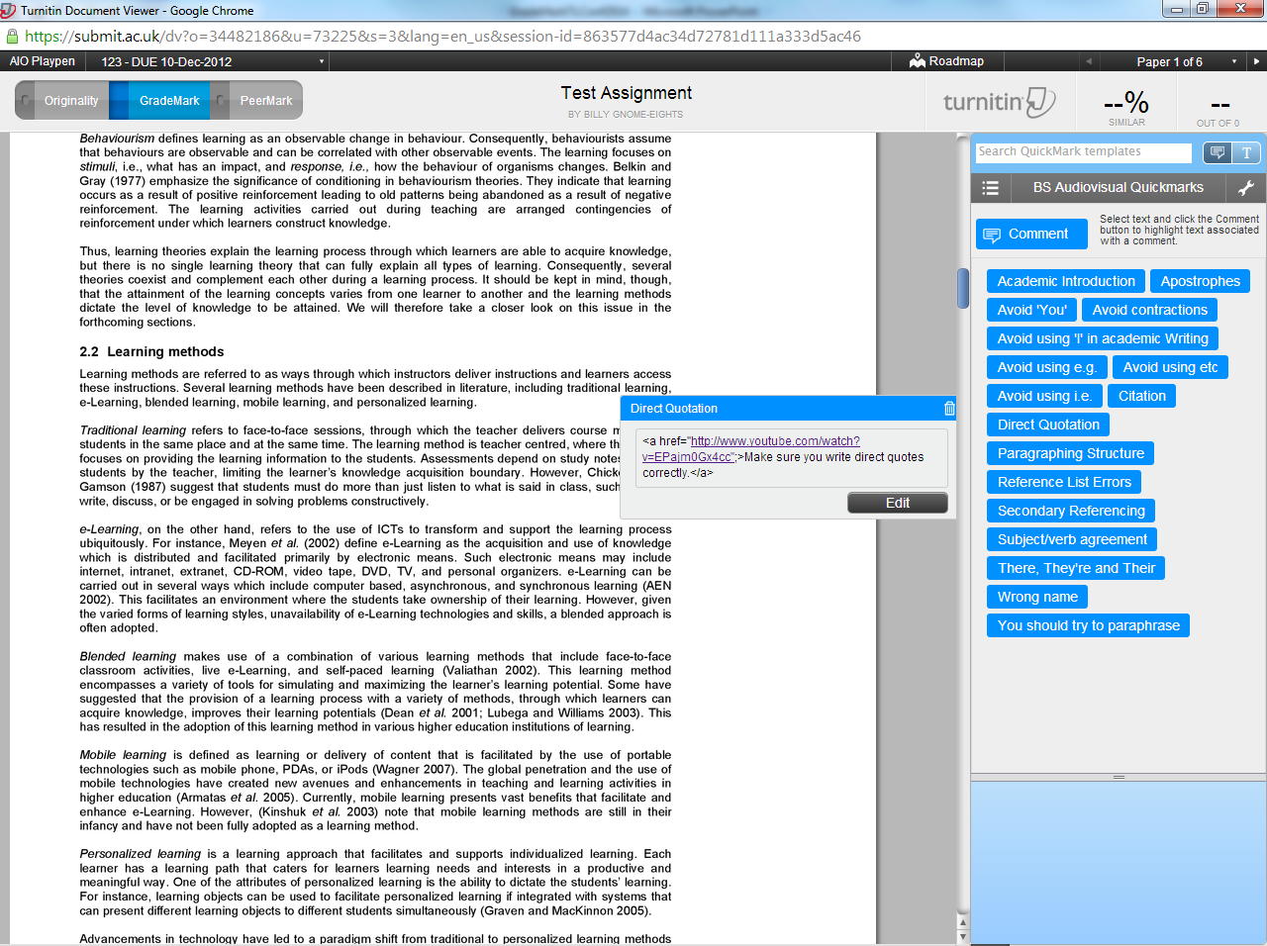

Slide 41
Any questions or comments?

