Slide 1
Consideration for crime prevention within the planning system: Responding to changes in policy and practice within England and Wales
Institute for Research in Citizenship
and Applied Human Sciences (IRCAHS)
Dr. Rachel Armitage
Reader (Criminology)
Deputy Director of Applied Criminology Centre
www.hud.ac.uk/ircahs

Slide 2
Today’s presentation has two aims:
Outline the consideration for crime prevention within planning policy and practice in England and Wales.
Present findings of major research project in England and Wales (Home Office).
To clarify and strengthen the evidence base regarding the impact of residential design on crime.
Notes:
So, the presentation has two aims:

Slide 3
Crime prevention within the planning system: England and Wales
Notes:
Start presentation by giving a brief outline of consideration for crime prevention within the planning system in England and Wales over the past 15 years.
This is aimed at those not familiar with the Eng/Wales system, for those who are, it’s a reminder of some of the changes taking place.

Slide 4
Legislation: Section 17 (Crime and Disorder Act)
Don’t mandate specific security standards in housing.
Overarching legislative requirement for ‘responsible authorities’ to consider the impact of their decisions on crime and disorder.
Includes local authorities.
“...exercise its functions with due regard to...the need to do all it reasonably can to prevent crime and disorder in its area”
Crime prevention not sole responsibility of the police.
Notes:
Although Eng/Wales doesn’t mandate specific security standards within residential housing, there is an overarching legislative requirement, under Section 17 of the Crime and Disorder Act (1998), for key agencies to consider the crime implications of the decisions that they make.
This includes agencies such as local authorities, who in Eng/Wales develop policy documentation to outline future development within an area. They also include responsibility for development control and making decisions regarding planning applications.
This really outlined the premise the crime reduction is not the sole responsibility of the police.

Slide 5
Planning Policy:
Planning Policy Statement 1: Delivering Sustainable Development (2005)
Sets out government’s national policies on land use planning.
“Poor planning can result in a legacy for current and future generations of run-down town centres, unsafe and dilapidated housing, crime and disorder.”
Planning Policy Statement 3: Housing (2006)
“Matters to consider when assessing design quality include the extent to which the proposed development...is safe, accessible and user-friendly.”
Notes:
Planning Policy Statement 1 set out the government’s national policies on land use planning. The importance of crime prevention as a consideration within sustainable design was highlighted within the document’s first paragraph, which sets the scene for the emphasis contained within the statement. It states that: “...”
This was accompanied by PP3: Housing, which again emphasised the importance of creating safe developments.

Slide 6
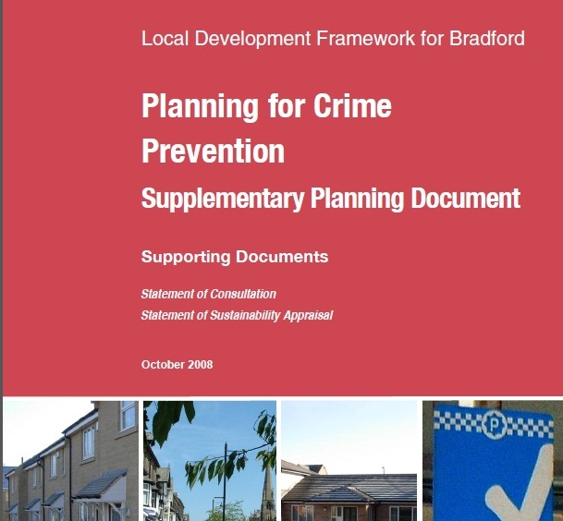
Planning and Compulsory Purchase Act (2004)
Encouraged local authorities to develop an overarching ‘Core Strategy’ supplemented by themed ‘Supplementary Planning Guidance/Document’.
Local authorities developed themed crime prevention-based documents.
‘Crime Prevention through Environmental Design’, ‘Planning for Crime Prevention’.
Focused on how crime prevention should be considered locally.
Notes:
The Planning and Compulsory Purchase Act (2004) introduced the requirement for local authorities to produce a Development Plan which set out the objectives in relation to development and land use for their area. One specific benefit of this was that many Las adopted a model of creating a core strategy/plan and supplementing this with themed SPGs.
These were generally entitled Planning out Crime, CPTED etc,
Also introduced requirement to produce design and access statements when submitting applications for outline or full planning permission. The government circular outlined what is required in a D&A Statement and this included the need to demonstrate how crime prevention measures, in particular the principles of Safer Places, would be addressed.

Slide 7
Planning Guidance
Safer Places: The Planning System and Crime Prevention (2004)
Outlined seven attributes of safer places.
Principles included: Access and movement, surveillance, structure, ownership, physical protection, activity and management and maintenance.
Supported by case studies and independent research.
Notes:
And alongside this was the publication of the replacement guidance to 5/94 and this was Safer Places.
108 pages (as opposed to 11) and outlined seven attributes of safer places.
Supported by case studies and evidence based research.

Slide 8
Practice
How is Crime Prevention through Environmental Design delivered on the ground?
43 police forces.
Each police force has at least one Architectural Liaison Officer (ALO) or Crime Prevention Design Advisor (CPDA).
Influence local planning policy.
Review planning applications.
Offer CPTED advice to mitigate any potential crime risks associated with the proposed development.
January 2009 = 347 ALO/CPDAs.

Slide 9
Crime prevention within the planning system: England and Wales – The last year
Dramatic changes largely related to deregulation and public sector spending cuts

Slide 10
Legislation
The Localism Act (2011)
Key message is to move towards neighbourhood planning and empowering communities.
“The Act is based on a simple premise: we must trust people who elect us and we must ensure that we trust them to make the right decision for their area...” (House of Commons, 2011, p.3).
Neighbourhood Development Plans
Allow communities to come together (local parish council, neighbourhood forum, minimum membership of 21) to produce a plan which sets out policies in relation to the development and use of land within a neighbourhood area.
Where development will be and what it will look like.
Notes:
In the last 12 months – two years there has been some drastic changes in the planning system in Eng/Wales and these are based around the Localism Act (2011) and its focus upon deregulation and neighbourhood planning. Many elements to this Act, one of interest is the introduction of Neighbourhood Plans.
Allow communities to come together (local parish council, neighbourhood forum) to produce a plan which sets out policies in relation to the development and use of land within a neighbourhood area.
The focus of the Act is to place power in the hands of communities to make decisions about the area in which they live....question being is this a good or a bad thing.
A neighbourhood forum must contain a minimum membership of 21 individuals residing or working within the designated area. Its membership must also have been drawn from different places within the neighbourhood area and from different sectors of the community.
There are procedures in place to ensure that Plans are produced with guidance and support from local authorities, and assessed by an independent examiner to ensure that what they contain is in line with national planning policy (the National Planning Policy Framework), with the strategic vision for the local area (the Local Plan) and that it is compatible with EU obligations and requirements (such as the Human Rights Act, 1998). Once agreed by the independent assessor, a local referendum must be conducted to ensure that the Neighbourhood Plan has local support (if 50% of those who vote are in favour, the planning authority must implement the plan).

Slide 11
Policy
National Planning Policy Framework (2012)
Cancellation of all Planning Policy Statements (44 documents).
Replaced with one 59 page document.
Discourages the production of Supplementary Planning Documents.
Taylor review of Planning Guidance (2012)
Recommends cancellation of Safer Places (as of 28th March).

Slide 13
Section 17
Section 17
Planning Policy Statement 1
X
Planning Policy Statement 3
X
& 42 additional PPSs
X
Safer Places: The Planning System and Crime Prevention
?X?
Local Themed Supplementary Planning Guidance (CPTED)
X
Nationally 350 ALO/CPDAs
Nationally 196 ALO/CPDAs

Slide 14
Between 1998 and 2011 huge progress in policy and practice in consideration for crime prevention within the planning system.
Recognition that design can, and does, impact on crime.
Recognition that crime prevention is the responsibility of many agencies.
BUT!!!
Knowing crime prevention SHOULD be considered is not the same as knowing HOW.
Notes:
BUT...!

Slide 15
As a means of addressing this.
In 2010 Home Office funded major project ‘residential design and crime’.
Strengthen and update evidence base on impact of residential design on crime.
Provide clear recommendations and solutions to crime problems that were linked to design features.

Slide 16
Scoping the evidence
74 policy, guidance and research documents.
Macro level
34 developments, 4091 properties, 3 police forces.
Comparing crime with prior assessments of ‘Housing Quality’ (CABE Housing Audits).
Micro level
12 developments, 2193 properties, 3 police forces.
Compare crime levels against individually assessed design features of EVERY property/development.
Large qualitative focus.

Slide 17
Micro-Level : 12 developments, 2193 houses, 3 police forces.
On-site Interviews/walk-about:
With police Architectural Liaison Officer, Local Authority Planning Officer, Neighbourhood Policing Team, Residents’ Association.
Discussed crime and disorder problems and their relation to design whilst one site.
Completed a Design Features Checklist:
Data relating to 31 design features for all 2193 properties.
Data relating to 19 design features of the development for all 12 developments.
Completed a Design Quality Checklist:
Data relating to design quality (character, architecture etc.) of EVERY property and development.

Slide 18
Two key themes emerged….
Car parking
Connectivity/through-movement

Slide 19
Impact of design and layout of car parking on crime and disorder

Slide 20
The design and layout of car parking provision within residential housing can have a significant impact on crime and anti-social behaviour.
Surprisingly, consistent priority/concern at all sites.
Poorly designed car parking not just linked to vehicle crime (theft of and from), can also lead to problems with:
Criminal damage.
Youths causing annoyance.
Neighbour disputes.
Violent crime.

Slide 21
Problems Identified in Case Studies

Slide 22
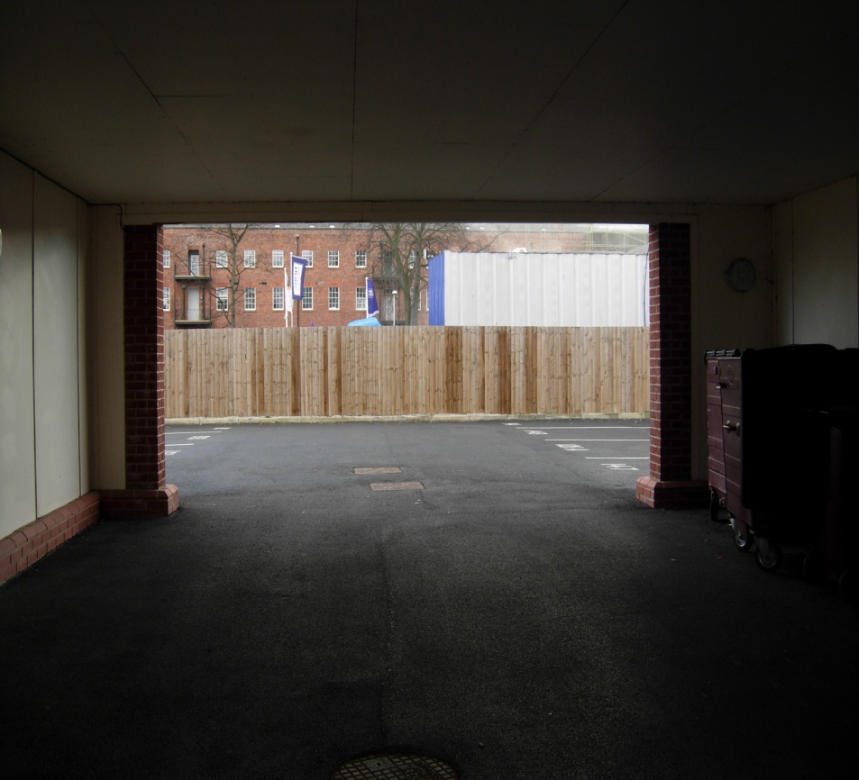
REAR PARKING COURTS
Popular response to UK policy.
Move cars away from property frontages. To improve the street scene.
By very nature out of view of properties and street users.
Often accessed via archway between/under dwellings.
Archway entrances can be narrow, dark with no surveillance.

Slide 23
Many residents, even where no alternative, were not parking in rear parking courts.
Safety – their own and that of vehicle.
Convenience – did not want to carry child, bags, work from court to house.
Where unused rear courts used for anti-social behaviour:
Youths hanging around.
Joy-riding.
The more used for illegal activity, less likely to be used by residents (and the cycle continues).

Slide 24
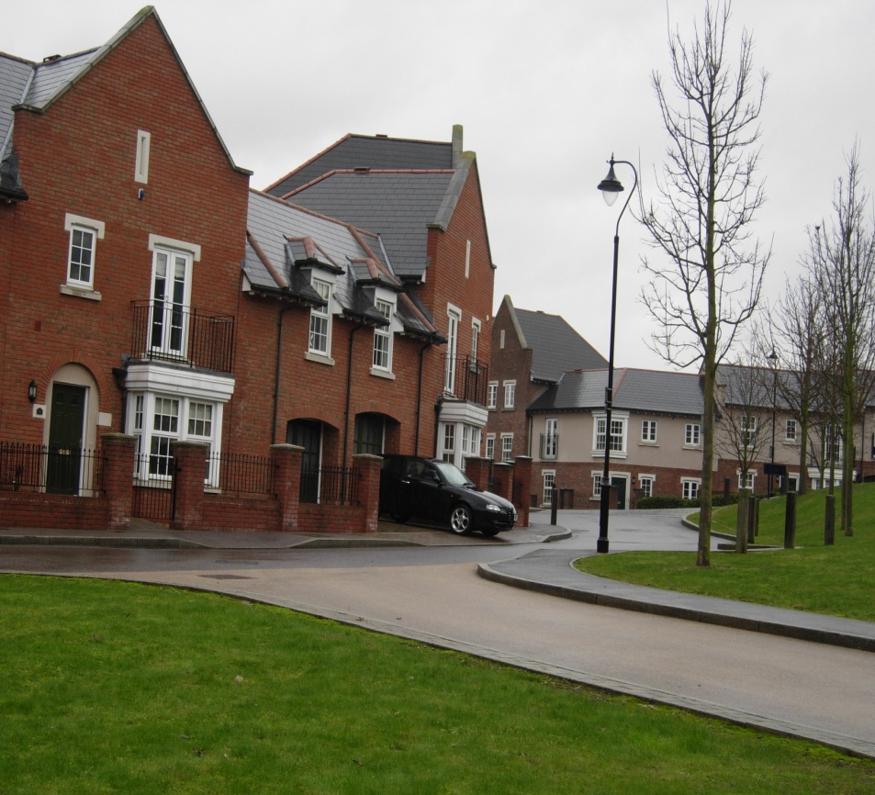
INCONSIDERATE PARKING SOLUTIONS:
Design solution to encourage residents to park away from the street scene.
Design the driveway too short for car – encourage parking in garage of rear court.
Residents continued to use drive (convenience and safety) with cars left jutting onto street.
Management companies employed to enforce regulations (cost).

Slide 25
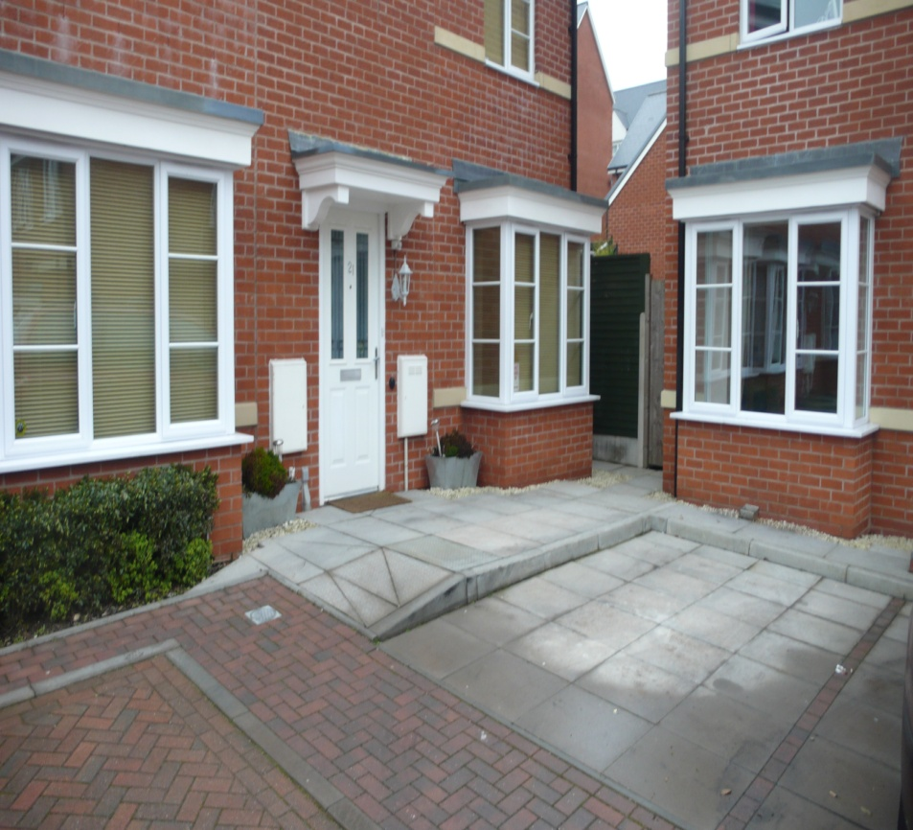
POOR ALLOCATION OF PARKING:
Design solutions which fail to consider end user.
Negative consequences.
Two properties each look directly onto parking space.
Space is for one property, so someone is looking out onto neighbour’s car.
If van or large vehicle could block view/light.

Slide 26
Neighbours left angry notes on parked cars.
Analysis of crime statistics - two serious crimes relating to neighbour disputes over parking:
One public order offence
One assault.

Slide 27
Developments with communal parking experienced more crime than those with on-plot parking.
Rear parking courts experience high levels of vehicle crime and criminal damage and facilitate access to the rear of properties.
Residents prefer to park close to their property, where not provided they will find their own solutions.
Lack of consideration for users can result in expensive retrofit solutions (management companies).
Disputes relating to car parking can lead to more serious violent crimes.

Slide 28
Impact of connectivity on crime and disorder

Slide 29
The type of road serving a property/development.
Through road
Cul-de-sac (dead end for vehicular access)
True cul-de-sac.
Leaky cul-de-sac
Linear cul-de-sac
Sinuous cul-de-sac
Movement throughout the development.
Position of footpaths – rear, side, front of properties.
Where do they lead to?
Length/width.
Lighting/surveillance.

Slide 30
Problems identified in Case Studies

Slide 31
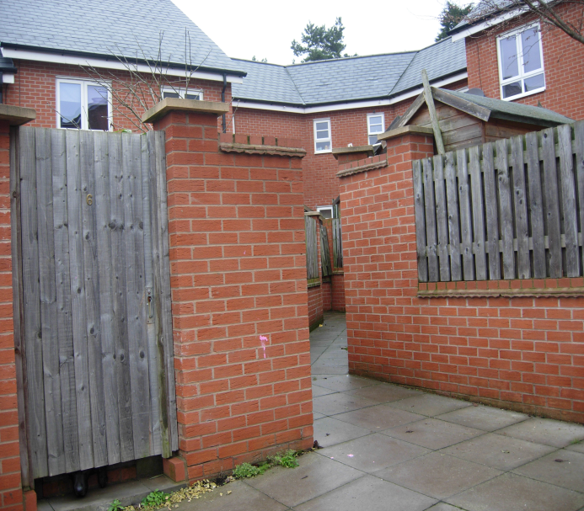
FOOTPATHS:
Major crime risk where....
Little or no surveillance.
Not direct.
Poor lighting.
Hiding places.

Slide 32
Side and rear footpaths leave properties vulnerable.
Analysis of offender modus operandi showed large number of burglaries committed with access via this boundary wall.

Slide 33
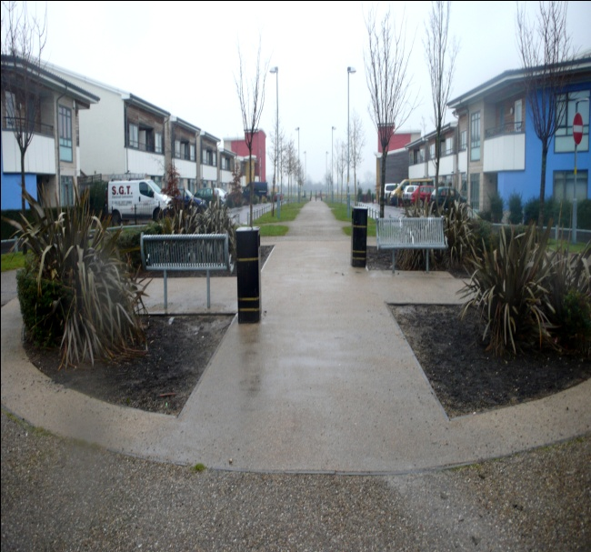
COMPROMISE:
One development, high crime area. Large number of footpaths but no burglaries in three year period.
Developers insisted on high levels of connectivity BUT did so with close consultation with police.
All footpaths ran at the front of houses, all required and therefore well-used, wide and well lit.
NO REAR FOOTPATHS!

Slide 34
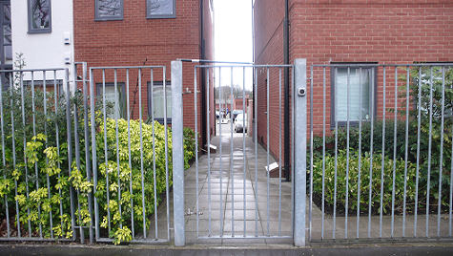
GATED DEVELOPMENTS:
Gated developments viewed by residents as safest option – research did not confirm this.
Unpopular with planners.
Planners felt privacy could be achieved using subtle techniques and expressed view that they would not repeat this design.
Unsuccessful at preventing crime.
Crimes still taking place.

Slide 35
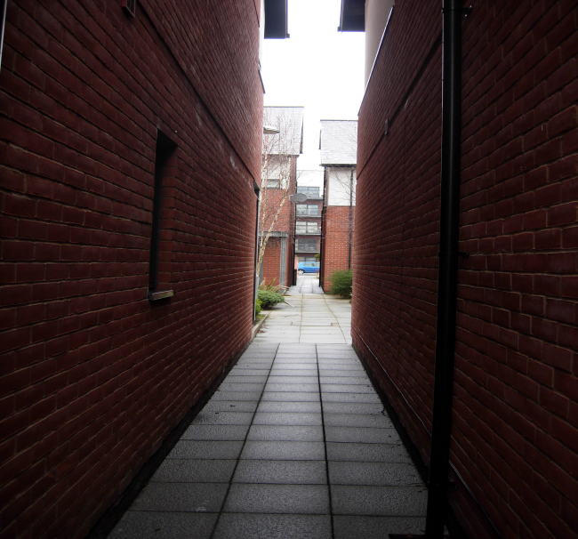
Main problem was gating at boundary but little further consideration for crime prevention.
High internal connectivity.
Dark, narrow alleys with no surveillance.
Reliance on gates alone.
Notes:
One of the main problems with the gated developments was that, although gated at the boundary, once inside, these developments were highly permeable with an abundance of alleys and pathways which were narrow, dark and with little or no surveillance from surrounding properties.
As if they were relying on the gates to do the job and it didn’t matter what happened inside.

Slide 36
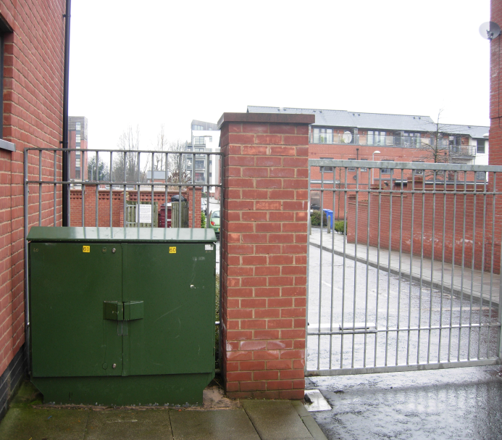
Security of gates compromised by poor positioning of street furniture, street signs and utility boxes.
Climbing aides for offenders.
Analysis of crime data showed that properties near to these points were the most vulnerable.
Notes:
In addition to the internal connectivity, the security offered by the gates was compromised by the poor positioning of street signs, utility boxes and street furniture which acted as climbing aides for offenders wishing to scale the gates. As the developments portrayed an impression of high security, yet offered little in terms of actual protection, it could be argued that the gating acts to entice offenders into the area – portraying an image that the development contains valuable possessions which require additional protection.

Slide 37
True culs-de-sac experience the lowest levels of crime.
Leaky culs-de-sac experience the highest levels of crime.
Sinuous culs-de-sac are safer than linear.
Gated developments do not experience lower levels of crime.
Footpaths which run at the rear and side of properties increase vulnerability.
Footpaths can be included within a development without increasing crime risk IF planned in close consultation with the police – key to avoid rear footpaths.

Slide 38
To conclude....
UK has seen progress in convincing agencies that you should design in crime prevention, but much slower to confirm HOW.
Become a greater priority amidst rapidly changing system within planning for crime prevention (deregulation and staff cuts).
Concern regarding the resources that remain (policy/guidance/staff) to offer advice.
With this in mind....essential that communities have evidence to make choices. The decisions they make will influence quality of neighbourhood for decades.
Research and dissemination – ‘what works?’ is vital.

