Slide 1
University of Huddersfield Press Scholarly publishing in the library
Graham Stone

Slide 2
University of Huddersfield Press Re-launched in 2010
To encourage new and aspiring authors to publish in their areas of subject expertise
Scholarly monographs related to specific areas of research in the University, one off conference proceedings and titles of local, regional or national interest
Journals and other specialist series such as annual conference proceedings
Sound recordings (via Huddersfield Contemporary Records)

Slide 3
University of Huddersfield Press OA journals and monographs
8 Journals
Based on the Jisc HOAP project (2011)
Hosted via the University Repository
Preserved in Portico
One title now available in DOAJ

Slide 4
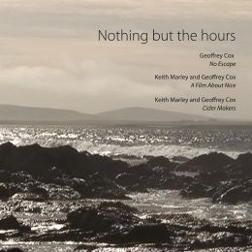
Huddersfield Contemporary Records
6 CDs & 1 DVD
1 Digital download album
Published with CeReNeM and /hcmf
Through CDBaby, iTunes and Amazon

Slide 5
University of Huddersfield Press Open Access Monographs
12 monographs published since 2011
6 OA monographs (all CC BY)

Slide 6
Open Access monographs Business model
A work in progress!
Proposals submitted to the Editorial Board (chaired by a Pro-Vice Chancellor)
Peer review process in place
Monographs are funded by Departments, Research Centres, Funders (HLF and Leverhulme Trust) and sometimes the Library
Operates on a cost recovery model
PDF on OA
Print on sale via the University online store, Amazon, Waterstone’s etc.

Slide 7
Open Access monographs So why are we doing this?
Opportunities
The demise of the scholarly monograph?
Whether true or not our academics are finding it harder to get published (and we know this is not a quality issue)
They also object to the price of scholarly monographs and their resulting sales
Open Access and digital distribution
Using the University Repository and DOAB, we can successfully disseminate our research
Building a brand in certain disciplines
Contemporary music, history

Slide 8
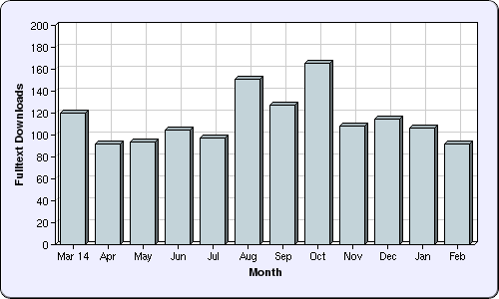
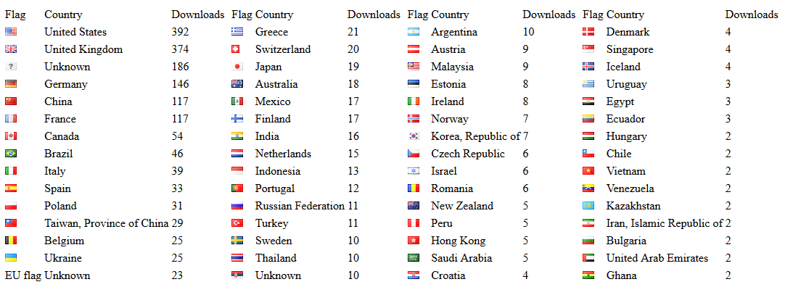
Open Access monographs Noise in and as music
Published Oct 2013
81 copies sold
2017 copies downloaded

Slide 9
Open Access monographs Challenges
Sustainability
At the moment things are not scalable
Funding
For administration/staffing in order to grow
Business Model
Still early days
Technology
We need to provide more than just a PDF

Slide 10
Open Access monographs Looking forward
Scalability
Do we work with partners? Platform, Technology?
There is a need for Library Publishing Coalition UK
eTextbooks
We couldn’t bid for the Jisc project due to the marking allocation
We are increasingly uncomfortable with the position being taken by textbook publishers, which are leading to complaints from staff and students
Is this an area we can look to develop using our own textbook authors?

Slide 11
University of Huddersfield Press
http://unipress.hud.ac.uk/
Graham Stone
g.stone@hud.ac.uk
@Graham_Stone
This work is licensed under a Creative Commons Attribution 3.0 Unported License

