Slide 1
Photo by marten vaher - Creative Commons Attribution-NonCommercial-ShareAlike License http://www.flickr.com/photos/7319418@N07
Created with Haiku Deck

Slide 3
Photo by Alex E. Proimos - Creative Commons Attribution-NonCommercial License http://www.flickr.com/photos/34120957@N04
Created with Haiku Deck

Slide 4
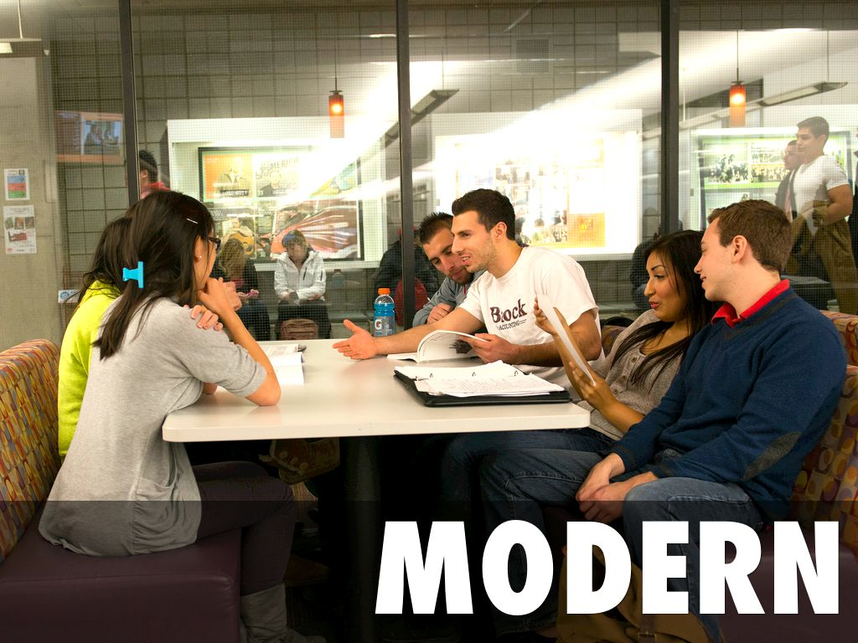
Photo by Matheson Learning Commons - Creative Commons Attribution-NonCommercial-ShareAlike License http://www.flickr.com/photos/35789325@N06
Created with Haiku Deck

Slide 7
Photo by yuan2003 - Creative Commons Attribution-NonCommercial License http://www.flickr.com/photos/81475308@N00
Created with Haiku Deck

Slide 8
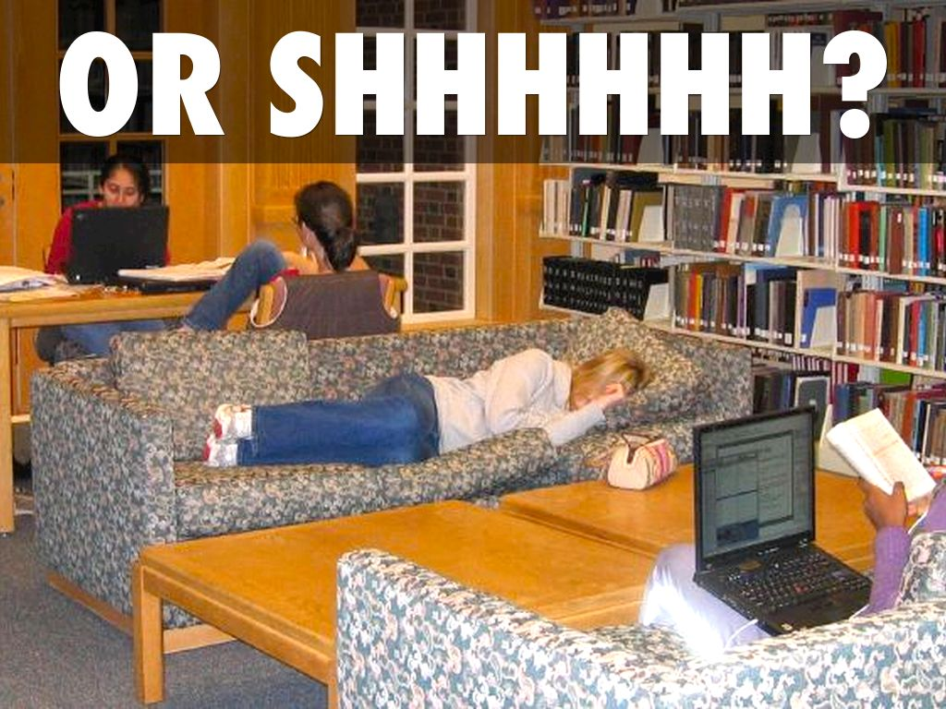
Photo by zsrlibrary - Creative Commons Attribution-NonCommercial-ShareAlike License https://www.flickr.com/photos/57643208@N00
Created with Haiku Deck

Slide 9
Photo by preater - Creative Commons Attribution-ShareAlike License https://www.flickr.com/photos/57989170@N00
Created with Haiku Deck

Slide 10
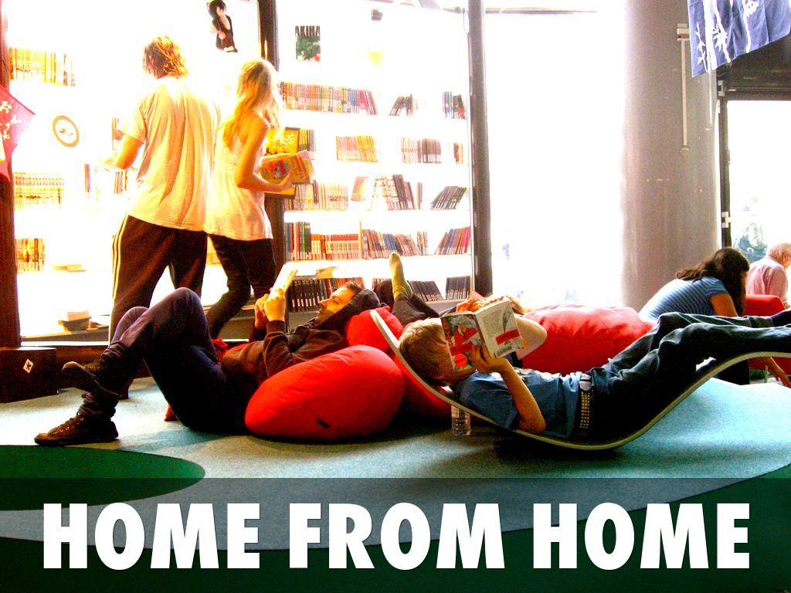
Photo by 917press - Creative Commons Attribution-NonCommercial-ShareAlike License https://www.flickr.com/photos/40603852@N00
Created with Haiku Deck

Slide 11
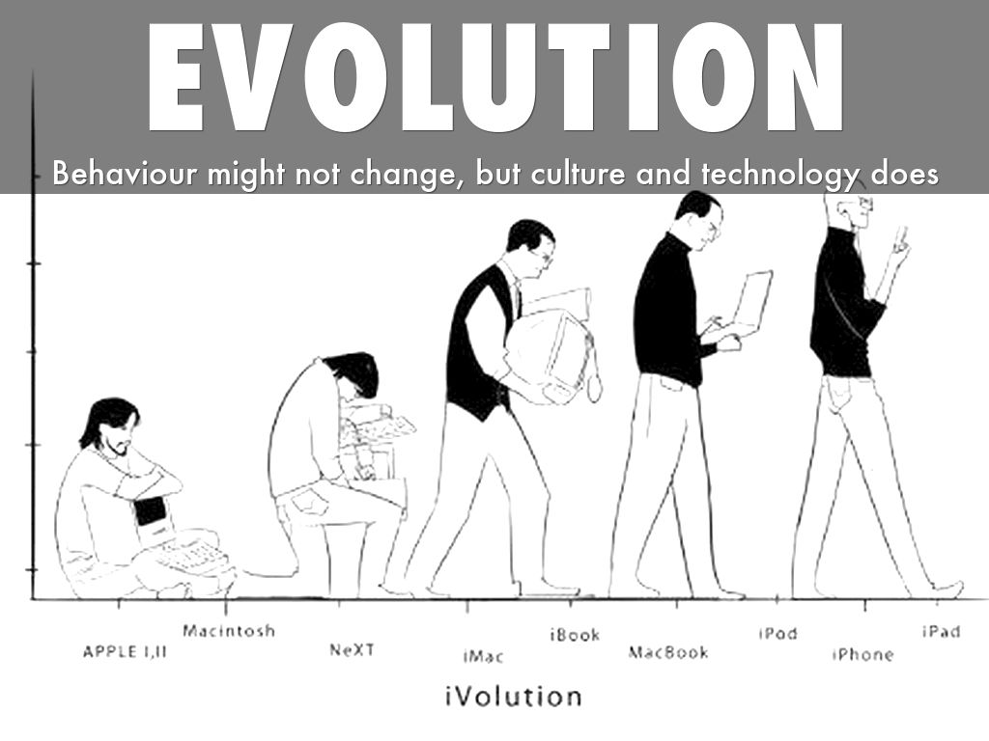
Photo by sidduz - Creative Commons Attribution License https://www.flickr.com/photos/76744449@N07
Created with Haiku Deck

Slide 12
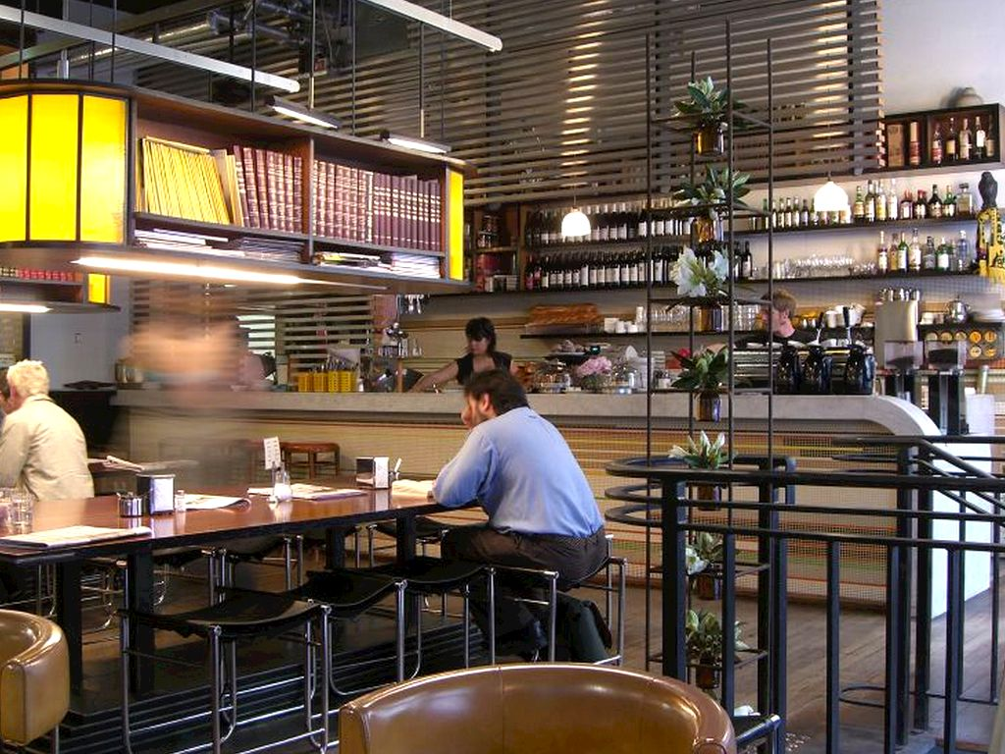
Photo by avlxyz - Creative Commons Attribution-NonCommercial License https://www.flickr.com/photos/10559879@N00
Created with Haiku Deck

Slide 13
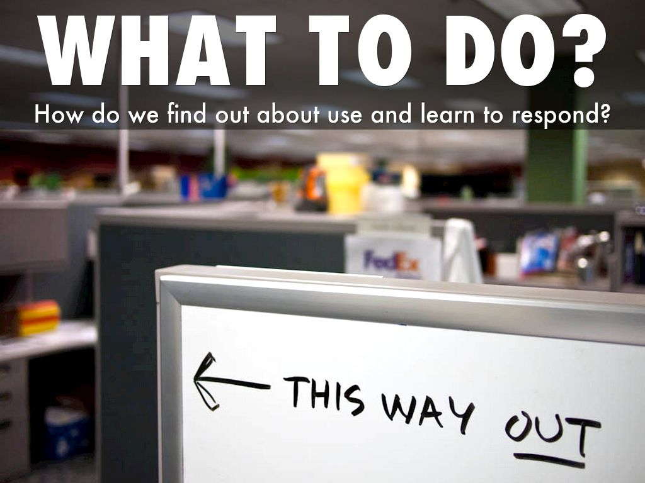
Photo by Robert S. Donovan - Creative Commons Attribution License https://www.flickr.com/photos/10687935@N04
Created with Haiku Deck

Slide 14
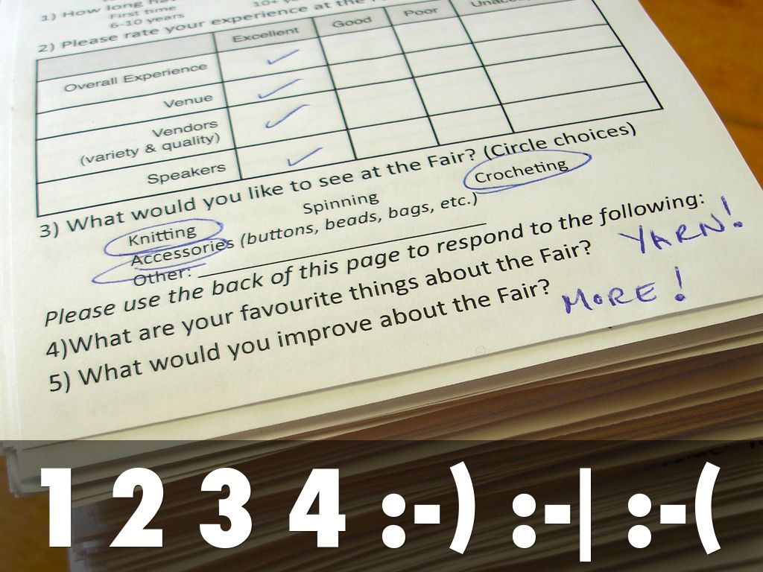
Photo by The Bees - Creative Commons Attribution-NonCommercial License https://www.flickr.com/photos/76236627@N00
Created with Haiku Deck

Slide 15
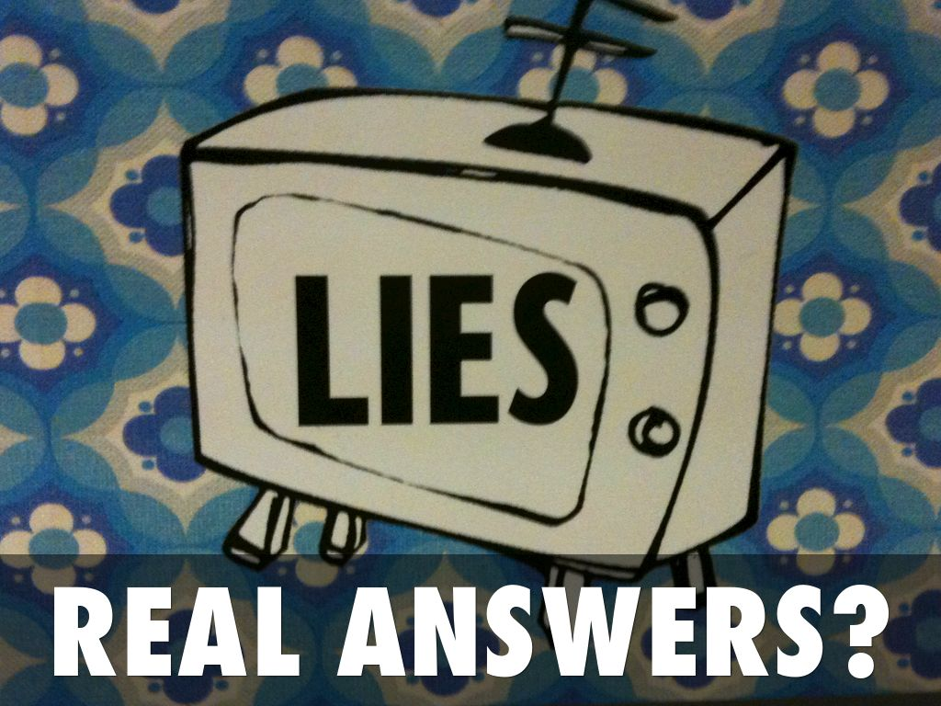
Photo by renaissancechambara - Creative Commons Attribution License https://www.flickr.com/photos/39435232@N00
Created with Haiku Deck

Slide 16
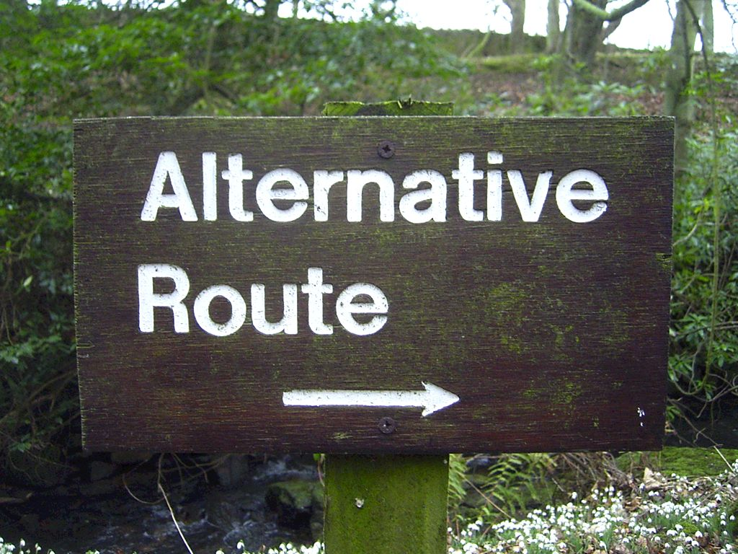
Photo by duncan - Creative Commons Attribution-NonCommercial License https://www.flickr.com/photos/34427470616@N01
Created with Haiku Deck

Slide 17
Photo by Portraits x Events x Reportage - Creative Commons Attribution License https://www.flickr.com/photos/55184980@N08
Created with Haiku Deck

Slide 18
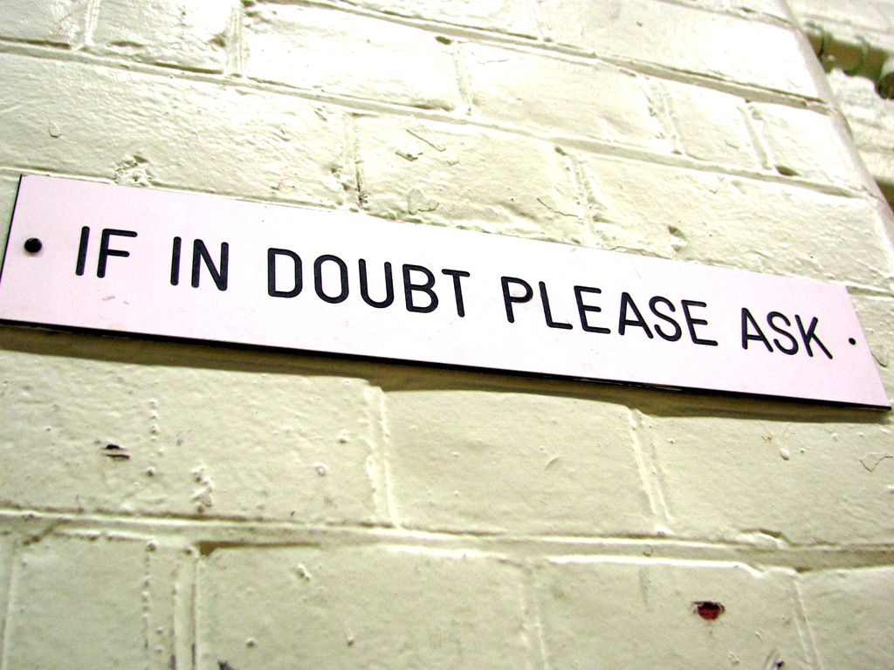
Photo by Roo Reynolds - Creative Commons Attribution-NonCommercial License https://www.flickr.com/photos/85429509@N00
Created with Haiku Deck

Slide 19
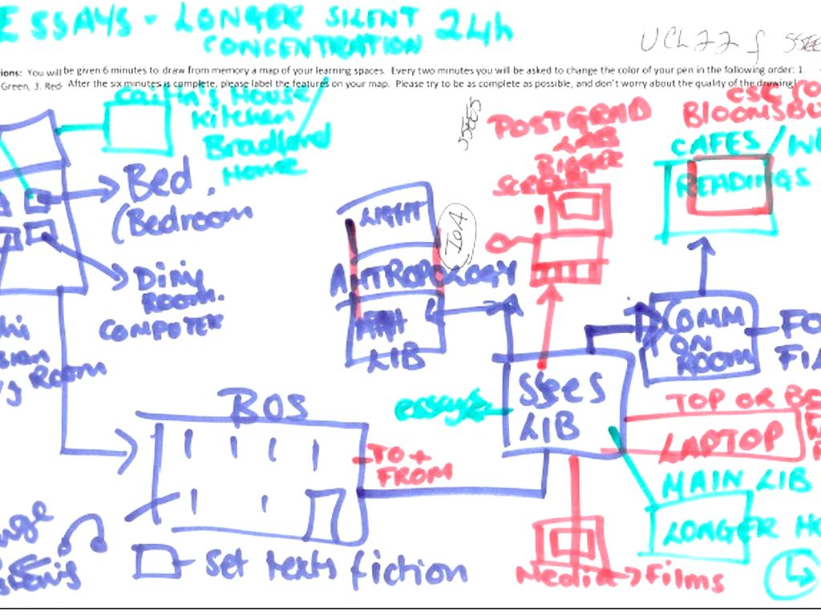

Slide 20
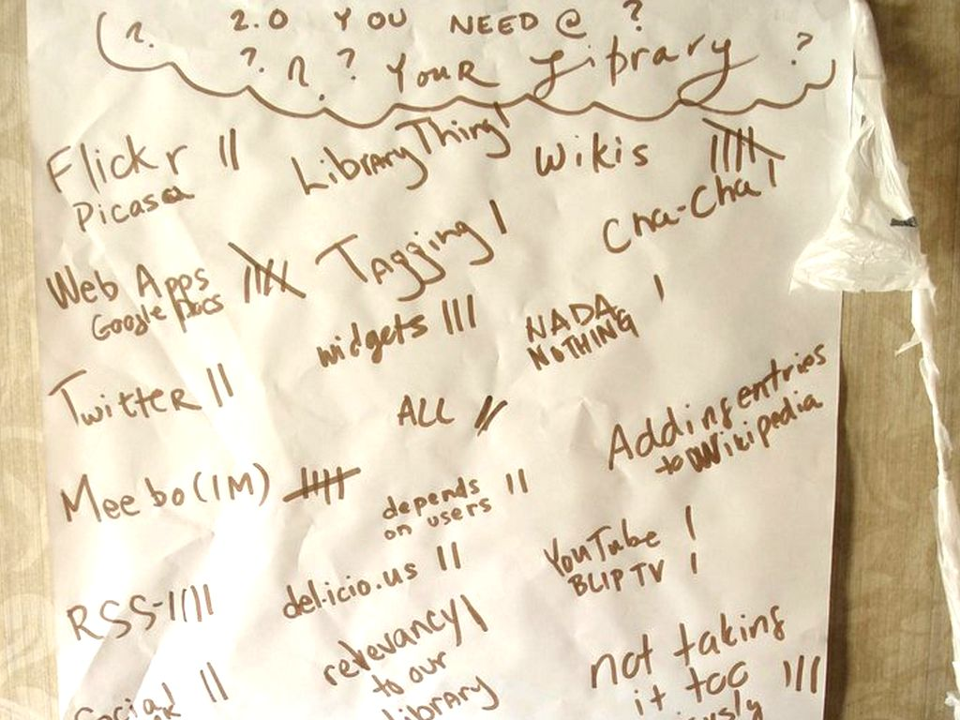
Photo by SPLAT IDAHO - Creative Commons Attribution-NonCommercial License https://www.flickr.com/photos/92941242@N00
Created with Haiku Deck

Slide 21
Photo by TheRLPL - Creative Commons Attribution-NonCommercial License https://www.flickr.com/photos/49835649@N00
Created with Haiku Deck

Slide 22
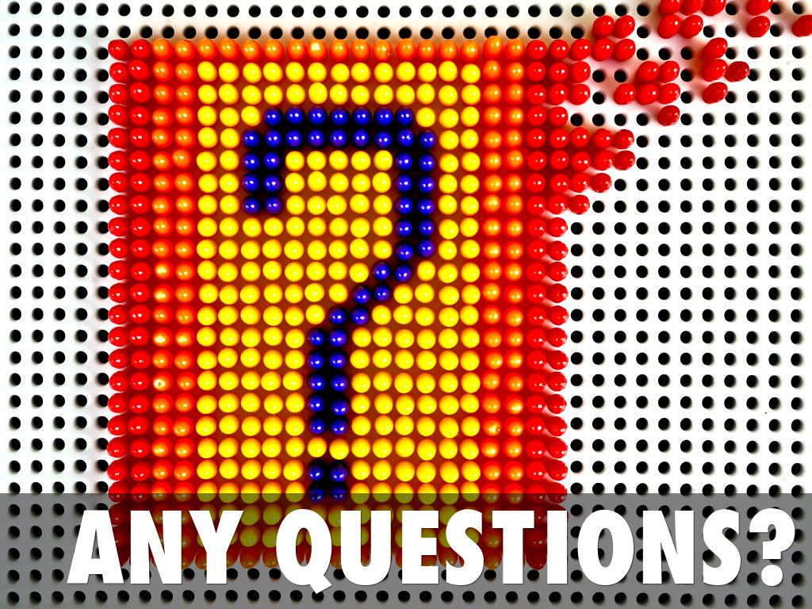
Photo by Ciccio Pizzettaro - Creative Commons Attribution-NonCommercial-ShareAlike License https://www.flickr.com/photos/70038540@N00
Created with Haiku Deck

Slide 23
References
Bourdieu, P., & de Saint Martin, M. (1994). The Users of Lille University Library. In P. Bourdieu, J.-C. Passeron, & M. de Saint Martin (Eds.), Academic Discourse: Linguistic Misunderstanding and Professorial Power. (pp. 122–133). Cambridge: Polity Press.
Donna Lanclos’ cognitive map:
http://atkinsanthro.blogspot.co.uk/2014/04/post-digital-learning-landscapes.html
Joyce Veranza discussing libraries as kitchens:
http://blogs.slj.com/neverendingsearch/2008/08/25/library-as-domestic-metaphor/

