Slide 1
Do or Do Not… There Is No Try: The Quest for Library Value
#acrlcorrelation
Megan Oakleaf
Graham Stone
David Pattern
Melissa Bowles-Terry
Kate Peterson
Shane Nackerud
Jan Fransen
ACRL ‘13

Slide 2
Introduction
Megan Oakleaf
http://meganoakleaf.info
moakleaf@syr.edu
Image source: http://nanozen.info/wp-content/uploads/2010/03/yoda.jpg
ACRL ‘13

Slide 3
www.acrl.org/value

Slide 4
Context
Few libraries exist in a vacuum, accountable only to themselves. There is always a larger context for assessing library quality, that is, what and how well does the library contribute to achieving the overall goals of the parent constituencies?
(S. Pritchard 1996)
Notes:
The report emphasizes library value within the context of overarching institutions.

Slide 5
Conceptions
Value
Inputs/
Outputs
Return-on-Investment
Impact
Service Quality
Satisfaction
Use
Competing Alternatives
Commodity
(p 20)

Slide 6
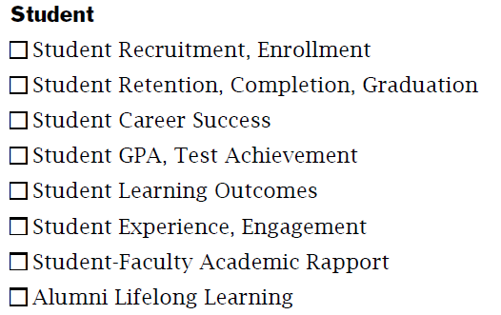
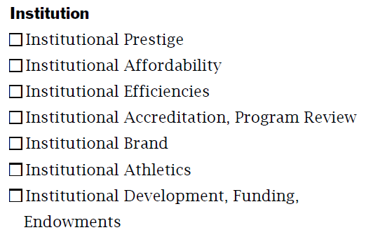
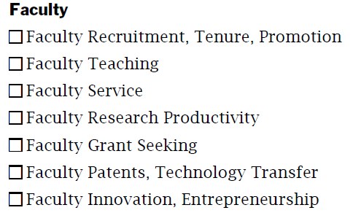
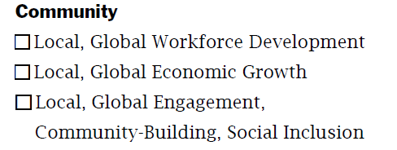
Institutional Impacts

Slide 7
Report Recommendations
Determine what libraries enable users to do.
Develop systems to collect data on individual library user behavior, while maintaining privacy.
Record and increase library impact on student enrollment, retention, graduation rates, grade and test achievement, learning outcomes, “student experience”, job success, etc.

Slide 8
Data, Evidence, & Proof
“Not only do stakeholders count on higher education institutions to achieve their institutional goals, they also require them to demonstrate evidence that they have achieved them.
The same is true for academic libraries; they too must provide evidence of their value.”
(VAL Report,p 26)

Slide 9
LIBRARY IMPACT MAP | Reference Service | Instructional Services | Circulation | Reserves | ILL | Acquisitions | Collections | Special Collections & Archives | Physical Space | Other:
Student Enrollment
Student Retention
Student Graduation Rates
Student Success
Student Achievement
Student Learning
Student Experience
Faculty Teaching
Workbook Activity # 26
Which of these library services/resources
impact which campus needs/goals/outcomes?
Notes:
Work with your elbow partner(s)…Pick one or two rows or columns and work through them.

Slide 10
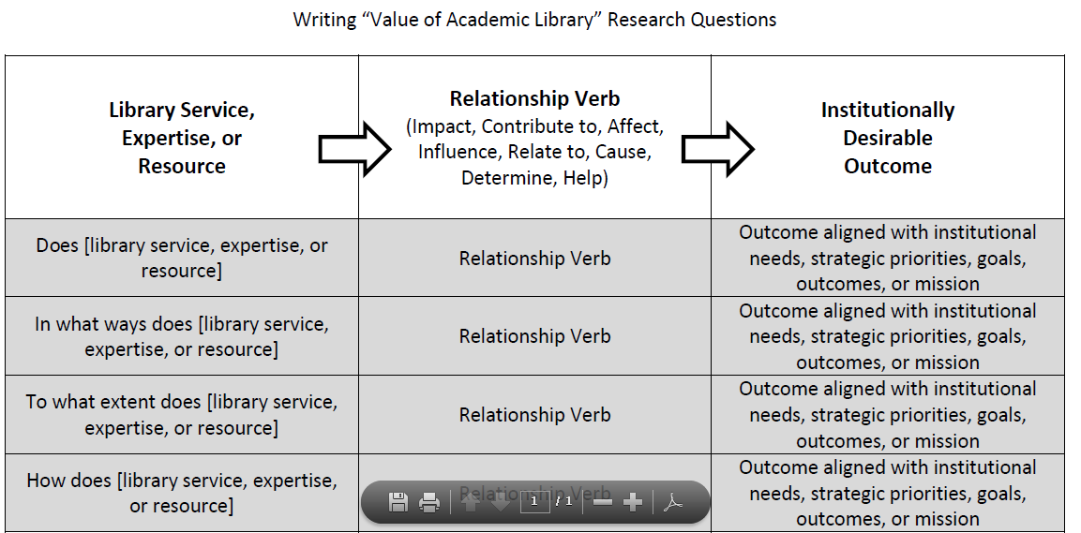
Correlations
http://meganoakleaf.info/valresearchquestions.pdf

Slide 11
The Question of Causation
Umm…you can’t actually demonstrate causation, only infer it.
Do we have the capability to isolate all variables?
Do we have the need to say we are the only ones contributing to outcomes?
Is it enough to describe the profile of successful students and seek to increase students that emulate those attributes?
What is our goal?
If it’s to “prove,” then we may “need” causal data.
If it’s to improve, we don’t.

Slide 12
University of Huddersfield
Graham Stone
David Pattern
Image source: http://nanozen.info/wp-content/uploads/2010/03/yoda.jpg
ACRL ‘13

Slide 13
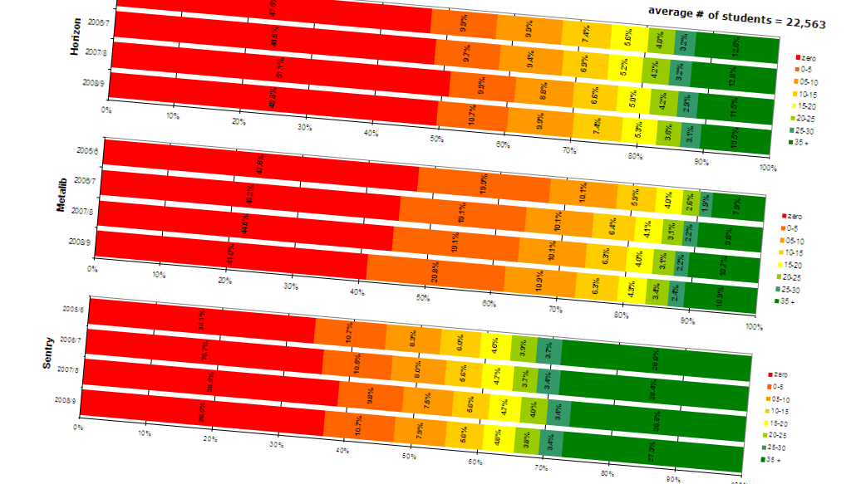
Using Usage Data since 2005…
…to improve existing services
…to gain insights into user behaviour
…to measure the impact of the library

Slide 14
Library Impact Data Project Phase I (Feb-Jul 2011)

Slide 15
To support the hypothesis that…
“There is a statistically significant correlation across a number of universities between library activity data and student attainment”

Slide 16
Library Impact Data Project 1 Original data requirements
For each student who graduated in a given year, the following data was required:
Final grade achieved
Number of books borrowed
Number of times e-resources were accessed
Number of times each student entered the library, e.g. via a turnstile system that requires identity card access
School/Faculty

Slide 17
Did we prove the hypothesis?
The relationship and variance means that you can believe what you see
And you can believe it across a range of data
Subjects
Partners
So library usage does impact on students attainment
Not a cause and effect relationship

Slide 18
Library Impact Data Project Phase II (Jan-Oct 2012)

Slide 19
Library Impact Data Project Phase II (Jan-Oct 2012)
Phase I looked at over 33,000 students across 8 universities
Phase II looks at around 2,000 FT undergraduate students at Huddersfield

Slide 20
Library Impact Data Project 2 Additional data
We had some new library usage metrics which weren’t available during Phase I
Demographics
Overnight usage
Off campus usage
The number of e-resources accessed
as distinct from the hours spent logged into e-resources
the number of e-resources accessed 5 or more times
the number of e-resources accessed 25 or more times.

Slide 21
Library usage Ethnicity

Slide 22
Library usage Country of domicile

Slide 23
Library usage Aggregated subject groups

Slide 24
Library usage Retention
Looking at one year of data for every student
Using a cumulative measure of usage for the first two terms of the 2010-11 academic year
Only looking at people who dropped out in term three
All the students included in this study were at the university in the first two terms, and they have all had exactly the same opportunity to accumulate usage.

Slide 25
Library usage Retention

Slide 26
Number of e-resources accessed Depth and breadth

Slide 27
Other factors Value added
Rank entry points and final grade as percentage
Does the difference correlate with measures of usage?
WARNING! This needs further testing!
Methods are untried
Missing data
Initial results are very encouraging ☺

Slide 28
Going forward @Huddersfield
Identifying retention issues and our impact on lowering them as part of a University dashboard
Look at specific subjects in order to work towards:
A best practice toolkit for information skills sessions
Further understanding by holding focus groups with target areas
Create an action plan to engage with academic colleagues
Showing value for money and the impact of the service on the student experience

Slide 29
Going forward @a national level
An analytics service providing libraries with actionable data to transform the services and support institutions provide to students and researchers

Slide 30
JiscLAMP Library Analytics and Metrics Project
The project will develop a prototype shared library analytics service for UK academic libraries
Envisioned as a data dashboard
To enable libraries to capitalise on the many types of data they capture in day-to-day activities
To support the improvement and development of new services and demonstrate value and impact in new ways across the institution
A partnership between Jisc, Mimas (University of Manchester) and the University of Huddersfield

Slide 31
References
Library Impact Data Project blog
http://library.hud.ac.uk/blogs/projects/lidp/
JiscLAMP
http://jisclamp.mimas.ac.uk/about-lamp/
Stone, Graham and Ramsden, Bryony (2013) Library Impact Data Project: looking for the link between library usage and student attainment. College and Research Libraries. Available as pre-print
Stone, Graham and Collins, Ellen (2013) Library usage and demographic characteristics of undergraduate students in a UK university. Performance Measurement and Metrics, 14 (1). Available as pre-print

Slide 32
University of Wyoming
Melissa Bowles-Terry
ACRL ‘13

Slide 33
Melissa Bowles-Terry Instruction & Assessment Coordinator mbowlest@uwyo.edu

Slide 34
The Correlation
A statistically significant difference in GPA between graduating seniors who had library instruction in upper-level courses and those who did not.
Melissa Bowles-Terry, “Library Instruction and Academic Success: A Mixed-Methods Assessment of a Library Instruction Program,” Evidence Based Library and Information Practice 7, 1 (2012): 82-95.
Notes:
Upper-level = sophomore, junior, or senior
Why this project: Who gets library instruction? Who doesn’t? And does it make a difference?
Librarians often approach questions from a librarian-centered perspective, gathering data on how many students attend, how many students successfully complete research assignments, etc. This project attempted to find out what the library instruction program looks like from a student perspective.

Slide 35
Process
4,489 transcripts of students who entered UW between 2005-2007 and graduated 2006-2011, excluding graduate & professional students
Dataset from registrar: classes taken, grades, major at entry, major at graduation, GPA at graduation, sex
Compared transcript data with internal library instruction records and sorted students into groups based on level of library instruction
Notes:
Why look at transcripts: initial interest was to see how many times/when we were seeing students for library instruction. Then, because of Value project and some other correlational research recently published, I was interested to see if there was a correlation between library instruction and student outcomes.
Who did the work: I did, over the course of a summer, with statistical analysis help from an instructor in the statistics department.
Created an Access database to match the transcript data with our records of library instruction sessions offered
If a student was in a class that had library instruction, I assumed the student was present for library instruction. Also, transfer students may have had library instruction at the freshman level at a different institution, but I did not control for that.

Slide 36
Comparison groups
MEAN GPA
Group 1: Upper-level library instruction | 3.289
Group 2: Freshman-level library instruction | 3.247
Group 3: No library instruction | 3.214
Notes:
The difference in mean GPA looks tiny
ANOVA revealed statistically significant difference
post hoc Dunnett test used “no library instruction” group as the control or baseline group, comparing other groups against it. Shows that the only group different from control group was upper-level instruction group. Freshman-only instruction did NOT make a significant difference.
reveal statistically significant difference between Group 1 and other groups
Ex post facto research – can’t claim that library instruction is cause of difference – way too many potentially confounding variables. Probably an effect from the repetition of instruction, not analyzed in this study.
But the statistically significant positive correlation does give us reasons to think that upper-division assignments that require research and library instruction that supports those assignments may have a positive effect on student performance.

Slide 37
Now what?
Developing a tiered information literacy program
Argument for not “front-loading” library instruction in freshman year
Identifying departments that don’t currently use library instruction
Notes:
The GPA analysis was combined with focus groups of graduating seniors, and both suggested that students could use an orientation to the library as freshman and upper-level instruction related to their majors and to specific research projects
Series of three writing/communication classes with information literacy/critical thinking and writing focus. Developing distinct learning outcomes for different levels.
Cutting some of our freshman-level instruction – public speaking course

Slide 38
The bigger picture
Image source: http://www.flickr.com/photos/andrewmalone/2177355189/
Notes:
How this fits into library value research: GPA is just one measure of student academic success and an imperfect surrogate for student learning. Other measures of student academic success: employment rates, employer evaluations of former students, percentage going to graduate school. GPA is not a direct measure of student learning, but it is a widely used surrogate that everyone understands.
Advice for a similar project: match instruction recording forms or spreadsheets to student transcripts and use the same fields
Why we need to prove and improve the value of academic libraries:

Slide 39
University of Minnesota
Kate Peterson
Shane Nackerud
Jan Fransen
ACRL ‘13
Notes:
Shane

Slide 40
University of Minnesota-Twin Cities Jan Fransen (fransen@umn.edu) Shane Nackerud (snackeru@umn.edu) Kate Peterson (katep@umn.edu) http://blog.lib.umn.edu/ldss/
Project Team:
Jan Fransen
Kristen Mastel
Shane Nackerud
Kate Peterson
David Peterson
Krista Soria
Notes:
Shane

Slide 41
Correlations for First Year Undergraduates in 2011-12
Statistically significant positive difference in GPA for library users vs. non-library users
Statistically significant relationship between library use and retention to Fall 2012
Statistically significant relationship between library use and both Scholarship and Academic Engagement, as measured by the SERU survey
Notes:
Each of these outcomes is commonly used by our Office of Institutional Research as they look for opportunities for the University to influence student outcomes.

Slide 42
How we found it: Layers of Data
Office of Institutional Research Performance Data
Term and Cum GPA, Retention
Office of Institutional Research Demographics Data
College, Level, Major, Gender, Ethnicity, Age
Libraries Data (13 Access Points)
Circulation, Digital, Instruction, Reference, and Workstation

Slide 43
Any (trackable) Library Use
Circulation (including ILL and renewals)
Digital (website, e-journal, database, e-book)
Reference (online and consulting, when an ID was captured)
Instruction (workshops, course-integrated, Intro to Library Research)
Workstation (our only “library as place” measure)
Notes:
We can only use access points where we can get an Internet ID.
You can find more details about the access points that make up these categories on our blog (http://blog.lib.umn.edu/ldss/) or in our article Analyzing Demographics: Assessing Library Use Across the Institution in the April 2013 issue of portal: Libraries and the Academy

Slide 44
Demographics by themselves illustrate big and important differences between colleges

Slide 45
College of Biological Sciences
College of Science and Engineering
Notes:
CBS first (but only by a little bit) – CSE last

Slide 46
College of Design
Notes:
CDES undergrads check out a lot of books, relatively speaking
Shane’s last slide

Slide 47
Layers of Data
Office of Institutional Research Performance Data
Term and Cum GPA, Retention
Office of Institutional Research Demographics Data
College, Level, Major, Gender, Ethnicity, Age
Libraries Data (13 Access Points)
Circulation, Digital, Instruction, Reference, and Workstation
Notes:
Jan’s first slide

Slide 48
Notes:
Initial analysis of all undergraduates by collage—not controlling for anything. A pilot study in Summer 2011 with similar results was enough to get OIR very interested in this project.

Slide 49
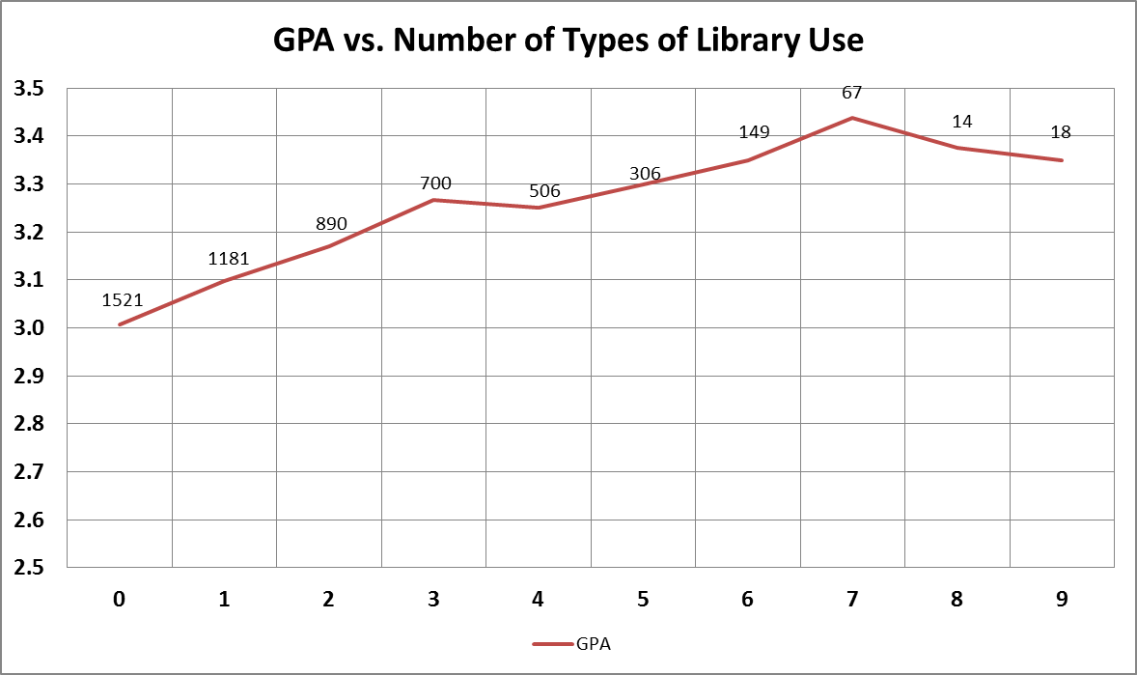
Notes:
In Fall 2011, we measured 13 library access points. No undergraduate touched the library in all these ways, but some used the library in more ways than others.
There is a positive association with increased library usage and higher GPAs.

Slide 50
Inferential Analyses
First-year students (non-transfer, n = 5,368)
Examined three outcomes:
Grade Point Average
Retention
SERU indicators for Academic Engagement and Scholarship
Many ways to slice the data:
Any use of the library
Type of library use
Frequency within type of library use
Notes:
Focus on first year students – this is common practice for institutional researchers. It’s easier to identify and control for factors that influence GPA for incoming freshmen than at any other time in their academic career.
You can find more information about the analysis in our article Library Use and Undergraduate Student Outcomes: New Evidence for Students' Retention and Academic Success in the April 2013 issue of portal: Libraries and the Academy

Slide 51
Other Characteristics Considered
Use of library (71.3%)
Demographics:
Gender (F = 47.8%)
Race/ethnicity (SOC= 18.4%)
Pell grant (22.3%)
Veteran status (.6%)
First-generation (25.9%)
College environment:
Freshmen seminar (27.8%)
Access to Success program (8.8%)
Dorm (85.2%)
Prior academics
ACT/SAT scores (M = 27.49)
AP credits (n = 3137, M = 8.73)
Notes:
Note that the institution has no control over demographic and prior academic factors. Part of what OIR does is look for places where the institution can affect outcomes.

Slide 52
GPA Results
Controlling for demographics, college environment, and prior academic variables:
For Fall 2011, using the library at least once was associated with a .23 increase in students’ GPA holding other factors constant
For Fall 2011, a one-unit increase in types of use was associated with a .07 increase in GPA
Less difference in Spring 2012, but still a significant positive correlation

Slide 53
Retention Results
Controlling for the same variables, we examined retention:
Fall 2011: Students who used the library at least once were 1.54 times more likely to re-enroll for Spring 2012
Spring 2012: Students who used the library during their first year were 2.075 times more likely to re-enroll for Fall 2012

Slide 54
Additional Retention Results
Fall 2011: Students who had “Intro to Library Research II” library instruction were 7.58 times more likely to re-enroll for Spring 2012
Spring 2012: Students enrolled in courses that included library instruction were 1.389 times more likely to re-enroll for Fall 2012
Database use had a significant positive correlation for both semesters

Slide 55
Student Experience in a Research University (SERU) Survey
Developed by the Center for Studies in Higher Education and administered to all degree-seeking U of M undergrads
Combined library data with SERU responses
FY Students who used the library had higher academic engagement and higher scholarship indicators on the SERU inventory

Slide 56
SERU: How often have you…
Scholarship
Examined how others gathered and interpreted data and assessed the soundness of their conclusions
Reconsidered your own position on a topic after assessing the arguments of others
Incorporated ideas or concepts from different courses when completing assignments
Used facts and examples to support your viewpoint
Academic Engagement
Asked an insightful question in class
Contributed to a class discussion
Interacted with faculty during lecture class sessions
Brought up ideas or concepts from different courses during class discussions
Had a class in which the professor knew or learned your name
Talked with the instructor outside of class about issues and concepts derived from a course
Found a course so interesting that you did more work than was required
Notes:
From About the SERU Survey: Academic Experience & Globalization, retrieved from http://www.seru.umn.edu/about-seru/survey on March 29, 2013.
Jan’s last slide

Slide 57
What have we done with these results?
Notes:
Kate’s first slide

Slide 58
Actions We’ve Taken
Used in our campus-wide Orientation messages
Highlighted in College of Science & Engineering recruiting event
Referenced in curriculum conversations
Part of reboot of Intro to Library Research
Deeper analysis of data for specific colleges
Exploring evidence of the most effective use of staff time (Library Course Pages, instruction)

Slide 59
By College Concerns
Deans immediately want to know how it looks for their college
College of Science & Engineering analysis
GPA: Statistically significant positive correlation
Retention: No correlation (93% retained)
Scholarship: Statistically significant correlation
Academic Engagement: No correlation
Notes:
This work will be presented at the American Society of Engineering Educations (ASEE) conference in June 2013. A paper will be available as part of the conference proceedings and, if copyright agreements allow, in the University of Minnesota Digital Conservancy. See our blog for details sometime in May.

Slide 60
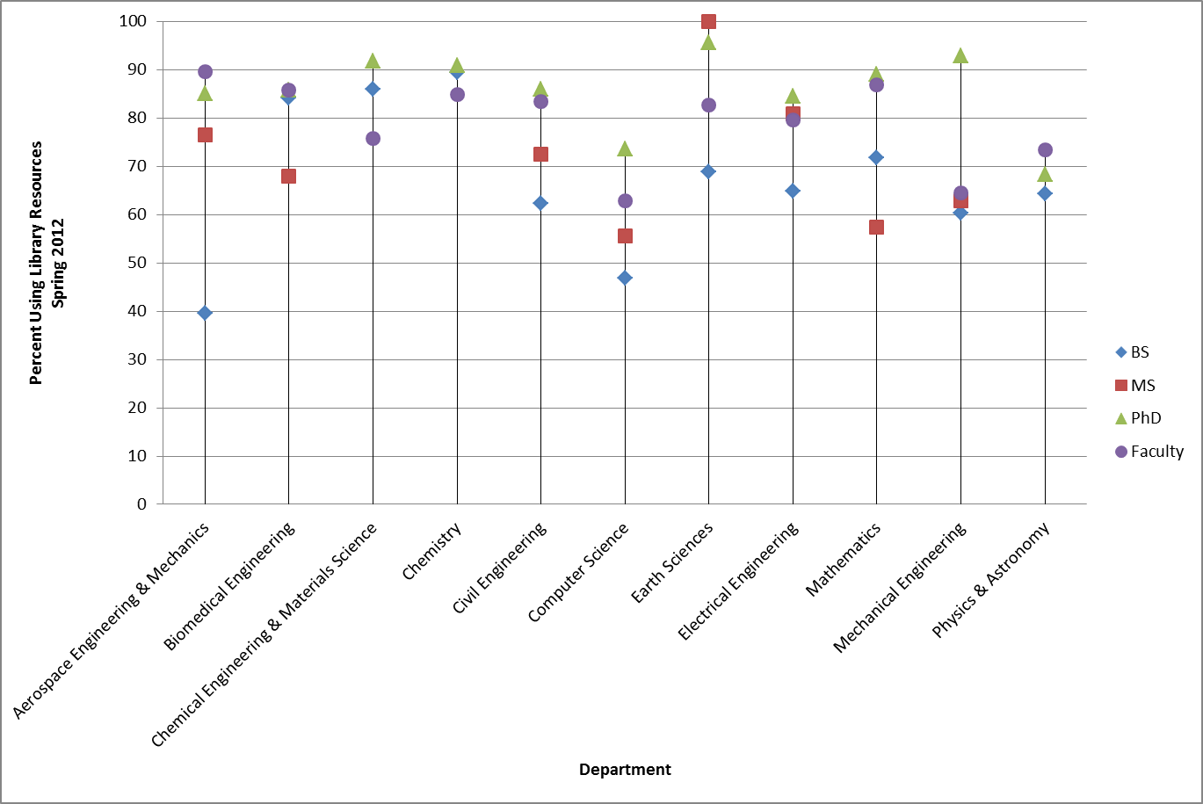
College of Science & Engineering Any Library Use
Notes:
No correlations here, but an interesting way to look at how departments differ from each other, and how degree sought and faculty differ from each other.

Slide 61
Conversations
Shown and explained our results to stakeholders and potential partners on campus
Libraries/University leadership
Faculty Senate Library Committee
Seen as “promising”
Led more to valuable conversations than to concrete actions

Slide 62
Next Steps
Working to share with campus
Longitudinal
Data collection – Never ending battle
Easier we make it for patrons…harder for us
Authentication system
Discovery system coming
VPN usage unknown

Slide 63
Questions?
ACRL ‘13

Slide 64
Do or Do Not… There Is No Try: The Quest for Library Value
#acrlcorrelation
Megan Oakleaf
Graham Stone
David Pattern
Melissa Bowles-Terry
Kate Peterson
Shane Nackerud
Jan Fransen
ACRL ‘13

