Slide 1
The Path of Least Resistance
Dave Pattern | Library Systems Manager | University of Huddersfield
http://daveyp.com/blog
twitter @daveyp

Slide 2
Dave’s Law...
Users should not have to become mini-librarians in order to use the library.

Slide 3
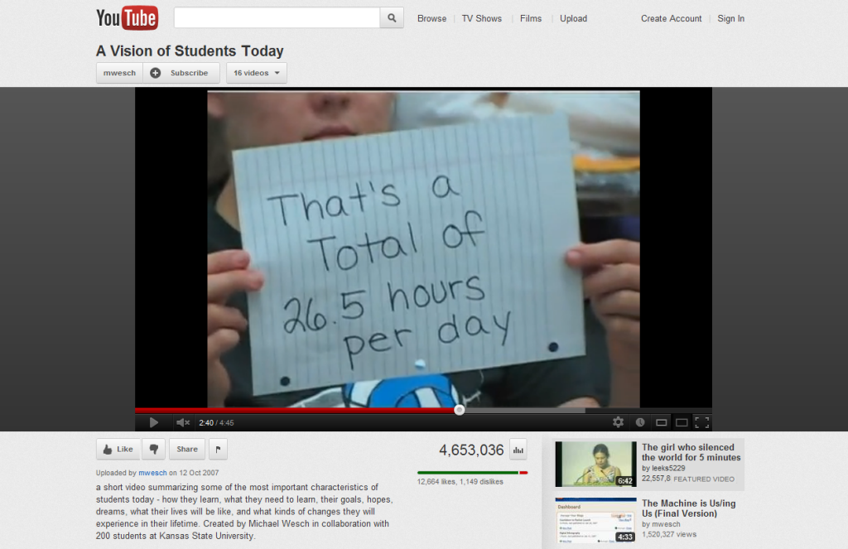
Time is a precious commodity...
youtube.com
Notes:
Prof Michael Wesch, Kansas State University
“A Vision of Students Today” (2004)

Slide 4
Libraries are too hard...
libraryjournal.com
“As early as 2004, in a focus group for
one of my research studies, a college
freshman bemoaned, ‘Why is Google
so easy and the library so hard?’”
  Carol Tenopir, University of Tennessee, Knoxville (“Visualize the Perfect Search”, Library Journal, 2009)
Notes:
Carol Tenopir (University of Tennessee, Knoxville)
http://www.libraryjournal.com/article/CA6639354.html?industryid=47130
Via Ken Chad http://www.kenchadconsulting.com/wp-content/uploads/2012/03/Transforming_LibrarySystems_Ken_Chad_UCISA_March2012.pdf

Slide 5
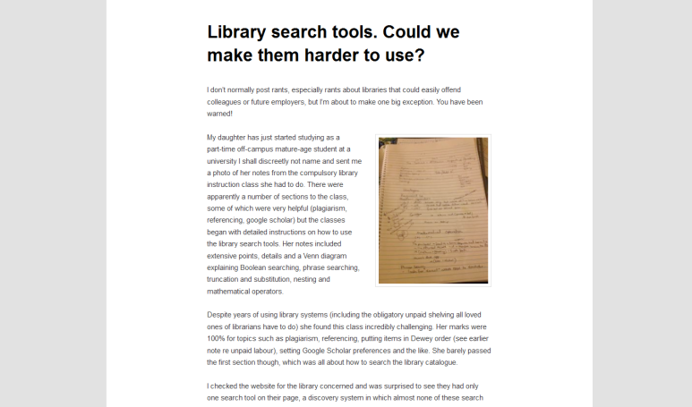
Librarians scare students...
Dear fellow librarians, ... if you make them feel stupid or scare them off the first time they hear about you they are unlikely to ever come back because they have plenty of other ways to get just enough information that is just good enough for their purposes.
@carolgauld
carolbycomputerlight.wordpress.com
Notes:
Caroline Gauld
http://carolbycomputerlight.wordpress.com/2012/06/04/library-search-tools-could-we-make-them-harder-to-use/
http://www.twitter.com/carolgauld

Slide 6

So, students choose to bypass the
library and use Google instead...
“...numerous studies have shown users are
often willing to sacrifice information quality
for accessibility. This fast food approach to
information consumption drives librarians
crazy. ‘Our information is healthier
and tastes better too’ they shout.”
  Peter Morville (“Ambient Findability”, 2005)
Notes:
ISBN: 0596007655
http://findability.org/
http://shop.oreilly.com/product/9780596007652.do

Slide 7
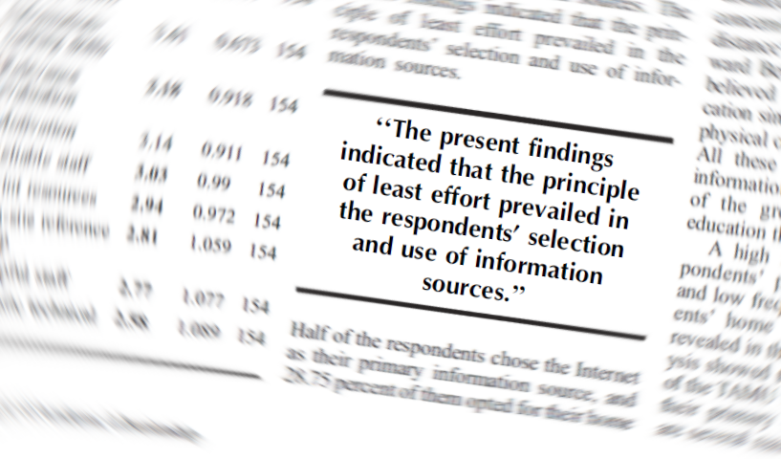
Because they prefer the path of
least resistance to information...
DOI: 10.1016/j.jal.2003.11.005
Notes:
“Factors Influencing Distance-Education Graduate Students' Use of Information Sources: A User Study”
Zao Liu and Zheng Ye (Lan) Yang
The Journal of Academic Librarianship
Volume 30, Issue 1, January 2004, Pages 24–35
http://dx.doi.org/10.1016/j.jal.2003.11.005

Slide 8
...and this is well understood
and documented behaviour
“...an information [seeker] will tend to
use the most convenient search
method, in the least exacting mode
available. Information seeking
behaviour stops as soon as minimally
acceptable results are found.”
en.wikipedia.org

Slide 9
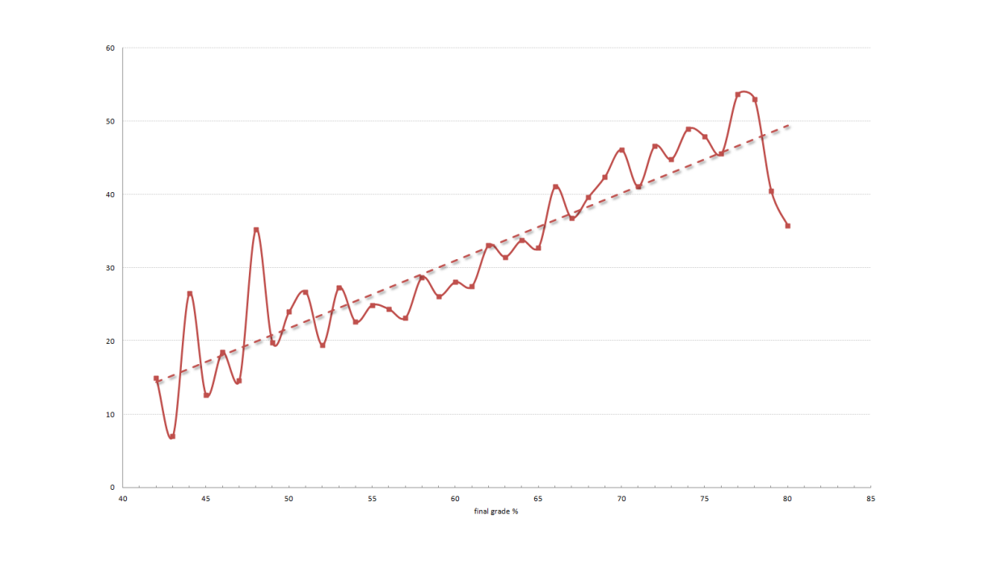
But the library is important...
average no. of hours →
Spearman ρ = 0.8943
p-value = 0
Library Impact Data Project
final % grade →
Notes:
2010/11 graduates and their use of e-resources in the final year (as measured via Ezproxy)
http://library.hud.ac.uk/lidp

Slide 10
So, we need to make it easier for
users to access our resources...
libraryjournal.com
“The challenge for academic libraries
[...] is to offer an experience that has
the simplicity of Google...”
  Judy Luther & Maureen C. Kelly (Library Journal, 2011)
Notes:
Judy Luther & Maureen C. Kelly
http://www.libraryjournal.com/lj/ljinprintcurrentissue/889250-403/the_next_generation_of_discovery.html.csp
Via Ken Chad http://www.kenchadconsulting.com/wp-content/uploads/2012/03/Transforming_LibrarySystems_Ken_Chad_UCISA_March2012.pdf

Slide 11
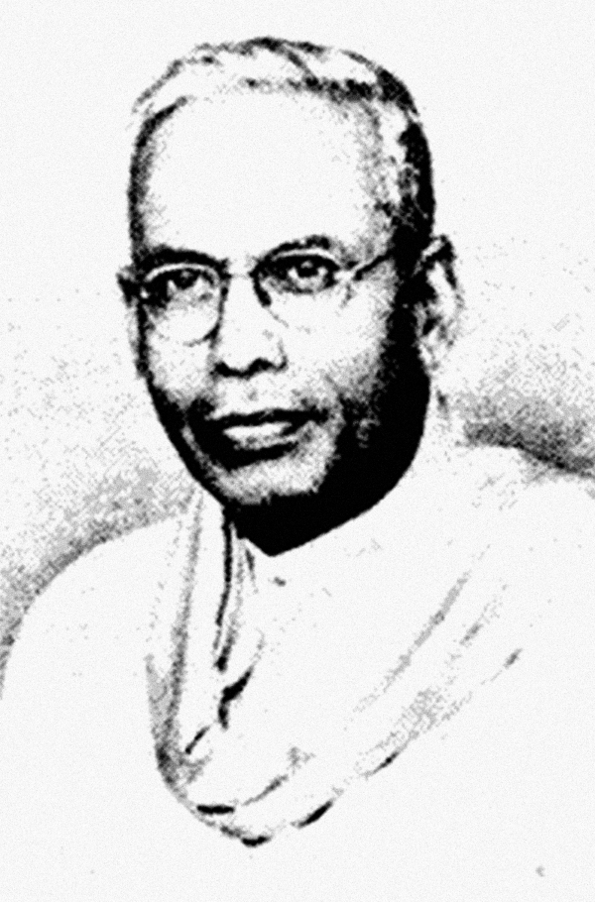
...and we need to help free up
their time to do other stuff
4th Law...
save the time of the reader
en.wikipedia.org
Notes:
http://en.wikipedia.org/wiki/Five_laws_of_library_science

Slide 12

More time to do stuff like...
Watching “El Nombre”
Going to the pub
Looking at Facebook
Maybe even evaluating
the articles they’ve
found on Summon? ☺

Slide 13
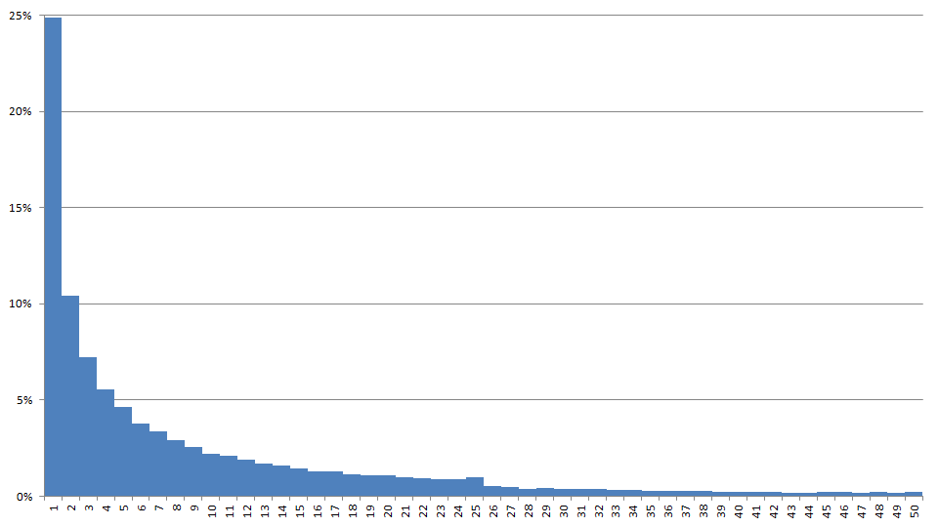
How to students use Summon?
% clicks per position of result

Slide 14
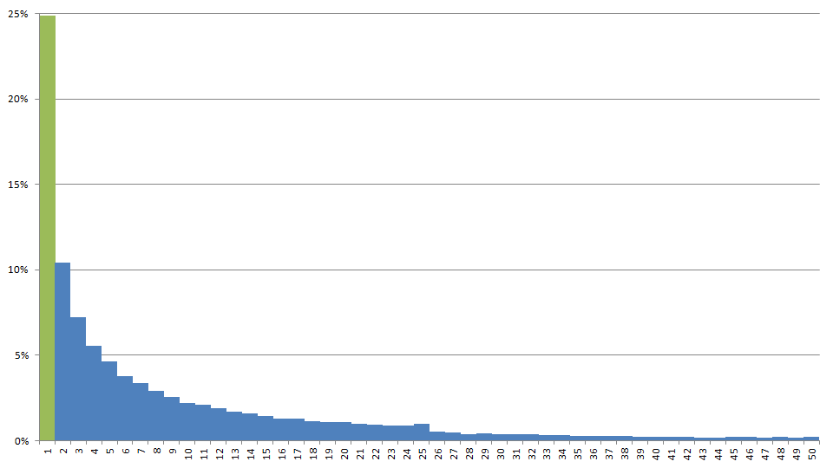
How to students use Summon?
% clicks per position of result
24.9% of clicks are on
the first result on page 1

Slide 15
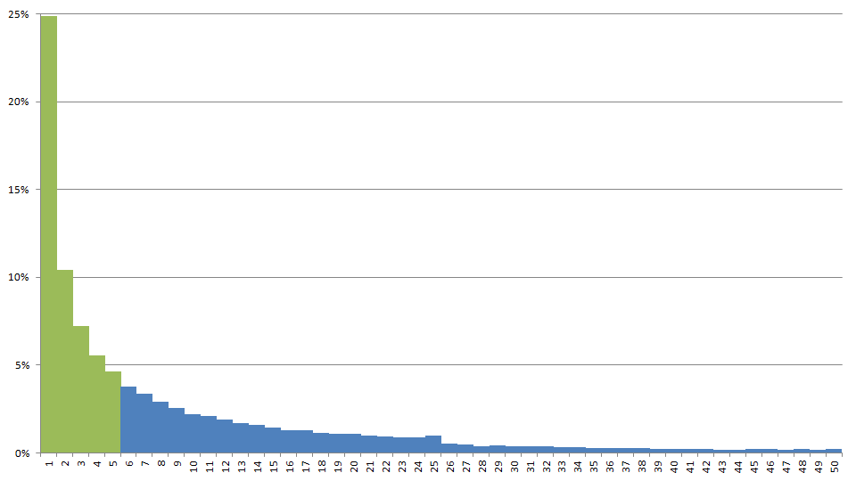
How to students use Summon?
% clicks per position of result
52.6% of clicks are on the first 5 results on page 1

Slide 16
How to students use Summon?
% clicks per position of result
users tend not to go beyond
the first page of results
#25 = 0.99%
#26 = 0.52%

Slide 17
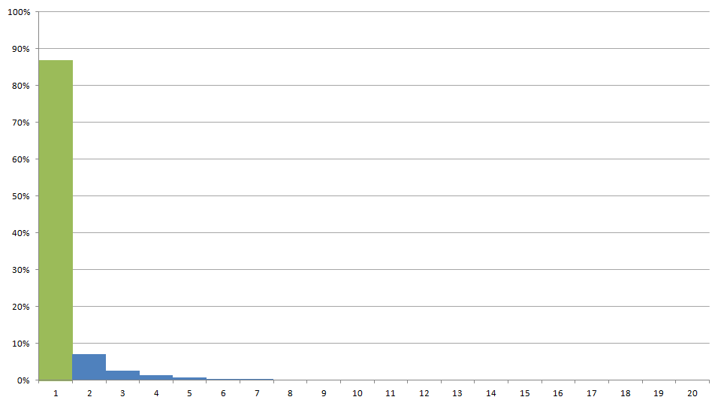
How to students use Summon?
% clicks per result page
86.8% of clicks are
on page 1 results

Slide 18
Search strategies
using facets to refine the result set
28.1% of searches used at least 1 facet
  content type 9.4%
  publication date 8.4%
  full text only 7.0%
  scholarly only 5.2%
  language 2.9%
  subject terms 2.1%

Slide 19
Search strategies
based on 78,274 searches
average number of keywords 4.6
searches containing Boolean 2.57%
  AND 2.47%
  OR 0.20%
  NOT 0.03%
  Human & Health Sciences Librarians tell their students to always put an AND between each keyword

Slide 20
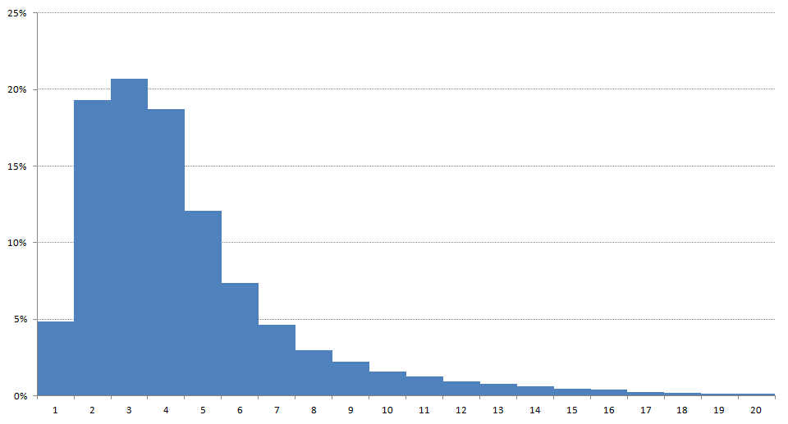
Search strategies
based on 78,274 searches
# of keywords used

Slide 21
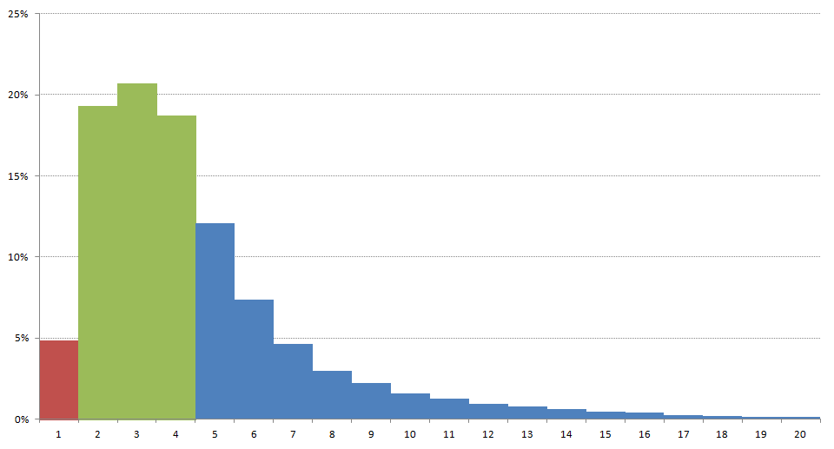
Search strategies
based on 78,274 searches
4.9% of searches
used only 1 keyword
58.7% of searches
contain 2 to 4 keywords

Slide 22
Search strategies
most search keywords: 185
  The literature reveals that errors of drug administration are a widely distributed and common occurrence The frequency of errors and their underlying causes are discussed, and the literature is surveyed to determine reasons for mistakes and possible remedial measures Ideas are drawn from industrial sources to describe a model of preventing mistakes at source, by making errors impossible The ideas of Crosby and Shingo are discussed and a zero defects philosophy is described and developed This paper attempts to determine if this quality model developed and used in industry can be transferred to the health service, and concludes that it needs adaptation and cautious application Recommendations are made for improved practices and improvements, both clinical and managerial The author recommends a multidisciplinary review of all practices and systems to develop a radically different procedure with no drug errors as its aim It is questioned whether this is possible in the present health service environment, as this would require sustained management commitment to both the idea and the quality system However, the author believes that some of the principles can be applied as individual quality initiatives
Summon results

