Slide 1
The Academy for British and Irish Studies
Developing Research and Teaching Excellence

Slide 2
Academy for British and Irish Studies
Founding Aims and Objectives of the Academy for the Study of Britishness:
To integrate the wide-range of current research, networking and teaching agendas across the University of Huddersfield
to initiate original research, conference and teaching activities across the UK and beyond.
To inform local, regional and national policy-makers and practitioners on the implications of debates about identities and their implications in Britain, Ireland and any part of the world which has/had a relationship with Britain.
Why change our name?

Slide 3
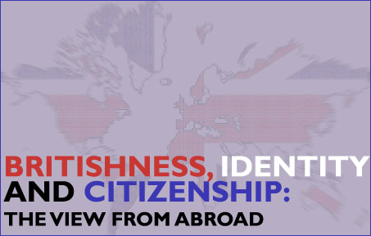
Major research achievements since 2008
Enriching research : publications listed in top-ranked journals and award winning books
Developing networks and internationally-recognised conferences: Britishness - The View from Abroad; Identity and the Other British Isles, Labour Orators (all leading to edited collections and excellent feedback from participants)
Developing the next generation of researchers: 9 research students successfully supervised to completion by members of the ABIS (17 in progress)

Slide 4
Public engagement and impact
New Perspectives on Britishness (2009/10), including Chris Harvie MSP, Adam Price MP, Dr David Hume, Bernardine Evaristo.
Community Cohesion seminars
Public lectures:
Paul Ward: James Mason film screening and lecture
Andy Mycock: In Defence of the Union
Public surveys and public seminars on St. George and Englishness
Regular contributions from Academy members to local, national and international media.
Government policy-making
Ministry of Justice Youth Citizenship Commission in 2008-9
DCLG Select Committee Inquiry into Prevent at the House of Commons in 2009

Slide 5
Success in 2011
Varied activities across and combining disciplines
External funding success from diverse range of funders, including Société Jersiaise, Scouloudi Foundation (IHR), Royal Historical Society, ESRC, European Science Foundation, Political Studies Association.
ESF ‘Teaching the post-empire nation-state’ workshop.
PSA sponsored ‘Party Politics of Identity’ workshop and roundtable on ‘English Questions under the Coalition’.
Public debates with Jon Cruddas, Lisa Nandy, Jason McCartney, Lord Jim Knight.
Paul Ward made series editor of 'British Identities since 1707' by Peter Lang - 4 books published so far.
The Academy is now home to the North American Journal of Welsh Studies.
Richard Hayton is series editor for MUP’s ‘New Perspectives on the Right’, and is convenor of the PSA’s specialist group on Conservative Studies.
‘Understanding British Society’ induction sessions for international PGRs
Research-led undergraduate and postgraduate teaching by ABIS members

Slide 6
2012 and beyond
Members of ABIS have several grant applications pending, the results of which will be announced in 2012:
Leverhulme, Beefeaters project (Paul Ward) £62,517 – following successful outline bid
British Academy bid on the British History Wars (Andy Mycock) £65,000
AHRC Connecting Communities (Jodie Matthews) £22,874
ESRC(with Jon Tonge) - £98,000 on the Democratic Unionist Party: an analysis of the social perspectives and political attitudes of its leadership, activists and members. [Submitted October 2011].
The Leverhulme Trust: The Possibility of Justice in Northern Ireland - An Intergenerational Perspective (Jim McAuley) £450,000 [Submitted October 2011].
‘Under a Different Banner’: Orangeism, Ulster Protestantism and the Diaspora – to be submitted to the AHRC, £350,000 [under preparation]

Slide 7
2012 and beyond
Developing connections
AHRC network and networking workshop; PSA Britishness group; IPPR
Internationalization: Institute of Irish Studies at Rennes
Networking and engagement:
PSA History-teaching conference
‘Solving the English Questions’ public debate
Peter Hennessey (historian of government) speaking February 9th
Roy Hattersley visiting March 8th
Profiling Research Excellence:
9 members of ABIS entering the REF across 2/3 UoAs
MA by Research in British and Irish Studies, modelled on the ERASMUS intensive programme and recruitment of PGRs

Slide 8
Wendy Webster

Slide 9
Migration histories
Vision of domestic stability at heart of post-war reconstruction
Complex connections between white and black women’s lives
Importance of empire in shaping Englishness

Slide 10
Domestic impact of empire
Narratives told about empire as it was ending
History and media
Transnational encounters and traffics
Impact of end of empire on English identity and culture

Slide 11
Gender and Migration
Focus on post-1945 migration to Britain
Impact of migration on men as well as women, male as well as female roles.

Slide 12
Abandoning Historical Conflict? By Peter Shirlow, Jon Tonge, Jim McAuley and Catherine McGlynn
Winner Brian Farrell Prize for Best Book on Irish Politics 2010

Slide 13
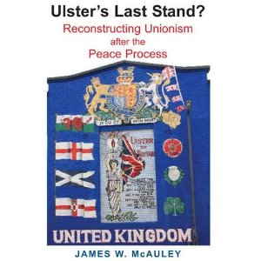
Ulster’s Last Stand? Reconstructing Unionism after the Peace Process by Jim McAuley

Slide 14
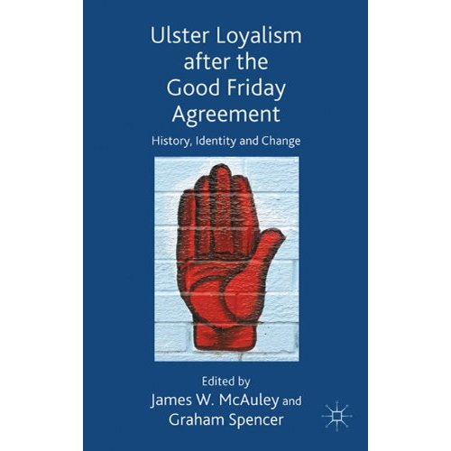
Ulster Loyalism after the Good Friday Agreement ed. by Jim McAuley and Graham Spencer

Slide 15
Loyal to the Core? Orangeism and Britishness in Northern Ireland by Jim McAuley, Jon Tonge and Andy Mycock
Widespread Media Coverage in Northern Ireland, including all main daily newspapers, (4 pages in Newsletter), BBC Spotlight (current affairs programme); BBC radio ‘Talkback’ (current affairs) and lead story on Ulster Television

Slide 16
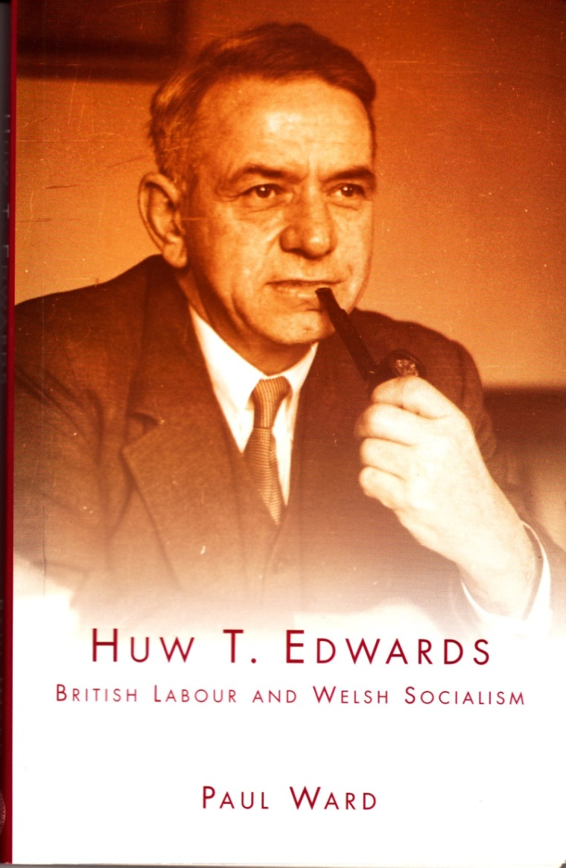
Huw T. Edwards: British Labour and Welsh Socialism by Paul Ward

Slide 17
Red Flag and Union Jack by Paul Ward

Slide 18
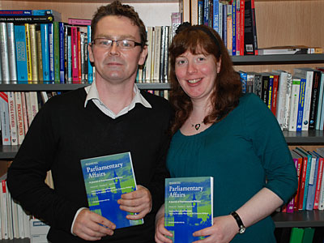
Parliamentary Affairs: Britishness special edition (2010) by Andy Mycock and Catherine McGlynn,

Slide 19
Britishness, Identity and Citizenship: The View from Abroad ed. by Catherine McGlynn, Andy Mycock and Jim McAuley

Slide 20
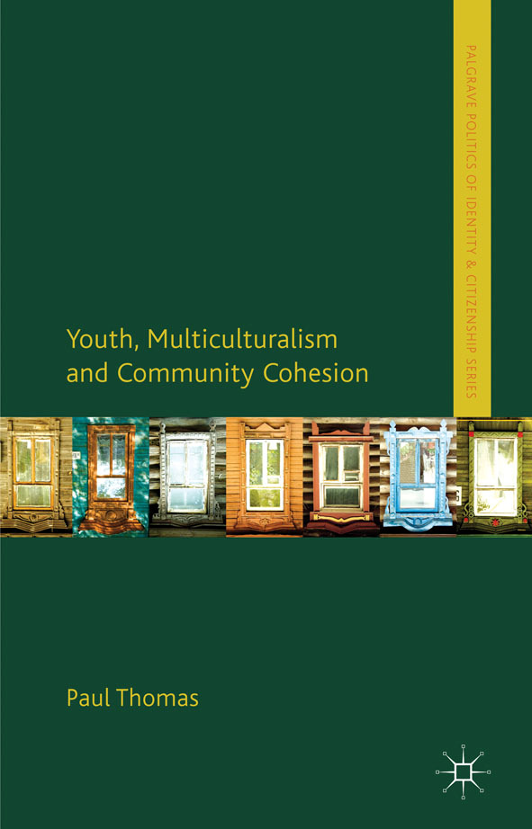
Youth, Multiculturalism and Community Cohesion by Paul Thomas

Slide 21
Responding to the Threat of Violent Extremism by Paul Thomas

Slide 22
Forthcoming next year
Post-imperial citizenship, national identity and education: Britain and post-Soviet Russia by Andy Mycock
Islands and Britishness: A Global Perspective, ed. by Jodie Matthews and Daniel Travers
Party Politics of Identity, Special Section of British Journal of Politics and International Relations

