Slide 1

Library Impact
Data Project
Bryony Ramsden (Subject Librarian)
Dave Pattern (Library Systems Manager)
University of Huddersfield
b.j.ramsden@hud.ac.uk | d.c.pattern@hud.ac.uk

Slide 2
Twitter
if tweeting, please use the hashtag!
#lidp
@graham_stone (Graham, Project Manager)
@librarygirlknit (Bryony, Research Assistant)
@daveyp (Dave, Technical Support)

Slide 3

Background
Library Non & Low Usage Project

Slide 4
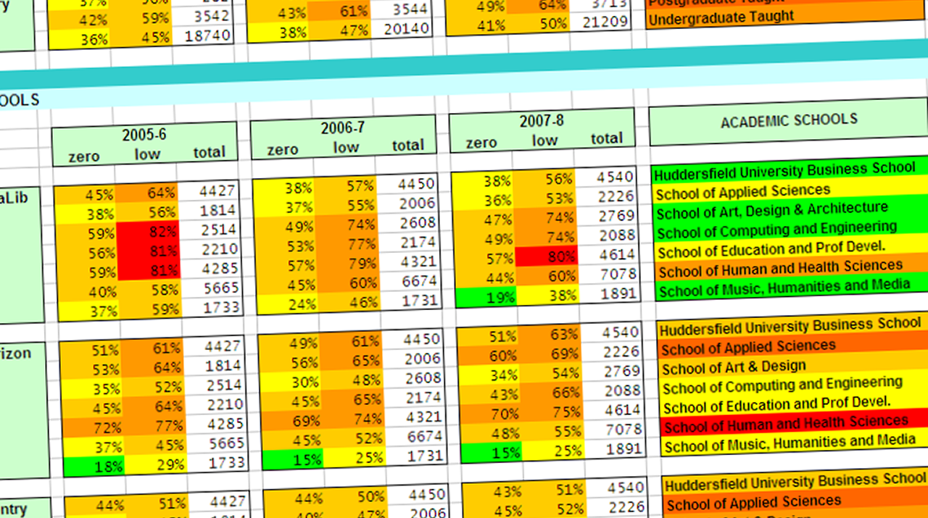
Library Non & Low Usage Project
analysing library usage since 2005
4

Slide 5
Measuring Library Impact
UK Undergraduate Degrees
First-class honours (1)
Upper second class honours (2:1)
Lower second class honours (2:2)
Third-class honours (3)
Ordinary degree (without honours)

Slide 6
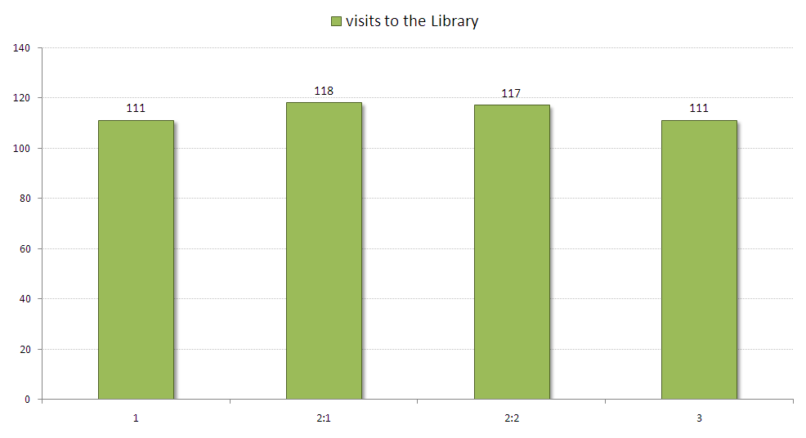
Library Visits
2007/8 & 2008/9 honours graduates
6

Slide 7
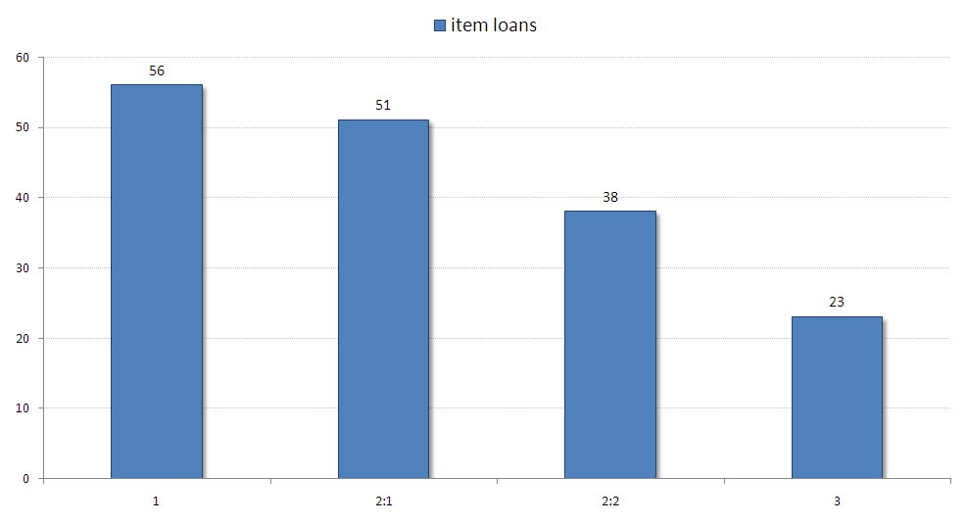
Library Loans
2007/8 & 2008/9 honours graduates
7

Slide 8
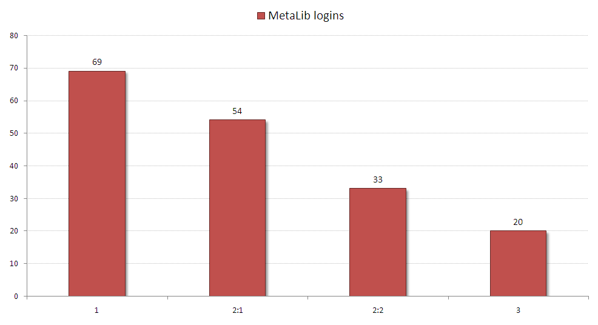
E-resource Logins
2007/8 & 2008/9 honours graduates
8

Slide 9

JISC Library Impact Data Project
9

Slide 10
Library Impact Data Project
project partners
University of Bradford
De Montfort University
University of Exeter
University of Huddersfield (lead partner)
University of Lincoln
Liverpool John Moores University
University of Salford
Teesside University
10

Slide 11
Library Impact Data Project
project hypothesis
“There is a statistically significant
correlation across a number of
universities between library activity
data and student attainment.”
  http://library.hud.ac.uk/lidp

Slide 12

Library Impact Data Project
disclaimer: not cause and effect!
borrowing more books
≠ better grade
...or does it? ;-)
flickr.com/photos/atoach/3344411469

Slide 13
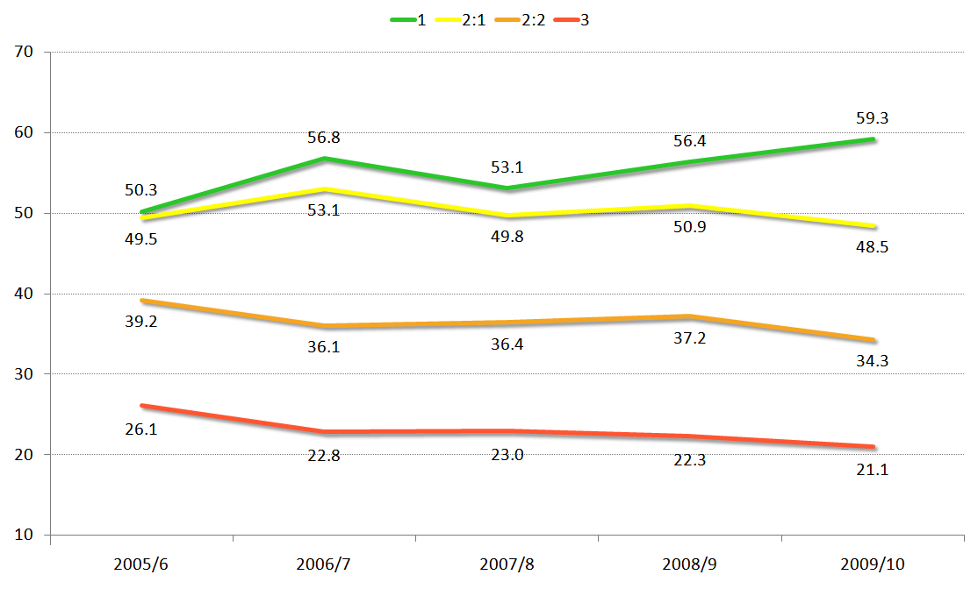
Library Impact Data Project
book loans at Huddersfield (5 years)
13
Notes:
Average number of books borrowed by students graduating with an honour for the last 5 years. For each student, 3 years worth of book loans are including in the average.
http://library.hud.ac.uk/blogs/projects/lidp/2011/04/12/5-years-of-book-loans-and-grades-at-huddersfield/

Slide 14
Library Impact Data Project
data collected for each student...
Final degree classification
Course/Subject details
Total number of...
  library loans
  e-resource logins
  visits to the library

Slide 15
Library Impact Data Project
legal issues...
UK Data Protection Act 1998
  University Student Handbooks
Data anonymisation
Project data release
  http://tinyurl.com/lidp-opendata
  Open Data Commons Licence

Slide 16
Library Impact Data Project
statistical analysis
Available data problematic
Began with averages for basic analysis
Analysis based on differences

Slide 17
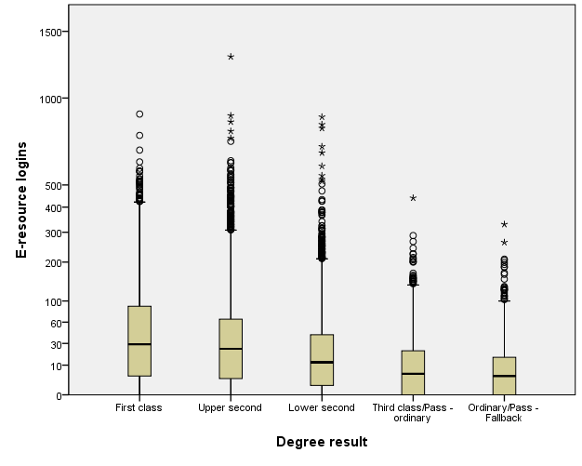
Library Impact Data Project
statistical analysis
Notes:
Total combined e-resource access from all institutions providing data

Slide 18
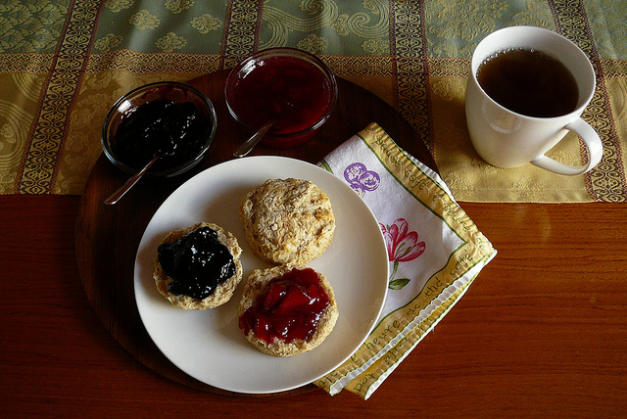
Library Impact Data Project
focus groups
flickr.com/photos/paige_eliz/6164526883/
Used as discovery tool
Ideal for unusual usage
Shameless
bribery ☺
Notes:
IMAGE FOR SLIDE http://www.flickr.com/photos/paige_eliz/6164526883/

Slide 19
Library Impact Data Project
project toolkit
  Guidance on how to
  replicate our research
  http://tinyurl.com/lidp-opendata
Notes:
Would be good to have some kind of image here but not found a good one yet ☹

Slide 20
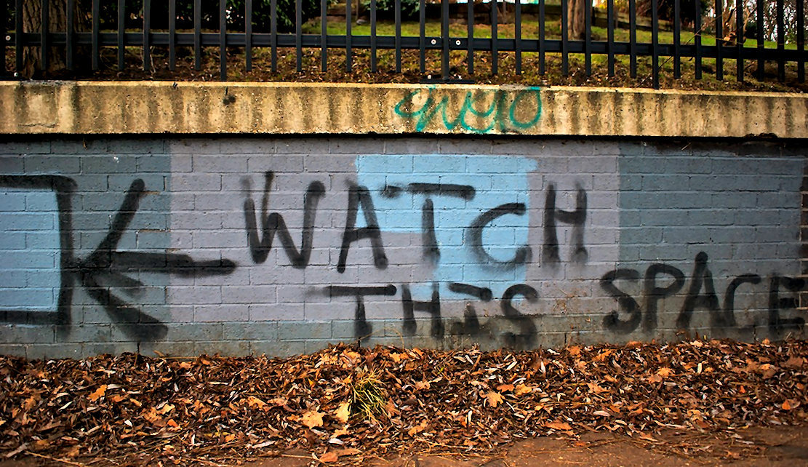
Library Impact Data Project
so, what next...?
flickr.com/photos/nicholasngkw/5512321874/
Notes:
Photo http://www.flickr.com/photos/nicholasngkw/5512321874/

Slide 21
Library Impact Data Project
so, what next...?
Further research at Huddersfield...
  analysis of the relationship at course level
  how to target staff resources more effectively
  the impact of reading lists and recommendations
  feasibility of a national level service

Slide 22
Library Impact Data Project
summary...
There is a relationship between library resource use and degree attainment as demonstrated across multiple universities
Independent research in other countries into this relationship has similar findings

