Slide 1
Caren Milloy, Head of Projects, JISC Collections
&
Graham Stone, Information Resources Manager, University of Huddersfield
Notes:
OAPEN-UK is a collaborative research project gathering evidence to help stakeholders make informed decisions on the future of open access scholarly monograph publishing in the humanities and social sciences (HSS).
Funded by JISC and the AHRC, OAPEN-UK will partner with publishers, research councils, authors, researchers and institutions in a practical, real time pilot that will gather a range of qualitative and quantitative data. The data will be evaluated to help stakeholders better understand the challenges and developments required to support open access scholarly monographs
In todays session, I am first going to give you a bit of background to OAPEN-UK and then after that we are going to hear from Graham Stone about the key challenges and issues identified by librarians at a recent workshop run by Ellen Collins, who is managing the research programme. We will then undertake an interactive session.

Slide 2
‘Scholars do not work in a vacuum; research is based on work from others and new discoveries must be disseminated in order to be used.’
Snijder,Ronald. 2010. The profits of free books - an experiment to measure the impact of Open Access publishing. http://sites.google.com/site/theprofitsoffreebooks/home
Notes:
The academic monograph is under threat. Increased costs and lower print runs are impacting on the principle means by which researchers share their knowledge and disseminate their findings. The gold standard for academic excellence in many disciplines, the effective dissemination of the monograph has major implications for the UK’s research base and its international standing.
OAPEN-UK is going to explore the challenges, risks and potential opportunities of unfettered online access to scholarly monographs.
This is a good time to explore this as we have so many developments in the monograph market will Muse, Jstor, UPEC and OUP and CUP launching their platforms at the same time that budget are under pressure and the introduction of student fees will potentially increase students expectations to have all their content available to them.
I always think its important to reiterate that just because we are talking about OA, it doesn’t mean that we are out to hurt publishers and their models, this project is not saying that print will disappear or that OA is the right model, what we hope to do is gather data and information in partnership with the key stakeholders to help us take an evidence based approach to future activity in the monograph market. This project is a stepping stone along the way, a way to experiment and explore, there is no wrong or right outcome, there is only data and collaboration.

Slide 3
60 HSS titles: 2006 - 2011
Experimental Group (30 titles)
Control Group
(30 titles)
OA with CC licence
OAPEN Library
Publishers website
Institutional Repository
?????
Standard e-book agreements
Publishers website
E-book aggregators
Print version available for sale
E-book device friendly version available for sale
Notes:
The OAPEN-UK model is a transitional hybrid model that stems from the OAPEN project which recognised the need, just as we have in the journals market for a model that allows not just publishers, but funding bodies and institutions to transition to an electronic and open access model in steps. I think this point is important as not only is just the transition to electronic formats a big deal in the HSS environment, moving to OA requires a whole level of change in terms of perceptions and attitudes, processes and it doesn’t happen over night.
In our project we are working with both back list and front list HSS titles. What we have done is ask publishers to submit matched pairs of titles (based on subject, publication date, format history, sales etc) and then randomly assigned the titles in each pair into an experimental OA pot and a control group. The titles in the OA pot are made available under a CC licence from the publishers website, the OAPEN Library website and IRs. The control group titles are made available for sale under the publisers normal route such as for sale to libraries as part of packages, via aggregators. All the titles, whether OA or Control are available for purchase in print format and some are also available in epub or specific e-formats such as amz. And this is where the hybrid model comes in, the title is available in OA but it can also be exploited for commercial reasons to help bring in revenue to sustain a dual format publishing environment.
So in our project we have partnered with Palgrave Macmillan, Taylor & Francis, Berg Publishers, Liverpool University Press and University Wales Press to make available 60 titles, 30 in each pot and over the next three years we will gather and compare sales and usage data for each group.

Slide 4
The research programme
How policies, processes and mechanisms need to change in order to enable OA publication of monographs?
What are the measurable effects of a move to OA monographs?
How do perceptions of OA monograph publication change among participants during the project?
Notes:
A core part of OAPEN-UK is data gathering. We have learnt from previous projects that it is necessary to gather data over at least a three year period if you are going to have anything useful to say, especially when dealing with citations and research.
We have condensed the research into three questions:
1. How policies, processes and mechanisms need to change in order to enable OA publication of monographs?
Business model will include looking at prices, variation in prices by publisher, e-only OA as a viable strategy and the potential ongoing need or demand for print, the most effective way to manage OA fees, licensing regimes, IPR and reuse rights and royalties.
Organisational policies will include changes that funders make to their OA policies, that libraries make to their purchasing and selection policies, that repositories make to their depositing policies and that institutions make to comply with all of the above.
Technical changes will include back- and front-end system changes made by publishers, integration into existing library systems, changes to funder systems for awarding grants and discoverability
2. What are the measurable effects of a move to OA monographs?
On readership/ usage, sales, citation - These issues should all be covered by the hard data that we are collecting – they are about things that can be measured by counting something. Changes in attitudes and perceptions should be covered in question 3.
3. How do perceptions of OA monograph publication change among participants during the project?
Perceived risks and benefits might include issues such as business models, readership, academic reward, discoverability, quality, depending upon who we are talking to.

Slide 5
Research process
2. Annual benchmarking survey
3. Initial focus groups
4. Initial scoping interviews / survey
9. Final evaluation and report
5. Quantitative data analysis
2. Annual benchmarking survey
6. Annual participant focus groups
8. Additional year 3 activities
1. Literature review
3. Initial focus groups
7. Planning for year 3
4. Initial scoping interviews / survey
9. Final evaluation and report
5. Quantitative data analysis
1. Literature review
6. Annual participant focus groups
8. Additional year 3 activities
7. Planning for year 3
Initiation
OAPEN-UK Research Plan
Year 1 end
Ellen Collins, Research Information Network
Year 2 end
Project end
http://www.flickr.com/photos/stewart/461099066/
Notes:
The research plan includes workshops, surveys, interviews, focus groups, data analysis of usage and sales data with those that are participating in the project such as the authors of the titles, the publishers and the funders.
We are also aware, that as we are doing a long term project, we need to keep up with developments in the ebooks environment which is constantly adapting, innovating and so we are taking an agile approach and have the opportunity to explore new developments during year three.
I think the key here is that we will be gathering a huge amount of data, both qualitative and qualitative under our three research questions and we hope that we will be able to come up with a good overview of the UK HSS scholarly monograph environment.
I am now going to hand over to Graham who is going to talk through some of the issues and challenges that were identified by librarians in the very first workshop we held on Monday. We will then hand over to you and the purple paper.

Slide 6
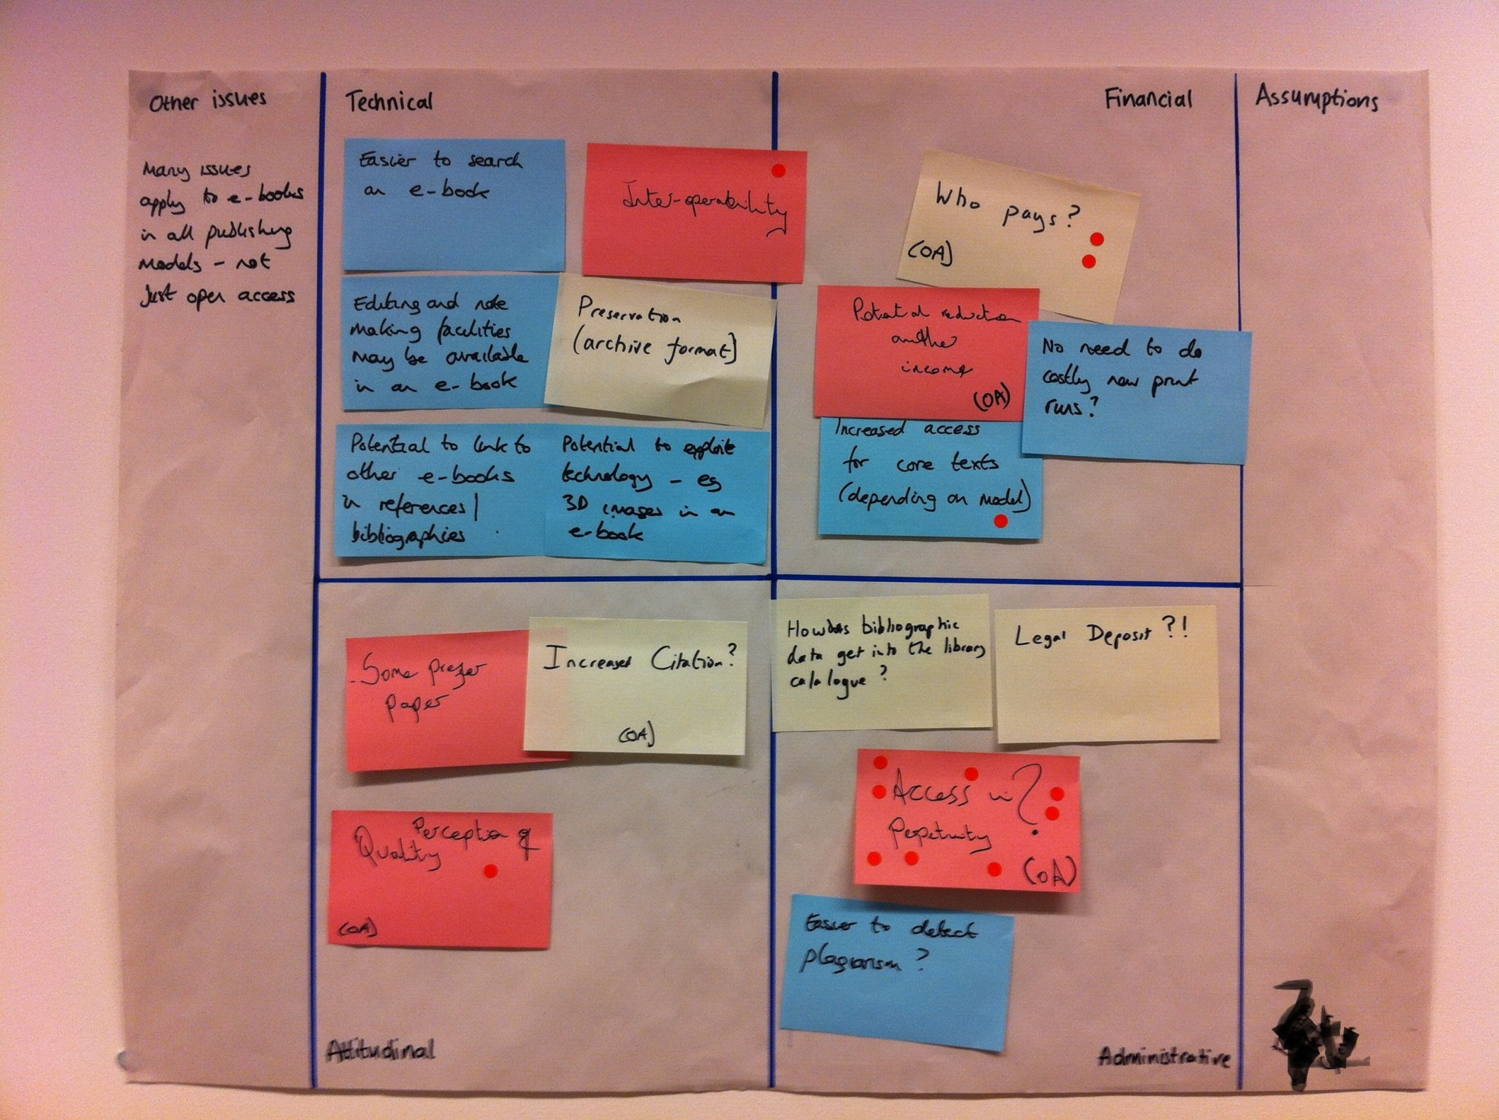

Slide 7
Who pays and how is it sustained?
How do we establish the cost for OA publishing and build into grant applications
Can Research Offices pump prime based on future grant income?
Advertising?
Print on demand?

Slide 8
Author royalties
How many royalties do authors really get?
Author reward
Are there are other ways to enumerate?
Tenure etc.

Slide 9
Perpetual access & preservation
Is this an OA issue or an e-books issue?
Certainly a smaller publisher issue, so OA could make it work?
Portico to the rescue?
there are already models out there that libraries use
Have ANY repositories really got robust digital preservation policies?
Is there a role for a national shared service?
No university could take on preservation issues and create the technical infrastructure
UKRR scheme to hold appropriate copy
We need an accreditation standard

Slide 10
The ‘new’ University Press
Powerful position
Own IP, data, and content
Is the Press a posh repository?
Can University Presses do more than just the PDF
Does the Press engage authors as readers?
Does the Press establish a University brand
Providing feeds to subject repositories, e.g. SSRN

Slide 11
Metadata & standards
Does it matter where it is published
Is it just about the metadata?
Librarians are not happy with quality of publisher metadata
Can ‘new’ University Presses provide better data
Using Repository workflows?
What about added value metadata
Chapter level DOIs?

Slide 12
Library selection v OA
Do academics/researchers/libraries want to access everything
Assumptions around the issue of quality?
Will subject specialists see this as a threat
lack of control over selection decisions
Do we stick to what we know?
Will we ‘select’ OA

Slide 13
Your turn
Discuss in groups the issues identified by the librarians
Add two additional challenges / issues
Prioritise top = highest priority
Feedback

Slide 14
Further Info
OAPEN-UK website:
http://oapen-uk.jiscebooks.org/
Twitter: @oapenuk #oapenuk
Contact: c.milloy@jisc-collections.ac.uk

Slide 15
Thank you!
Caren Milloy
c.milloy@jisc-collections.ac.uk
Graham Stone
G.Stone@hud.ac.uk

