Slide 1
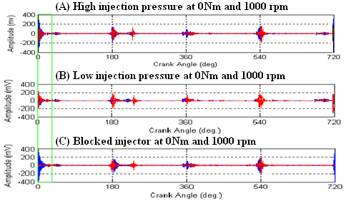
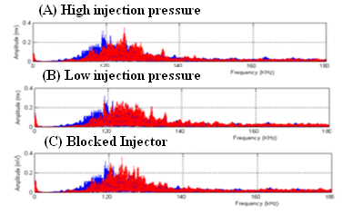
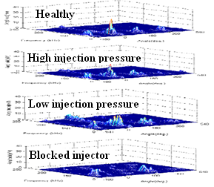
Detection of Diesel Engine Injector
Faults Using Acoustic Emissions
Fathi Elamin, 2nd Year PhD
supervised by
Professor Andrew Ball and Dr. F.Gu
AIM
To record Acoustic Emission (AE) signals from engine cylinder head and process the signal in angular domain, frequency and joint angular-frequency domain.
To investigate the potential of AE to monitor the combustion process of the diesel engine.
To extract features in the AE signal to identify the faults of injector during the operation of the engine.
INTRODUCTION
Early detection of diesel engine faults is essential in order to take early correction actions and avoid costly repair.
Injection faults due to defects in a fuel pump, fuel lines and injectors affect the power of the engine, increase the polluting particles in the exhausted gas and reduce the life cycle of the engine.
High frequency AE signal measured from engine cylinder head has a very high signal-to-noise ratio and can be used to monitor the condition of engines.
Three injection faults were seeded (injector pressure decrease, increase and injector blocked) in a four-stroke, four-cylinder diesel engine in the experimental study to investigate the potential of AE diagnostic technology.
PRELIMINARY RESULTS
1 - Analysis in the Angular Domain
In the angular domain, the analysis can clearly correlate AE transient events to the operation of the engine. Every signal contains 40,000 samples. It can observed from the figure 1 that clear AE bursting transients were excited when a crank angle rotation was about 15° after one of the pistons reached its top dead centre. The AE transient caused by fuel injection and combustion in the chamber one was the highest at an angle 0° and 720° because the AE sensor was positioned next to it. As seen from figure 1 the condition of the injector of cylinder one can be monitored by analysing the AE transients at angle 0° .
TEST RIG AND INSTRUMENTATIONS
Figure 1
2 - Analysis in the Frequency Domain
The acoustic emission signals in the frequency domain are obtained using the Fast Fourier Transformation (FFT).
It can be seen from figure 2 that high acoustic emission energy can be observed between 100 and 140 KHz. However, one clear change could be observed in the spectra even when the injector was completely blocked (blue is healthy and red is faulty).
Figure 2
A host computer is used to analyse the raw AE data collected from the engine test rig using MATLAB software.
3- Analysis in the Angular-Frequency Domain
Large AE events occur at crank angles integer-multiple of 180°, when the piston of each cylinder reaches the top dead position and immediately afterward during combustion. The AE signals at these angles are significantly larger in the 100 kHz to 140 kHz frequency domain and last about 15 degrees especially for cylinders 3 and 4. This proved that the AE transients observed in the time domain were mainly caused by the combustion in each cylinder. The higher frequency components relating to cylinder one increased when more fuel was injected due to the reduction in injection pressure. This indicated that AE signals with higher frequency were generated when the combustion became stronger. No signal components in the frequency range from 100 kHz to 200 kHz could be clearly observed from figure 3 when the injector was completely blocked. Therefore, the motions of the pistons and other moving parts were not main AE sources within this frequency band. An injection fault is expected to be diagnosed by observing its influence on combustion.
The output of the AE sensor is amplified by
pre-amplifier.
The experimental study employed JCB engine test rig available in the Automotive Laboratory. It is a four-cylinder four-stroke, turbocharged, in-line OHV, direct injection engine with a displacement of 4.4 litres. The fuel is injected directly into the combustion chambers at pressure of 270 bars in the firing order of 1-3-4-2. AE sensor was placed on the front side of the cylinder head and AE data is acquired using high speed AE data acquisition system (PCA PCI-2).
Figure 3
INTERIM CONCLUSION
Angle domain representation of the acoustic emission signal measured on the cylinder head are shown to be effective for the detection of injector faults. The analysis in the angular domain provides a straightforward method to identify the malfunction of the injectors. Analysis in the angular-frequency domain has the potential of separating several AE sources occurring at the same time but having different frequency content. It was found that the main AE transients were generated by the combustion in each cylinder and the faults of injection can be reflected in these main AE through their influence on the combustions.

