Slide 1
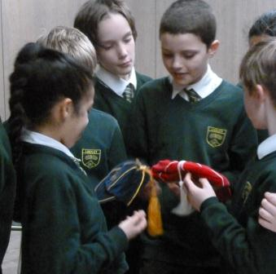
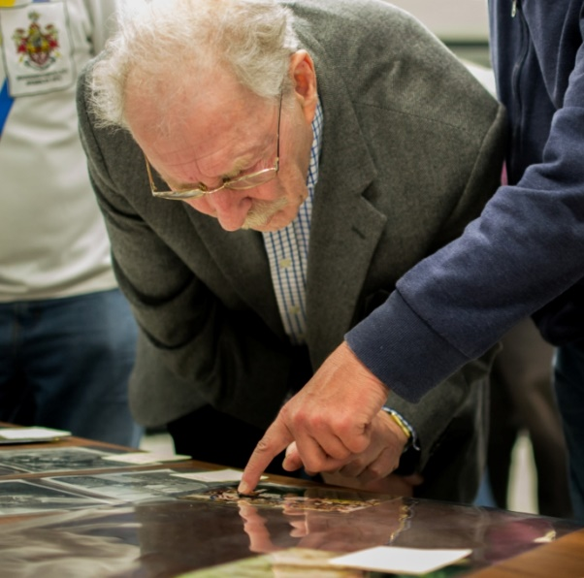
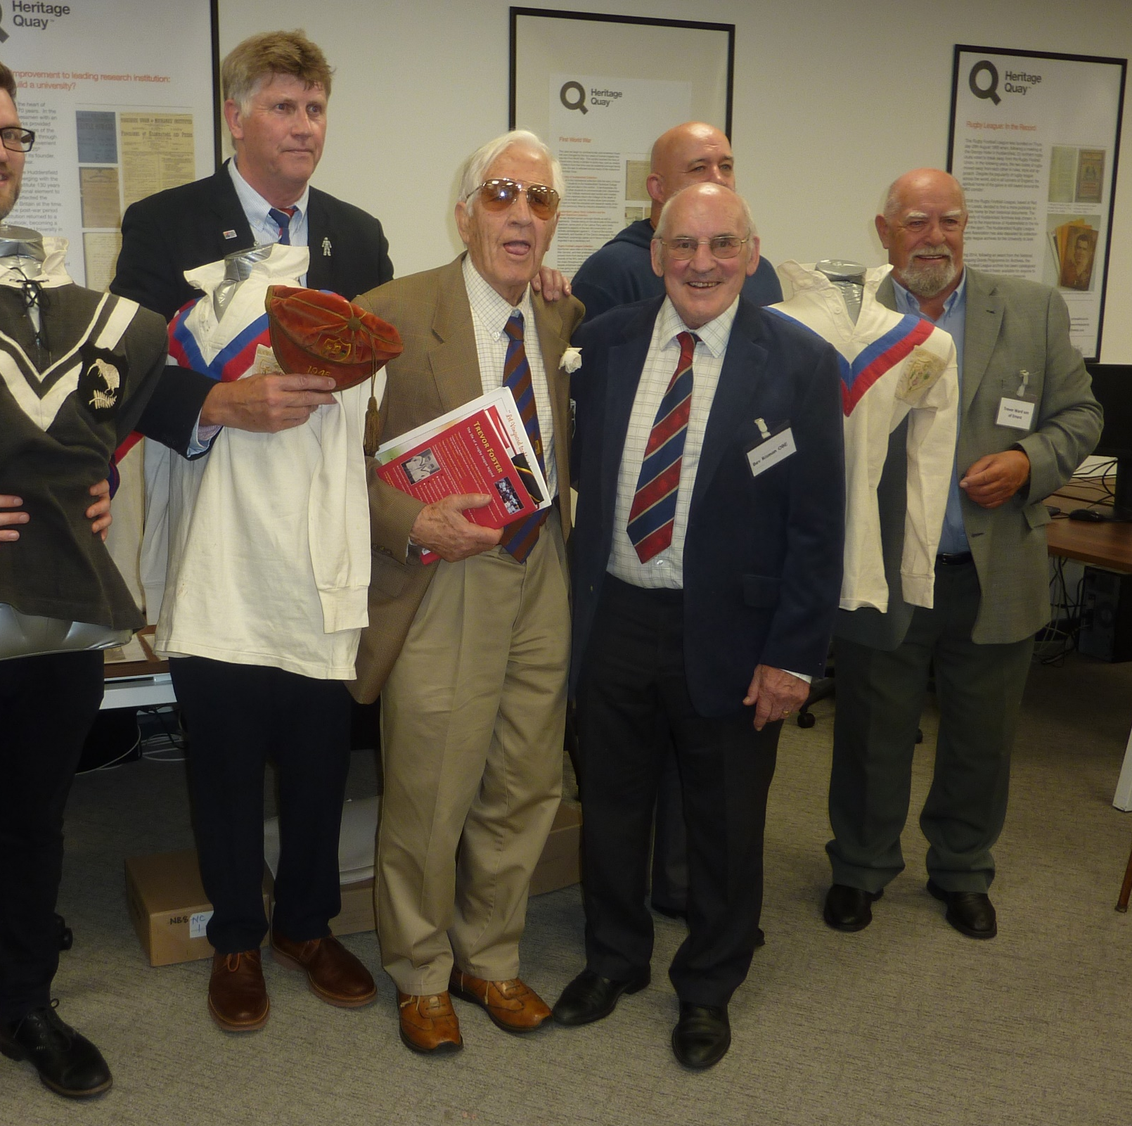
Sharing the Rugby League Archive David Smith Public Engagement Officer Heritage Quay University of Huddersfield

Slide 3
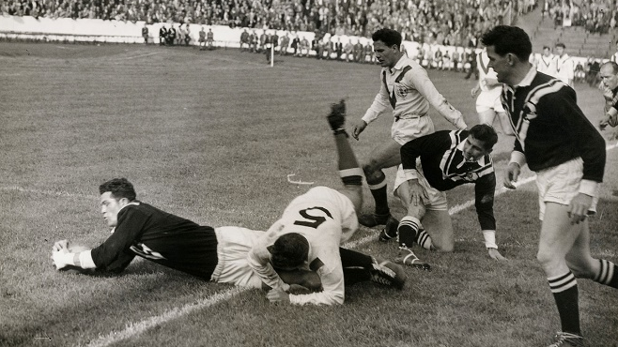
The Rugby Football League archive

Slide 4
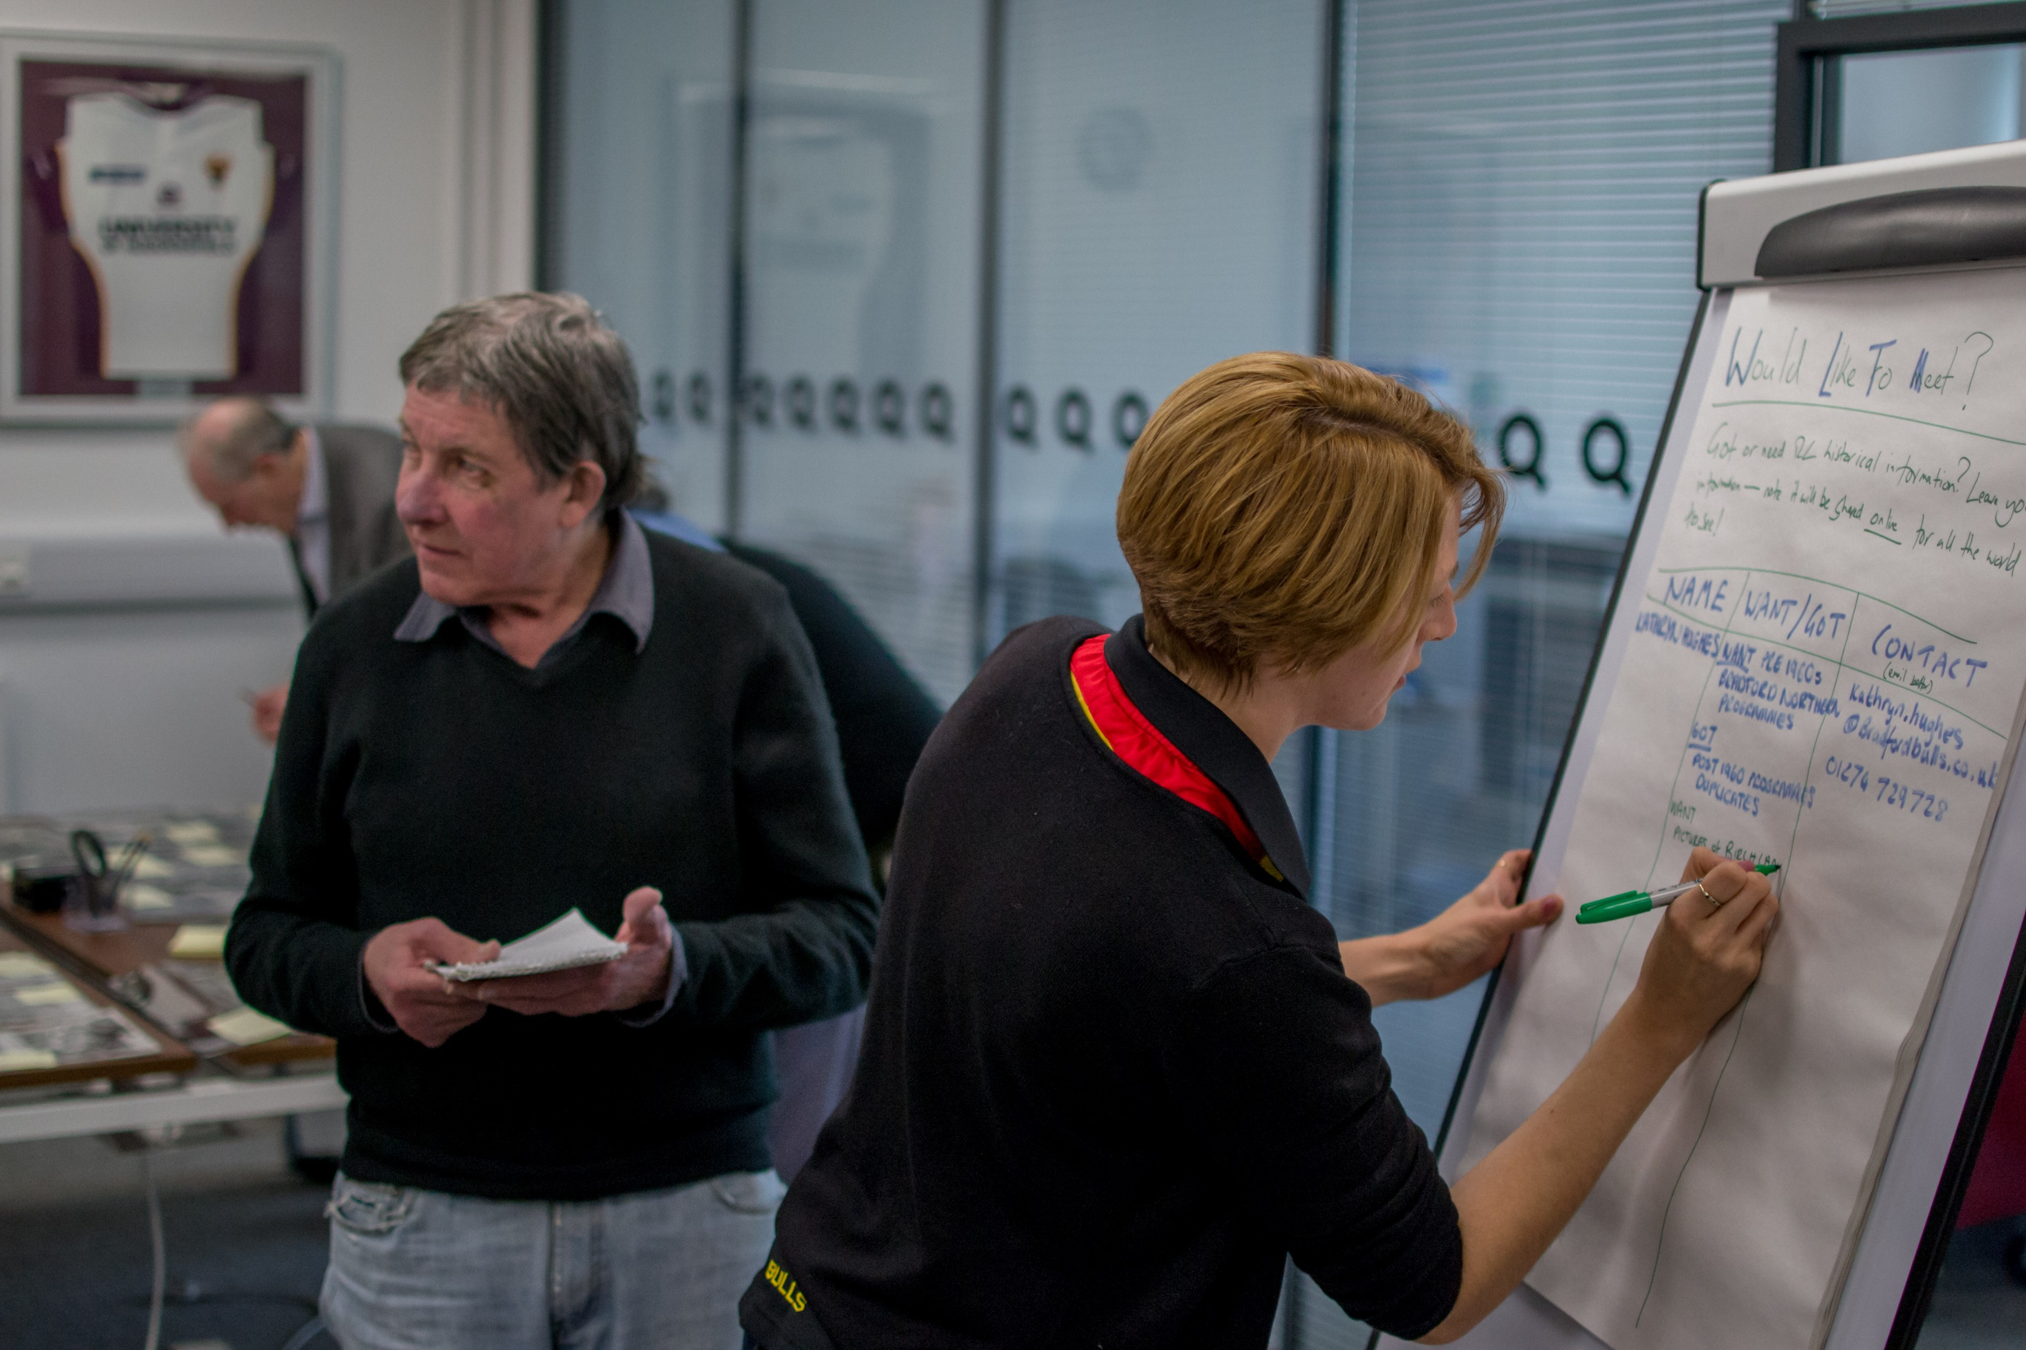
Co-production and the
Rugby League Programming Group

Slide 5
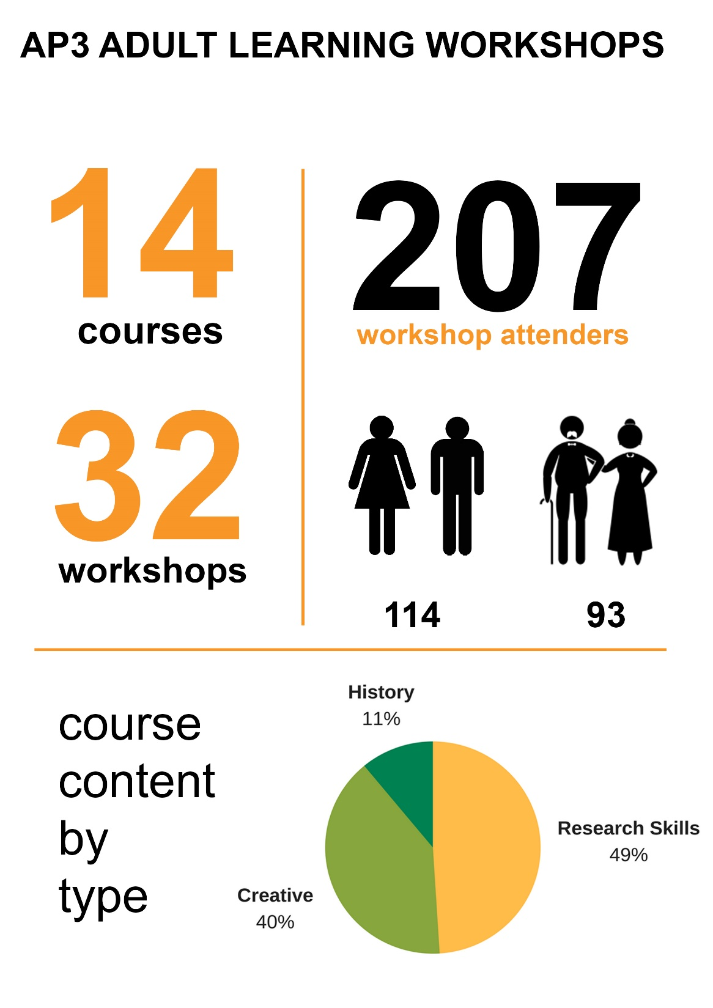
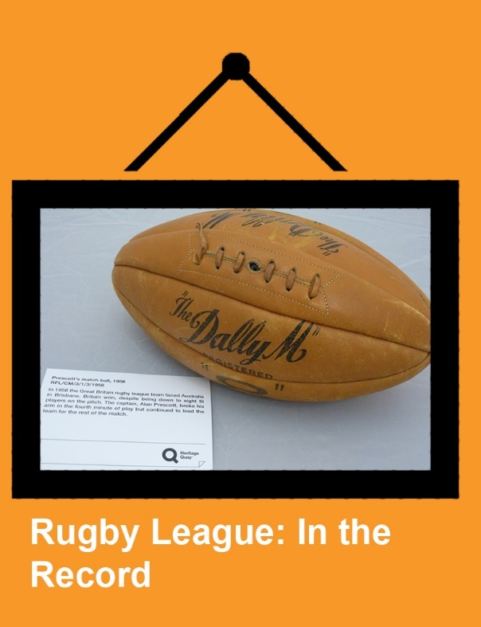

Slide 6
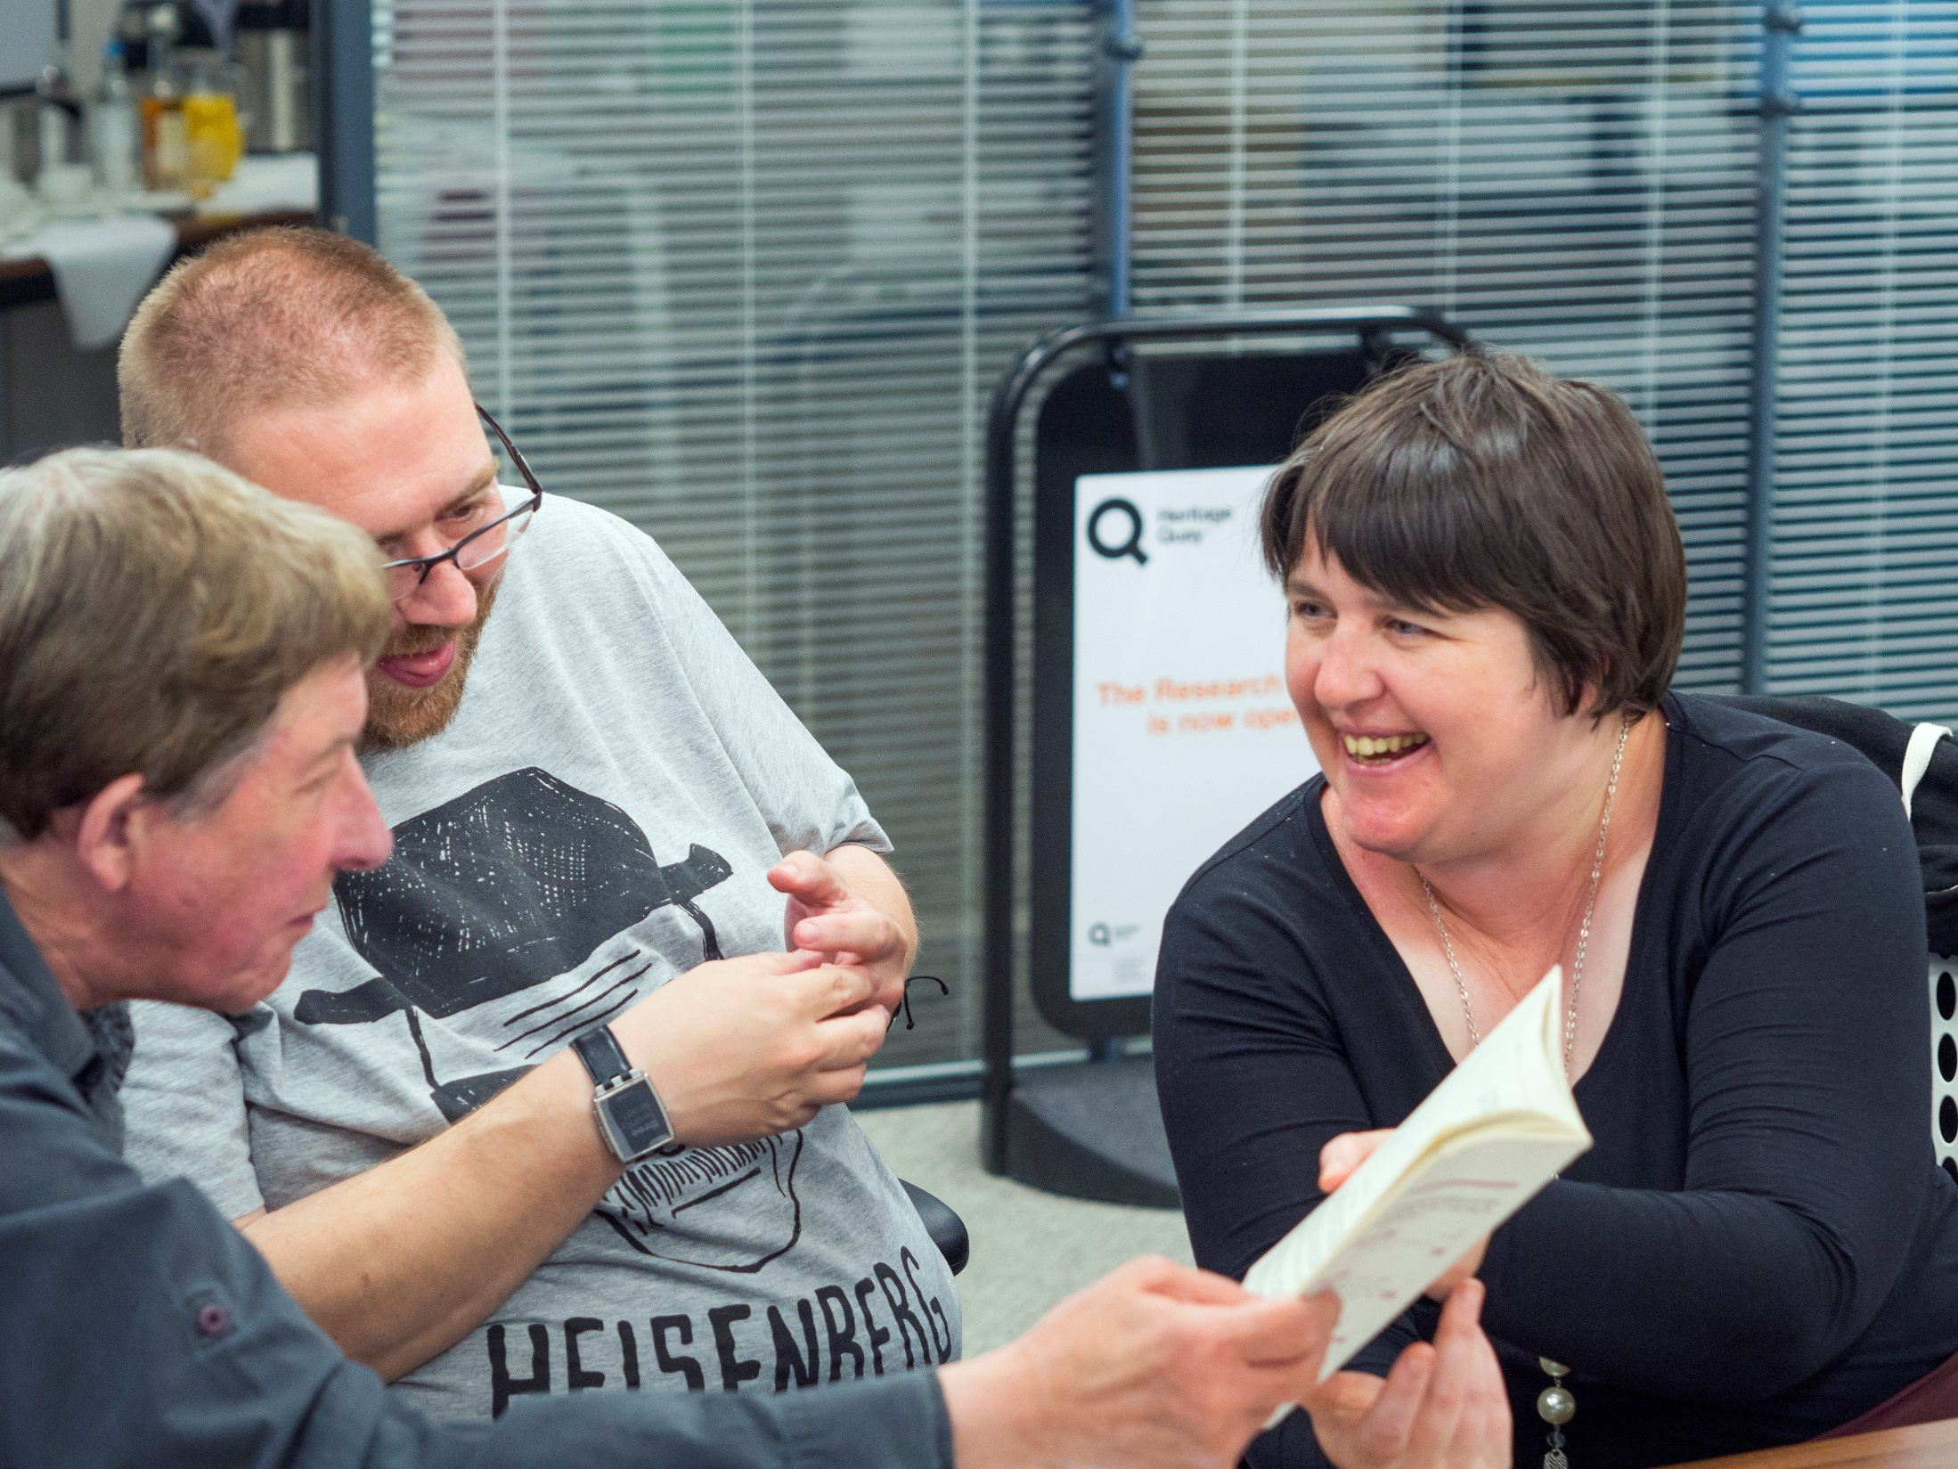
What worked

Slide 8
What is your standout memory of being involved in the Programming Group?
“Met a lot of like minded volunteers and RL historians.”
“Meeting so many like minded people who are committed to rugby league and the staff are all amazing and passionate about what they do. Thanks for the opportunity to get involved.”

Slide 9
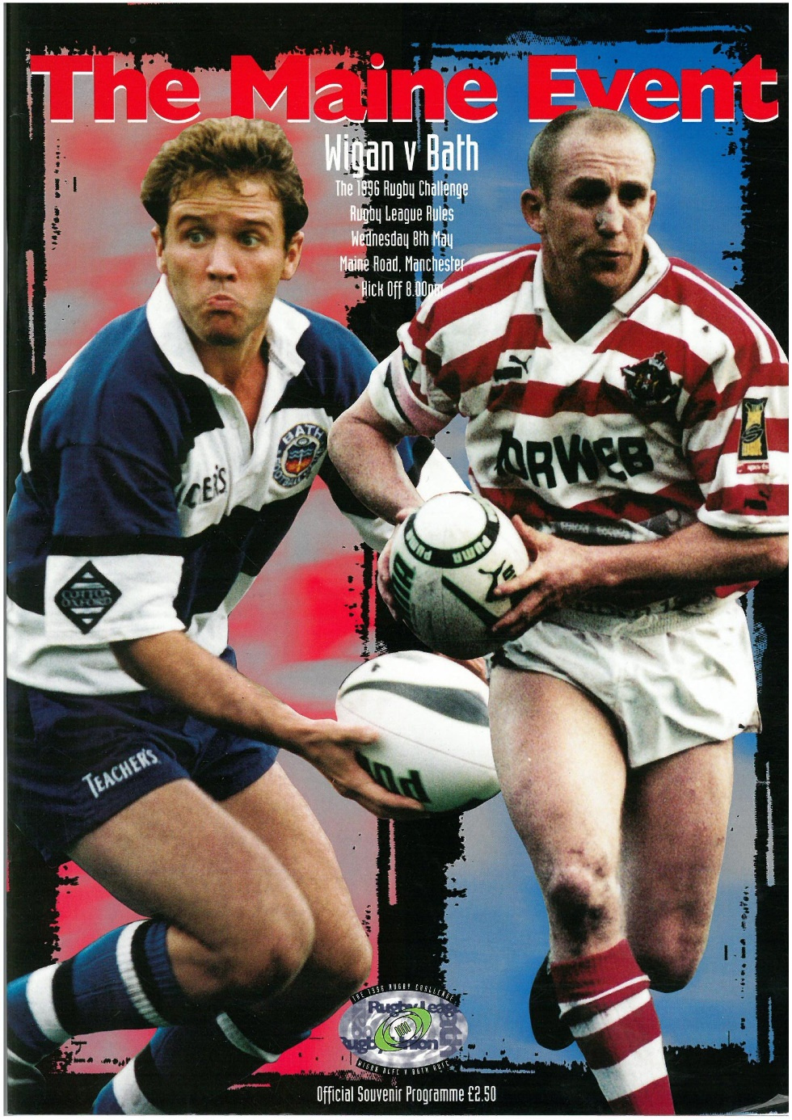
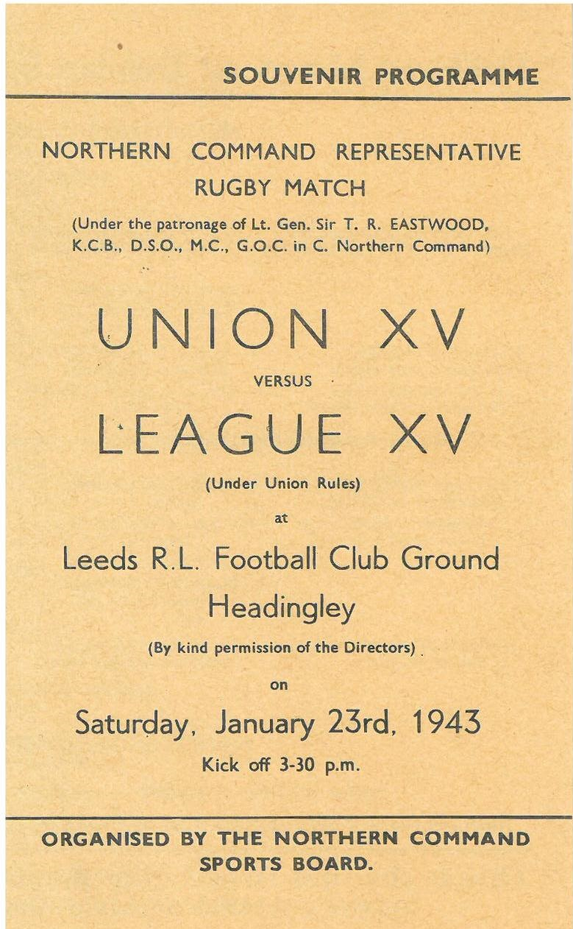
Context

Slide 10
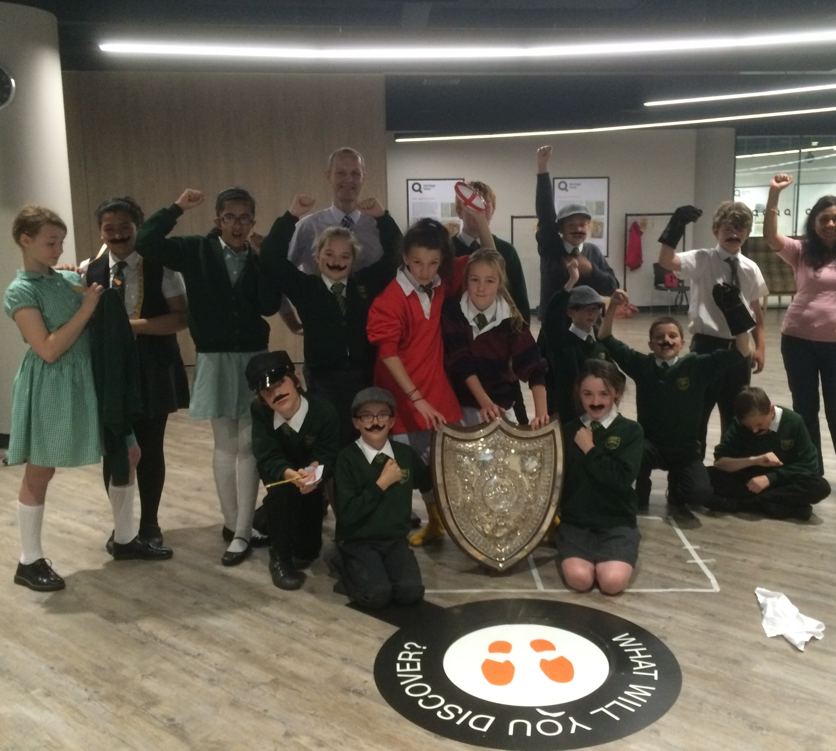
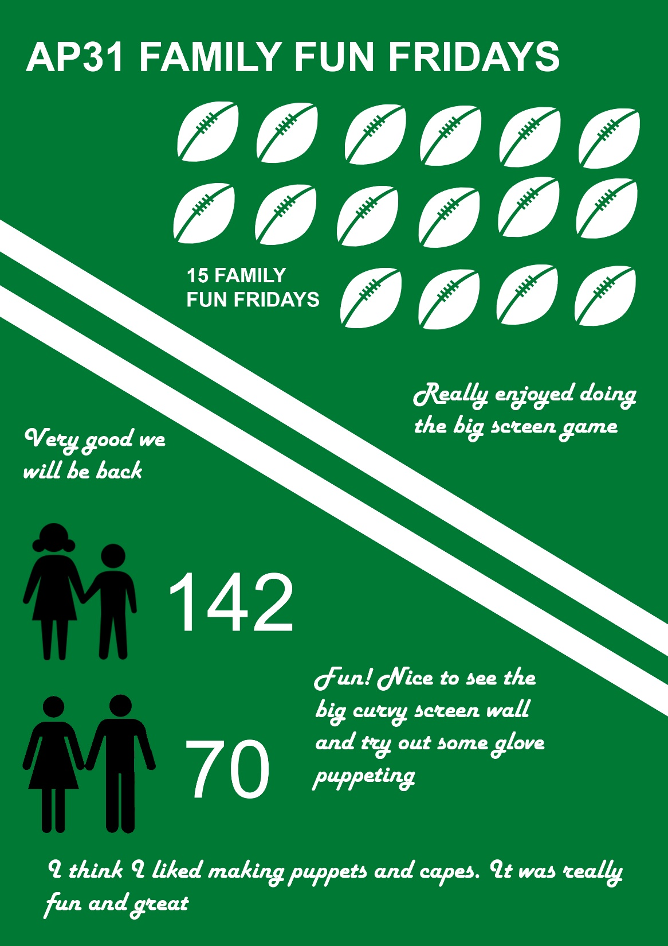

Slide 11
Volunteering

Slide 12
Top tips

