Slide 1
Breaking down the invisible barrier:
Connecting the university estate with the local community
Lindsay Ince
Assistant Archivist at the
University of Huddersfield Archives

Slide 2
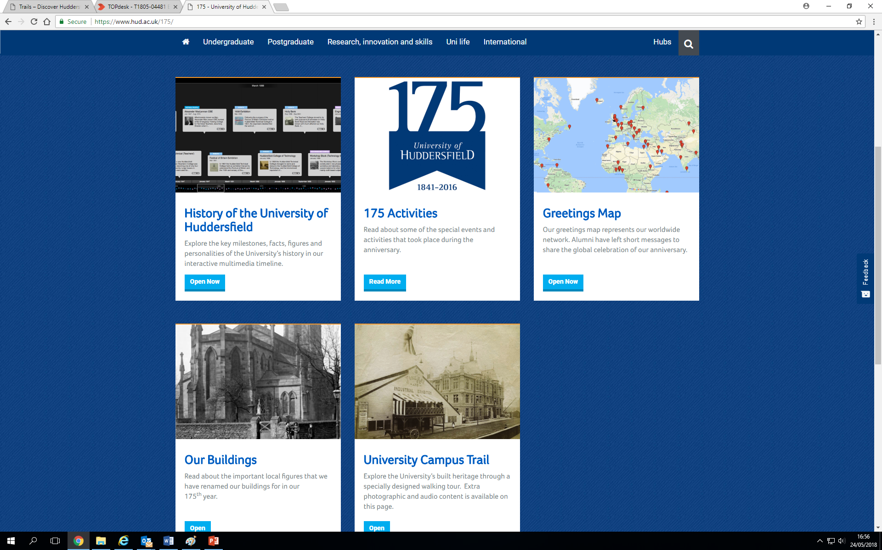
175th ANNIVERSARY

Slide 3
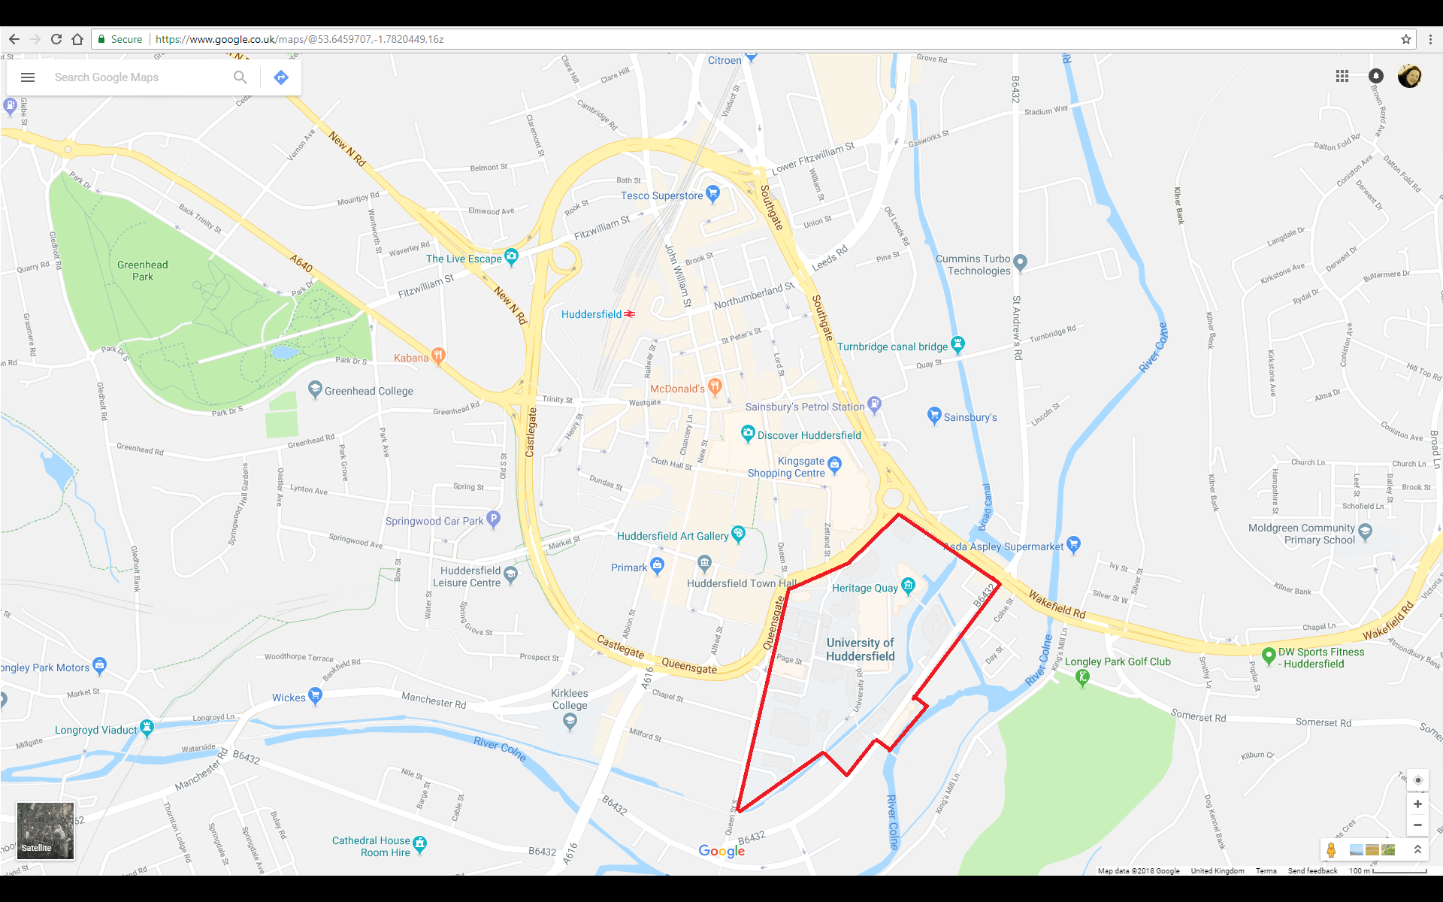
THE UNIVERSITY ESTATE IN HUDDERSFIELD

Slide 4
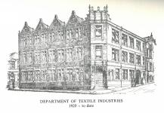
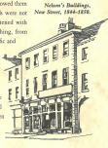
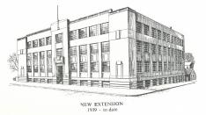
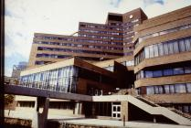
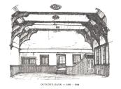
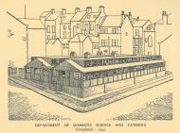
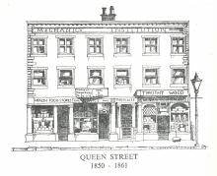
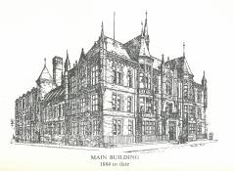
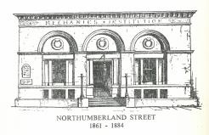
The University of Huddersfield Collection
CHANGING THE LANDSCAPE OF HUDDERSFIELD
Demolishing and rebuilding isn’t just a modern university phenomenon we’ve been doing it over a century!

Slide 5
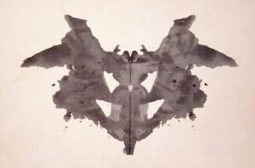
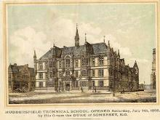
University Environments/
Universities within their environment
Changing Places
William Whyte (Redbrick, 2015) described university history as a kind of Rorschach blot, you see something different depending on your point of view:
External/Public view: Unchanging, closed and static.
Internal/Staff-Student view: Actually chaotic, transitory, with a new ‘generation’ every 3 years.
Academic profession steeped in the textual world existing within an oral/aural uni environment.
Old institutions vs. new institutions, motivations for their foundation. Old focused on communities, new on HE for (predominantly) young.
Keith Vernon (Universities and the State in England, 2004) discusses ‘civic ideal’ of 19th century institutions: philanthropy; access to HE; by, for and in their locality vs 60s ‘new unis’

Slide 6
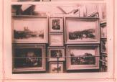
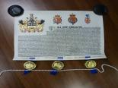
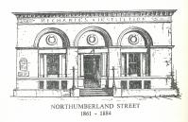
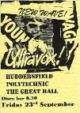
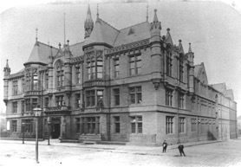
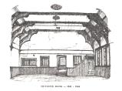
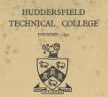
University of Huddersfield
PAST TO PRESENT–AN OVERVIEW OF OUR HISTORY
1861 – The first dedicated MI building was built in town
1958 – Institution is re-branded as the College of Technology
1825 – Failed attempts at member libraries etc.
1883 – A Fine Art and Industrial Exhibition ran for 5 months
1992 – After being granted a charter, the University of Huddersfield was created.
1825
1841
1860
1883
1884
1896
1958
1970
1992
1841 – First classes taught at Outcote Bank, by 1850s a Mechanics Institute
1896 – Changes in educational policy meant the institution became Huddersfield Technical College
1884 – The new building was created and the institution renamed the Technical School and Mechanics Institute
1970 – Institution became a Polytechnic, and other institutions, e.g. Oastler (1970) and Holly Bank (1974), merged with it.

Slide 7
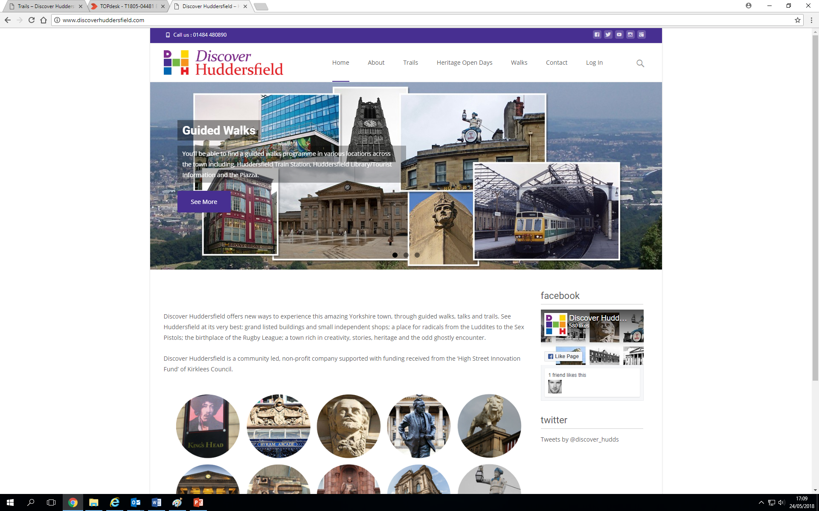
PAST TO PRESENT–AN OVERVIEW OF OUR HISTORY

Slide 8
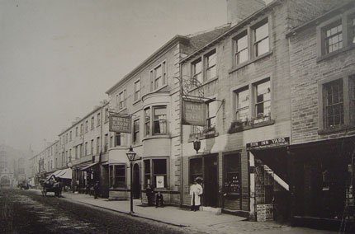
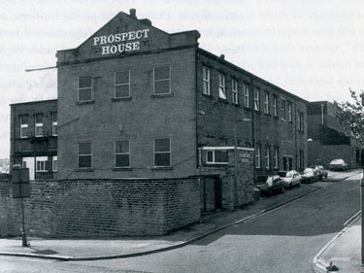
Temperance Hotel,
Cross Church Street, 1841
British School Room, Outcote Bank, 1841

Slide 9
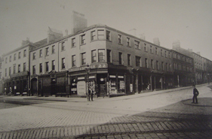
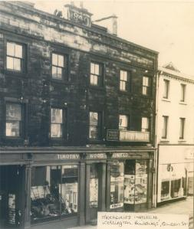
Nelson’s Buildings, New Street, 1844-1851
Wellington Buildings, Queen Street, 1851-1860
Purchased for £1025 and refurbished from a warehouse for £600.

Slide 10
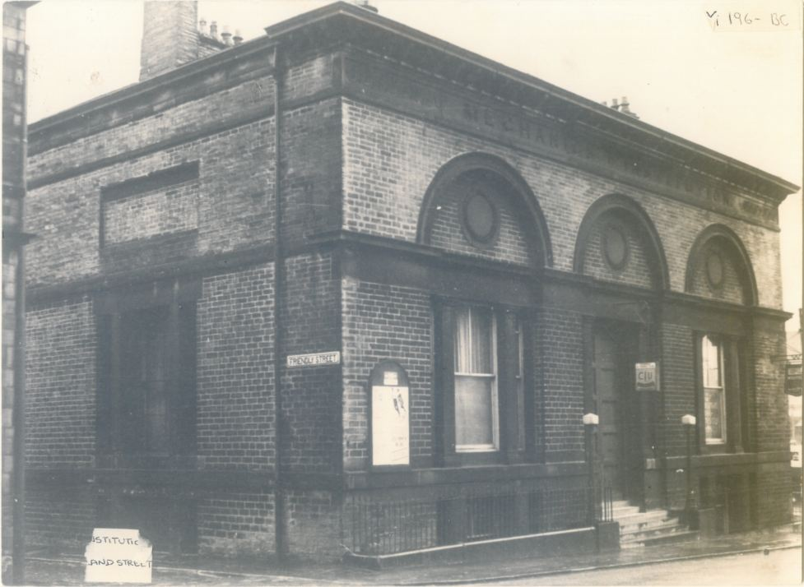
Northumberland Street, 1861-1883

Slide 11
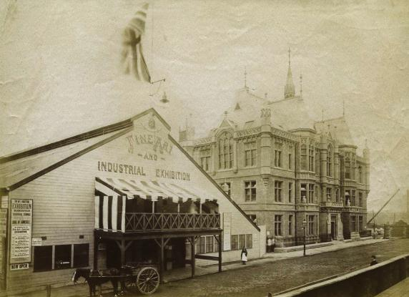
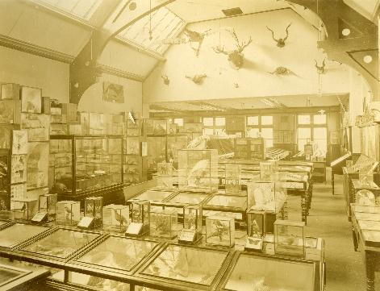
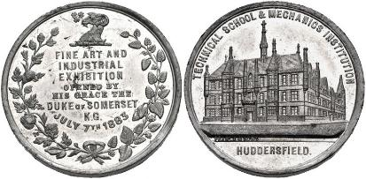
Fine Art and Industrial Exhibition, 1883
Opened by the Duke of Somerset
Visited by 329,629 in 6 months
Took 3 months to clear the building

Slide 12
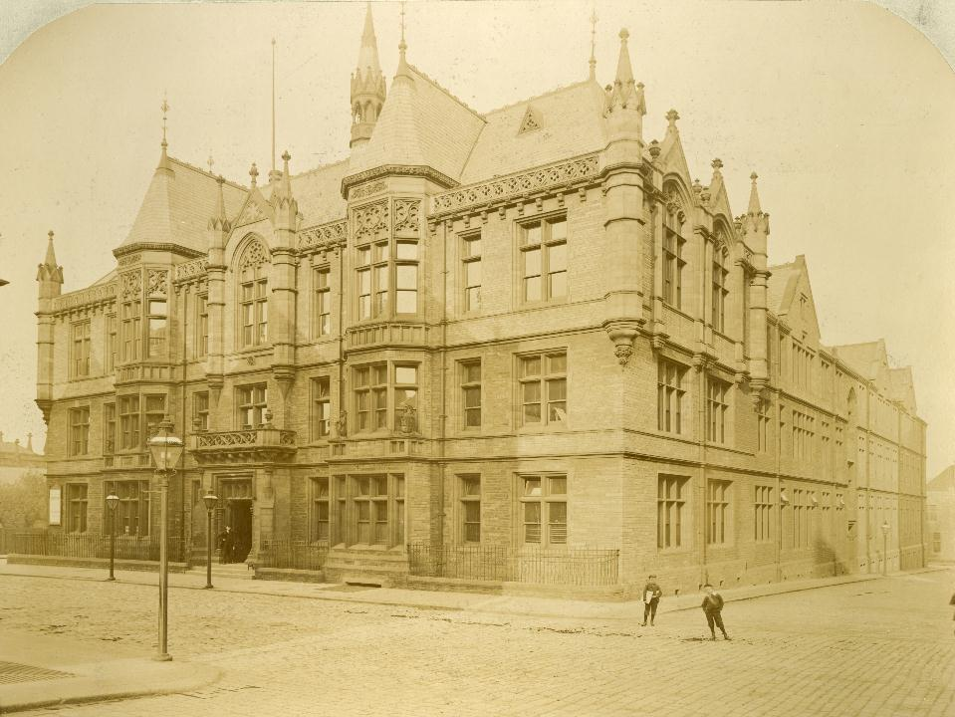
Ramsden Building, 1883-Present

Slide 13
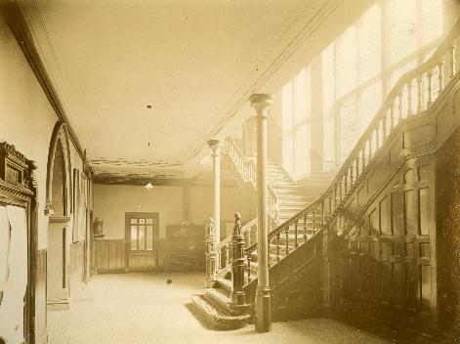
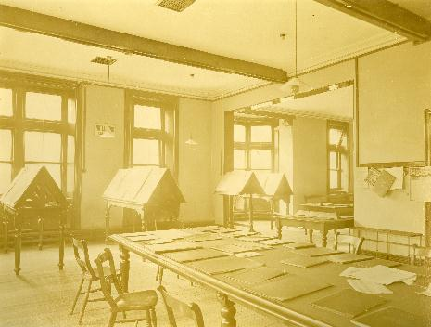
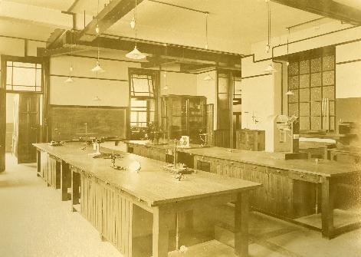
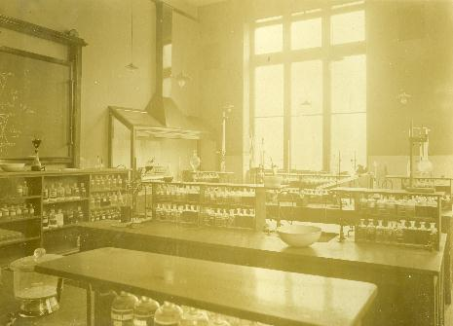

Slide 14
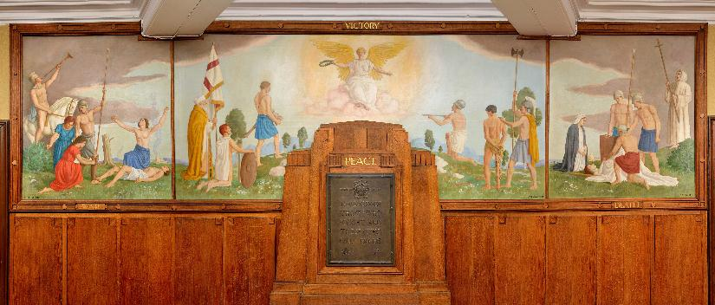
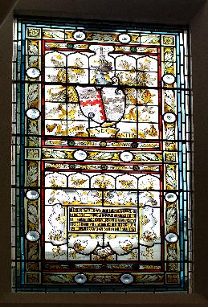
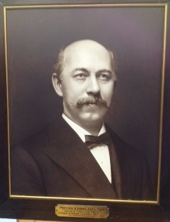
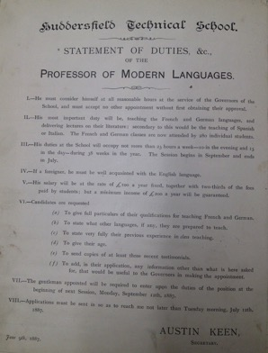

Slide 15
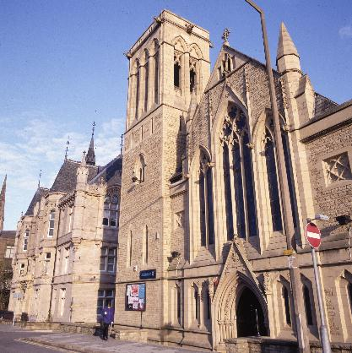
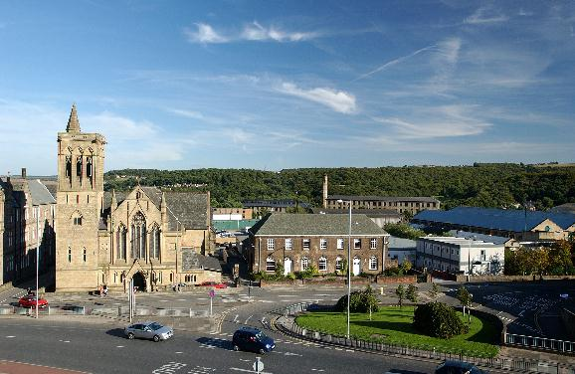
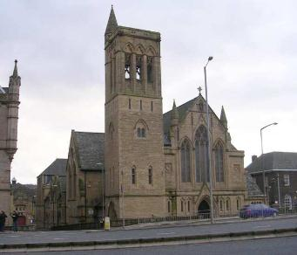
Sir Patrick Stewart Building,
2016- Present
Milton Congregational Church,
1883-Present

Slide 16
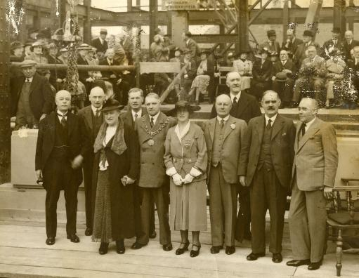
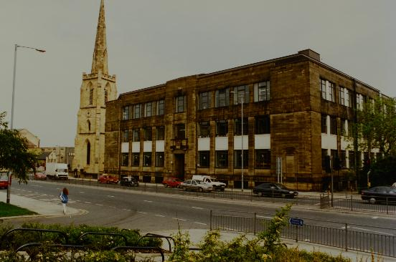
Joseph Priestley Building, 2016-Present
Chemistry Building, 1936

Slide 17
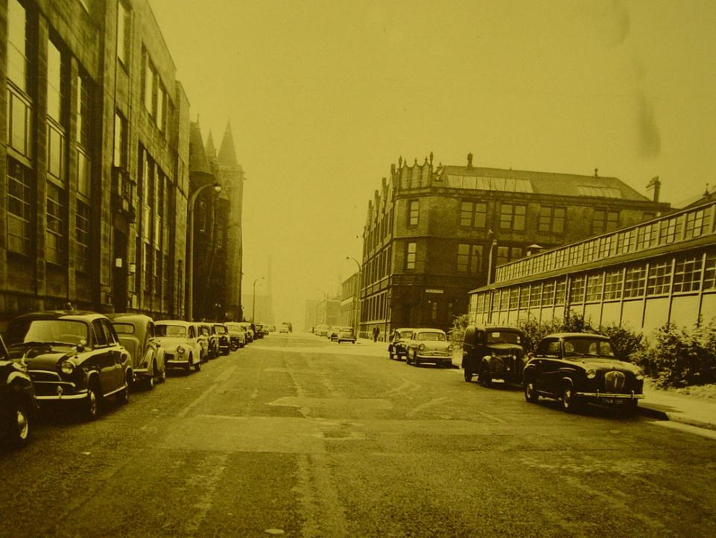
View of the Textile Industries Building, 1950s

Slide 18
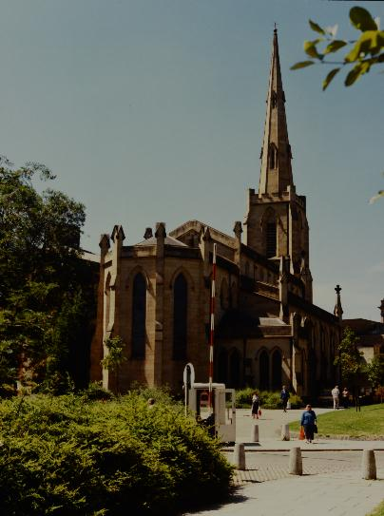
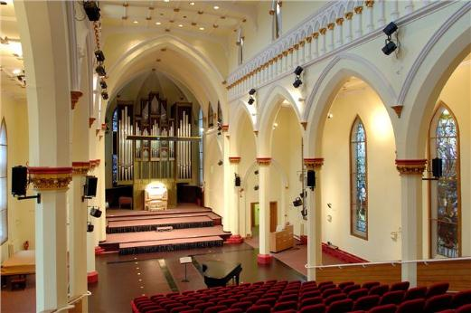
St Paul’s Hall, 1829
University Concert Hall, 1968 - Present
Designed by John Oates, built by Joseph Kaye

Slide 19
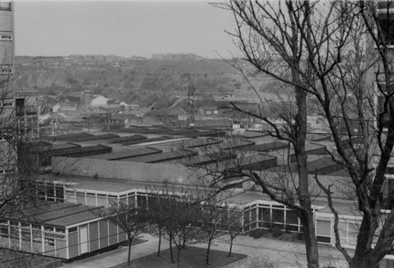
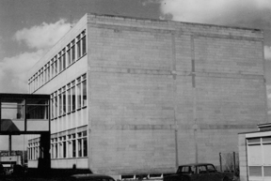
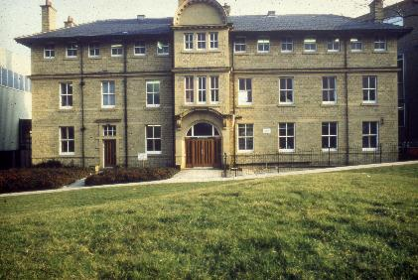
View over the workshop block before the Schwann building was built
Catering Block
Brunswick Building

Slide 20
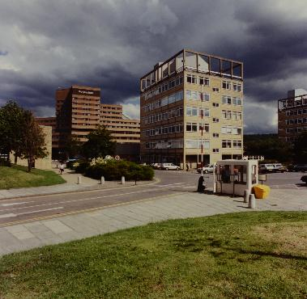
The changing face of
the University Entrance
and Plaza

Slide 21
Creative Arts Building
Oastler Building - 2017
New additions...
Student Central - 2014

Slide 22
Central Services to the Schwann Building 1976 - Present

Slide 23
Canalside before redevelopment...

Slide 24
Redeveloping Firth Street...

Slide 26
Thank you! Any Questions?

