Slide 1
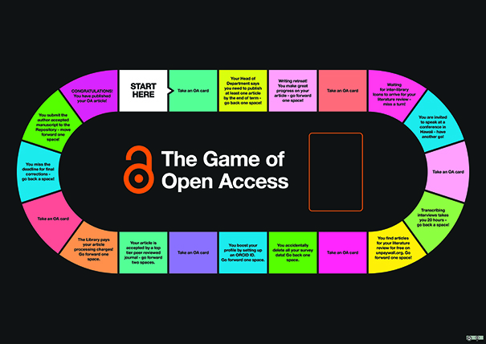
The Game of Open Access – making mandates more memorable
Catherine Parker
Collections & Scholarly Communications
Librarian
@ScholComsLib
DARTS6 May 2018

Slide 2
Outline
Background
Research @ Hud
The Game
Let’s play
Future plans
Feedback from you
Any questions

Slide 3
University of Huddersfield
Post 1992 university
1841- Young Men’s Mental Improvement Society (400 students)
19,300 students
5100 Researchers
900 academic staff
1000 support staff
7 schools - campus in centre of Huddersfield

Slide 4
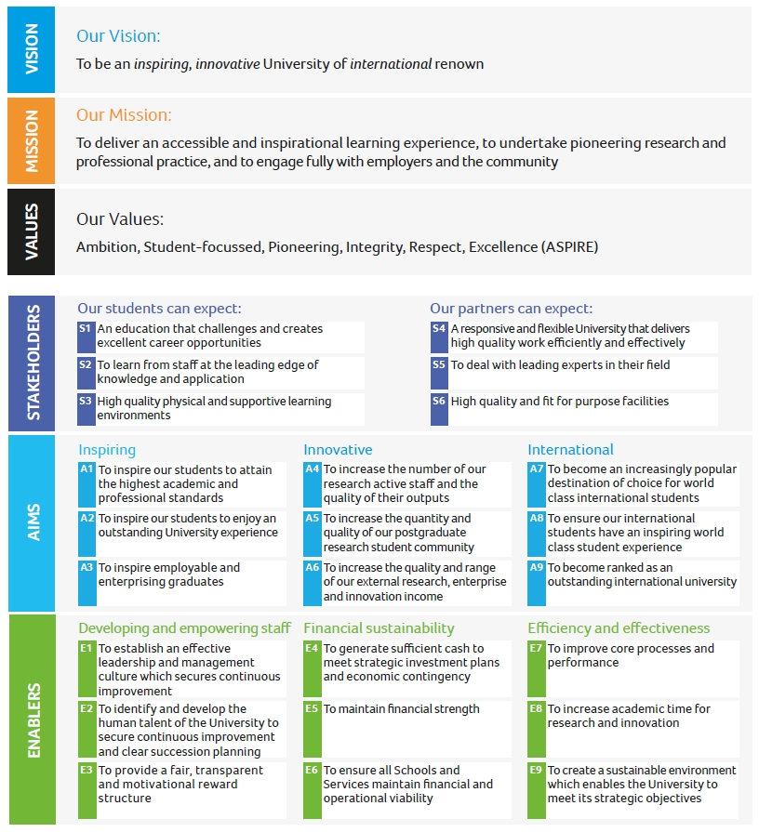
2013-2018 Strategy

Slide 5
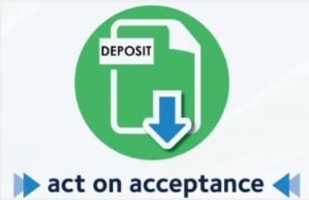
Research focus

Slide 6
Researcher journey map

Slide 7
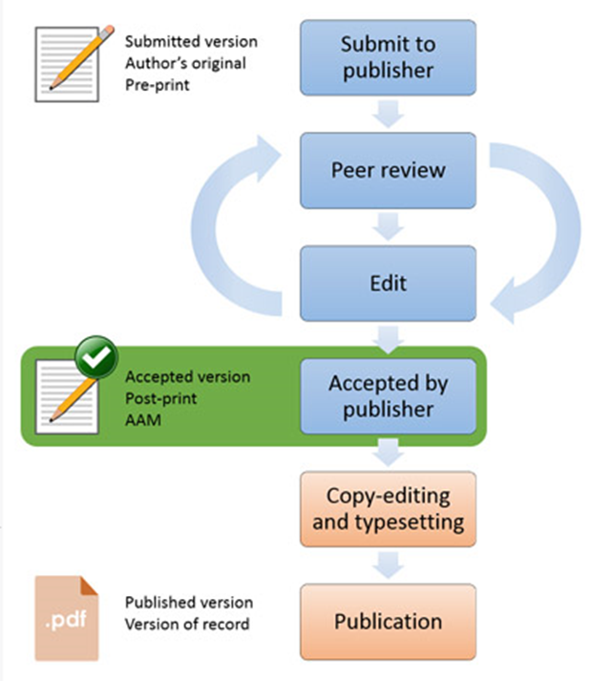
Too much information
University research strategy

Slide 8
Eligibility for REF 2021

Slide 9
A complex Open Access glossary
Article Processing Charges (APC): The fee charged by a publisher for making articles Open Access at the time of publication. (This is not the same as 'page charges' or 'colour charges‘).
Author Accepted Manuscript: The author's final, peer reviewed and corrected manuscript, usually created in Word or LaTeX. When publishers require authors to upload their final manuscript into a formatted page, this document is considered to be the Author Accepted Manuscript (AAM). It can be distinguished from the final published version as it lacks page numbers and the volume and issue number.
Gold Open Access: Open access at the time of publication. Gold Open Access can be considered to be 'born Open Access'. Fully Open Access journals sometimes (but not always) charge a fee for publication.
Green Open Access: Making a version of work (usually an AAM) available in an open access repository. These can be an institutional repository or subject based (such as arXiv or PubMed Central). Placing work in ResearchGate or Academia.edu does not meet the criteria for green open access. Green Open Access can be considered to be 'secondary Open Access'.
Hybrid journals: Hybrid journals are subscription journals that charge an extra fee to make a specific article OA while the remainder of the journal remains behind a paywall. This type of Gold Open Access is always accompanied by a fee.
Open Access (OA): Open Access is making research results freely available to anyone with an internet connection rather then keeping those results hidden behind a subscription paywall.
Repository: An online database of Open Access works. Repositories do not undertake peer review but do hold material that has been peer reviewed elsewhere. In addition repositories may hold 'grey literature' such as theses, datasets and other material.
Adapted from:
Office of Scholarly Communication (OSC), University of Cambridge Open Access glossary http://osc.cam.ac.uk/open-access/faq-about-open-access/open-access-glossary

Slide 10
Focus on engagement & publicity

Slide 11
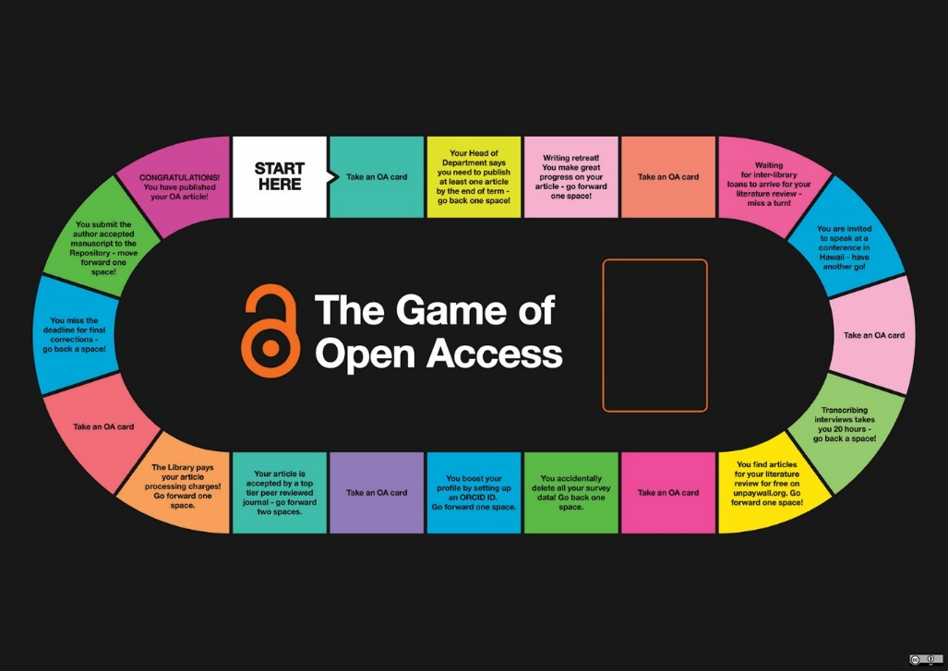
The Game of Open Access
Why?
Who?
How?
When?
So what?
http://eprints.hud.ac.uk/id/eprint/33874/

Slide 12
Playful learning
To engage researchers with the key concepts and tools required to meet Open Access mandates
Aims to develop an understanding of the role of Open Access through the initial idea for an article to its acceptance for publication
Game based learning
Andrew Walsh aka @playbrarian (http://innovativelibraries.org.uk/)
Other examples of games to engage researchers :
The Impact! Game
The Publishing trap
The Copyright game

Slide 13
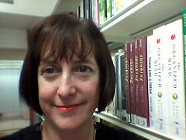
Creative talent
Kate McGuinn – Subject Librarian for Human & Health Sciences
The timescale was quite short (Spring 2017)
2-3 weeks to design the game
Graphic design magic
Play testing
Tweaking
CLS Showcase (June 2017)
Further tweaking
Mike Spikin
Graphic Designer

Slide 14
Adaptations
“The only change we made following initial feedback was to amend one square from ‘have another go’ to ‘move forward one space’.
If the player threw a six on their first go and landed on this square, then threw another high number, they ended up half way around the board without having to pick up a card and answer a question!”

Slide 15
When & where

Slide 16
What did our researchers say?
A fun way to remember the content of Open Access training
The Game of Open Access is an innovative training method that encourages imaginative thinking, it allows participants to reflect on the Open Access session and be able to apply what has been learnt. I was inspired by it usefulness.
I got round the board too quickly because I threw two sixes, therefore didn’t manage to collect many cards
Great opportunity to discuss the insight and understanding about OA with other participants

Slide 17
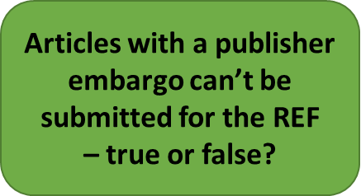
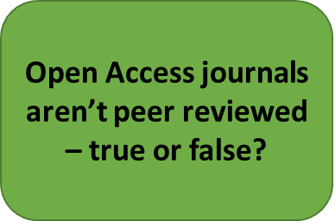
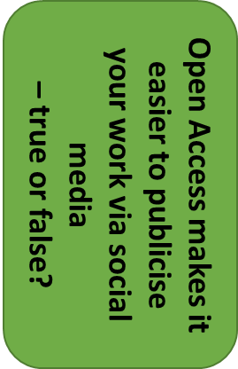
Let’s play

Slide 18
Future plans
Special editions for Pure & Ref 2021
Wildcards
Actual boards!
How else could we improve it?

Slide 19
Your feedback

Slide 20
Thank you
c.s.parker@hud.ac.uk
@ScholComsLib

