Slide 1
Preparing professionals to listen to and respond to children's voices in a university course
EECERA 2017 CONFERENCE
BOLOGNA, ITALY
Wednesday 30th August
Jim Reid
Frances Marsden
Judith Hunter

Slide 2
Preparing professionals to listen to and respond to children's voices in a university course
Theorizing a university module exploring the concept of 'voice' arising in the UNCRC and the social study of childhood - James Reid
Creating space in learning to hear and respond to the voices of children - Frances Marsden
Utilising the Mosaic Approach to explore ways of listening to children and student reflexivity - Judith Hunter

Slide 3
‘Beyond the baby and the bathwater’
(Burman 2000)
Fictional accounts of childhood
… and their oppressions
Agency – structure dualism
It’s political – dominant, normative, masculinist narratives
Stereotypical, gendered units of production
The child is a story waiting to be told rather than a unique, relational teller of a story
The secret life of 4 year olds…
The individuated object of concern
The (continuing) struggles of theorizing childhood
Adult privilege, cultural privilege and the privilege of interpretation
Outcomes focused. Developmental reductionism
The child as an object of concern

Slide 4
It’s ‘political’!
The problem of theorizing childhood
  Subjectivity / objectivity
  Agency / structure
Continuing dualisms
  Global south / global north (macro)
  Rights bearing or rights recipients?
  Competent / not competent
The individuated child
  Virtuous (educational, morally, emotionally)
  ‘troubled’ (normative regulation)
Masculinist narratives
  Including; gender, morals
The political ethic of care (Tronto 1993)
To imagine a world organised to care well requires that we focus on three things:
Politics: recognition and debate/dialogue of relations of power within and outside the organization of competitive and dominative power and agreement of common purpose;
Particularity and Plurality: attention to human activities as particular and admitting of other possible ways of doing them and to diverse humans having diverse preferences about how needs might be met; and,
Purposiveness: awareness and discussion of the ends and purposes of care. (Tronto 2010, 162).

Slide 5
Care?
On the most general level, we suggest that caring be viewed as a species activity that includes everything we do to maintain, continue and repair our “world” so that we can live in it as well as possible. That world includes our bodies, our selves, and our environment, all of which we seek to interweave in a complex life-sustaining web (Fisher and Tronto 1990, 40)
Any notion that human capacity and action is equal fails to account for inequality in relations that arises when some people are cared for, some are givers and others can absent themselves from caring responsibility all together. Such inequality renders the notions of attentiveness, responsibility or privileged irresponsibility problematic and of moral concern.

Slide 6
Nancy Fraser (2007) and the politics of recognition:
Participatory Parity
Recognising children as rights bearers but who is doing the recognising, from what position and for what purpose? Malrecognition?
Redistribution of rights through the auspices of the UNCRC (1989) or is it maldistribution? Contingencies?
Representation or systematic exclusion for reasons of politics, class, gender, poverty, (dis) ability…
It is therefore crucial in developing a module focused on issues of power and the ‘voice’ of the child that we attend to intersectionality including that of the student.

Slide 7
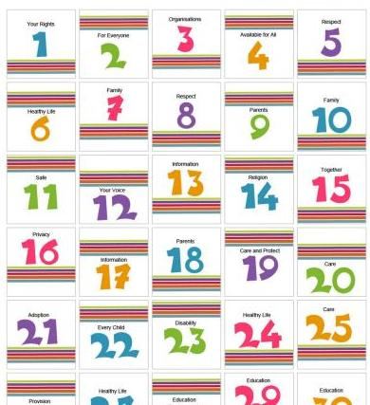
Planning The Module
Situated in the final year as the specialist module for BA (Hons) Childhood Studies to be completed before the Major Study (Dissertation).
The structure of the content came from the critical understanding of
the UNCRC particularly article 12. (Rights of the child to
engagement and participation).
Academic theory of Education and developing students ability to
really listen to children’s voices in order to enhance their
employability skills.
We wanted students to critically reflect on the impact of research with children. Moon, J. (1999:74). “exploring reasons for an event in the broader, social, ethical, moral and historical context”.

Slide 8

Teaching and Learning
Develop skill of how to write and present a conference paper.
Research how children and young people are listened to.
Application of UN Conventions on the Rights of the Child.
Application of Models of Empowerment and Participation.
International, Ethical and Cultural implications considered.
Types of voice, listening and evaluating voice mechanisms.

Slide 9
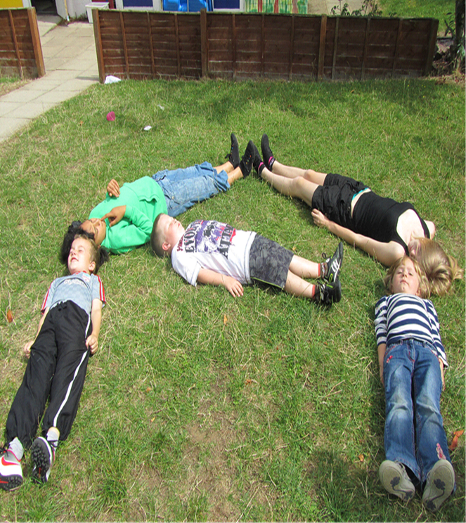
Ethical Practice
Ethical practice developed through a range of reflective sessions and completion of research documentation to meet university standards. (proposal, permission, consent, participation) BERA (2013).
Discussions around their proposed methods of research are supportive but challenging. Morals, Values and Culture are all considered.
Students develop reflexivity in their work by recognising their
impact on children’s lives as developing researchers.
Positions of power in research are discussed and debated in
relation to the child and young person’s voice.

Slide 10

Assessment
Final year BA Hons students to achieve the best they can be, aimed at the majority of students who gain a 1st and 2:1.
A university agenda of students as researchers was the inspiration for a student conference based on listening to children’s and young peoples voices. (Wood, Bruner and Ross 1976).
Students need to complete a small piece of research with children or young people. We develop a need to recognise the “agentic child”
Sorin, R.(2005) emotional responsiveness and being moral and
working with children as equals (Glassard 2012). Alanen L (2011).

Slide 11
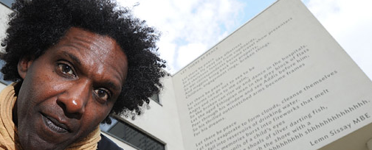
Conference
Learning is assessed through empirical research, ethically achieved.
Writing a conference paper and presenting it at a student conference (2 part assessment).
Key note speakers are 1st Children’s Commissioner Professor Sir Al Aynsley Green and the Poet Lemn Sissay MBE.
Both Honorary Doctors of the University
who inspire students to improve policy and practice in their future careers, affirming childhood education services as shared spaces for re affirming children’s rights and participation.

Slide 12

The student’s own voice
We acknowledge the students own voice in their research and explore the contemporary Higher Educational context of how they can be framed as economical capital through the NSS/ HESA/ TEF awards.
Students then are able to relate to the child’s capital, both politically
and ethically.
Students are given the freedom to present their papers in any format
they chose, developing their creativity and presentation skills for
the future.

Slide 13

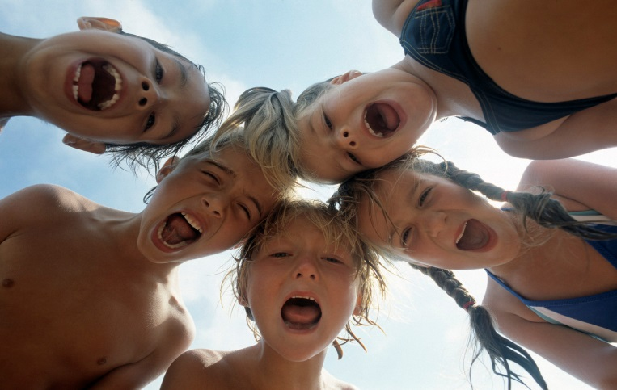
Children and young people are ‘experts in their own lives’

Slide 14
Knowledge and Understanding.
1. Shows a critical and systematic understanding of theories and models of Participation in the context of supporting children and young people.
2. Shows a systematic understanding of the importance of empowerment arising from international political socio economic ethical and cultural implications within the context of the United Nations Convention on the rights of the child (UN,1989).
3. Critically evaluate the mechanisms that allow children and young people’s voice to be heard.

Slide 15
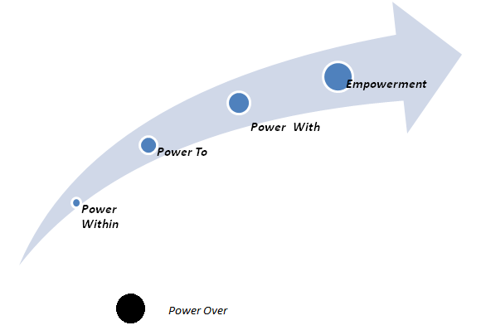
Models of Voice
Authentic ways of gaining Children’s and Young peoples opinion.
Informs teaching & learning strategy.
Builds relationships.
Aids review and reflection.
Leads change.
A model of Empowerment

Slide 16
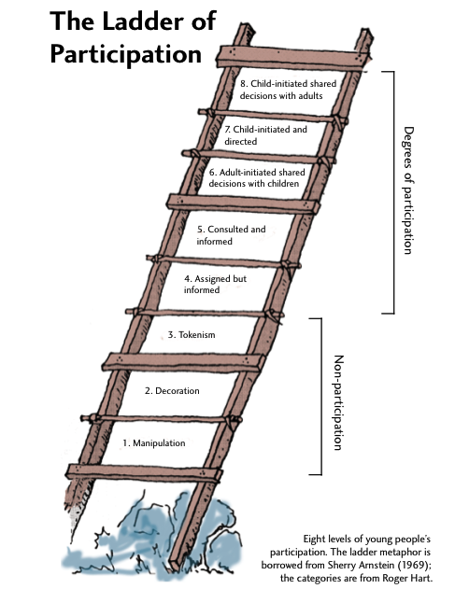
Notes:
Hart Ladder of Participation .
Clark & Moss (2011)Mosaic approach,
Zimmerman (1992) Woodall (2010)
Hassan (2014) Kim Sherman & Taylor (2008)

Slide 17
Abilities
Demonstrate the ability to appropriately research participation and empowerment of Voice in a context of supporting children and young people.
Critically evaluate the implications of supporting the voices of children and young people.
Demonstrate the ability to present a conference paper on one aspect of voice and the implications of your research findings on children and young people.

Slide 18
Reggio Emilia & Malaguzzi
Reggio Emilia have inspired the Mosaic approach. These have hinged around the notion of the competent child and of the pedagogy of listening and the pedagogy of relationships.
Focused his work around the view of a rich active child in contrast to viewing children as passive and in need.

Slide 19


The Mosaic Approach
Starts from the viewpoint of young children as competent meaning makers and explorers of their environment
The Mosaic approach brings together a range of methods for listening to young children about their lives.

Slide 20

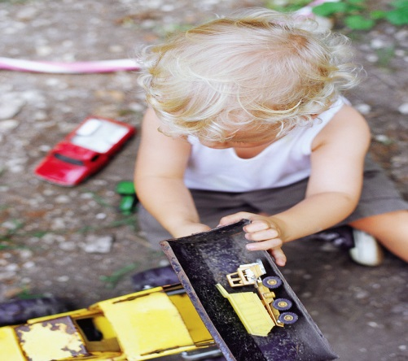
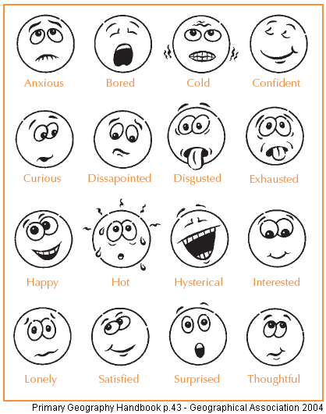
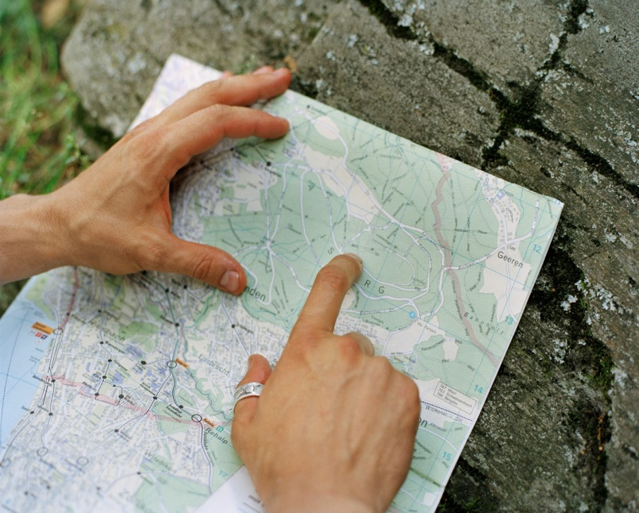
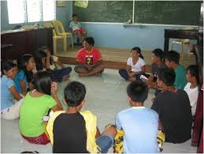
Methods used to gather the data
Observation
Emotion maps
Book making
Map making
Interviews
Focus Groups

Slide 21
Titles developed by our students
What does my drawing say?
What effects can living in a deprived area have on the way children experience play?
Living with Attention Deficit and Hyperactivity Disorder: a young person’s perspective
Are children able to express themselves during Family Intervention sessions?
Children affected by domestic abuse: finding a voice through an interactive educational workshop
Why does the doctor not ask me how I feel? The voice of the child in a doctor’s office

Slide 22
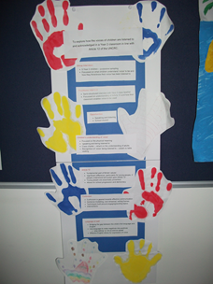
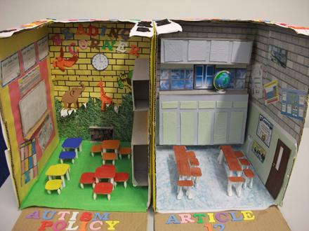
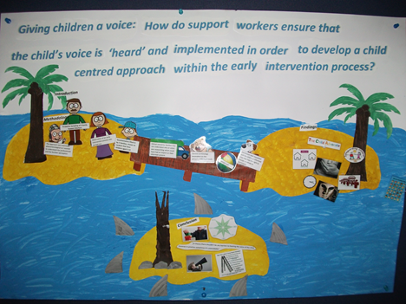
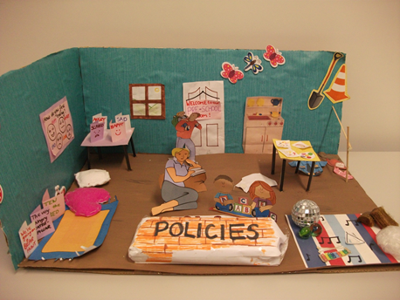
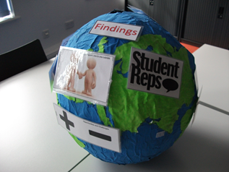
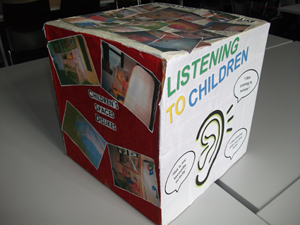
Conference Papers & Resources

Slide 23
Nancy Fraser (2007) and the politics of recognition:
Participatory Parity
Recognising children as rights bearers but who is doing the recognising, from what position and for what purpose? Malrecognition?
Redistribution of rights through the auspices of the UNCRC (1998) or is it maldistribution? Contingencies?
Representation or systematic exclusion for reasons of politics, class, gender, poverty, (dis) ability…
It is therefore crucial in developing a module focused on issues of power and the ‘voice’ of the child that we attend to intersectionality including that of the student.

Slide 24
References
Alanen L (2011) Critical Childhood Studies. Childhood 18(2) 147-150
Bauman, E. (2001). Beyond the baby and the bathwater: Postdualistic developmental psychologies for diverse childhoods. European Early Childhood Education Research Journal, 9, 1, 5-22.
BERA (2013). Ethical guidelines for Educational Research. Sage.
Clark, A. (2005) ‘Ways of seeing: using the Mosaic approach to listen to young children’s perspectives’, in Clark, A., Kjørholt and Moss, P. (eds.) Beyond Listening. Children’s perspectives on early childhood services. Bristol: Policy Press, pp. 29–49.
Fisher, B. and Tronto, J.C. (1990). Towards a feminist theory of caring. In E.K. Abel & M.K. Nelson (Eds). Circles of Care: Work and Identity. In: Women’s Lives. Albany, NY: State University of New York Press, 35-62.
Fraser, N. (2007). Mapping the feminist imagination: From redistribution to recognition to representation. In: Browne, J. (Ed.) The Future of Gender . Cambridge: Cambridge University Press.
Glassard, J. (2012). Tuning into children’s voices: Exploring the perceptions of primary aged children about their education in one primary school in England. International journal of Education, 4(3).49-66

Slide 25
Hart, R. A. (1992). Children’s participation, from Tokenism to Citizenship. UNICEF: Florence.
Moon, J. (1999). Reflection and Learning and Professional Development. Kogan Page, London.
Shier, H. (2001). Pathways to Participation: Openings, Opportunities & Obligations. Children & Society, 15.2, 107-117.
Sorin, R. (2005).Changing images of childhood: Reconceptualising early childhood practice. International Journal of Transitions in Childhood. 1 12-21.
Tronto, J.C. (1993). Moral Boundaries. A Political Argument for an Ethic of Care. London: Routledge.
Tronto, J.C. (2010). Creating Caring Institutions: Politics, Plurality, and Purpose. Ethics and Social Welfare, 4, 2, 158-171.
United Nations (1989). United Nations Convention on the Rights of the Child (UNCRC). Geneva: United Nations.
Wood,D.J. Bruner, J.S., and Ross,G. (1976). (scaffolding) The role of tutoring in problem solving. Journal of Child Psychology, 17(2), 88-100.

