Slide 1
Copies of Vygotsky exercise
Print off of consent form, surveys
Print off of survey results
Slides
NearPod exercise - screenshots
GoogleForms exercise
Notes:
Not part of presentation-just to remind me what I need to bring/have on screen!

Slide 2
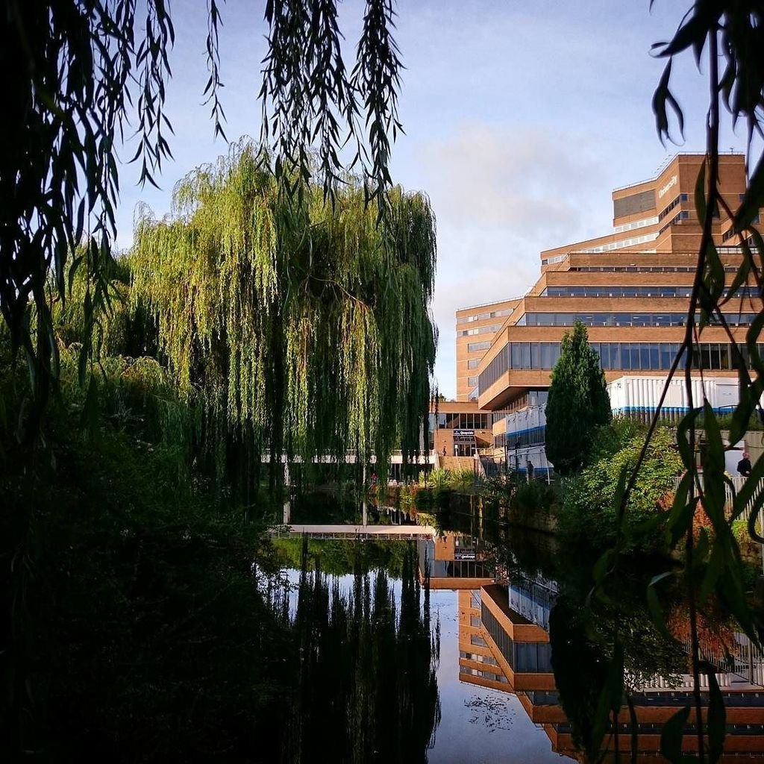
Embedding interventions for better critical writing and reading: collaboration between librarians and Academic Skills Tutors
Jess Haigh
j.m.haigh@hud.ac.uk
(@BookElfLeeds)
Jane Mullen
Elizabeth Caldwell

Slide 3
The Context…
Schools
The Library
Teaching and Learning Team
Academic Skills Tutors
Subject Team
Subject Librarians (me!)
Notes:
Academic Skills Tutors are embedded into the Schools, each school has at least one AST which are part of the School team rather than part of a central skills unit
With each School is a Teaching and Learning Team, which AST are part of. These teams are responsible for overview of School curricula. Gives an holistic view of School practice-this varies depending on the School.
The librarians are different, we are centred in the library, with each having responsibility for a different subject/School. Some librarians are split across two Schools, some School have more than one librarian
I am the SL for the School of Education and Professional Development.

Slide 4
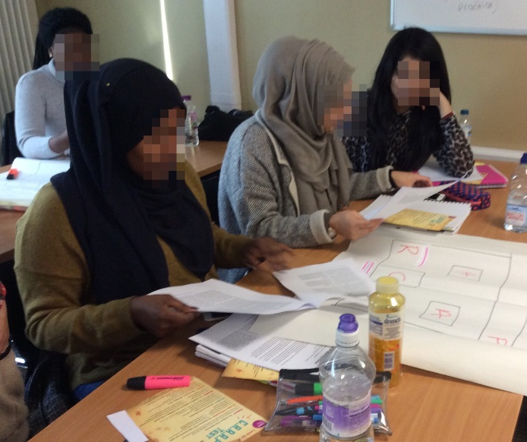
The students (#notallstudents)
“Vocational” backgrounds
Little experience of academic sources
Little experience of large quantities of text
Time poor
“Widening Participation”
Itua, I., Coffey, M., Merryweather, D., Norton, L., & Foxcroft, A. (2014). Exploring barriers and solutions to academic writing: Perspectives from students, higher education and further education tutors. Journal of Further and higher education, 38(3), 305-326.
Notes:
“perceived difficulties some undergraduate students have in reading and thinking critically, and to explaining their thinking clearly in their writing (Itua et.al., 2014).”
Our students often have vocational (BTEC) backgrounds with little experience of using academic sources, finding sources for themselves, or reading critically/dealing with large quantities of text
Students are time poor. Often having caring responsibilities or have to work. A lot of our students live at home and commute to University from local (or not so local) towns. Many first-generation students. This informs their view of what studying is and expectations in regards to reading and writing.

Slide 5
I have no idea what I’m reading…
"Learning the Ropes: How Freshmen Conduct Course Research Once They Enter College," Alison J. Head, Project Information Literacy, Passage Studies Research Report, December 4, 2013.
Notes:
Why do searching (library skillz)? Because this forms part of a wider skills set-also (purely annecdotally) students don’t understand difference between source types and academic conventions regarding what and how much to read.
“How long should my reference list be?”
Don’t know what a peer reviewed journal is
Don’t know why academics want them to use peer reviewed journal articles

Slide 6
Researching gaps
Issues apparent in final year-interventions placed into second year curriculum
Resource pilots in BA Childhood Studies
Notes:
Jane interviewed academic tutors to find where significant gaps were most apparent/where interventions could be embedded into curriculum
Issues become apparent in the final year so interventions would be placed in the second year.
Research Methods and Major Study-all students do this in third year
Resource pilots target Second Years, before they start these modules.
Childhood Studies BA cohort chosen as pilot group-already positive relationship with tutors and course reps.

Slide 7
Investigating How Others Work
Escape Rooms
Kahoot!
Videoscribe
Mentimeter
Notes:
Escape Rooms training day – informed critical writing resource-theme running throughout, puzzles,
Video sharing platforms – YouTube, videoscribe
Online learning tools –Kahoot, Mentimeter, Unilearn quizzes-not always suitable!
Teachmeets REALLY helpful for this!

Slide 8
Academic Skills Tutor Resources
Critical Reading
Two sessions, based on three texts. These would be done in class by either AST or class tutor
Piloted in November and now taught as part of curriculum
Critical Writing
“Inspired” by Escape Room, theme and puzzles
http://hud.ac/c4i
Currently a Google Form Quiz-any suggestions?
Critical Reflective Writing
In progress….
Notes:
Critical Reading – Jane – Vygotsky texts – November 2016
See hard copies of example
Two sessions based on three texts – done in class by tutors/AST
Piloted and now rolled out
Critical Writing – Beth and Jane – inspired by Escape Room
See link to Google quiz – explain theme informed by subject content – going into module – testing phase
Critical reflective writing – in progress

Slide 9
Subject Librarian Resource
Finding resources using keywords, synonyms, related terms
Enable students to think about language in context
Notes:
Finding resources using keywords, synonyms and related terms and enable students to think about context of language use
Able to be run in class or online (flipped classroom?) so could concentrate on the “whys” rather than the “hows” during (limited) lesson time.
Must be relevant to what students are doing-subject specific
Nearpod – allows you to have quizzes and interactivity for up to 30 for free…. For more for more money….you can do loads of other stuff
Integrated with videos made through VideoScribe and Adobe Spark Vid

Slide 10
The pilot…
Attitudes towards resource mostly positive,
“informative” “helpful” “useful”
One negative comment, was not worth coming in for as had done in the first year
Majority felt more confident in searching library catalogue after completion
Majority either wouldn’t, or probably wouldn’t have completed task if had been optional on VLE
Very small pilot!
https://theinstituteblog.co.uk/blog/https://theinstituteblog.co.uk/2017/03/08/creating-online-resources-to-develop-student-information-search-skills/
Notes:
Completed during a group tutorial
Reported on in Teaching and Learning Institute blog/hopefully conference in September

Slide 11
The catch…
Notes:
Dollah dollah bill yo

Slide 12
Strategies for Collaborative Working (that work)
Leave a paper trail that is understandable and open
Shared Drives
Open reflective diaries/blogs
“Paper Trails” by Leland Francisco is licensed under CC BY 2.0
Notes:
Leave a paper trail that is understandable and thorough,– shared drives ( you don’t need to give editing right as if you don’t want to! And can make private), open reflective diaries
Use each other to test stuff on!

Slide 13
Strategies for Collaborative Working (that work)
Take the time away together
Regularly communicate
Clear strategy and end goals
Notes:
Communication and regular meeting
Take the time away together
Share a clear strategy and have end goals-but also personal projects-as you come from different places and will have different priorities

Slide 14
Strategies for Collaborative Working (that work)
Recognise your own skills set and what you can bring to a group project
Recognise any developmental needs you would like to fulfil
Notes:
you come from different places and will have different priorities
You also have very different skill sets but also will have stuff you want to do extra
Collaborative working is a great way of trying out or developing new skills-as you have what is hopefully a “safer” place to try them out.
So for example I knew I wanted to create educational videos using different platforms so I managed to do that on this project. I knew I wanted to do classroom based research, so I managed to do that too.
Now my big thing will be writing up this research into a bid to include the resource on the curriculum and to show my findings in a way that makes sense to the Higher Ups.

Slide 15
Strategies for Collaborative Working (that work)
Plan, share, just in case…
Notes:
plan for the unexpected

Slide 16
Take aways
Using subject specific examples and real world research students can relate to or already find useful will engage them
Find out how academics search, if it works for them, and how they demonstrate good critical research in practice to students
Notes:
Using subject specific examples and real world research the students find themselves to prompt discussion-not just tired examples you rely on
How do your academics search? If it is working for them, can they demonstrate this to students?

Slide 17
“They don’t read”
If your students are not doing the reading-find out WHY
Is it because they have no time outside of class?
The expectation of time outside classes for study is a privilege that must be recognised as such.
Notes:
Timetable in sessions for critical reading and provide support for students during this-don’t presume students will have time outside of lectures in a quiet place to do the reading. Students living at home sharing timetables with parents will often be given caring responsibilities or be expected to work when not timetabled to be at University, the “three hours study to every hour in class” expected ratio must be recognised as a privileged notion.
Online activities provided must be promoted by tutors and be embedded into modules-students do not have time/inclination to do extra curricula stuff.
Any activities you create that are not embedded in modules AND TIMETABLED are Othering and discriminatory – you being flexible doesn’t account for the fact that students aren’t. You need to be in the classroom or you don’t exist in the lives of these students AND THAT IS NOT THEIR FAULT.
How can you be in the classroom? This is a discussion that needs to be had. You need to be making content that fits in with the student’s needs and practicalities.

