Slide 1
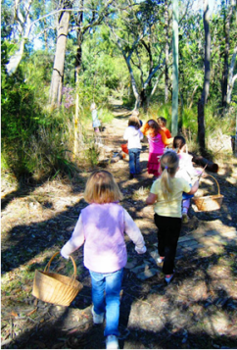
Engaging Children and Young People: Creative Methods and Research Ethics
‘What’s so interesting outside?’
Judith Hunter
School of Education and Professional Development
University of Huddersfield
Monday 20 June - Tuesday 21 June 2016

Slide 2
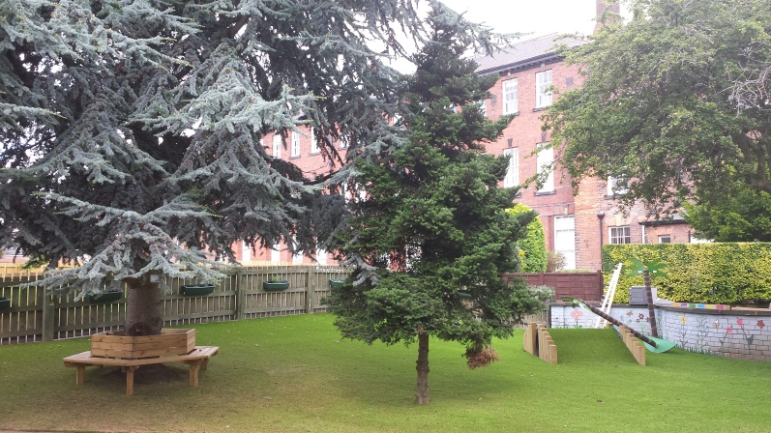
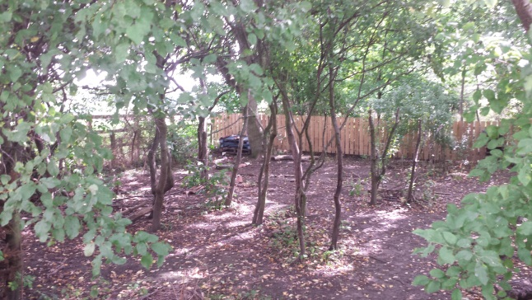
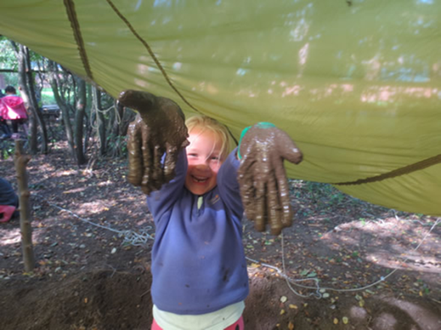
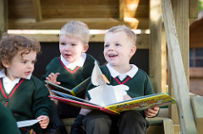
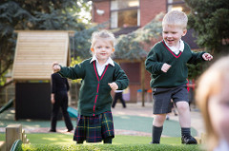
Outdoor Play Spaces & Pedagogy
An exploration into the different affordances of outdoor play spaces and the relationship to early childhood pedagogy

Slide 3
Research aims
To gain a deeper understanding of the ways in which children are given opportunities to shape their learning in outdoor environments.
To explore the interactive relationship between teachers, children and their environment.
To identify how outdoor environments affect the pedagogy of teachers and practitioners.

Slide 4
Multiple Learning Environments
Learning Spaces
Transitional Spaces
Inside
Outside
Beyond
Inside
Beyond
Outside

Slide 5
Children as co-researchers
Young children as active participants and competent meaning makers as explorers of their environment
To identify aspects of the outdoor environment that are of special interest to them and not that imposed by adults.
The Mosaic approach (Clark and Moss, 2001) brings together a range of methods for listening to young children about their lives.
Notes:
Children are knowledgeable about their own experiences and their own lives so it is important that I listen to them.
I want the children to become researchers themselves and be active participants rather than just be ‘the observed’.

Slide 6
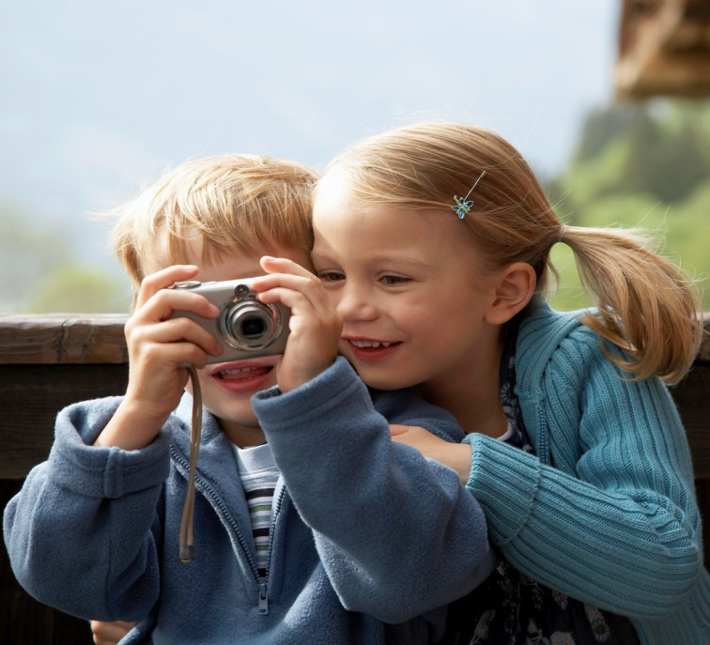
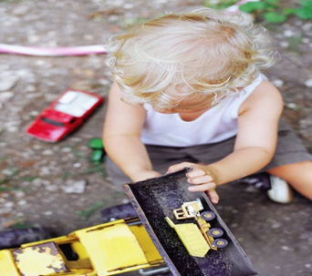
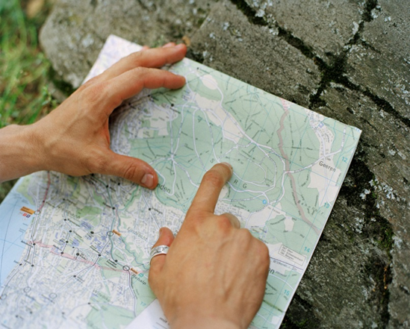
Mosaic Approach: Methods to be used by the children
Observation
Cameras
Book making
Tours
Map making
(Clark and Moss, 2001).
Notes:
I intend to use aspects of the Mosaic approach to gather the data.
Children have the capacity to act independently...to make choices about the things they do and to express their own ideas. This approach combines the traditional tools with participatory methods.
Cameras and photographs – children will have access to cameras in order to capture areas or things of interest to them rather than imposed by me ......
This approach will be methodologically challenging especially as I am a novice .

Slide 7
Floor Books (Warden, 2007).

Slide 8
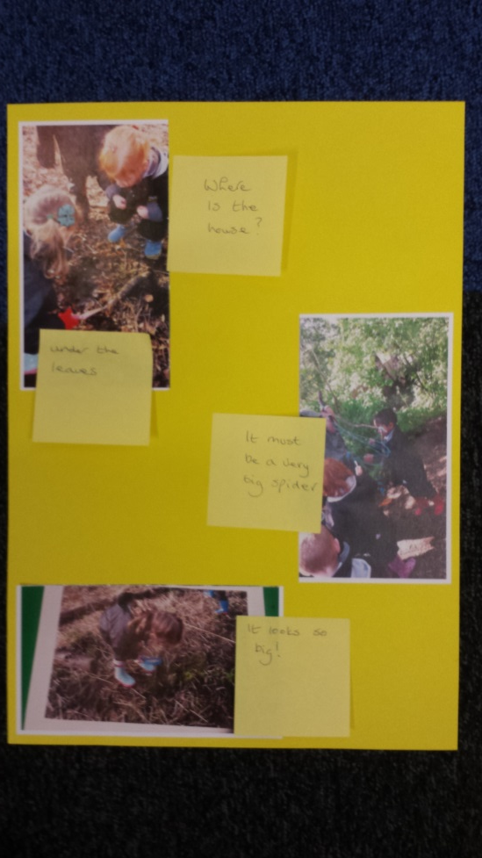
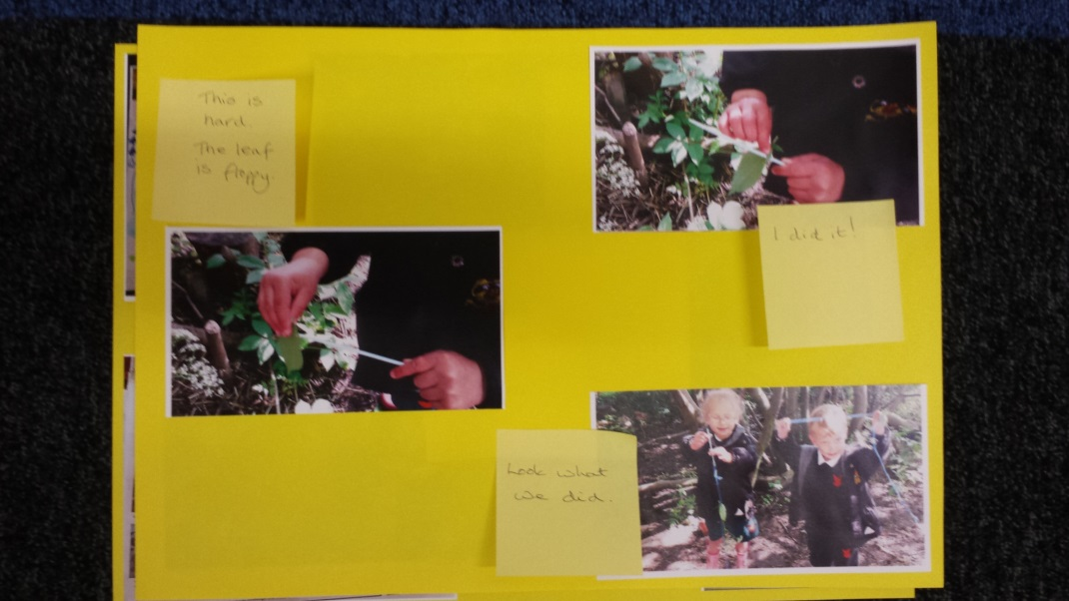
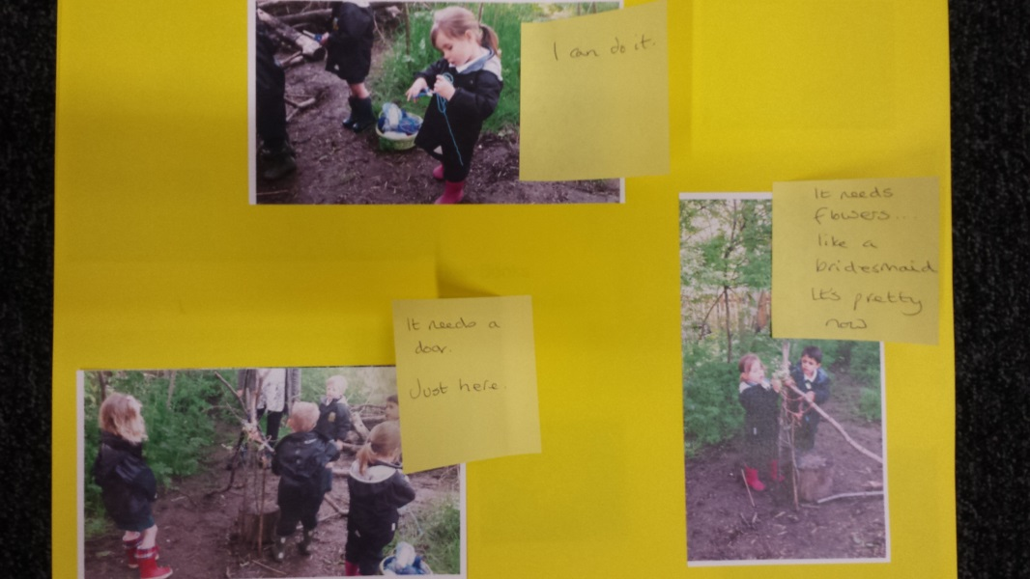
The first step...

Slide 9
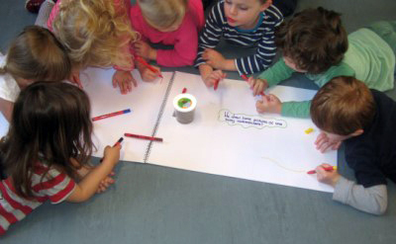
The next step...
To produce a floor book with/by the children that is a celebration of the group learning journey:
that will allow children to share their thinking and communication in a way that works for them and achieves inclusivity
that demonstrates links in learning from inside to outside and beyond
Shares the child’s voice, analysis of learning, next steps for learning
It is valued and kept to allow children to revisit thinking.

Slide 10
References
Clark, A. and Moss, P. (2001). Listening to Young Children: The Mosaic approach. London: National Children’s Bureau.
Warden, C. (2015). Learning with Nature: Embedding Outdoor Practice. London: Sage.

