Slide 1
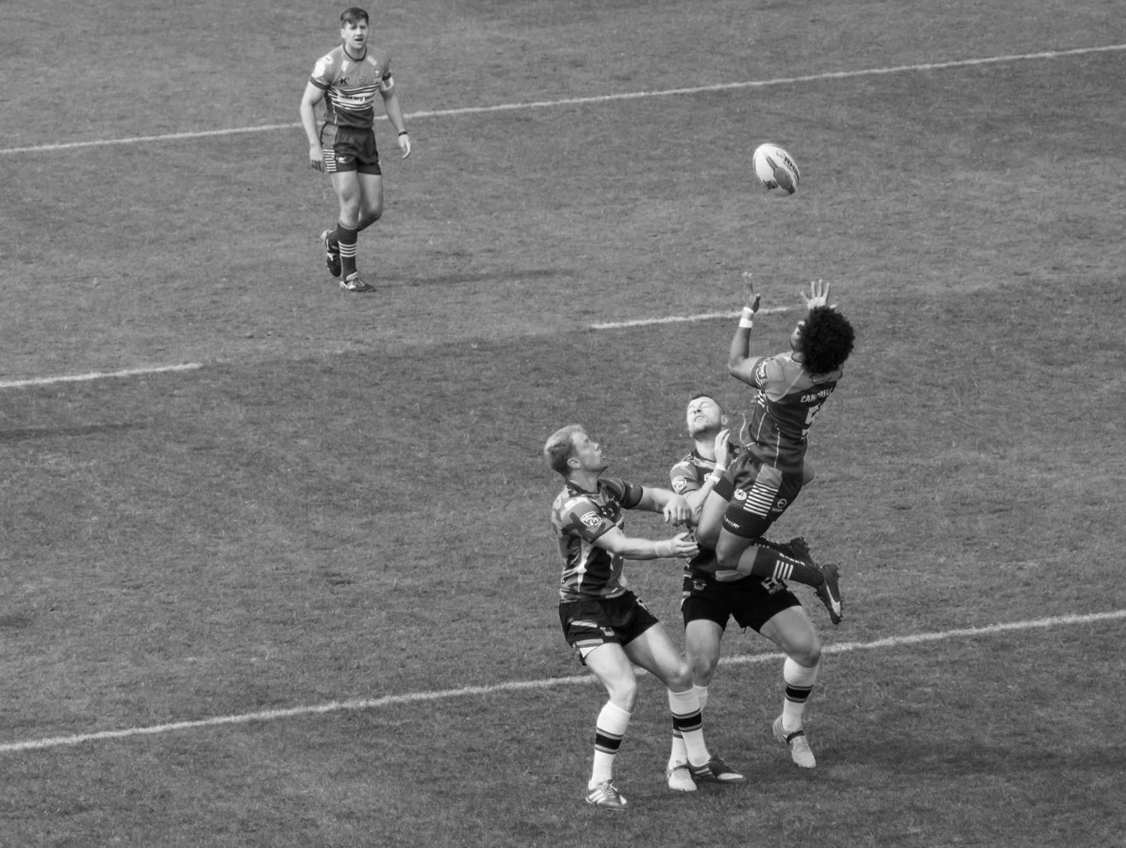
Bloody Shirts and Muddy Boots:
Tackling the Rugby Football League Archive at Heritage Quay
Robert Clegg, Collections Access Officer

Slide 2
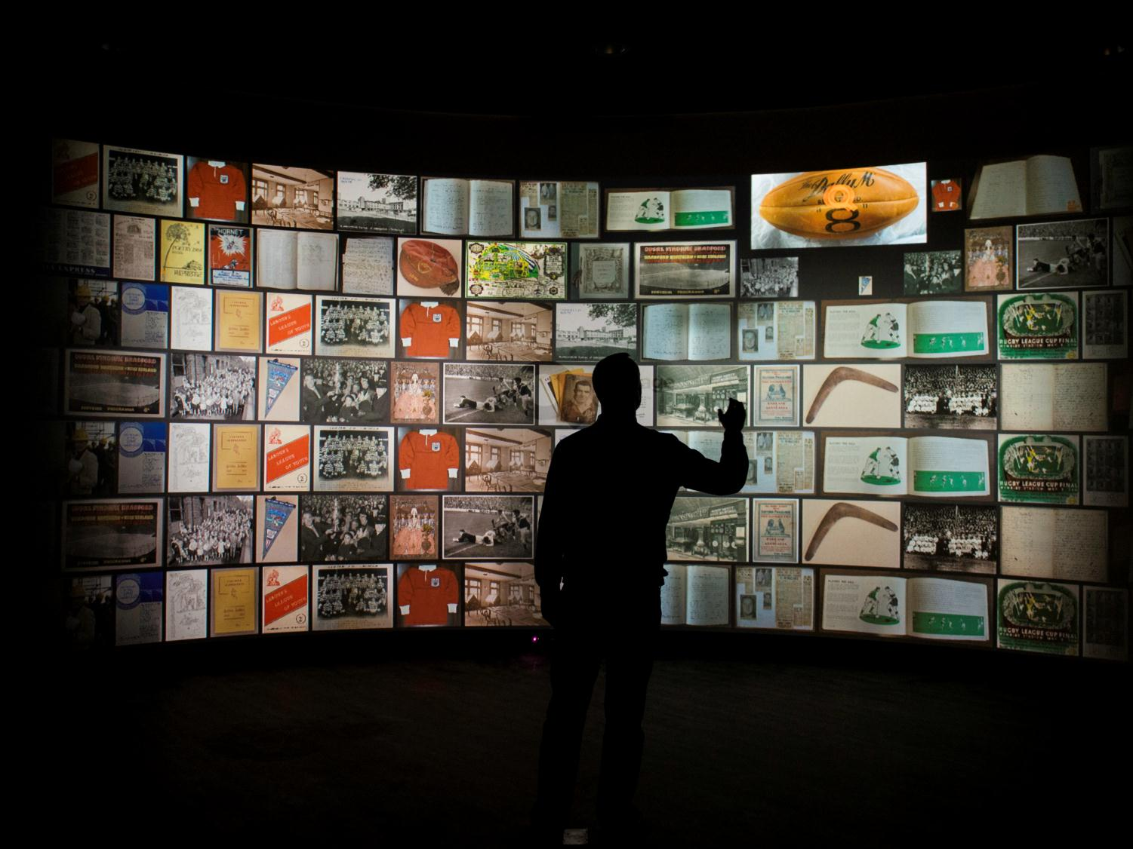
Who are we?
Heritage Quay
8 themes Sport
Music
Politics
Education
Women
The Arts
Industry
Non-conformity

Slide 3
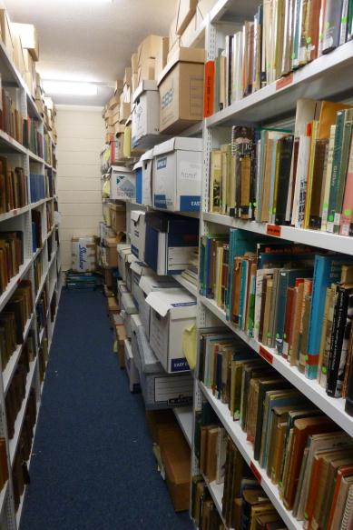
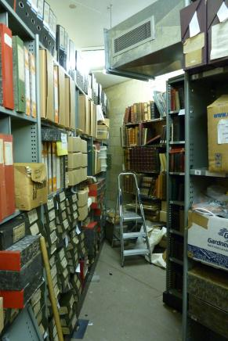
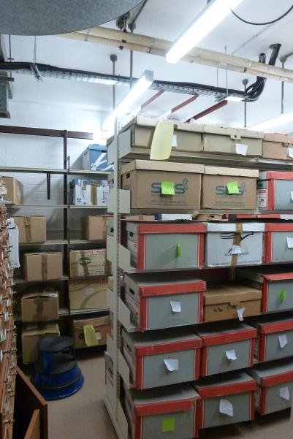
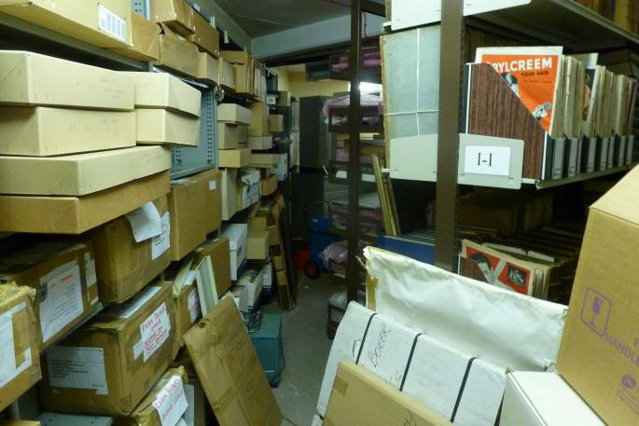
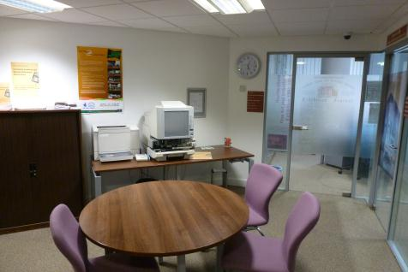

Slide 4
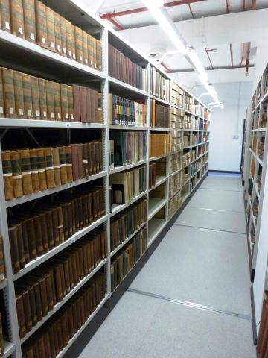
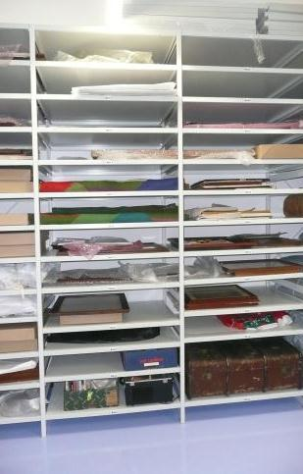
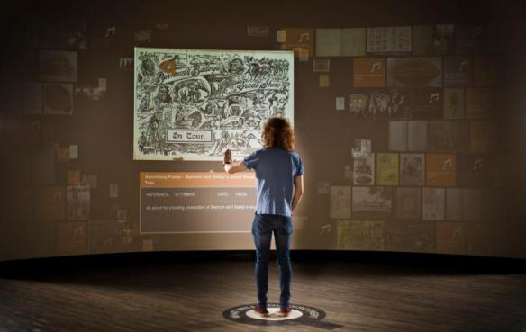

Slide 5
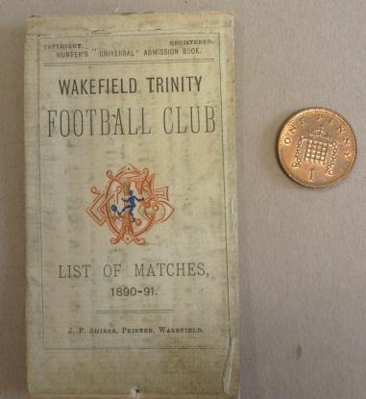
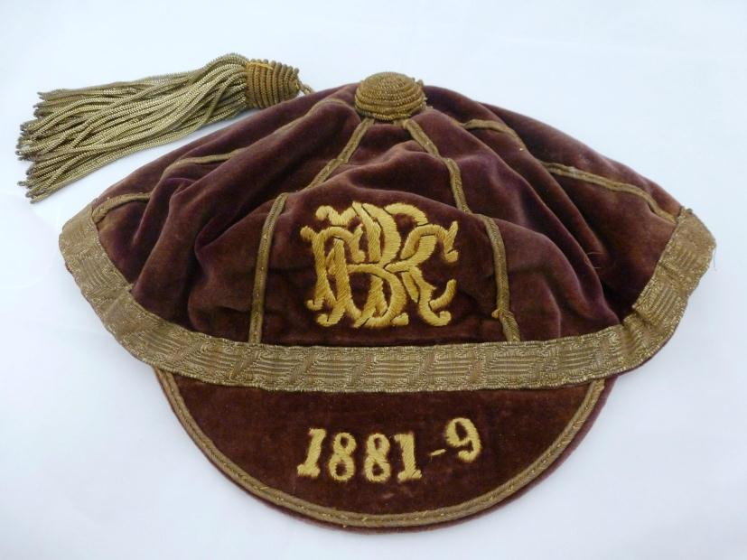
FOUNDATIONS OF THE GAME - 1895
Henry Hirst Waller's Brighouse cap, 1889.
HH Waller chaired the famous meeting on 29 August 1895 in which the Northern Union was formed
Wakefield Trinity season ticket 1890-91.
Wakefield Trinity were one of the 21 teams that broke away and formed the Northern Union

Slide 6
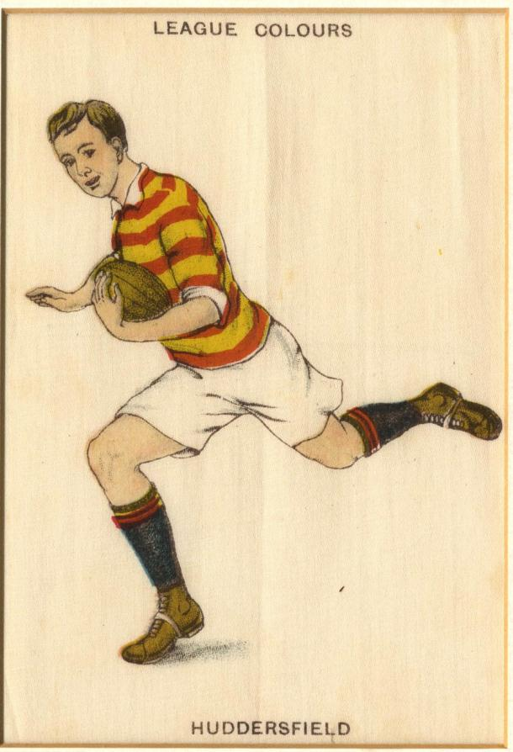
The Rugby Football League Archive - What have we got?
The collection pre-dates the founding of the sport in 1895
Strategic planning and central administration
Competition records
Commercial publications
Player and supporter collections
Most popular records:
Player registers
Official guides (annual year books)
Programmes
Photographs
Famous players shirts & boots

Slide 7
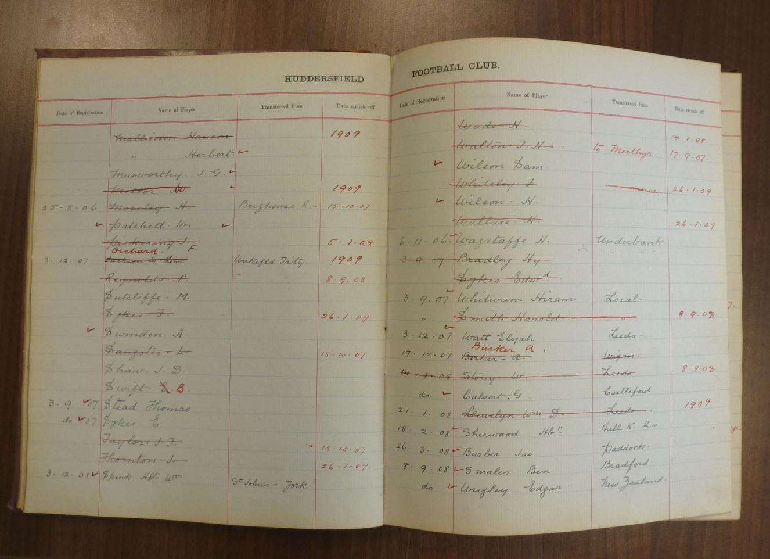
Player Registers

Slide 8
The Rugby Football League Archive - What have we got?
The collection pre-dates the founding of the sport in 1895
Strategic planning and central administration
Competition records
Commercial publications
Player and supporter collections
Most popular records:
Player registers
Official guides (annual year books)
Programmes
Photographs
Famous players shirts & boots

Slide 9
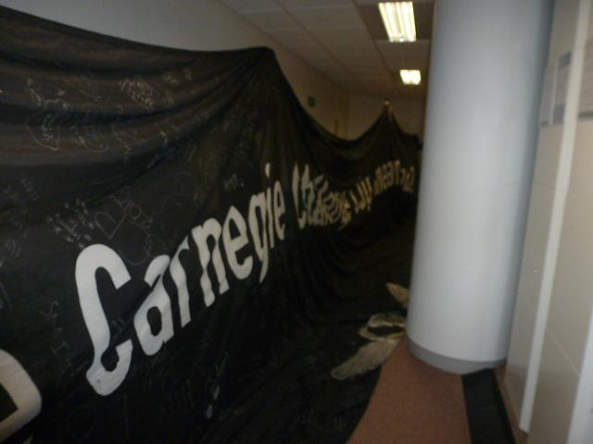
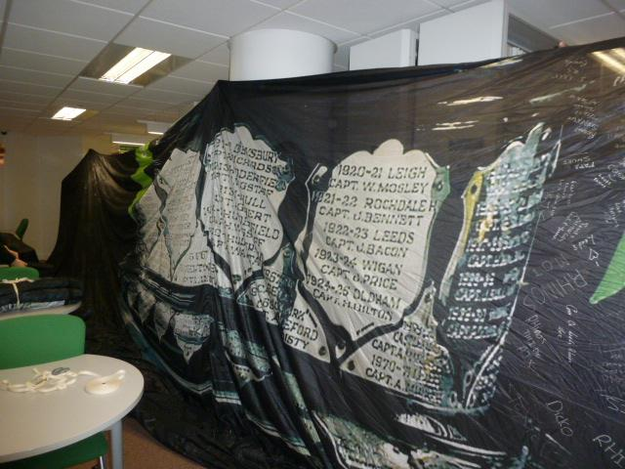
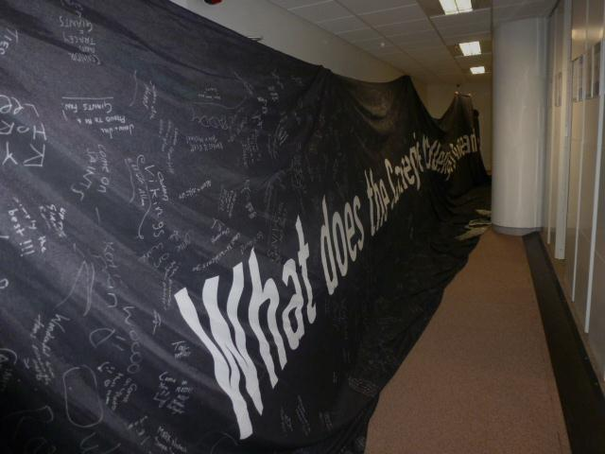
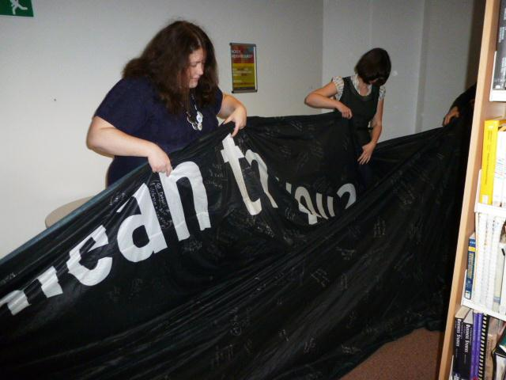
Biggest!

Slide 10
The Rugby Football League Archive - What have we got?
The collection pre-dates the founding of the sport in 1895
Strategic planning and central administration
Competition records
Commercial publications
Player and supporter collections
Most popular records:
Player registers
Official guides (annual year books)
Programmes
Photographs
Famous players shirts & boots

Slide 11
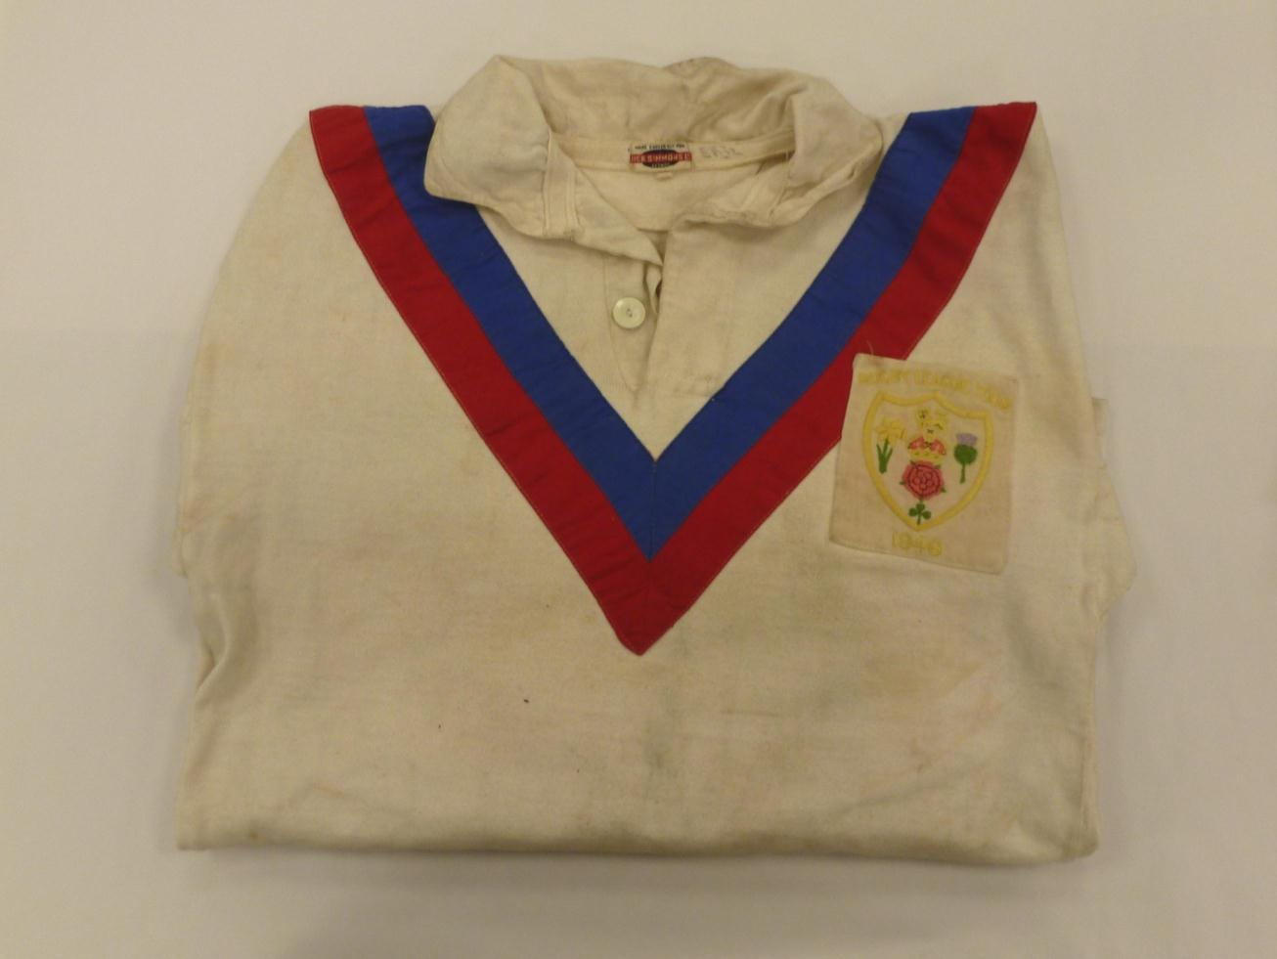
Dai Jenkin’s Great Britain Tour shirt, 1946

Slide 12
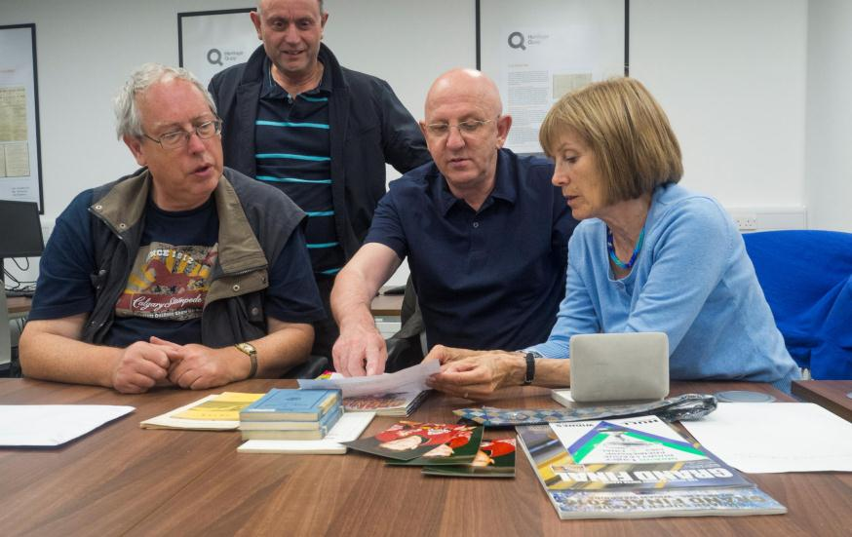
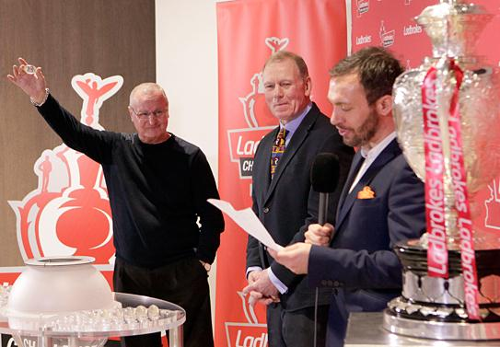
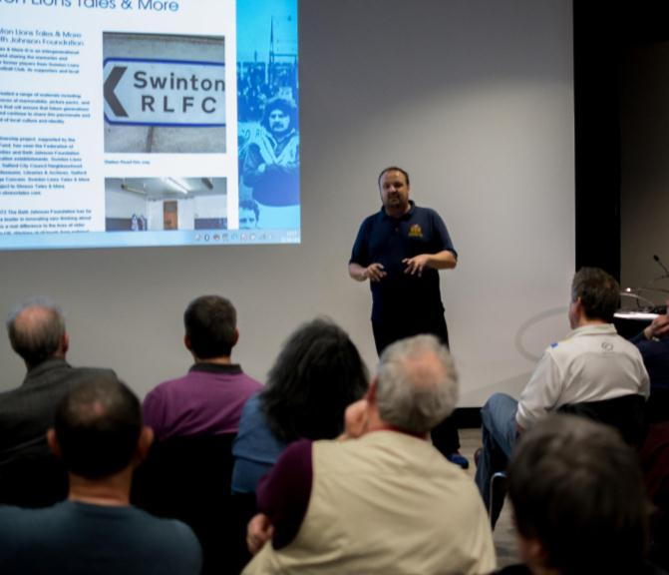
Engagement

Slide 13
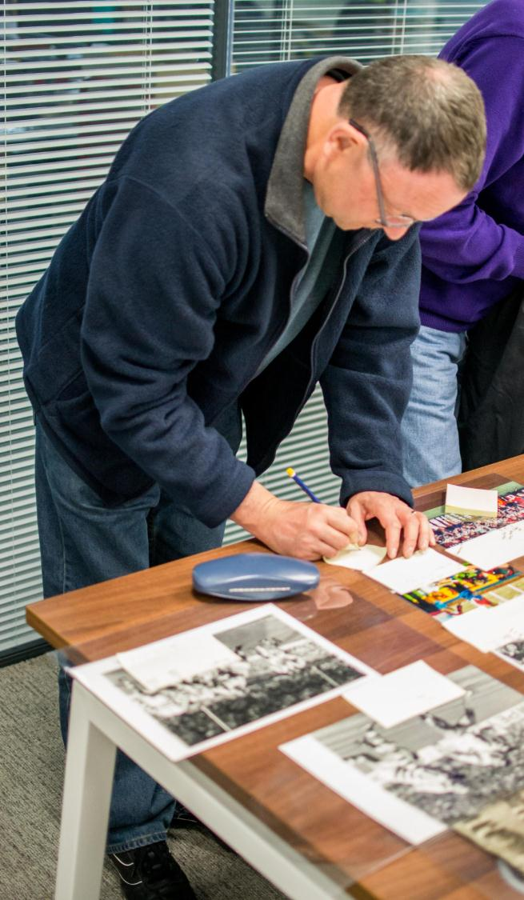
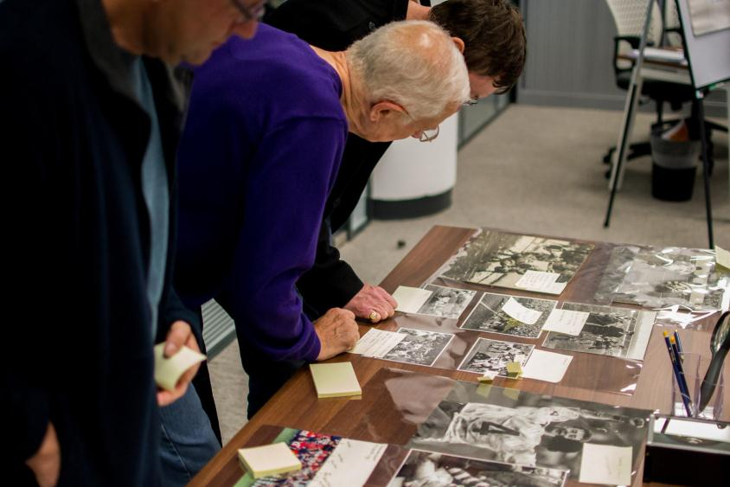
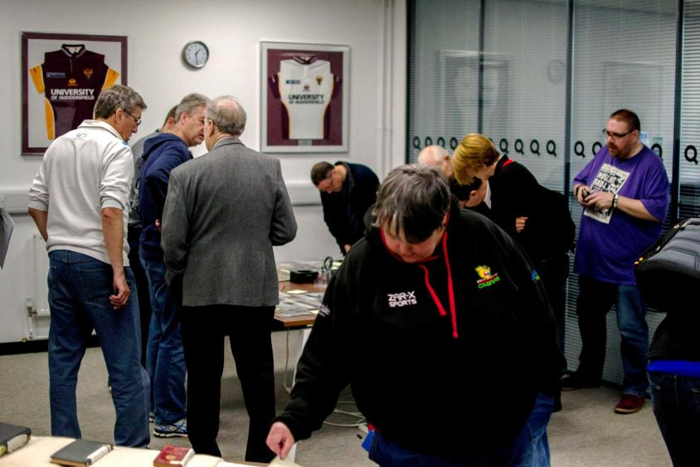

Slide 14
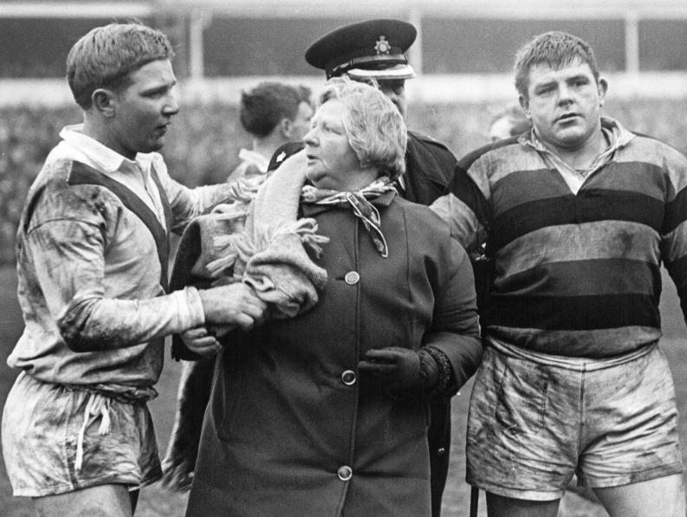
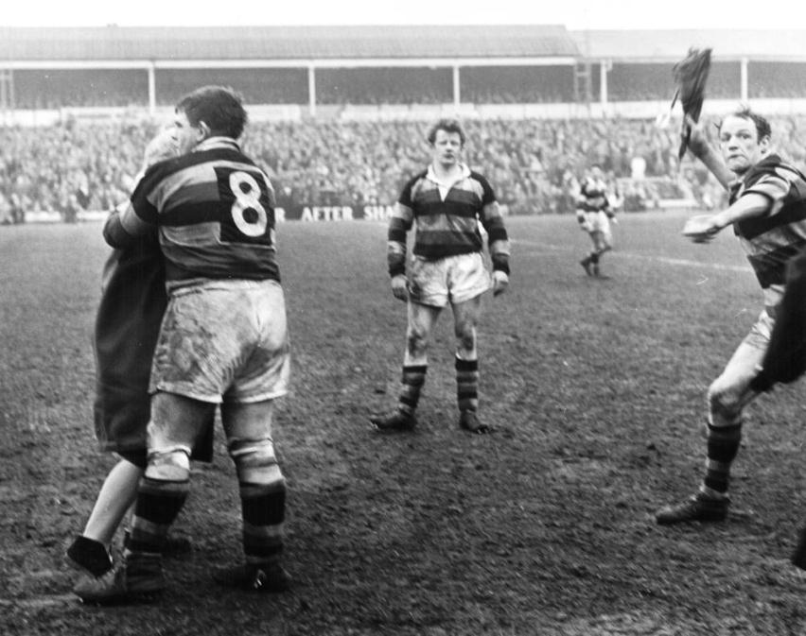
1966 Challenge Cup Semi Final, 16 April
St Helens v Dewsbury
Station Road, Swinton
John Warlow
Minnie Cotton
Trevor ‘Tank’ Walker

Slide 15
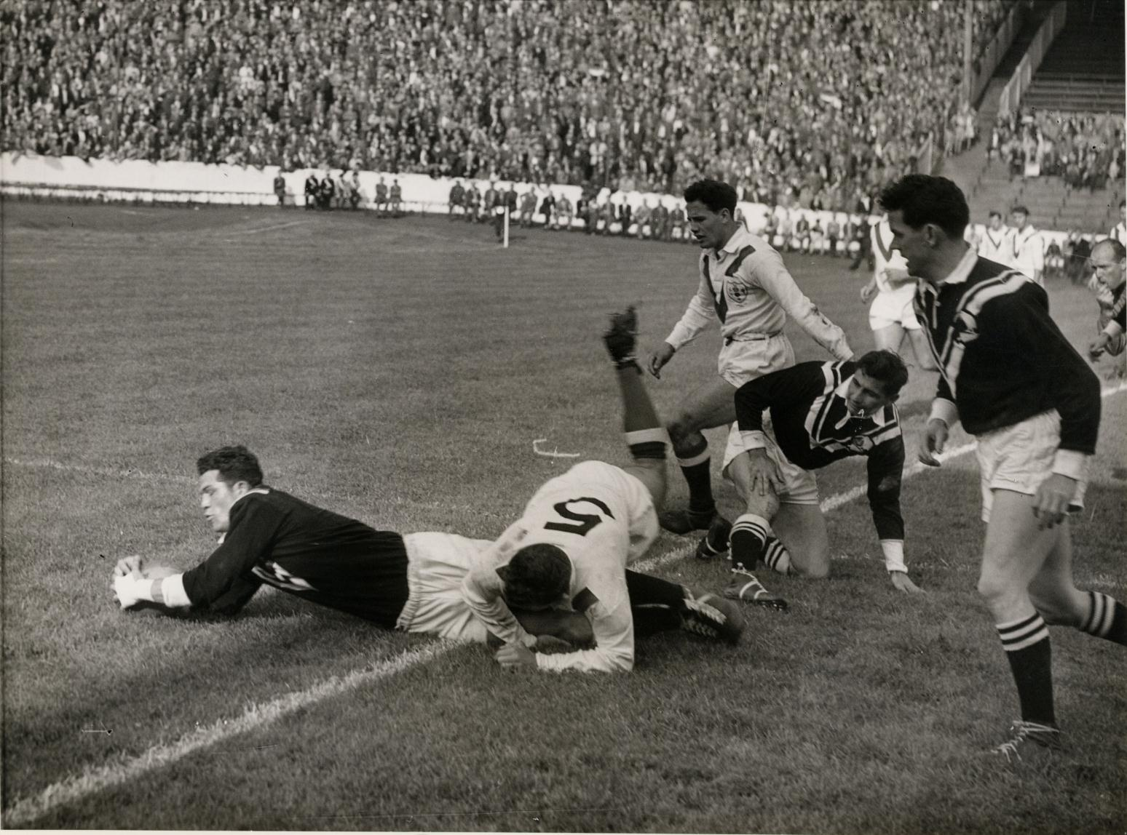

Slide 16
Thank you!
Any questions?

Slide 17
Further Reading - Rugby League History
Collins, Tony, 'Rugby's Great Split‘, 2nd revised edition, Routledge, 2006
Collins, Tony 'Rugby League in Twentieth Century Britain’, Routledge, 2006

