Slide 1
There is power in the top management team: team based learning and immediate feedback assessment in strategic management. Dr Deborah Allcock

Slide 2
Experimental teaching
Rationale for choice.
Introduction to team based learning.
Formation of groups/teams.
Immediate feedback requested.
The design and delivery.
Reflections.

Slide 3
There is power in the top management team: The rationale
Teaching strategic management.
Module context.
Queensgate – 380 students – standard 24 week delivery.
Shanghai – 120 students – flying faculty (mini block) + local tutors (seminar sessions weekly over 12 weeks).
Hong Kong – 120 students - flying faculty (block delivery).
Feedback – timing, validity and supporting feed-forward.

Slide 4
Team based learning
Lectures
Team based learning
Lecturer choses subject material and prepares.
Pre-class: student might study concepts.
In class: student takes notes.
Student accountability: mainly to self, seminar/tutorial, assignment and/or final exam.
Lecturer choses subject material and prepares.
Pre-class: student must study concepts (tests).
In class: student tested on concepts, joins team to be tested and solve problems, completes tasks.
Student accountability: individual marks, team marks, application marks.

Slide 5
Typical module planning with TBL (Michaelsen and Sweet, 2008)
Typical TBL module division
Readiness Assurance
1-1.5 hours
Application Activities
2 – 5 class sessions
Readings
iRAT
Significant problem
Same problem
Specific choice
Simultaneous reporting
tRAT
Appeals
Plenary –
Mini lecture
The focus for the immediate feedback technique
Notes:
Significant Problems. Teams work on a relevant, significant problem.
For a successful application activity, it is best to select a significant, relevant problem that captures the interest of students. The quality of the problem ultimately is the most powerful factor in influencing the effectiveness of an application activity. Problems should require students to use course concepts to solve them. Backwards Design can be used here to: _rst decide on the problem, and then
trace things back to the course concepts that the students would need to solve the problem. By understanding the course concepts at play, you can then select appropriate readings and construct appropriate Readiness Assurance Tests.
Same Problem. Teams work on the same problem.
Teams are given the Same Problem Giving the same problem to all teams lets you create
reporting opportunities for teams to defend, challenge, discuss, and examine each other’s thinking and problem-solving process. Having the teams work on the same acts as a potent discussion starter. The sequential report, where teams work on different problems, is often a very low energy event, where other students have little motivation to examine the thinking and decisions presented.
Specific Choice. Teams required to make a specific choice.
Each team must make a Specific Choice Open-ended questions have long been the hallmark of
our efforts to foster critical thinking in our students, but complex, open-ended question might be too challenging for the novice learner. The most significant drawback in using open-ended questions is the difficulty in efficiently letting students report their answers and the difficulty in comparing their answers with their peers. This opportunity for comparability of decisions is one of the major strengths
of the TBL reporting process.
Simultaneous Report. Teams report simultaneously.
Teams Simultaneously Report their decision Simultaneous reporting can be accomplished with the
simple holding up of a card indicating a particular choice. When a particular team sees that another team has made a different decision, they naturally want to challenge the other teams’ decision. In the ensuing conversation, the teams challenge each other and defend their own thinking.
The reporting requires teams to articulate their thinking to other teams – putting their thoughts into words. This helps cognitively with the process of creating enduring, deep understanding. The feedback from their peers is very immediate and focused on “how did you arrive at yourdecision” and not “which is the right answer”
In the TBL classroom, the bulk of class time is spent having student teams solve and discuss relevant, significant problems. Structuring the problems around the TBL 4S’s lets you leverage the power of team processing without many of the problems (like social loafing) that are inherent in other forms of small-group work learning. The structure of the TBL activities gives individuals, teams and the whole
class many opportunities to reflect and get feedback on the specifics of their thinking and their process for arriving at their answer. The activity reporting allows students to engage with a diverse set of perspectives and approaches to problem-solving.
is the right answ

Slide 6
Teams v groups
Team
Group
2 or more people interacting in a common activity.
Individual commitment: longer term as repeated activities.
Common purpose, develops high level of trust.
97% of teams will outperform the best member on learning related tasks (Michaelsen et al, 1989).
2 or more people interacting in a common activity.
Individual commitment: casual, temporary or permanent.
Notes:
Here, there are grammatical semantics that link with both the subject context and perception of groups versus teams, in that the definition of a group equals a number of people or things that are located, gathered, or classed together, as opposed to team: group of players forming one side in a competitive game or sport, or a verb; come together as a team to achieve a common goal
Michaelsen, L. K., Watson, W. E., & Black, R. H. (1989). A realistic test of individual versus group consensus decision making. Journal of Applied Psychology, 74(5), 834.

Slide 7
Formation of teams
Properly formed and managed - groups should be formed in a way that avoids establishing groups whose characteristics are likely to interfere with the development of group cohesiveness.
Diversity of skills / characteristics.
Pick me….
Random…
Allocation…
Notes:
Generally, when considering group allocation, there are three prime thoughts, 1 – student self-selected groups, 2 – the random allocation of groups or 3 – lecturer allocation, attempting to engineer groups according to a defined characteristic (Huxham & Land, 2000). Studies often recommend the last option (Jaques, 2003; Katzenbach & Smith, 1993), which ties in with team-based learning views. For team-base learning the first principle for consideration is the formation of groups, and this was a consideration in the experimental teaching session design. Principle 1 in implementing team-based learning is that “Groups must be properly formed and managed” (Michaelsen et al., 2004:p 28). By this Michaelsen et al. (2004: pp 28-29) recommend that “groups should be formed in a way that avoids establishing groups whose characteristics are likely to interfere with the development of group cohesiveness”. There is a further important aspect here, in that groups need to have the opportunity to form in to teams. So a diversity of skills (just like in the reality of a top management team) is advised. Considerations should be given to characteristics ranging from which course the student is enrolled on (there are 21 different courses taking the module), linked to courses are considerations around being a ‘top up’ student (direct entry to the final year), also gender, ethnicity and birth language. Thus diversity should bring a wealth of different perspectives to undertake discussions around the task, although it is acknowledged that conditions to promote true team cohesiveness may take time (Watson, Kumar, & Michaelsen, 1993). Students were already in seminars, so there was no flexibility over the whole cohort, but within the seminar constraints lecturers did assign groups, with 5-7 students in each.
Three further principles of the group are also included in the team based learning philosophy. Accountability – students are to be accountable to each other for their individual preparation and group contribution. Feedback – students are to receive frequent and timely feedback (the immediate feedback technique helps to support this), and lastly assignment design – the group assignment must promote learning and team development (Michaelsen et al., 2004; Michaelsen et al., 2008).

Slide 8
Formation of teams

Slide 9
Formation of teams

Slide 10
Formation of teams

Slide 11
Formation of teams

Slide 12
Formation of teams

Slide 13
Formation of teams

Slide 14
Issues considered
Timing and subjects.
Test security – with so many seminars and 2 week cycle (thank goodness for maths – combinations)
Students wanting to have second chances “we didn’t mean to scratch that box!!”.
Free – rider problems of group work.
Notes:
“Millenials want to change the rules”
“can we take tests like this”
“I didn’t mean to scratch that box!”
Solution: Must be clear before and firm right from the start
Free-rider problem
Solution: You have to walk around and observe/encourage
Time consuming
10 minutes alone then 10 minutes group
Plus discussion time
Note: I find it to be less than on quizzes without the IF-AT, because they have already figured out most questions missed
Solution: I only use these every other chapter
10 factorial questions (3628800) x 4 factorial 24 = 9809210

Slide 15
Items for experimental session
Student information sheet.
Multiple choice test question papers.
Individual answer sheet (and instructions) for the multiple-choice questions.
Team instructions, with a reminder of scoring.
Team scoring scratch card for immediate feedback assessment.
Sheet for collation of marks for top individual and team mark.
Academic marking sheet for staff (identical to student individual answer sheet with answer squares blacked out for easy marking by overlay on to students sheet).

Slide 16
Instructions
On your own – in silence – like a test, do your prep and answer the questions.
Read the questions on the white paper.
Put your individual answers on the marking sheet and annotate the sheet with the questions too.

Slide 17
Partial credit for MCQs
MCQ often right or wrong – promotes guess against uncertainty.
Limited feedback for staff re ‘the guess’ v true understanding.
Question | A | B | C | D | Individual points gained | Team points gained
1 |  |  | 4
2 | 2 | 2
3 | 3 |  |  | 1
4 | 1 | 1 | 1 | 1
“I am absolutely certain C is right”
“I think it is A, sure it is A, but it may just be D”
“I know it is not C or D, but can’t decide between A and B”
“I really don’t have a clue , but at least I will get 1 mark”

Slide 18
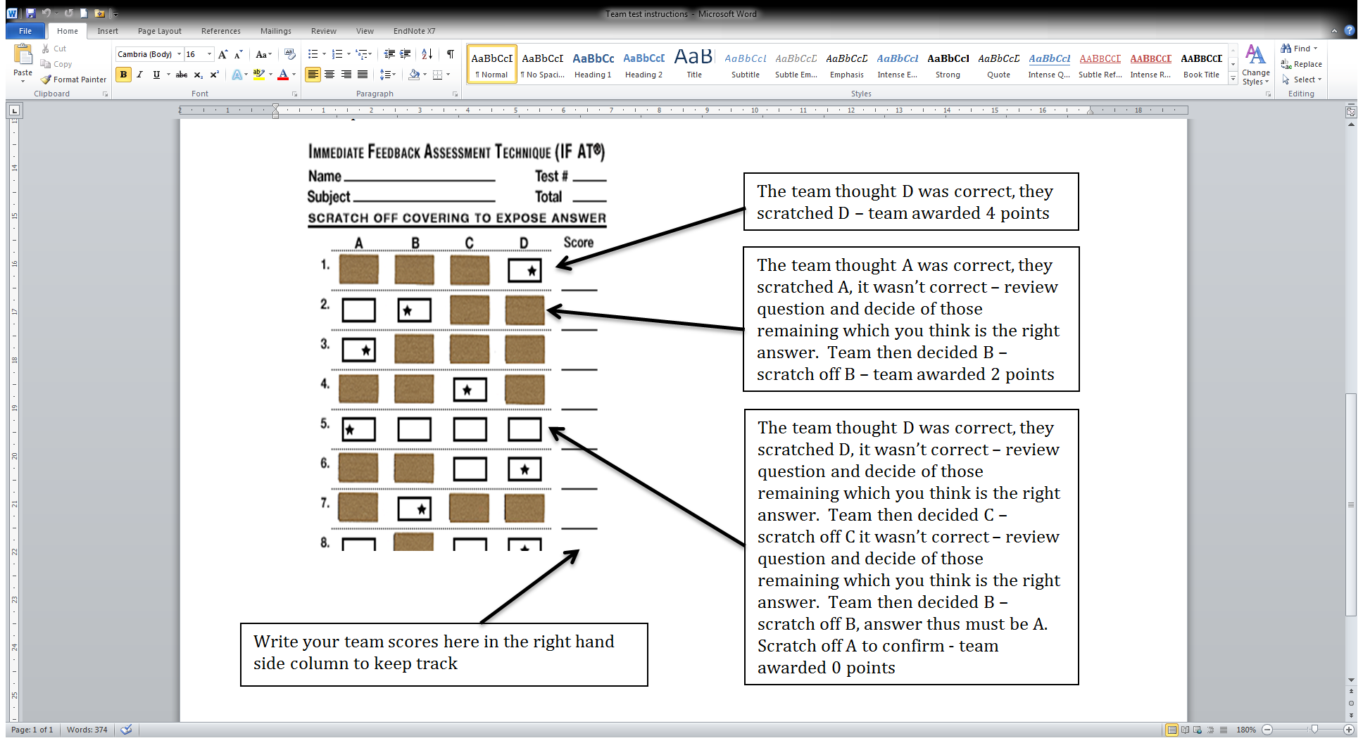
Discuss your answers as your team
Discuss your answers as a team – decide on a team answer.
Use the scratch card for your team answer.
Do not make a mistake, only scratch when you are sure, there are no second chances, scratch incorrectly and you loose the points.
Notes:
There are multiple versions of every form (I have 4)
Perforated tab on bottom can be removed, and via math – combinations, all groups had same questions but different sequence and difference answer sequence to adi secutity.
But I don’t let them keep the cards, just the quizzes (which should not have the version/key noted on it!)
You do have to keep an eye on them to make sure groups don’t cheat or share answers, but this has not been a big issue (most are competing with other groups)

Slide 19
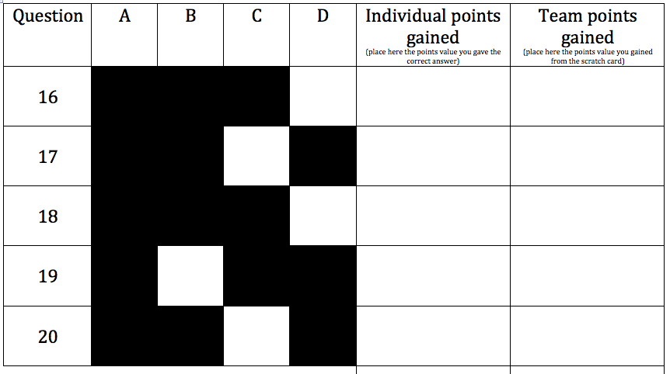
Reflections
Immediate feedback was achieved.

Slide 20
Reflections
Immediate feedback was achieved.
As the partial credit relied on honesty – able to review any “I’m not sure” patterns for the theme to enhance understanding, easy to identify in the individual marking.
Large student numbers – gives flexibility, prep time was more, but marking less.
Reliability.

Slide 21
A brief look at results
Have 56 teams’ data (teams usually 5-7).
In 5 of the 56, the top individual outperformed the team.
The average highest individuals mark 68.2%.
The average individual mark 51.2%.
The average team mark 77.9% so teams > by 9.7%.

