Slide 1
Embedding Open Access: an advocacy perspective
May 2016
Rachel Westerbeek
Open Access Support and Advocacy Officer

Slide 2
Embedding Open Access: an advocacy perspective
Context: Open Access at UCLan
What has worked so far?
Next steps

Slide 3
Open Scholarship Team at UCLan
Research Office
Open Scholarship Team
Repository Manager
Repository Administrator (vacant)
Research Data Manager
Open Access Advocates x 3
= 6.0 FTE

Slide 4
What are we Advocating?
Green Open Access route
‘Semi-mediated’ deposit process
Researchers upload publications/ data to our institutional repositories with the majority of the metadata

Slide 5
What are we Advocating?
Dependent on researcher engagement
Communication of what to do, how to do it, why, and what the benefits are
for researchers
for research communities
for the institution
Requires large-scale changes in culture and practice

Slide 6
Embedding Open Scholarship Culture and Practice at UCLan
Know your snakes
Identify your ladders

Slide 7
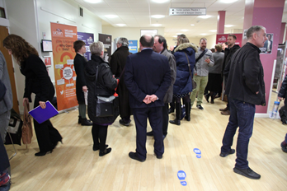
Embedding Open Scholarship Culture and Practice at UCLan – What’s Working?

Slide 8
No.1 Get Out There
Don’t wait for your ship to come to you, row out and meet it

Slide 9
No.1 Get Out There
Open Scholarship Roadshow:
Five days, six foyers, 200+ staff

Slide 10
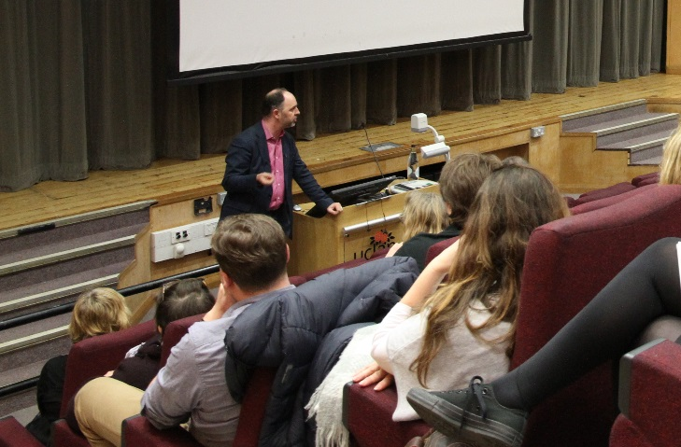
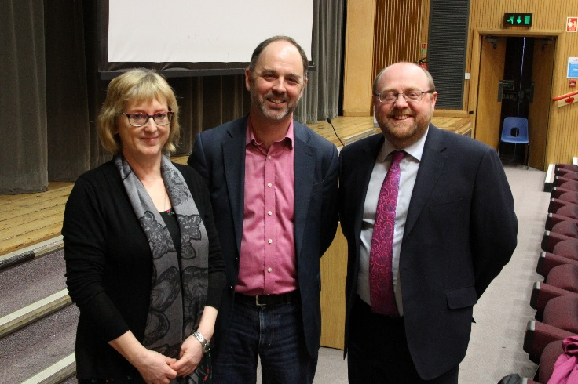
No.2 Value of External Speakers
A prophet is not always recognised in her own country
External speakers support your message

Slide 11
No.2 Value of External Speakers
Cameron Neylon
Why Open Access? Beyond the Who, What and How.
https://vls.uclan.ac.uk/Play/12538
@UCLanOpenAccess

Slide 12
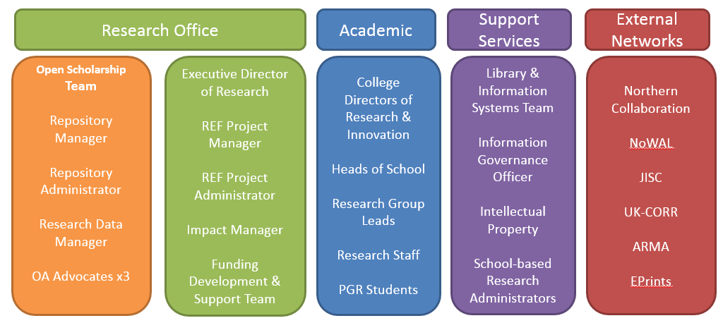
No.3 Discover Networks, Build Networks
Cultivate interest anywhere and everywhere you find it

Slide 13
No.3 Discover Networks, Build Networks
Champions, known networks, unknown networks
Research Office
Academic
Support Services
External Networks
Open Scholarship Team
Repository Manager
Repository
Administrator
Research Data Manager
OA Advocates x3
Executive Director of Research
REF Project Manager
Impact Manager
Funding Development & Support Team
Research Development & Support
College Directors of Research & Innovation
Heads of School
Research Group Leads
Research Staff
PGR Students
Library & Information Systems Team
Information Governance Officer
Intellectual Property
School-based Research Administrators
Northern Collaboration
NoWAL
JISC
UK-CORR
ARMA
EPrints

Slide 14
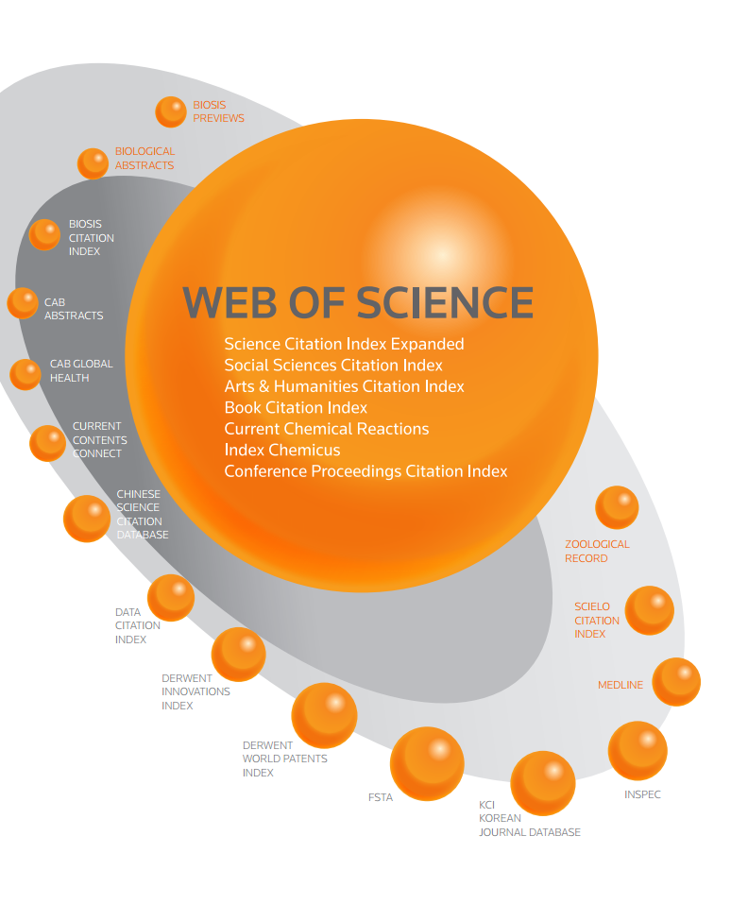
No.4 Sell the Benefits
Sell the benefits, don’t just focus on compliance

Slide 15
No.4 Sell the Benefits

Slide 16
No.5 Don’t Lose Sight of the ‘Why’
Don’t lose sight of the ‘Why’
Institution for the Diffusion of Useful Knowledge

Slide 17
No.5 Don’t Lose Sight of the ‘Why’
‘Why’ is a powerful advocacy tool
Institution for the Diffusion of Useful Knowledge, Preston
Notes:
The ‘why’ can be a powerful advocacy tool
The ‘why’ can help unstick a conversation that has been stalled by how’s and what’s and who’s

Slide 18
Next Steps
Reassess the baseline, take the temperature
Notes:
C

Slide 19
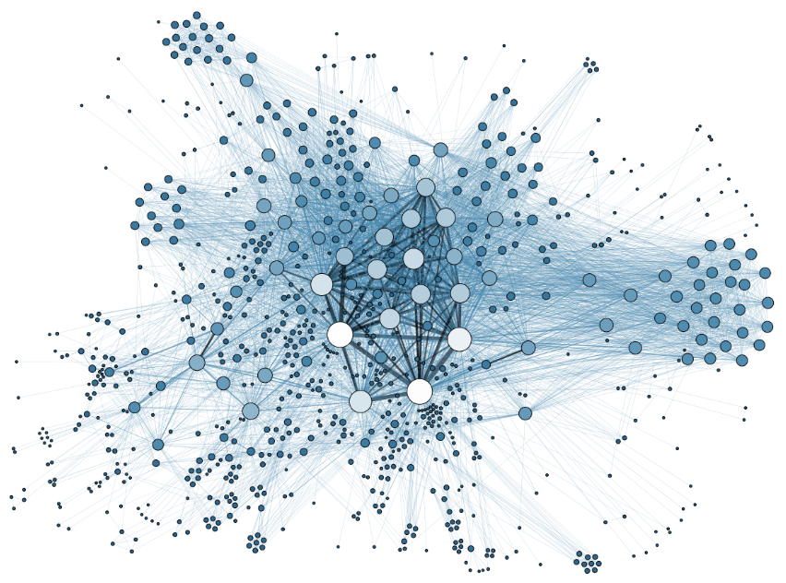
Next Steps
Build networks

Slide 20
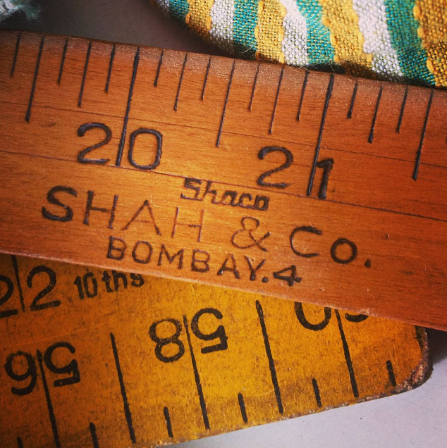
Next Steps
Measure the impact of advocacy activities, and do more of what works

Slide 21
Thank you
rwesterbeek@uclan.ac.uk
@UCLanOpenAccess
Institution for the Diffusion of Useful Knowledge, Preston

