Slide 1
Managing the dynamics of shame in breastfeeding support
Dawn Leeming
University of Huddersfield

Slide 2
Question:
What can we learn about supporting breastfeeding women from the literature on shame and shame management?

Slide 3
Shame - the invisible dynamic
Shame is a taboo in Western countries
(Scheff, 1995)

Slide 4
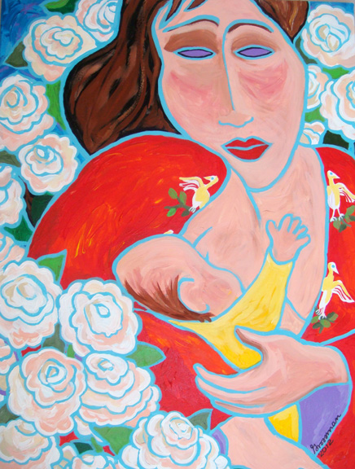
‘Shame if you do, Shame if you don’t’ (Thomson et al, 2015)
Breastfeeding:

Slide 5
When struggling is seen to represent failure or inadequacy…
I just cried and cried and cried ‘cos it was just such a big disappointment I felt like I had failed really, almost as a woman really, you feel like this is a natural thing, why can I not do this?… my baby would die if he was in a country where they didn’t have bottles
It [‘topping up’ with a bottle of formula milk] also made me feel very, um, just like a really crap mother, to be honest . . .I just felt that I couldn’t um, produce what she was needing . . . It just made me feel very inadequate.
Williamson et al (2012)
(See also e.g. Burns et al., 2010; Guyer et al., 2012; Mozingo et al., 2000; Shakespeare et al., 2004; Thomson et al., 2014)

Slide 6
Shame vs guilt:
Negative judgement of self vs negative judgement of behaviour:
‘I’m a bad mother & a failure as a woman’ (shame)
vs
‘I’m not trying hard enough at breastfeeding’ (guilt)
Flaws exposed before the other vs breaching own moral standards:
‘Everyone can see I’m a bad mother & a failure’ (shame)
vs
‘I’m doing something morally wrong by formula-feeding’ (guilt)

Slide 7
Guilt
Self (able)
Source of hurt
Intact and capable
Focus on own actions
Wrong doing
Putting it right
Other (unable)
Needful, hurt
Incapable
(Gilbert et.al,1994; Gilbert, 2003 - adapted from Lewis,1986)

Slide 8
Shame
Self (unable)
‘Bad’ self in focal awareness
Object of scorn, ridicule
Inferior, smaller, weaker
Involuntary body response (rage, blush..)
Functioning poorly (mind blank, desire to hide, paralysed, helpless..)
Other (able)
Source of scorn, ridicule
Laughing, rejecting
Superior, bigger, stronger
Adult & in control
(Gilbert et.al,1994; Gilbert, 2003 - adapted from Lewis,1986)

Slide 9
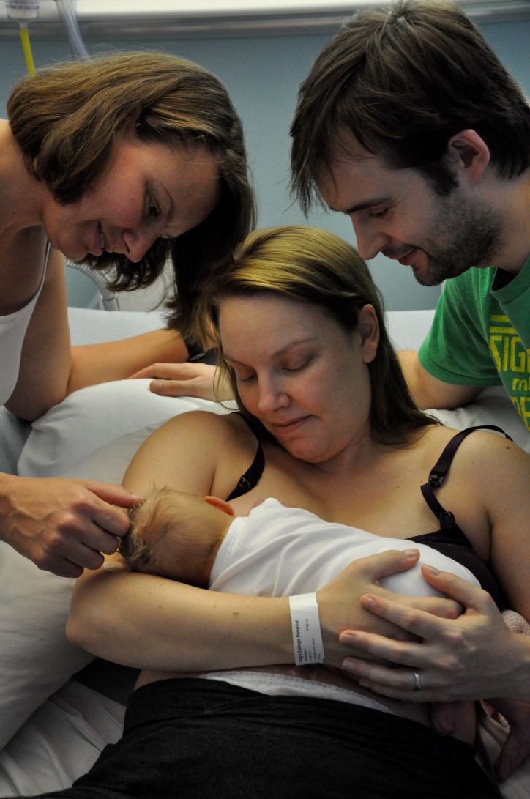
Shame and the expert gaze
“I didn’t well I didn’t want my baby screaming if nobody else’s baby was screaming I …didn’t want the nurses coming in all the time or the midwives thinking what’s wrong with her (.) she’s not managing very well.”
Leeming et al., 2013

Slide 10
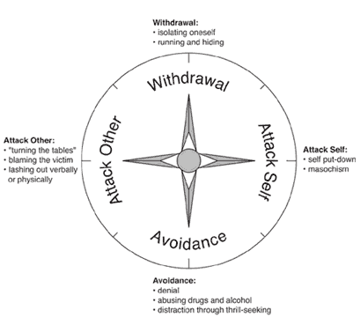
Responding to the threat of shame
Nathanson’s ‘Compass of Shame’:

Slide 11
Scheff & Retzinger: Mutual shaming cycles
1. Exposed as ‘inadequate’
2. Perceived disrespect / insult
7. Rage/attack
3. Humiliation
6. Humiliation
4. Rage/attack
5. Veiled insult

Slide 12
Resisting shame in breastfeeding promotion
Lift focus on responsibility of individual mothers to make healthy ‘choice’
Increase emphasis on challenging constraints on women’s right to breastfeed

Slide 13
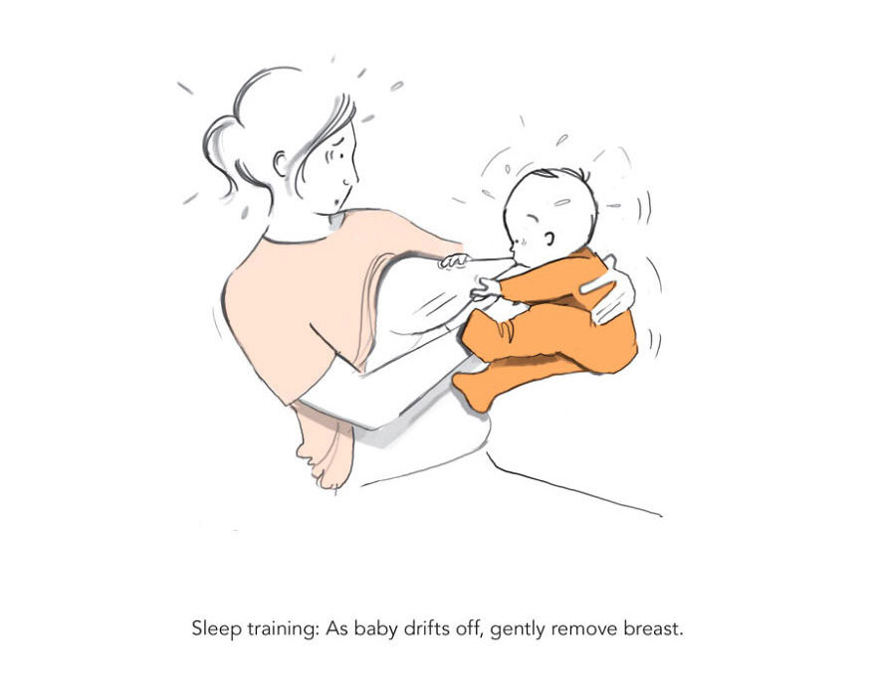
To normalise breastfeeding difficulties or not?
Art work credit: Lucy Scott/Running Press

Slide 14
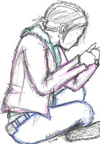
Shame resilience
Acceptance, validation, empathy
Connection
Articulating & acknowledging shame
Normalisation & contextualisation of experiences
Art work credit: Hero-in-shame, Deviantart.com
Rebuilding self
Empowerment
(Brown, 2006, 2008; Dayal, Weaver & Domene, 2015; Leeming & Boyle, 2013; van Vliet, 2008)

Slide 15
Shame resilience
“Shame needs three things to grow exponentially in our lives: secrecy, silence and judgement”
Brene Brown, 2013

