Slide 1
What students really think of their reading lists: reading list software at the University of Huddersfield
Alison Sharman
2015

Slide 2
MyReading The background
2008: Library received reading lists for only 40% of modules
Many lists contained out of date or inaccurate information
Manual processes for reading list management were laborious and outdated
A systematic, automated approach was required

Slide 3
MyReading, an in-house system
Developed in-house & is fully integrated with Uni systems
To ensure the provision of reading lists is a managed, positive experience for staff and students
MyReading launched summer 2011
Academics create and maintain their own lists

Slide 4
Chart showing MyReading use from Jan 2012 – April 2015
Notes:
We were able to gather statistics on MyReading usage; we define usage as the number of times a list is accessed and how many times items in the lists are clicked on.

Slide 5
Evaluate
Evaluation phase in 2015: need to evaluate MyReading in terms of impact on student experience and usability
Next steps for development – what do students really want from their reading lists?

Slide 6
Building an even bigger picture
Survey to gather data on students use of MyReading
Survey ran for 4 weeks
Embedded into MyReading software
Prize draw to incentivise students to complete it
https://www.flickr.com/photos/kodamapixel/5656712570/

Slide 7
772 Questionnaire Responses

Slide 8
Split between Schools
University School | Percentage
Applied Sciences | 9.8%
Art, Design and Architecture | 4.4%
Business | 25.6%
Computing and Engineering | 1.7%
Education and Professional Development | 9.6%
Human and Health Sciences | 28.6%
Music, Humanities and Media | 20.3%

Slide 9
Frequency of use
Notes:
Couple of headline facts

Slide 10
Usefulness of lists

Slide 11
Students asked to qualify their answer and say how MyReading could be improved
Notes:
8 main themes

Slide 12
1. Students found the lists helpful
I find the reading lists useful because they help me identify and narrow down the specific areas I need to study to better grasp information and complete my assignments
I find that some lectures provide the bones of a particular subject, the reading list provides the context for subject areas
Notes:
Help them understand lectures and put the subject into context

Slide 13
Students like to use lists as a starting point for research
Fabulous starting point by people who have done wide ranging preliminary research

Slide 14
3. Ease of use/saves time
It allows me to easily find all relevant books in one place that are specific to my course and recommended by my tutor. It saves time and ensures I'm not reading irrelevant material.

Slide 15
4. Quality of the lists
I am getting expert advice from my lecturers about relevant reading material
Notes:
Students also valued the reading lists because the items were picked by their tutor which effectively gave the reading lists a seal of quality.

Slide 16
Different categories provided by the software
I like the fact they are split into essential reading and recommended so I can target essential texts first.
Make them all like the Extraordinary Gentlemen reading list (as seen above) - organising the list by week makes everything 100 times easier!
Notes:
The fifth theme covered different categories available in the software and this is a feature that the students found very useful. Comments were subdivided into two sections: 1. the division of some reading lists into weekly reading. 2. Some students appreciated the essential, recommended, background sections.

Slide 17
Students used the lists as a basis for further reading
They allow you to read further into the subjects you have covered in lectures and seminars. They also help in my academic research for essays.
Notes:
However, there were no comments regarding wider reading outs of that recommended in the reading lists themselves.

Slide 18
What students would really like to see their lecturers do

Slide 19
Reduce the length of lists!
I sometimes feel like they are revisited to be added to, but are rarely pruned back. As a result there are an overwhelming amount of suggested texts, some of which might have been suggested years ago for a really particular reason.
Notes:
Picked out the main themes

Slide 20
Make them well-structured and annotated
Probably using more headings and adding a little description about the book on the page. Having tutors write a small summary of what we will be using a particular item for would be really useful for organisation.

Slide 21
Maintain and update the lists
Some of the books on the reading list seem to be either a bit dated, or standard texts. There is nothing specific and directed for certain lectures or areas of interest. They should be regularly maintained.

Slide 22
Include more than books…
Reading lists made up entirely or even mostly of basic textbooks are very unhelpful… Even though there can be value in reading the same thing explained or described in different ways from different perspectives that doesn't change that the opportunity cost is too large compared to just a few textbooks and a good list of focused research papers.

Slide 23
Improve and enhance the software
27% of respondents thought improvements could be made
Design and structure of the software: needs updating; colour coding; use of book covers; topic tags
Better functionality: e.g. access through an app that you could download to a phone; email alerts
Location: Link from the student portal; University App
Notes:
Colour scheme to highlight essential, recommended and background reading items

Slide 24
What have we done since?
Promoted changes staff can make at various university events
Created a leaflet
Added a link from the student portal

Slide 25
Notes:
Produced a leaflet for staff. Highlighted the winning reading lists for each School complete with a URL for staff to get inspiration for the design of their lists./
You’ll notice too that we have used the same graphics.

Slide 26
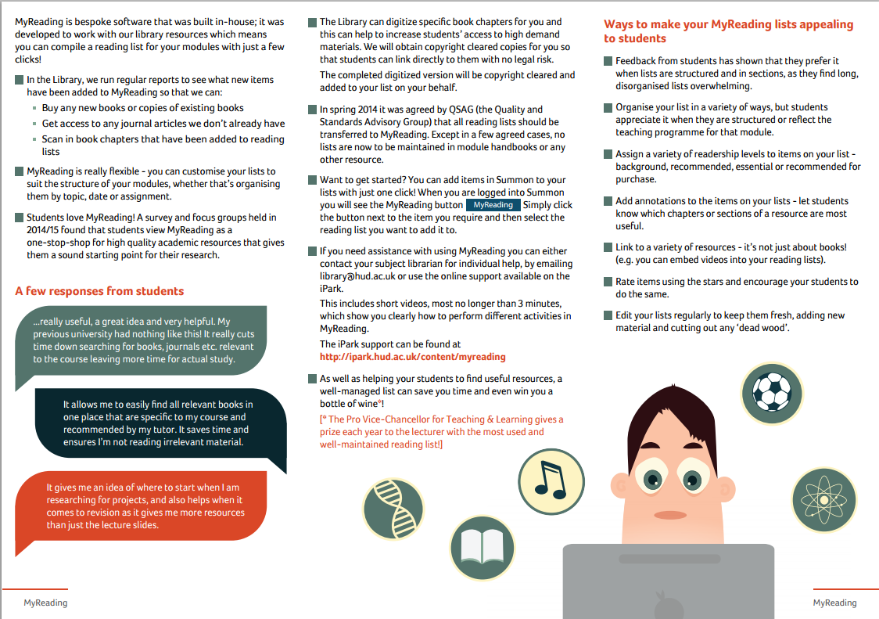

Slide 27
New Business School Post
Reading List and Collection Development Librarian in post
Funded by the Business School
Started with Economics as a pilot, will then roll out to other subjects

Slide 28
Any questions?

