Slide 1
Photo by kennymatic - Creative Commons Attribution License http://www.flickr.com/photos/99472898@N00
Created with Haiku Deck
Notes:
A little bit about myself: I'm a librarian, worked in public and academic libraries for the last 17 years ish in various guises. Currently I work at the University of Huddersfield supporting nursing students. I have ended up taking a track in my career that wasn't anything planned, but has led to discovering interests in research I wasn't aware existed when I went to library school...

Slide 2
Photo by garryknight - Creative Commons Attribution-ShareAlike License http://www.flickr.com/photos/8176740@N05
Created with Haiku Deck
Notes:
Let me tell you a story! Not long after I graduated from library school, Huddersfield's Teaching and Learning Institute called for applications to fund small projects, and having just completed some refurbishments in the library, the member of staff leading the changes won a bid for money for post-occupancy evaluation of library use. I applied to be research assistant for the project and was appointed. I had some interest already in investigating how students use academic libraries, and a lot of staff, me included, had been speculating about what kind of impact the design changes might have on use. We had less than a year to collect data and report on the findings

Slide 3
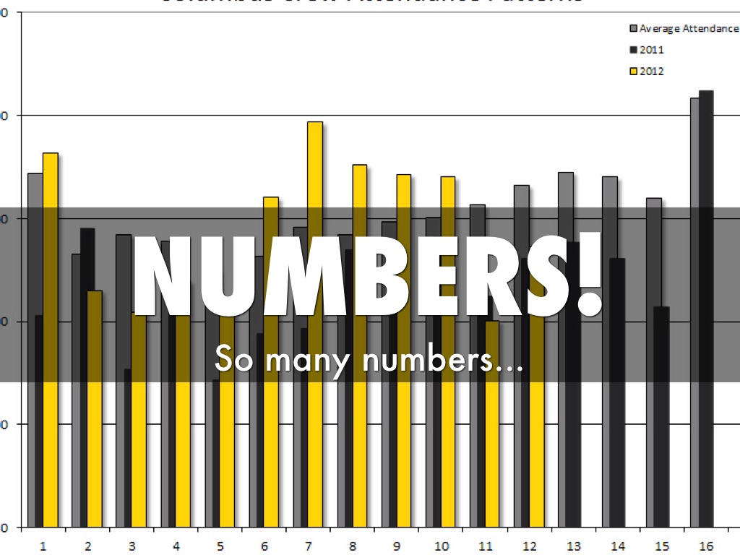
Photo by Bernhardt Soccer - Creative Commons Attribution-ShareAlike License http://www.flickr.com/photos/64500102@N05
Created with Haiku Deck
Notes:
I set about running a literature review to find appropriate methods of data collection, and found early reports in Educause by Aimee Whiteside on work at the University of Minnesota, she kindly sent me the final report once it was finished! Aimee's work used the seminal piece of work by Foster and Gibbons on undergrad students to inform methods. Foster and Gibbons conducted a huge qualitative study (but more on that later). I got excited when I started reading about photo logs, and the references she used referring to ethnographic methods really caught my imagination. I compiled a list incorporating the qualitative methods involving students in things like design workshops (where they create their ideal library space), but in the end due to the limitations of time scale and staff availability the project leader selected methods that primarily collected quantitative data. Used seat counts which were run over a month 4 times each day on each 4 floors (comprising around 4-8 separate areas), and simple exit surveys. The qualitative elements were based around ad hoc observations from staff and one rather problematic diary of use method from one group of students. We relied on a member of academic staff to distribute diaries with the request to complete them and to provide USB sticks that the students could keep, with the proviso that they supply photos of their favourite study space in the library. However, the staff member didn't follow the negotiated instructions when distributing the kit, and we only received a handful of diaries. In the end we had a LOT of numbers and not very much qualitative data...

Slide 4
Photo by play4smee - Creative Commons Attribution-NonCommercial License http://www.flickr.com/photos/91661522@N00
Created with Haiku Deck
Notes:
HOWEVER, we decided to run some opportunistic sampling that led to interesting data. A colleague and I went around randomly selecting students in the library to ask if they’d answer a couple of questions about the purpose of their visit. While the answers were interesting in themselves, what was really intriguing was how what they said they were doing didn't match what we could see! It really caught our interest, but to learn more was outside the size and timescale of the project. Once the project was complete, I was given the opportunity to undertake a PhD, and I knew exactly what I wanted to do...

Slide 5
Photo by RLHyde - Creative Commons Attribution-ShareAlike License http://www.flickr.com/photos/36655009@N05
Created with Haiku Deck
Notes:
I wanted to move well away from the numbers. Universities are too interested in quantitative data, and I personally feel that there’s too much emphasis placed on things like results from the NSS when it doesn’t tell academic libraries enough about what’s right or wrong in them, and you catch someone on a bad day, they’ll give a negative response. So having seen such interesting data in the opportunistic sampling, I chose to conduct research using ethnographic methods. RESEARCH AIMS - investigate use of academic libraries and whether use matches design intention - examine how students relate to each other and staff

Slide 6
Photo by WA State Library - Creative Commons Attribution-NonCommercial License https://www.flickr.com/photos/28920380@N06
Created with Haiku Deck
Notes:
Ethnography originates from anthropology, and is used to study cultural groups. It's meant to represent the voices of the group members, but also to be reflexive, and to make a contribution to the understanding of that cultural group. The key terms here are understanding and representing. Ethnography is meant not to change how people behave but to learn from them. Often it isn't meant to do any more than that, but in libraries, if we use ethnographic based methods, we can use them to ask the right kind of questions of libraries, change what we do to support the way people work. For us, it's about improving user experience, if we can. It can also be approached from a critical perspective, looking at power relations or under-represented groups, something that is becoming increasingly common in library ethnography (see Penny Andrews' contribution to the Priestner/Borg edited User Experience In Libraries, due out in 2016, in particular)

Slide 7
Photo by askpang - Creative Commons Attribution-NonCommercial-ShareAlike License https://www.flickr.com/photos/52015062@N00
Created with Haiku Deck
Notes:
You can use ethnographic methods for learning about all kinds of library use. My own research is based around library space use, partially mirroring and heavily influenced by that of key library ethnographers/anthropologists like Donna Lanclos, Andrew Asher, and Nancy Fried Foster. They've also used ethnography to help redesign service provision and library/university websites, and to learn about research processes from both academics and students. Moving beyond the library itself, there are studies into information seeking behaviour that can help inform serials provision, interface selection, and training content, and currently examining Open Access. Sometimes observation of the process of seeking out information is used to learn about these, but a particularly important technique is to utilise interviewing techniques to gather opinion, thoughts and worries about resources, changes to publishing requirements, demands from the REF. Interviewing can draw out voices that would otherwise sometimes be afraid to speak.

Slide 8
Photo by Novowyr - Creative Commons Attribution-NonCommercial-ShareAlike License https://www.flickr.com/photos/62602097@N00
Created with Haiku Deck
Notes:
There's a few ways of collecting data. The main one that most people think of when they think of ethnography and anthropology is observation. You can learn a huge amount via observation, especially in libraries. Obviously observations need to be conducted ethically, but they are incredibly revealing. There are all kinds of study/user actions that happen unconsciously, that library visitors can't tell you about because they don't know they happen. Observations will tell you about the unknown, the unconscious actions. A second key method is the interview. Interviews in ethnography are much more in-depth than the ones you might be familiar with and seek out rich, deep qualitative data. They are usually semi-structured or unstructured, so you don't have questions so much as pointers and prompts for discussion. Ethnographic interviews are about allowing the participant to talk openly, tell their stories, which may answer some of your research questions, but also lead to more questions... There are many more methods you can utilise: you can find out about these by looking at the further reading list at the end of the presentation.

Slide 9
Photo by tantek - Creative Commons Attribution-NonCommercial License http://www.flickr.com/photos/39039882@N00
Created with Haiku Deck
Notes:
Time and money. It isn't expensive in itself, but because of the amount of staff time, involved it can cost money. Ideally you would appoint an anthropologist to conduct the research as it can be quite nuanced and require a careful, experienced eye. It is also very intensive, so if you don't have a formal role for it, it's probably on your own time and costs... You need support from management - doing it as a PhD is great as I'm basically giving my time and data to participating institutions for free! But in working practice it can potentially be more difficult to get that support if it isn't part of your job. It is context specific, so you can't assume the data is always generalisable to all users at all times. But this can be an issue with any data! Once you pass data and analysis on, you can't guarantee it will be used or that recommendations will be followed up. Data can also tell you things you don't want to hear.. However, lots of this applies to any kind of data collection!

Slide 10
Photo by giulia.forsythe - Creative Commons Attribution-NonCommercial-ShareAlike License http://www.flickr.com/photos/59217476@N00
Created with Haiku Deck
Notes:
Benefits are extensive. The depth of data collection is huge - you can't get the same quality of data without it. As suggested earlier you learn more about hidden or sub/unconscious behaviours and actions. Sometimes when speaking to people you get them saying that they do something in a particular way, but they take some things for granted and observation leads to more information actors can't or won't articulate. While it might cost money in staff time, it can help institutions to create spaces both physical and virtual that match use, inform policy, and are supportive of a variety of people. As a result, it can actually save money in the long term that would have been spent on making expensive stuff that doesn't work! Staff can gain a better understanding of their patrons, and can support them better. You can use this to help bridge any library anxiety issues - students feel more comfortable in the environments we provide for them.

Slide 11
Photo by MyLifeThroughPhotography - Creative Commons Attribution-NonCommercial-ShareAlike License http://www.flickr.com/photos/65972251@N03
Created with Haiku Deck
Notes:
Ethnography is problematic but ace, utilising in depth methods to gain understanding of the cultures you research. It's important to try and obtain this kind of data to get the bigger picture and provide the best we can for our visitors.

Slide 12
Photo by dullhunk - Creative Commons Attribution License http://www.flickr.com/photos/14829735@N00
Created with Haiku Deck

Slide 13
Further reading
Antonijević, S. & Cahoy, E. S.(2014). Personal Library Curation: An Ethnographic Study of Scholars’ Information Practices. portal: Libraries and the Academy 14(2), 287-306
Connaway, L. S., Hood, E. M., Lanclos, D., White, D., & Le Cornu, A. (2013). User-centered decision making: a new model for developing academic library services and systems. IFLA journal, 39(1), 20-29.
Foster, N. F., & Gibbons, S. L. (Eds.). (2007). Studying students: The undergraduate research project at the University of Rochester. Assoc of Cllge & Rsrch Libr.
Kelty, C. M., Fischer, M. M., Golub, A., Jackson, J. B., Christen, K., Brown, M. F., & Boellstorff, T. (2008). Anthropology of/in circulation: The future of open access and scholarly societies. Cultural Anthropology, 23(3), 559-588.
Xia, J. (2011). "An anthropological emic‐etic perspective on open access practices", Journal of Documentation, 67(1), 75-94
Websites
Donna Lanclos: http://www.donnalanclos.com/
ERIAL project: http://www.erialproject.org/

