Slide 1
Postgraduate Education case Study – Cross disciplinary Approaches to Live Briefs Dr Karen Shah Senior Lecturer Historical and Theoretical Studies
Case study:
Fair Trade project - MA Art and Design

Slide 2
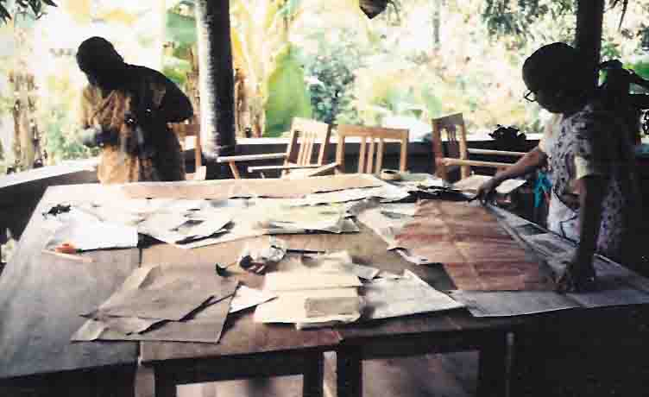
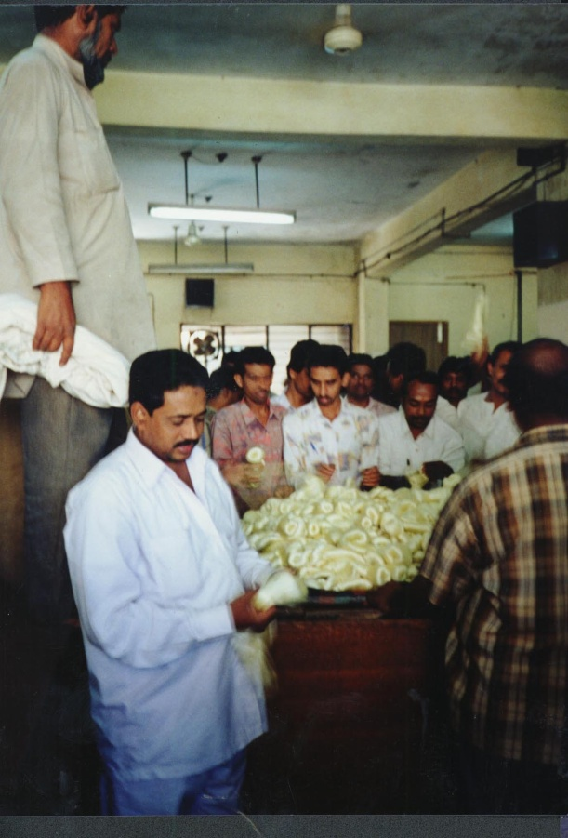
Investigation into:
Production processes
Technology transfer
Poverty alleviation
Income generation
……ECO DESIGN…….ETHICAL PRODUCTION ……SUSTAINABILITY…..FAIR TRADE…….

Slide 3
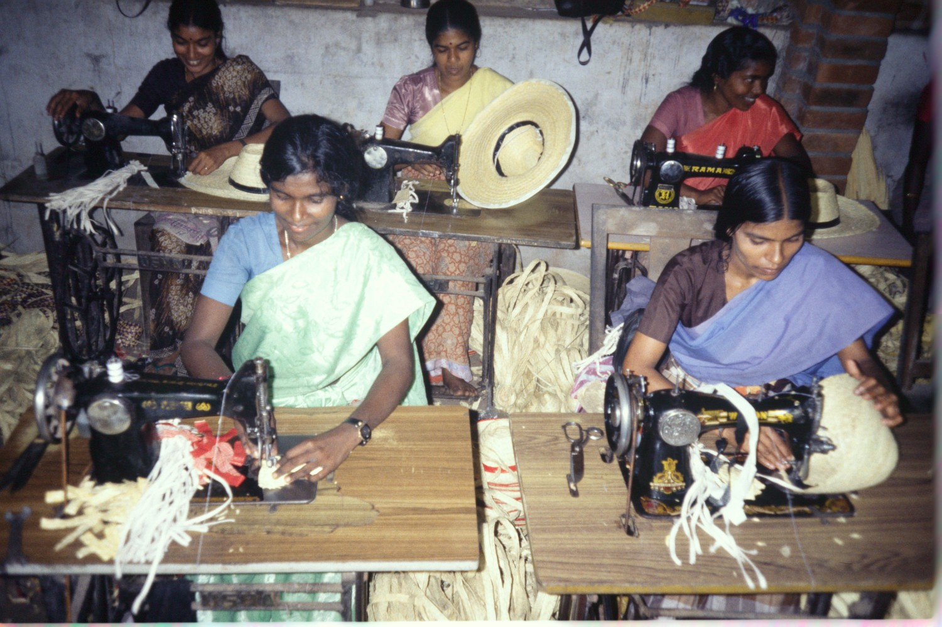

Slide 4
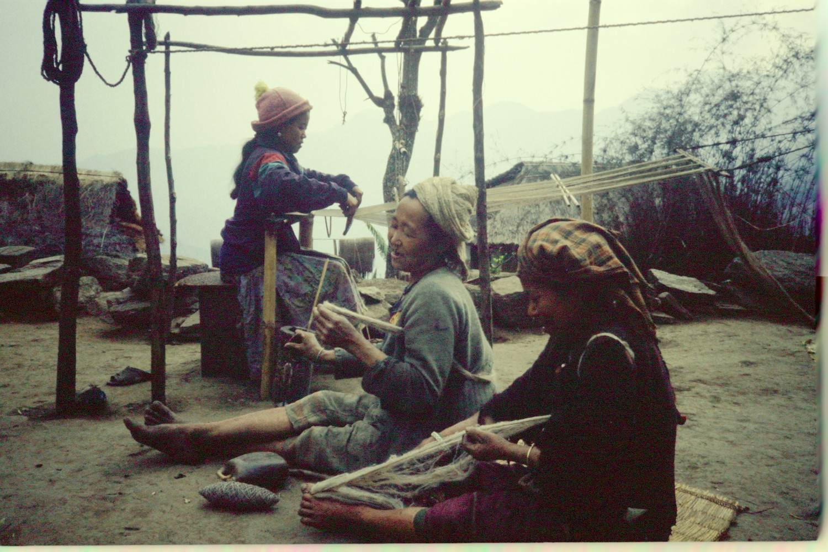

Slide 5
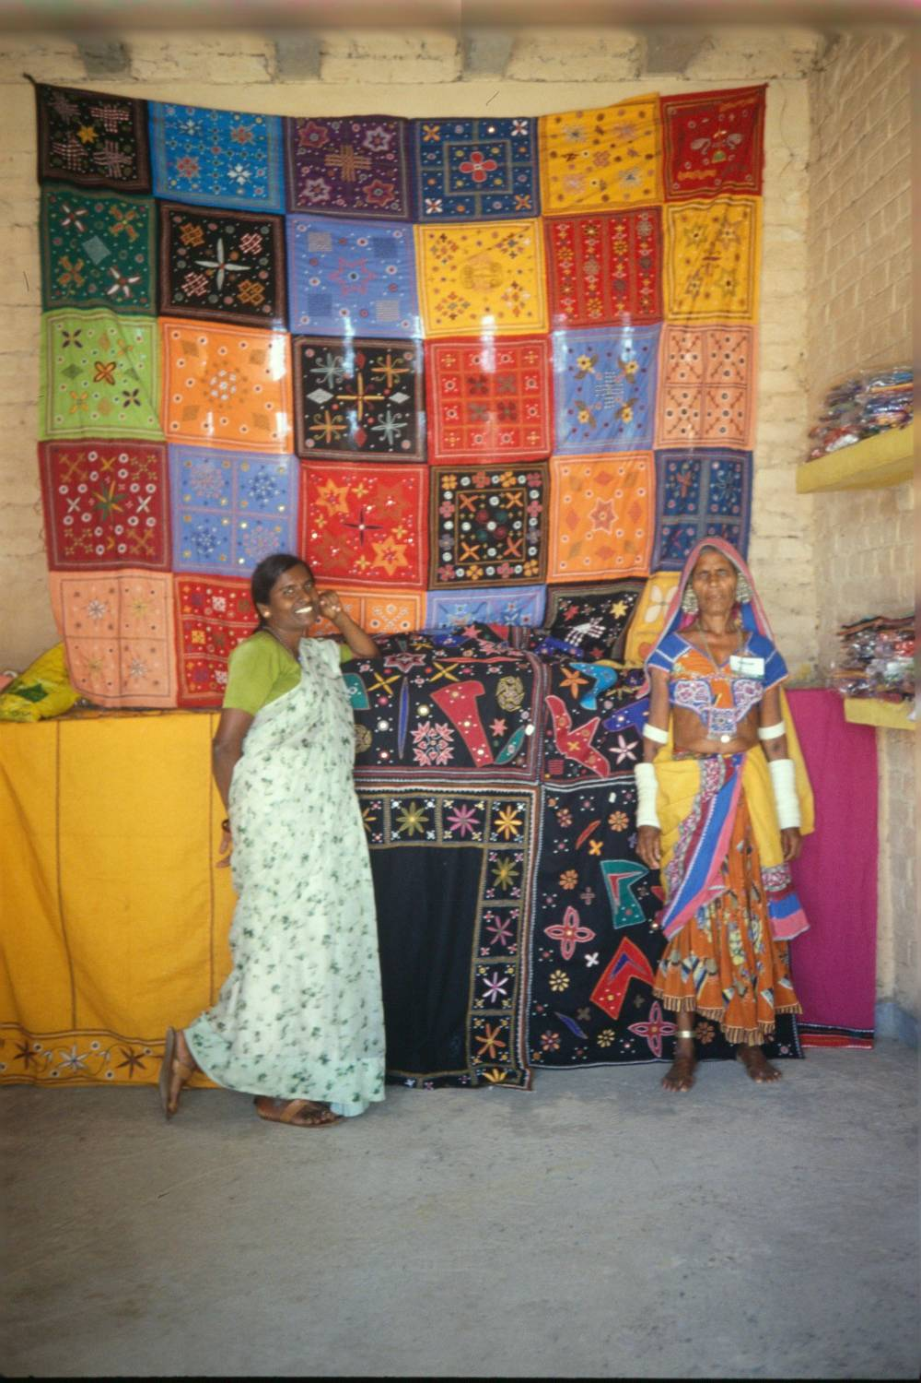
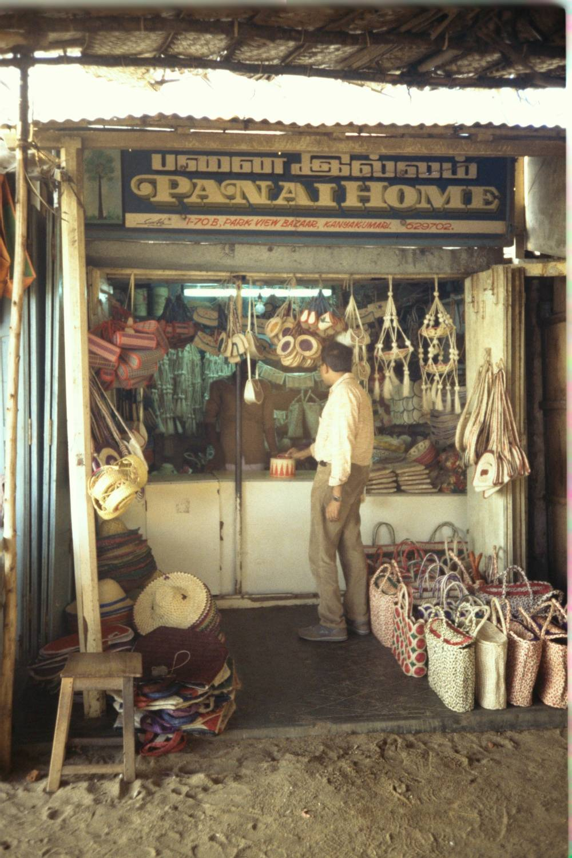
OXFAM Fair - Delhi
Nettle producer Co-op - Nepal

Slide 6
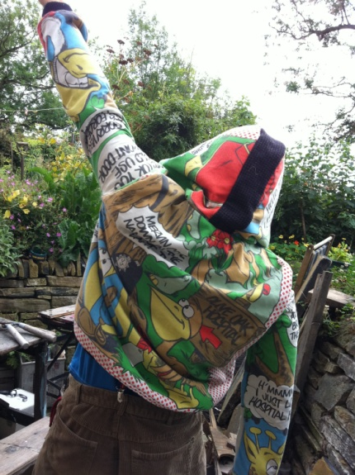
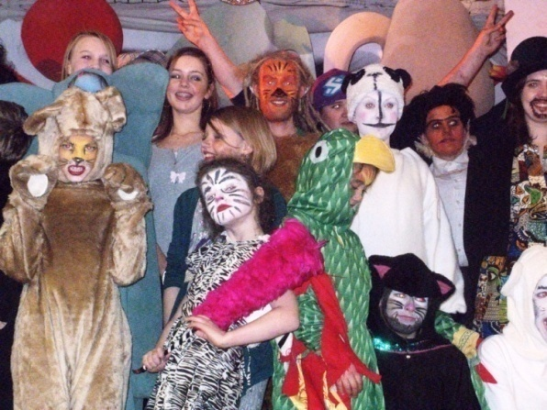
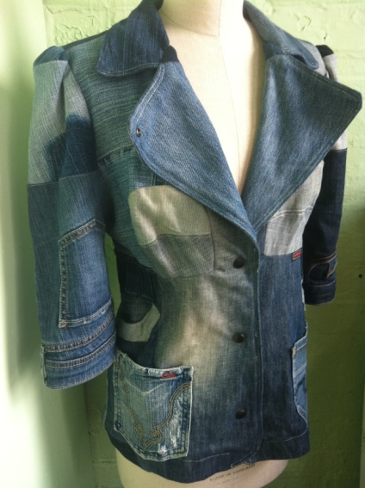
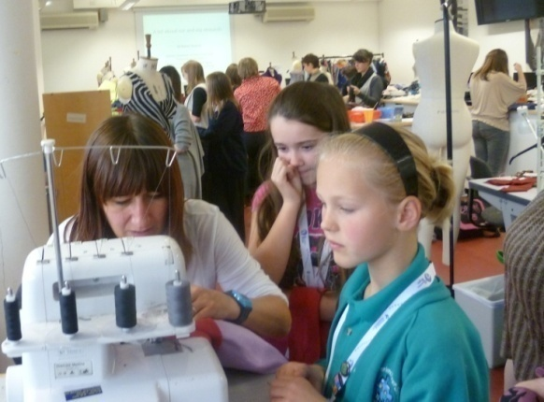
Until a designer honestly confronts the reality of his or her own work in order to determine whether and how it contributes to the ruination of the planet there is little incentive to change. Until now, the design discourse has too easily supported a rhetoric of idealism that is at odds with the reality of daily practice.
(Margolin, 1998, p. 89)
Margolin, V., 1998, Design for a Sustainable World, Design Issues, Vol.14, No.2, pp.83-92

Slide 7
Community Design in Practice

Slide 8
Anti- shopping shopping

Slide 9
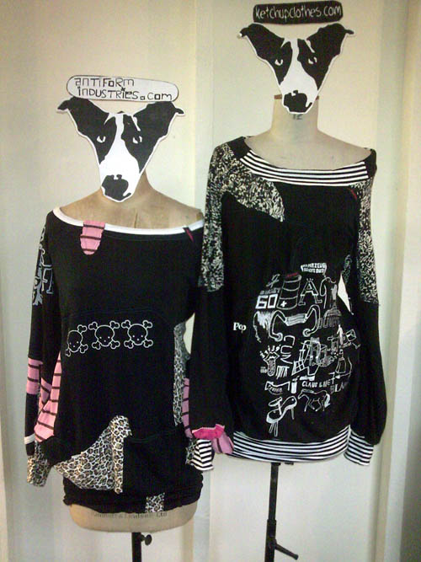
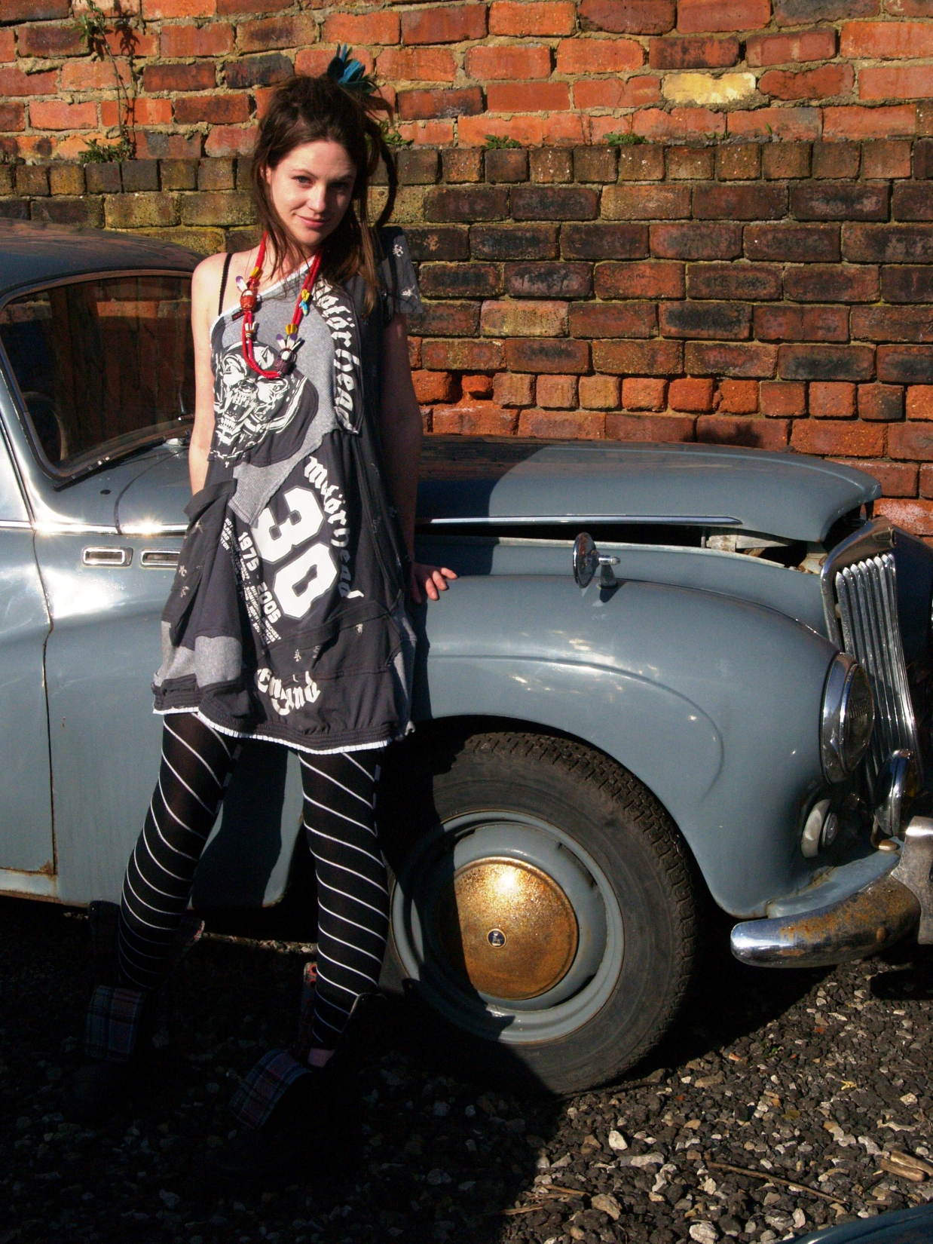

Slide 10
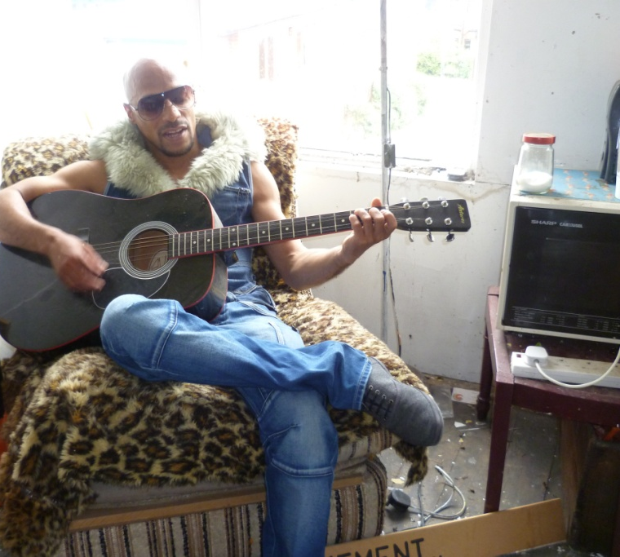
Global Denim Project Sophie Woodward Exploration of materiality Working with discarded garments – why throwing away, life stories behind garments Looked at life cycle of material and ways of extending use and attachment

Slide 11
Creativity in Context
Mixed cohort – MA Art and Design
Graphic Design
Product Design
International Fashion Design,
Marketing, Management, Communication
Fine Art
Textiles
Notes:
Introduce ourselves. Explain what is in the pack. Housekeeping. Show the timetable. Name tags.

Slide 12
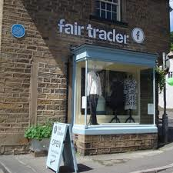
http://www.youtube.com/watch?v=Ovg88fTgt98#t=13
http://www.thefairtraderscooperative.co.uk/

Slide 13
Thoughts on Fairtrade
http://carinazhou.blogspot.co.uk/2013/04/exhibition-of-fair-trade.html
http://beverleywhittaker.wordpress.com/
http://rateenanta.wordpress.com/
http://zhangmengyi.blogspot.co.uk/2013/05/a-report-of-fair-trade.html
http://wangaina.tumblr.com/

Slide 14
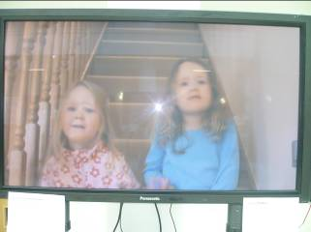
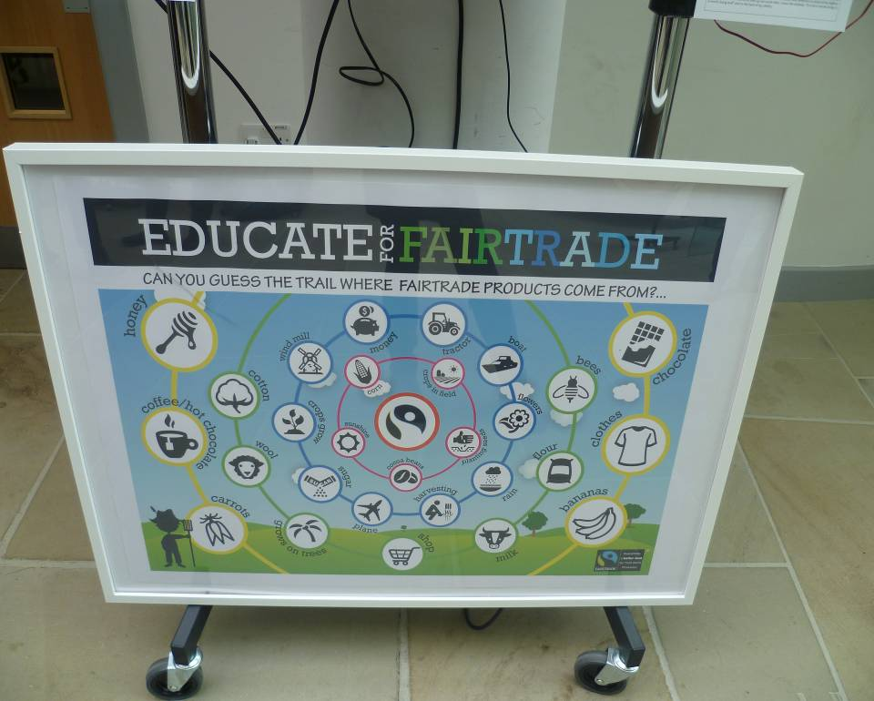
http://www.youtube.com/watch?v=jZuhqSIpsGk

Slide 15
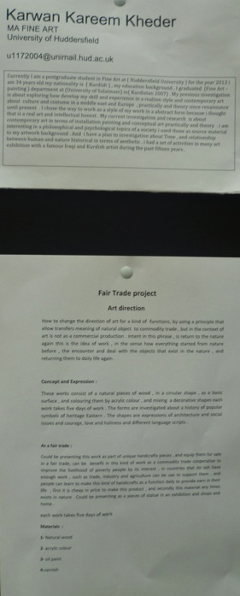

Slide 16
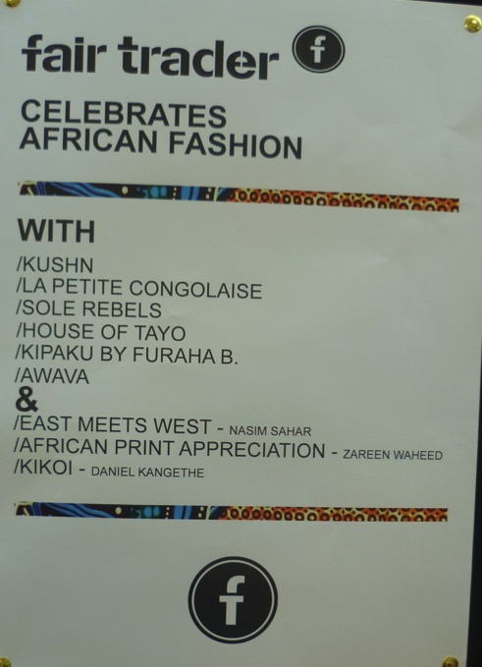

Slide 17
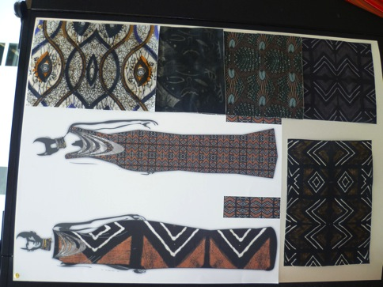

Slide 18
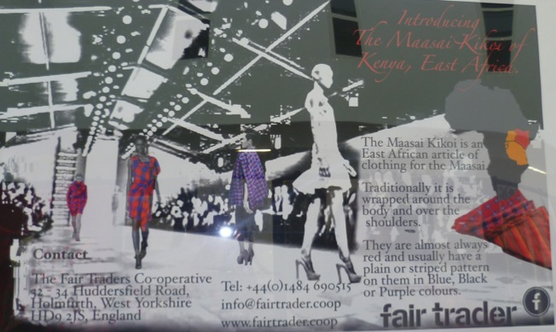
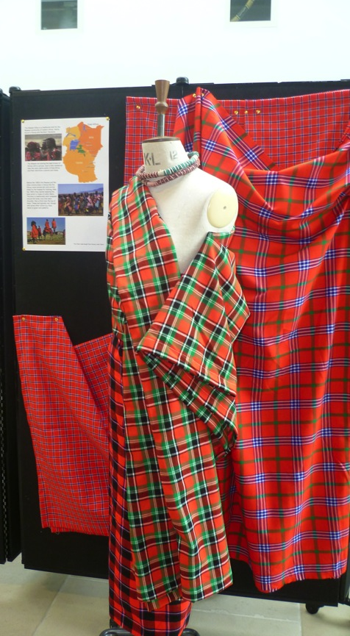

Slide 19
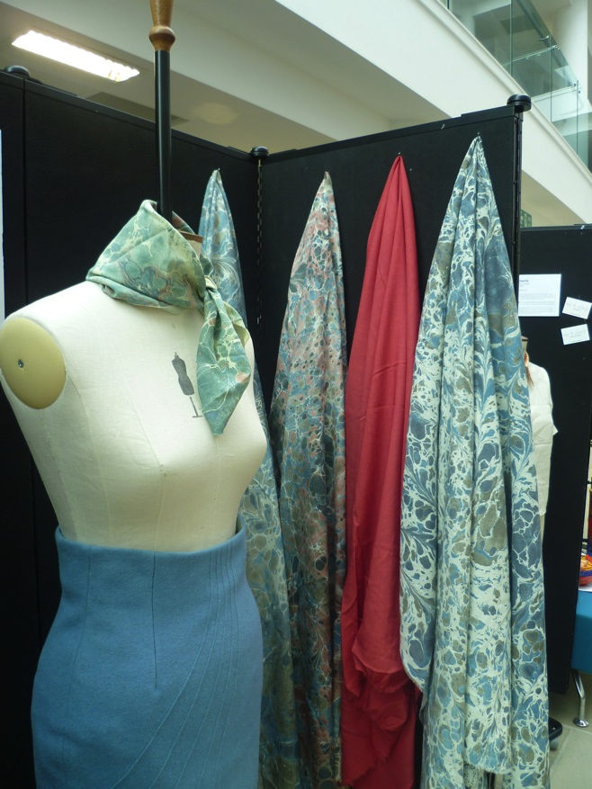
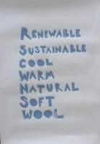

Slide 20
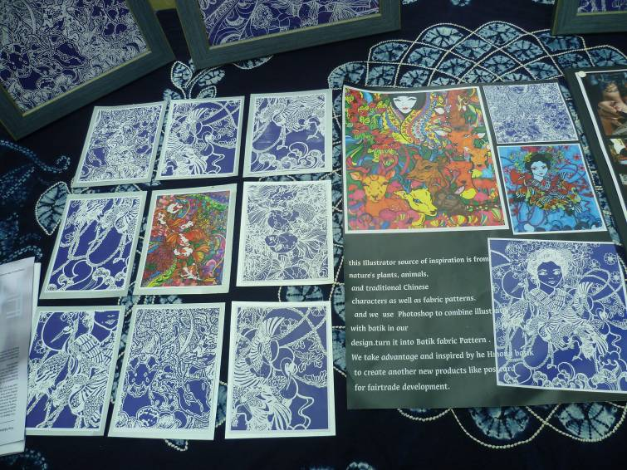

Slide 22
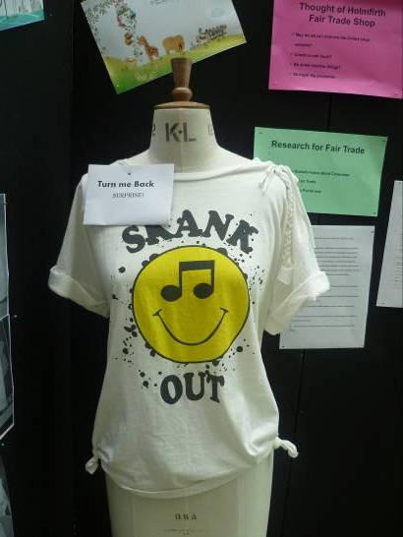
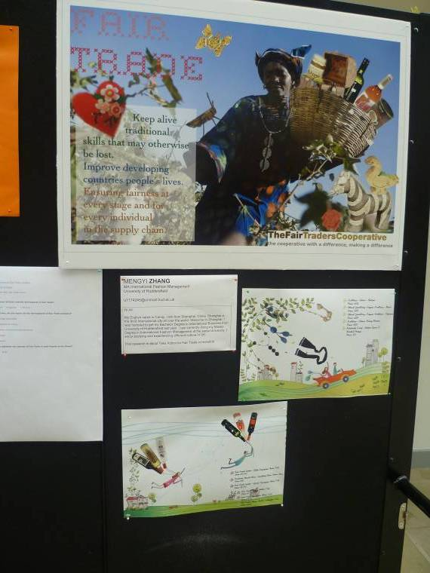
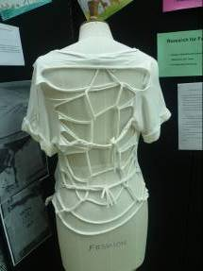
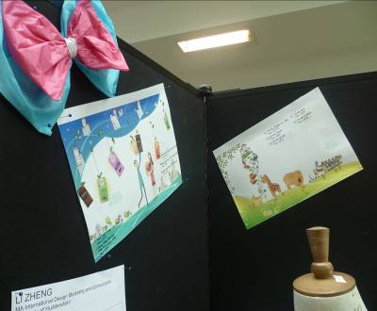
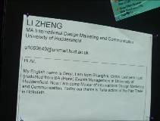

Slide 23
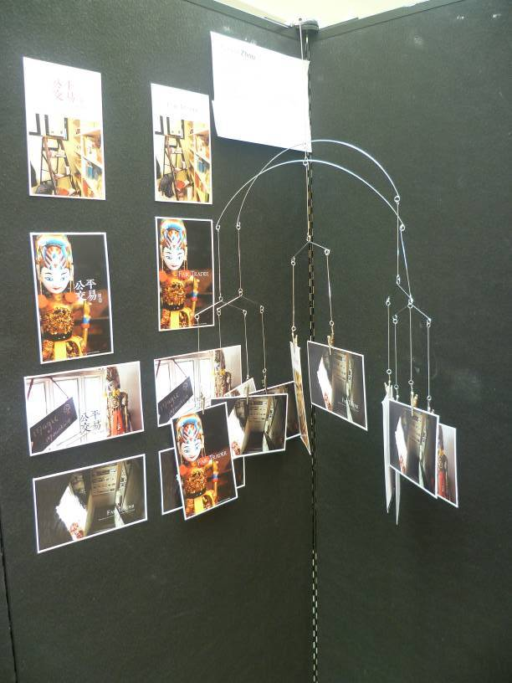

Slide 24
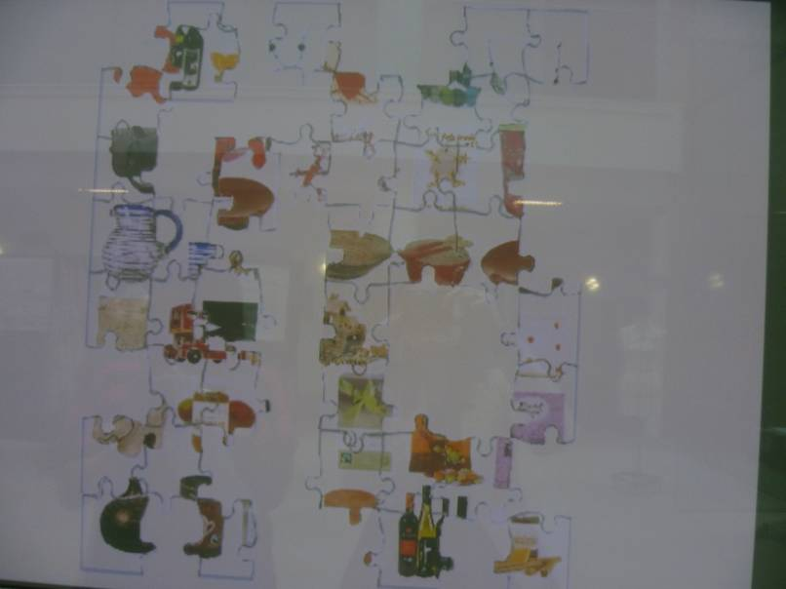
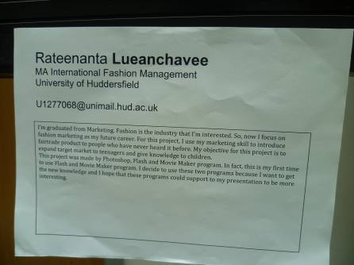
http://www.youtube.com/watch?v=9DLOdbyItXQ

Slide 25
Student responses
http://irgmediacreations.com/
http://www.youtube.com/watch?v=D9y1CsqEa5U
http://www.youtube.com/watch?v=9DLOdbyItXQ
http://www.youtube.com/watch?v=NqUjQXo3wQY&feature=youtu.be

Slide 26
I’ve learnt many things from exhibition day. First of all, I know more about fair-trade such as products and materials. Moreover, I’ve seen other ways of presentation. I saw other works and the methods that they presented, for example post card, poster and catalogue. In addition, some group of people, they showed the product that made by themselves. Fairtrade also influences my future career. As fashion marketing is my dream career, I will consider the fairtrade when I do the marketing. I can help promote fairtrade by focusing on the fairtrade material and people who originally made the raw supply.

Slide 27
Personally I thought the atmosphere was really thriving throughout the exhibition set up, there was a lot of enthusiasm for each other’s work and it felt like it was a personal unveiling for everyone, mainly because we hadn’t seen each other’s work till now.

Slide 28
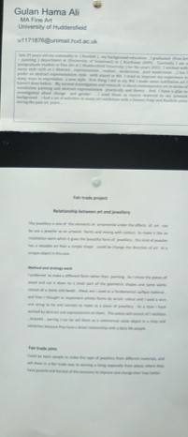

Slide 29
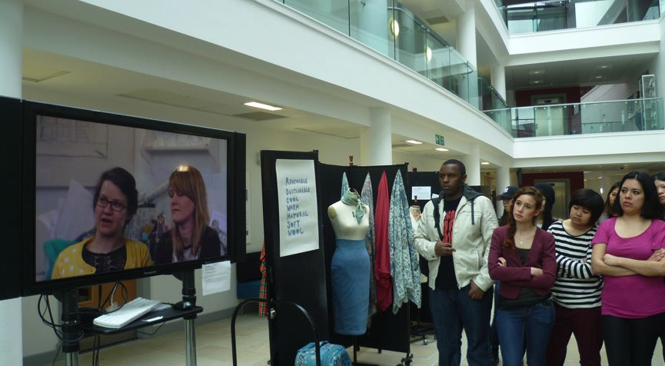
http://www.youtube.com/watch?feature=player_embedded&v=NVdyqOo-lJw

Slide 30
Reflections on collaboration and exhibition
Diversity in quality of work and engagement
Danger of ‘project’ driven work
Tension and friction in organising of exhibition – some much more proactive than others
Nerves and anticipation
Full school involvement to make the experience more real.
Value of seeing work alongside peers

Slide 31
Reflections on effectiveness
Ideals – tutor, student, client
Facts (vs fiction) – the research process
Ideas – culminated in a variety of responses
Actions – limited due to project nature of brief but hope will feed into future work.
(Brown, 2010)

