Slide 1
Transitional Support online maths bridging course
Rukhsana Rahim Din

Slide 2
Contents
Transition
Summer Maths Bridging Course
Approach
Preliminary feedback
Next steps

Slide 3
Transition to Higher Education
lack of ‘preparedness’ for learning in higher education (Ozga and Sukhnandan, 1998; Haggis and Pouget, 2002)
lack an understanding of what learning at university involves (Gamache, 2002)
most students need learning support available ‘for successful achievement and progression within the education system and beyond’. Universities should devise inclusive strategies to enable all students to study successfully (Thomas, 2002)
Pre-induction is an innovative way of providing additional support at a time when many students feel anxious (Wingate, 2007)

Slide 4
Academic Skills Tutors
Rukhsana R Din & Caroline Corley
Academic Skills Tutors (AST)
Specific to School of Applied Sciences (SAPP)
Teach on multiple degree routes
Support with numeracy, literacy, revision & exam techniques and other academic support

Slide 5
Maths Summer Bridging Course
Basic Maths
Fractions
Decimals
Percentages
Algebra
Indices
Basic Numbers

Slide 6
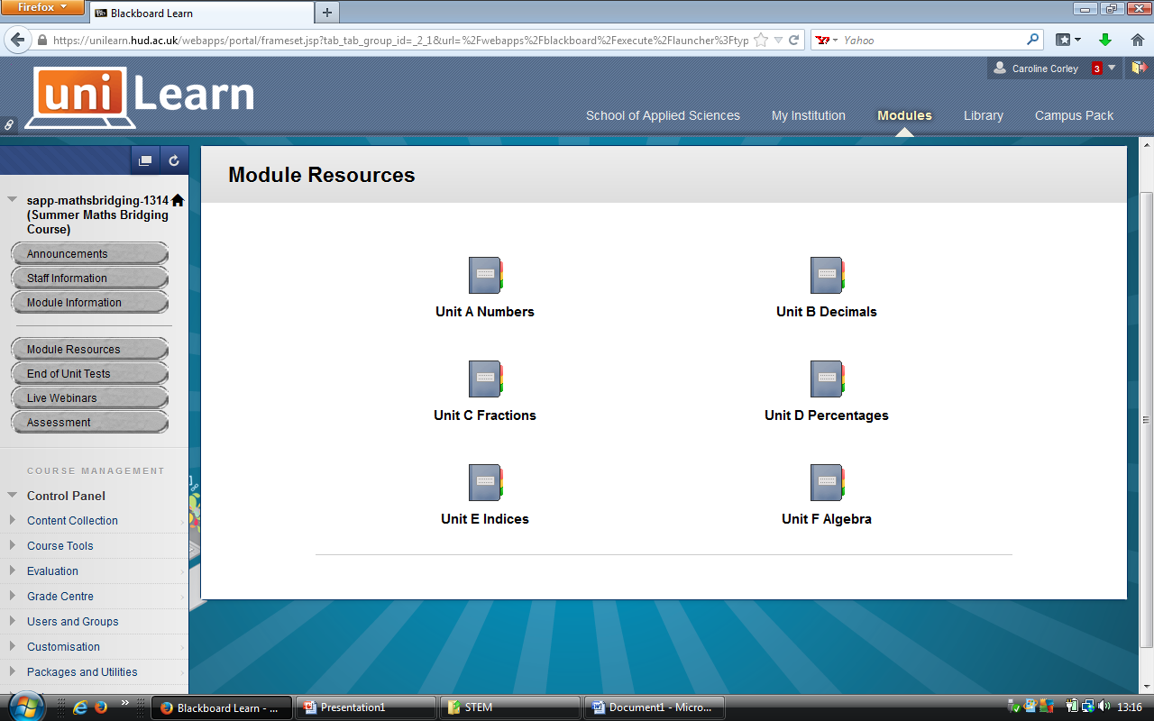
The Virtual Learning Environment

Slide 7
Course Content
Worksheets with worked answers
Pencasts
Live webcasts
Discussion Forums
Screencasts & Powerpoint

Slide 8
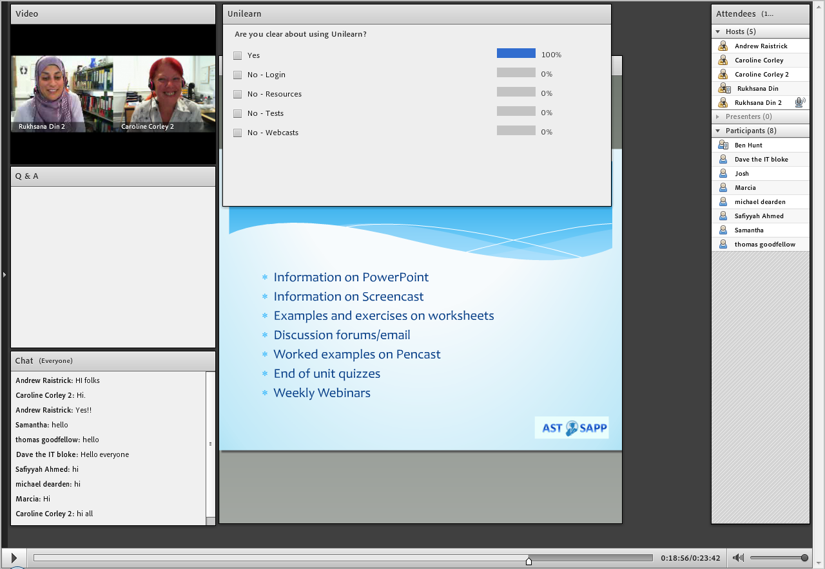
Weekly Webinar

Slide 9
Worksheets

Slide 10
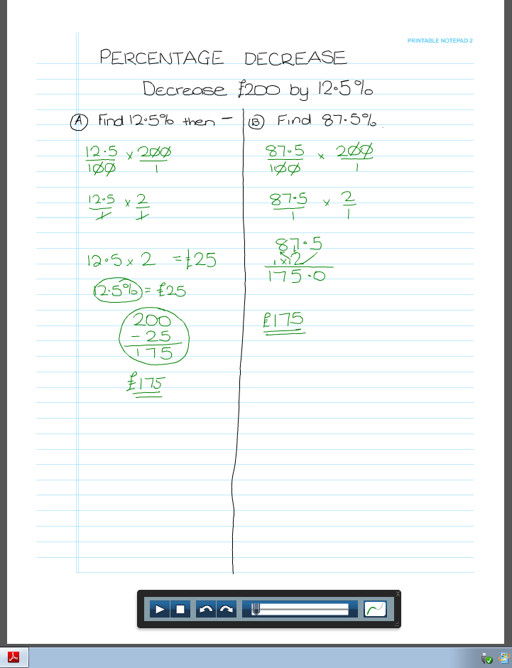
Screencasts and Pencasts

Slide 11
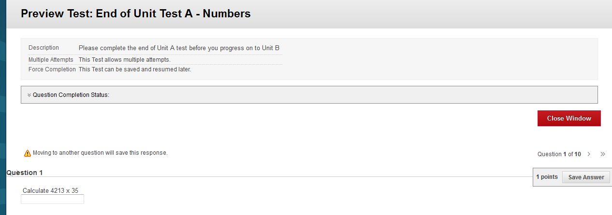
End of Unit Tests

Slide 12
Automatic Marking

Slide 13
Usage Reports

Slide 14
Student Engagement
Increased confidence when starting
Ease of transition
Increased sense of belonging
Discussion Forums
Reduced anxiety

Slide 15
Next Steps - Roll-out for 2014-15
Modification to course
Advertise throughout the School
Potentially rollout to all first year undergraduates in the School

Slide 16
Benefits of Maths Bridging Course
Ease the transition to HE
Improve retention
Low confidence in suitability of course (Cook, 2004)
Poor attendance (Newman, Ford et al., 2009; Woodfield et al., 2006)
Lack of engagement (Tinto, 1993; Yorke, 2012)
Improve Student Satisfaction

Slide 17
Further Information
W2/44
r.r.din@hud.ac.uk
c.m.corley@hud.ac.uk

