Slide 1

trace.{instructions for mapping space}
Sophia Emmanouil and Alex Bridger
LCCT | London | June 2014

Slide 2
The following is a presentation of work produced after Sophia Emmanouil got together with artists Juliet Macdonald and Rob Lycett to respond to the ROTOR call for proposals in Huddersfield.
Through discussions in the summer of 2013 we discovered common ground and cohesive threads which united our practices.
In particular, we discovered a shared interest in exploring concepts of place, location, mapping and drawing.
The exhibition trace.[instructions for mapping space] was born of a common desire to question the ways in which people impact upon, and respond to, their environments – and vice-versa.

Slide 3
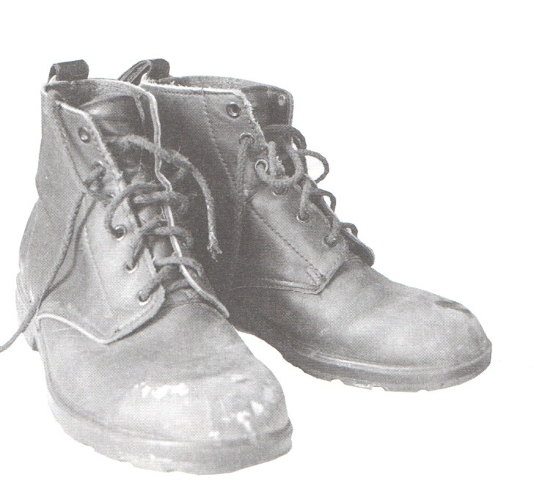
Alex and Sophia worked in collaboration with members of the health and arts organisations HOOT and OOB.
This presentation , showcases the inspiration and references behind the trace project, introduces the groups that took part and the methodology-instructions followed during the workshops.
Indicative work from the participants is also demonstrated in this document.
The findings of the explorations of the trace participants , were exhibited alongside the art projects of Rob Lycett and Juliet McDonald in Huddersfield Art Gallery, from February till May 2014.

Slide 4
Background | Inspiration
Psychogeography, dérive, detournement, negation and attempting to create situations!
‘Psychogeography could set for itself the study of the precise law and specific effects of the geographical environment, consciously organised or not, on the emotions and behaviours of individuals’ (Debord, 1955: n.p).
Playfulness as political and subverting ‘everyday’-ness

Slide 5
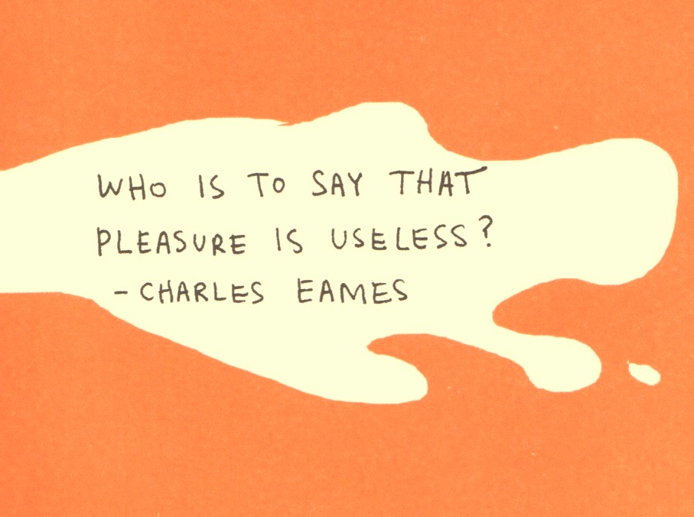
Illustration by Keri Smith
“The Pocket scavenger| penguin.com/kerismith”

Slide 6
Approach
trace workshop participants had the chance to visit or revisit , both physically and metaphorically , some places they already know quite well, routes, journeys of their everyday life.
They investigated modes of mapping based on personal experience and memory, and initiated activities such as walks as means of enacting a sense of belonging and re-location.
They were then asked to consider their emotional response to each location and document it in various ways, by composing poems, creating collages, building sculptures, making sketches, taking pictures and making maps.

Slide 7

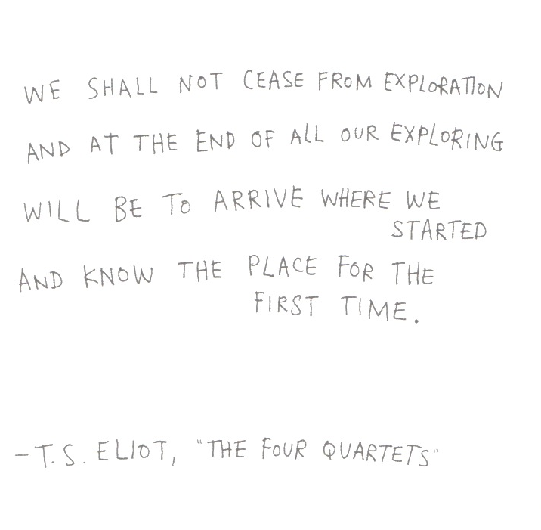
Illustration by Keri Smith
“The Pocket scavenger | penguin.com/kerismith

Slide 8
Questions
Questions considered during the walks (informed by Khatib’s 1958 I.S. paper):
What does it feel like where you walk?
How do you engage with your surroundings?
Do you notice any notable changes in ambience?
What do you think of the environment?
What do you think needs to be changed in the environment?
What should the environment look like?

Slide 9
Workshops
The workshops were divided in 5 different themes:
1:Spirit of the Place, 2:Sculpting Paths, 3:Dice Walk, 4:Scavenger’s Hunt, 5:Map Making.
After the gentle movement and warm up exercises, participants were briefed about the task of the day and a short walk was followed in order to conduct the tasks given, following a set of playful instructions.
Discussions about consumerism, built environment, sustainability, politics, emotional well being, art, relationships, urban life and creativity were brought up during the walks and participants engaged in a series of interesting reflections.
The findings of the explorations were documented, after discussion and arrangement with the participants based on ethical conduct agreed by both parties.

Slide 10
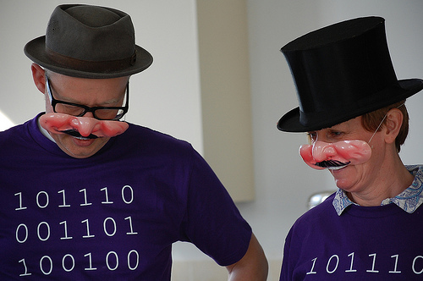
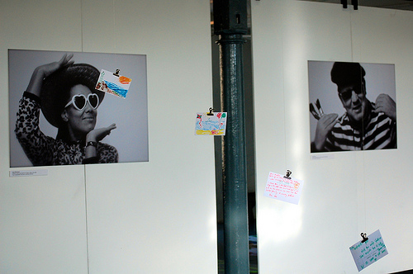
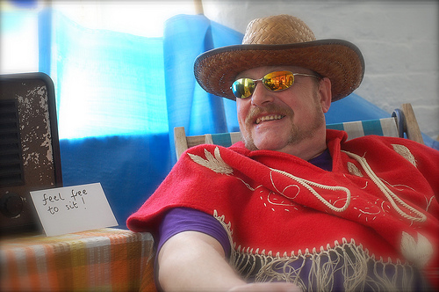
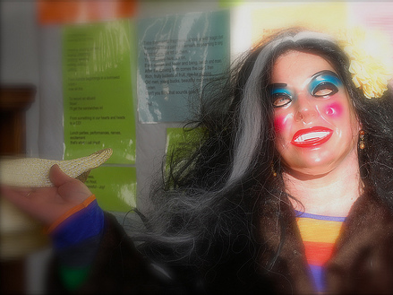
Meet The Artists
Hoot is an arts & health organisation based in West Yorkshire.
Hoot’s purpose is to make the arts accessible to everyone as a means of improving health, enhancing wellbeing and achieving creative and personal potential.
From their base in Huddersfield, they bring people together from all sections of the community to build confidence, encourage creative expression and help people find their voice.
Their belief is that everyone has a creative capacity that can help them grow and develop, and that through supporting people to flourish as individuals and groups Hoot can help communities and wider society to grow too.

Slide 11
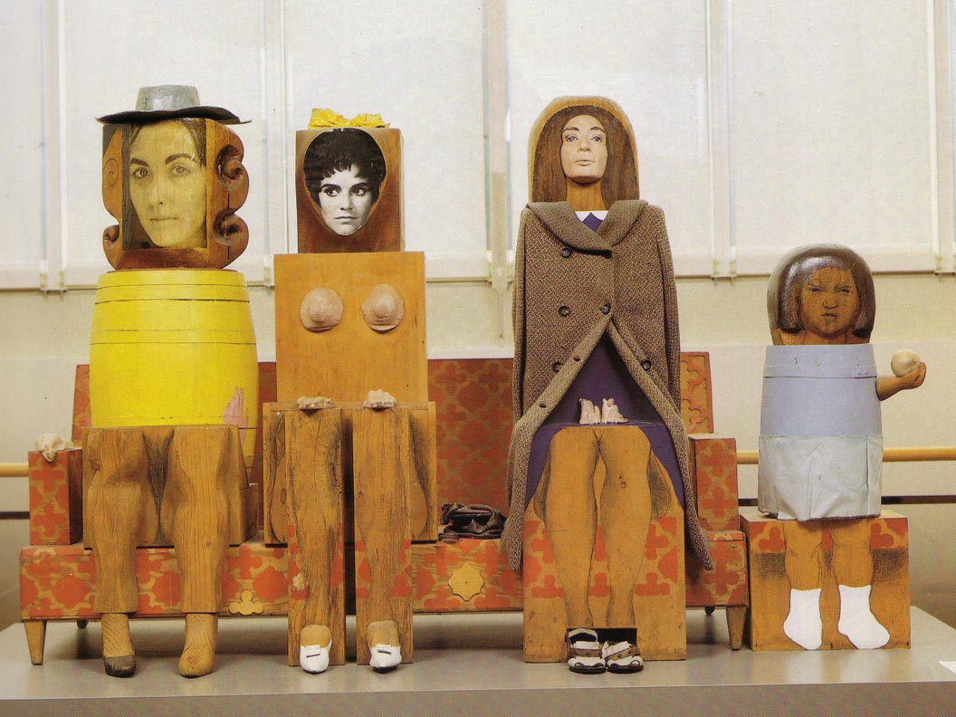
Meet The Artists
Students of Architecture were introduced to the workshops as part of their design communication module.
Those who agreed to participate, as this is by invitation , they were asked to conduct the explorations based on a set of instructions they got .
Their findings were documented in their sketchbook journal as a narrative and reflections.
As architecture students are often asked to address issues of urban design for their studies , this sort of experiments allowed them to engage in a more creative way with their urban environment and develop their creative skills of sketching, writing, reflecting, documenting and narrating .

Slide 12
EXPLORATION 1:
SPIRIT OF THE PLACE

Slide 13
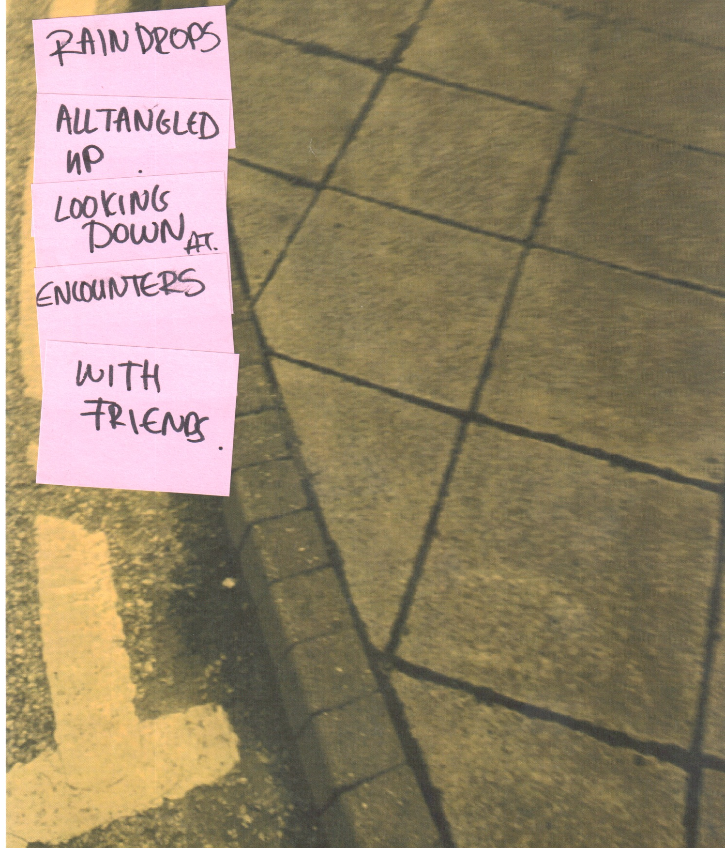
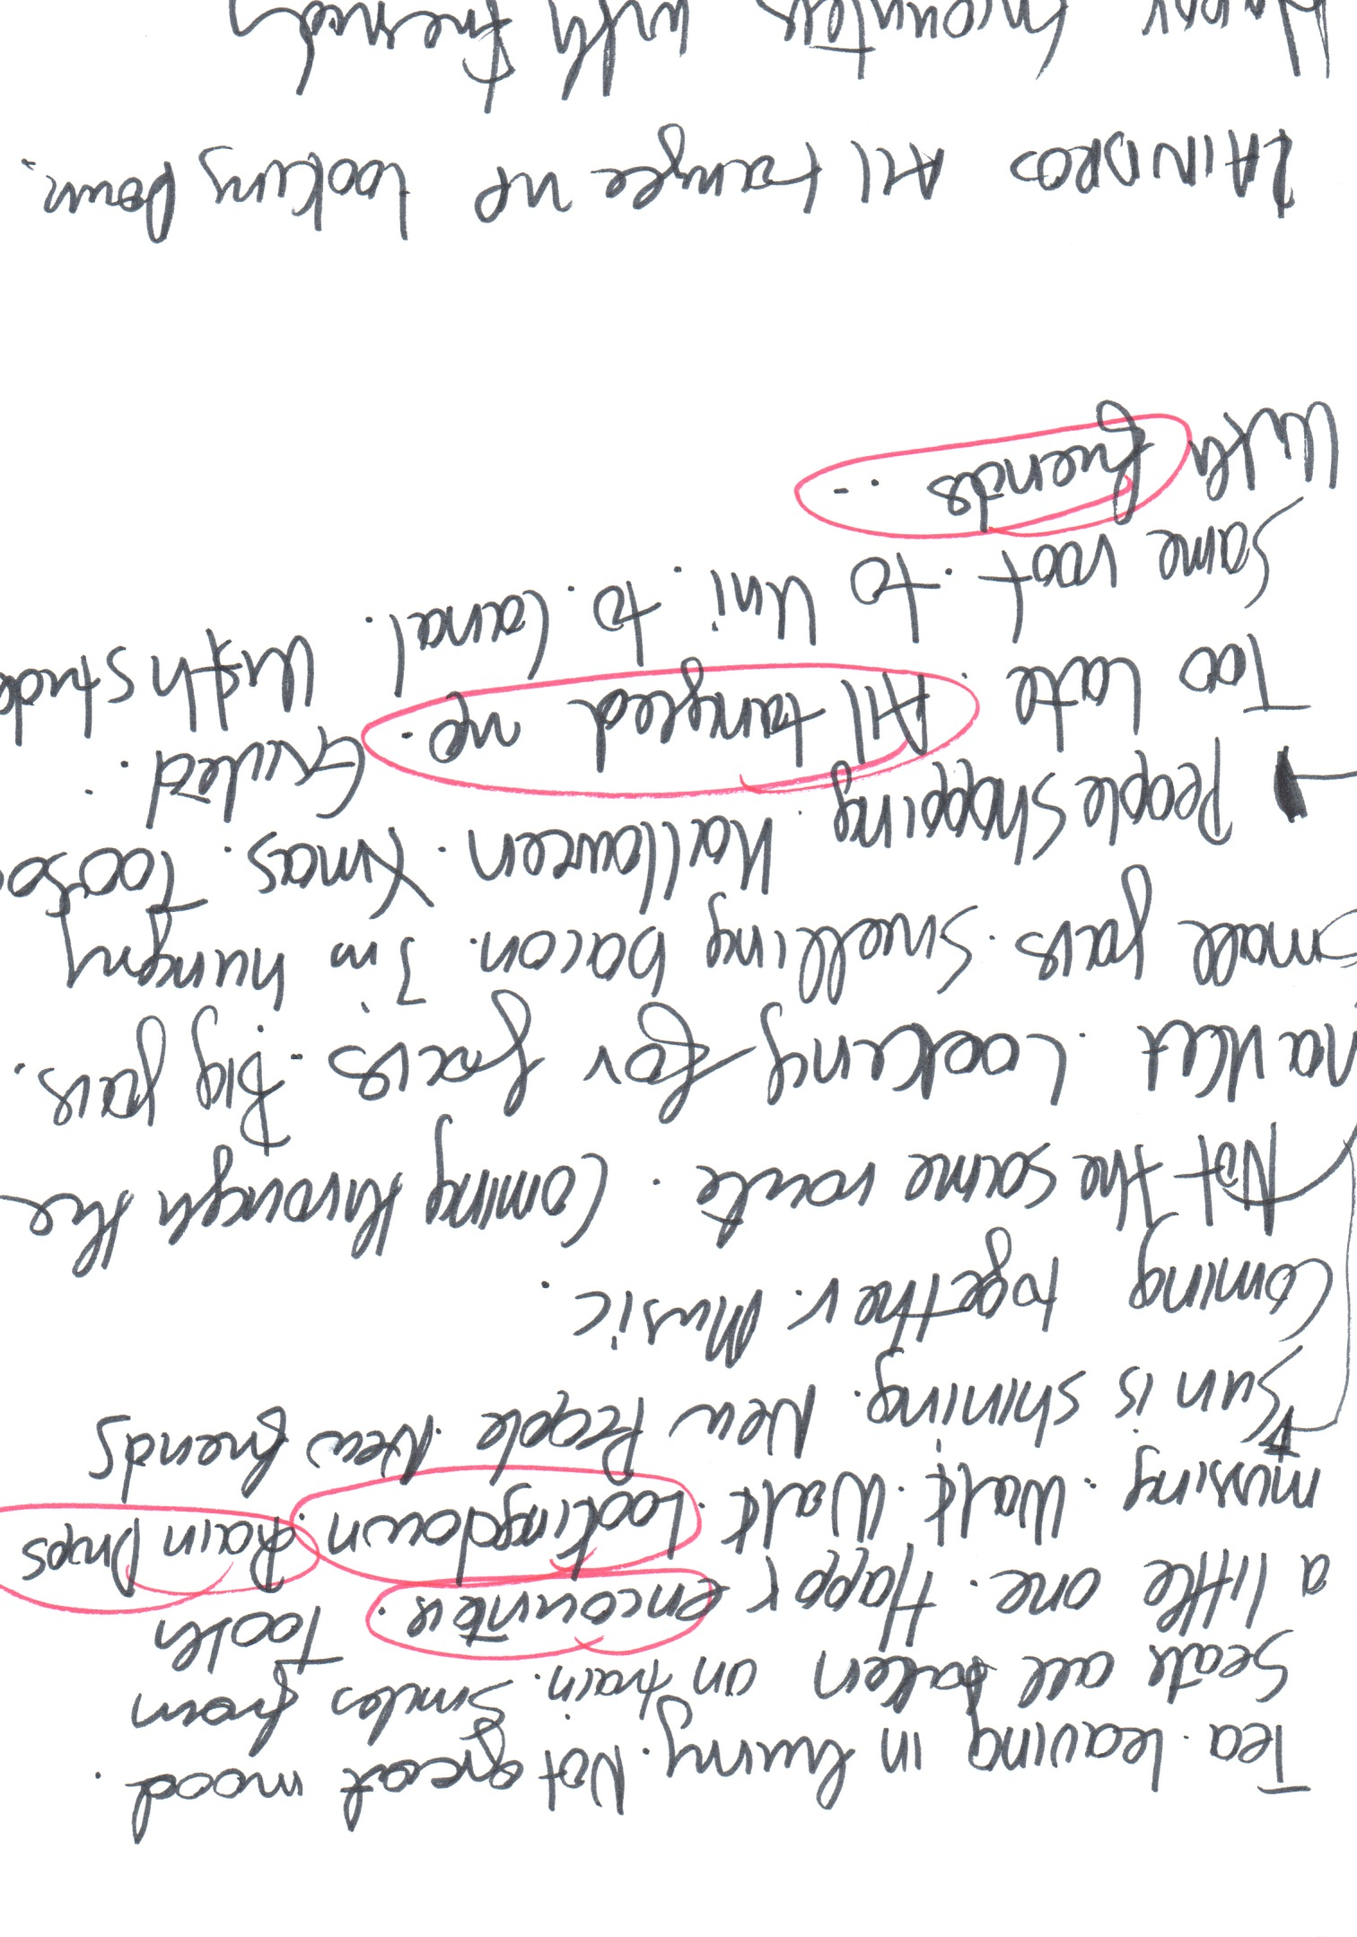
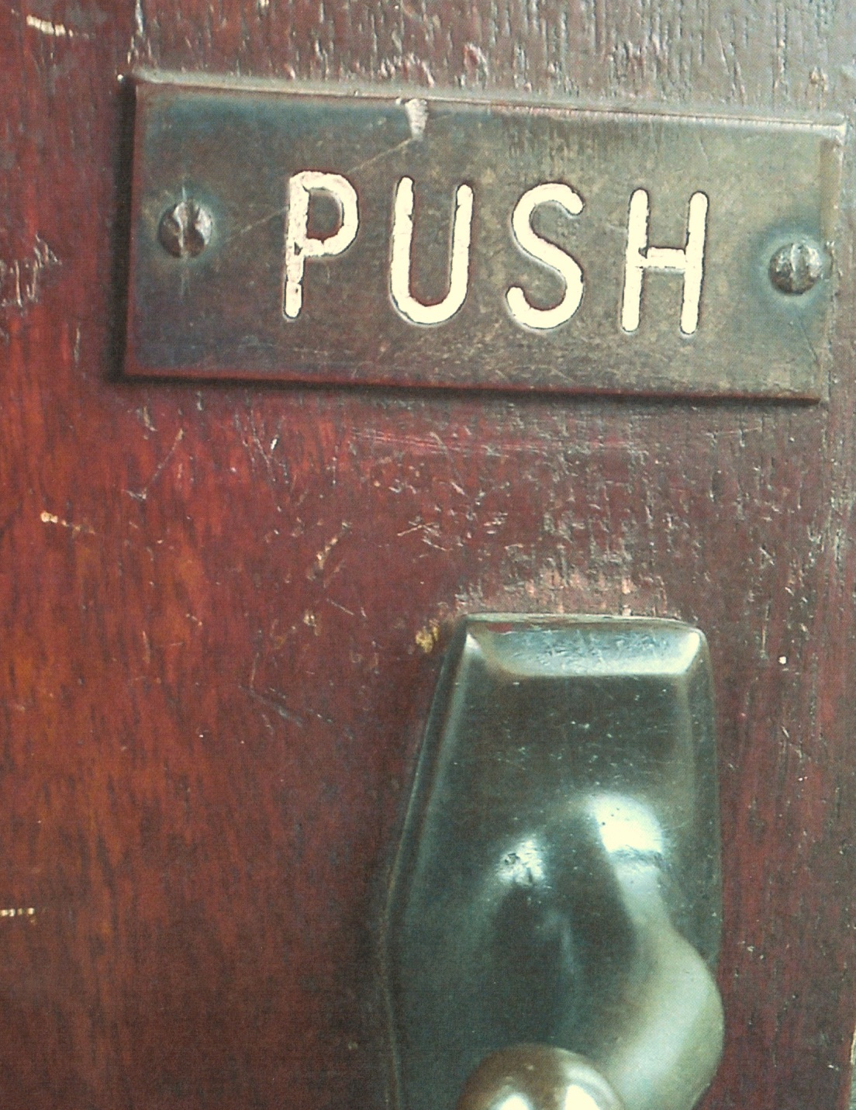
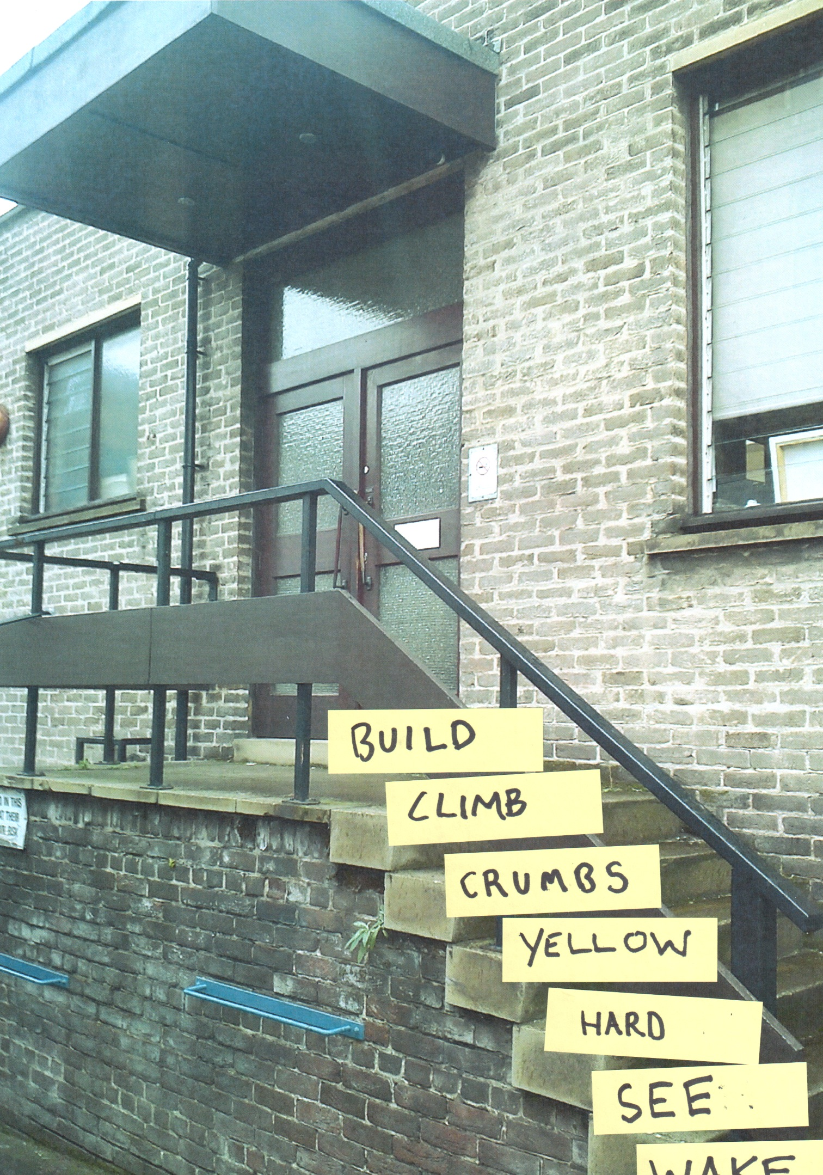
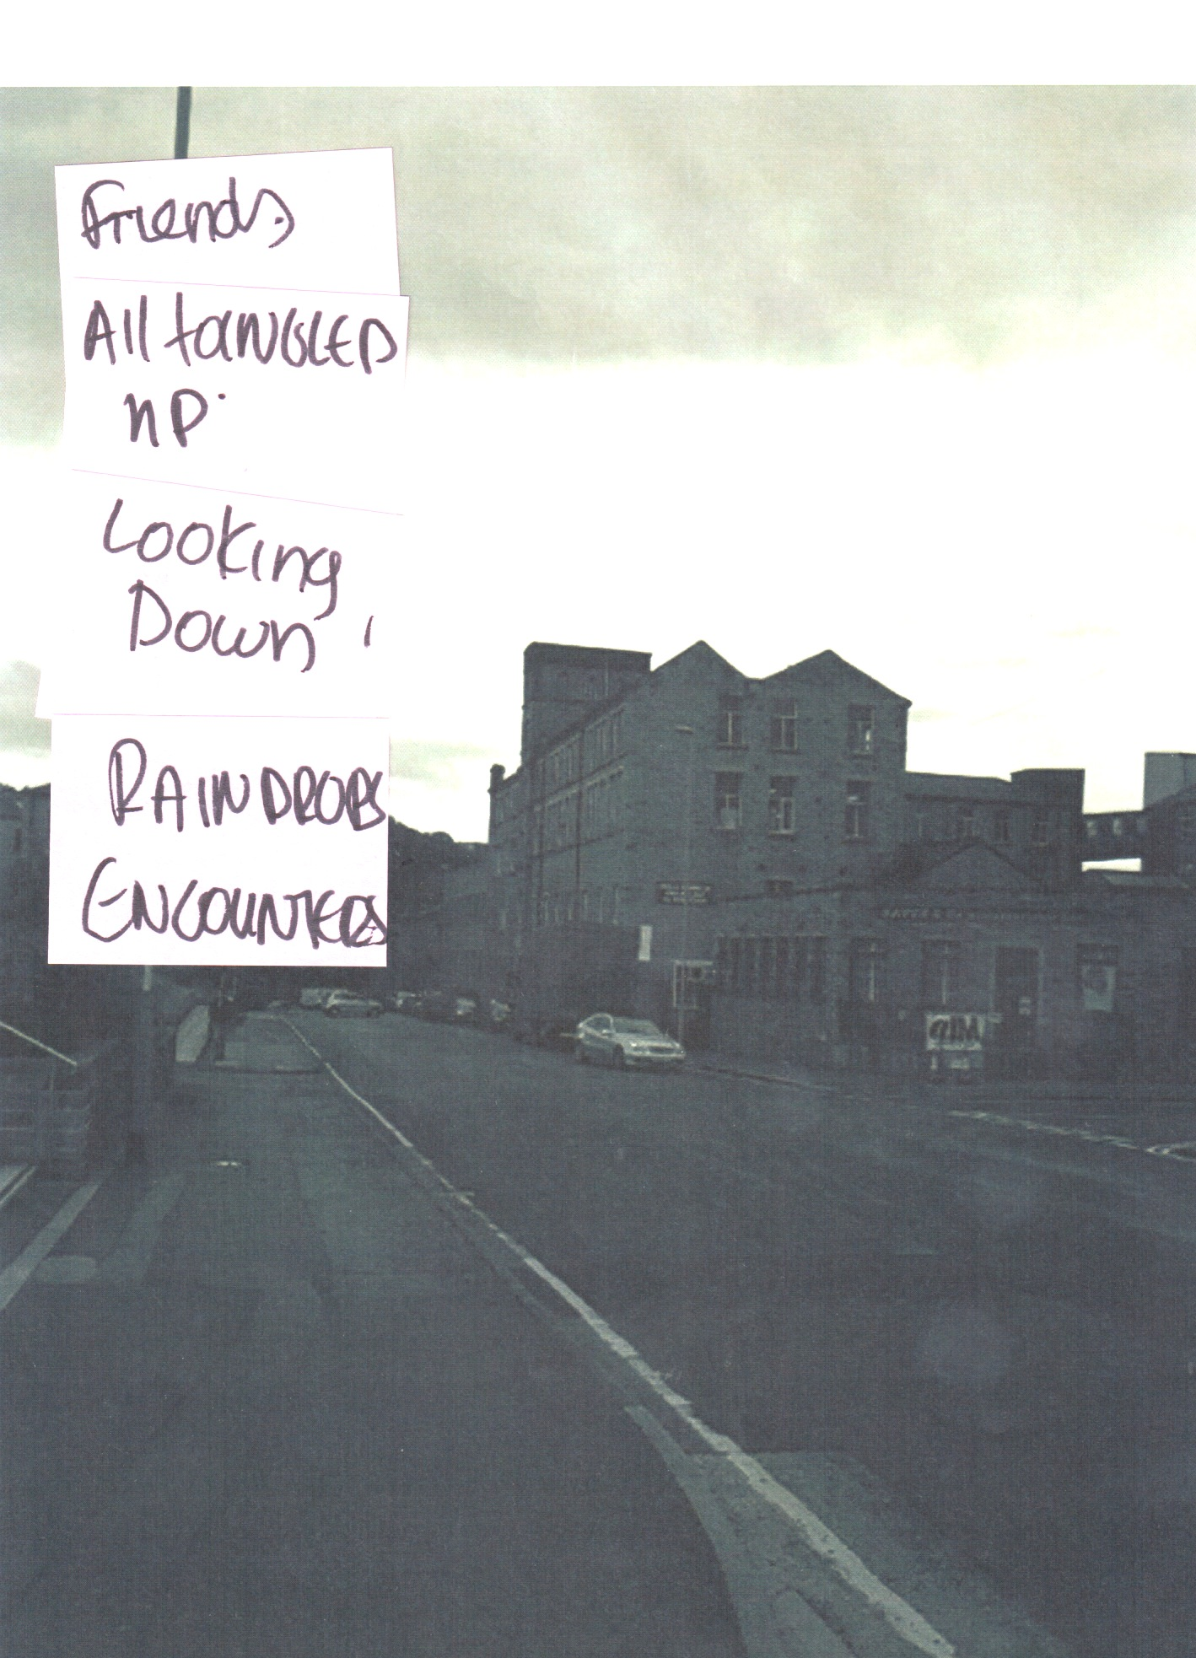
EXPLORATION 1:
SPIRIT OF THE
PLACE
ARTISTS
RIKKI ROYSTON
REBECCA MILNER
TERRY BARNES
DAVID SLATER
BARRIE WALSH
L. DEVI. SEEPUJAK
RICHARD TAYLOR
ALEX BRIDGER
DAVE JORDAN

Slide 14
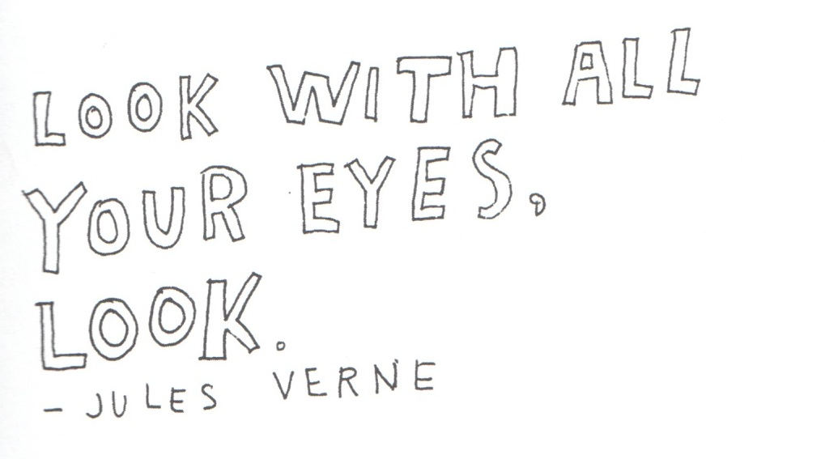
EXPLORATION 1:
SPIRIT OF THE
PLACE
INSTRUCTIONS
Recall your journey .What brought you here today. Both literally and metaphorically. Did you come by bus, cycling, walking? Did you take the train?
Recall the starting point of your journey. Is it a large urban area? A city? A small town? A countryside? What do the buildings look like? What about the textures? The materials? The smells? The colours? What about the roads and paths?
During your journey what did you encounter ?Did you meet different people? Recall what they were wearing, how did they look.
Arriving and entering the building, how does this feel? Whom do you meet and greet? How is this building making you feel ?Are you warm, cold? Is there enough light and air? What is the spirit of this place?
Now start writing. Keep your hand moving for 10 min. Don’t pause to reread the line you have just written. Don’t cross out. Don’t worry about punctuation, spelling , grammar. Don’t care about staying within the margins and lines on the page.
Circle the words in coloured pen that speak most to you. Use a black marker to write each word on a post it note
Stick them on a photograph you took earlier during your journey, to compose a short poem and composition.
Take a picture. Rearrange. Exhibit. Discuss.
ARTISTS
RIKKI ROYSTON
REBECCA MILNER
TERRY BARNES
DAVID SLATER
BARRIE WALSH
L. DEVI. SEEPUJAK
RICHARD TAYLOR
ALEX BRIDGER
DAVE JORDAN

Slide 15
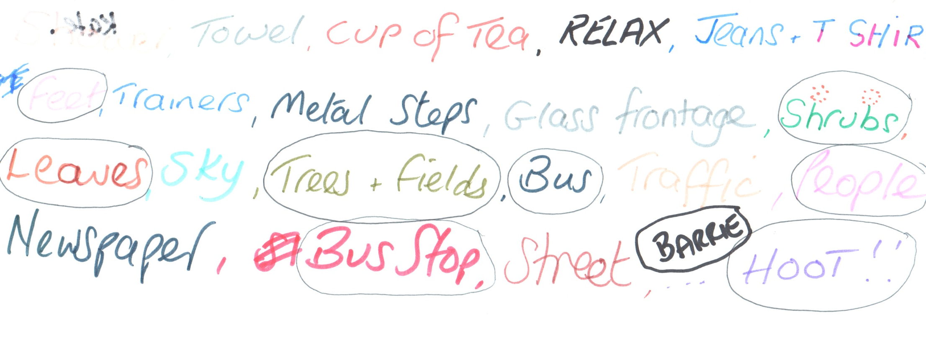
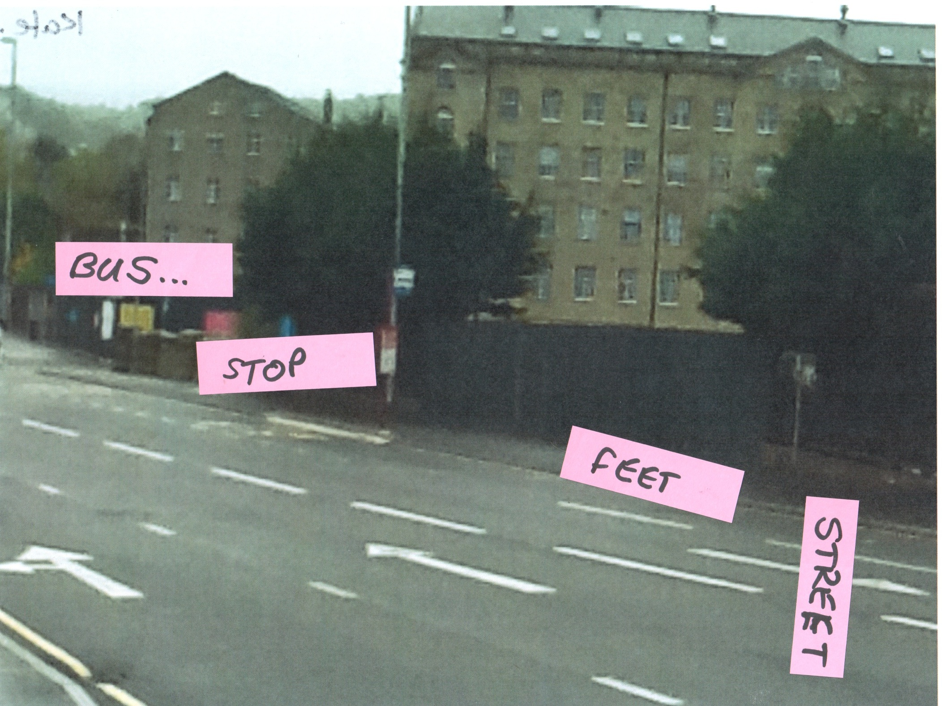
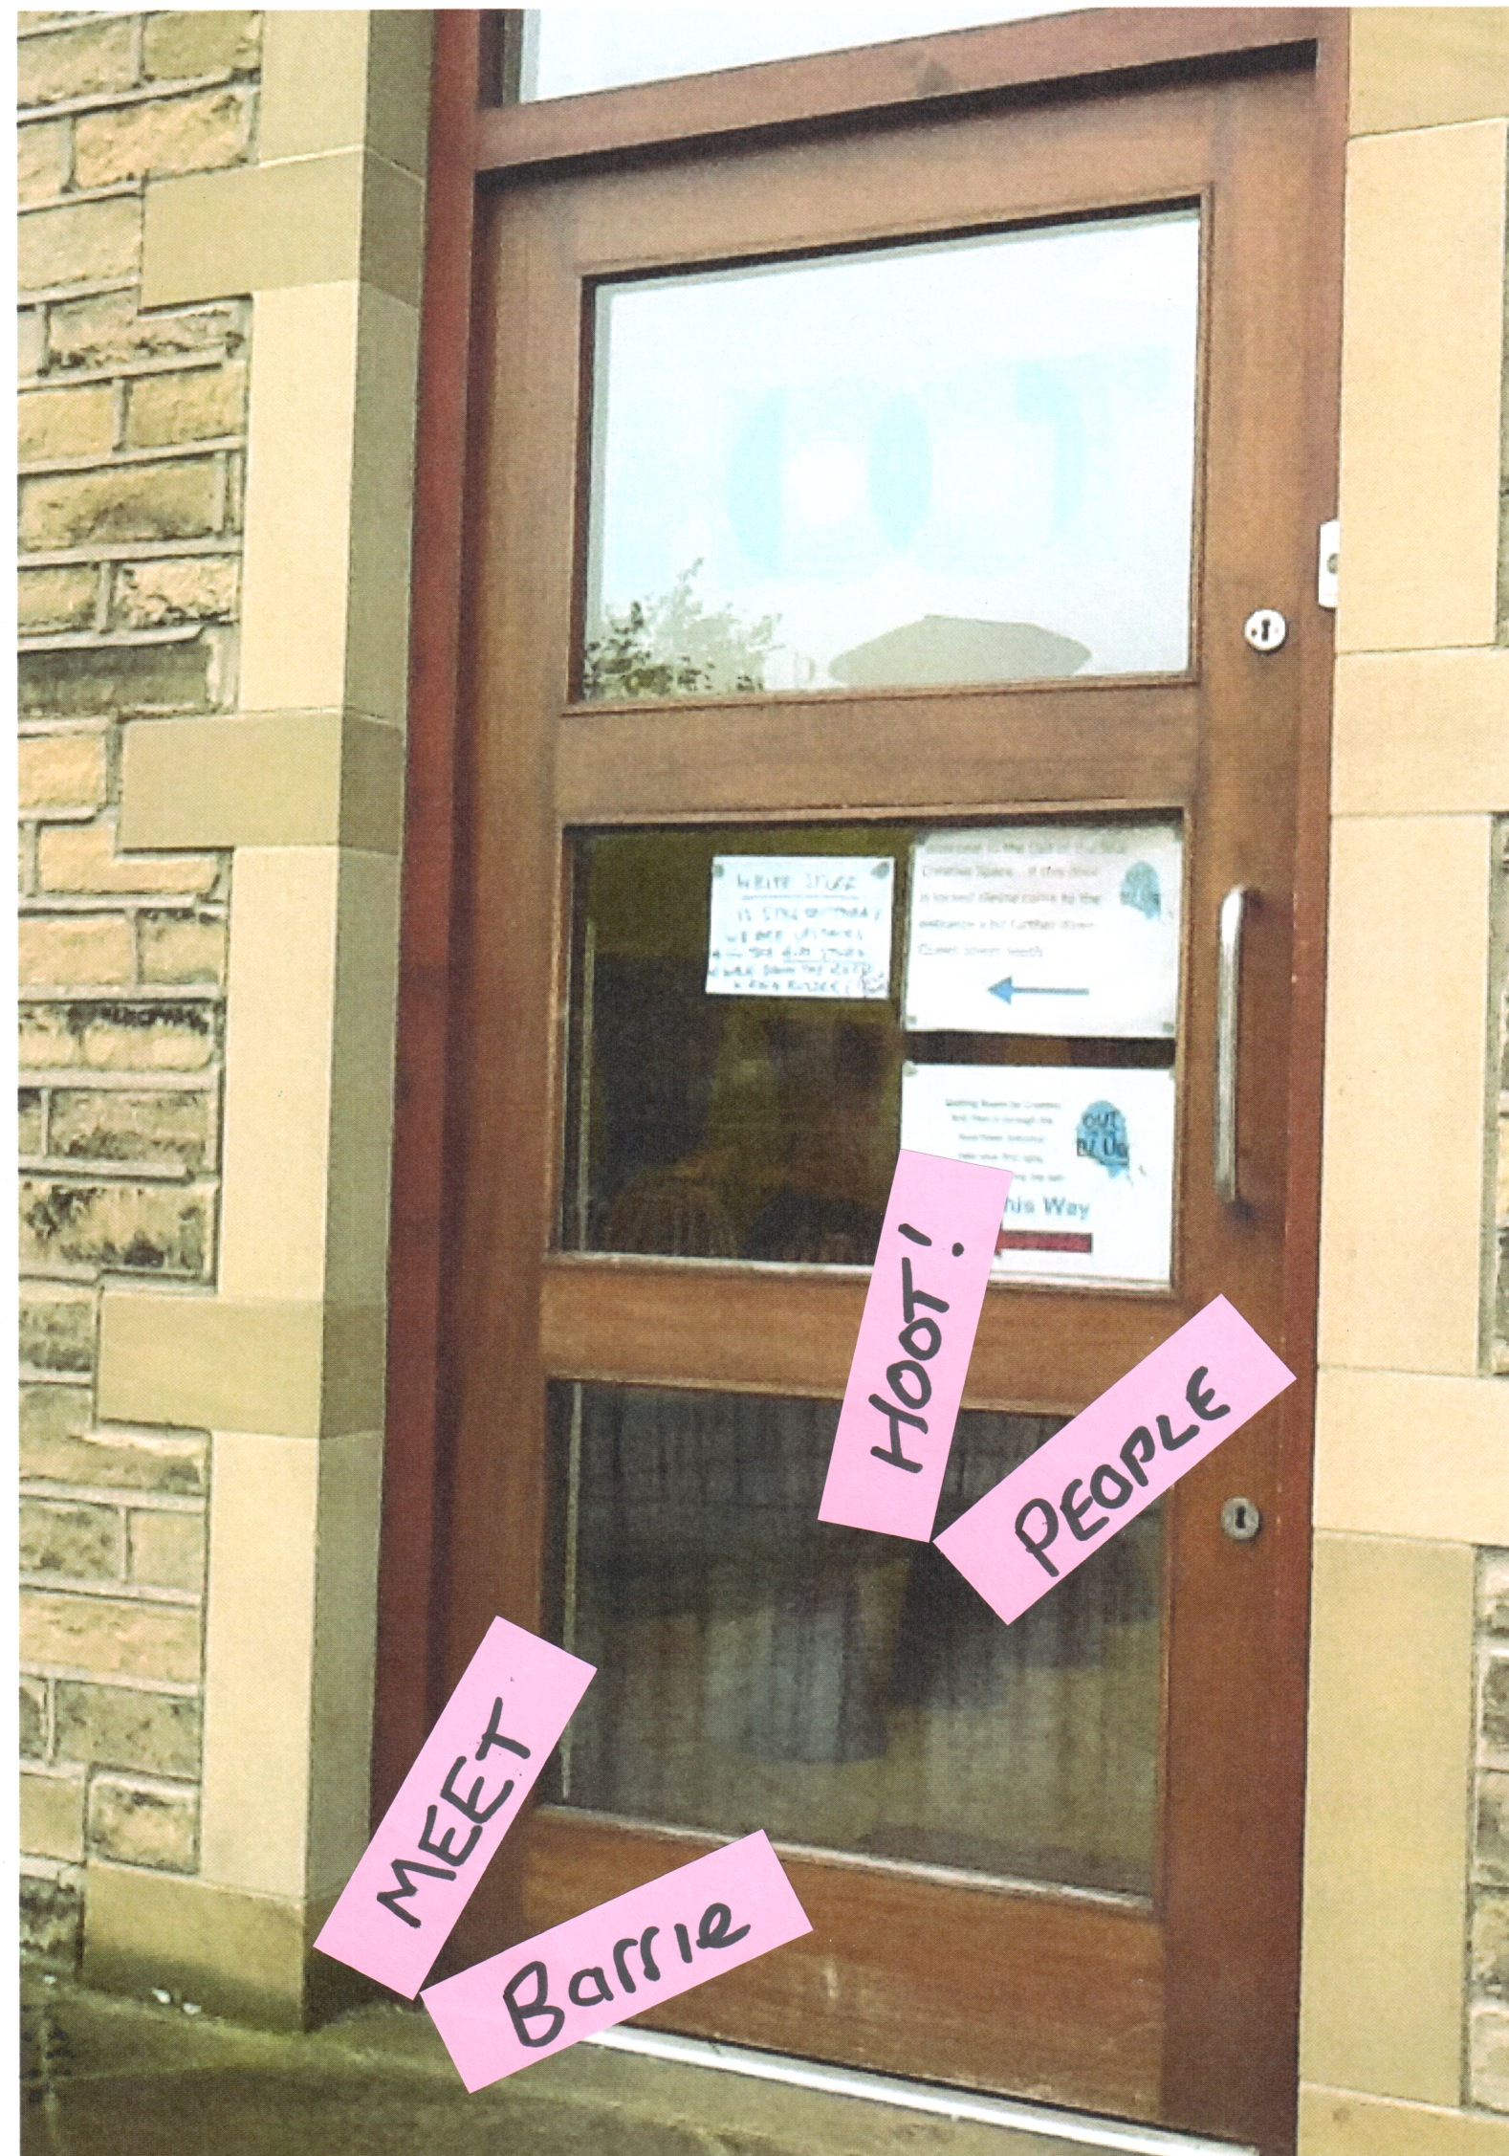
EXPLORATION 1:
SPIRIT OF THE
PLACE
ARTISTS
RIKKI ROYSTON
REBECCA MILNER
TERRY BARNES
DAVID SLATER
BARRIE WALSH
L. DEVI. SEEPUJAK
RICHARD TAYLOR
ALEX BRIDGER
DAVE JORDAN

Slide 16
EXPLORATION 2:
SCULPTING PATHS

Slide 17
EXPLORATION 2:
SCULPTING
PATHS
INSTRUCTIONS
Go for a walk. Collect objects that you see and find on your walk. You decide what the connection between the objects is(could be based on shape, colour, texture, size etc). Look for teabags, leaves, fabric, grass,, water, pebbles and stones of different sizes, driftwood, timber, bones, feathers, bottles, glass, pieces of rope etc
Use the bags provided to store your found objects. Make sure, if you work in pairs that you recognize your objects.
Choose a location for your sculpture or installation. The way you can choose your location will arise from your ability to see things from many angles. Sight, sound, texture, smell, movement, light, function , symbol, contrast, colour might inform your decision.
Now create 3 sculptures with a partner .Document all 3 sculptures in location by taking 3 pictures each using the ipads or cameras provided.
Write a short story based on the experience of the day ,a short score, create a collage or a poem. Use pictures of your sculptures and your writings to document and log the experience. You might want to use one of the experience logs provided to help you with your short story.
Make a 5 min sketch of the location map as you can remember it, without trying to be precise. Think where you have created your installation and put a note there.
ARTISTS
RIKKI ROYSTON
REBECCA MILNER
TERRY BARNES
DAVID SLATER
BARRIE WALSH
L. DEVI. SEEPUJAK
RICHARD TAYLOR
ALEX BRIDGER
DAVE JORDAN

Slide 18
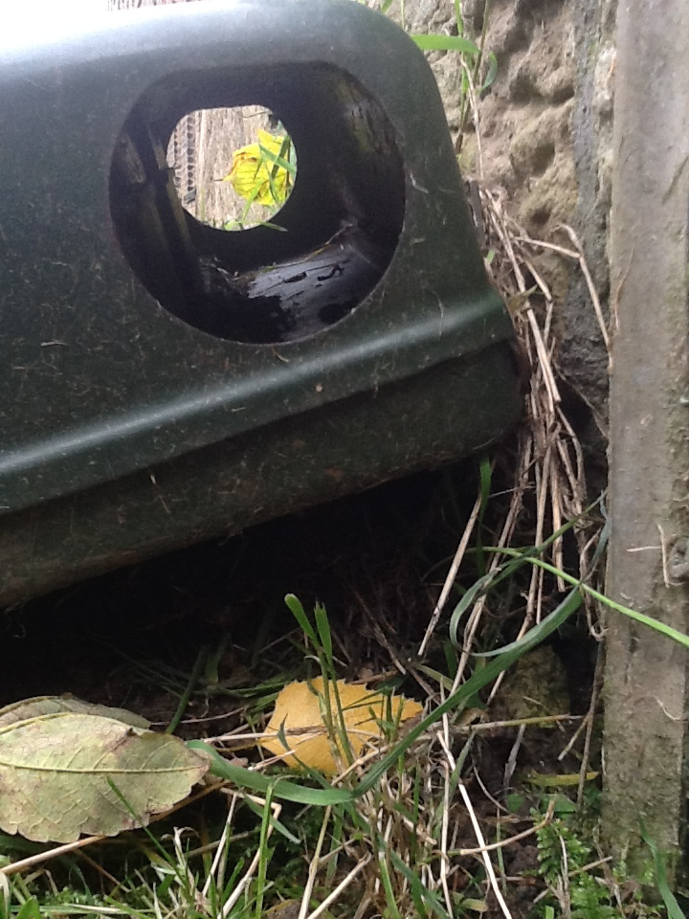
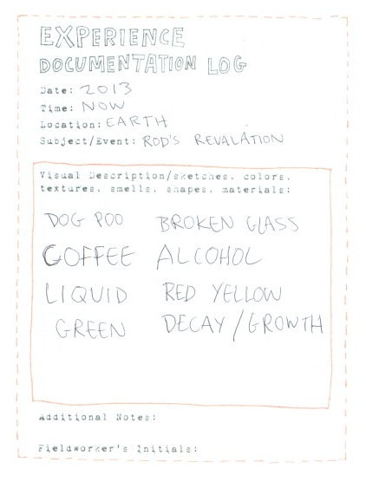
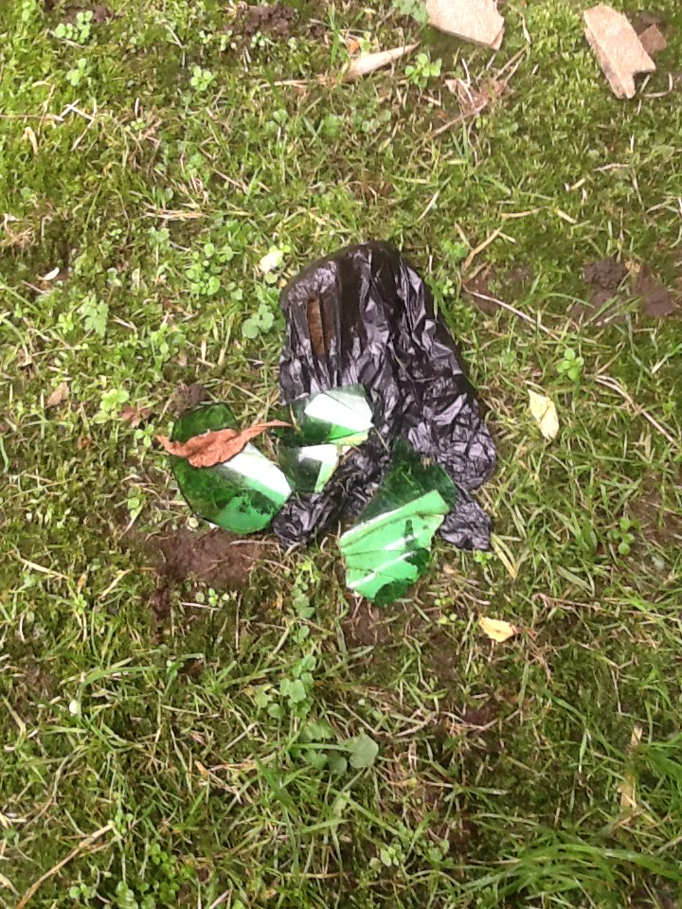
EXPLORATION 2:
SCULPTING
PATHS
ARTISTS
RIKKI ROYSTON
REBECCA MILNER
TERRY BARNES
DAVID SLATER
BARRIE WALSH
L. DEVI. SEEPUJAK
RICHARD TAYLOR
ALEX BRIDGER
DAVE JORDAN

Slide 19
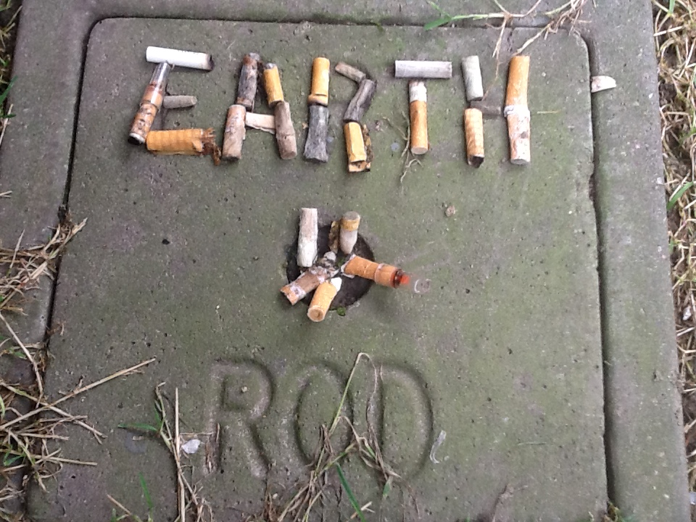
EXPLORATION 2:
SCULPTING
PATHS
ARTISTS
RIKKI ROYSTON
REBECCA MILNER
TERRY BARNES
DAVID SLATER
BARRIE WALSH
L. DEVI. SEEPUJAK
RICHARD TAYLOR
ALEX BRIDGER
DAVE JORDAN

Slide 20
EXPLORATION 3:
DICE WALK

Slide 21
EXPLORATION 3:
DICE WALK
INSTRUCTIONS
Go for a walk with the dice provided.
One player throws the dice with directions on it. All group to follow that direction.
The next player throws the dice with an activity written on it.
Change. Follow instructions for the activities.
Document. Exhibit. Discuss.
Activities suggested on the dice:
Take pictures s of 2 letters formed by cracks on the street, shapes and patterns of nature.Write down words that start from that letter. Put all words together/make a story that reflects the environment and spirit of the day. Change order of words.
Say something nice to the person next to you.
Follow something red. Take a picture.
Hug or handshake the person next to you
Sing a tune that comes into your mind and captures the spirit of the place you are standing.
ARTISTS
RIKKI ROYSTON
REBECCA MILNER
TERRY BARNES
DAVID SLATER
BARRIE WALSH
L. DEVI. SEEPUJAK
RICHARD TAYLOR
ALEX BRIDGER
DAVE JORDAN

Slide 22
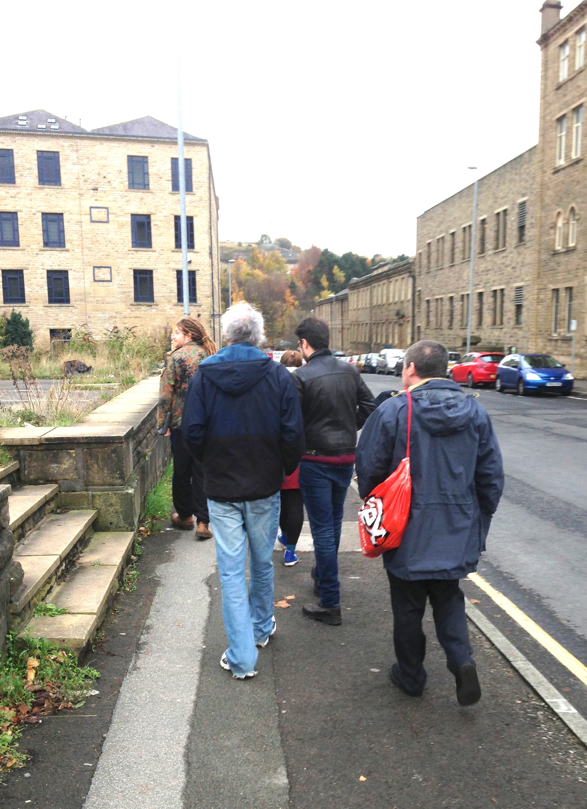
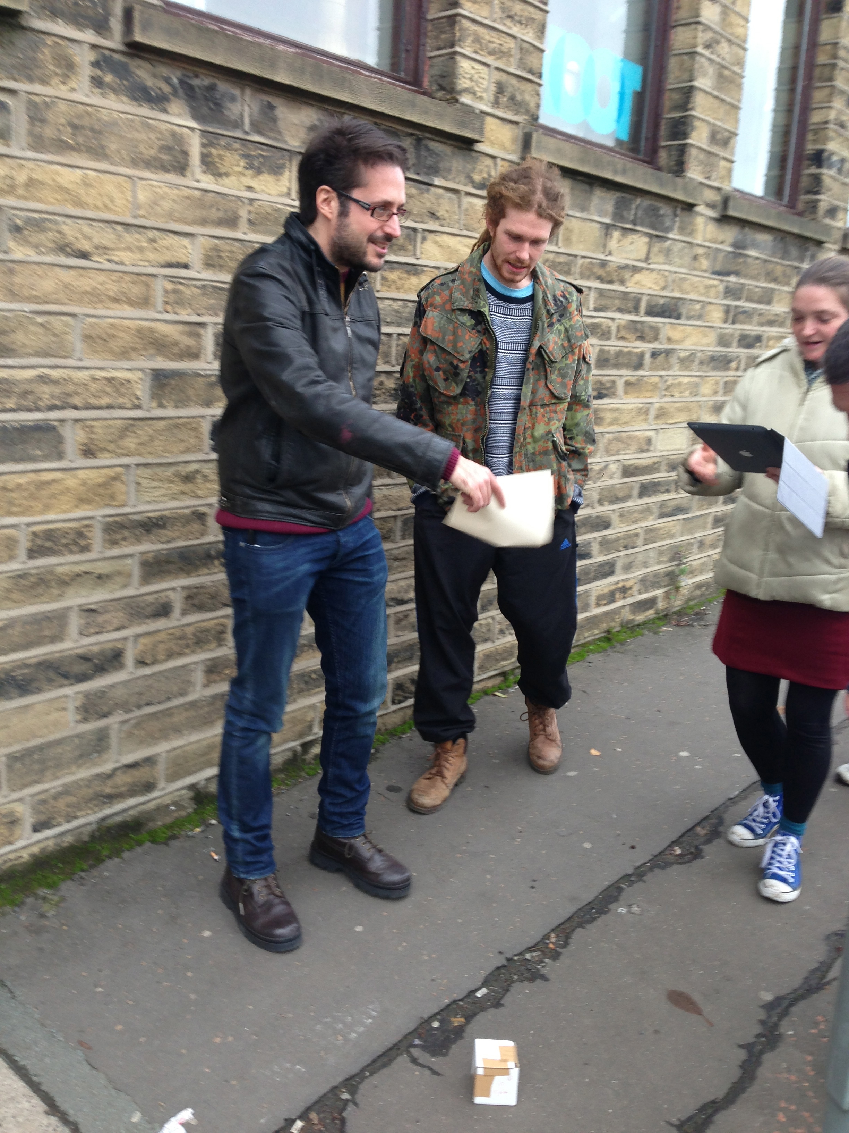
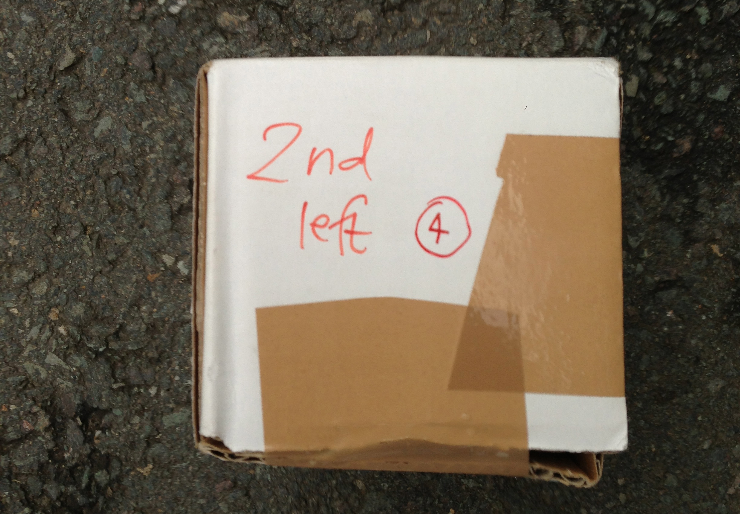
EXPLORATION 3:
DICE WALK
ARTISTS
RIKKI ROYSTON
REBECCA MILNER
TERRY BARNES
DAVID SLATER
BARRIE WALSH
L. DEVI. SEEPUJAK
RICHARD TAYLOR
ALEX BRIDGER
DAVE JORDAN

Slide 23
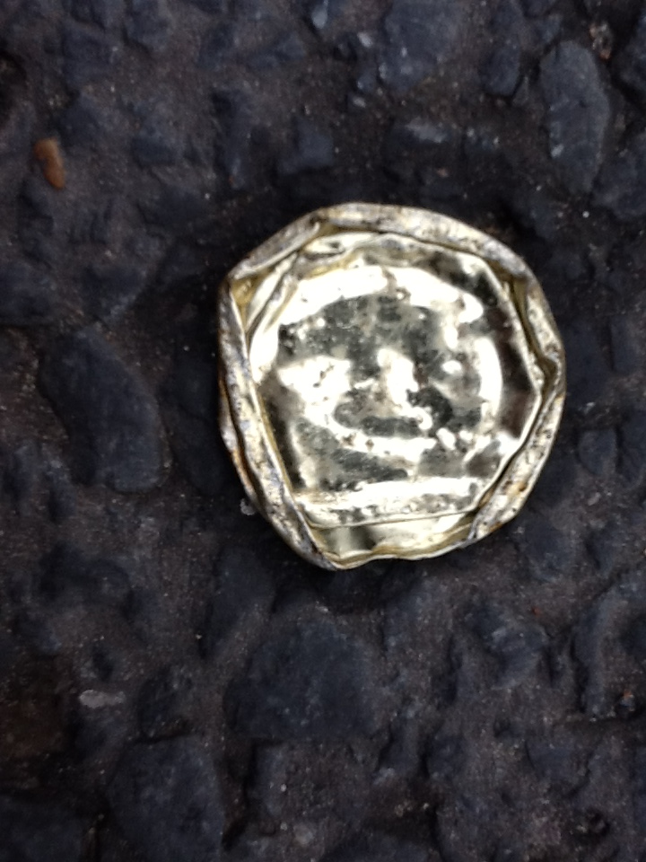
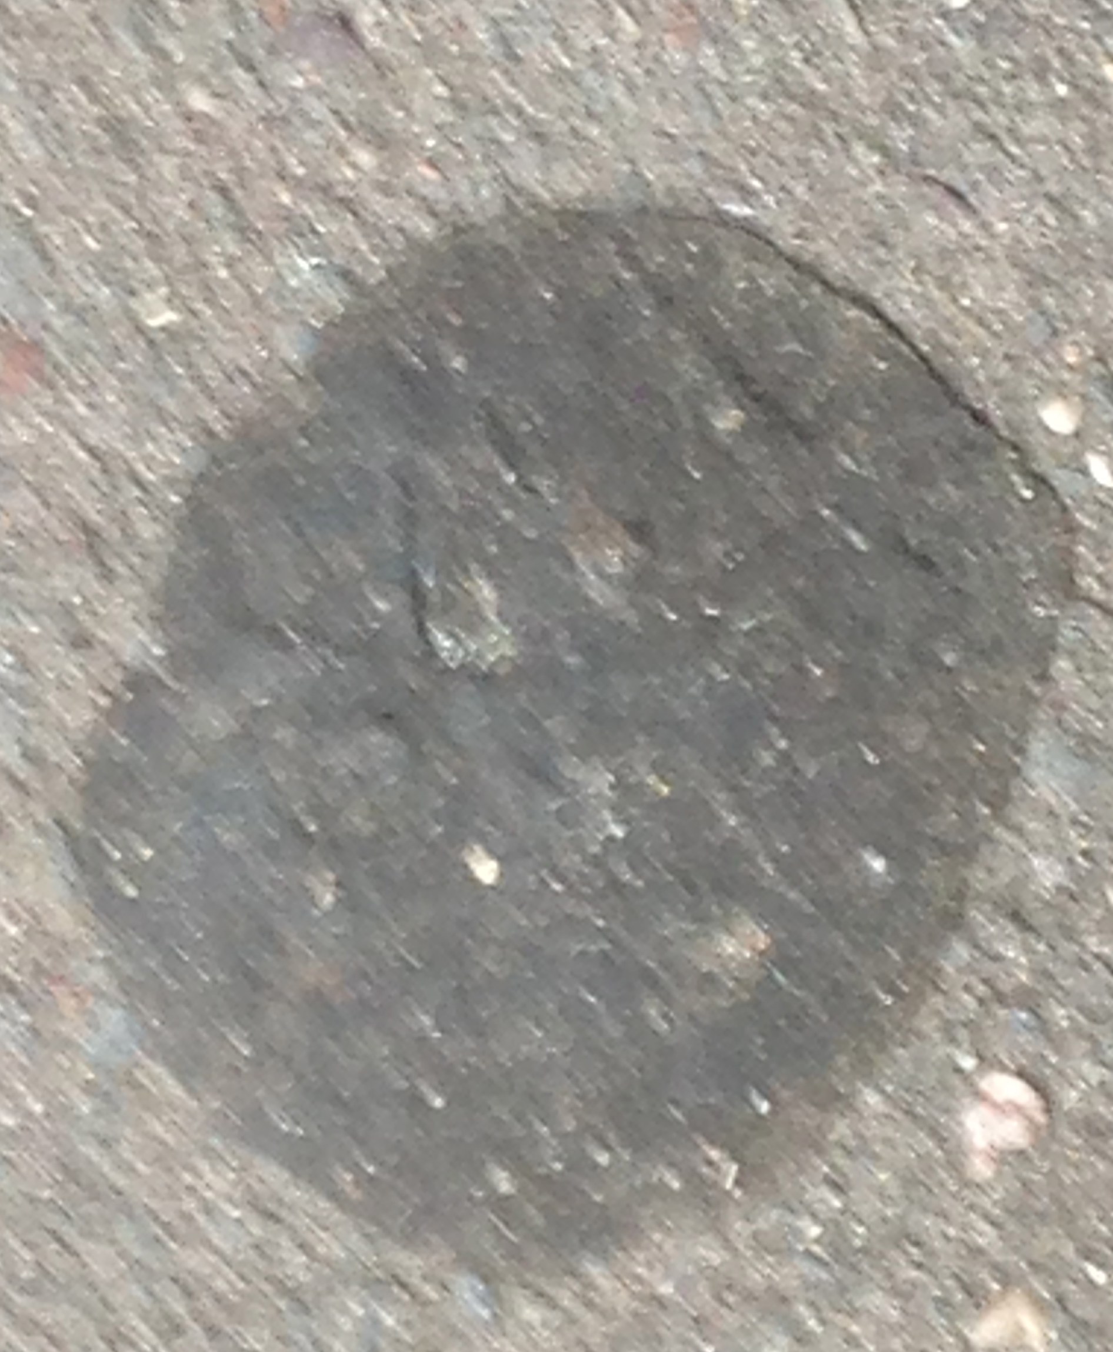
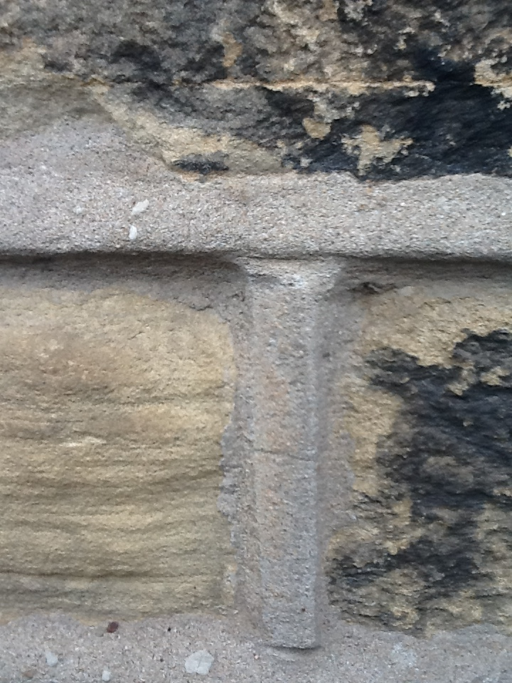

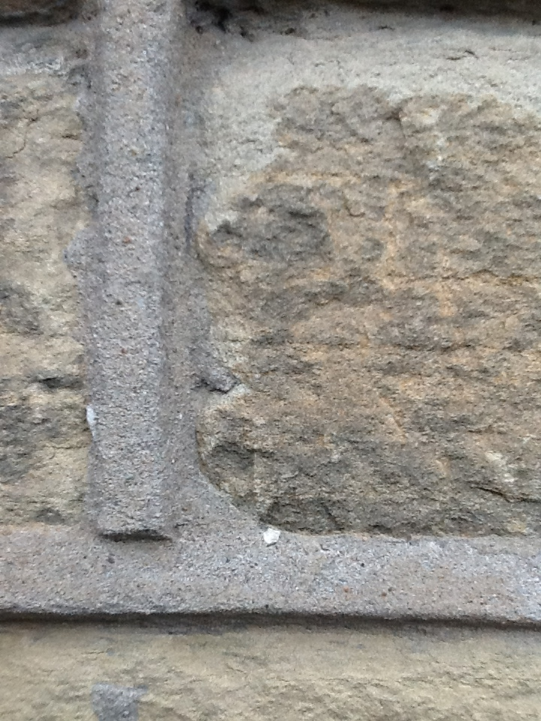
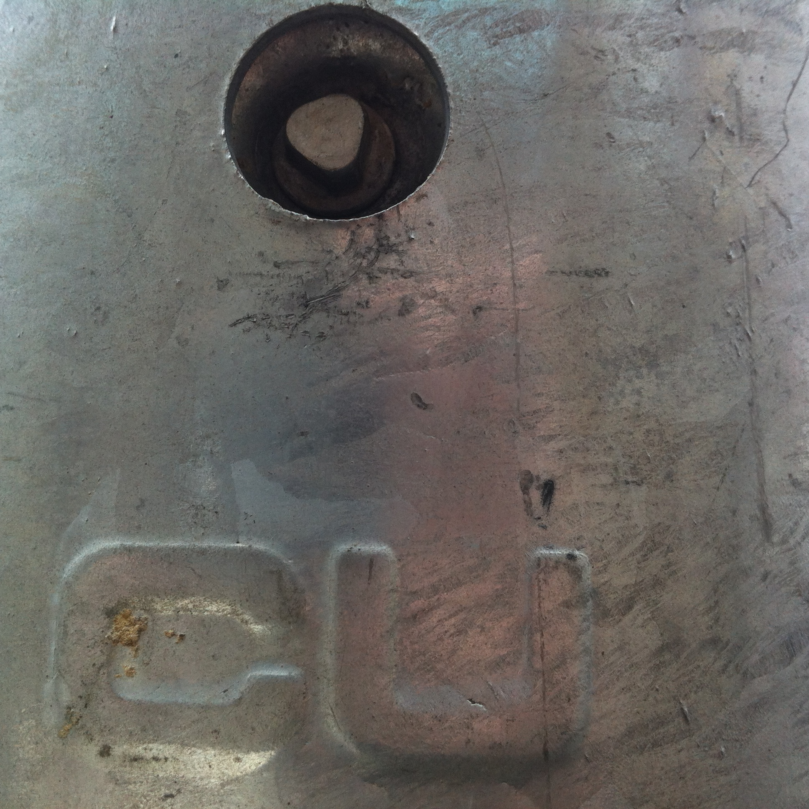
EXPLORATION 3:
DICE WALK
ARTISTS
RIKKI ROYSTON
REBECCA MILNER
TERRY BARNES
DAVID SLATER
BARRIE WALSH
L. DEVI. SEEPUJAK
RICHARD TAYLOR
ALEX BRIDGER
DAVE JORDAN

Slide 24
EXPLORATION 4:
SCAVENGER’S HUNT

Slide 25
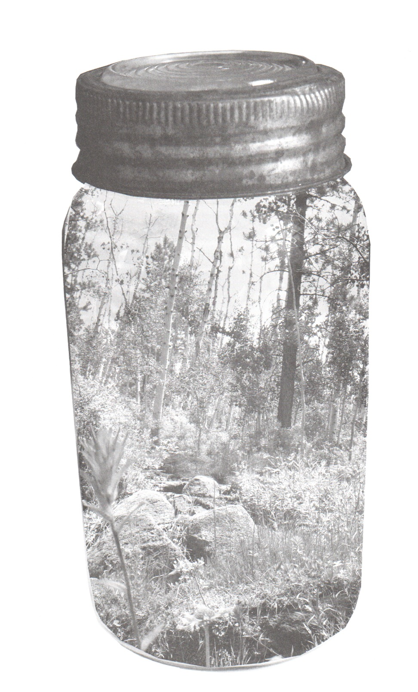
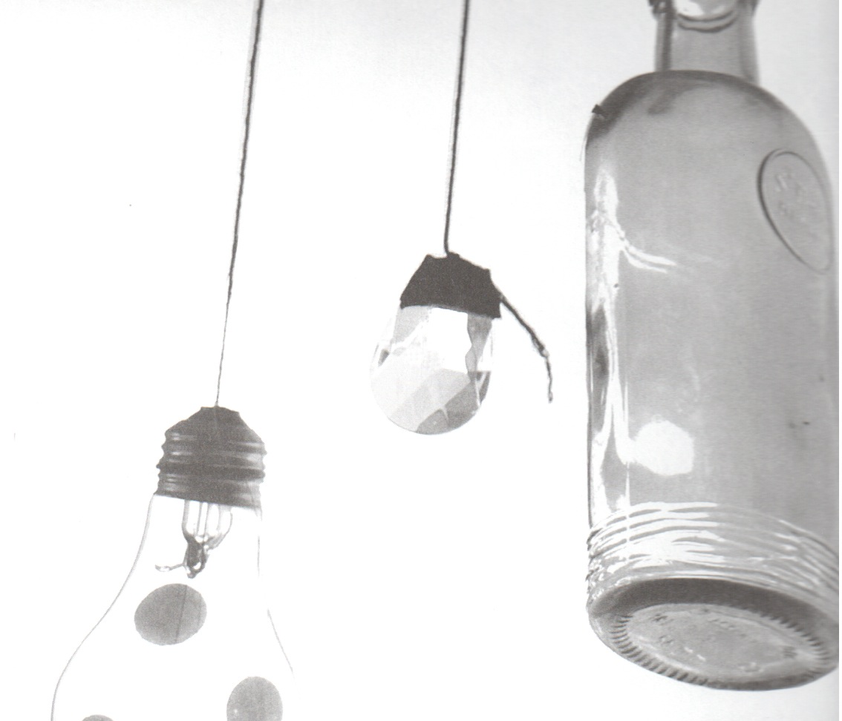
EXPLORATION 4:
SCAVENGER’S
HUNT
INSTRUCTIONS
Take a walk.
Collect 10 things you find. You could collect: different kinds of wild plants, rubber bands, tickets, stamps, driftwood, plastic bits, leaves, grass, acorn hats, candy wrap, coins, buttons…
Document them on a map.
Exhibit them in the jars provided and use the tags to label what it is and where it was found.
Write a short story about your found items.
Exhibit. Discuss. Reflect.
ARTISTS
RIKKI ROYSTON
REBECCA MILNER
TERRY BARNES
DAVID SLATER
BARRIE WALSH
L. DEVI. SEEPUJAK
RICHARD TAYLOR
ALEX BRIDGER
DAVE JORDAN

Slide 26
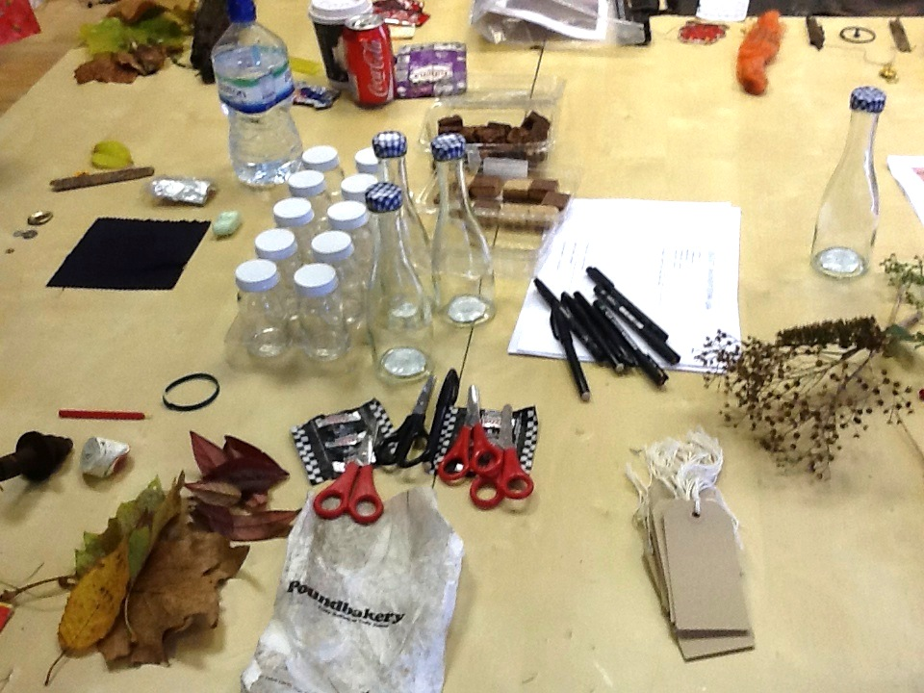
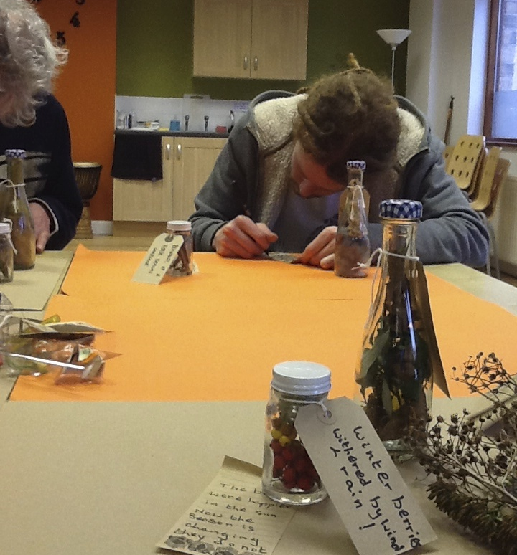
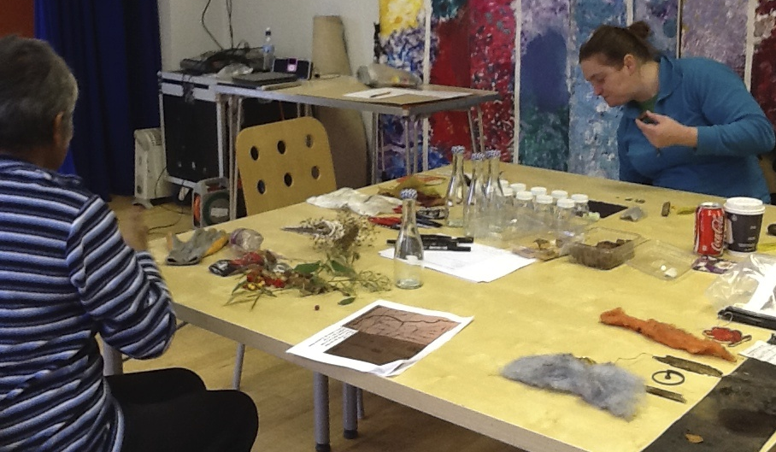
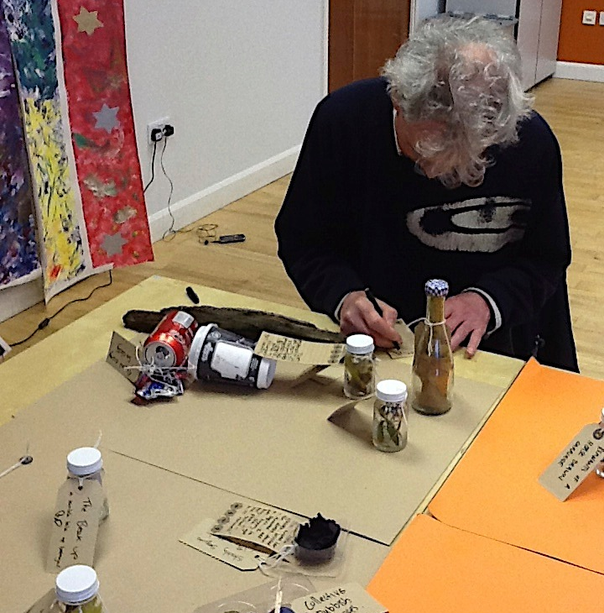
EXPLORATION 4:
SCAVENGER’S
HUNT
ARTISTS
RIKKI ROYSTON
REBECCA MILNER
TERRY BARNES
DAVID SLATER
BARRIE WALSH
L. DEVI. SEEPUJAK
RICHARD TAYLOR
ALEX BRIDGER
DAVE JORDAN

Slide 27
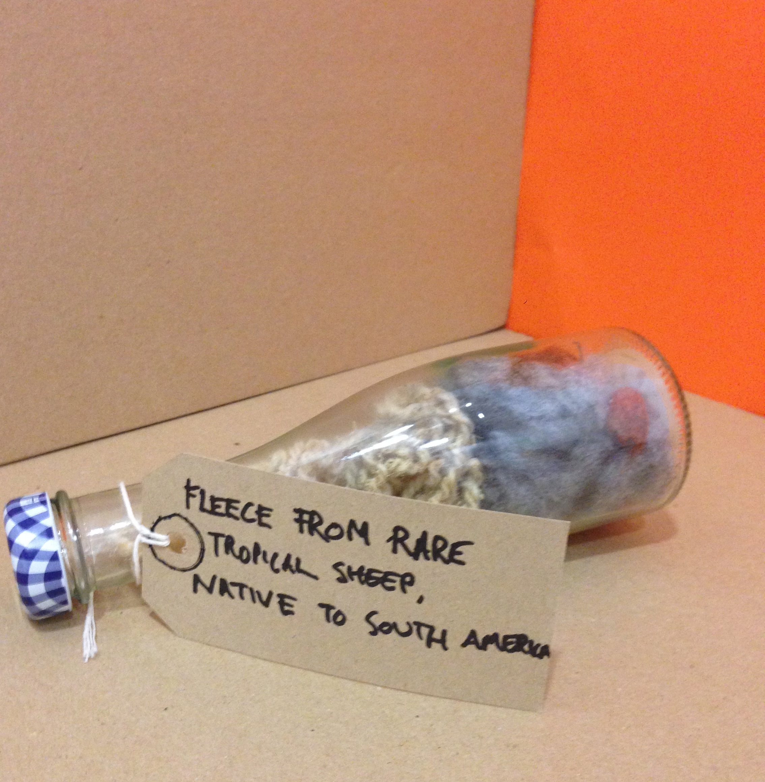
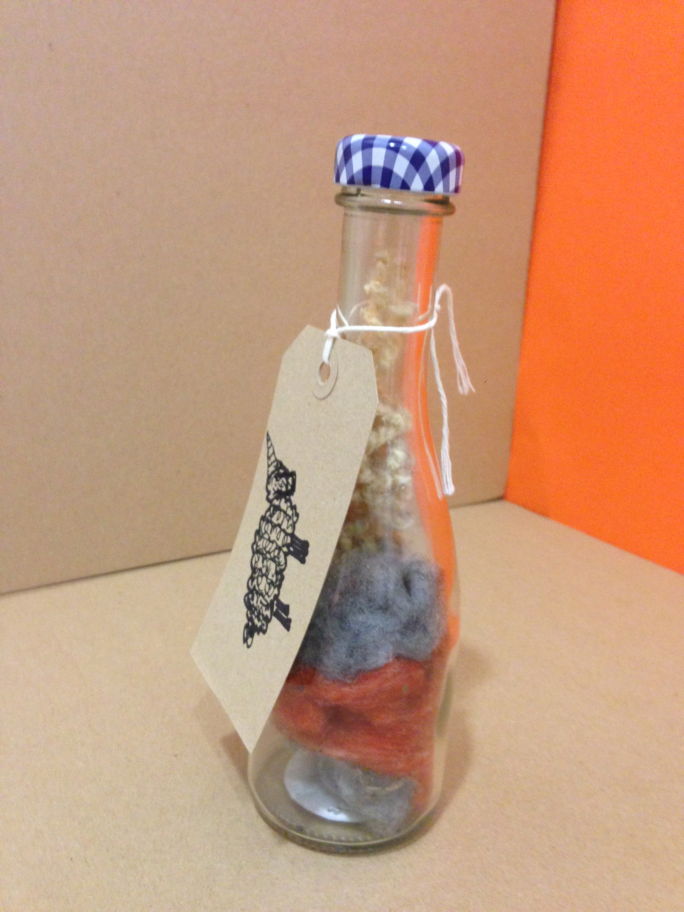
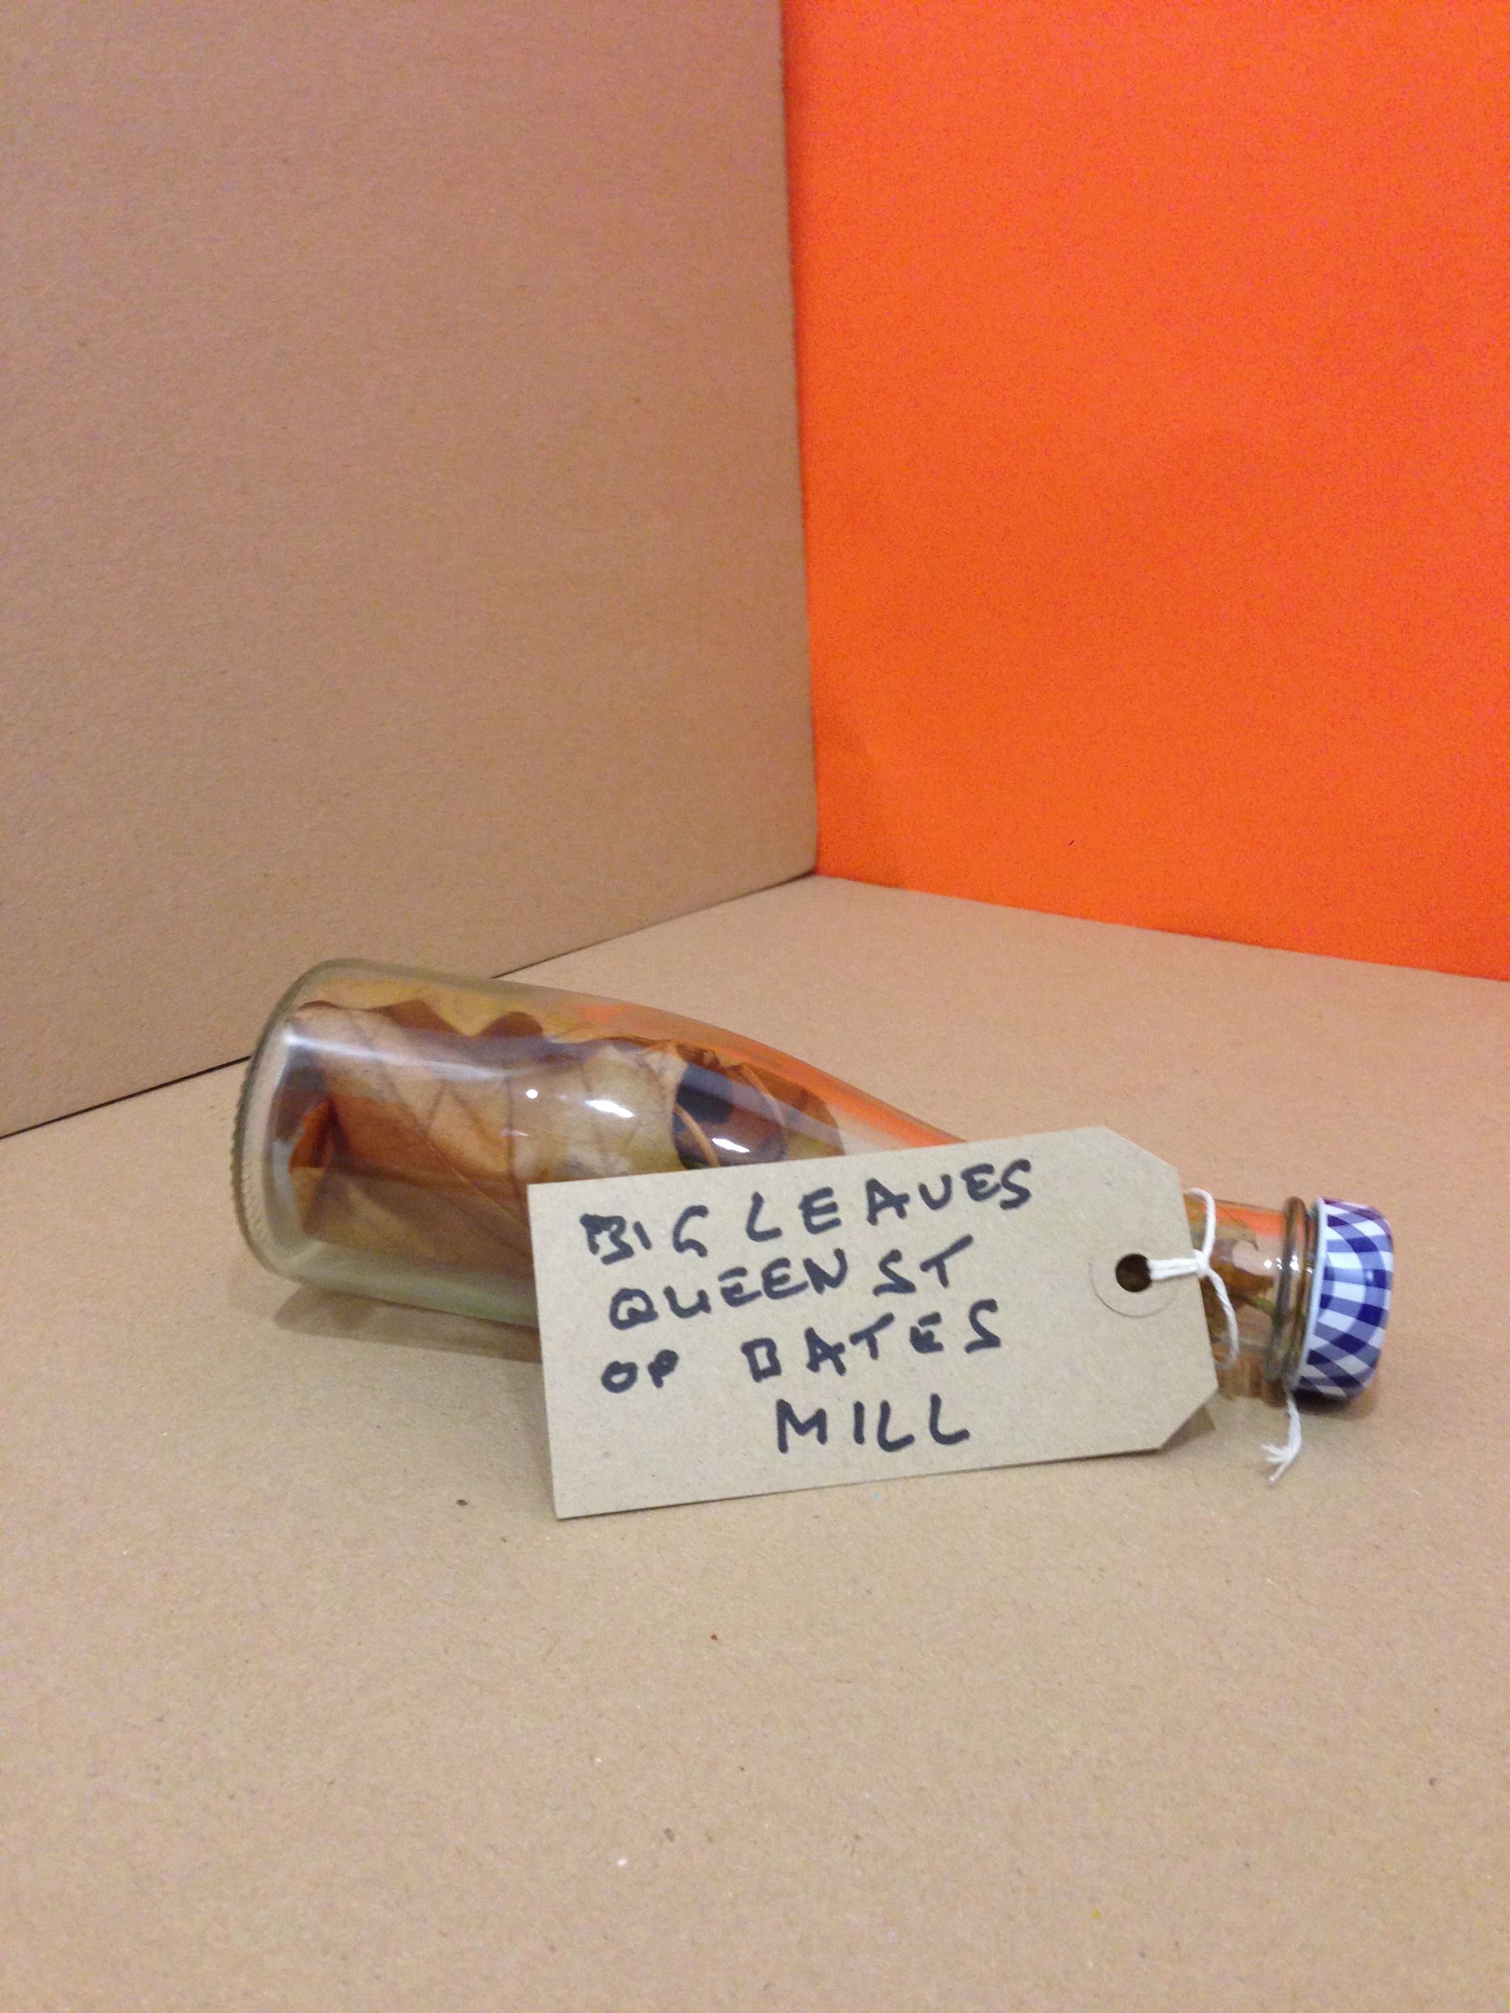
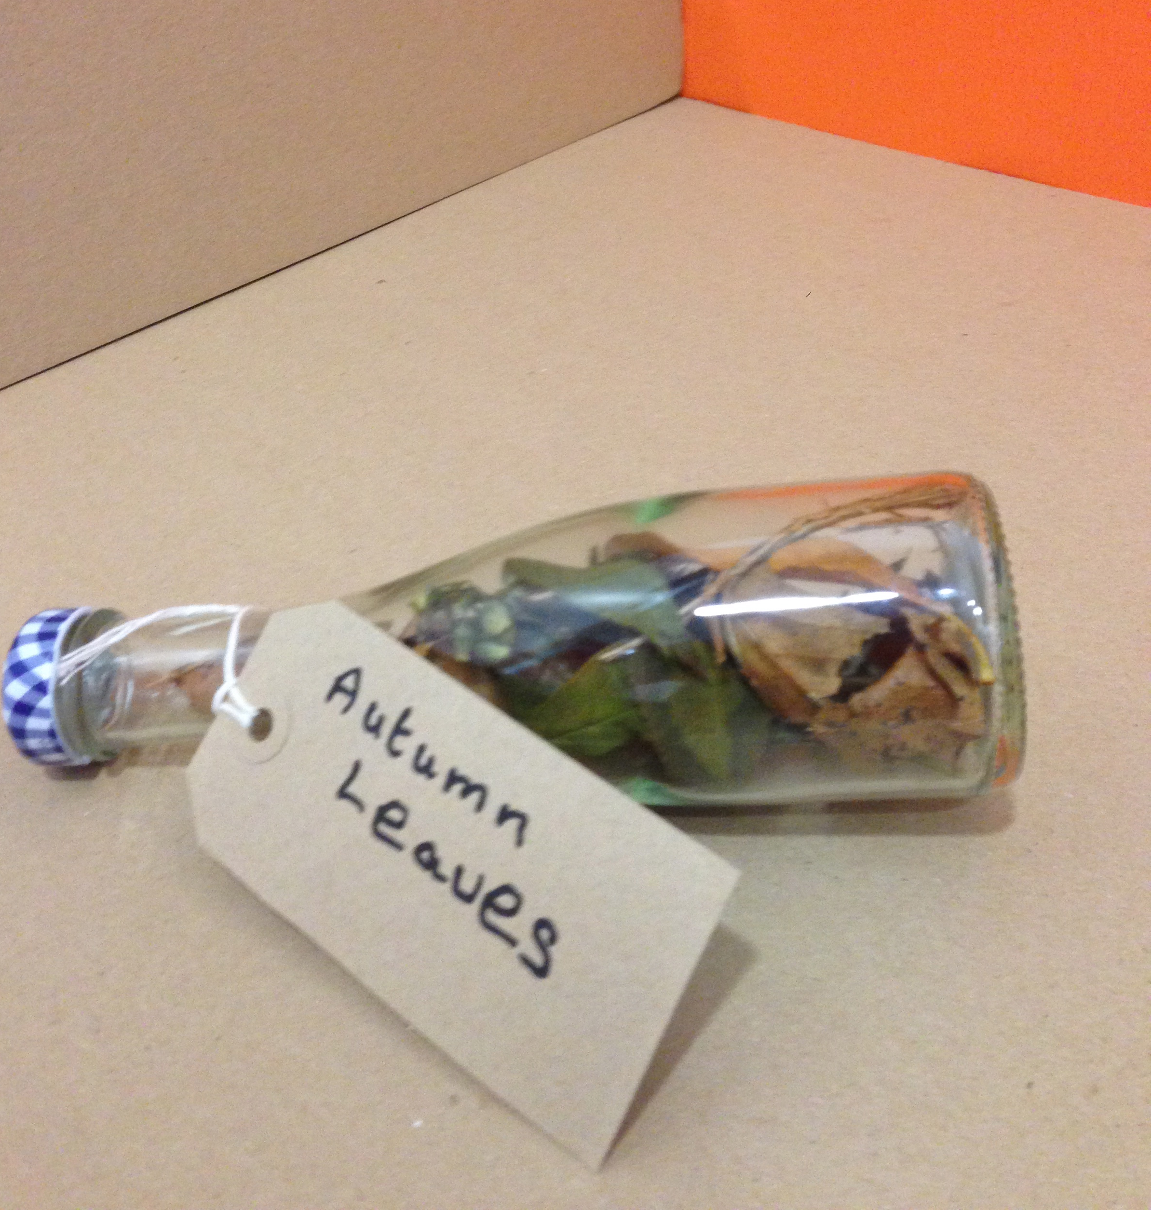
EXPLORATION 4:
SCAVENGER’S
HUNT
ARTISTS
RIKKI ROYSTON
REBECCA MILNER
TERRY BARNES
DAVID SLATER
BARRIE WALSH
L. DEVI. SEEPUJAK
RICHARD TAYLOR
ALEX BRIDGER
DAVE JORDAN

Slide 28
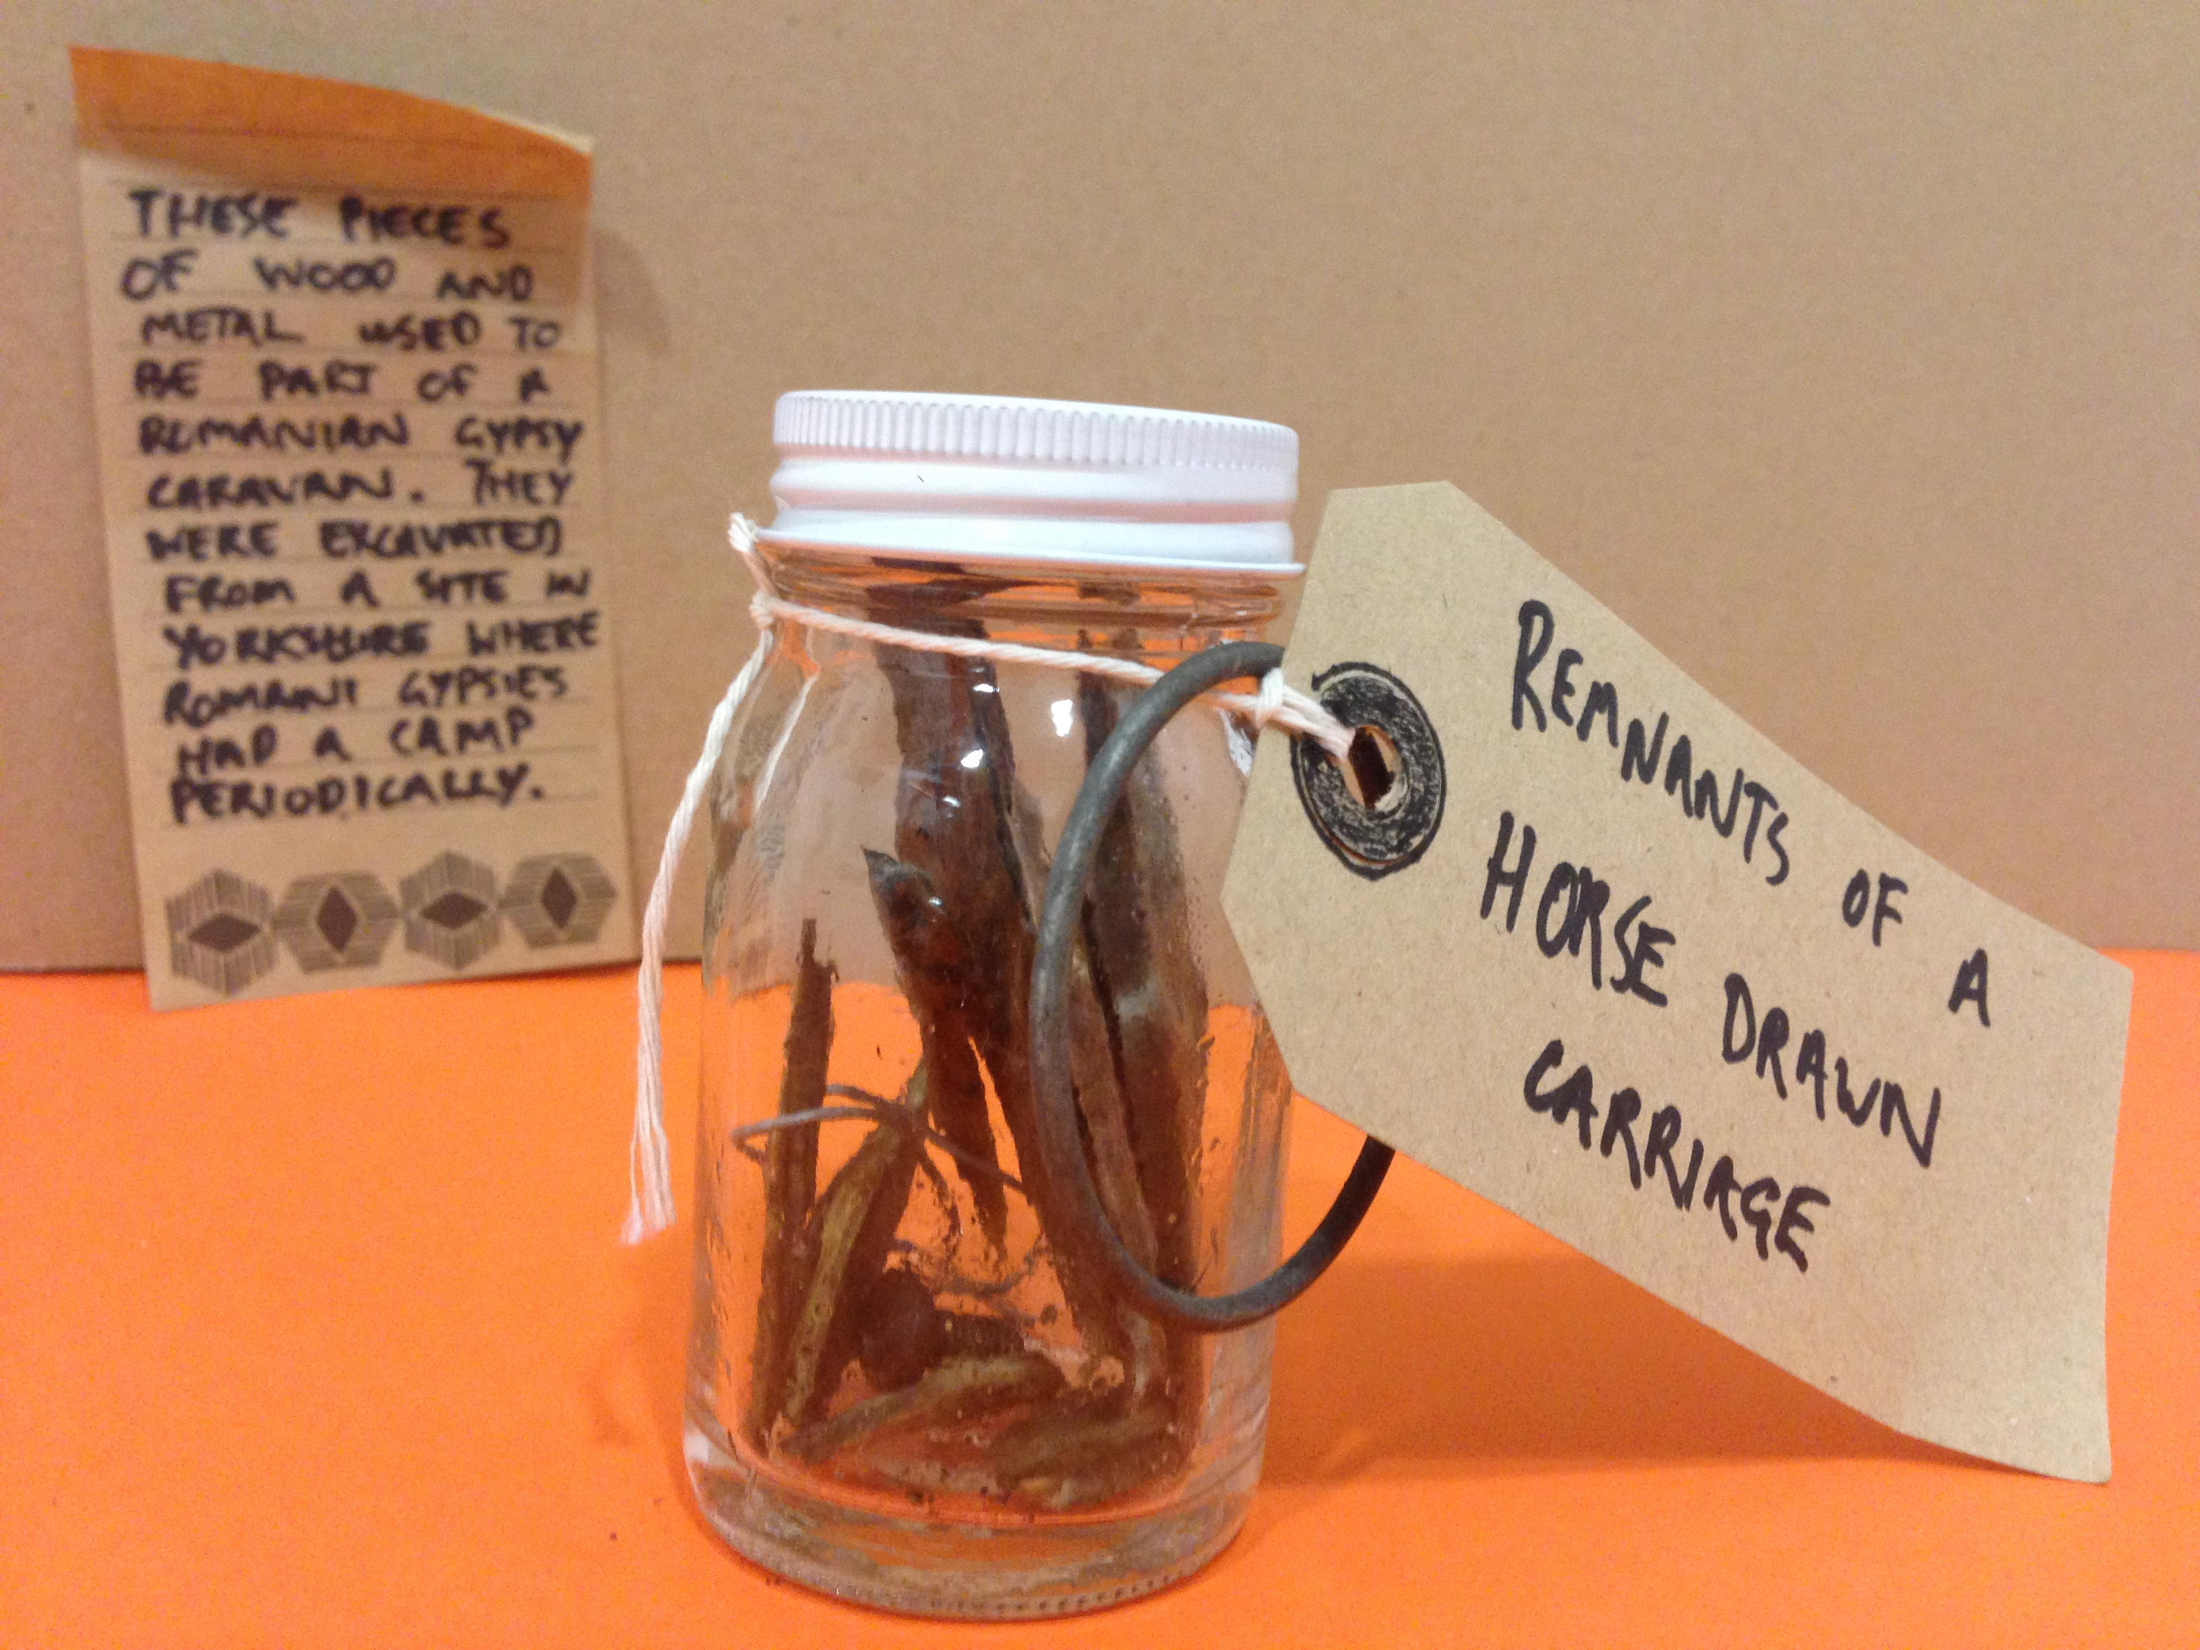
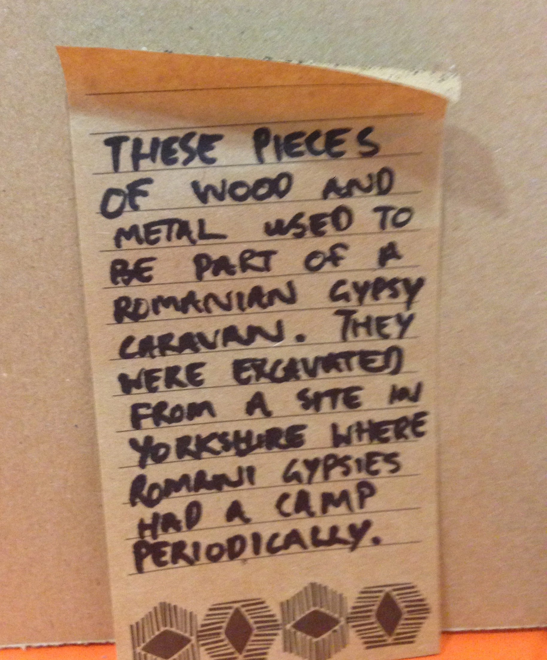
EXPLORATION 4:
SCAVENGER’S
HUNT
ARTISTS
RIKKI ROYSTON
REBECCA MILNER
TERRY BARNES
DAVID SLATER
BARRIE WALSH
L. DEVI. SEEPUJAK
RICHARD TAYLOR
ALEX BRIDGER
DAVE JORDAN

Slide 29
EXPLORATION 5:
MAP MAKING

Slide 30
EXPLORATION 5:
MAP MAKING
INSTRUCTIONS
1. Gather the items you collected and created during your scavenger’s hunts. Poems, pictures of your sculptures, writing, sketches and collages.
2. Explore the above items further. Where did you find them? Recall their origins. Trace their stories. Or make up new stories.
3. Create subverted maps based on the memories of the places you visited during your explorations. Recall smells, textures, sound, patterns you encountered.
4. Super impose the maps and use images, notes and your imagination to alter the conventional maps in order to create some sort of narrative.
5. Change rules of mapping.
6. Create maps based on emotions, memories, and instinct.
7. Exhibit. Discuss. Reflect.
ARTISTS
RIKKI ROYSTON
REBECCA MILNER
TERRY BARNES
DAVID SLATER
BARRIE WALSH
L. DEVI. SEEPUJAK
RICHARD TAYLOR
ALEX BRIDGER
DAVE JORDAN

Slide 31
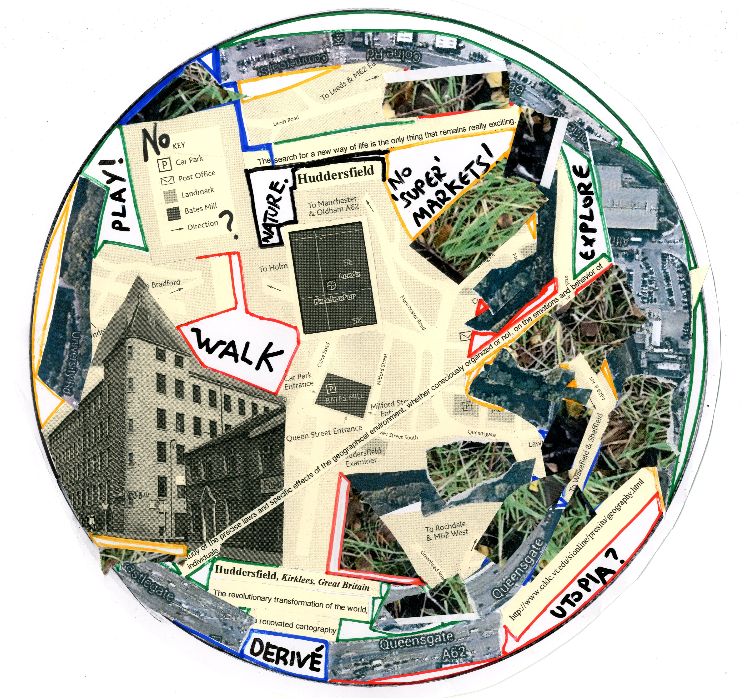
EXPLORATION 5:
MAP MAKING
ARTISTS
RIKKI ROYSTON
REBECCA MILNER
TERRY BARNES
DAVID SLATER
BARRIE WALSH
L. DEVI. SEEPUJAK
RICHARD TAYLOR
ALEX BRIDGER
DAVE JORDAN

Slide 32
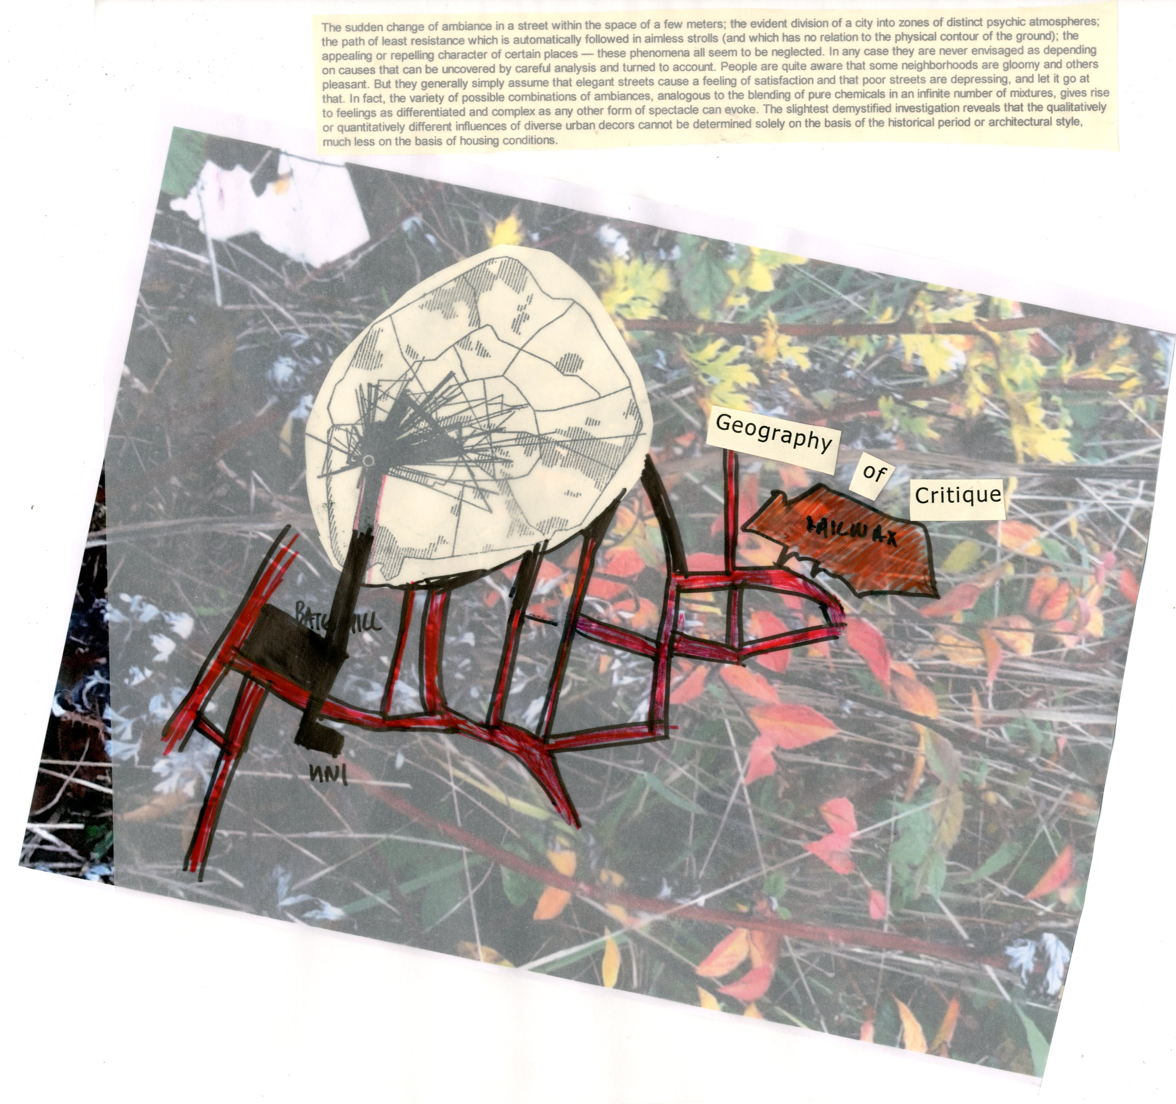
EXPLORATION 5:
MAP MAKING
ARTISTS
RIKKI ROYSTON
REBECCA MILNER
TERRY BARNES
DAVID SLATER
BARRIE WALSH
L. DEVI. SEEPUJAK
RICHARD TAYLOR
ALEX BRIDGER
DAVE JORDAN

Slide 33
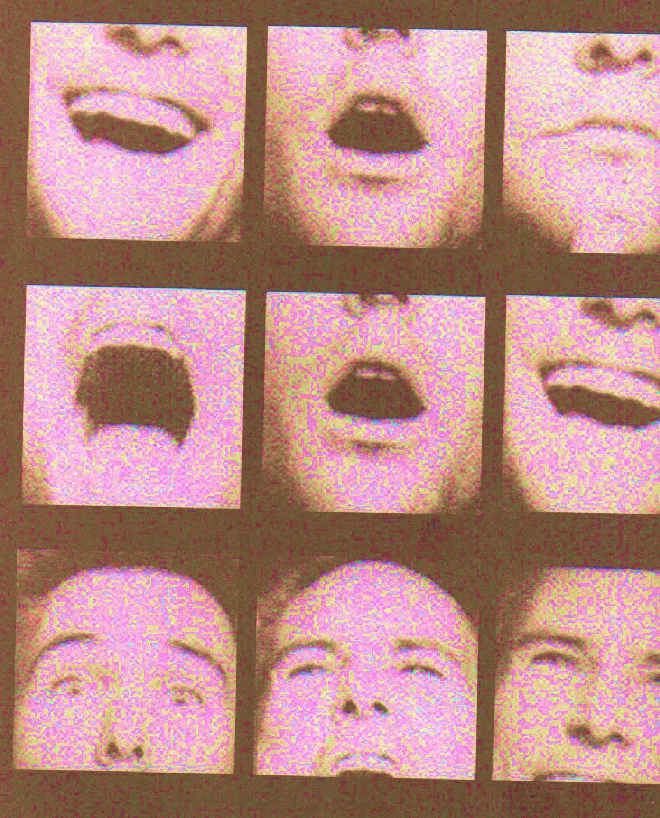
Being Heard
Space affects our behaviour and is the canvas upon which we draw our itineraries and unfold the string of our lives.
By recognizing which elements of their surrounding built environment are contributing to their well-being, the participants of the workshops engaged in a more subjective way of recording information about space and suggested a more participatory way of planning space.
Illustration by Keri Smith
“The Pocket scavenger”| penguin.com/kerismith

Slide 34
References
156a infoshop (2005) “You are here but why? A free festival of mapping”, http://www.56a.org.uk/mapfesttext.html accessed 16 February 2014.
Bevington, D., and Dixon, C. (2005) ‘Movement-relevant theory: Rethinking social movement scholarship and activism’. Social Movement Studies 4 (3): 185-208.
Bridger, A. (2011) ‘Psychogeography and the study of social environments’, in Paula Reavey (ed.) Visual Methods in Psychology: Using and Interpreting Images in Qualitative Research. London: Routledge, pp. 284-295.
Bridger, A.J. (2012) ‘Psychogeography, anti-methods and urbanism’. Paper presented at: Situationist Aesthetics: The Situationist International Now Conference, 8th June 2012. University of Sussex, Brighton.
Bridger, A.J. (2014) ‘Visualising Manchester: Exploring new ways to study urban environments with reference to situationist theory, the dérive and qualitative research’, Qualitative Research in Psychology, 11 (1): 78-97.
Cobarrubias, S. and Pickles, J. (2009). “Spacing movements: The turn to cartographies and mapping practices in contemporary social movements.” Pp. 36-59 in B. Warf, B. and S. Arias, eds. The spatial turn: Interdisciplinary perspectives. London: Routledge.
ARTISTS
RIKKI ROYSTON
REBECCA MILNER
TERRY BARNES
DAVID SLATER
BARRIE WALSH
L. DEVI. SEEPUJAK
RICHARD TAYLOR
ALEX BRIDGER
DAVE JORDAN

Slide 35
De Botton, A. (2006) The Architecture of Happiness. London: Penguin
Debord, G. (1955) “Introduction to a Critique of Urban Geography”, at http://library.nothingness.org/articles/SI/en/display/2 accessed 19 February 2014
Debord, G. (1967) The Society of the Spectacle. Paris: Buchet-Chastel
Dillon, J. (2011). The personal is the political. In M. Rapley, J. Moncrieff & J. Dillon (Eds.),
Dillon, J., & May, R. (2002). Reclaiming experience. Clinical Psychology, 17, 25-28.
Firth, R. (2012) ‘Transgressing Urban Utopianism: Autonomy and Active Desire’, Geografiska Annaler Series B: Human Geography, 94 (2): 89-106.
Guattari, Félix. 2013. Schizoanalytic Cartographies. Trans. A. Goffey. London: Bloomsbury.
Vaneigem, R. (2006). The Revolution of Everyday Life. Translated by D. Nicholson-Smith. London: Rebel Press.
ARTISTS
RIKKI ROYSTON
REBECCA MILNER
TERRY BARNES
DAVID SLATER
BARRIE WALSH
L. DEVI. SEEPUJAK
RICHARD TAYLOR
ALEX BRIDGER
DAVE JORDAN

Slide 36





ARTISTS
RIKKI ROYSTON
REBECCA MILNER
TERRY BARNES
DAVID SLATER
BARRIE WALSH
L. DEVI. SEEPUJAK
RICHARD TAYLOR
ALEX BRIDGER
DAVE JORDAN

