Slide 1
Psychogeography: Research, revolution and education
Dr Alexander J Bridger
University of Huddersfield

Slide 2
Aims of session
Explain the term ‘psychogeography’
Discuss academic literature on environments and why research needs to be explicitly political
Discuss situationist, critical psychological, affective position
Argue for academic, activist and artistic work – participatory research
Provide reflections and implications of the research

Slide 3
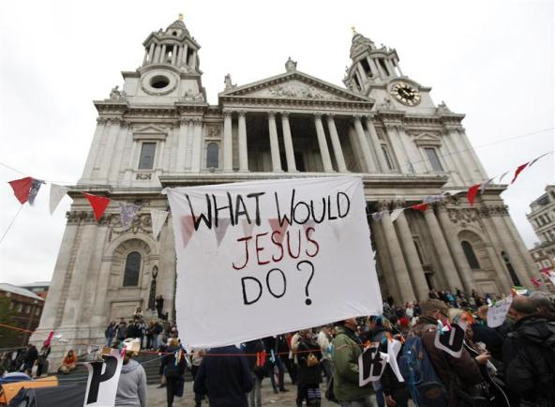
Occupation, space and cities
Notes:
Occupy Movement
Wall Street
London

Slide 4
Mainstream and critical psychologies
Limits of research from environmental psychology (cognitions) and social psychology (place identity)
Turn to politicising studies of environments
Cultural geography - subjectivity
Critical psychology – mobile methods, situationist work
Affect and psychoanalysis – unconscious/conscious
Situationism – politics of space

Slide 5
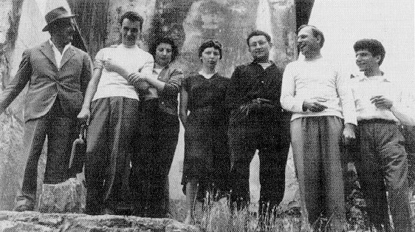
Situationism and psychogeography
‘Psychogeography could set for itself the study of the precise law and specific effects of the geographical environment, consciously organised or not, on the emotions and behaviours of individuals’
(Debord, 1955: n.p).
Notes:
Routine modes of behaviour – free association, spontaneity ….
Their first task was to ‘enable people to stop identifying with their surroundings and with model patterns of behaviour’
(Kotanyi & Vaneigem, 1961).

Slide 6
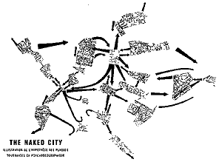
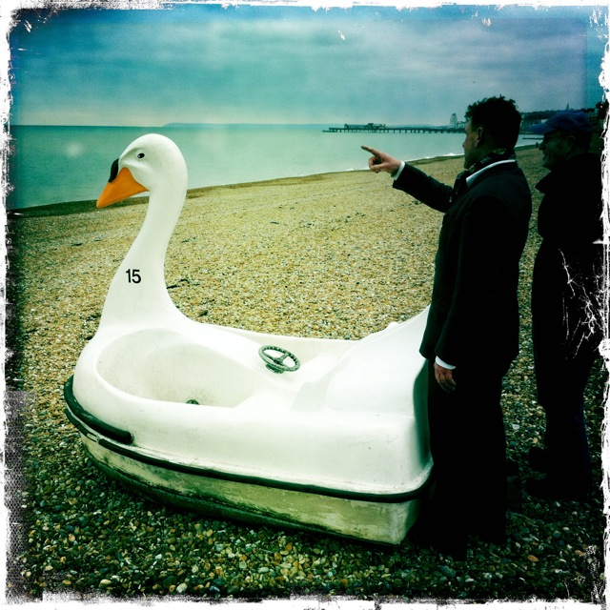
Situationist psychogeography: Concepts and ‘playful’ tactics
Play vs empiricism?
Dérive
Detournement
Negation
Creating ‘situations’
Notes:
‘The desire to play has returned to destroy the hierarchical society which banished it. At the same time it is setting up a new type of society, one based on real participation’ (Vaneigem, 1967: n.p)

Slide 7
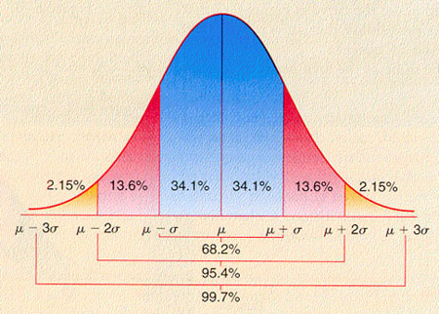
OMD Obsessive methodolatry disorder
Situationism and the anti-methods approach
Tactics and strategies rather than methods
Intervening and creating situations rather than simply measuring and interpreting environments …

Slide 8
A ‘how to’ guide to psychogeography!
Begin with a theme to explore say consumerism, privatisation, surveillance and power relations in spaces …
Choose a psychogeography approach like a dice walk or a map swap
Consider the following sorts of questions: What does it feel like where you walk? How do you engage with your surroundings? Do you notice any notable changes in ambience? What do you think of the environment? What do you think needs to be changed in the environment? What should the environment look like?
Document and write up the dérive
Conduct further dérives!

Slide 9
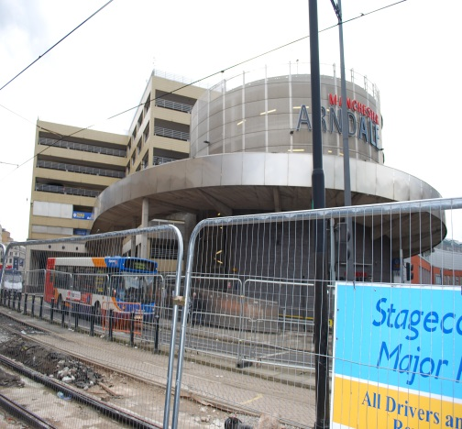
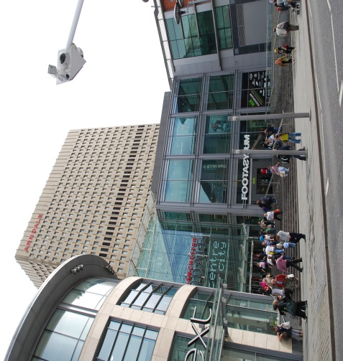
A psychogeographical study
My ‘Visualising Manchester…’ paper
Site specific study – post IRA bomb and gentrification
Themes: consumerism and privatisation; surveillance and control

Slide 10
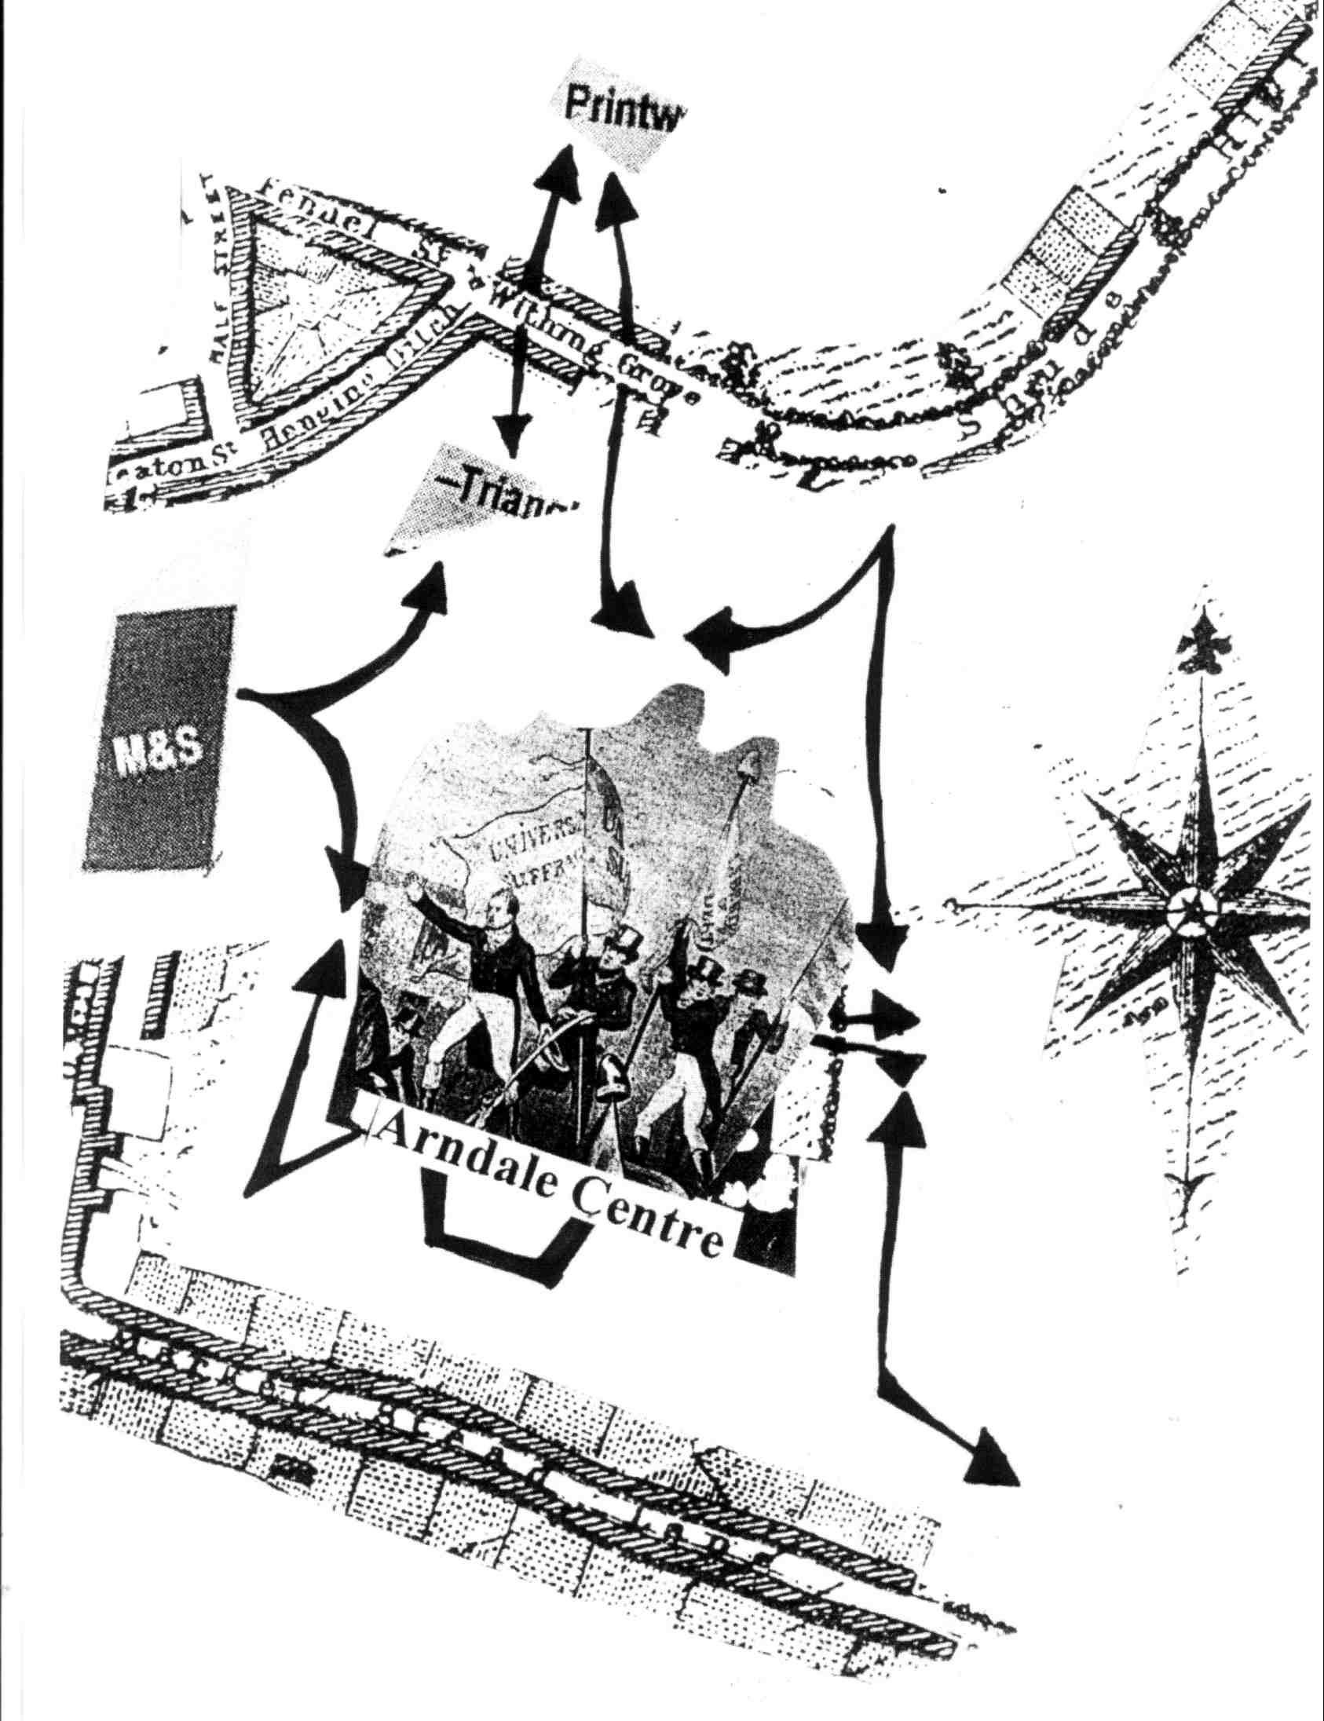
Not a ‘garden path analysis’ (Richards, 1998)
Extract from dérive report: ‘So then having walked endlessly around the Arndale Centre, the food court and the Arndale Market, I decided to walk through the glass tunnel to the building which houses Selfridges and Marks and Spencers. On route, I encountered many visual and textual motifs of consumerism such as ‘The centre of your city’, being encouraged to ‘Shop. Eat. Relax. Treat’ and to consider ‘shopping, fashion, eating and drinking’. Here is evidenced a new Western discourse of consumption which can be linked to individualism and consumer citizenship’ (Bridger, 2014: 88).

Slide 11
Contributing to psychogeographical studies
Form, function and use of neoliberal environments
Political analyses of environments
Need for developing further psychogeographical work
Research making connections with activist and art practice – participatory research

Slide 12
Change?
Teaching and writing
Psychogeography groups, individual and public activity
Public consultations
And deradicalisation and recuperation?
‘Creating situations’ and revolution?

Slide 13
What sort of environments do we want?
……………………….

Slide 14
Chtcheglov’s (1958) suggestion discussed here:
‘Bizarre Quarter — Happy Quarter (specially reserved for habitation) — Noble and Tragic Quarter (for good children) — Historical Quarter (museums, schools) — Useful Quarter (hospital, tool shops) — Sinister Quarter, etc. And an Astrolarium which would group plant species in accordance with the relations they manifest with the stellar rhythm, a planetary garden along the lines the astronomer Thomas wants to establish at Laaer Berg in Vienna. Indispensable for giving the inhabitants a consciousness of the cosmic. Perhaps also a Death Quarter, not for dying in but so as to have somewhere to live in peace — I’m thinking here of Mexico and of a principle of cruelty in innocence that appeals more to me every day. The Sinister Quarter, for example, would be a good replacement for those hellholes, those ill-reputed neighborhoods full of sordid dives and unsavory characters, that many peoples once possessed in their capitals: they symbolized all the evil forces of life. The Sinister Quarter would have no need to harbor real dangers, such as traps, dungeons or mines. It would be difficult to get into, with a hideous decor (piercing whistles, alarm bells, sirens wailing intermittently, grotesque sculptures, power-driven mobiles, called Auto-Mobiles), and as poorly lit at night as it was blindingly lit during the day by an intensive use of reflection. At the center, the “Square of the Appalling Mobile.” Saturation of the market with a product causes the product’s market value to fall: thus, as they explored the Sinister Quarter, the child and the adult would learn not to fear the anguishing occasions of life, but to be amused by them.

Slide 15
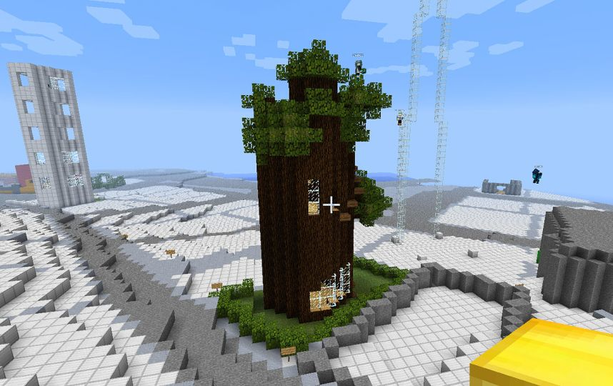
Blockholm – A new Stockholm in Minecraft: ‘Blockholm is an exact replica of Stockholm reproduced in Minecraft. All districts, islands, streets, bridges, parks and squares are depicted as in real life with one big exception - we have deleted all the city buildings. Only plots are left. On October 24, we start to build Block Holm - a new Stockholm in Minecraft! Join in and take the first sod! Old Town is the first’ (http://www.blockholm.com/participate).

Slide 16
Any questions?
My contact details:
Email: a.j.bridger@hud.ac.uk Work web: http://www2.hud.ac.uk/hhs/staff/shumajb.php
Facebook: Huddersfield Psychogeography Network Blog: notanotherpsychogeographyblog.wordpress.com

