Slide 1
Self-perception, Self-esteem and Relationship Behaviour
Dr Chris Bale
Department of Behavioural and Social Sciences
University of Huddersfield
c.bale@hud.ac.uk

Slide 2
The problem of low self-esteem
“Low self-esteem is the root of all of the problems in the world”
(Oprah Winfrey)
“I cannot think of a single psychological problem—from anxiety and depression, to fear of intimacy or of success, to spouse battery or child molestation—that is not traceable to the problem of low self-esteem” (Dr Nathaniel Branden)
Author of “How to raise your self esteem” (£5.99)
The “epidemic of low self-esteem” (Senator John Vasconcellos).
“Facebook users are ‘insecure, narcissistic and have low self-esteem” (Daily Mail, Sept 2010)

Slide 3
A quick experiment
What percentage of people do you think you are more likeable than?
Most likeable
0%
50%
100%

Slide 4
The better than average effect
Most people think that they are above average on a wide range of positive traits, and below average on negative ones (e.g. Williams & Gilovich, 2008).
E.g. intelligence, attractiveness, sense of humour, driving skill etc.
This even applies to the effect itself! (Pronin, Gilovich, & Ross, 2004)

Slide 5
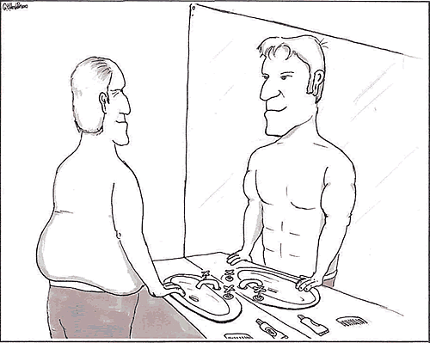
An epidemic of low self-esteem?
Most people score above the mid point of self-esteem scales.
Vast literature on positive biases in self-perception:
Social comparisons
Attributions and self serving bias
Self-handicapping
Memory
Psychological benefits of self-deception
E.g. optimism and self-fulfilling prophecies

Slide 6
Consequences of self esteem
No clear relationships between self-esteem and adolescent smoking, drinking, drug abuse and sexual behaviour.
Often high self-esteem is associated with
aggression and prejudice.
Problems of interpreting these relationships (i.e. direction of causation).
E.g. Significant (but weak) relationships between self-esteem and academic performance (Baumeister et al. 2003).
“Top down” vs “Bottom up” explanations of relationships between self-esteem and self-perceptions.

Slide 7
Sociometer Theory
Leary & Baumeister (2000).
Functional, evolutionary explanation of self-esteem.
Self-esteem functions as an interpersonal monitor of:
the quality and quantity of existing relationships,
perceived eligibility for relationships,
and motivates individuals to act accordingly.

Slide 8
Attractiveness and Self-esteem
Self-perceived attractiveness (SPA) positively correlates with self-esteem in both sexes. (e.g. Nell & Ashton, 1996)
Especially strong relationship in women.
Correlational data is consistent with Sociometer theory (“bottom-up”).
However data can also be explained by “top-down” theories (e.g. Brown et al. 2001)
Studies showing that there is little relationship between self and other rated attractiveness (e.g. Diener et al, 1995) suggest against Sociometer theory.
Need for experimental studies to examine direction of causation.

Slide 9
Does self-perceived attractiveness affect self-esteem?
Female participants asked to rate attractiveness of (study 1; n = 128) or compare own attractiveness to (study 2; n = 137) “hot” or “not” pictures.
Then completed a variety of measures of SPA and SE.
“Hot”
“Not”

Slide 10
Results
No initial differences in SPA between groups.
After the comparison task, participants in the “Not” condition rated themselves as significantly more attractive than those in the “Hot” group.
No group differences on any self-esteem scales or subscales.
Does SE affect SPA? (Study 3)

Slide 11
Study 3: Method
2 groups: +ve / -ve manipulation (Riketta & Dauenheimer, 2003) .
76 female participants asked to complete a “reaction time” test.
Then complete SE manipulation check and a measure of SPA.
+
I BAD
JKDWCBZV
Fixation Prime (60 ms) Mask (60 ms)
Respond: Left / Right

Slide 12
Results
p<.05
p<.05
Participants in +ve condition reported significantly higher subsequent levels of both SE (d = .50) and SPA (d = .39).

Slide 13
Self-esteem and relational behaviour
Sociometer theory predicts SE should affect relational behaviour.
Limited and inconsistent evidence on this relationship (Baumeister et al, 2003).
Dependency Regulation perspective (Murray et al, 2006)
Individuals with low self-esteem are especially sensitive to rejection.
They often react to this by denigrating and emotionally distancing themselves from their partners.
How do individuals behave in the absence of relational threats?

Slide 14
Aims and predictions
Study 4 examined relationships between women’s:
Self-esteem.
Self-reported relational behaviour.
Perceptions of their own and their partners’ relational desirability.
Sociometer theory suggests low SE should predict more positive relational behaviour.
Equity Theory (Thibaut & Kelly, 1959) suggests lower relative desirability should predict more positive behaviour.

Slide 15
Method
192 women aged 18-60 (mean = 27.2) engaged in long term relationships (> 3 months, mean = 5 years) completed online measures of:
Self-esteem: SES (Rosenberg, 1965) & PEI (Shrauger & Schohn, 1995).
Relational desirability: MVI (Kirsner et al, 2003) Self & Partner.
Relational behaviour: MRI (Buss, 1988) & PSII (Ellis, 1998).

Slide 16
Results
After controlling for age and length of relationship:
Self–esteem (SES) did not significantly predict relational behaviour.
Relative desirability significantly negatively predicted partner investment behaviour (r² = .27, p<.05).
Women who feel less desirable than their partners invest more heavily in their relationships.

Slide 17
Conclusions
Self-esteem seems to influence self-perceptions of attractiveness.
No evidence that self-perceived attractiveness influences self-esteem:
Implications for possible effects of media images on body image and self-esteem.
Self-esteem does not seem to predict relational behaviour in women.
What about men?
Possible implications for understanding partner violence and abuse.

Slide 18
Summary
It’s unclear whether self-esteem affects behaviour.
We should be cautious in interpreting correlational data on self-esteem.
Most people are good at feeling good about themselves.
This seems to contribute to happiness, health and wellbeing.
Certain individuals (especially those who suffer from depression) are less able to do this.
Beware of narcissistic and self-loathing facebook users!

Slide 19
Thanks for your attention
Thanks for listening.
Chris Bale
c.bale@hud.ac.uk

