Slide 1
Does Buying Books Help Students Build
a Brighter Future?
Dave Pattern
Library Systems Manager
University of Huddersfield
d.c.pattern@hud.ac.uk

Slide 2
so, does buying books help students build a brighter future?
...probably!
Notes:
Thought I’d start the presentation with the end of the presentation, in the style of “Sunset Blvd”, “Shallow Grave”, “Citizen Kane”, etc

Slide 3
♥
we library usage data at Huddersfield
Notes:
http://www.flickr.com/photos/davepattern/2183416874/in/photostream/

Slide 4
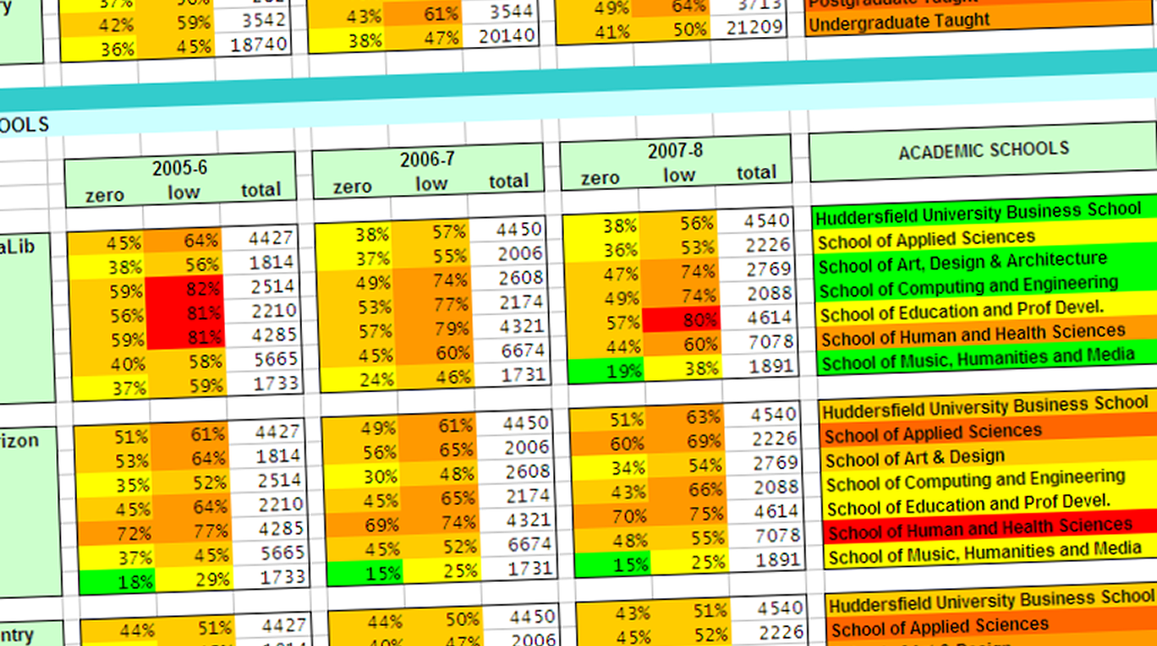
Non & Low-Usage Project 2005 onwards
“is there a link between library usage and final grade?”
Notes:
We’ve been analysing library usage (and non-usage) data for nearly a decade

Slide 5
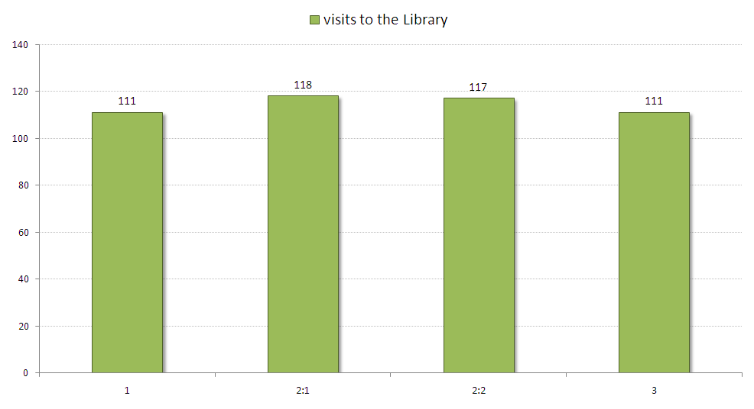
Honours Graduates 2007/8 & 2008/9 – visits to the library
1
2:1
2:2
3

Slide 6
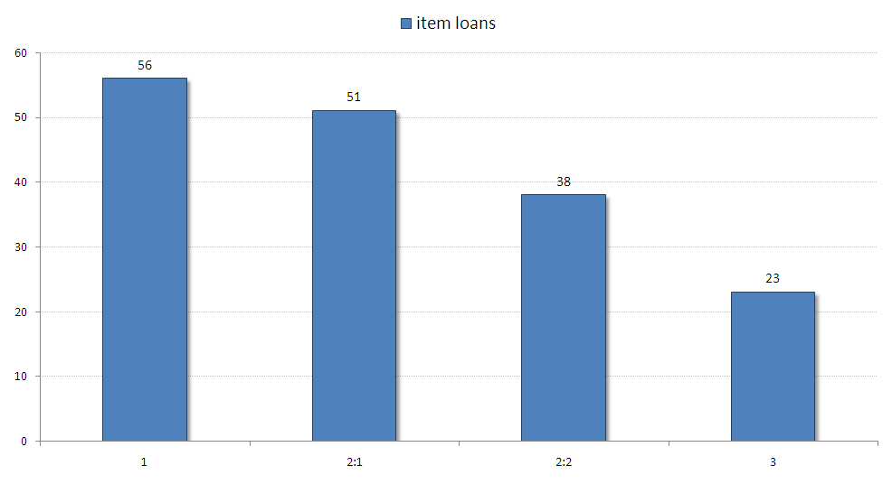
Honours Graduates 2007/8 & 2008/9 – item loans
1
2:1
2:2
3

Slide 7
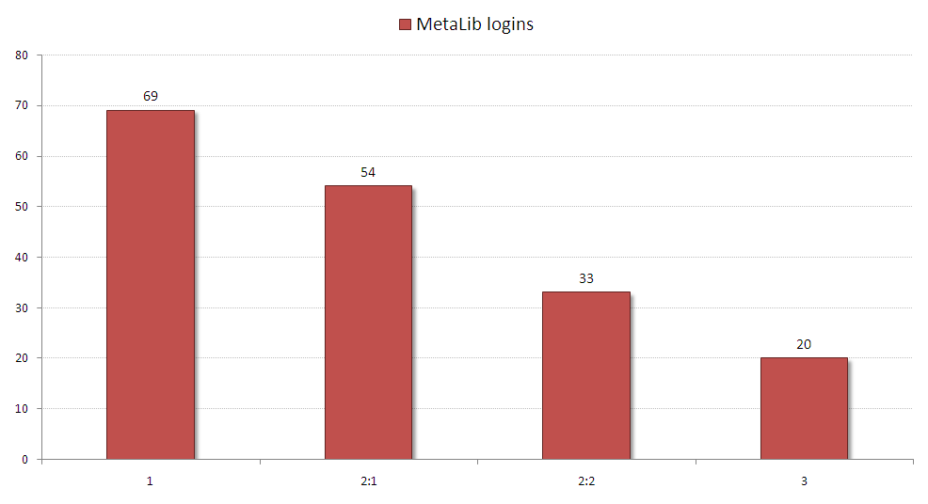
Honours Graduates 2007/8 & 2008/9 – e-resource logins
1
2:1
2:2
3

Slide 8
JISC Library Impact Data Project Phase 1
33,000 graduates across 8 UK universities

Slide 9
JISC Library Impact Data Project Findings from Phase 1
Huddersfield’s usage data is broadly representative of UK HE libraries
Highly statistically significant link between usage (books and e-resources) and final degree level...
...however, as data wasn’t continuous, we couldn’t support a correlation

Slide 10
JISC Library Impact Data Project Phase 2 (Jan-Oct 2012)
In-depth analysis of Huddersfield’s 2010/11 graduates, including:
final % grade mark (to prove correlation)
demographic data
more than 120 library usage metrics, including usage by hour of day, PC usage, journal article downloads, etc

Slide 11
JISC Library Impact Data Project Findings from Phase 2 (Jan-Oct 2012)
http://library.hud.ac.uk/lidp
gender differences in library usage
marked differences in domicile
(predictable) differences in discipline areas
breadth of reading is important
non-usage as a retention predictor
initial evidence of causality!

Slide 12
that’s all very well, but what about students buying books?!
...unfortunately, we don’t for sure what books students buy, however...

Slide 13
MyReading Project
reading list software developed in-house
winner of NAG Award for Excellence 2012
runner up Guardian Education Awards 2013
reading lists for 98% of all modules

Slide 14
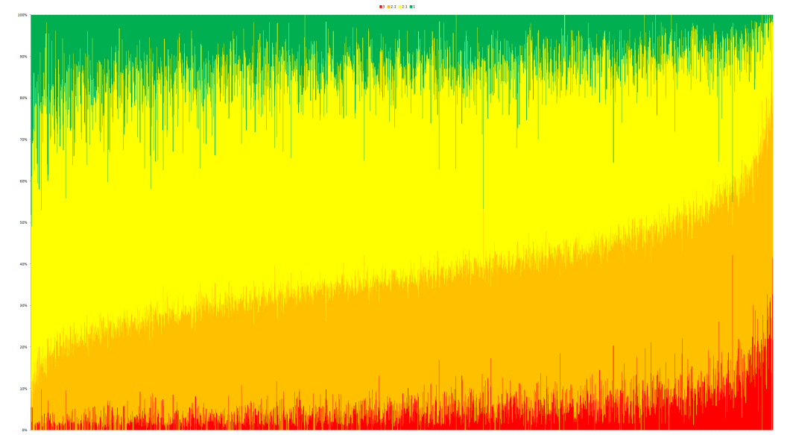
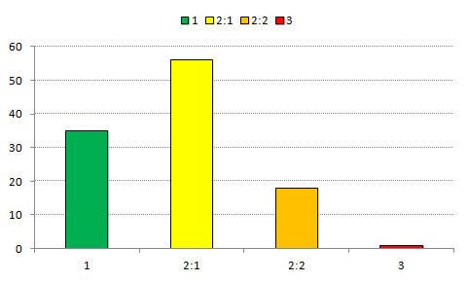
The most scholarly books? Stacked graph of loaned items & grades
Notes:
An example of an item where it was predominantly loaned to students who achieved better results

Slide 15
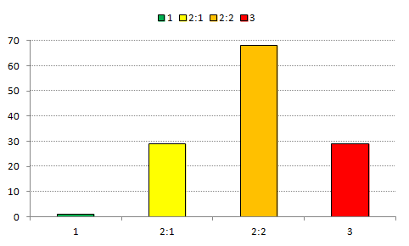
The most scholarly books? Stacked graph of loaned items & grades
Notes:
An example of an item where it was predominantly loaned to students who achieved lower class honours degrees and was (for whatever reason) shunned by students who got a first

Slide 16
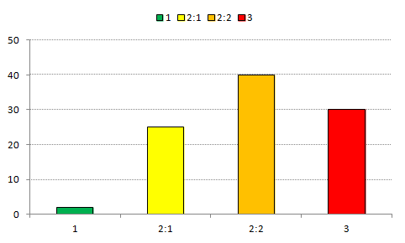
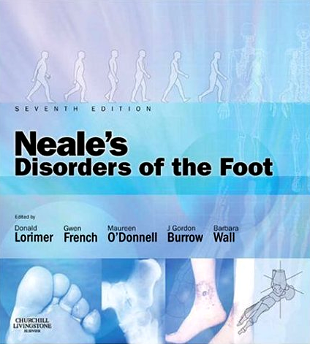
The most scholarly books? Stacked graph of loaned items & grades
essential reading on several modules!
Notes:
Some examples of core/essential reading titles that weren’t borrowed as highly by first & 2:1 students...

Slide 17
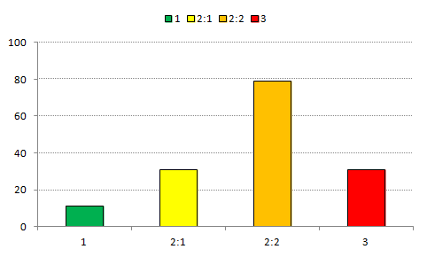
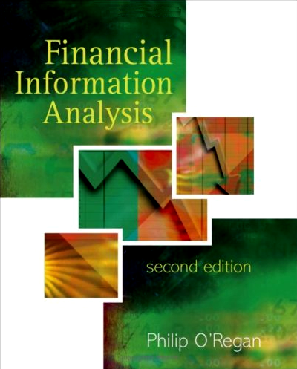
The most scholarly books? Stacked graph of loaned items & grades
core text reading on several modules!
Notes:
Some examples of core/essential reading titles that weren’t borrowed as highly by first & 2:1 students...

Slide 18
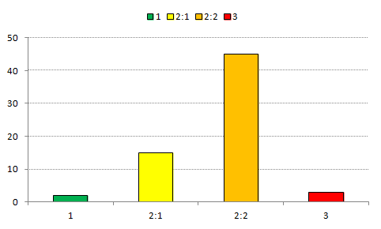
The most scholarly books? Stacked graph of loaned items & grades
essential reading on several modules!
Notes:
Some examples of core/essential reading titles that weren’t borrowed as highly by first & 2:1 students...

Slide 19
Huh?!?
Q. Why aren’t the highest achievers borrowing core texts from the library?
A. We can’t say for sure (yet!), but the working assumption is that they’re not borrowing them because they don’t need to, or to put it another way...

Slide 20
they’ve already bought them

Slide 21
So, what next?
We need to do more analysis of how core texts are promoted and used
Q. What would happen if you gave all the students their own copies of the core texts? (hypothesis: grades would improve)

Slide 22
so, does buying books help students build a brighter future?
...probably!

Slide 23
That’s all folks!
Thank you for listening ☺
http://library.hud.ac.uk/lidp
email: d.c.pattern@hud.ac.uk

