Slide 1
Lecturer identity: juggling tensions
Liz Bennett
University of Huddersfield
BERA 2012
@lizbennett1
e.bennett@hud.ac.uk

Slide 2
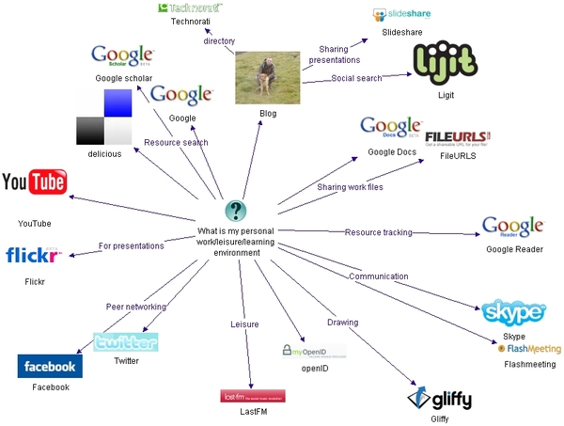
Web 2.0 = collaborative and participatory
Weller (2007) http://nogoodreason.typepad.co.uk/no_good_reason/2007/12/my-personal-wor.html
Notes:
Dynamic ie changes over time and personal

Slide 3
Structure
Identity and Web 2.0 tools
Outline of my research
methodology
Identity management
Strategies

Slide 4
Crook’s 4 features of Web 2.0
Scaling up participation, where quality of the service is improved with greater number of participants;
Sharing and joint knowledge building functions, i.e. user collaboration;
Using a range of formats, not just text e.g. video and picture and audio;
Rich and democratic forms of participation means there are novel frameworks for research and inquiry (2008, p.9).
Notes:
Web 2.0 fit with good practice ie Franklin and Van Hamelem (2007) say web 2.0 allows:
greater student independence and autonomy, greater collaboration, and increased pedagogic efficiency. (2007, p.1)

Slide 5
Web 2.0 different way of knowing (Beetham et al. 2009)
Academic Knowledge practice | Internet knowledge practice
Individual authority | Shared ownership
The individual occupies a stance/position from which a judgement can be made | The individual is “a node through which various kinds of message pass” (Lyotard, 1984)
Philosophy | Design
Truth value | Use value
Quality of method | Quantity of links/citations/uses
(Disciplinary) tradition of what knowledge matters, and how it comes to mean | The eternal ’now’ of what technology makes possible
How I come to know | Who I know
Synthesis (in a dialectical sense) | Aggregation, re-use
Dialogue, disputation | Comment
Discipline/profession as resources (of methods, codes of practice, etc) | Multi-modality, interdisciplinary as resources
Copyright | Digital commons
Qualification (followed by reputation) | Reputation/recognition first
Research | Problem-solving
Subject knowledge and know-how | Generic skills and aptitudes ‘just in time’ knowledge and know-how
Text-based communication of ideas | Multiple media used to express ideas
Sharing within scholarly communities, according to established roles and rules | Sharing without boundaries, across ephemeral and unregulated networks
Notes:
Land and Bayne (2008) talk about how digital technologies “undermine the authority of academic knowledge” (p.676). Dohn (2009) discusses, in depth, the ontological basis of Web 2.0 and argues that the Web 2.0 leads to “people acting differently in sharing collaborating and negotiating meaning on the net in more bottom up ways than before” (p.117) and that Web 2.0 practices embody dynamic, participatory view of knowledge

Slide 6
Problem space
How do academics experience these clashes?
How do they negotiate these tensions?

Slide 7
Structure
Identity and Web 2.0 tools
Outline of my research
methodology
Identity management
strategies

Slide 8
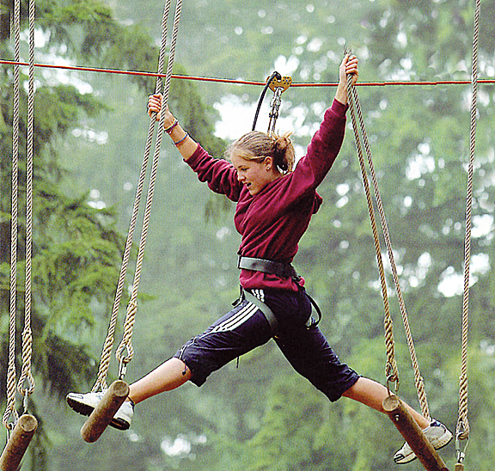
The early adopters
http://glam.co.uk/2011/04/2011s-top-ten-family-destinations/go-ape/
Notes:
Hold the lived experience; taking the risks, innovating in their practice

Slide 9
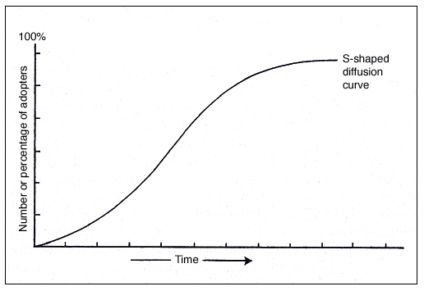
Early adopters from Rogers 1983
Notes:
Focus on lecturers; Ecclesfield and Rebbeck argue that e-maturity in colleges is not about the kit but about the skills
Focus on what can be learnt from lecturers; in terms of their rationale for uptake, personal journeys – structure and agency, their motivations, emotional journey, their skills and how acquired

Slide 10
Not the laggards or technophobes
Youtube Ipad
Notes:
Focus not on the laggards – SimFin’s blinkered horses, or technophobes
Ipad clip – learning what new pedagogies are in practice- are they just new tools used in old ways?
Know that they will talk about the time, the skills, support ‘the usual suspects’

Slide 11
A comment on methodology
Learning from the voices of practitioners;
‘shed light on the interactions between professional identity and agency and how this impacts on their professional practices in times of change’ (Jephcote and Salisbury, 2009, p.967)

Slide 12
Methodology
Phenomenological
Small scale (n=16) lecturers
Across the university – post 1992
Semi structured interviews
Thematic analysis

Slide 13
Structure
Identity and Web 2.0 tools
Outline of my research
methodology
Identity management
strategies

Slide 14
Shards of identity (Stronach et al., 2002)
teacher as recollected pupil;
teacher as pressured individual;
the subject specialist;
the person/teacher I am;
the socialized apprentice;
the coerced innovator;
the convinced professional;
professional critic;
sceptical pragmatist.
I extended these shards with further 12
Notes:
Coupland et al. (2008, p.331) characterise identity as practical project or discursive accomplishments.
Identity located within complexity of structures around them:
The new performative worker is a promiscuous self, an enterprising self, with a passion for excellence. For some, this is an opportunity to make a success of themselves, for others it portends inner conflicts, inauthenticity and resistance. (Ball, 2003, p.215)
Mini narratives, self accounting, exist in tension, toggle between notions of self
Clegg 2008 professionals as split, conflicted plural
My further 12
The anxious innovator;
The coerced employee;
The willing experimenter;
Marginalised innovator;
Qualified and confident;
The student pleaser;
The demanding teacher;
The scared unskilled;
All skilled up;
Equal with students;
A distinct work identity;
Exposed professional.

Slide 15
Identity management and technology
Exposed professional;
Distinct work identity;
Equal with students;
Notes:
But technology not fore grounded in the participant’s discussion.

Slide 16
Economies of performance versus ecologies of practice (Stronach et al., 2002)
Notes:
Mini narratives, self accounting, exist in tension, toggle between notions of self
Economies of performance outside-in – Ball’s performativity agenda
Ecologies of practice inside-out – the self motivated pressure to do the best for your students

Slide 17
Web 2.0 and authority
Valued Web 2.0 for its new ways of knowing
Surprising and different from Clegg et al. (2006)
““nightmare” of a stream of unanswerable questions” (p.96)
Applied to all epistemological traditions
Notes:
As unsettled and uncertain state when undergo changes to practice, with features of anxiety
Lecturers designed activities where students could explore the web, challenge the conventional practices in their subject and suggest new meanings:
I’m quite happy with that [my authority might be undermined]. I quite like a debate. I don’t know how many within the group have retail jobs or have experience, but where does the experience lie? They are obviously far more experienced in their subject area certainly I felt that I was learning from them. [Adrian]
I think in a Web 2 environment, there is more of a levelling out. People assume the same status, in a way that is very different to a physical space particularly when you are stood at the front of a group of learners who are all facing you, but I think it is least important because I don’t particularly have a problem with my authority being examined in that way or not challenged is perhaps too strong a word. I think it is part and parcel of moving to a Web 2 way of working and thinking that this is perhaps in some ways more democratic. That will introduce possibilities for students to contribute in a way that probably feels less constrained in a class room environment but it will also introduce problems as well, potentially such as people going off into topics that you think are completely irrelevant or perhaps behaving in a way that targets individuals personally. [Richard]
I think in HE you are hoping that students will challenge your views and that would just be a part of that. It is not always a comfortable process. It is a process that we would want to happen anyway and the web is just an extension of that obviously with all the provisos about the quality of what they are getting... But on any level it is a psychological challenge but it is a necessary and a good one. [Sue]
I don’t think I know it all and... if my students expect me to then they are misconceived really. We are all learning together and also students come up with some super resources that you can then use next time around. [Emily]

Slide 18
Web 2 is making it seem more and more ridiculous in that we try to maintain this crumbling ivory tower that we are living it... Some of the gate keeping we are doing is just because we can, because we have the power to do so...
Notes:
Web 2 is making it seem more and more ridiculous in that we try to maintain this crumbling ivory tower that we are living it... Some of the gate keeping we are doing is just because we can, because we have the power to do so... don’t want to close gates and open gates just because I can do so and I think a lot people just like the power that academy gives them

Slide 19
They [students] are accessing discussion forums and they can see what other students from other institutions are presenting as solutions or how they solve some difficulties in understanding the content that is presenting and that is something wonderful.
[Crista, a lecturer in control engineering]

Slide 20
Liminality
Meyer and Land (2005) the conceptual space that students enter and occupy
Clegg et al. (2006) the unsettled and uncertain state academics experience as part of adopting new practices
Smith (2010) dissonance during an academic’s induction period

Slide 21
Liminality and ontological security
The majority identified with liminality
Acceptance of risk
Stuck places Mayer and Land (2005); ontological security
Notes:
As unsettled and uncertain state when undergo changes to practice, with features of anxiety
Range of replies (from flat rejection of the concept to total agreement) Range relates to personality type.
Although uncertain and unsettled, and risky
Not ontologically challenged, not in a stuck place as web 2.0 not epistemologically challenging suits their CCSF p 139 orientation to T&L.

Slide 22
Surprises
Economies of performance did not emerge
Anxiety real but not a blocker (not a stuck place)
What overcomes anxiety is belief in value of tools to support their view of good t&l and this is based on a) knowledge of tools, b) match between tool’s affordances for t&l and tutor’s epistemological orientation (CCSF) c) commitment to undertaking risky practice to serve students

Slide 23
Practical strategies – coping
Not positioning themselves as ‘expert’
Accepting the limitations of their skills
Bringing students with you
Being highly prepared
Working through feelings of anxiety
All teaching is risky
Focussing on the potential benefits (commitment to the tool’s potential)
Notes:
See page 116
Practical strategies to manage challenge to their identities brought about by greater access to knowledge;
Page 135

Slide 24
Problem space
How do academics experience clashes between academic practices and Web 2.0 practices?
How do they negotiate these tensions?

Slide 25
Some conclusions;
Belief in potential of tools
Fit epistemologically and ontologically
The ‘stock photo’
I’m doing it because I think that the benefits that accrue might be really important. [Catherine]
Notes:
Tutors believe in the potential of the tools, to support their visions of t&l, value the epistemological traditions of web, acknowledge these tensions, know that we need to teach for them not ignore them (not got this sorted)
they hold this belief of potential in their mind’s eye
Develop strategies to deal with tensions.
Acceptance of change as risky
Fit ontologically and epistemologically with teachers CCSF
Stock photo – ‘a photo that shows the happy (unblemished) faces but what early adopters do is believe in the of positive outcomes of benefits being realised. “I do it anyway, because of the benefits that might accrue”
Because I’m teaching in a new context that has new affordances there is scope to do different things as a teacher that you wouldn’t normally do and so you then have to thinking through for yourself “Is that pedagogically a good decision? Is it ethically a good decision to do it in that way?” And you are making those decisions. And what you are doing is risky because you might make the wrong decision and then you know things can go wrong. You can make students unhappy. But I do it none the less, for a couple of reasons, one is that I think there might be benefits to teaching and learning and that is a central reason why you do anything isn’t it? ... but I’m doing it because I think that the benefits that accrue might be really important. [Catherine]
That belief in the benefits is a key driver for adoption, and that one killer affordance drives uptake. Lecturers have a profound commitment to delivering quality and if they understand the potential then of the tools this can drive them forward.

Slide 26
Lecturer identity: juggling tensions
Liz Bennett
University of Huddersfield
BERA 2012
@lizbennett1
e.bennett@hud.ac.uk
Notes:
Quote comes from Sian Bayne and Ray Land’s study published in 2008 funded by HEA which was based on evaluating what happens in practice

Slide 27
References
Bradwell, P. (2009). The Edgeless University - Why Higher Education must embrace technology: Demos.
Clegg, S., McManus, M., Smith, K., & Todd, M. J. (2006). Self-development in Support of Innovative Pedagogies: Peer support using email. International Journal for Academic Development, 11(2), 91 -100.
Cope, B., & Kalantzis, M. (2008). Ubiquitous Learning: An Agenda for Educational Transformation. Paper presented at the Proceedings of the 6th Networked Learning, Greece.
Cormier, D. (2008). Rhizomatic Education: Community as Curriculum. Innovate: Journal of Online Education, 4(5).
Crook, C. (2008). Web 2.0 technologies for learning: The current landscape – opportunities, challenges and tensions: Becta.
Downes, S. (2006). Learning Networks and Connective Knowledge.
Garrison, D. R., & Anderson, T. (2003). E-learning in the 21st century: A Framework for Research and Practice. London: Routledge Falmer.
Goodyear, P., Banks, S., Hodgson, V., & McConnell, D. (2004). Research on network learning:an overview. In P. Goodyear, S. Banks, V. Hodgson & D. McConnell (Eds.), Advances in research on networked learning. Dordrecht: Kluwer Academic Publishers.
Jephcote, M., & Salisbury, J. (2009). Further education teachers' accounts of their professional identities. Teaching and Teacher Education, 25(7), 966-972.
Kennedy, D., & Lefevre, D. (2009). Epigeum: Learning Technologies Online. In T. Anderson (Ed.), Internet Based Collaborative Technologies
Kop, R. (2010). Networked Learning and Connectivity: Social Media, the Knowledgable other and Distance Learning University of Wales, Cardiff.
Rogers, E. M. (1983). Diffusion of Innovation (Third ed.). London: Free Press.
Siemens, G. (2004). Connectivism: a learning theory for the digital age. Retrieved 24 March 2012, from http://www.elearnspace.org/Articles/connectivism.htm
Weller, M. (2011). A pedagogy of abundance. Spanish Journal of Pedagogy, 249, 223–236.
Wenger, E. (1998). Communities of practice: learning, meaning, and identity. Cambridge: Cambridge University Press.
Wiley, D. (2008). Openness and the Disaggregated Future of Higher Education. Retrieved 10 March 2012, from www.slideshare.net/opencontent/openness-and-the-disaggregated-future-of-higher-education-presentation
Williams, R., Karousou, R., & Mackness, J. (2011). Emergent Learning and Learning Ecologies in Web 2.0. International Review of Research in Open and Distance Learning 12(3), 1-21.

