Slide 1
Learning from the early adopters: the Digital Practitioner Framework
Liz Bennett
University of Huddersfield
ALT2012
@lizbennett1
e.bennett@hud.ac.uk
Notes:
Quote comes from Sian Bayne and Ray Land’s study published in 2008 funded by HEA which was based on evaluating what happens in practice

Slide 2
Structure
Context
Outline of my research
methodology
Digital Practitioner Framework
So what?

Slide 3
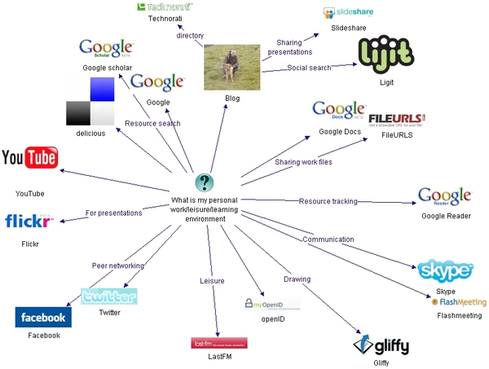
Web 2.0 = collaborative and participatory
Weller (2007) http://nogoodreason.typepad.co.uk/no_good_reason/2007/12/my-personal-wor.html
Notes:
Dynamic ie changes over time and personal

Slide 4
Crook’s 4 features of web 2
Scaling up participation, where quality of the service is improved with greater number of participants;
Sharing and joint knowledge building functions, i.e. user collaboration;
Using a range of formats, not just text e.g. video and picture and audio;
Rich and democratic forms of participation means there are novel frameworks for research and inquiry (2008, p.9).
Notes:
Web 2.0 fit with good practice ie Franklin and Van Harmelem (2007) say web 2.0 allows:
greater student independence and autonomy, greater collaboration, and increased pedagogic efficiency. (2007, p.1)

Slide 5
Pedagogies of web 2.0
Emergent learning (Williams et al., 2011)
Connectivism (Siemens, 2004, Downes, 2006)
Participatory Learning (Davidson and Goldberg 2009)
Rhizomatic learning (Cormier, 2008)
Learning 2.0 (Downes, 2005)
Networked Learning (Goodyear et al. 2004)
Ubiquitous Learning (Cope and Kalantzis 2008)
Communities of Inquiry (Wenger 1998, Garrison and Anderson 2003)
Abundant learning Weller (2011)
Notes:
Flipped curriculum – student as teacher/teacher as student is this another example
Under evaluated in practice????

Slide 6
Common features
Student led – agency
Student activity
Knowledge creation
Use of networks
Learning with and through conversations

Slide 7
Problem space
Rhetoric of pedagogies – over hyped?
Literature infused with negativity
Anecdotal examples
Theorising space between
Focusing on tutors
Notes:
Came to ALT-C Nottingham in 2010 with paper titled HE practice and Web 2.0 - What’s stopping us? Based on the lit surrounding web 2 tools in practice.

Slide 8
Range of dimensions to the study
Tools in use
Pedagogy and how it is understood
Emotional journey
Identity management
Understanding and modelling the ‘digital practitioner ‘
Understanding the digital practitioner’s development
Institutional context is part of the story too.
Notes:
Identity addressed issues of risk and challenges to authority and taking on new practices (liminality and anxiety)

Slide 9
Structure
Context
Outline of my research
methodology
Digital Practitioner Framework
So what?

Slide 10
The early adopters
http://glam.co.uk/2011/04/2011s-top-ten-family-destinations/go-ape/
Notes:
Hold the lived experience; taking the risks, innovating in their practice

Slide 11
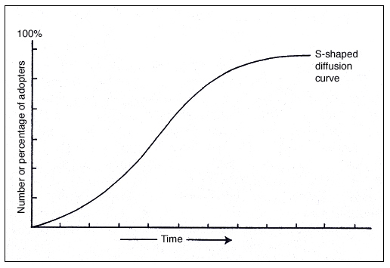
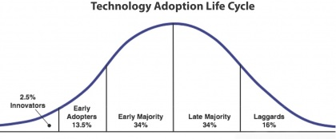
Early adopters from Rogers 1983
Notes:
Focus on lecturers; Ecclesfield and Rebbeck argue that e-maturity in colleges is not about the kit but about the skills
Focus on what can be learnt from lecturers; in terms of their rationale for uptake, personal journeys – structure and agency, their motivations, emotional journey, their skills and how acquired

Slide 12
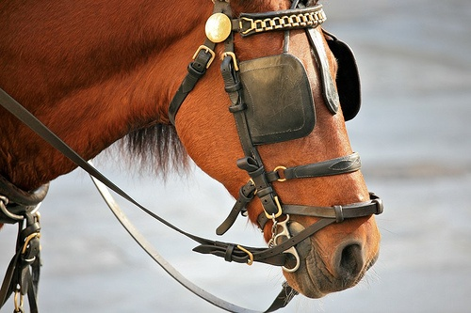
Not the laggards or technophobes
Youtube Ipad
Notes:
Focus not on the laggards – SimFin’s blinkered horses, or technophobes
Ipad clip – learning what new pedagogies are in practice- are they just new tools used in old ways?
Know that they will talk about the time, the skills, support ‘the usual suspects’

Slide 13
A comment on methodology
Learning from the voices of practitioners;
‘shed light on the interactions between professional identity and agency and how this impacts on their professional practices in times of change’ (Jephcote and Salisbury, 2009, p.967)

Slide 14
Methodology
Phenomenological
Small scale (n=16) lecturers
Across the university – post 1992
Semi structured interviews
Thematic analysis

Slide 15
Structure
Context
Outline of my research
methodology
DPF
So what?

Slide 16
Digital Practitioner Framework (part of)
attributes
practices
skills
access
Digital practitioner from Ecclesfield et al 2012
Based on Sharpe and Beetham (2010)’s Digital Literacies Framework
Notes:
The framework represents the notion of the ‘digital practitioner’ proposed by Ecclesfield et al. (2012) to describe
lecturers who are confident in their use of TEL, have a self-managed approach to adoption, a willingness to experiment and a willingness to invest time in exploring the tools and tools they might be applied to teaching and learning practice.
The framework suggests that there are some attributes that digitally confident practitioners share that build on their access, skills and practices. These are represented in a hierarchical relationship with the most fundamental features, related to ‘access’ to tools and support at the bottom, moving up the pyramid to ‘skills’, then to the application of the tools to their teaching and learning ‘practices’, and, at the top, the more stable dimensions of personality ‘attributes’. One of the frequent barriers to uptake of TEL practices is a belief that lecturers do not have technological skills (Cooke, 2008, p.28; Browne et al., 2010, p.8) however this study illustrated that lecturers need, not just the technological skills, but equally an understanding of how the technology impacts on the content and pedagogy. This new knowledge has been labelled as TPCK by Mishra and Koehler (2006) “technicalities should be subordinate to educational concerns” (Vogel, 2010, p.14).

Slide 17
Digital Practitioner Framework – movement up
attributes
practices
skills
access
Notes:
I explored the data to see to what extent movement up and down the pyramid was evident.
Movement up is where access to tools, drives adoption of skills, practices and attributes
Whereas movement down is where attitudes drive adoption of practices and development of skills and access to tools.
Movement up
lecturers did not problemetise access to kit or networks
Lecturers were not in awe of tools
Lectuerers were not worried about their tech skills (or digital literacy skills)
Lecturers did not want technology for sake of it
Occasionally a successful practice leads to change in belief, or a skill from non teaching world leads to adoption into practice. (eg Fb)
Movement down
Motivation by attributes drives adoption into practice and developement of skills
Driven by willingness to invest time, belief in potential to change t&l,
Decontextualised skills useless eg ECDL and classes in blogging

Slide 18
Digital Practitioner Framework movement down
attributes
practices
skills
access
Notes:
Movement down

Slide 19
Digital Practitioner Framework
attributes
practices
skills
access
 | I am confident in my attitude to TEL; willing to experiment with technology and how it can be used in teaching and learning; able to balance risks of change with its potential; convinced by the radical potential of technology to enhance and transform learning; willing to invest time in exploring and evaluating TEL.
 | I design learning activities to suit my students’ needs using TEL as appropriate. I facilitate learning using appropriate technological tools. I explore the capabilities of technology. I behave ethically in contexts where the digital media is blurring boundaries. I evaluate my practices. I reflect on innovations in my practice. I experiment with tools in my practice.
 | I can: use the appropriate privacy settings for my needs; evaluate the affordances of TEL tools to suit my needs; manage the blurring of boundaries between private and work time.
 | I have access to: networked devices and applications. media devices. people who can support me in using technology. a network of people with ideas for using technology.

Slide 20
Context
Outline of my research
methodology
Digital Practitioner Framework
So what?

Slide 21
Problem space
Rhetoric of pedagogies – over hyped?
Literature infused with negativity
Anecdotal examples
Theorising space between
Focusing on tutors
Focussing on early adopters
Their lived experience
Notes:
SKIP PERHAPS

Slide 22
Some conclusions and implications for practice?
attributes
practices
skills
access
Digital Practitioner Framework
Moving up less in evidence than movement down the pyramid ie attitudes drive adoption
Amplification could be used to support staff development/CPD

Slide 23
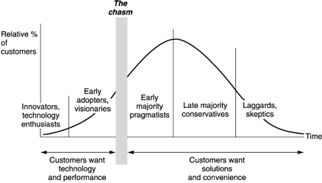
There is further work to be done...
Notes:
But my DPF is worth of further testing.
And the institutional context

Slide 24
Learning from the early adopters: the Digital Practitioner Framework
Liz Bennett
University of Huddersfield
ALT2012
@lizbennett1
e.bennett@hud.ac.uk
Notes:
Quote comes from Sian Bayne and Ray Land’s study published in 2008 funded by HEA which was based on evaluating what happens in practice

Slide 25
References
Cope, B., & Kalantzis, M. (2008). Ubiquitous Learning: An Agenda for Educational Transformation. Paper presented at the Proceedings of the 6th Networked Learning, Greece.
Cormier, D. (2008). Rhizomatic Education: Community as Curriculum. Innovate: Journal of Online Education, 4(5).
Crook, C. (2008). Web 2.0 technologies for learning: The current landscape – opportunities, challenges and tensions: Becta.
Davidson, C., & Goldberg, T. (2009). The Future of Learning Institutions in a Digital Age. Massachusetts: MIT Press.
Downes, S. (2005). E-Learning 2.0. Elearning Magazine Retrieved 24 March 2012, from http://elearnmag.acm.org/featured.cfm?aid=1104968
Downes, S. (2006). Learning Networks and Connective Knowledge. AECT Instructional Technology Forum. Retrieved from http://it.coe.uga.edu/itforum/paper92/paper92.html
Ecclesfield, N., Rebbeck, G., & Garnett, F. (2012). The Case of the Curious and the Confident - The Untold Story Of Changing Teacher Attitudes To E-Learning And "Technology IN Action" In The FE Sector. Compass: The Journal of Learning and Teaching at the University of Greenwich, 5.
Goodyear, P., Banks, S., Hodgson, V., & McConnell, D. (2004). Research on network learning:an overview. In P. Goodyear, S. Banks, V. Hodgson & D. McConnell (Eds.), Advances in research on networked learning. Dordrecht: Kluwer Academic Publishers.
Rogers, E. M. (1983). Diffusion of Innovation (3rd ed.). London: Free Press.
Sharpe, R., & Beetham, H. (2010). Understanding students’ uses of technology for learning: towards creative appropriation. In R. Sharpe, H. Beetham & S. de Freitas (Eds.), Rethinking learning for the digital age: how learners shape their experiences (pp. 85 - 99). London and New York: Routledge Falmer.
Siemens, G. (2004). Connectivism: a learning theory for the digital age. elearning space. Retrieved from http://www.elearnspace.org/Articles/connectivism.htm
Weller, M. (2011). The Digital Scholar. London: Bloomsbury Academic.
Wenger, E. (1998). Communities of practice: learning, meaning, and identity. Cambridge: Cambridge University Press.
Williams, R., Karousou, R., & Mackness, J. (2011). Emergent Learning and Learning Ecologies in Web 2.0. International Review of Research in Open and Distance Learning 12(3), 1-21.

