Slide 1

Library Impact Data Project
Dave Pattern
Library Systems Manager
University of Huddersfield
d.c.pattern@hud.ac.uk
Twitter: @daveyp

Slide 2
Twitter
If tweeting, please use the hashtag...
#lidp
@graham_stone Graham Stone, Project Manager
@ellenscollins Ellen Collins, Research Assistant
@librarygirlknit Bryony Ramsden, Research Assistant
@daveyp Dave Pattern, Technical Support

Slide 3
Why Investigate Library Impact?
Because we can!
  libraries are increasingly seeing the benefits of capturing & analysing library usage data
Because we need to!
  library budgets are being squeezed &
  usage data can demonstrate value

Slide 4
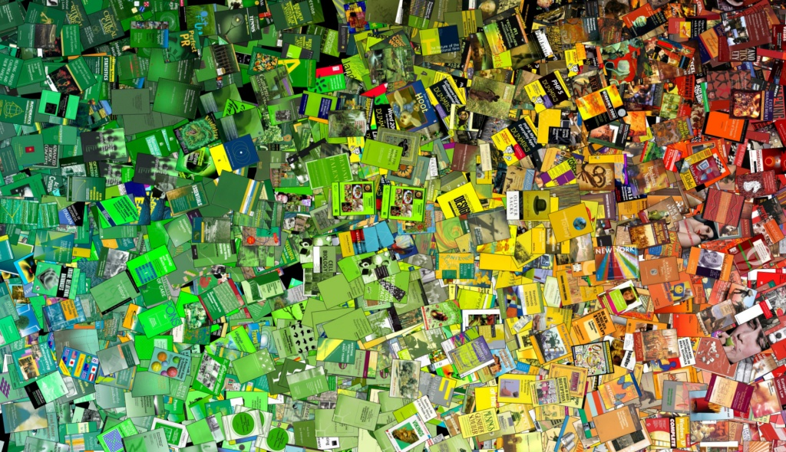
Usage Data at Huddersfield

Slide 5
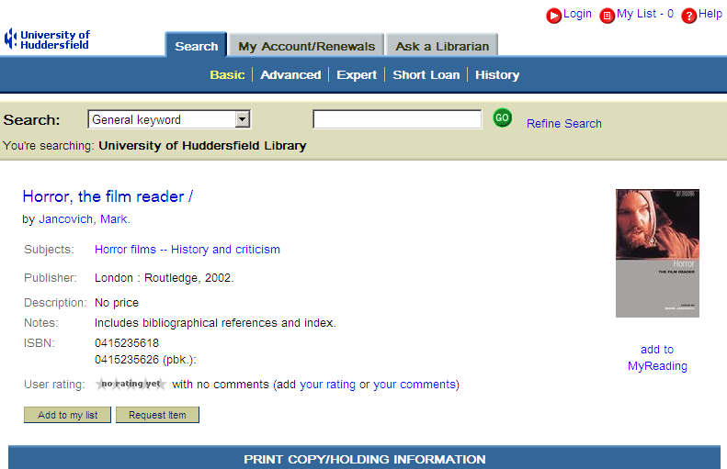
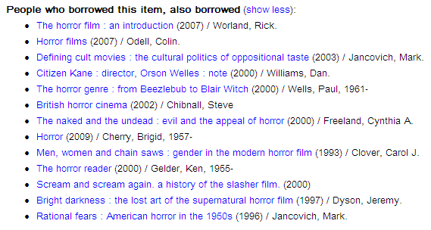
Borrowing Suggestions based on circulation data

Slide 6
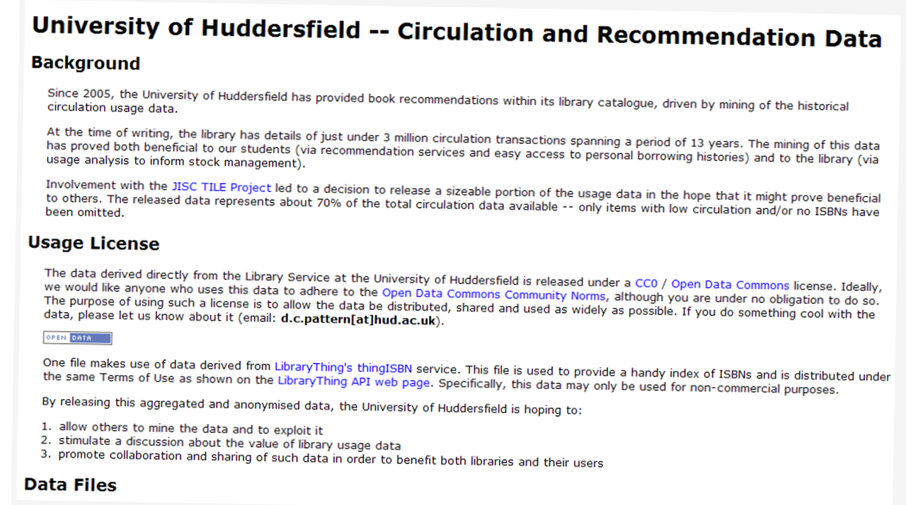

Sharing Library Data
usage data release (Dec 2008)
6
Notes:
aggregated usage data for 2 million circulation transactions, covering around 80,000 book titles & recommendation data for over 37,000 titles
http://library.hud.ac.uk/data/usagedata/
http://www.daveyp.com/blog/archives/528

Slide 7
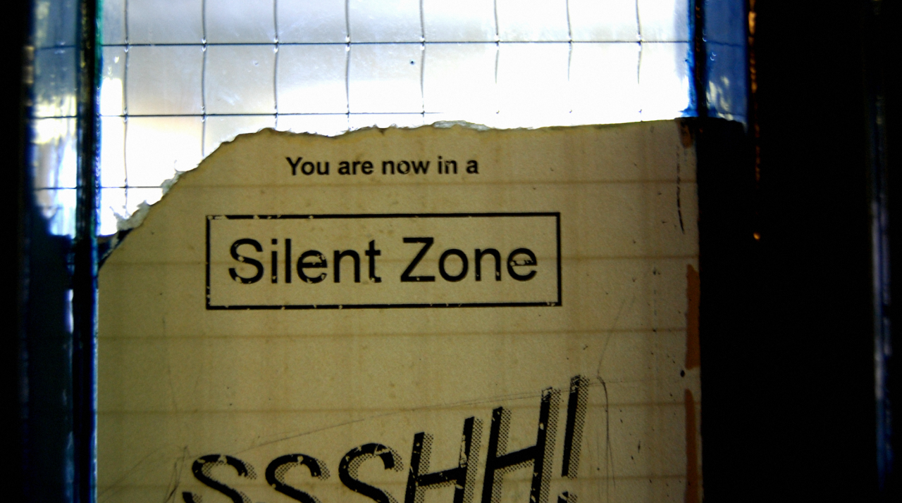
Measuring Library Impact
is there a link between usage & grade?

Slide 8
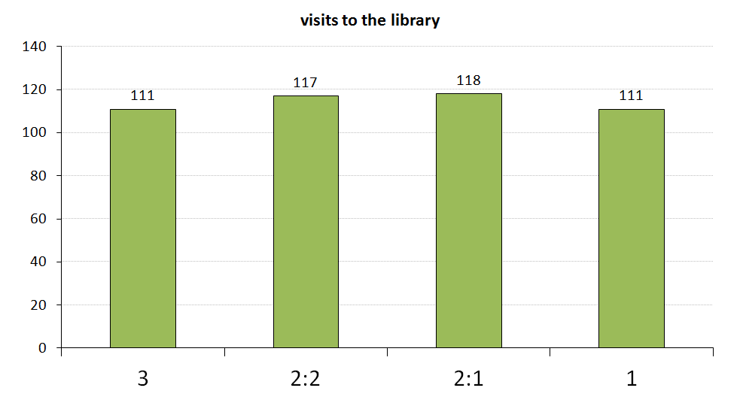
Measuring Library Impact
2007/8 & 2008/9 honours graduates
8
Notes:
Average # of visits to the library by two years worth of honours degree graduates

Slide 9
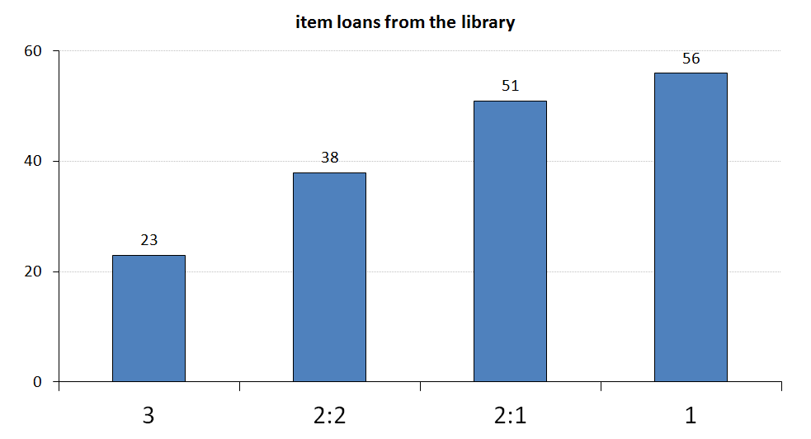
Measuring Library Impact
2007/8 & 2008/9 honours graduates
9
Notes:
Average # of items borrowed from the library by two years worth of honours degree graduates

Slide 10
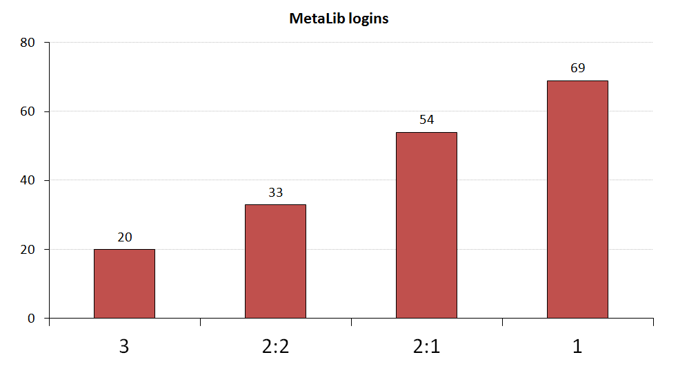
Measuring Library Impact
2007/8 & 2008/9 honours graduates
10
Notes:
Average # of e-resource logins by two years worth of honours degree graduates

Slide 11

JISC Library Impact Data Project
11

Slide 12
Library Impact Data Project
JISC funded project with...
University of Bradford
De Montfort University
University of Exeter
University of Huddersfield (lead partner)
University of Lincoln
Liverpool John Moores University
University of Salford
Teesside University
12

Slide 13
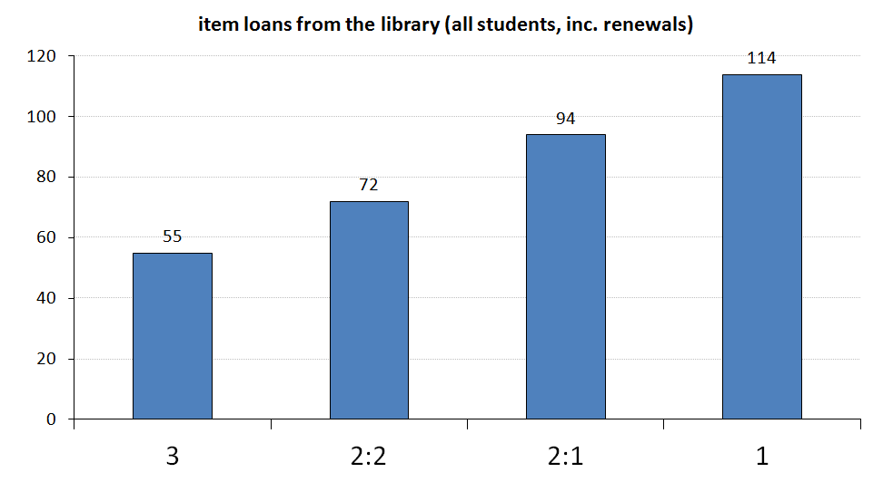
Library Impact Data Project
findings – book loans

Slide 14
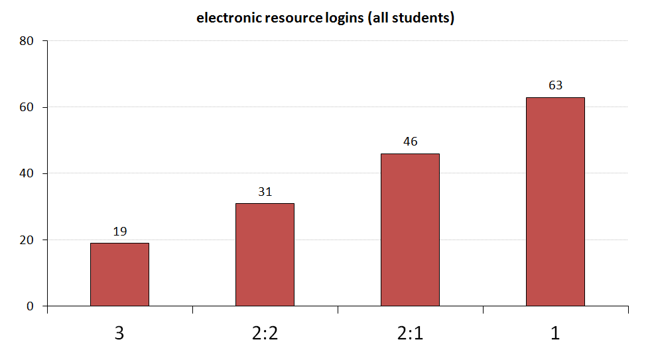
Library Impact Data Project
findings – e-resource logins

Slide 15
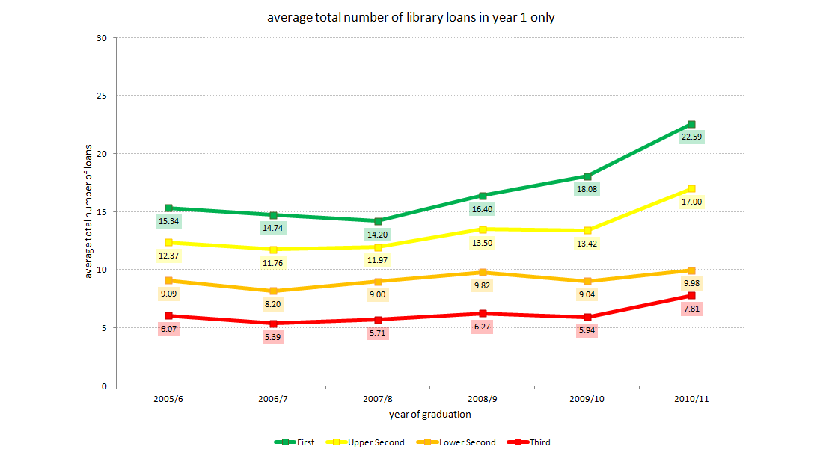
Library Impact Data Project
book loans at Huddersfield (6 yrs)
15
Notes:
Average number of books borrowed during the 1st year of study by students graduating with an honour for the last 6 years.
http://www.flickr.com/photos/davepattern/6972182315/in/set-72157629087302688/

Slide 16

Library Impact Data Project
Phase 2

Slide 17
Library Impact Data Project
Phase 2
January to September 2012
Much more in-depth analysis of library usage at Huddersfield... over 100 different library usage metrics were analysed!
Final % grade marks were used to prove the correlation

Slide 18
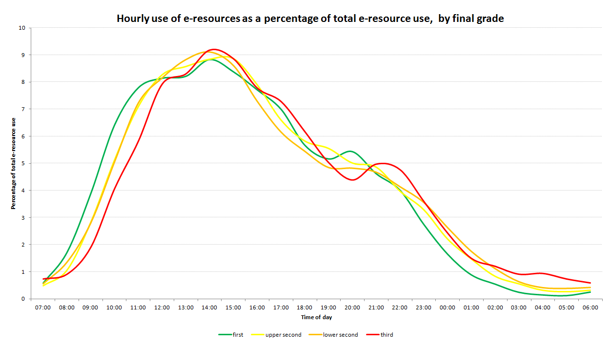
Library Impact Data Project
is time of day important?
The “TV Soap Opera” effect!
Top students start using e-resources earlier in the day

Slide 19
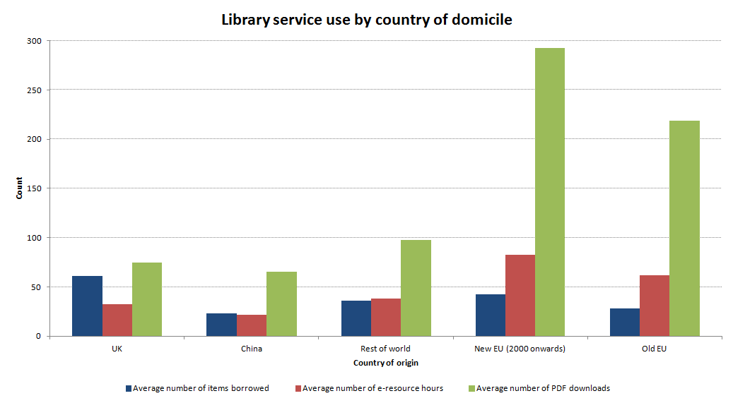
Library Impact Data Project
phase 2 findings
item loans
e-resource hours
PDF downloads
EU students

Slide 20
Library Impact Data Project
more findings on the project blog...
Breadth of reading is important
Relationship between accessing
e-resources off-campus & better grades
Owning the book may give students an advantage over students who have to borrow it

Slide 21
Library Impact Data Project
more findings on the project blog...
Non-use of the library’s resources could be used as one of the early warning signs that a student might drop out of their course
Usage of the library varies greatly by academic discipline

Slide 22
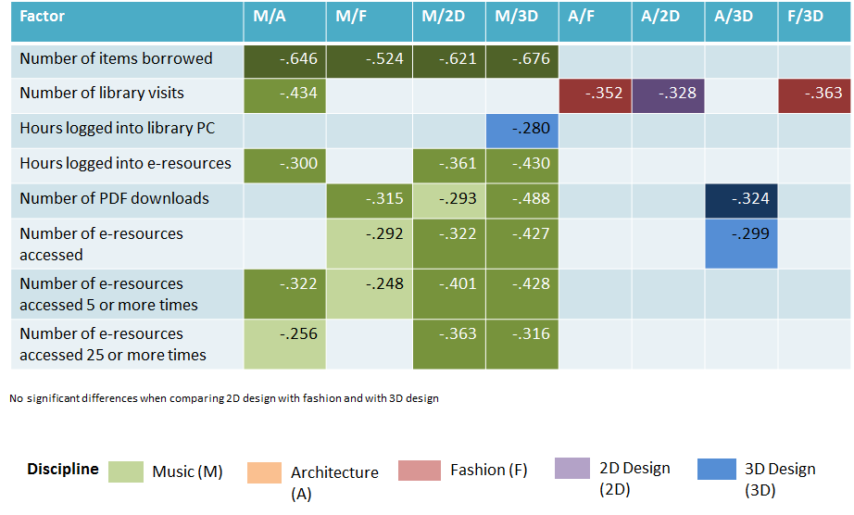
Library Impact Data Project
more findings on the project blog...
http://library.hud.ac.uk/lidp

Slide 23
See also...
University of Wollongong
“Capturing Business Intelligence Required for
Targeted Marketing, Demonstrating Value,
and Driving Process Improvement” (2012)
“Measuring the value of library resources and
student academic performance through
relational datasets” (2011)
Brian Cox & Margie Jantti
http://bit.ly/JZ03AY http://bit.ly/JZ0bAB

Slide 24
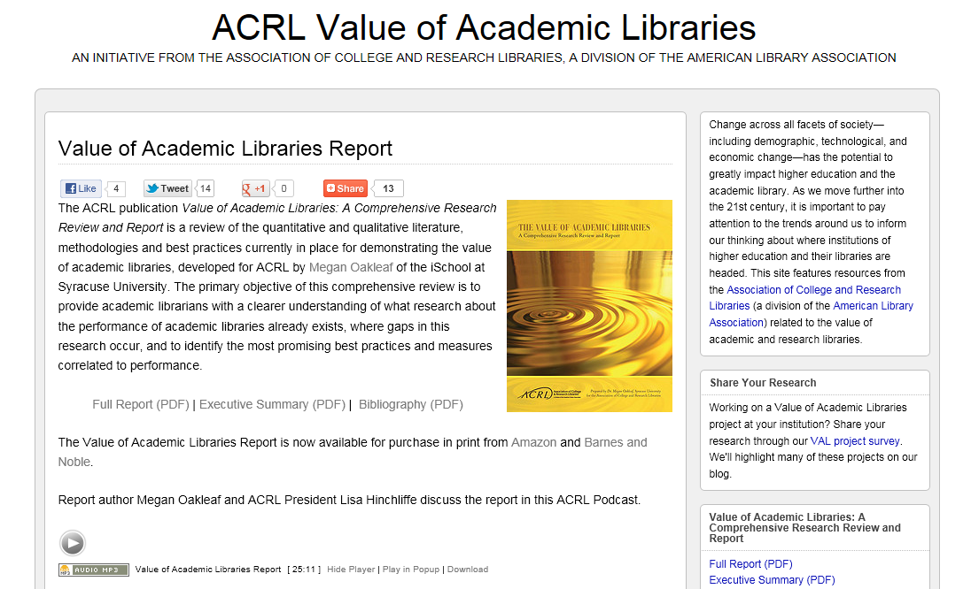
See also...
ACRL
http://bit.ly/JZ1zTK

Slide 25
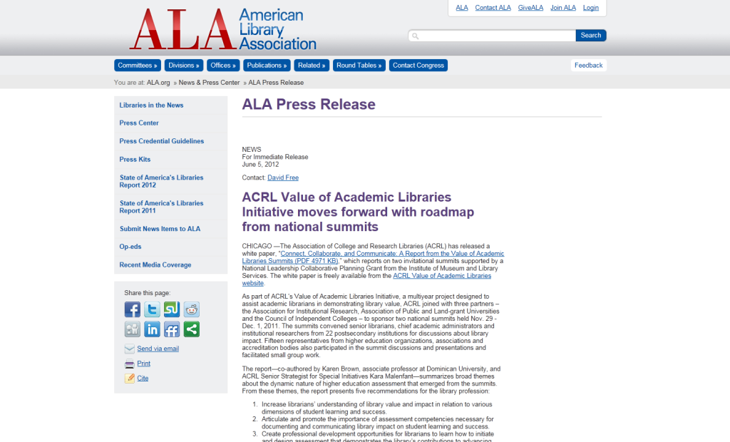
See also...
ACRL
“Increase librarians’ understanding
of library value and impact in
relation to various dimensions of
student learning and success.”
http://bit.ly/Kdh22K

Slide 26
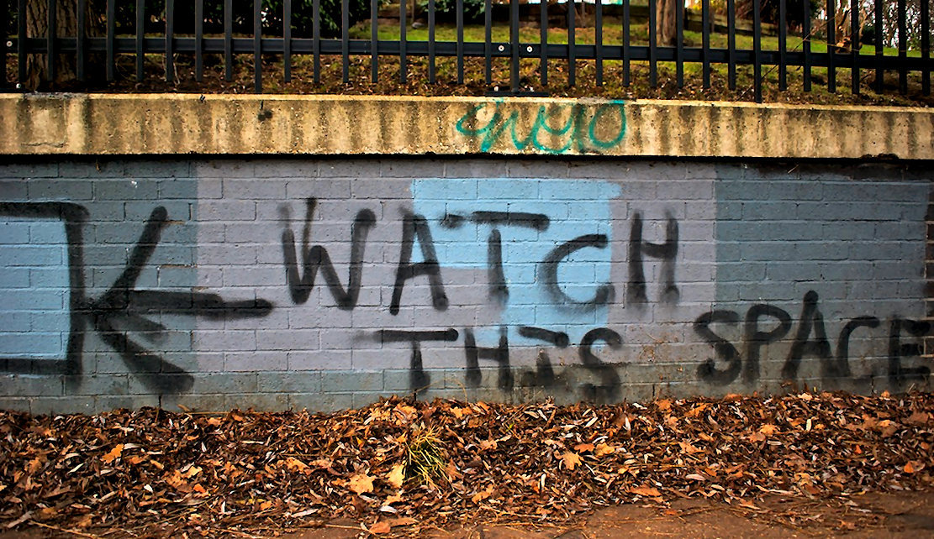
Library Impact Data Project
so, what next...?
http://library.hud.ac.uk/lidp
flickr.com/photos/nicholasngkw/5512321874/
Notes:
Photo http://www.flickr.com/photos/nicholasngkw/5512321874/

