Slide 1
(H)appiness is a warm API!
Using APIs to develop new library services
Dave Pattern
Library Systems Manager
University of Huddersfield
d.c.pattern@hud.ac.uk
http://daveyp.com/blog/

Slide 2
What is an API?
An Application Programming Interface allows separate pieces of software to communicate with each other, typically to share content
A web-based API is usually called a “Web Service” and often uses XML or JSON (JavaScript Object Notation)
Notes:
http://en.wikipedia.org/wiki/Application_programming_interface

Slide 3

An example: OCLC’s xISBN
Convert a 10 digit ISBN to 13 digits
Convert a 13 digit ISBN to 10 digits
Fix an incorrect ISBN checksum
Fetch basic metadata
Fetch details of other
editions of a book – e.g.
Notes:
Example book: http://www.amazon.co.uk/Carlo-Really-Librarian-Jessica-Spanyol/dp/184428512X/

Slide 4

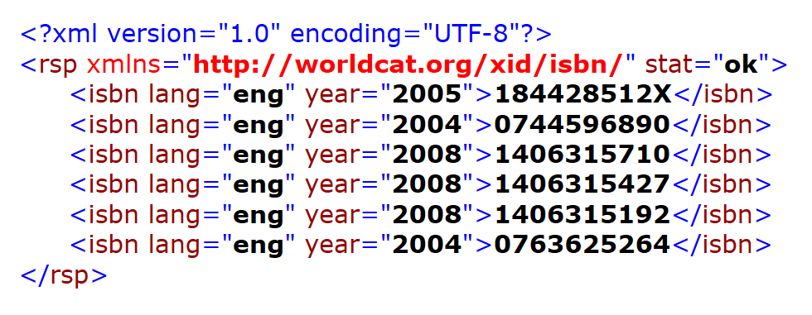
184428512X (2005)
http://xisbn.worldcat.org/webservices/xid/isbn/184428512X?fl=year,lang
Notes:
http://xisbn.worldcat.org/webservices/xid/isbn/184428512X?fl=year,lang

Slide 5
MyReading
reading list project at Huddersfield
A reading list is a list of books, journal articles, etc for each module on an academic course
Only 1 developer, working 1.5 days a week
Just 10 months to deliver a working product
Lots of technical challenges ... especially with getting data into the system!
Notes:
By using existing APIs, we were able to rapidly deliver a working prototype and to fast-track the development work.

Slide 6

How can we make it
easy for academics to
add books from the library catalogue?

Slide 7
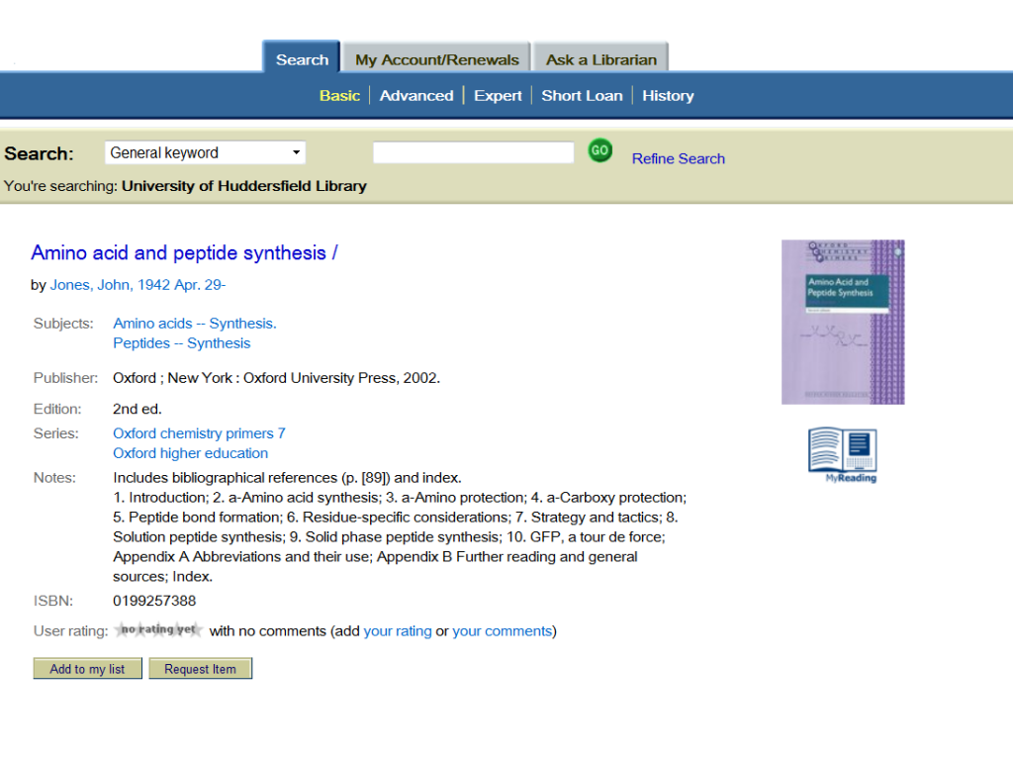
Notes:
We’ve embedded links into the OPAC interface for academics. The link uses the OPAC’s XML API to retrieve the metadata for the item, so it can be inserted into the MyReading software.

Slide 8

Title Amino acid and peptide
synthesis
Author Jones, John
Date 2002
Edition 2nd
Series Oxford chemistry primers
ISBN 0199257388
Notes:
The Horizon Information Portal has a rudimentary API which generates XML output. Accessed by appending “&GetXML=true” to the URL of a page.

Slide 9
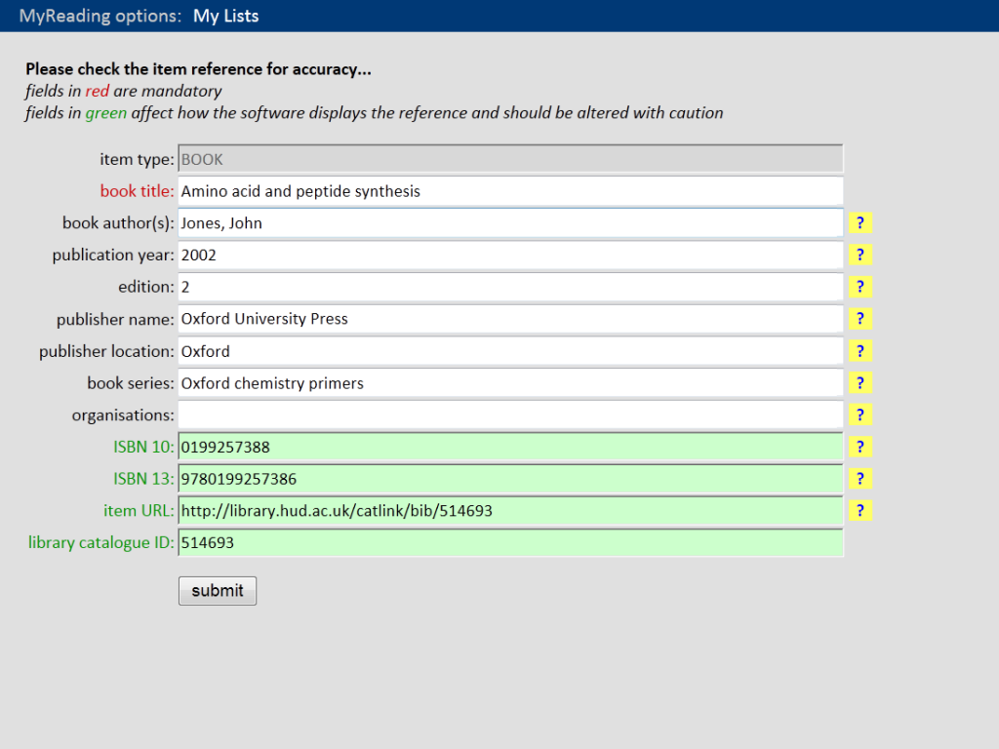
Notes:
All the academic needs to do is to check the reference for accuracy – the form is automatically filled in using the metadata from OPAC’s API.

Slide 10
How can we make it
easy for academics to
add journal articles
to their reading lists?

Slide 11
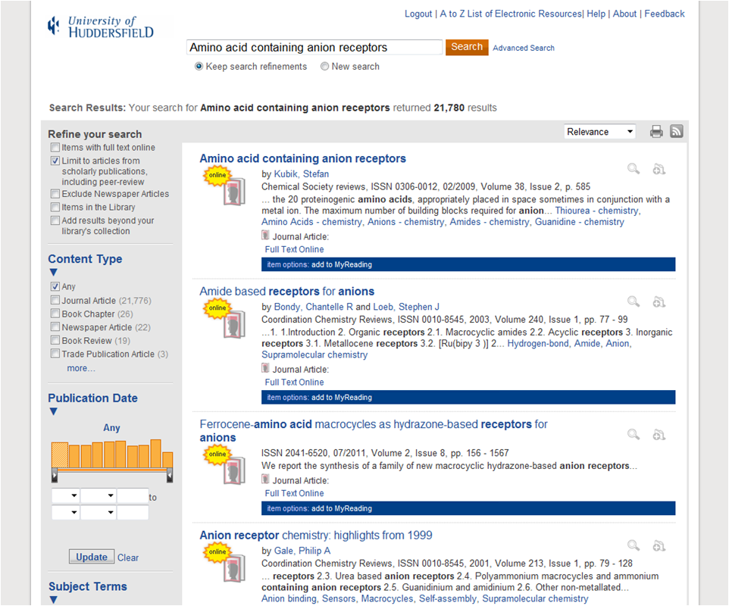

Notes:
We’ve embedded “add to MyReading” links into the Summon interface. The link uses the Summon API to retrieve the metadata for the item, so it can be inserted into the MyReading software.

Slide 12
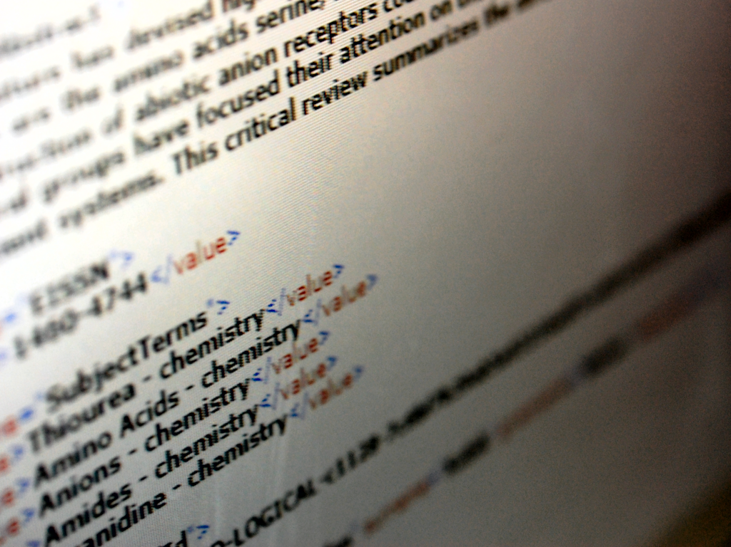
Title Amino acid containing
anion receptors
Author Kubik, Stefan
Journal Chemical Society reviews
ISSN 0306-0012
Page 585
Date February 2009
Notes:
Summon API: http://api.summon.serialssolutions.com/

Slide 13
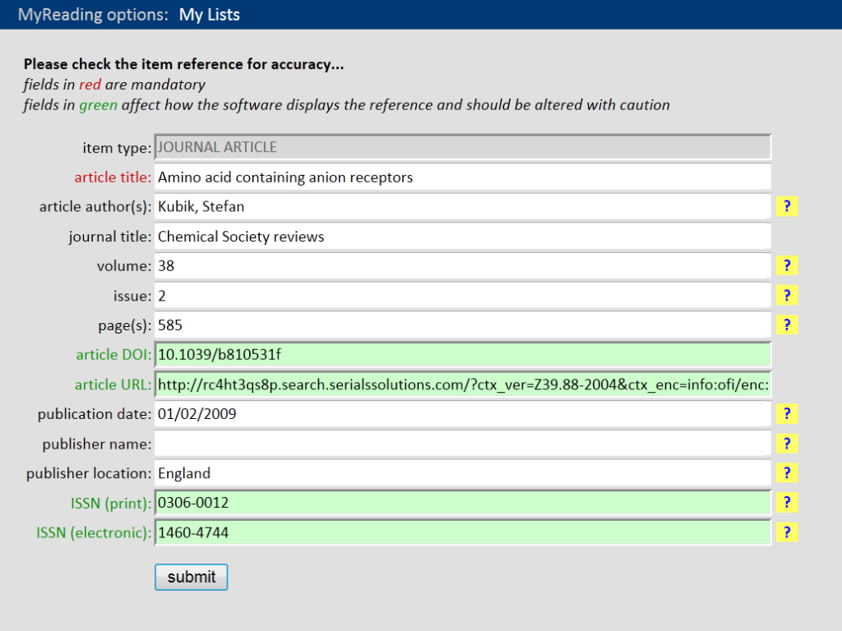
Notes:
All the academic needs to do is to check the reference for accuracy – the form is automatically filled in using the metadata from Summon.

Slide 14
How do we ensure journal article links will continue to work, even if we change to
a new platform?

Slide 15
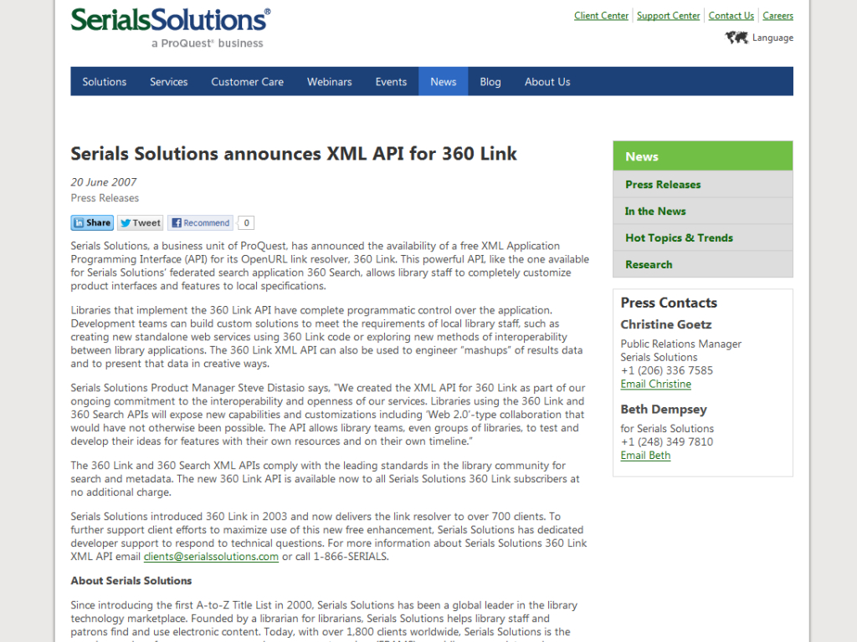
Notes:
We store the openURL link for the journal article and the pull in the current access links using our link resolver’s API: http://www.serialssolutions.com/en/news/detail/serials-solutions-announces-xml-api-for-360-link

Slide 16
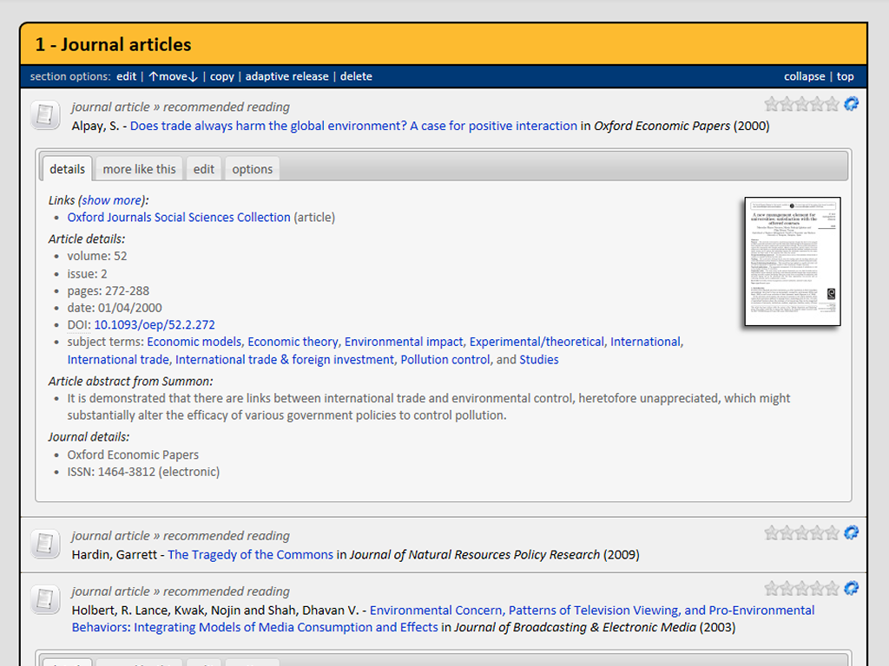
the link resolver’s
API returns the current access links
Notes:
By storing the openURL in MyReading (rather than a direct access link), we can pull in the most up-to-date access links automatically via the link resolver’s API

Slide 17
If an academic has added an older edition, how do we let students know about the latest edition?

Slide 18
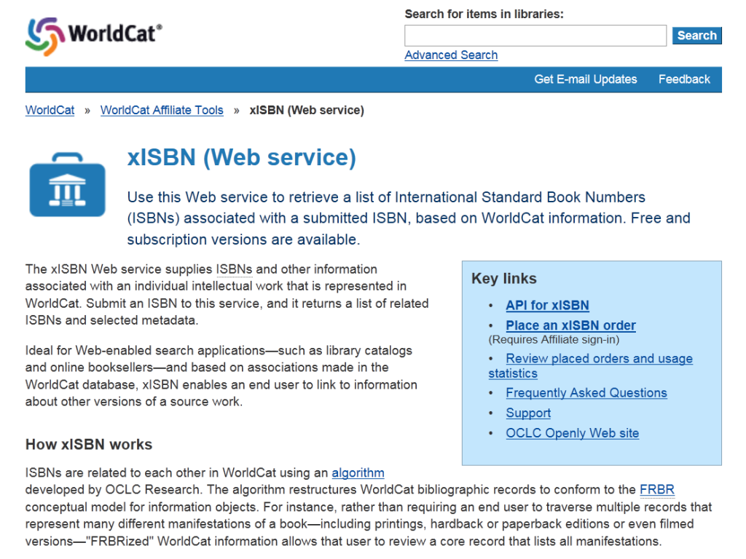
Notes:
OCLC’s xISBN web service allows you to identify and link together different editions of books: http://www.worldcat.org/affiliate/webservices/xisbn/app.jsp

Slide 19
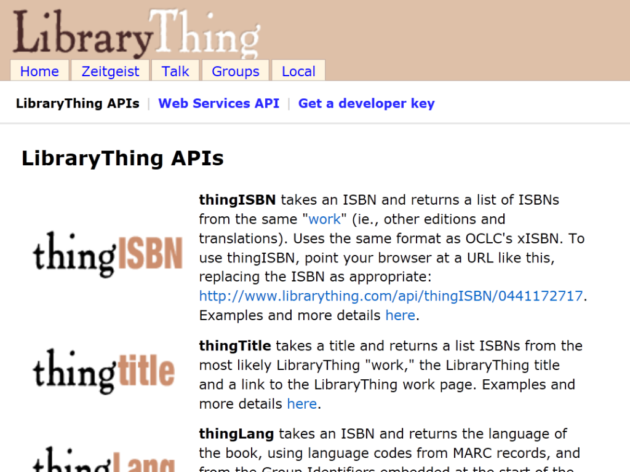
Notes:
LibraryThing also has a similar API (thingISBN), along with other very useful APIs: http://www.librarything.com/api

Slide 20

Title Amino acid and peptide
synthesis (1992)
ISBN 0198556683
xISBN 2nd edition
published in 2002
0199257388 (pbk)
Notes:
By cross-referencing the ISBNs returned by OCLC’s xISBN with books we hold in stock, we can generate links to the other editions of books

Slide 21
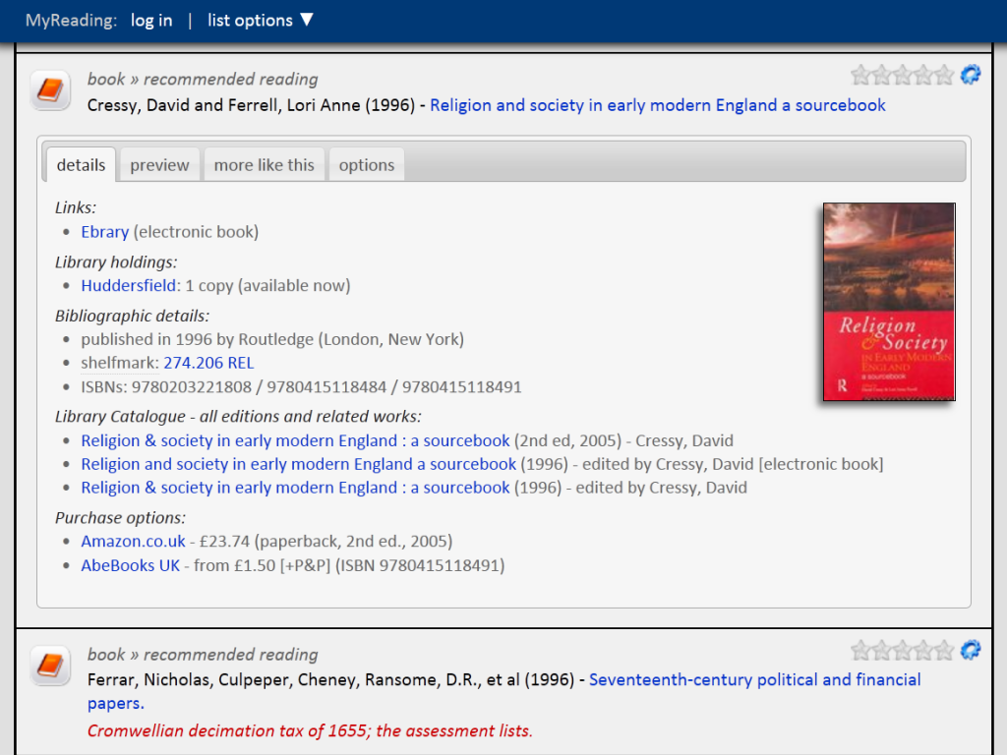
academic added the 1996 edition
student can see we have a newer
edition from 2005

Slide 22
If a student has to buy a book for the course, can we provide them with purchase links?

Slide 23
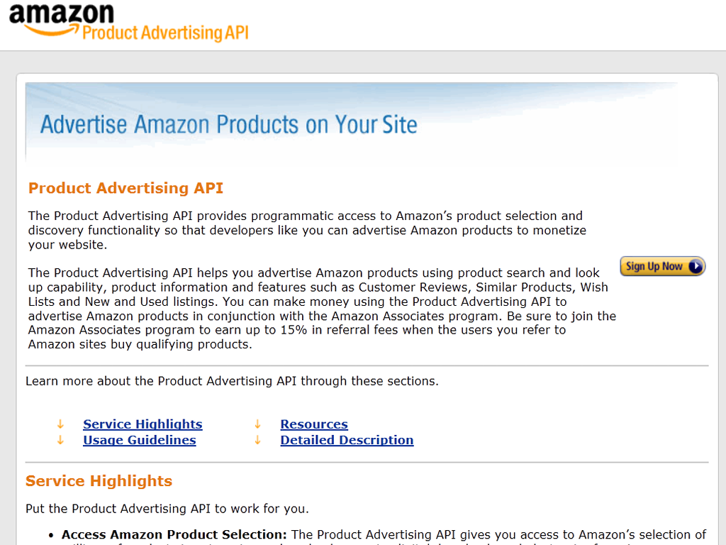
Notes:
https://affiliate-program.amazon.co.uk/gp/advertising/api/detail/main.html

Slide 24
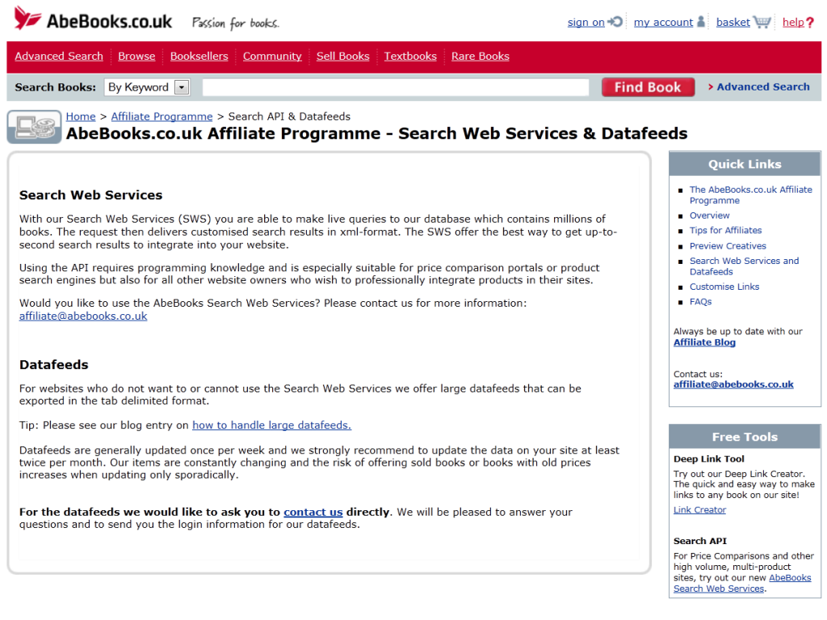
Notes:
http://www.abebooks.co.uk/affiliate-programme/search-web-services-datafeed.shtml

Slide 25
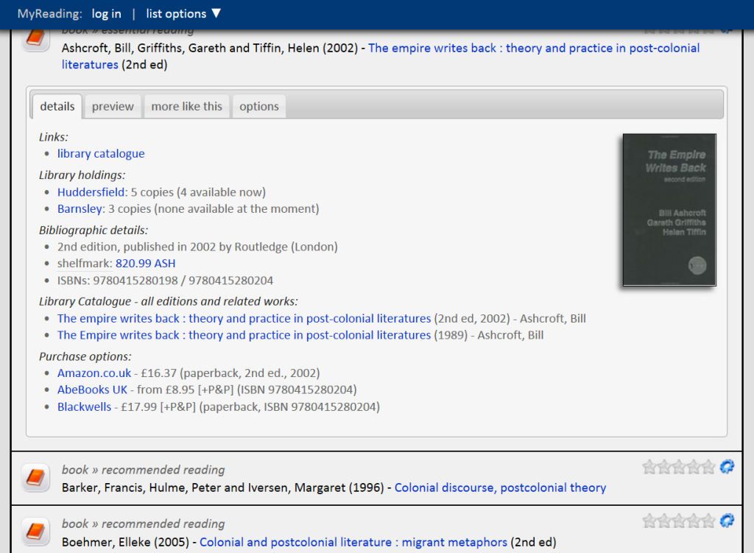
student can see the current book price
at various web sites

Slide 26
Summary
APIs allow developers to enrich existing library services and to rapidly develop new ones
APIs allow you to “glue” together different services and products, and this then allows data to flow automatically

Slide 27
Summary
When purchasing new software, remember to ask the vendor...
  does it have an fully-featured API?
  is the documentation publicly available?
  what have other libraries developed using your API?

