Slide 1
Summon at Huddersfield
Dave Pattern
Library Systems Manager
University of Huddersfield
d.c.pattern@hud.ac.uk

Slide 2
Table of Contents
Background
Why Summon?
Implementation & launch
Student focus groups
Usage stats

Slide 3
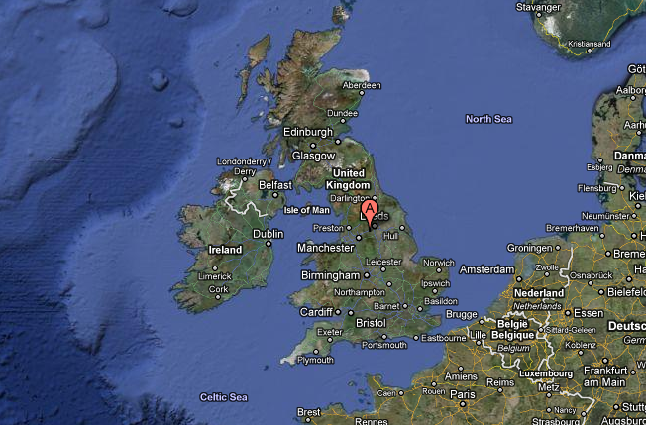
“Where’s Huddersfield?”

Slide 4
University of Huddersfield
20,000+ students
350,000+ items held by the library
Established in 1825 as the Huddersfield Science and Mechanics' Institute
Gained university status in the 1990s
The only(?) university in the world with a Federation star ship captain at the helm! ☺

Slide 5
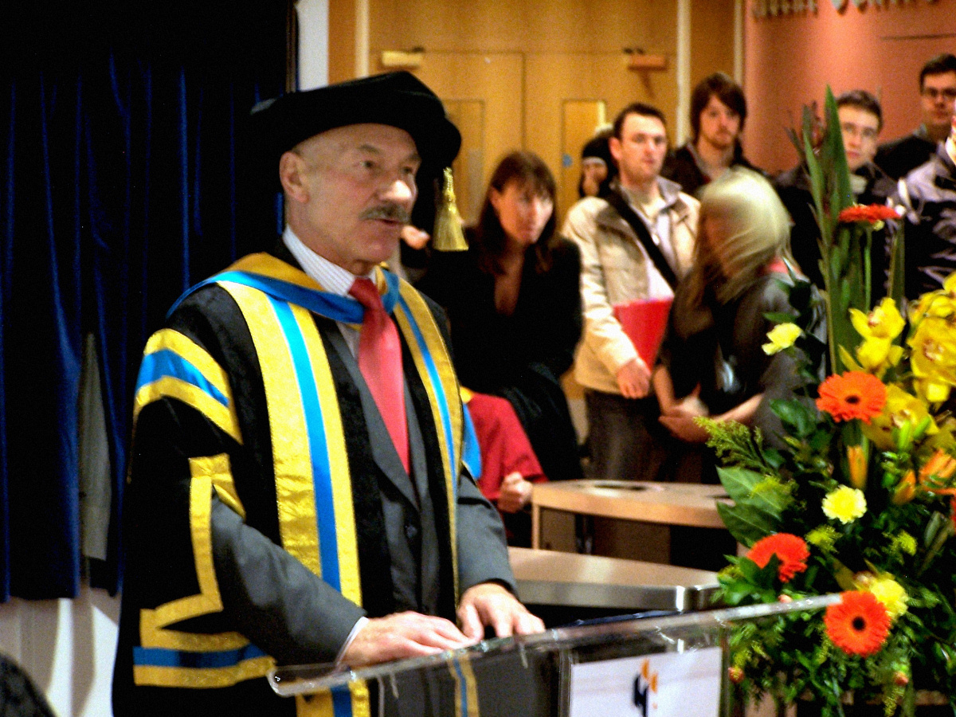

Slide 6
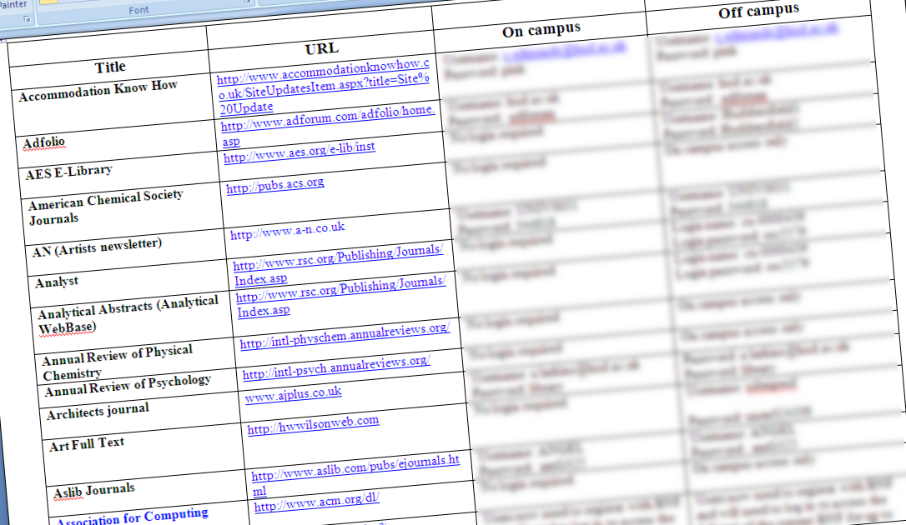
E-Resource Provision
A Word Document(!) (2000)

Slide 7
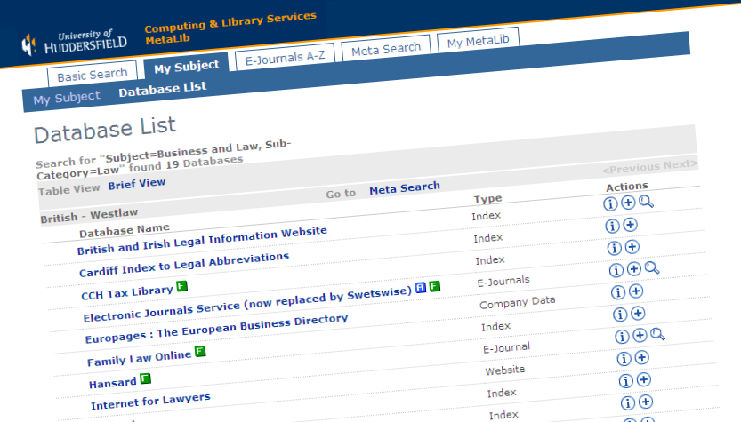
E-Resource Provision
Ex Libris Metalib (2006)

Slide 8
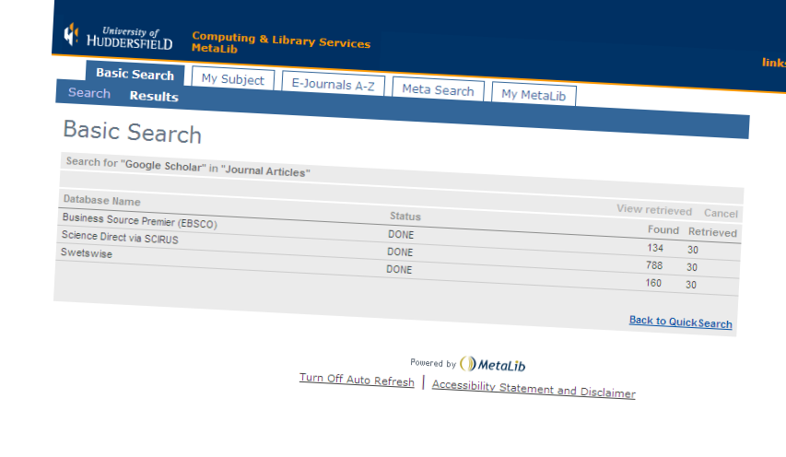
E-Resource Provision
Woot! Woot! Federated Search!

Slide 9




E-Resource Provision
Federated Search?! Meh… ☹

Slide 10

Meanwhile, in the real world…
Google Scholar (launched Nov 2004)

Slide 11
Electronic Resources Review
April 2009
“Make recommendations for future
provision, e.g. for the next 5 years,
taking into account system
interoperability and future-proofing.”
(terms of reference document)

Slide 12
Electronic Resources Review
April 2009
“To provide ease of searching and access
for the user, whilst reducing the
workload for Systems and Technical
Services, and remaining within current
budget levels.”
(terms of reference document)

Slide 13
Electronic Resources Review
“The Vision”
First class search engine
  - relevancy ranking, facets, fast results, etc
The “one-stop shop”
  - personalisation, reduce silos of data, etc
Improved systems management
  - interoperability, usage stats, open standards, etc
Improved value for money

Slide 14
Electronic Resources Review
“The Vision”
Selection of vendors invited to give 45 minute product demos
Products rated against “The Vision”
Report to Library Management Group
  3 options for moving forward with pros & cons

Slide 15
Summon
first impressions
“My killer-app moment [at Midwinter ALA 2009] was with Summon, a new unified-search service … [that] makes your typical metasearch tool look like a rusty wagon with square wheels.”
K.G. Schneider (Free Range Librarian)
http://bit.ly/mrpIpm
Notes:
“A Dozen Neat Take-aways from ALA Midwinter 2009”
http://freerangelibrarian.com/2009/02/02/a-dozen-from-ala-midwinter-2009/

Slide 16
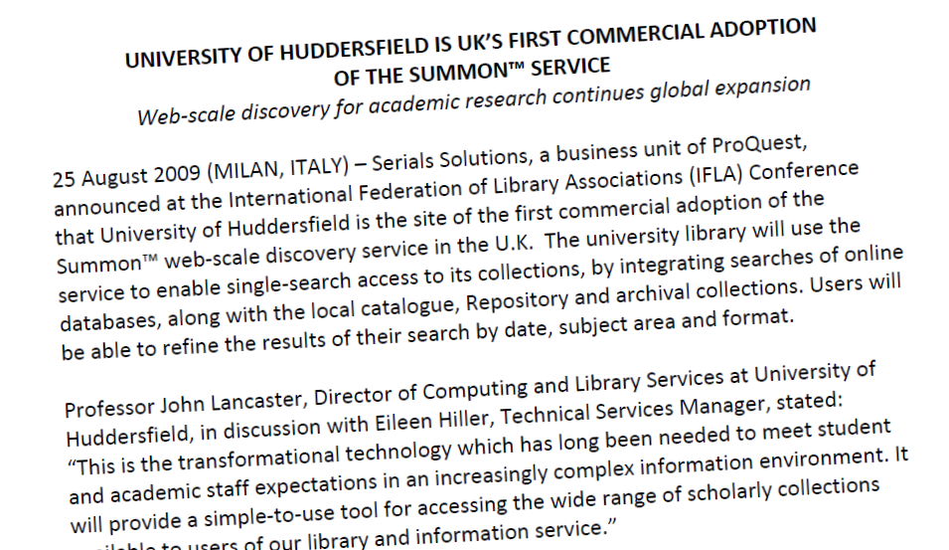
Huddersfield Adopts Summon
August 2009
“This is the transformational technology which has long been needed to meet student and academic staff expectations in an increasingly complex information environment.”
Notes:
http://www.serialssolutions.com/news-detail/university-of-huddersfield-is-uks-first-commercial-adoption-of-the-summon-s/

Slide 17
Why Summon?
94% of our subscribed journals were already full-text indexed in Summon…
  at the time, other vendors were unable and/or unwilling to supply any coverage data
…therefore, no need to make do with a compromise(d) solution using federated search for the non-indexed material

Slide 18
Why Summon?
New platform, developed with Open Source software
  Serial Solutions have fed their improvements back to the Lucene/SOLR developer community
Excellent developer APIs
  for both Summon and 360 Link

Slide 19

Summon Implementation

Slide 20
Implementation Timeline
…playing it cautiously
…actually, we were ready to
go fully live in January 2010!
Sep 2009 implementation starts
Oct 2009 Summon instance delivered
Feb 2009 360 Link goes live
Mar 2010 Summon “soft launch”
Aug 2010 Summon replaces Metalib

Slide 21
Implementation
technical stuff
Access predominantly via EZproxy
  resolved majority of off-campus issues
Students encouraged to report any access problems
Journal print holdings added to 360 Core
  …although these initially displayed as being “available online” within Summon!

Slide 22
Implementation
technical stuff
Serials Solutions 360 Core
  Knowledge base for Summon and 360 Link
  Our journals staff found it extremely simple and quick to use

Slide 23
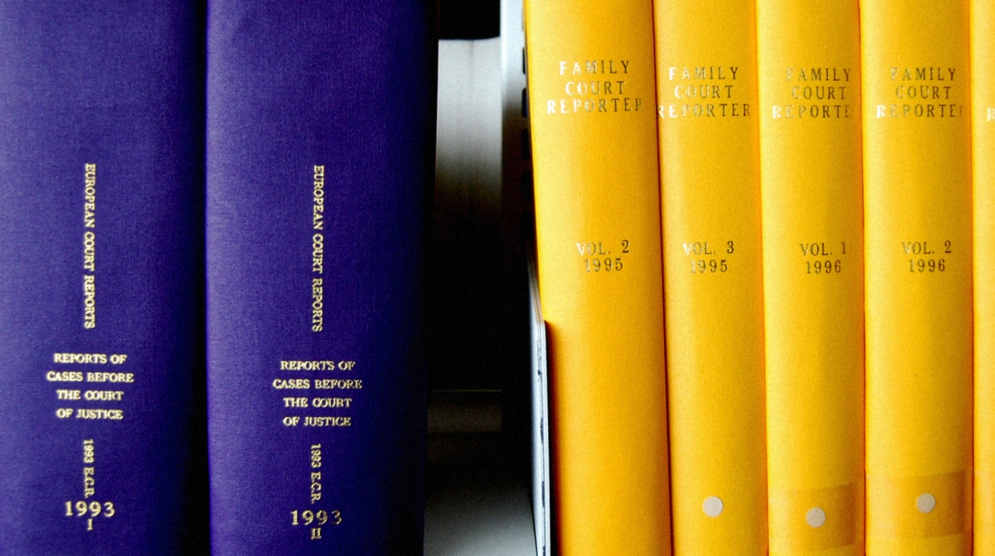
Summon Launch

Slide 24
Summon Launch
Promoted internally from Nov 2009
Promoted to all staff from early 2010
Formally launched by PVC for Research & Enterprise during the University’s annual Research Festival (Mar 2010)

Slide 25
Summon Launch
From March 2010 onwards, promoted to students from within Metalib
  “Coming soon…”
  “Get ahead of the game…”
  “Test drive it today and give us your feedback!”
Summon replaced Metalib in Aug 2010

Slide 26
Summon Launch
Lots of promotional items & materials…
  Summon pens with logo & URL
  bags with “Summon – Research in the bag”
Two main slogans:
  “Research has never been so easy”
  “A serious Research engine”
http://eprints.hud.ac.uk/9447/

Slide 27
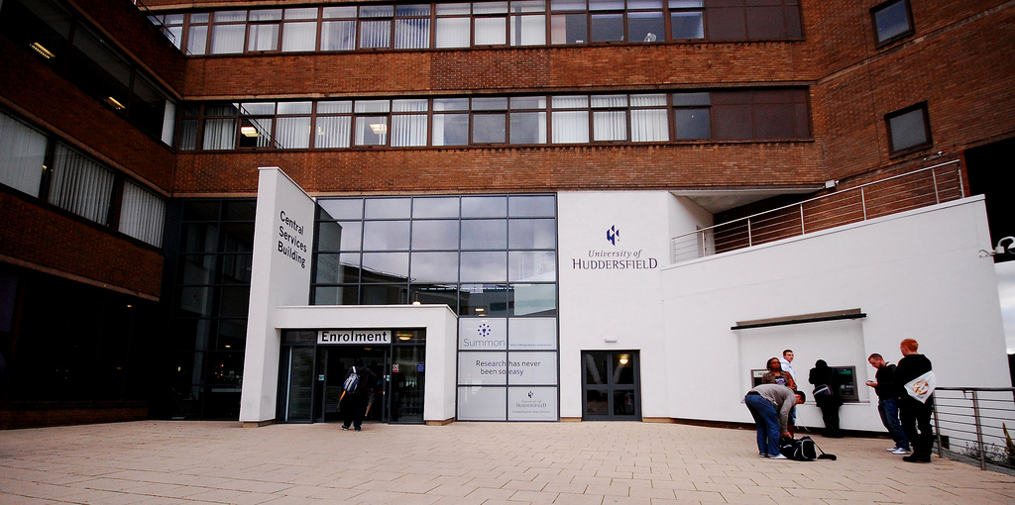
Summon Launch
on-campus publicity

Slide 28

Summon Launch
on-campus publicity

Slide 29
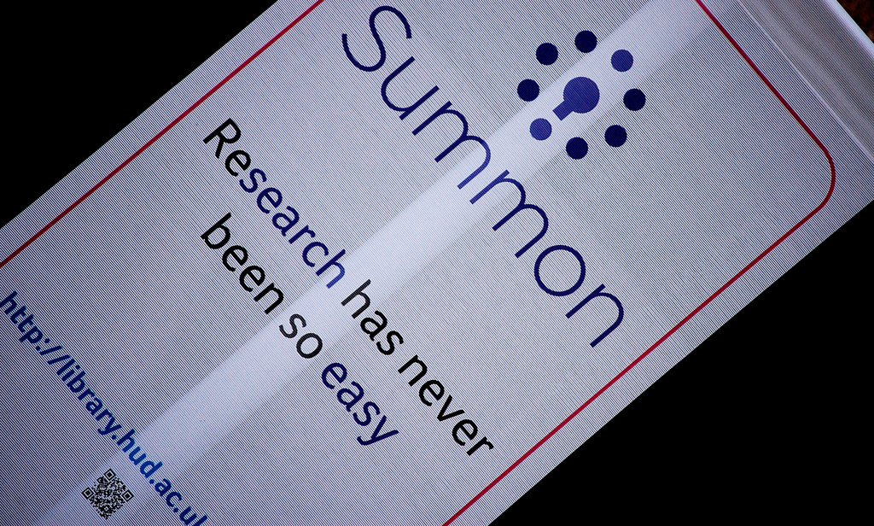
Summon Launch
on-campus publicity

Slide 30
Summon Launch
…did the publicity work?
On average, since the launch, just over 4,000 students use Summon every week
  by Dec 2010, e-resource logins were up 20% on the same period in 2009
83.8% of students have heard of Summon and have used it at least once
  2011 Computing & Library Services Student Survey

Slide 31

Focus Groups

Slide 32
Focus Groups
objectives
To examine the existing search behaviours of students
  via questionnaire
To observe how students use Summon
  observation and group discussion
To explore participants initial responses to using Summon
  observation and group discussion

Slide 33
Focus Groups
selected findings
Inputting one or two keywords into search engines was most popular search method
Evidence from this and other studies, clearly shows that students are transferring their search behaviour from web search engines, to academic research
Notes:
Inputting one or two keywords into search engines was most popular search method.
Recorded by previous studies,
Tallent (2004: 70) points that having a keyword based method “is not just the approach (students have) to this resource, but to database searching in general.”
Evidence from this and other studies, clearly shows that undergraduate students are transferring their search behaviour from web search engines, to academic research.
21 of our participants said when searching for academic information using an information retrieval system, they inputted one or two keywords into a search box.
30 out of the 33 participants were observed exhibiting these same search behaviours.
This evidence, plus the recorded comments made by students in the group discussion, corresponds with much of the studies that have already been conducted.
This would suggest that libraries should be providing what students, as Oberhelman (2006: 6) puts it, “have long wished for”, namely “a clean, Google-like box into which they can plug a keyword or two for a search and… instantly get the results they want.”

Slide 34
Focus Groups
selected findings
Article preview feature was joint most used feature in in Summon
  91% of the participants made use of this feature, which suggests they found it a very useful tool for their research
Although intuitive and relevant results retrieved, resource discovery products need such features that add-value
Notes:
From the observations the preview of article function was the joint most used feature when participants spent twenty minutes using Summon.
30 out of the 33 participants made use of this feature, which suggests they found it a very useful tool for their research.
Apart from the intuitiveness and relevant results of a resource discovery product; such systems also need to provide features to add-value.
The literature (Stubbings, 2003; Oberhelman, 2006; Korah & Cassidy, 2010) is littered with examples of students being frustrated with poor one-stop-shop products or ones that have been poorly implemented.

Slide 35
Focus Groups
findings – refining facets
Generally, participants did not use the refining facets within Summon
  reason may be 20 minutes time during structured search task
  could also be impatience?
  (see Oberhelman, 2006)
  will recent UI changes to Google alter this?
Notes:
From the observations and the group discussion it was clear that, generally, participants did not make use of the refining facets within Summon.
Facets are numerous tick boxes where users have the capacity to narrow their results down further.
Eg. including or excluding subject terms; date, content type, peer-reviewed material, etc.
Participants didn’t fully explore Summon and make use of some of the additional features.
Only 20 minutes allotted for participants to use Summon probably had a big bearing on whether participants used the additional features or not.
Interestingly not about facets or the refining style:
Google added refining facets onto their results page in 2009
As students become more accustomed with facets in their general web searches, they are more likely to use such features on Summon when conducting academic research.
Hope is that, resource discovery products such as Summon, may end up being the search engine of choice for undergraduates, as they ‘do’ the basic search very well but also provide more options for the more advanced user.
Firstly, much of the literature (Oberhelman, 2006), as we have seen, describes students’ search behaviour as impatient, and that they are unwilling to spend a lot of time analyzing the initial list of retrieved results.

Slide 36
Focus Group Comments
easy/intuitive
You’ve not got as many fiddly bits to do; you just type in what you want. It’s almost like Google Scholar, so I like it for that.
Nicole

Slide 37
Focus Group Comments
lots of results
I think you get a lot more articles from Summon because [in Metalib] you’ve got to search within each different database and your research takes you a little bit longer.
Caroline

Slide 38
Focus Groups
more info available here…
http://eprints.hud.ac.uk/9824/
“Do students want a one-stop-shop to
help them navigate their way around
the maze of library resources?”
Martin Philip (2010)

Slide 39

Usage Stats

Slide 40
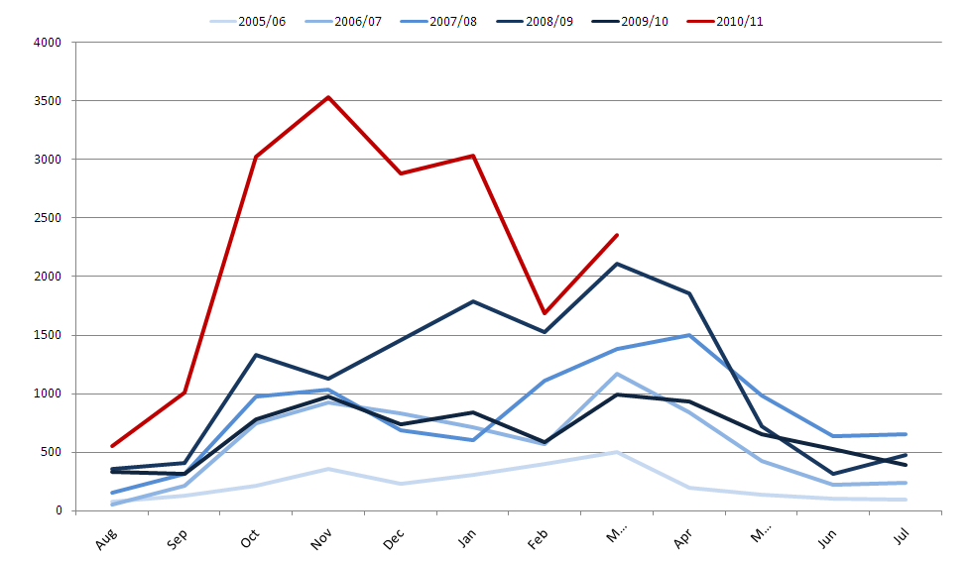
Full Text Downloads
resource 1

Slide 41
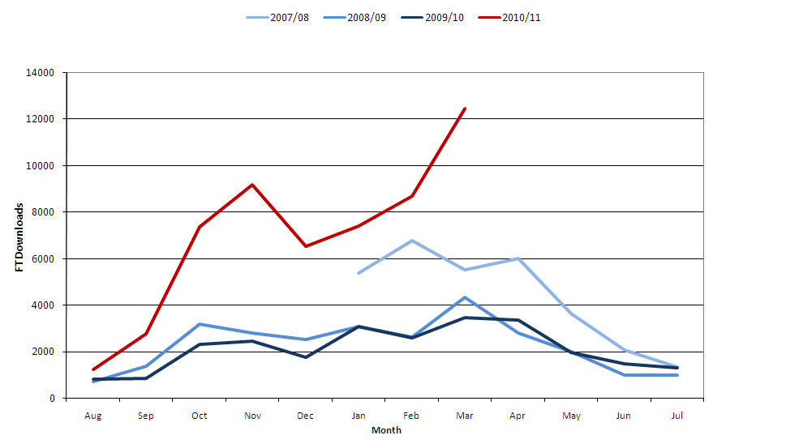
Full Text Downloads
resource 2

Slide 42
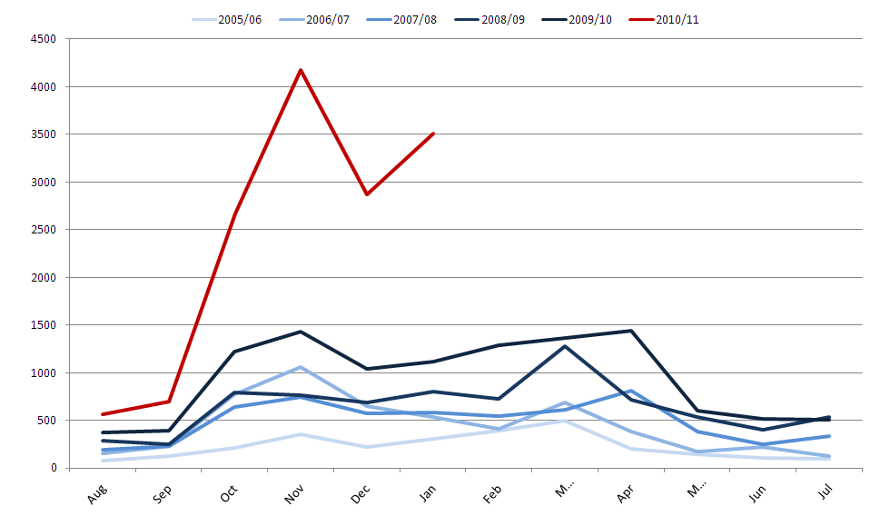
Full Text Downloads
resource 3

Slide 43
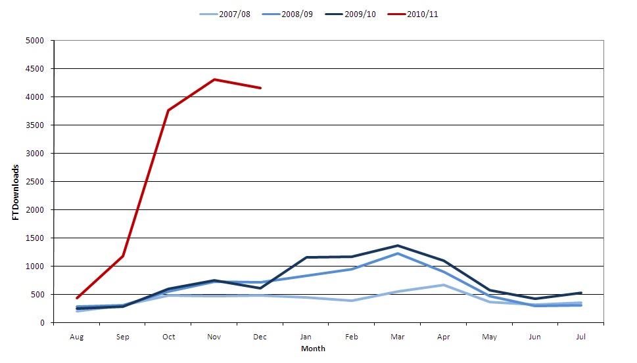
Full Text Downloads
resource 4

Slide 44

One final word...

Slide 45
One final word...
“Summon is bloody brilliant. It blows
Metalib out of the water! It gives fast,
efficient and above all relevant
research results. I found on Summon
in 2 days what would have taken 2
weeks on Metalib.”
  Abdul, PHD student and part-time lecturer

Slide 46
Thank you!
Any questions?
d.c.pattern@hud.ac.uk

